Slide 1
CT Theory
Neck Procedures

Slide 2
CT Imaging of the Neck
Module Objectives
Review anatomy of the neck
Label anatomical structures on a CT image
Scanning protocols including:
  Positioning
  Indications & Contraindications
  Exposure Factors
Most common CT Neck exams done
Pathology

Slide 3
CT Imaging of the Neck
Positioning for a CT Neck
Patient Position
  Head holder or molded sponge
  Patient supine, -first into the gantry
  Reduce patient motion
  Suspend respiration
  Suspend .
Anatomy Position
  Will differ from site to site
  No rotation, neck slightly extended
  Angle patient so hard palate is perpendicular to the table
  Lower as much as possible.

Slide 4
CT Imaging of the Neck
Modified Valsalva Maneuver
Site protocol will vary
Patient blows out cheeks
Air/pressure on the trachea
Purpose: Distend the _ _ _ for better visualization.

Slide 5
CT Imaging of the Neck
How are CT images of the Neck acquired?
  Axial plane
  Helical Scanning
  Almost always contrast enhanced
  Commonly referred to as .

Slide 6
CT Imaging of the Neck
Challenges in scanning
Dental work
  Management – can split the scan superior and inferior to dental work and try to angle the patient in between – to avoid streak artifact.
Large shoulders
  Management – depress shoulders as much as possible

Slide 7
CT Imaging of the Neck
How are CT images of the neck viewed?
Multiple MPR
Multiple window settings on reformats
Standard / Soft-Tissue
WW WL
Bone Algorithm
WW WL

Slide 8
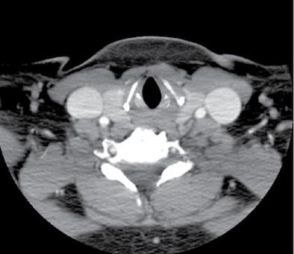
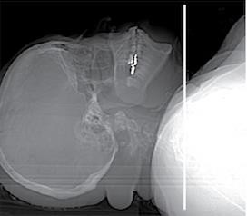
CT Imaging of the Neck

Slide 9
CT Imaging of the Neck
Protocols and Pathology
Unless contrast is contraindicated, a CT Soft-Tissue neck will almost always involve IV contrast
Some sites use oral contrast and specific timing (scan immediately post swallowing or during swallowing) to evaluate esophageal pathology
Always follow specific site protocols, as they will vary.

Slide 10
CT Imaging of the Neck
CT Soft Tissue Neck - Goals of IV contrast
  Enhance the mucosa, lymph nodes, and pathologic tissue
  Enhance vasculature
Challenges – timing
Solution – Split Bolus
  1st injection (half volume), delay .
  2nd injection (half volume), scan immediately following complete injection.

Slide 11
CT Imaging of the Neck
Common indications for CECT Soft Tissue Neck
•
  Vascular abnormality
  Lymphadenopathy
  Cysts
Common indications for NECT Soft Tissue Neck
  Salivary Stones

Slide 12
CT Imaging of the Neck
Contraindications for Neck CT
  Pregnancy (weigh risk vs. benefit)
  Contraindication for contrast media

Slide 13
CT Imaging of the Neck
CECT Soft Tissue Neck
Scouts: AP & Lateral
Anatomy Included:
Helical Acquisition
Position the patient’s hard palate to be perpendicular to the table,
depress shoulders

Slide 14
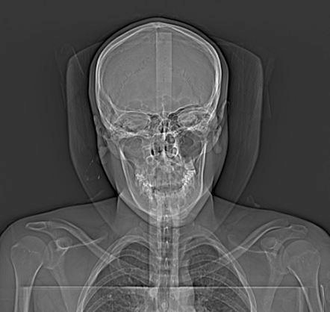
CT Imaging of the Neck

Slide 15
CT Imaging of the Neck
CECT Soft Tissue Neck
SFOV: Body
DFOV:
Algorithm: Standard / Soft Tissue
Window: WW 450 WL 75

Slide 16
CT Imaging of the Neck
CECT Soft Tissue Neck
Acquisition kVp: 120
Acquisition mA: 150*
•
Reconstruction details will vary
  MPR
  Slice Thickness
  Windowing
  Apply Filters (soft filter)
  3D, if indicated

Slide 17
CT Imaging of the Neck
CECT Soft-Tissue Neck
IV Contrast: _ ml at ml/sec
Scan delay: Split bolus (will vary!)
  50ml
  delay
  75 ml
  Scan initiated 25 sec after 2nd injection
Split bolus protocol allows time for venous return, and enhancement of some structures; as well as arterial enhancement.
Oral Contrast: none (rare)

Slide 18
CT imaging of the neck
https://radiopaedia.org/cases/normal-ct-neck?lang=us
https://radiopaedia.org/cases/normal-ct-of-the-neck?lang=us

Slide 19
CT Imaging of the Neck
CT Angiography for neck imaging
  Describes a CT scan with contrast enhancement.
  To evaluate vascular disease
  Scan carotid arteries & circle of willis together
  Gold standard for stroke imaging
    Non-invasive technique compared to catheter angiography
•
    Efficient

Slide 20
CT Imaging of the Neck
CTA Carotids & COW – Goals
  Accurately measure of the carotid arteries and vertebral arteries, and their branches.
  Evaluate completeness of the circle of willis.
  Detect vascular lesions such as or occlusions.
  Alternative method for venous abnormalities are called CT Venography –
similar technique, but scan occurs in the venous phase.

Slide 21
CT Imaging of the Neck
Stroke is primarily caused by the reduction of blood flow to the brain.
20-30% of stroke victims do not survive
55% (+) have disability following a stroke
3 categories of stroke:
•
•
  Hypotensive

Slide 22
CT Imaging of the Neck
Risk factors for stroke
•
  Homocysteine and Vitamin B deficiency
  High Cholesterol
  Atrial Fibrillation
  Heart Disease
•
  Migraines
  Heredity
  Smoking
  Obesity
  Substance Abuse

Slide 23
CT Imaging of the Neck
Ischemic Stroke – _ _ _ _ __.
  Most common type (80%) of stroke
  Ischemia is defined as a:
  Two main types
Thrombotic – Blood clot or fatty deposit within artery
Embolic – Traveling particle in bloodstream that lodges in a smaller artery, cutting off supply.

Slide 24
CT Imaging of the Neck
Hemorrhagic Stroke
  About 20% of strokes caused by hemorrhage
  Rupture of a blood vessel that causes blood leakage into the
.
Hypotensive Stroke
  Very rare
  Blood pressure is too low, and can reduce oxygen supply to the brain

Slide 25
CT Imaging of the Neck
Transient Ischemic Attack
  TIA – A reversible episode of neurologic dysfunction that could last a few minutes to a few hours.
  Caused by tiny emboli that lodge in an artery, but then move on or dissolve with no long term damage.
  An indicator of:

Slide 26
CT Imaging of the Neck
TIA of the Carotid Arteries
•
  Symptoms include
    Vision Loss
    Speech
    Partial or temporary paralysis
    Tingling
    Numbness
    Unilateral symptoms

Slide 27
CT Imaging of the Neck
TIA of the Basilar Artery
  Symptoms include
    Dim, grey, blurry vision
    Vision loss in both eyes
    Tingling in mouth, cheeks, gums
    Headache (posterior, often)
    Dizziness
    Nausea, Vomiting
•
    Inability to speak clearly (confusion)
    Weakness in arms or legs

Slide 28
CT Imaging of the Neck
CT and the Treatment of Stroke
  Foothills Hospital & U of A are global leaders
  t-PA: tissue plasminogen activator
  Able to treat up to 80% of ischemic strokes, and reduce patient disability
  Effective when administered within of the first signs of stroke

Slide 29
CT Imaging of the Neck
CT and the Treatment of Stroke
  Video: How does t-PA work?
  Video: t-PA use in Calgary
  Video: Stroke Ambulance in Alberta
  Video: Stroke Program in Rural Alberta

Slide 30
CT Imaging of the Neck
CTA COW & Carotids “Stroke Protocol”
Scouts: AP & Lateral
Anatomy Included:
Helical acquisition
Reference angle – N/A

Slide 31
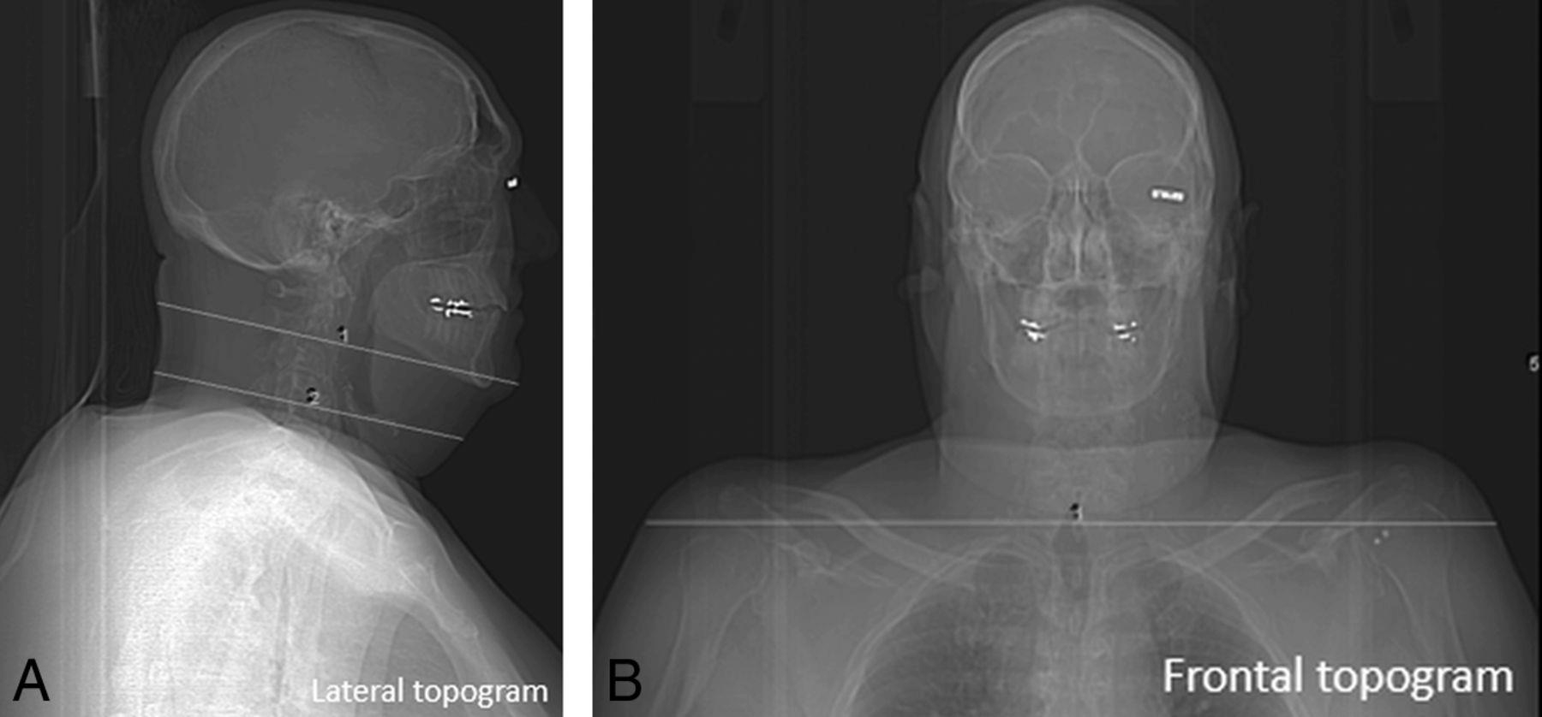
CT Imaging of the Neck

Slide 32
CT Imaging of the Neck
CTA COW & Carotids “Stroke Protocol”
SFOV: Body / Large
DFOV:
Algorithm: Standard
Window
  WW 250 WL 30 (through foramen magnum)
  WW 140 WL 40 (through base of skull)
  WW 90 WL 35 (through cerebrum)

Slide 33
CT Imaging of the Neck
CTA COW & Carotids “Stroke Protocol”
Acquisition kVp: 120
mA:
•
  High mA to adequately image the dense contrast in the vessels
Reconstruction details will vary: MIP
  MPR – may include obliques
  Slice thickness – thin, to include all anatomy
  Windowing - WW 800 WL 200
  3D -

Slide 34
CT Imaging of the Neck
CTA COW & Carotids “Stroke Protocol”
IV Contrast: 80ml at 4 ml/sec
Scan delay: Timing Bolus
  Localizer Scan –
  ROI –
Some sites use bolus tracking
Oral Contrast: none

Slide 35
CT Imaging of the Neck
https://radiopaedia.org/cases/normal-neck-ct-angiogram?lang=us
https://radiopaedia.org/cases/cta-neck-normal-exam?lang=us

Slide 36
CT Imaging of the Neck
What does a stroke look like on CT?
  Within first 6 hours of a stroke, a NECT head will appear normal in at least 1/3 of patients.
  Why is this?
What can be done?

Slide 37
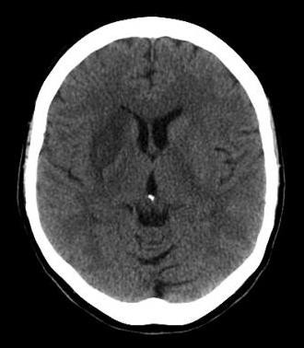
CT Imaging of the Neck
Image Source: http://emedicine.medscape.com

Slide 38
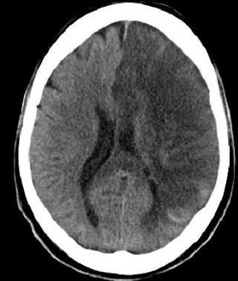
CT Imaging of the Neck
Image Source: http://emedicine.medscape.com

Slide 39
CT Imaging of the Neck
What does a TIA look like on CT?
  Thrombus, Embolus, or Stenosis = Filling defect of contrast within in the arteries
  Stenosis appears as a narrowing
  Complete occlusion shows an abrupt stop in contrast enhancement.

Slide 40
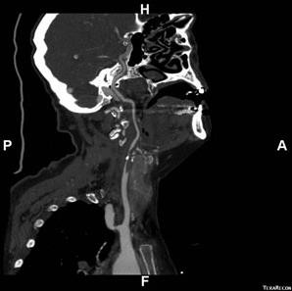
CT Imaging of the Neck
Image Source: http://www.lvhn.org/for_health_professionals

Slide 41
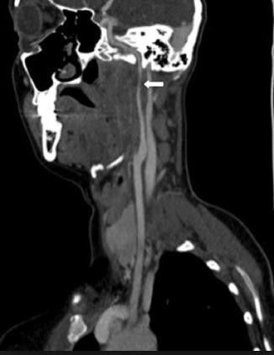
CT Imaging of the Neck
Image Source: http://www.lvhn.org/for_health_professionals

Slide 42
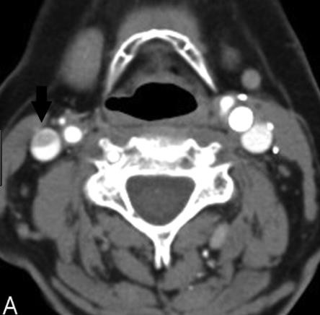
CT Imaging of the Neck
Image Source: American Journal of Neuroradiology

Slide 43
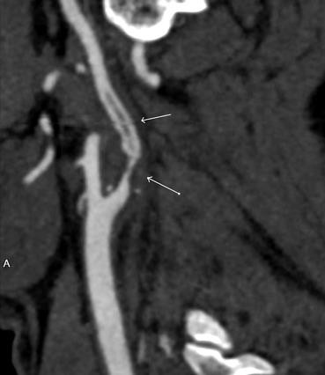
CT Imaging of the Neck
Image Source: American Journal of Neuroradiology

Slide 44
CT Imaging of the Neck
Summary
Review anatomy of the neck, and its vasculature.
Review indications, contraindications and technical factors involved in different CT examinations of the neck.
Attention to detail is SO important!
Brain perfusion will not be tested on!
Use the Neck self-test as a study tool

