Slide 1
CT Theory
Outcome 7 – Explain CT imaging for an examination of the extremities
MSK Imaging Procedures
MRT Program

Slide 2
CT imaging of the extremities
Module Objectives
Review Anatomy
Label anatomical structures on a CT image
Scanning protocols including:
  Positioning
  Indications & Contraindications
  Exposure Factors
Most common MSK CT scans done:
  Shoulder, Elbow, Wrist, Hip, Knee, Ankle

Slide 3
CT imaging of the extremities
When is an MSK CT procedure ordered?
Evaluating bone and soft tissue tumors
To add information to radiographs
Complex fractures
Pre-arthroplasty planning
Evaluate joints

Slide 4
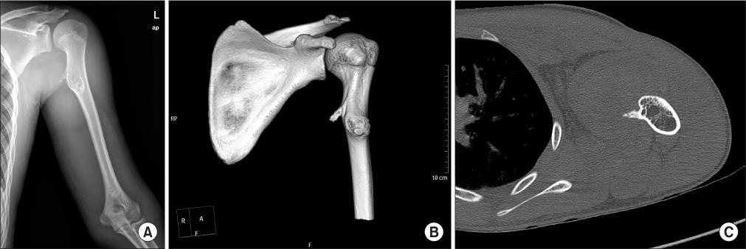
CT imaging of the extremities

Slide 5
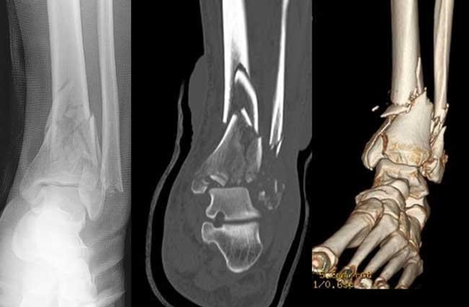
CT imaging of the extremities

Slide 6
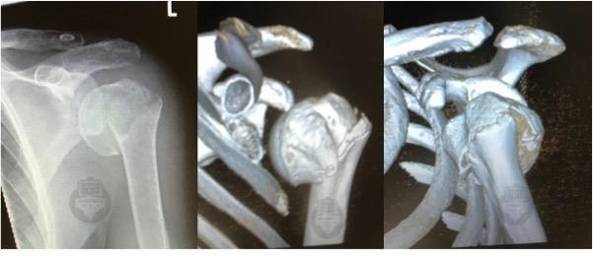
CT imaging of the extremities

Slide 7
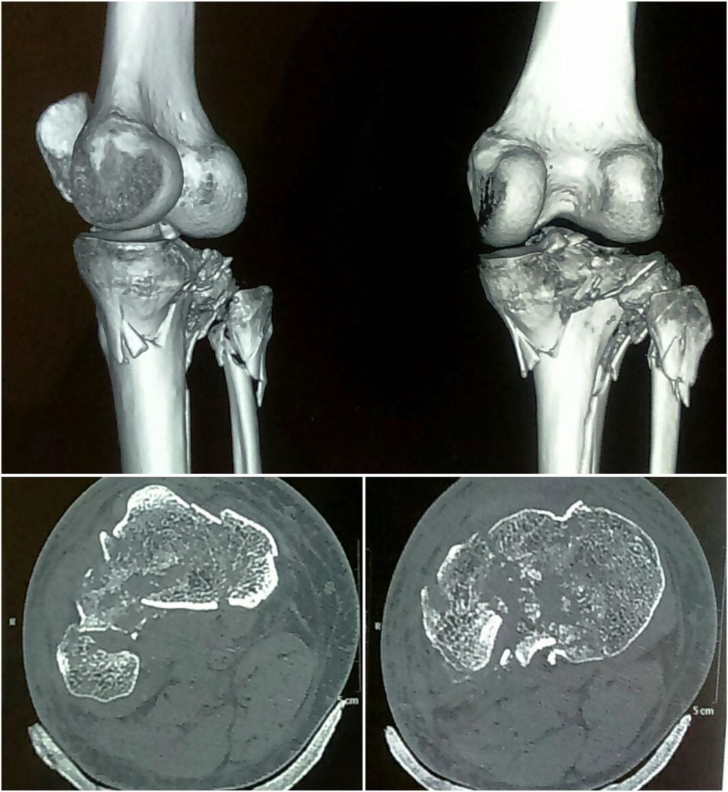
CT imaging of the extremities

Slide 8
CT imaging of the extremities
Advantages of CT over plain radiographs
Spatial Relationships
Ability for comparison of joints
Bone & soft tissue can both be demonstrated with one scan
Excellent contrast resolution
MPR & 3D post-processing features

Slide 9
CT imaging of the extremities
Other advantages in trauma patients:
Retrospective reconstructions
  Example: Pelvic Floor trauma – perform a vascular scan looking for injury to vessels, but bony pelvis can also be evaluated.
Thin slices allow excellent coverage of anatomy - as thin as 0.5mm is common.
3D reconstructions often used for pre- operative planning.

Slide 10
CT imaging of the extremities
Contraindications for CT MSK procedures
Extensive hardware
Pregnancy

Slide 11
CT imaging of the extremities
Positioning – General Rules
Lower extremities: Supine, feet first
Upper extremities: Supine, head first
Ensure symmetry
Position long axis of the anatomy perpendicular to the plane of acquisition
AP and Lateral scout images
Use pillows & sponges to prevent patient motion

Slide 12
CT imaging of the extremities
There are many variations in positioning
Remember, tech enters the patient orientation on the console and the scanner usually assigns a ”L” and ”R” based on this orientation.
Special care must be taken when scanning extremities.
Some sites have tiny lead markers

Slide 13
CT imaging of the extremities
NECT Shoulder Scout – AP & Lateral
Anatomy included – Just above AC joint – just below scapula
Positioning -Patient supine, affected arm at side with unaffected arm raised above head.

Slide 14
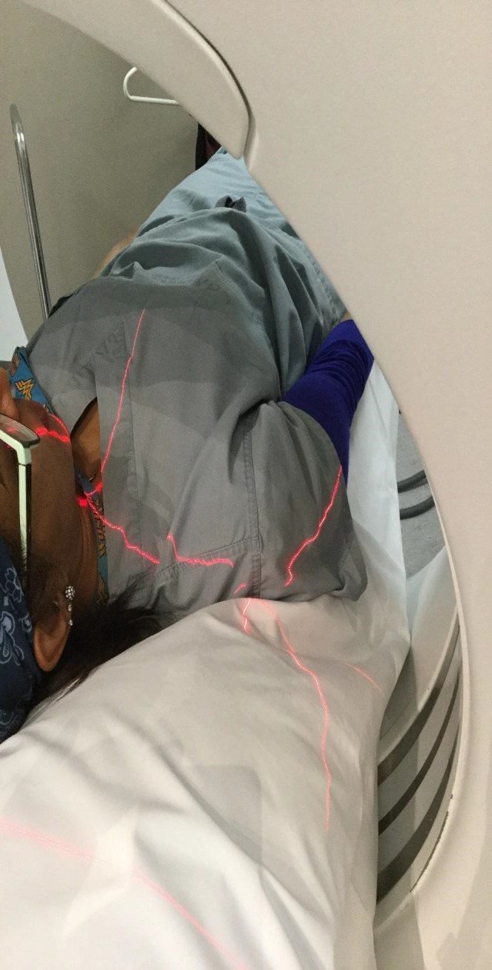
CT Imaging of the extremities

Slide 15
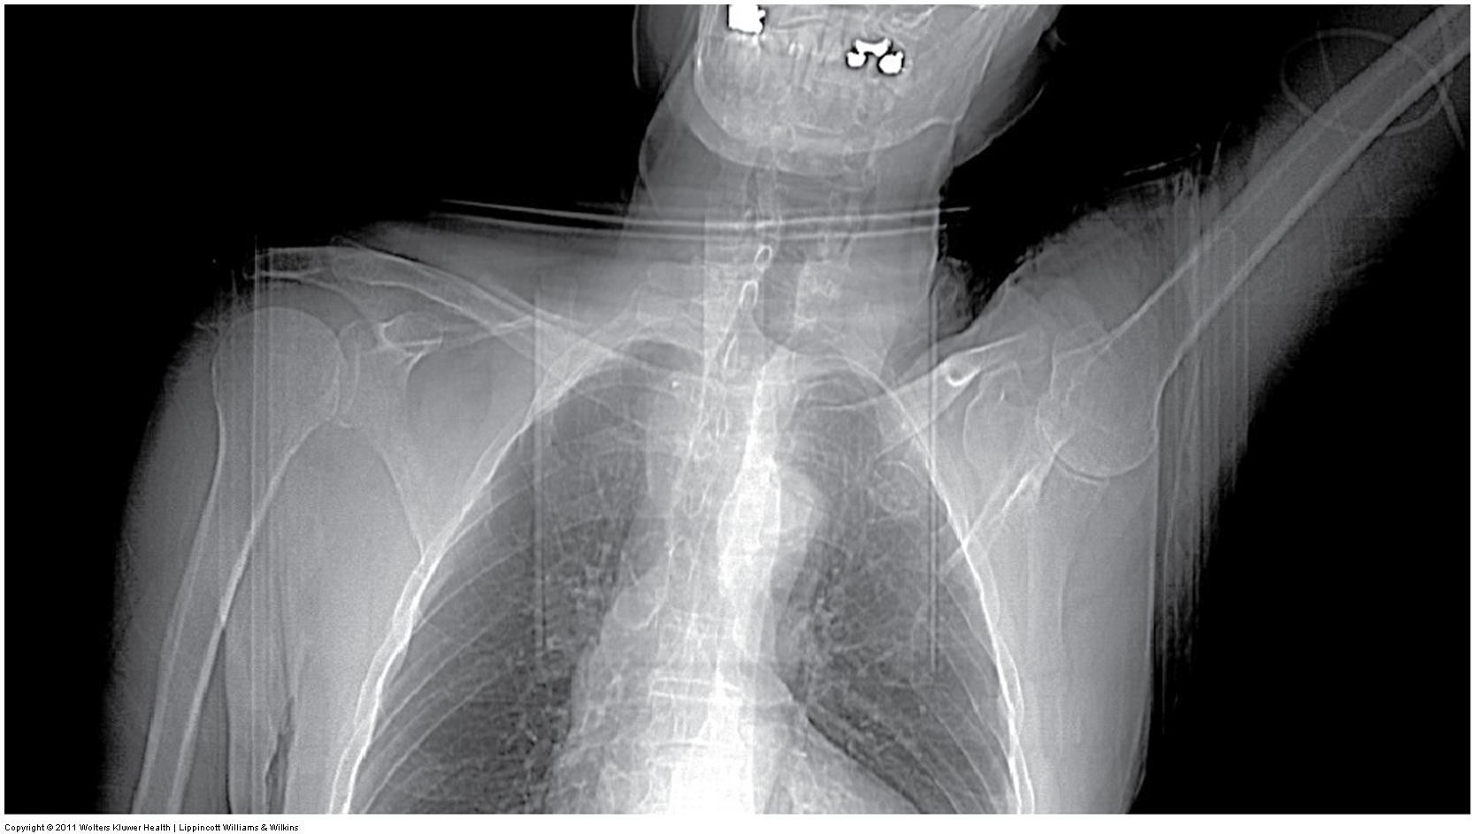
CT Imaging of the Extremities

Slide 16
CT Imaging of the Extremities
NECT Shoulder
SFOV – Large / body
DFOV – 25 cm
Algorithm – Bone
  WW 2000 WL 500

Slide 17
CT Imaging of the Extremities
NECT Shoulder
Acquisition kVp: 140
Acquisition mAs: 300
  ATCM range 100 – 500 (approximately)
Reconstruction details will vary
  MPR – align imaging plane to be perpendicular to the long axis of the anatomy
  Slice Thickness – thin slices
  Windowing – soft tissue WW 500 WL 50
  Apply filters – high-resolution bone
  3D, if indicated

Slide 18
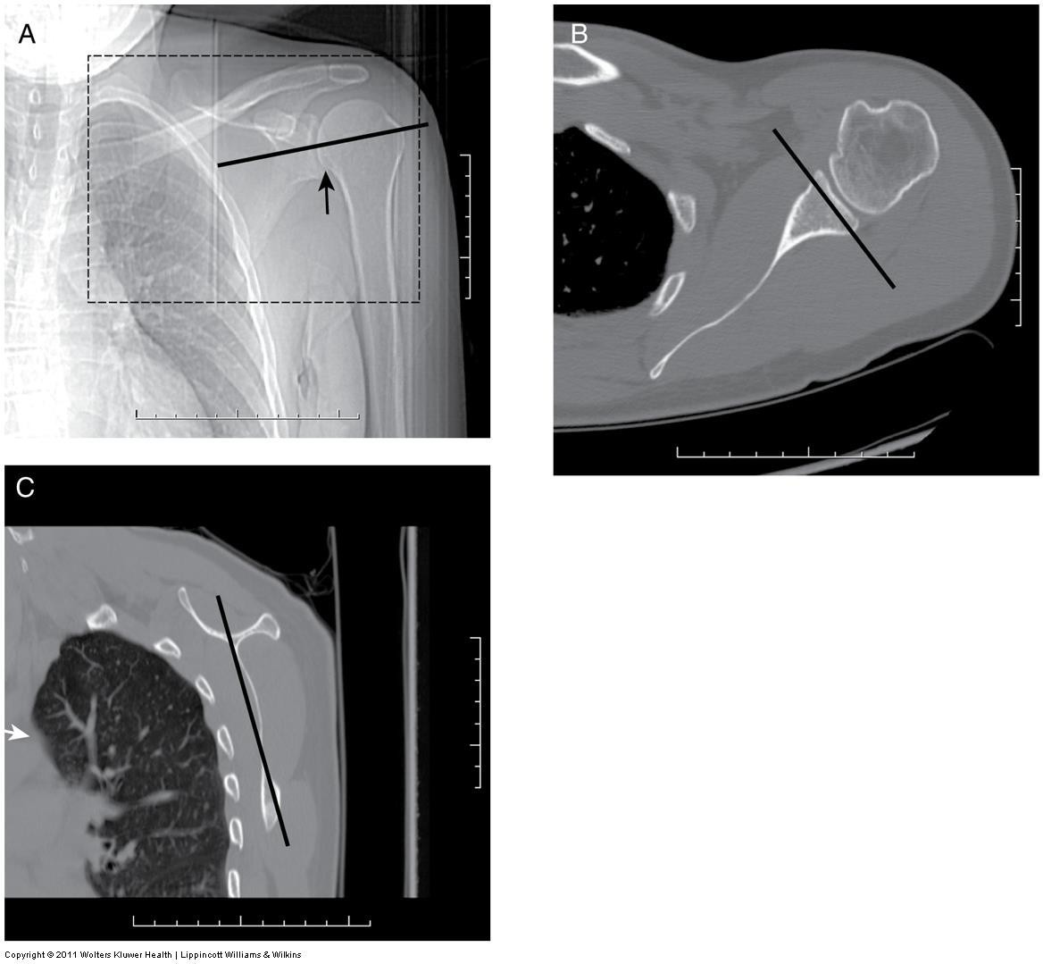
CT imaging of the extremities

Slide 19
CT imaging of the extremities
Shoulder
Shoulder Arthrography can be done
Useful to demonstrate:
  Joint capsule
  Extrascapular structures (muscles of the rotator cuff)
  Loose bodies within the joint
Double contrast
  Up to 3 ml iodinated contrast media
  Up to 10 ml air
Scan includes above AC joint – glenoid fossa

Slide 20
CT Imaging of the extremities
https://radiopaedia.org/cases/normal-ct- shoulder- 2?lang=us
https://radiopaedia.org/cases/posterior- shoulder-dislocation- with-reverse-hill-sachs- and-reverse-bankart-lesions?lang=us
https://radiopaedia.org/cases/rotator-cuff- tear-ct- arthrography?lang=us

Slide 21
CT imaging of the extremities
NECT Elbow
Scout – AP & Lateral
Anatomy included – just above elbow joint – just below radial tuberosity
Positioning – Patient prone, affected arm extended over head.
  Alternative: patient supine with arm at side in anatomical position.
  Alternative: patient prone, arm bent into lateral
    elbow position

Slide 22
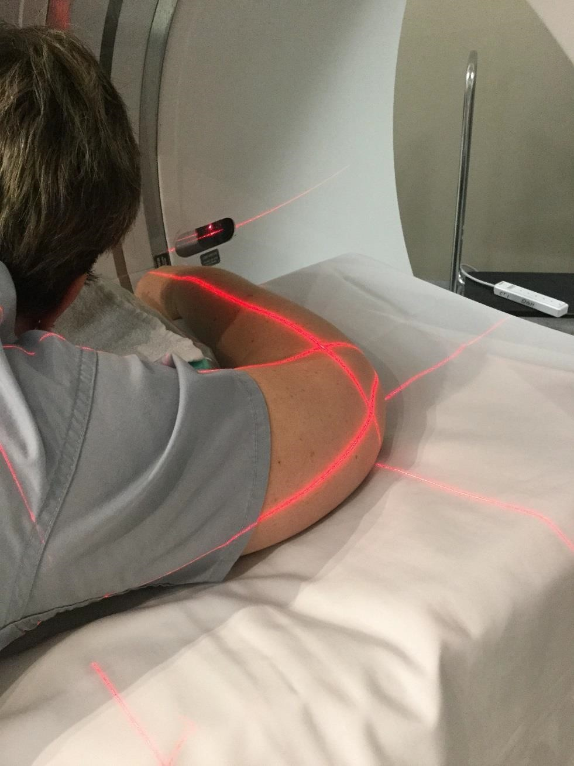
CT imaging of the extremities

Slide 23
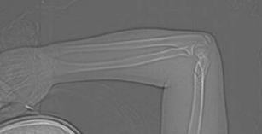
CT imaging of the extremities

Slide 24
CT Imaging of the extremities
NECT Elbow
SFOV – Large / body
DFOV – 15 cm, set to patient
Algorithm – Bone
  WW 2000 WL 500

Slide 25
CT Imaging of the extremities
NECT Elbow
Acquisition kVp: 140
Acquisition mAs: 200-300
  No need for ATCM
Reconstruction details will vary
  MPR – align imaging plane to be perpendicular to the long axis of the anatomy
  Slice Thickness – thin slices
  Windowing – soft tissue WW 500 WL 50
  Apply filters – high-resolution bone
  3D, if indicated

Slide 26
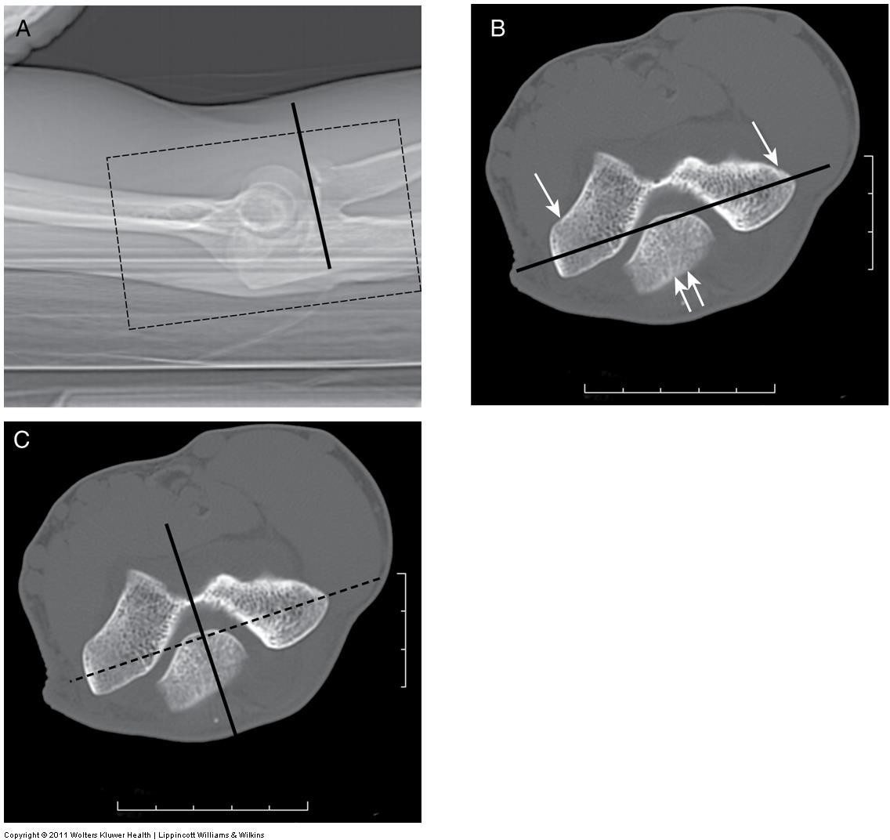
CT Imaging of the extremities

Slide 27
CT imaging of the extremities
https://radiopaedia.org/cases/normal-elbow- ct?lang=us

Slide 28
CT imaging of the extremities
NECT Wrist
Scout – AP & Lateral
Anatomy included – Proximal to the distal radioulnar joint – proximal
metacarpals.
Positioning – Patient prone, affected arm extended over head.
  Alternative: patient supine with arm at side in anatomical
    position.
  Alternative: patient seated outside the scanner with arm extended on table.
    Instruct patient to look away from the scanner.
    Shield patient

Slide 29
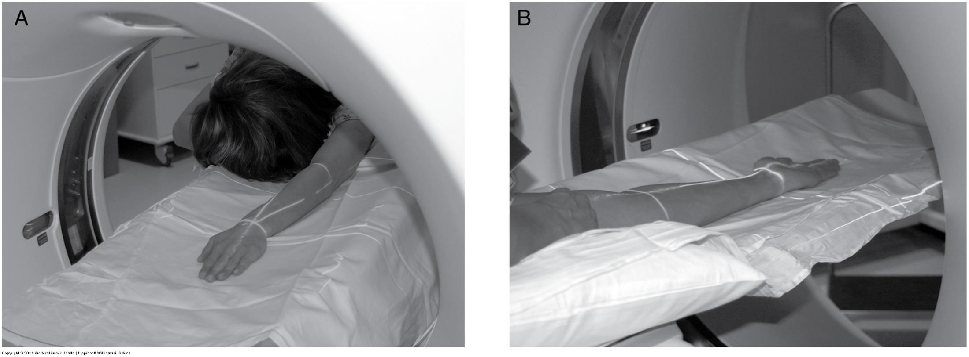
CT imaging of the extremities

Slide 30
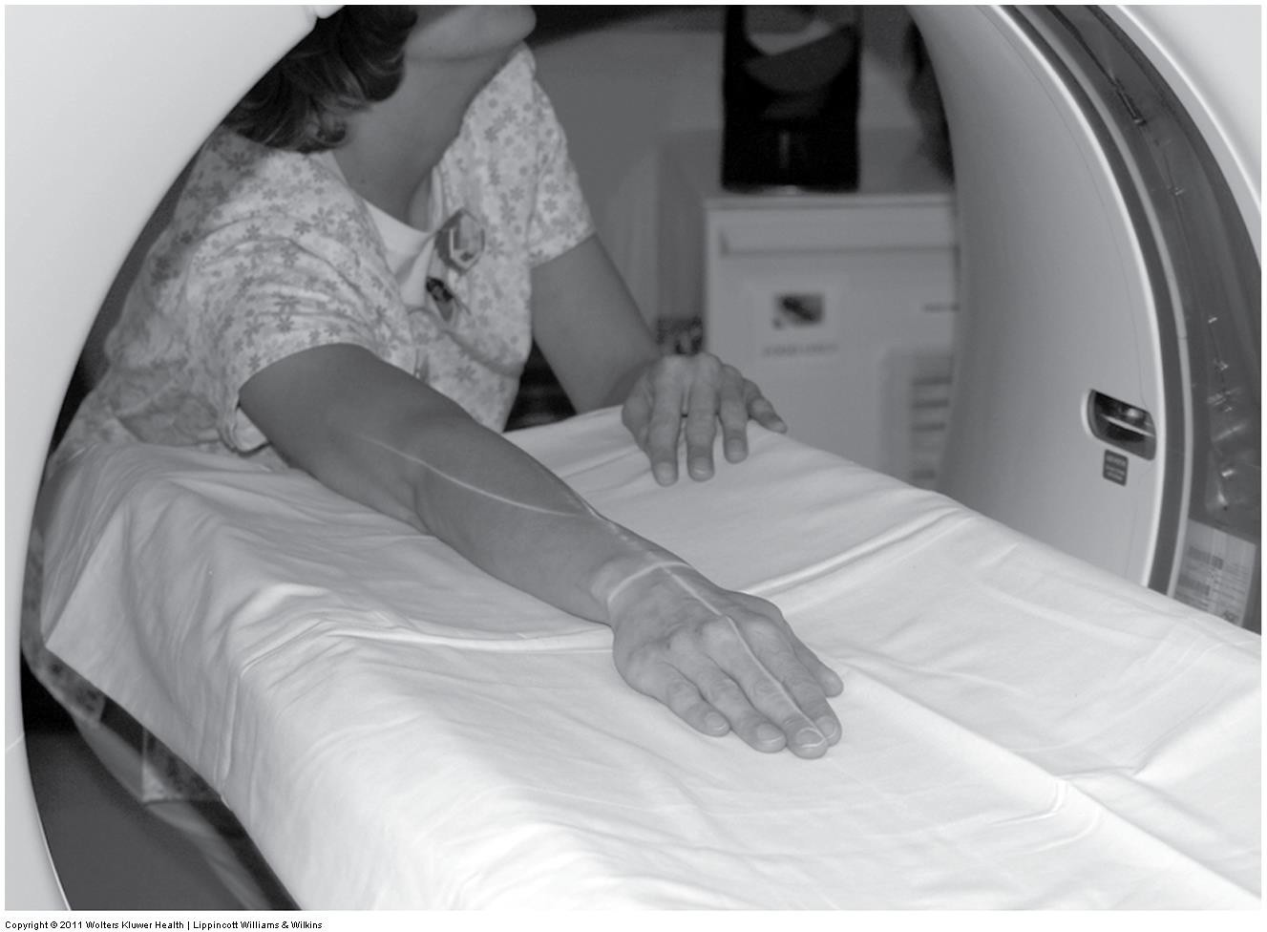
CT imaging of the extremities

Slide 31
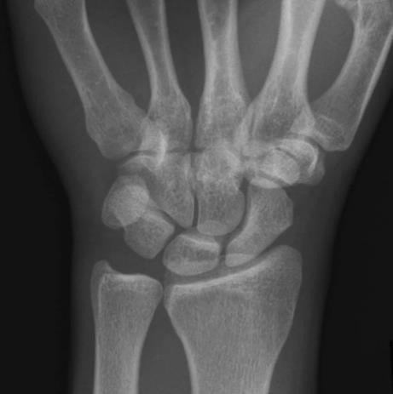
CT Imaging of the extremities

Slide 32
CT imaging of the extremities
NECT Wrist
SFOV – Large / Body
DFOV – 10 cm (adjust to skin surface)
Algorithm – Bone
  WW 2000 WL 500

Slide 33
CT imaging of the extremities
NECT Wrist
Acquisition kVp: 140
Acquisition mAs: 200-300
  No need for ATCM
Reconstruction details will vary
  MPR – align imaging plane to be perpendicular to the long
    axis of the anatomy
  Slice Thickness – thin slices
  Windowing – soft tissue WW 500 WL 50
  Apply filters – high-resolution bone
  3D, if indicated

Slide 34
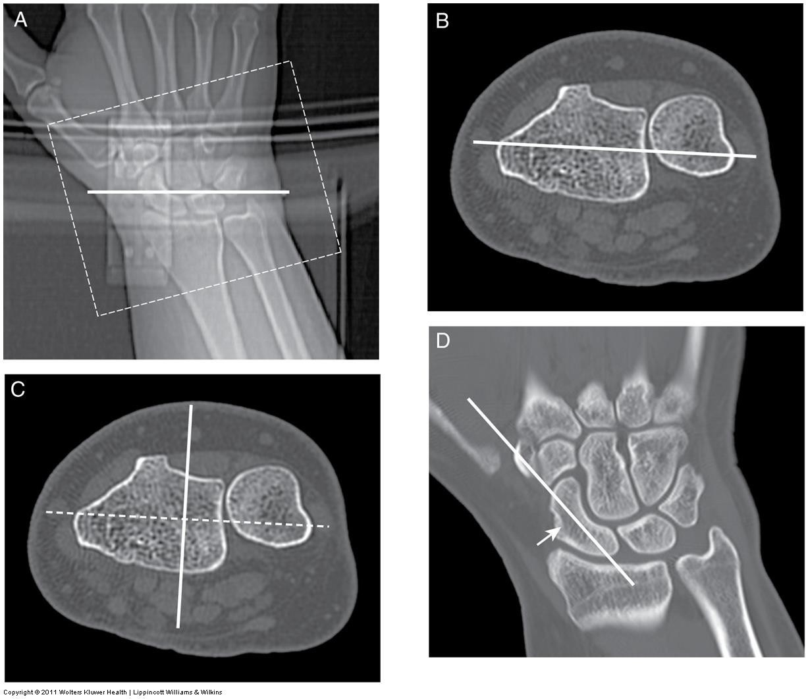
CT imaging of the extremities

Slide 35
CT imaging of the extremities
https://radiopaedia.org/cases/normal-wrist-ct- including- 3d?lang=us

Slide 36
CT imaging of the extremities
NECT Hip
Scout – AP & Lateral
Anatomy included – Just above SI joints - 4 cm below lesser trochanters (include fracture, if present)
Positioning - Patient supine legs flat on table. Do not elevate the knees.
  May wrap lower legs, tape feet together to prevent motion

Slide 37
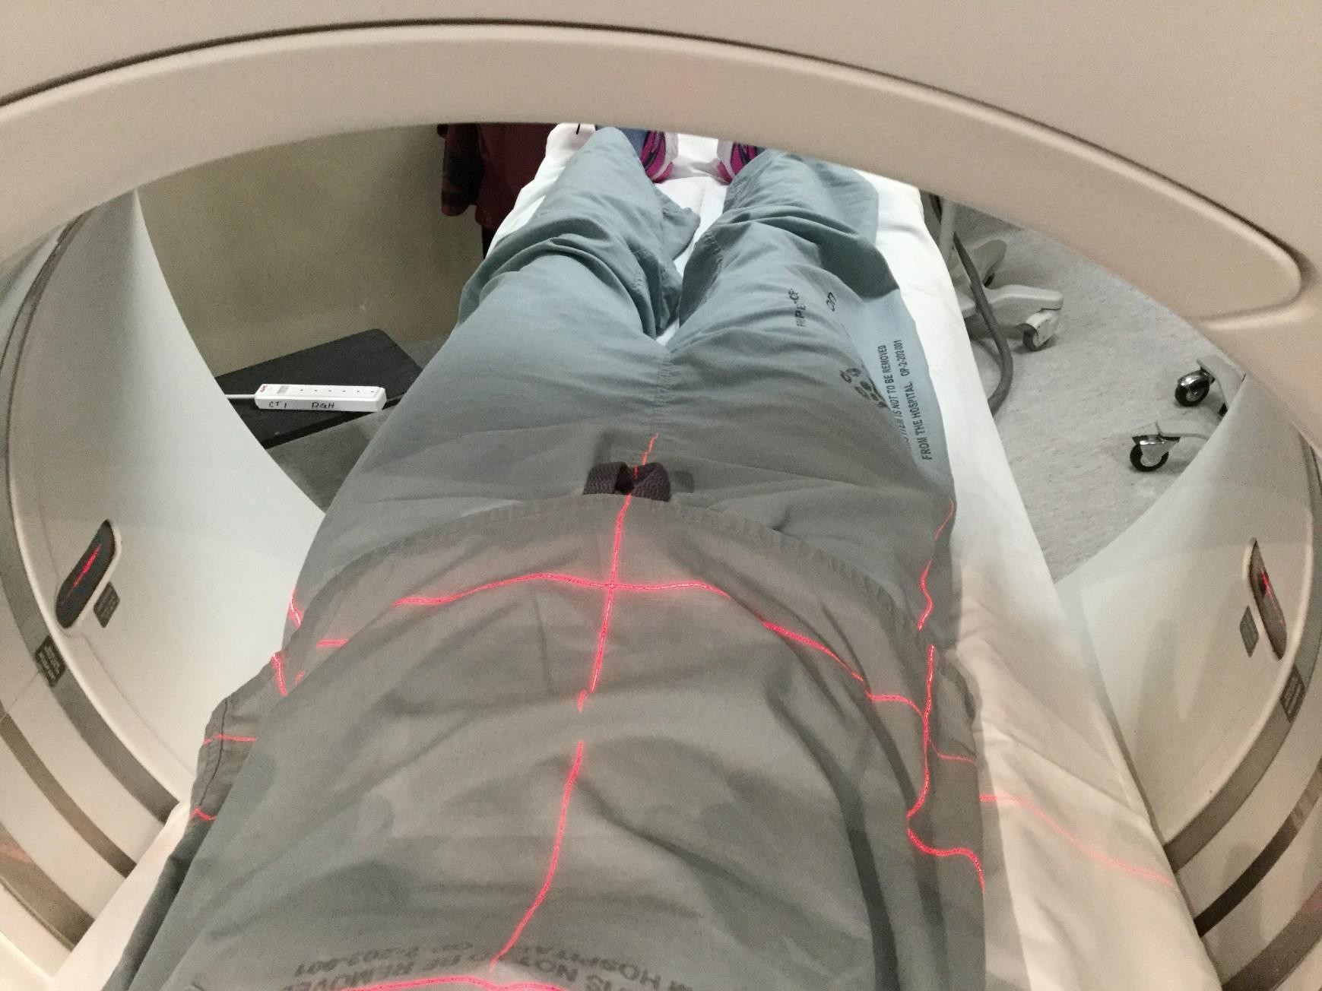
CT imaging of the extremities

Slide 38
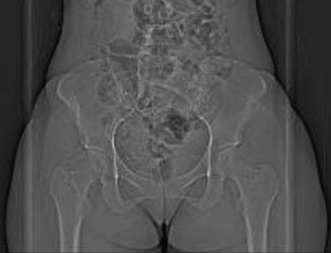
CT imaging of the extremities

Slide 39
CT imaging of the extremities
NECT Hip
SFOV – Large / Body
DFOV – 30 cm (symphysis pubis - to skin surface)
Algorithm – Bone
WW 2000, WL 500

Slide 40
CT imaging of the extremities
NECT Hip
Acquisition kVp: 140
Acquisition mAs: 400
  No need for ATCM
Reconstruction details will vary
  MPR – align imaging plane to be perpendicular to the long
    axis of the anatomy
  Slice Thickness – thin slices
  Windowing – soft tissue WW 500 WL 50
  Apply filters – high-resolution bone
  3D, if indicated

Slide 41
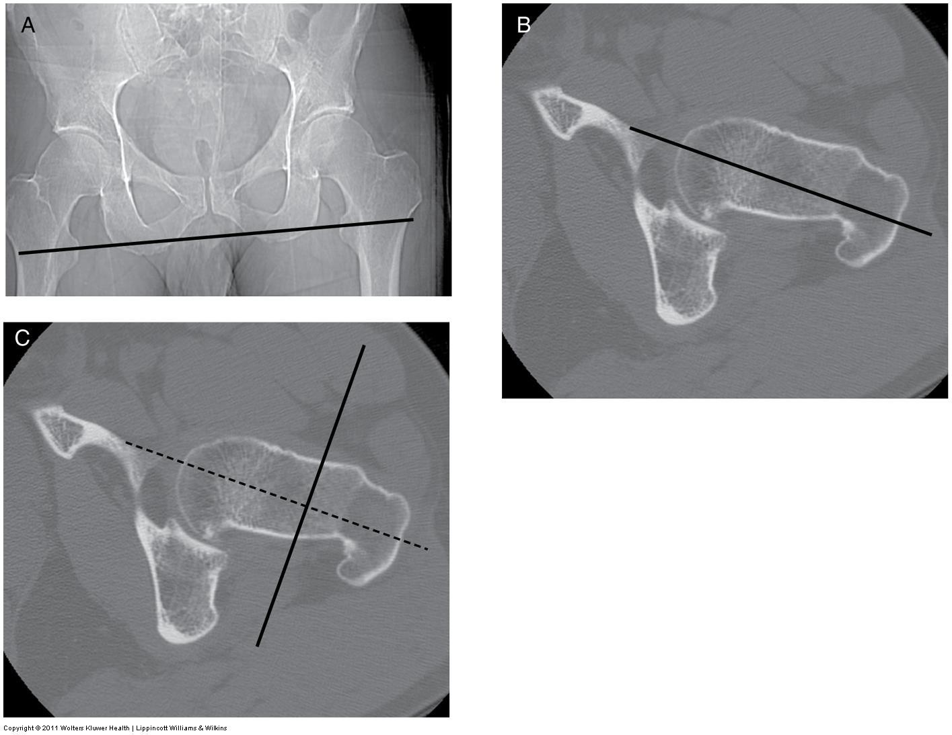
CT imaging of the extremities

Slide 42
CT imaging of the extremities
https://radiopaedia.org/cases/normal-ct-hip- 2?lang=us
https://radiopaedia.org/cases/hip-fracture- dislocation?lang=us

Slide 43
CT imaging of the extremities
NECT Knee / Tibial Plateau
Scout - AP & Lateral
Anatomy included – Just above patella – just below fibular head
Patient Positioning – Patient supine, legs flat on table.
  May wrap lower legs or tape feet together to prevent motion.

Slide 44
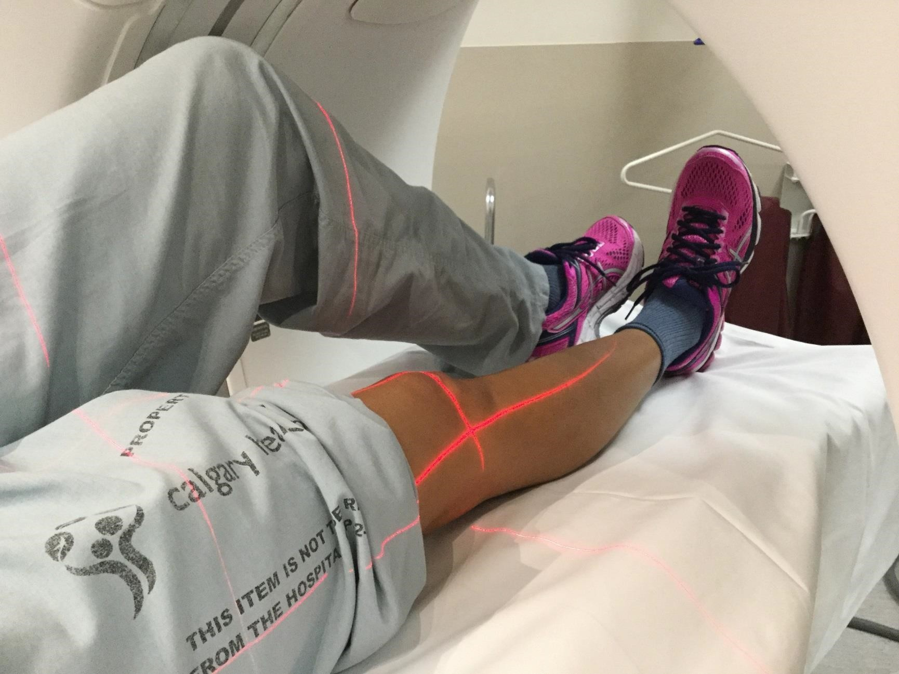
CT imaging of the extremities

Slide 45
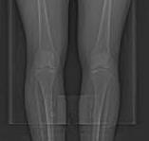
CT imaging of the extremities

Slide 46
CT imaging of the extremities
NECT Knee
SFOV – Large / Body
DFOV – 20 cm adjust to skin surface
Algorithm – Bone
  Bone Plus on some scanners, specific for tibial plateau fractures. Provides
excellent contrast and spatial resolution. Useful for pre-op planning.
WW 2000 WL 500

Slide 47
CT imaging of the extremities
NECT Knee
Acquisition kVp: 140
Acquisition mAs: 300
  No need for ATCM
Reconstruction details will vary
  MPR – align imaging plane to be perpendicular to the long axis of the anatomy
  Slice Thickness – thin slices
  Windowing – soft tissue WW 500 WL 50
  Apply filters – high-resolution bone / bone plus
  3D, if indicated

Slide 48
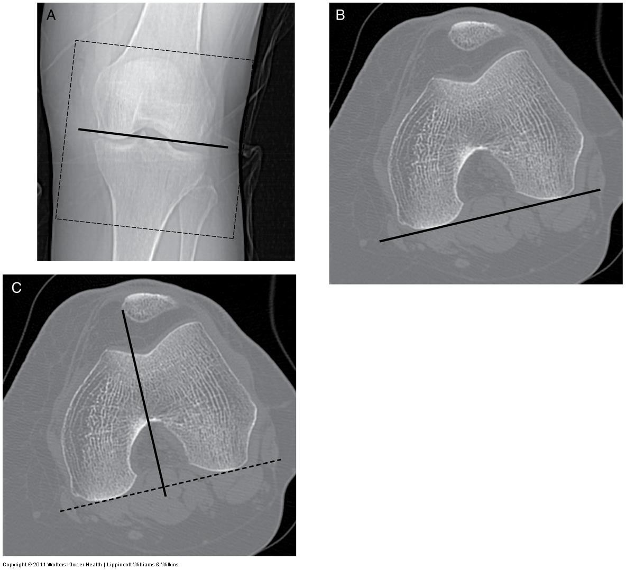
CT imaging of the extremities

Slide 49
CT imaging of the extremities
https://radiopaedia.org/cases/normal-ct-knee- 1?lang=us
https://radiopaedia.org/cases/knee-lipohaemarthrosis- due-to- tibial-plateau-fracture?lang=us

Slide 50
CT imaging of the extremities
NECT Foot and/or Ankle
Scout – AP & Lateral
Anatomy Included:
  Ankle: Just above ankle joint – through calcaneus
  Foot: Distal phalanges, tarsals, metatarsals, talus & calcaneus
Patient positioning: Supine, legs flat on the table
  May wrap lower legs or tape feet together to prevent motion
  May also move unaffected leg completely out of scan field
  Alternative – include foot/feet in the axial plane, with knees bent and flat on the table.

Slide 51
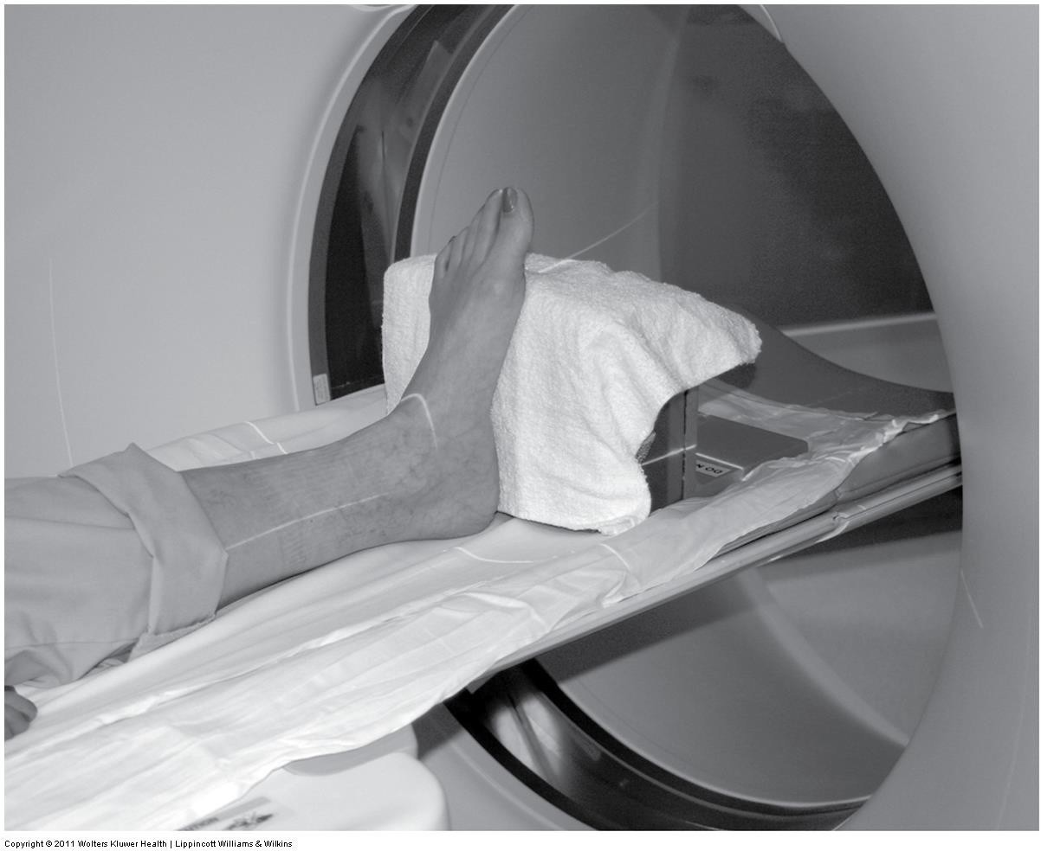
CT imaging of the extremities
NECT Ankle

Slide 52
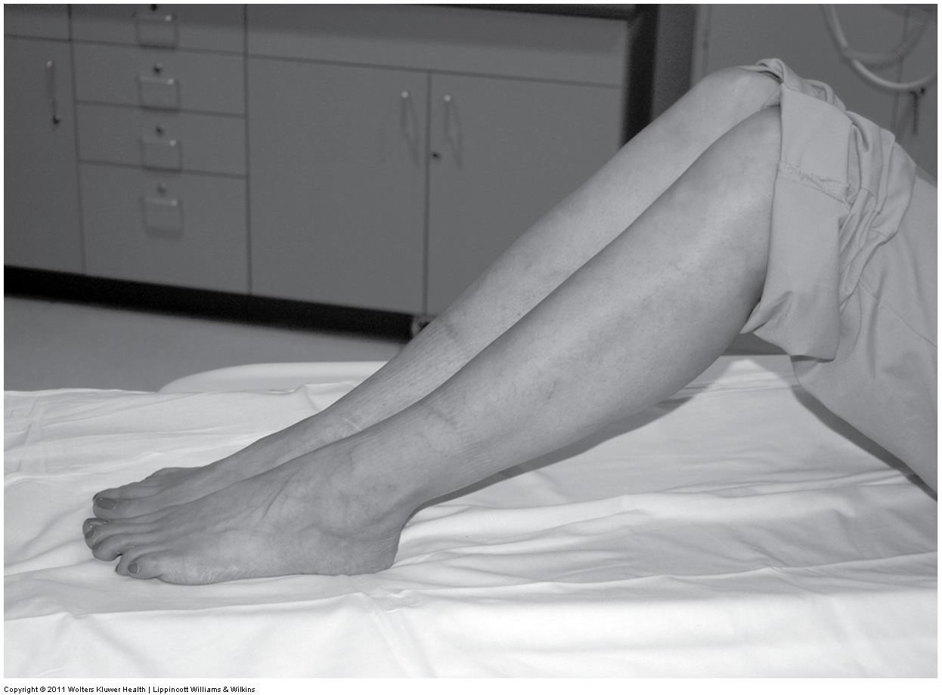
CT imaging of the extremities
NECT Foot & Ankle
Alternative positioning – Patient supine, knees bent with feet flat on the table.

Slide 53
CT imaging of the extremities
NECT Foot and/or Ankle
SFOV – Large / Body
DFOV – 16 cm adjust to skin surface
Algorithm – Bone / Bone plus
WW 2000 WL 500

Slide 54
CT imaging of the extremities
NECT Foot and/or Ankle
Acquisition kVp: 140
Acquisition mAs: 200
  No need for ATCM
Reconstruction details will vary
  MPR – align imaging plane to be perpendicular to the long
    axis of the anatomy
  Slice Thickness – thin slices
  Windowing – soft tissue WW 500 WL 50
  Apply filters – high-resolution bone / bone plus
  3D, if indicated

Slide 55
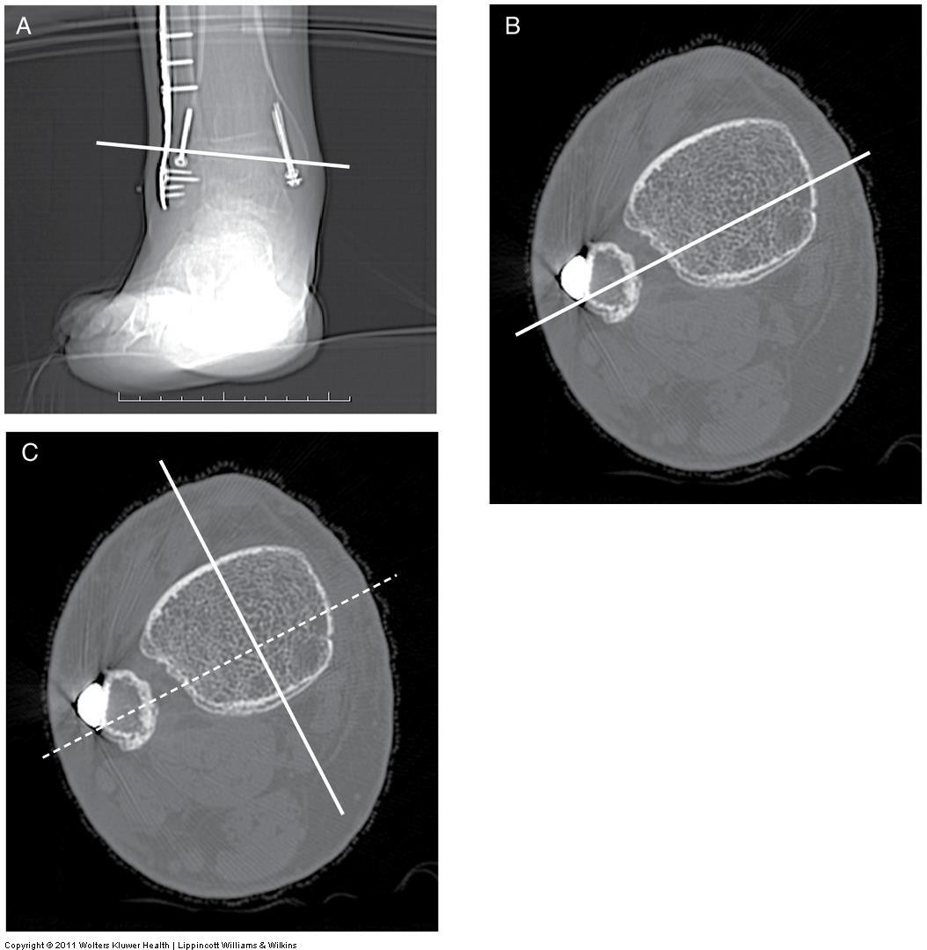
CT imaging of the extremities

Slide 56
CT imaging of the extremities
https://radiopaedia.org/cases/normal-ct-of- the-ankle- 1?lang=us
https://radiopaedia.org/cases/talar-body- fracture-1?lang=us

Slide 57
CT imaging of the extremities
Summary
Review anatomy of the shoulder, elbow, wrist, hip/pelvis, knee, ankle and foot
Review indications, contraindications and technical factors involved in CT MSK examinations
Next up – final exam preparation!

