Slide 1
MRAD 204:
Radiographic Technique 1
Outcome 6-10:
Positioning – Ankle, Foot, Calcaneus & Toes

Slide 2
Affiliated Readings
Module Reading
Bontrager
Pgs: 228→230
Pgs: 232→236
Pgs: 237→238
Pgs: 239→242

Slide 3
Overview
Guidelines/Considerations
Protocol
Positioning

Slide 4
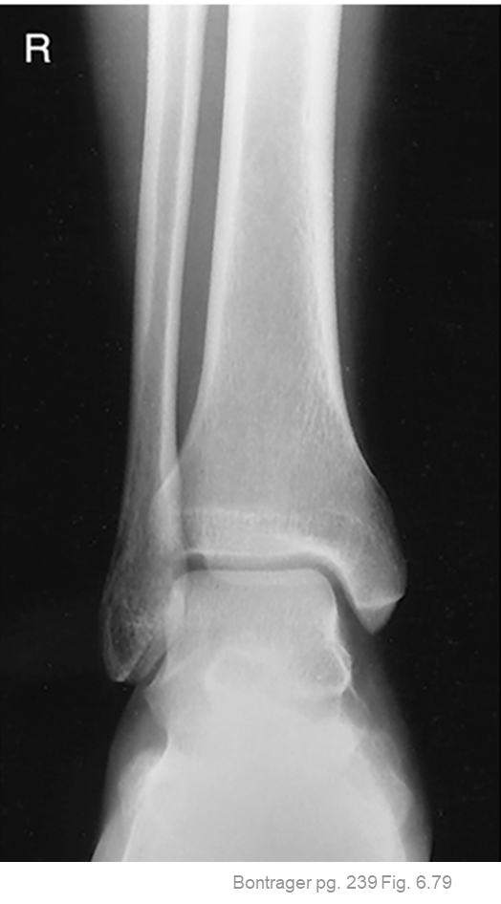
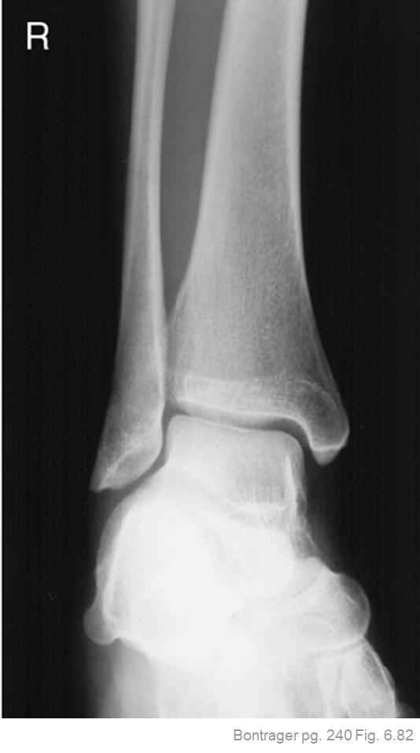
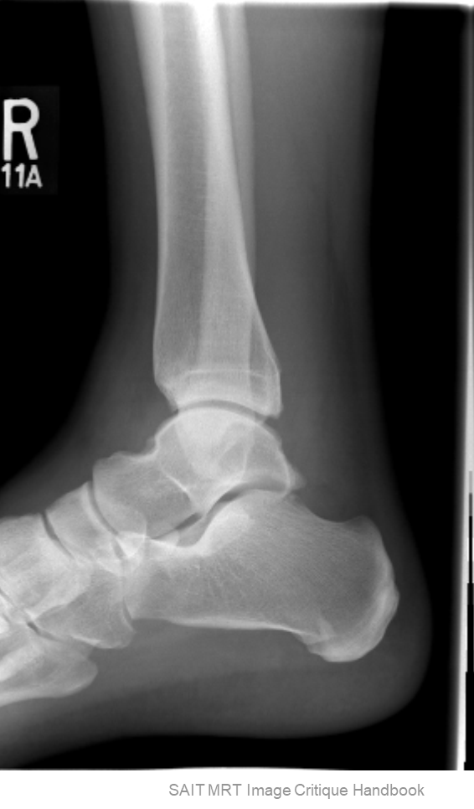
Guidelines/Considerations – Ankle
Identify required anatomy
R
Lateral projection must also display the entire calcaneus, navicular and base of 5th metatarsal
All ankle projections require visualization of 1/3rd of distal tib/fib

Slide 5
Guidelines/Considerations – Ankle
2. Select appropriate equipment/technical factors
*Using the smallest field size possible
100cm SID, measured manually
  Using cassettes or wireless digital IR
Prepare the control panel/console
  *your 1st projection
Ankle technique = 60→75 kVp

Slide 6
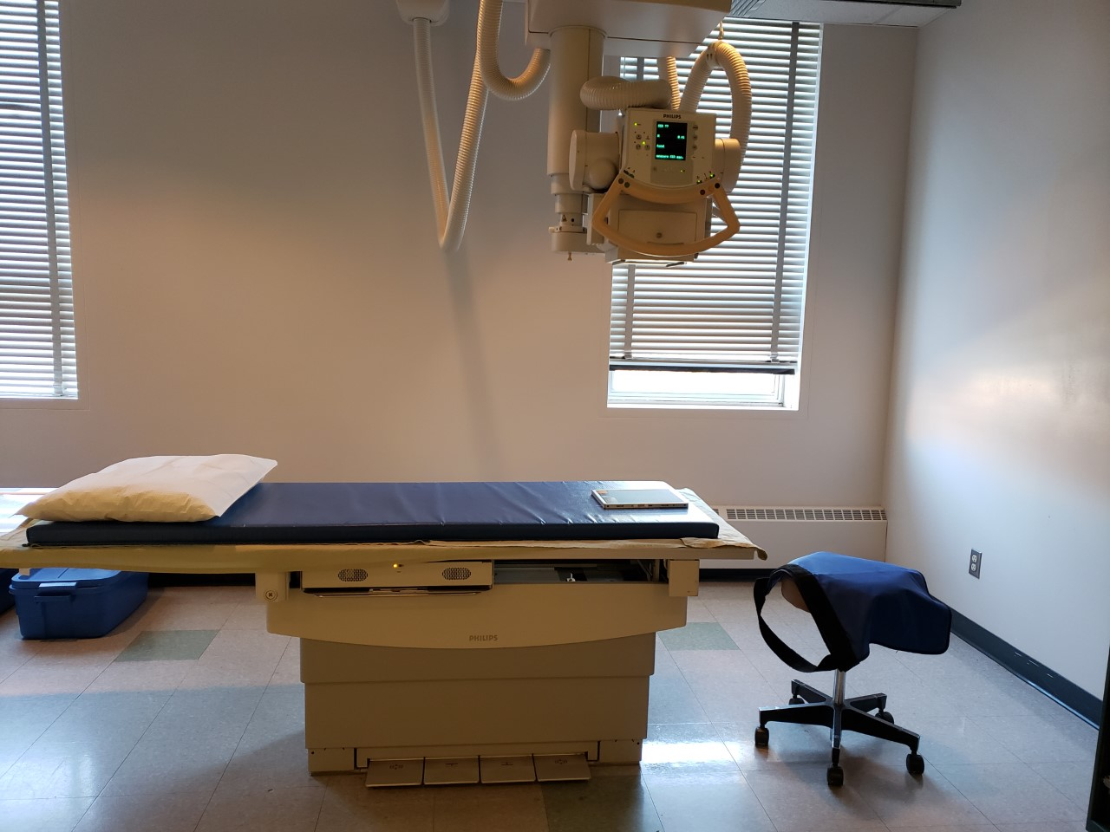
Guidelines/Considerations – Ankle
Setup room before bringing the patient in
  Note: can be done at either end of table
Tube and IR aligned using 100cm SID
Field size matches size of IR
Correct anatomical marker selected
Ensure the table IR is not directly under the IR
SAIT Campus 2021

Slide 7
Guidelines/Considerations – Ankle
3. Artifact Removal
Any clothing or objects from the knee down
*i.e. shoes, socks, and any jewelry must be removed
  Marker NOT under soft-tissue anatomy shadow
Notes: when the patient is in the room:
Use external landmarks when positioning
  Correct patient position is determined by:
    Femoral epicondyles: for AP & Lateral projections
    Intermalleolar line: for Mortise projection

Slide 8
Protocol - Ankle
Routine:
AP
AP Mortise (15-20⁰ medial oblique)
Lateral (Mediolateral)

Slide 9
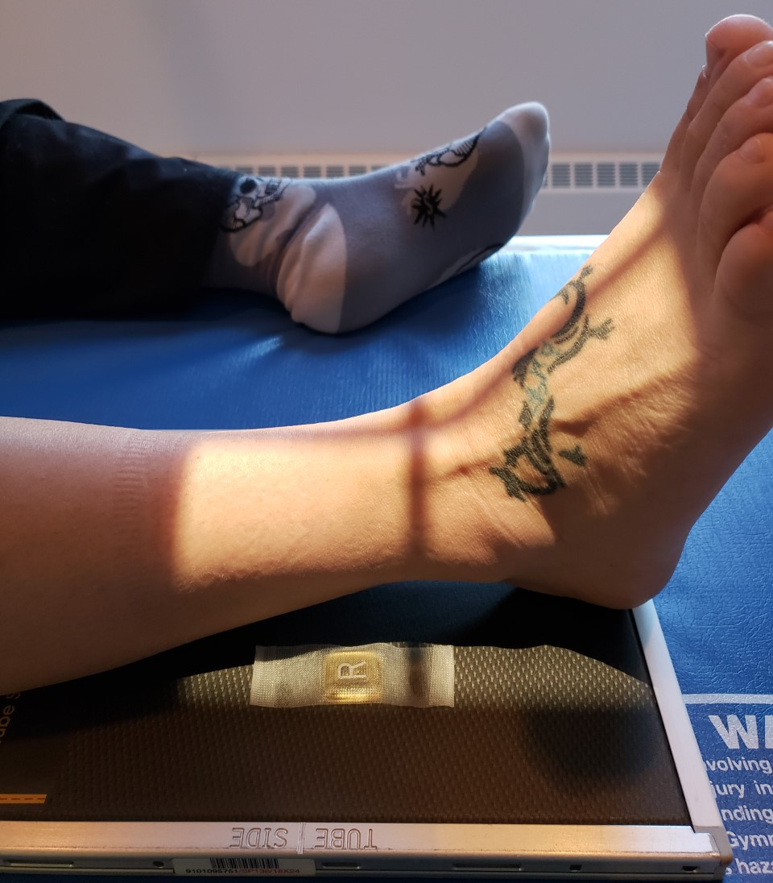
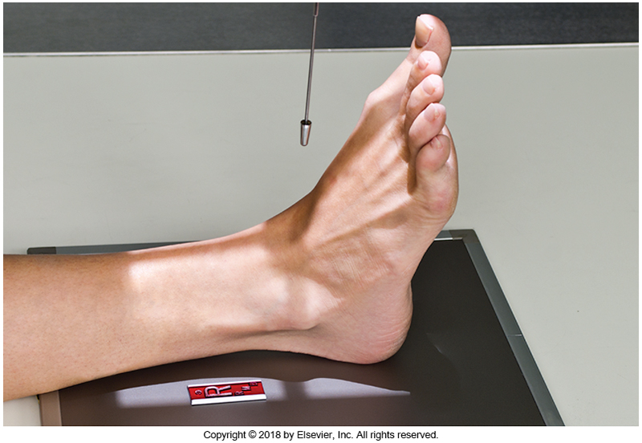
Positioning – AP Ankle
If positioned with the calcaneus over inferior edge of the IR; the light field will extend beyond the active surface
Knee must be positioned in true AP
  Femoral epicondyles parallel to IR
Dorsiflex foot 90º
  (if patient condition allows)
Place an anatomical marker (using Anderson Marker Rules), and make final adjustments
Note: ankle joint is not ½ between all the required anatomy
If ankle joint is centered over the IR; the light field will include the entire foot (i.e. phalanges and metatarsals)
Bontrager pg. 239 Fig. 6.78 & SAIT Campus 2021

Slide 10
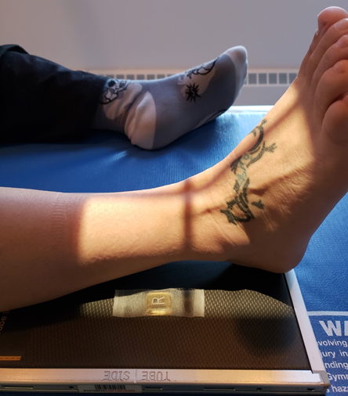
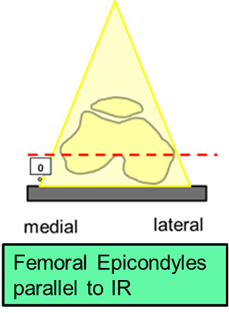
Positioning – AP Ankle
Toes not superimposing ankle joint
Foot dorsiflexed 90⁰
Bontrager pg. 239 Fig. 6.78
CR should be over ankle joint
Lengthwise crosshair centered ½ between malleoli
Inferior light field will include entire foot, and may extend beyond the active surface of the IR
Lateral-medial collimation: @ least ½ inch beyond soft-tissue
“Top” of light field on pt. to include 1/3rd of distal tib/fib
Marker on lateral side, not under anatomy shadow

Slide 11
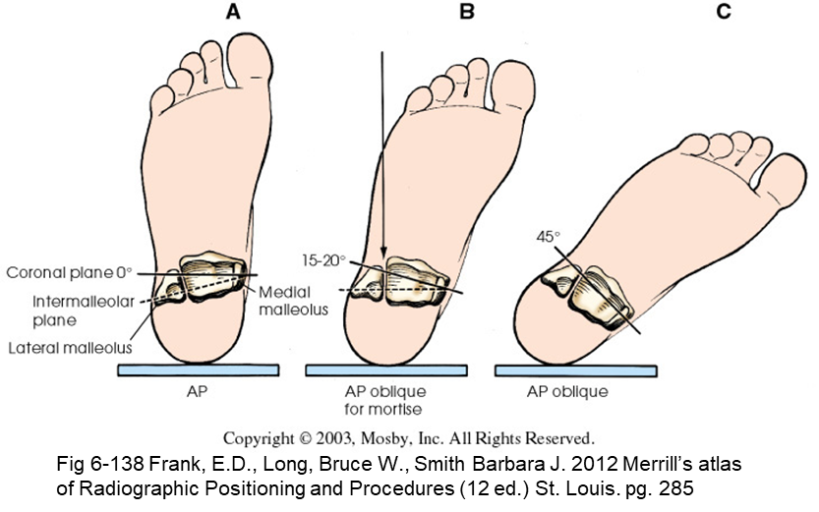
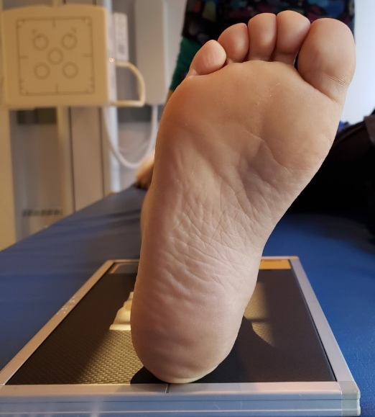
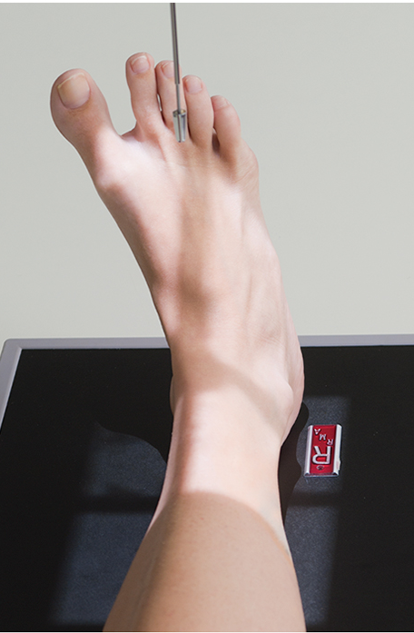
Positioning – AP Mortise Ankle
Place malleoli parallel to IR
  15-20º medial rotation
Dorsiflex foot 90º
  (if patient condition allows)
Place an anatomical marker (using Anderson Marker Rules), and make final adjustments
Bontrager pg. 240 Fig. 6.81

Slide 12
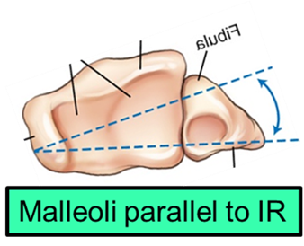

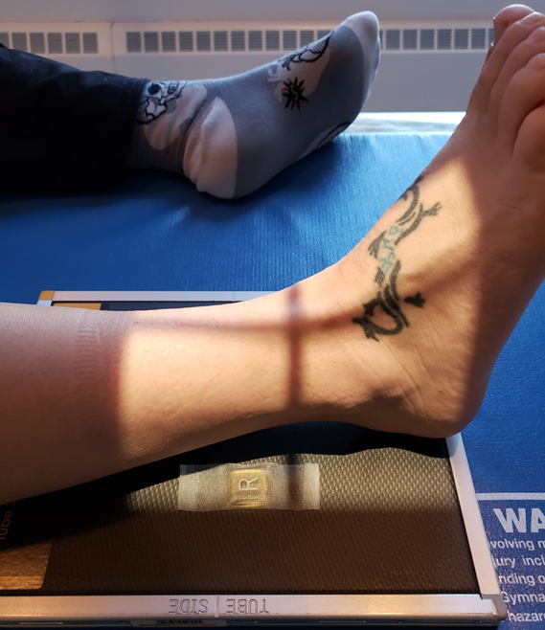
Positioning – AP Mortise Ankle
Toes not superimposing ankle joint
Foot dorsiflexed 90⁰
Lengthwise crosshair centered between malleoli
CR should be located over ankle joint
Lateral-medial collimation: @ least ½ inch beyond soft-tissue
Inferior light field will include entire foot, and may extend beyond the active surface of the IR
“Top” of light field on pt. to include 1/3rd of distal tib/fib
Marker on lateral side, not under anatomy shadow

Slide 13
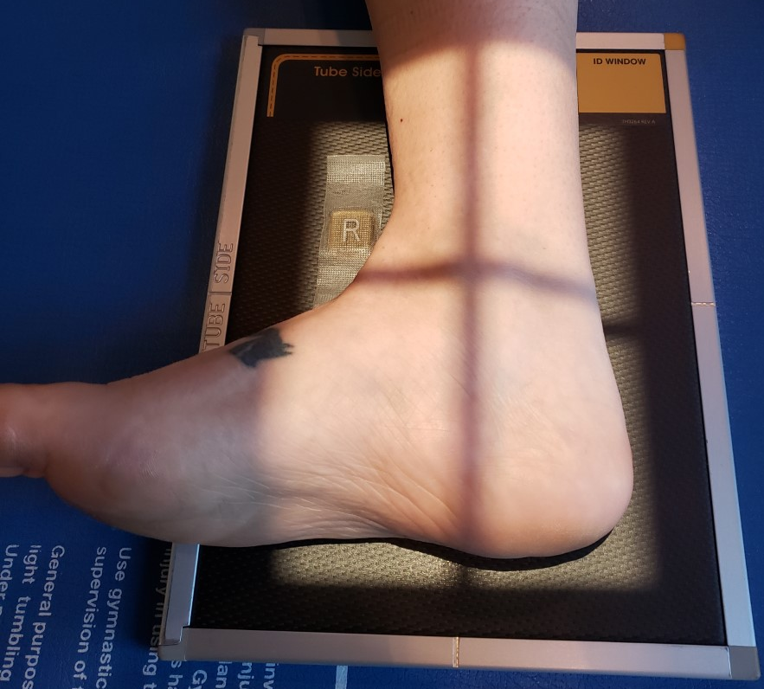
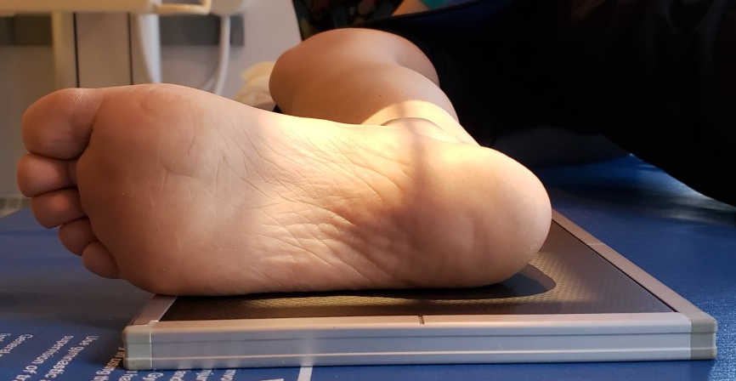
Positioning – Lateral Ankle
Femoral epicondyles perpendicular to IR
Dorsiflex foot 90º
Entire lateral surface of foot in contact with IR
Place an anatomical marker (using Anderson Marker Rules), and make final adjustments

Slide 14
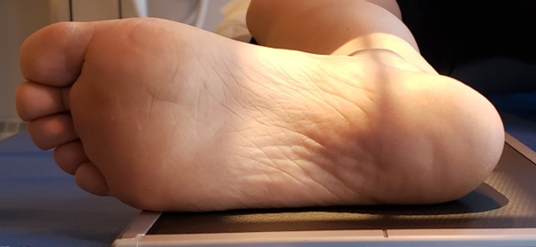
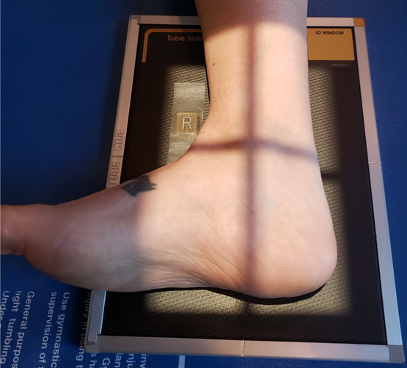
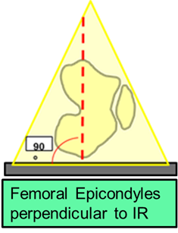
Positioning – Lateral Ankle
“Top” of light field on pt. to include 1/3rd of distal tib/fib
CR should be located over ankle joint
Lateral surface of foot “flat” against IR
Marker anterior, not under anatomy shadow
Lengthwise crosshair to pass thru medial malleolus
Collimate anteriorly to include navicular & base of 5th metatarsal
Foot dorsiflexed 90⁰
Collimate posteriorly to include @ least ½ inch beyond soft-tissue of calcaneus
“Bottom” of light field on IR @ least ½ inch beyond soft-tissue of calcaneus

Slide 15
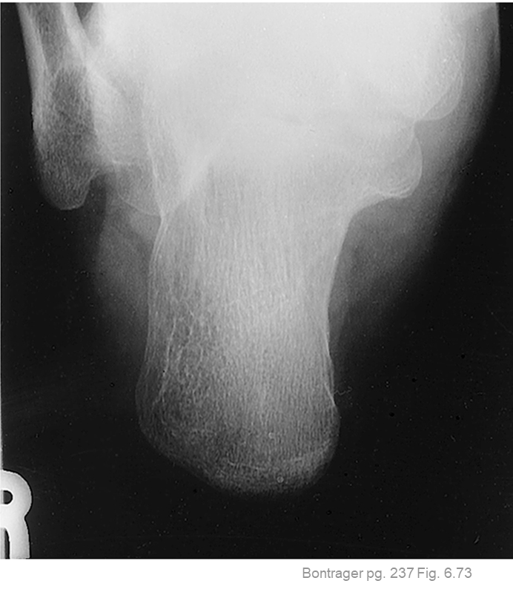
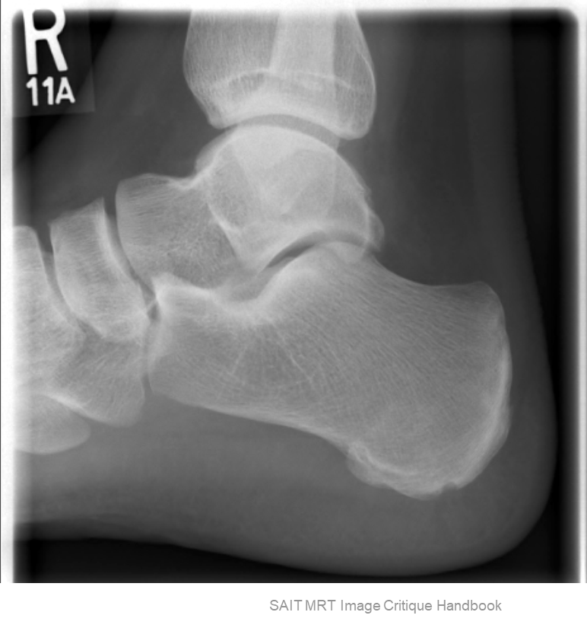
Guidelines/Considerations – Calcaneus
1, 2 & 3. Same as Ankle EXCEPT:
Lateral projection must also display ~1 inch of distal tib/fib & all soft-tissues
R
All calcaneus projections require visualization of entire calcaneus, base of 5th metatarsal & the talocalcaneal joint
Calcaneus technique = *60→75 kVp (*Axial = 65-75)

Slide 16
Protocol – Calcaneus (aka. os calsis)
Routine:
Plantodorsal Axial
Lateral (Mediolateral)

Slide 17
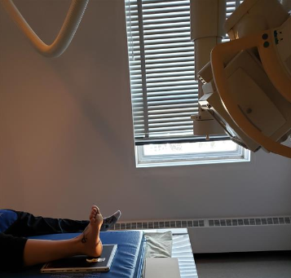
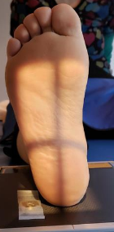
Positioning – Plantodorsal Axial Calcaneus
Tube Angle & ankle flexion should always = 130º
Direct CR to base of 3rd metatarsal (superior border of “heel pad”)
  Crosshair should be distal to lateral malleolus
Dorsiflex foot 90º
  (if patient condition allows)
Place an anatomical marker (using Anderson Marker Rules), and make final adjustments
40⁰

Slide 18
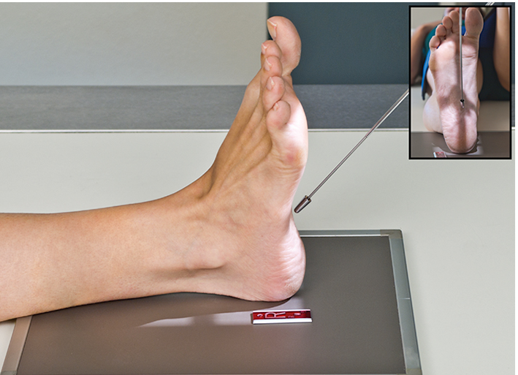
Positioning – Plantodorsal Axial Calcaneus
Tube Angle and ankle flexion should always = 130º
Superior light field inferior to phalanges
Lengthwise crosshair centered between malleoli
Lateral-medial collimation: @ least ½ inch beyond soft-tissue
Collimate distally to include @ least ½ inch beyond soft-tissue shadow of calcaneus
Foot dorsiflexed 90⁰
CR ~5th metatarsal base (aka. diverging crosswise crosshair should be inferior/distal to lateral malleolus)
Marker on lateral side, not under anatomy shadow
Bontrager pg. 237 Fig. 6.72

Slide 19
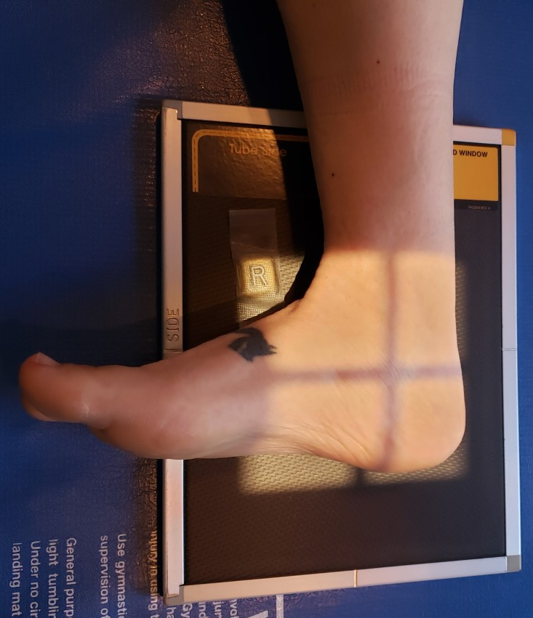
Positioning – Lateral Calcaneus
Center ~1 inch (2.5cm) distal to medial malleolus
Same positioning as lateral ankle:
Dorsiflex foot 90º
  (if patient condition allows)
Lateral surface of foot in contact with IR
Place an anatomical marker (using Anderson Marker Rules), and make final adjustments

Slide 20
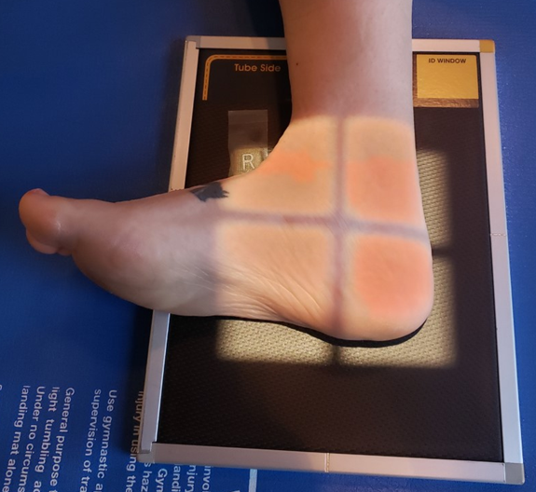
Positioning – Lateral Calcaneus
“Top” of light field on pt. to include 1 inch of distal tib/fib
CR ~1 inch distal to medial malleolus
Lateral surface of foot “flat” against IR
Marker anterior, not under anatomy shadow
Lengthwise crosshair to pass thru medial malleolus
Collimate anteriorly to include navicular & base of 5th metatarsal
Foot dorsiflexed 90⁰
Collimate posteriorly to include @ least ½ inch beyond soft-tissue of calcaneus
“Bottom” of light field on IR @ least ½ inch beyond soft-tissue of calcaneus

Slide 21
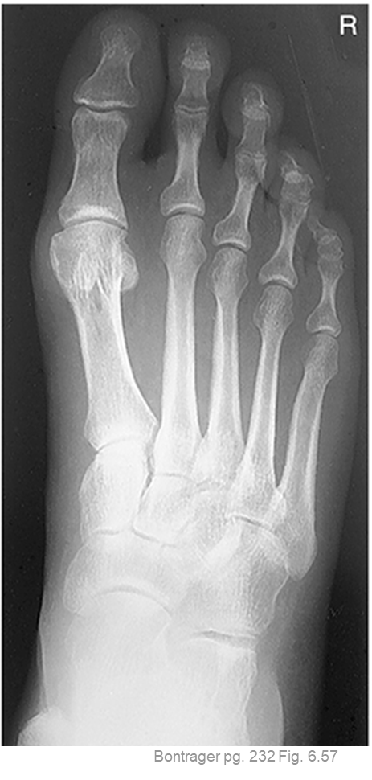
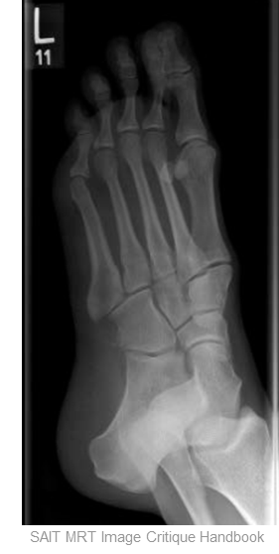
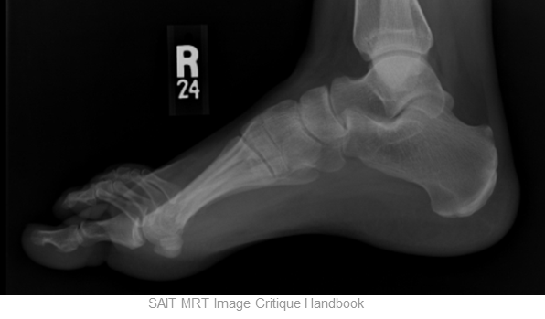
Guidelines/Considerations – Foot
1, 2 & 3. Same as Ankle EXCEPT:
Oblique & Lateral Foot projections should demonstrate entire foot, including entire calcaneus and soft-tissues
Lateral projection must also display ~1 inch of distal tib/fib
AP (axial) projection is only required to display all anatomy anterior to the talus
Correct patient position is determined by:
  Plantar surface of foot: for AP (axial) projection
  Transverse arch: for Oblique projection
  Metatarsal heads: for Lateral projection
Foot technique = *55→70 kVp (*AP = 55-65 & Obl. & Lat. = 60-70)

Slide 22
Protocol - Foot
Routine:
AP (10º Axial – Dorsoplantar)
AP Oblique (with medial rotation)
Lateral (Mediolateral)
Non-Routine Views:
Weight-bearing AP (10º Axial)
Weight-bearing Lateral (Mediolateral)

Slide 23
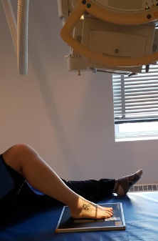
Positioning – AP (Axial) Foot
Entire plantar surface flat on IR
Ensure entire foot is parallel to long edge of IR
Knee and tib/fib should be aligned with foot
Place an anatomical marker (using Anderson Marker Rules), and make final adjustments

Slide 24
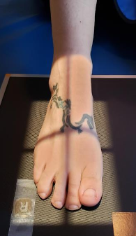
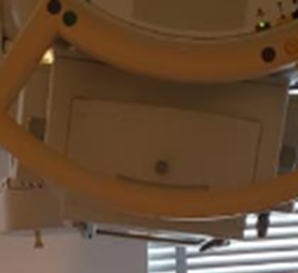
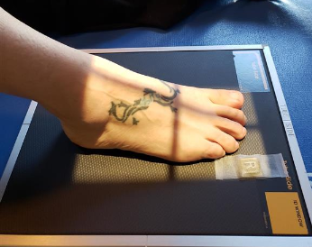
Positioning – AP (Axial) Foot
Knee & ankle aligned with foot (i.e. parallel to long edge of IR)
Lengthwise crosshair centered ~2nd and 3rd phalanx
10⁰ Cephalad CR angle
Lateral-medial collimation: @ least ½ inch beyond soft-tissue
Distal light field @ least ~½ inch beyond digits
Entire plantar surface flat on IR
Posterior light field on pt. to exclude ~½ inch of calcaneus
Marker on lateral side, not under anatomy shadow

Slide 25
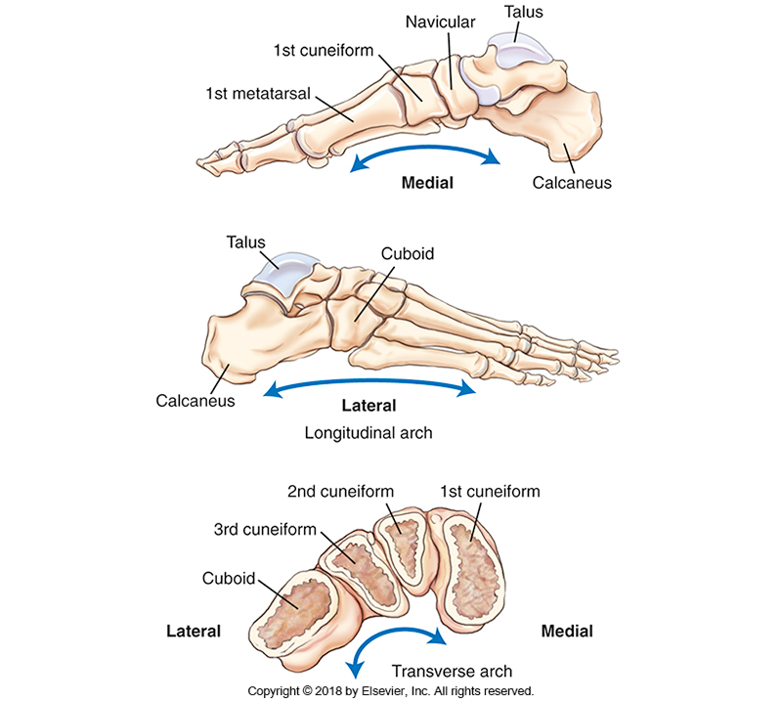
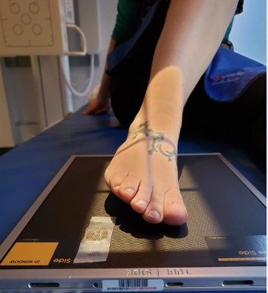
Positioning – AP Oblique Foot
Note: 3cm OID under lateral side of foot = adequate rotation for most people
Rotate foot medially until transverse arch is parallel to IR
  ~30-40º rotation
Ensure entire foot is parallel to long edge of IR
Knee and tib/fib should be aligned with foot
Place an anatomical marker (using Anderson Marker Rules), and make final adjustments
SAIT Campus 2021

Slide 26

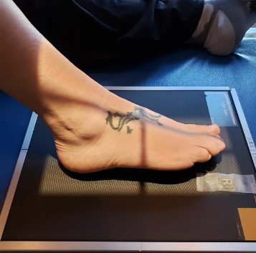
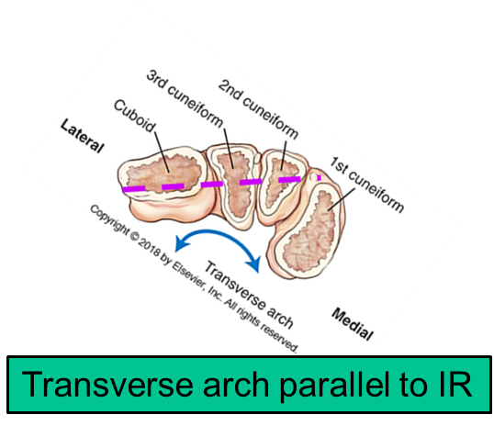
Positioning – AP Oblique Foot
Lateral-medial collimation: @ least ½ inch beyond soft-tissue *ensure shadow of talus is included medially
Lengthwise crosshair centered ~2nd and 3rd phalanx
Distal light field @ least ~½ inch beyond digits
Foot parallel to long edge of IR
Posterior light field on IR to @ least ~½ inch beyond calcaneus
Marker on lateral side, not under anatomy shadow

Slide 27
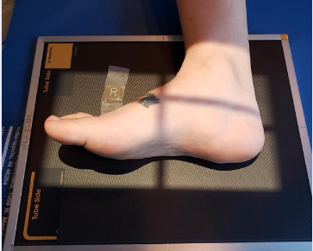
Positioning – Lateral Foot
Flex patient’s knee and place lateral side of foot on IR
Dorsiflex foot 90º
Ensure plantar surface is perpendicular to IR
  i.e. Metatarsal heads perpendicular to IR
Place an anatomical marker (using Anderson Marker Rules), and make final adjustments

Slide 28
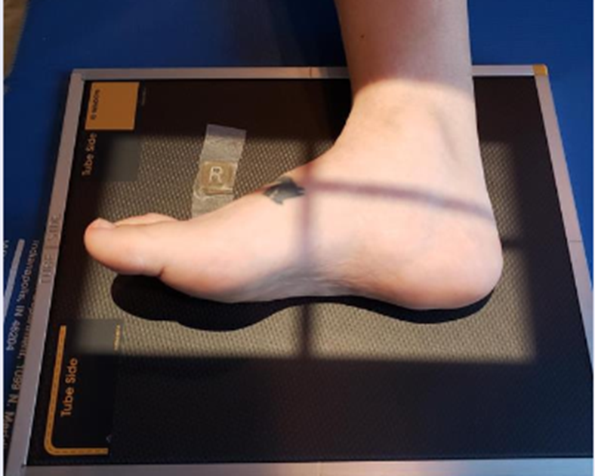
Positioning – Lateral Foot
“Top” of light field on pt. to include 1 inch of distal tib/fib
Metatarsal heads perpendicular to IR
Marker anterior, not under anatomy shadow
Foot dorsiflexed 90⁰
Collimate anteriorly to include @ least ½ inch beyond shadow of digits
Collimate posteriorly to include @ least ½ inch beyond soft-tissue of calcaneus
“Bottom” of light field on IR @ least ½ inch beyond soft-tissue of the foots plantar surface

Slide 29
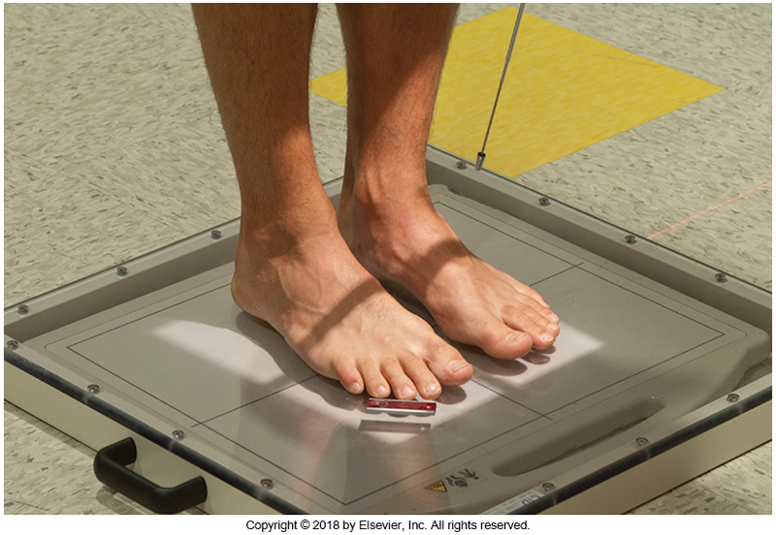
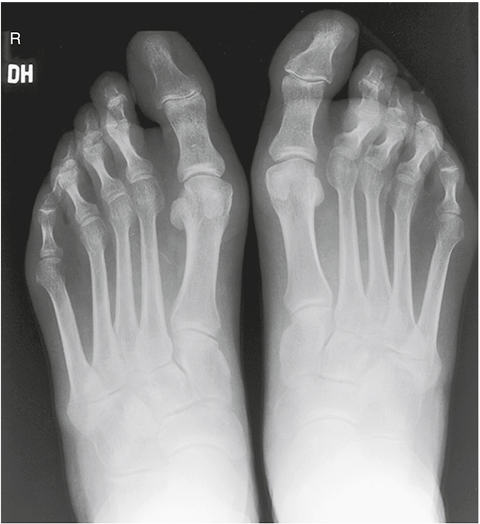
Positioning: AP (Axial) Weight-bearing Feet
Entire plantar surface of both feet flat on IR
  Weight evenly distributed
Ensure feet are parallel to long edge of IR
Angle CR 10º→15º posteriorly
Place anatomical markers (using Anderson Marker Rules), and make final adjustments
  i.e. Weight-bearing, and R & L markers required
L
R
Bontrager pg. 235 Fig. 6.67
Wt. bearing
Bontrager 9th Ed. pg. 235 Fig. 6.68

Slide 30
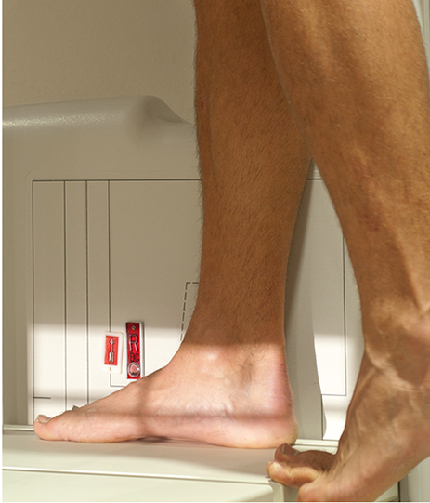
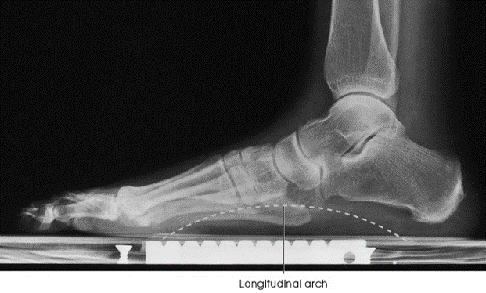
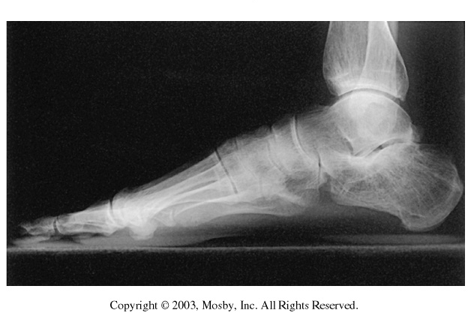
Positioning – Lateral Weight-bearing Feet
Evaluates longitudinal arch when body weight is applied
L
R
Wt. bearing
Requires weight bearing and anatomical markers
Bontrager pg. 236 Fig. 6.69
Fig 6-55 and 6-56 Frank, E.D., Long, Bruce W., Smith Barbara J. 2012 Merrill’s atlas of Radiographic Positioning and Procedures (12 ed.) St. Louis. pg. 263

Slide 31
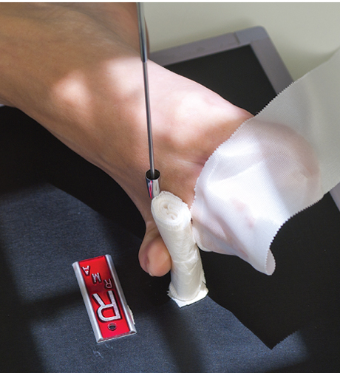
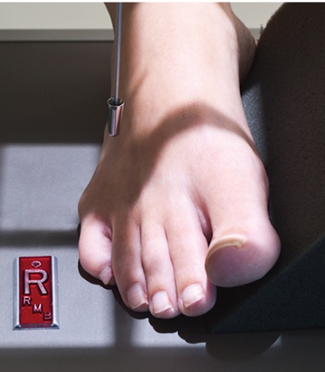
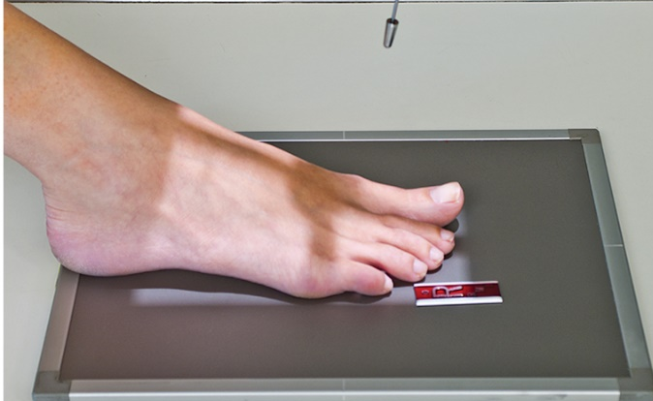
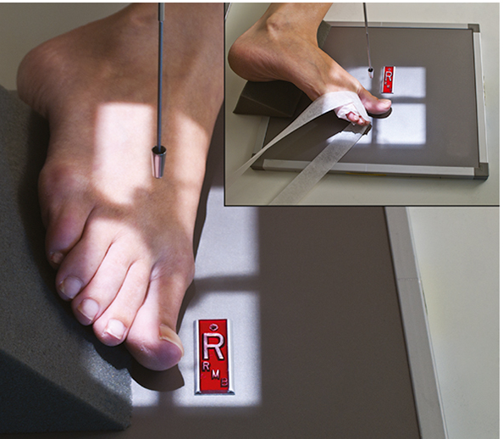
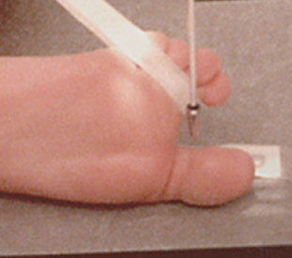
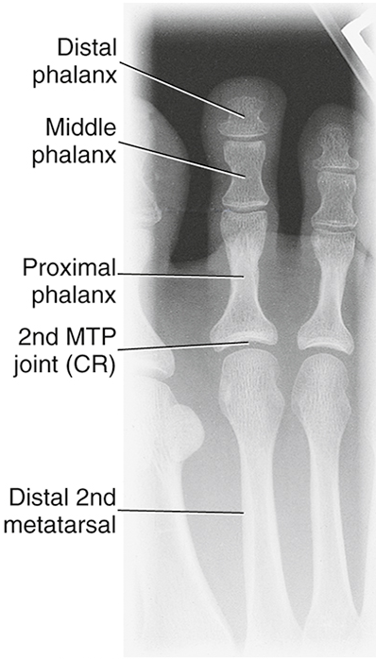
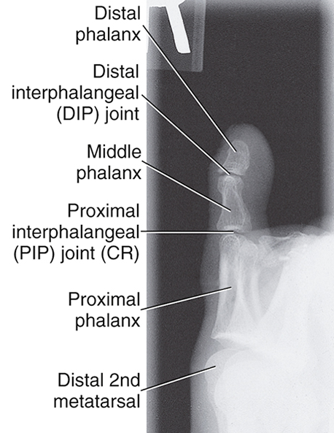

Positioning – Toes
Oblique in direction which removes superimposition and minimizes OID
AP = axial projections
Bontrager pg. 228-230 Fig. 6.39, 6.42, 6.43, 6.44, 6.46, 6.47, 6.49 & 6.51

