Slide 1


Business Operations
Unit 7

Slide 2

Why is important?
-Without Marketing, buyers and clients will not know that you are offering services
99% of businesses go out of business due to a lack of no marketing or poor marketing management
Your budget for opening a business should include money for continued marketing

Slide 3

The Beauty Business
Marketing Strategies for Building Your Business

Slide 4

According to a survey conducted by the Professional Beauty Association (PBA), the top three ways that clients find a service provider are
recommendations or referrals,
a convenient location, and
advertisements.

Slide 5

Viral Marketing
Viral marketing technique can pass your message along to hundreds and thousands of potential clients through social media sites and e-mail campaigns.
When speaking of viral marketing what ideas come to mind?
Let’s discuss…..

Slide 6

Social Media for the Business Owner
The following are a few ways you might use social media to provide consistent content oriented around your business:

Slide 7

This is accomplished by consistently providing content that is seen as valuable and relevant to your audience
Write a blog reflecting your knowledge, talent, and skills with beauty and wellness tips and resources.
Post beauty and wellness tips of the day.
Network with cosmetic and beauty brands and give your personal review of new products.
Start a beauty and wellness advice column.

Slide 8

Advertising
Advertising includes all activities that promote your salon, spa, or barbershop favorably, from newspaper ads to radio spots to charity events that the business participates in, such as fashion shows or community outreach. In order to create a desire for a service or product, advertising must attract and hold the attention of readers, listeners, or viewers

Slide 9
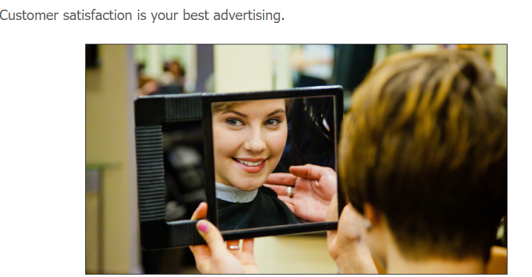

Slide 10
Tools you may choose to use to attract customers
Newspaper ads and coupons
A website
If you don’t have a large budget now, buy your domain name and keep that ownership current. You can set up a site very inexpensively and as your business grows, you can build it to have many pages and features. A website is an easy way for new clients to find you through Internet searches or friends sharing links.
E-mail newsletters and discount offers to all clients who agree to receive such mailings
Always include an Unsubscribe link. You can also purchase e-mail lists targeted to your demographic to help you build your subscriber list.
Website offerings, including those on your own website, social networking websites, and blogs
Direct mail to mailing lists and your current client list
Classified advertising

Slide 11
Giveaway promotional items, such as branded combs, or retail packages, like shampoos and colognes
Window displays that attract attention and feature the shop and your retail products
Radio advertising
Television advertising
Community outreach: Volunteer at men’s and women’s clubs, church functions, political gatherings, charitable affairs, and on TV and radio talk shows
Donations of your services for local organizations like school fundraisers
Client referrals
In-shop videos promoting your services and products
An on-hold message featuring your business’s best attributes

Slide 12

Did you know?
The first goal of every business should be to maintain current clients
It takes at least three visits for a new client to become a loyal current client.
Have a pre-booking system in place
Contact any client who has not been in for more than eight weeks.

Slide 13

Let’s do Marketing
Divide yourself in groups
Chose what type of business you will have
Choose a name
Design your different marketing ideas ( 1 hr. )
Be creative!
Present your ideas to the class

