Slide 1
APPH 226: Contrast
Objectives: 5.1, 5.2, 5.3, 5.6

Slide 2
Radiographic Quality
Radiographic Image Quality
Photographic Properties
Visibility
Density
Geometric Properties
Sharpness
Contrast
Recorded Detail
Distortion

Slide 3
Radiographic Contrast
Can be described as the difference in optical density (OD) between adjacent structures (density differences)
Variation of OD on an image
Function:
  Makes the anatomy visible
  Differences in density

Slide 4
Levels of Contrast

Slide 5
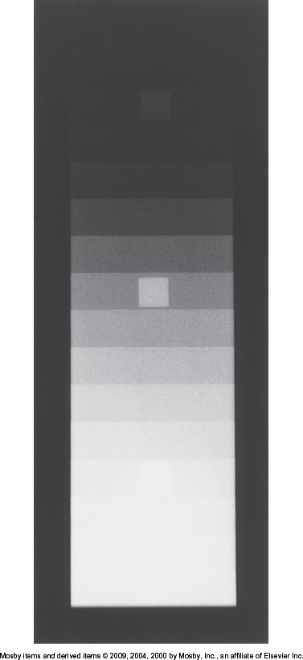
Levels of Contrast
High contrast
  Also referred to as short-scale contrast
  Few densities, but great differences between them.
  ‘black and white’

Slide 6
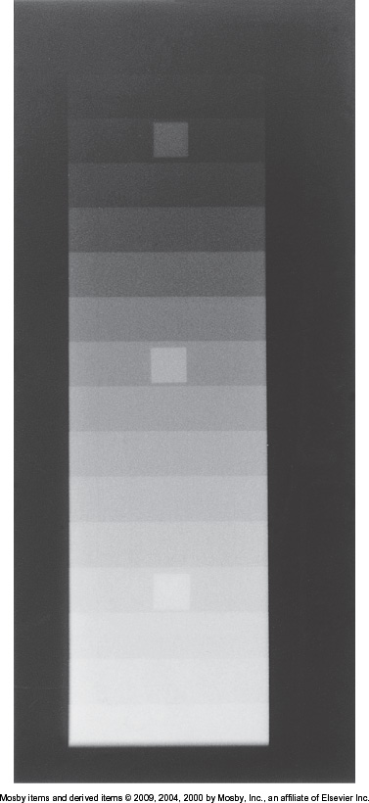
Levels of Contrast
Low Contrast
  Also referred to as long-scale contrast
  Large number of densities, but small differences between them
  ‘more shades of grey’

Slide 7
High Vs. Low

Slide 8
Radiographic Contrast
Is a product of both image receptor contrast and subject contrast
Image Receptor contrast
  Determined by the properties that are manufactured into the image receptor
  Technologist has no control over this, but can be influenced by processing and exposure
Subject contrast
  Determined by absorption characteristics of tissues in the area being imaged, and kVp used
    Thickness of part, density of tissue, atomic number

Slide 9
Image Receptor Contrast
Determined by the manufacturer
Simplest way to work with this is to standardize it
  Digital IR
    Ensure appropriate exposure is used every time
      Optimal OD for images (between 0.25-2.5)
    Maximize the exposed area of the image receptor

Slide 10
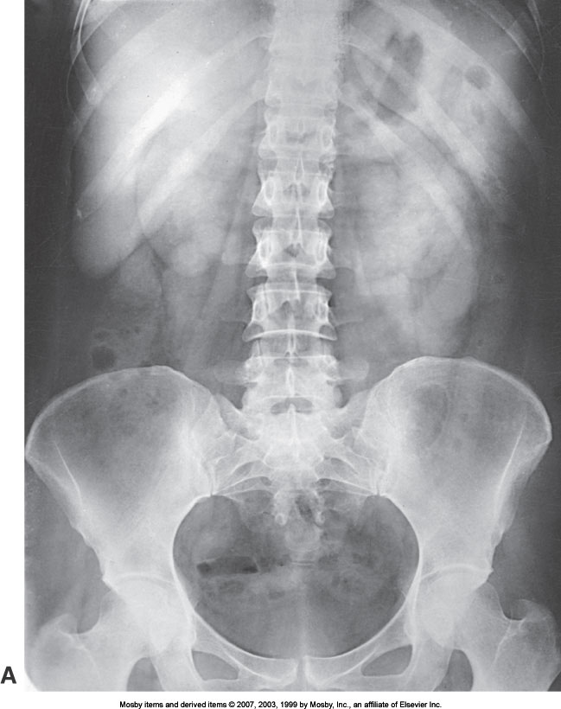
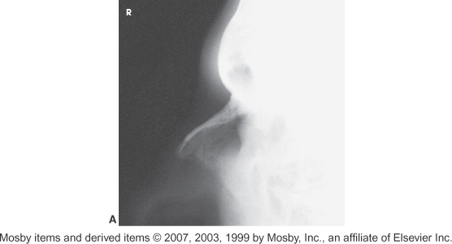
Evaluating Contrast
Lower contrast – more shades of grey. Higher contrast - few shades of grey.

Slide 11
Contrast Evaluation
Contrast is more complex than density
Subjective to the viewer
Determined by the subject/area being imaged
  Amount of information needed to visualize tissue for optimum accuracy of diagnosis
  Personal preference

Slide 12
Body Part Composition
What is the anatomy being imaged?
What is optimal visualization?
  i.e. soft tissue vs bony extremities
When selecting technical factors, need to consider the composition of anatomy (bone, muscle, fat, soft tissue, air)
Ideal contrast – for the part – will maximize the amount of information visible for diagnosis

Slide 13
Density and Contrast
Density, in most situations, has no effect on contrast
The occasions where it does affect contrast are:
  Density too high
  Density too low
    Cannot assess radiographic contrast
    Must be at an acceptable level
    Unless specified, assume that the density is within the ideal range

Slide 14
Scatter – What factors can affect it?
Based on your knowledge thus far, can you think of what factors would affect the amount of scatter that reaches the IR?
  Grids
  Collimation
  OID
  Filtration
    Why do these factors seem familiar?
      Density – scatter contributes to density, and also affects contrast

Slide 15

The key to contrast is… scatter

Slide 16
Grids
Review: What is the purpose of using a grid?
To absorb scatter that leaves the patient before it reaches the IR
If there is less scatter on an image, contrast is increased
If the grid ratio (efficiency) is increased, the result is a greater effect on contrast (increased contrast)

Slide 17
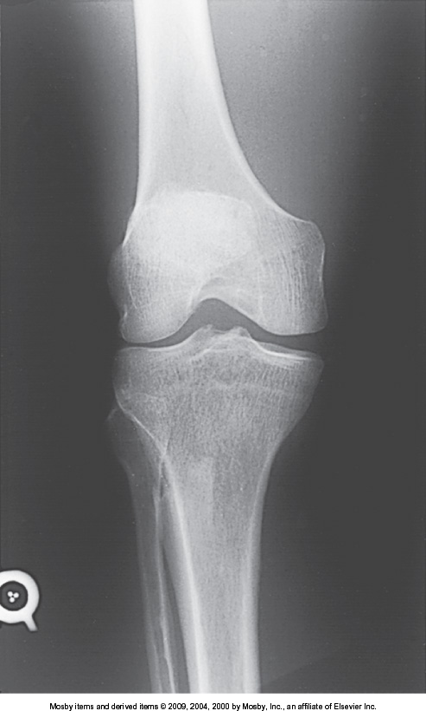
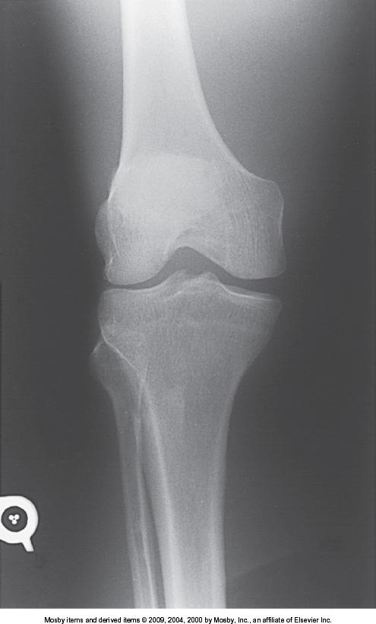
Grid Usage

Slide 18
Collimation
When the field size is changed, this affects the amount of tissue being irradiated
More matter, more scatter
With more collimation, the field size is smaller, less scatter is produced
With less collimation, this results in a larger field size, more scatter is produced

Slide 19
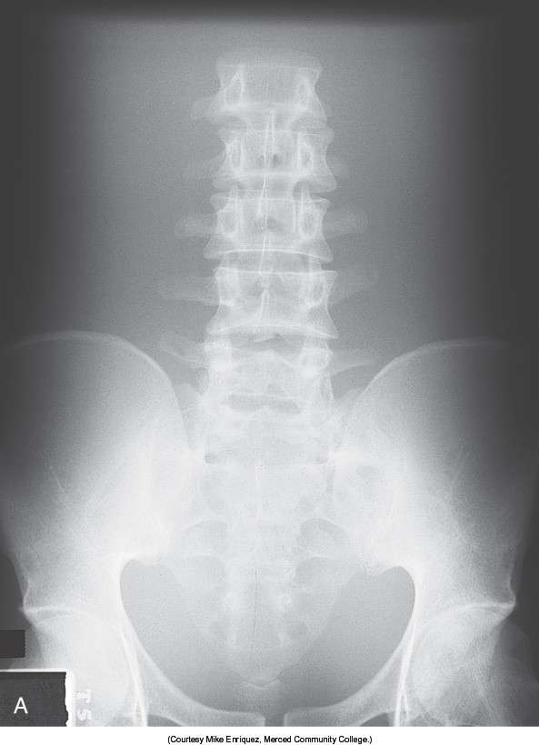
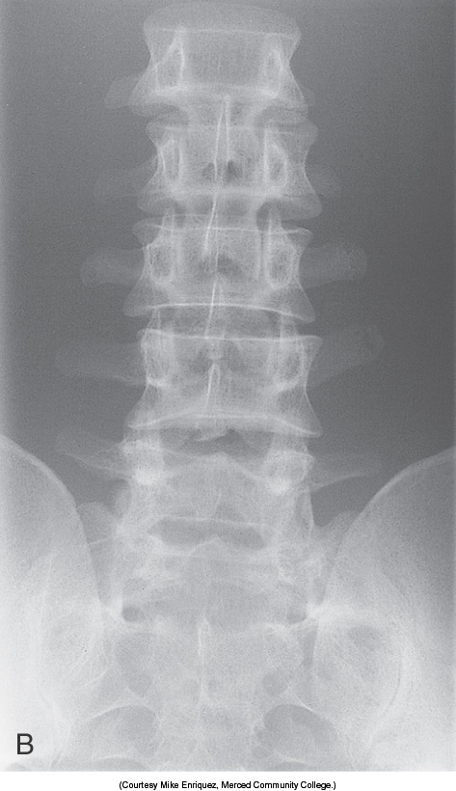
Collimation and Contrast

Slide 20
OID
If OID is increased intentionally, it is the air gap technique.
If this technique is utilized, what happens to the radiographic density and why?
  Decreased radiographic density as some scatter will miss the IR
  May require compensation with mAs (increase)
What happens to the scatter?
  It is decreased, which then effectively increases the contrast on the image

Slide 21
Filtration
Review: What happens to the x-ray beam when it is filtered?
  Low energy photons are filtered out
  Average energy of the photons will be increased
  Results in a more penetrating beam
Due to the increased x-ray energy, scatter is increased, why?
  Fewer interactions within matter, but increased proportion of Comptons interactions vs photoelectric effect (PE)
  Scatter is increased, contrast is decreased

Slide 22
Subject Factors – the Patient
This group of factors involve the patient
  Subject contrast
  Patient’s body part thickness
  Tissue mass density
  Effective atomic number
  Object shape

Slide 23
Subject contrast – the Patient
Results from how body tissues attenuate the beam differently
This is more general – description of the anatomic part
  Thickness , composition
    Within the anatomy, how is the tissue attenuating differently? Bone, soft tissue, air
    Similar thickness
      Low subject contrast – similar composition
      High subject contrast – greater variance in composition

Slide 24
Patient Thickness – the Patient
As the thickness increases, the amount of scatter produced also increases
If scatter interactions increase, the contrast decreases
Patient thickness has an additional effect on subject contrast, due to attenuation
A thick part will attenuate more than a thin part, so if the area that is being imaged has areas of differing thickness, subject contrast will increase

Slide 25
Thickness of Part
Incident X-rays
Image receptor

Slide 26
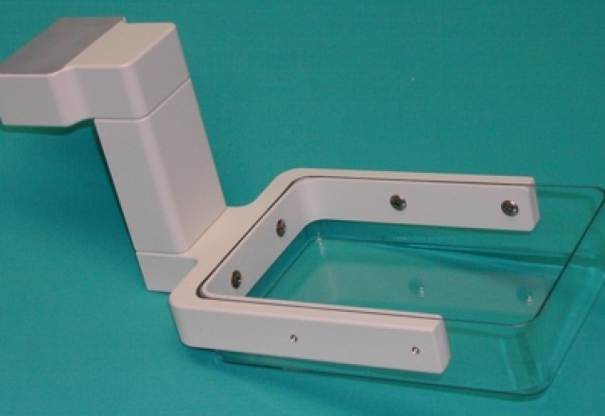
Patient Thickness
Compression devices and positioning can help create a more uniform thickness
Compression devices
  Paddles, bands
Positioning
  PA vs AP
Decreased thickness will:
  Decrease patient dose
  Increase contrast
http://livingstonproducts.com/?portfolio=biopsy-and-spot-compression-paddles

Slide 27
Tissue Mass Density
Sections of the body may have equal thicknesses, but different mass densities
Examples: Fat vs Air vs Bone vs Soft tissue vs Muscle
Chest and abdomen have similar thickness, but very different tissue mass densities
The effects of different mass densities on subject contrast can be demonstrated

Slide 28
Atomic Number (tissue)
This factor also affects subject contrast
Compton scattering is independent of atomic number, but photoelectric effect (PE) interactions vary in proportion to atomic number
If the atomic number of adjacent tissues is very different, subject contrast is high

Slide 29
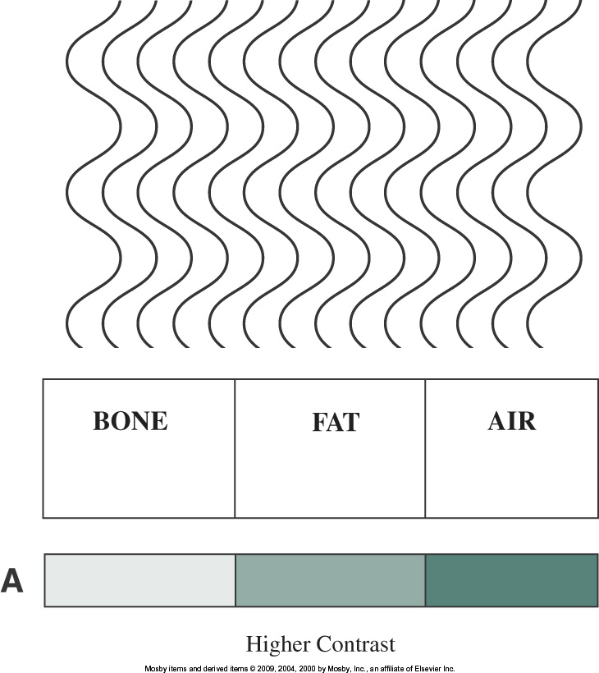
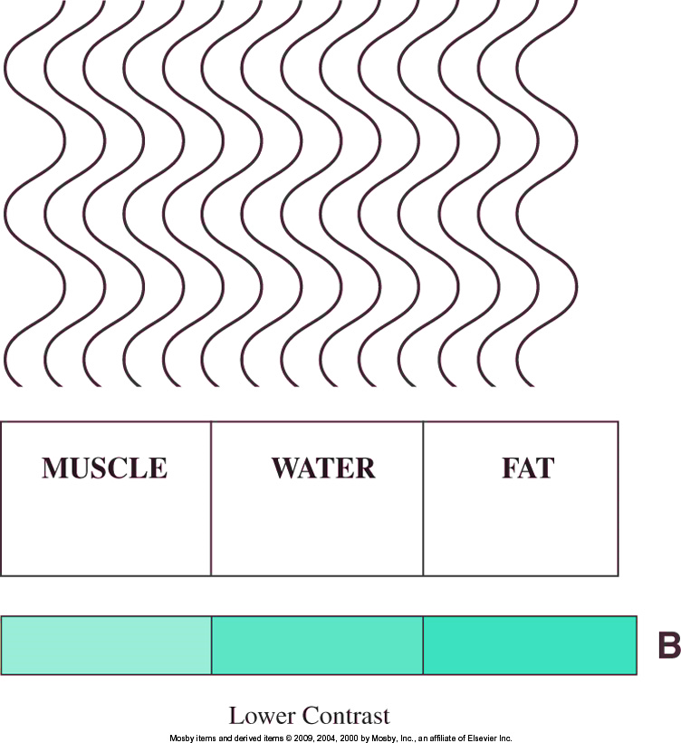
Composition

Slide 30
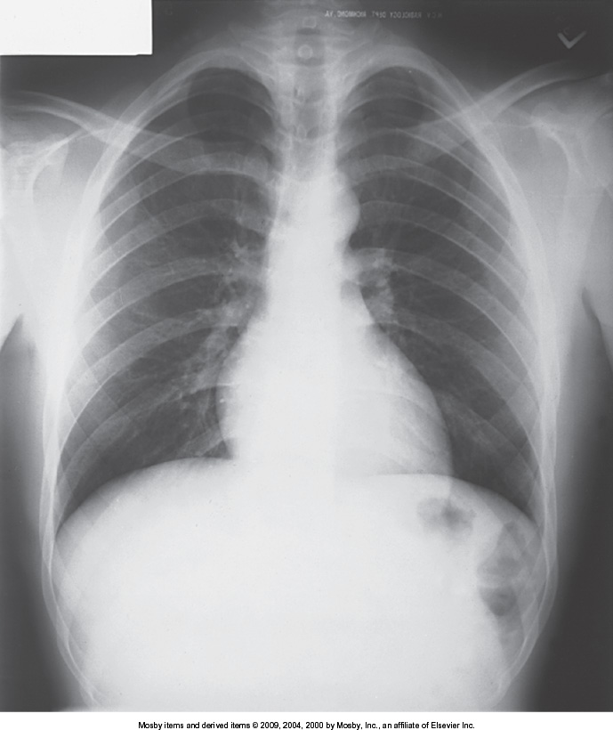
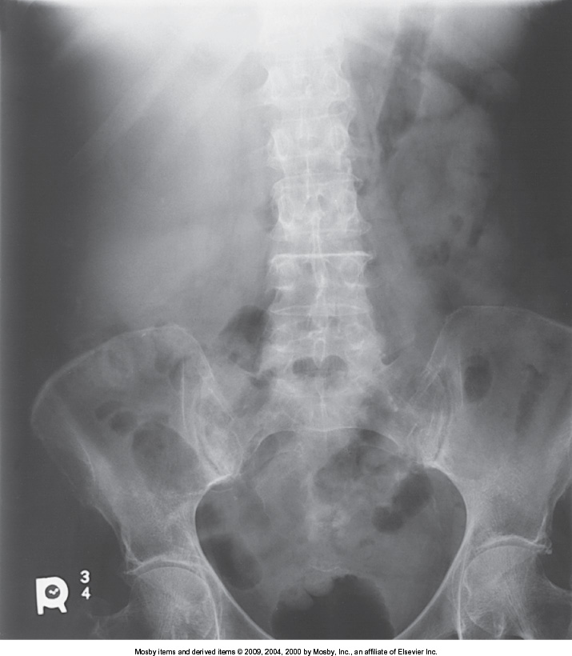
Composition

Slide 31
Contrast Media
Used to image anatomy with low subject contrast
  Soft tissue structures most commonly
PE interactions vary with atomic #
  With larger differences in atomic #, subject contrast will increase
Changes absorption characteristics of tissue
  Increase/decrease attenuation of beam

Slide 32
Contrast Media
Positive Contrast Agent
  High atomic number
  Absorbs more x-rays than surrounding tissues
  Barium, iodine
Negative Contrast Agent
  Low atomic number
  Decreased attenuation – more transmission
  Air

Slide 33
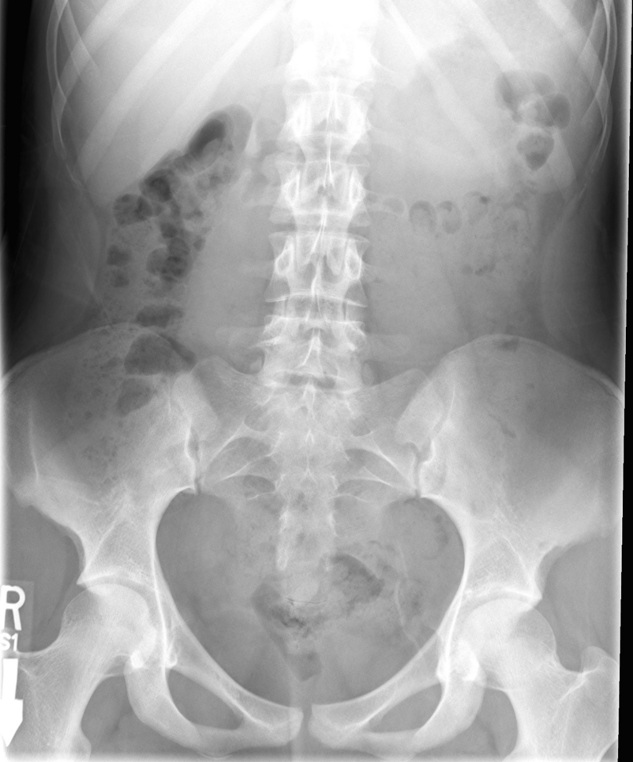
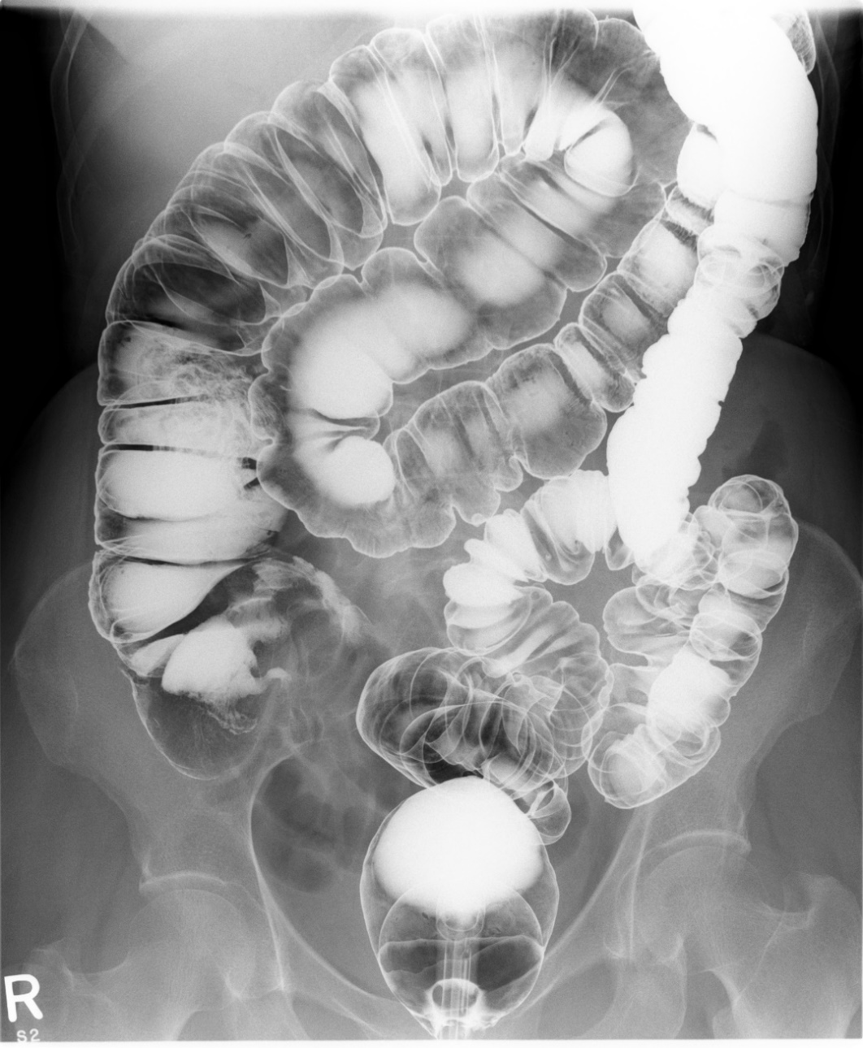

Slide 34
Digital Imaging – Contrast Resolution
Contrast Resolution
This is the ability of a digital system to display subtle changes in the shade of grey
High contrast resolution means that the difference between adjacent densities is enhanced – greater difference
  Can be manipulated with software
  Allows the user to enhance the difference between similar densities
  Contrast resolution in digital imaging is related to pixel bit depth
    kVp does not control contrast in digital imaging (kVp controlled contrast for film/screen IR)

Slide 35
Digital Imaging – Contrast Resolution
With digital imaging, higher kVp values can be used without impact to the contrast that would have occurred with old technology when using film/screen as the IR
  This results in lower patient dose
Scatter is still a major concern
  Digital systems are sensitive to scatter
  All efforts to decrease scatter should be routinely applied
kVp is still an important factor for providing adequate penetration of all tissues
  If contrast is too low, the system cannot correct for this, there needs to be enough grey shades for the system to differentiate signals

Slide 36
kVp
When kVp is altered, what happens?
  Affects penetrating power
    Results in changing the absorption and transmission of the beam
  High kVp means less absorption, more transmission
  Low kVp means more absorption, less transmission

Slide 37
Readings
Bushong: Radiographic Science for Technologists, 11th ed
Pg 179-181 (Stop before Motion Blur)
Pg 182-183 (Selection of Technique Factors)
  Pg 187-191 (Stop before Beam Restrictors)
Pg 204-205 (Air Gap Technique)
Pg 248-251 (Stop before Image Detail)

