Slide 1


Medical Esthetics
Acne

Slide 2
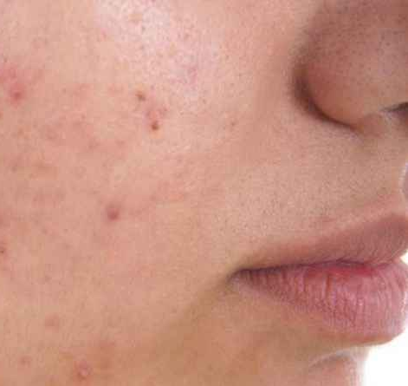
What is Acne?
Inflammatory skin disorder of the sebaceous glands, medically known as acne simplex or acne vulgaris. It is characterized by excess sebum production. This excess oil and dead skin cells can plug pores, creating comedones, papules and pustules, and cysts. This causes a growth of Propionibacterium acne (P. acne) bacteria.

Slide 3
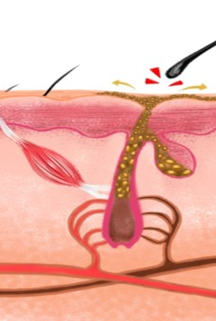
Bacteria in the follicles are anaerobic, that is, the bacteria cannot live in the presence of oxygen.
When follicles are blocked with sebum and dead skin buildup, oxygen cannot reach the bottom of the follicle.
Sebum can irritate follicles and cause inflammation. As bacteria and inflammation grow, pressure is exerted on the follicle wall.
If the wall ruptures, it becomes infected, and debris spills out into the dermis.

Slide 4

How it happens

Slide 5
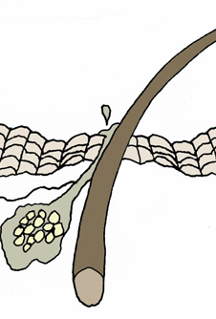
Causes of Clogged Follicles
Knowledge of the anatomy of the pilosebaceous unit gives you a deeper understanding of how acne behaves.
Pilosebaceous unit is the term for the entire follicle that includes the hair shaft, sebaceous gland, and sebaceous duct or canal to the surface.
The hairless follicle (with attached sebaceous glands) is the main follicle involved in acne. Clogged follicles are caused by many factors, including excess oil,
Retention hyperkeratosis, and sebaceous filaments.
Another reason follicles get clogged is that the opening, or ostium, of the follicle may be too small to let impactions out.

Slide 6
Types of Clogged Follicles
COMEDO:
Is a noninflamed buildup of cells, sebum, and other debris inside follicles
OPEN COMEDO:
Is a blackhead open at the surface and exposed to air. When the follicle is filled with excess oil a blackhead forms. It is dark because it is exposed to oxygen and oxidation occurs
CLOSED COMEDO:
Follicles are blocked with debris and white cells. It is also referred to as a whitehead but should not be confused with the more hardened white type of papules called milia

Slide 7
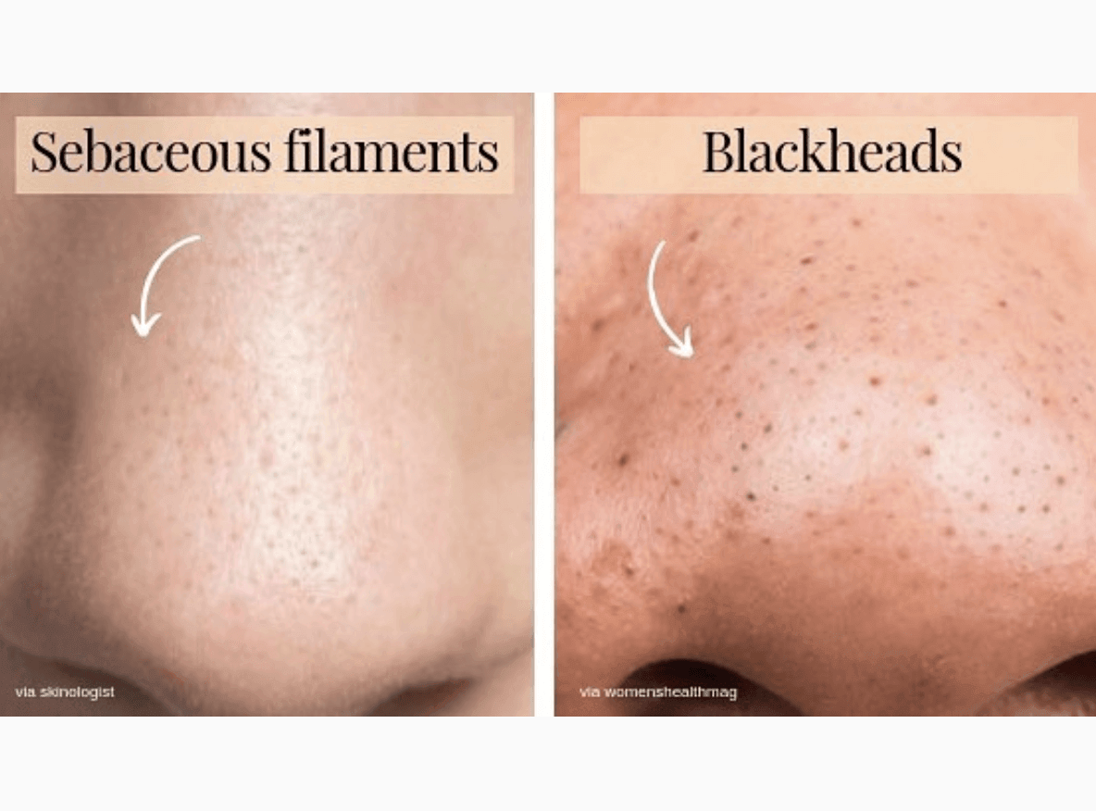
Sebaceous Filaments
Sebaceous filaments, similar to open comedones, are mainly small, solidified impactions of oil without the cell matter. These filaments also block the follicle and can cause an acne breakout. They are often found on the nose.

Slide 8
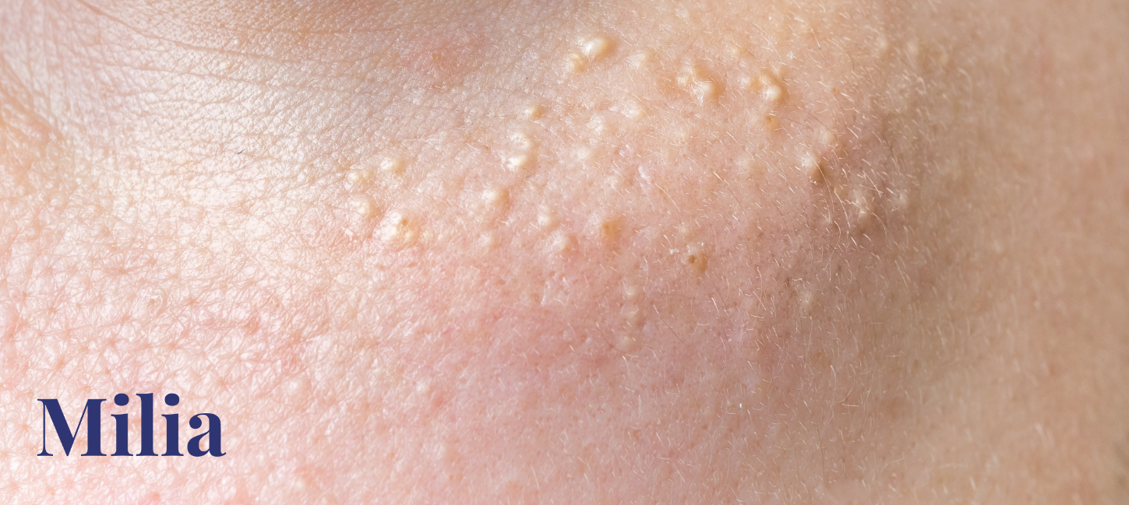
Milia
Are small epidermal cysts that appear as firm white papules. Milia are whitish, pearl-like masses of sebum and dead cells under the skin with no visible opening and are often mistakenly called whiteheads (whiteheads look similar but are soft). Hardened and closed over, milia are more common in dry skin types and may form after skin trauma, such as a laser resurfacing or chronic exposure to UV radiation.

Slide 9
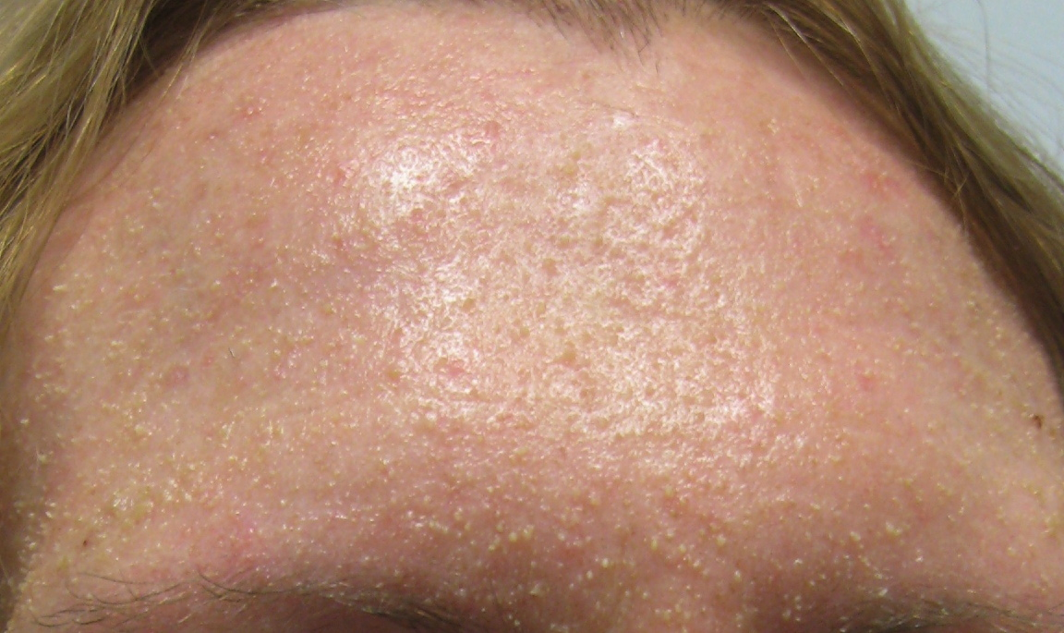
Retention Hyperkeratosis
Is a hereditary factor in which dead skin cells build up because they do not shed from the follicles as they do on normal skin. Additionally, excessive sebum production can overtax the sebaceous follicles and cause further cell buildup. Sebum mixed with cells in the follicle become comedones (plugs in the follicles). Consequently, open and closed comedones are formed. While not inflamed, these comedones are the beginning of acne problems if they are not treated with proper skin care to alleviate the impaction.

Slide 10
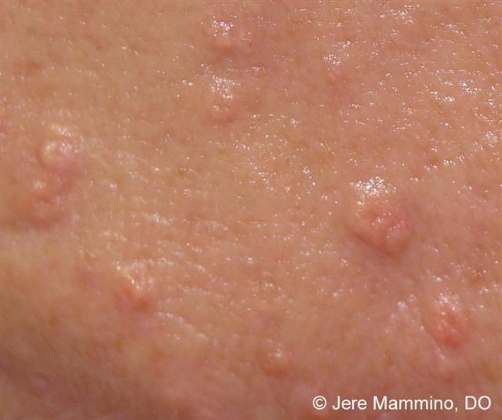
Sebaceous Hyperplasia
Involves benign lesions frequently seen in oilier areas of the face. They are often white, yellow, or flesh-colored. Sebaceous hyperplasia is described as doughnut-shaped with an indentation in the center. Sebaceous mate-rial may be found in the center. As cell turnover rate slows with age and androgen levels decline, this causes abnormal cell buildup with very little oil that crowds and enlarges sebaceous glands. Do not mis-take these overgrowths of the sebaceous gland for comedones or milia, which may look similar at first. These harmless lesions cannot be removed by extraction. Cryotherapy, surgery, or laser excision are recommended treatment options.

Slide 11
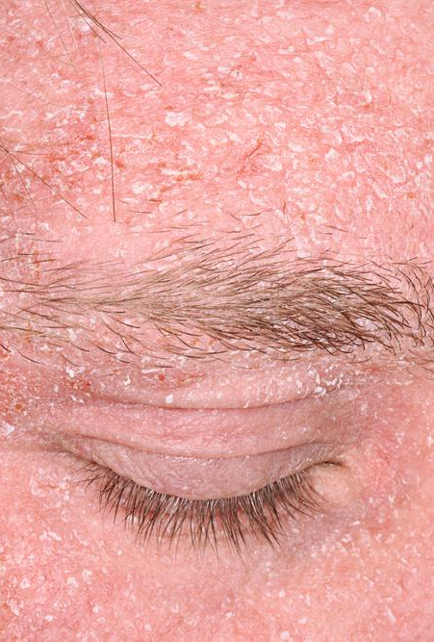
Seborrhea
Is a severe oiliness of the skin; an abnormal secretion from the sebaceous glands. When it is in the scalp it is called dandruff or seborrheic dermatitis, but it can occur around the eye-brows, behind the ears, and around the nose or other areas of the face. It is not acne, although the inflammation in the skin from seborrhea can be misidentified as acne. Later in this chapter you will learn more about seborrheic dermatitis.

Slide 12
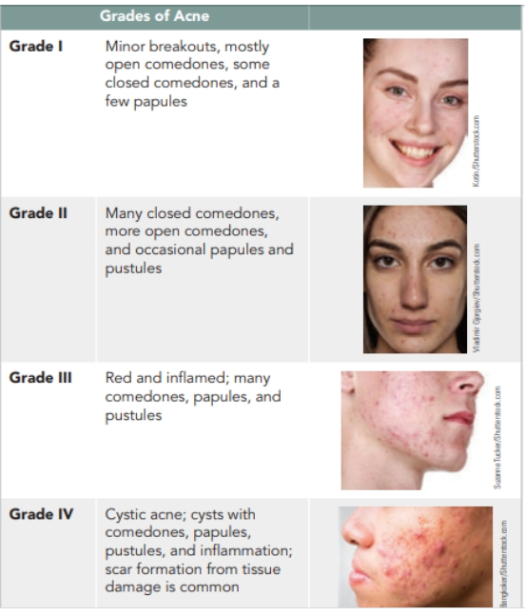
Grades of Acne

Slide 13
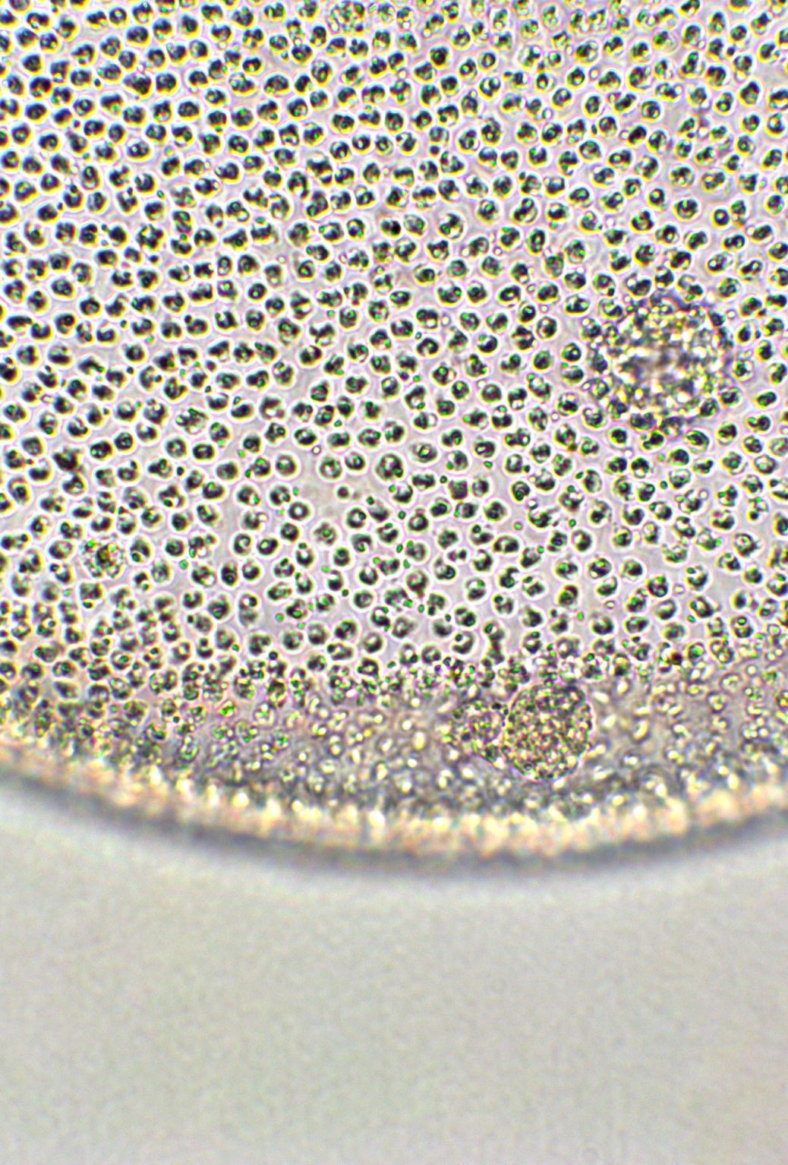
Acne Triggers
Lifestyle
Environment
Genetics
Hormonal Imbalances
Cosmetics and skin care products
Food allergies

Slide 14
Treatment
Once the cause of acne and the type ( grade ) is properly assessed, many treatment options can be applied

Slide 15
Consultation
Consultation with your client will help you properly assess the cause of the disorder
For Food allergies, a referral to a nutritionist or a doctor will be the solution to your client problem
For Hormonal imbalances, a combination of in office treatment plus hormonal therapy by a doctor can yield very good results
When it comes to bad habits or skin routines, wrong cosmetic usage, you can make a big impact by recommending the right treatment and skin care
For Genetics, a more aggressive line of treatment might be needed including antibiotics, Accutane or oral medication.

Slide 16
Considerations for Medicated Acne TREATMENT
Home care products should include ingredients with benzoyl peroxide and vitamin A products like tretinoin, retinoids, and adapalene.
Moisturizers and serums that are low on the comedogenic scale are best. Skin care ingredients are discussed in the chapter on Chapter 6 Skin Care Products: Chemistry, Ingredients, and Selection.
Benzoyl peroxide products are often combined with topical anti-biotics. This combination helps reduce the chances of developing antibiotic resistance. Topical antibiotics alone aren’t typically pre-scribed. These products should be applied in the morning because they can discolor pillowcases.
Vitamin A products should be applied in the evening because they are photo-sensitizing. Clients should apply a very small pea-sized amount beginning twice a week, increase the application to three times a week, then use the product every other day and finally every day as a tolerance to the product is developed. These products work by thinning the stratum corneum, increasing cell turnover, and pre-venting hair follicles from becoming clogged with sebum and dead skin cells.
Salicylic acid and azelaic acid are both antibacterial. Salicylic acid is lipophilic, so it works to digest sebum.
Oral medications to help with acne in addition to antibiotics are of-ten drugs to counter the effects of androgen hormones. An example is spironolactone.
Birth control pills are another prescription medication that can influence acne, reducing breakouts from hormonally induced acne

Slide 17
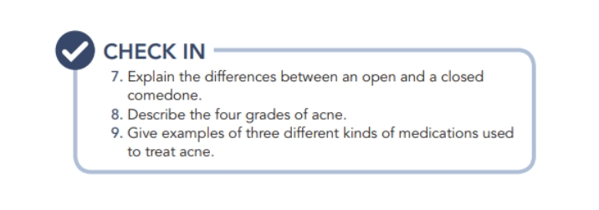

Slide 18

QUESTIONS?

