Slide 1


Business Operations
Unit 6

Slide 2
Personnel
Your personnel is your staff or employees. The size of your business will determine the size of your staff. Large salons, spas receptionists, assistants, and housekeepers in addition to beauty professionals with a variety of specializations. Smaller establishments often employ personnel who are expected to perform more than one type of service

Slide 3
When interviewing potential employees, consider the following:
Level of skill. What is their educational background? When was the last time they attended an educational event? How long have they been in the industry? What can they bring to the organization beyond their technical skills?
Personal grooming. Do they look like professionals you would consult for personal grooming advice?
Image as it relates to the business. Are they too progressive or too conservative for your environment? Does their image reflect the image of your business?
Overall attitude. Are they mostly positive or mostly negative in their responses to your questions? Do they seem self-motivated and self-directed?
Communication skills. Are they able to understand your questions? Can you understand their responses?
Work history. Have they been at a previous business for many years, or do they hop from shop to shop? Are they bringing a clientele, or do they expect you to build one for them?

Slide 4

Make it your top priority to meet your payroll obligations. In the allotment of funds, this comes first. It will also be your largest expense.
Whenever possible, offer hardworking and loyal employees as many benefits as possible. Either cover the cost of these benefits, or simply make them available to employees, who can decide if they can cover the cost themselves.
Provide staff members with a schedule of employee evaluations. Make it clear what is expected of them if they are to receive pay increases.
Create and stay with a tipping policy. It is a good idea both for your employees and your clients to know exactly what is expected. It is also important to be familiar with the tax laws around tipping.
Put your entire pay plan in writing.
Create incentives by giving your staff opportunities to earn more money, prizes, or tickets to educational events and trade shows; rewards can inspire employees to achieve more.
Create business policies and stick to them. Everyone should be governed by the same rules, including you!
Payroll and Employee Benefits

Slide 5
Managing Personnel
Managing others is a serious job
One of your most challenging tasks will be managing your staff.
If you are good at managing others, you can make a positive impact on their lives
People can learn how to manage other people, just as they learn how to drive a car or perform hair services.
Whether or not it comes naturally to you, it takes time to become comfortable with the role

Slide 6
Human resources (HR)
Is an entire specialty. It not only covers how you manage employees, but also what you can and cannot say when hiring, managing, or firing. All employers must be familiar with various human rights laws, including equal employment opportunities, disabilities Act, discrimination etc.
Every business should have a written personnel policies and procedures manual, and every employee must read and sign it. If you choose to use a payroll company, they can provide HR services and employee manuals for a nominal fee. The more documented systems you have for managing human resources, the better.

Slide 7
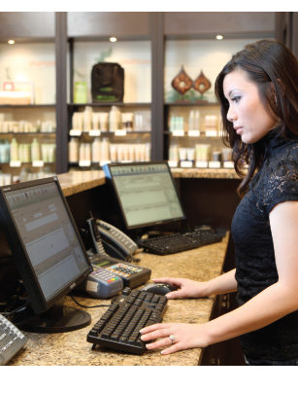
The Front Desk
The best businesses employ professional receptionists to handle the job of answering phones, scheduling appointments, greeting clients, and attending to client needs.

Slide 8
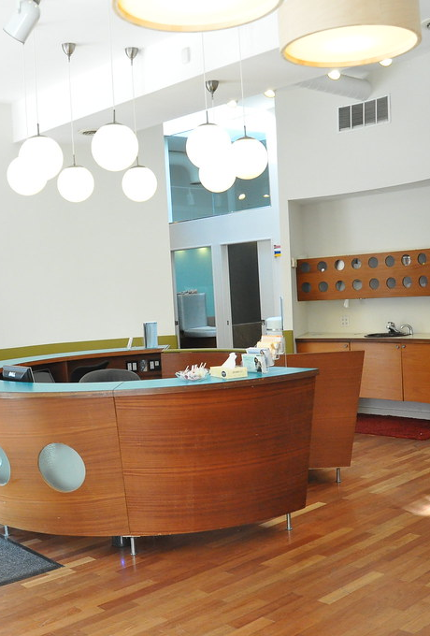
The Reception Area
First impressions count, and since the reception area is the first thing clients see, it needs to be attractive, appealing, and comfortable. This is your business’s nerve center, where retail merchandise will be on display, where the phone system is centered, where financial transactions will be carried out, and where your receptionist will stand (should you employ one).
Make sure that the reception area is stocked with business cards and a prominently displayed price list that shows at a glance what your clients should expect to pay for various services.

Slide 9
The Receptionist Duties
The receptionist is the first and last person the client contacts
Answering the phone, booking appointments, informing beauty professionals that a client has arrived, preparing daily appointment information for the staff, and recommending additional services and products to clients
knowledge of all retail products carried by the shop so that they can also serve as a salesperson and information source for clients.
During slow periods, it is customary for the receptionist to perform certain other duties and activities, such as straightening up the reception area and maintaining inventory and daily reports.

Slide 10

BOOKING APPOINTMENTS
Increasingly, the appointment book is computerized and easily accessed through the business’s computer system. Or, it may be an actual hardcopy book located on the reception desk. Some shops have websites with online booking systems, which tie into scheduling software
In larger establishments, the receptionist prepares the appointment schedule for staff members; in smaller shops, each person may prepare their own schedule
Appointments must be scheduled to make the most efficient use of everyone’s time—both the client and the beauty pro. Under ideal circumstances, a client should not have to wait for a service, and a professional should not have to wait for the next client.

Slide 11
The Telephone
The majority of beauty business is handled over the telephone. Good telephone habits and techniques make it possible for the owner and employees to increase business and improve relationships with clients and suppliers. With each call, a gracious, appropriate response will help build the shop’s reputation. For example, “Thank you for calling Spa Anderson, Shannon speaking. How may I help you?”

Slide 12
Good Planning
Use a pleasant telephone voice, speak clearly, and use correct grammar. A smile on your face will be reflected in your voice and counts for a lot.
Show interest and concern when talking with a client or a supplier.
Be polite, respectful, and courteous to all (even when people may test the limits of your patience).
Be tactful. Do not say anything to irritate the person on the other end of the line.

Slide 13
Incoming Telephone Calls
Answer the phone promptly. A good rule of thumb is to pick up the phone by the fourth ring. On a system with more than one line, if a call comes in while you are talking on another line, ask to put the first person on hold, answer the second call, and ask that person to hold while you complete the first call. Take calls in the order in which they are received.
Do not talk with a client standing nearby while you are speaking with someone on the phone. Have one conversation at a time to avoid doing a disservice to both clients.

Slide 14
Booking Appointments by Phone
When booking appointments, write down the client’s first and last name, their phone number, their e-mail address, and the service booked
All employees should be familiar with all the services and products available in the salon
if someone calls to ask for an appointment with a particular professional on a particular day and time, make every effort to accommodate the client’s request
If that beauty pro is not available, handle the situation in one of the following ways:
Suggest other times that the professional is available.
If the client cannot come in at any of those times, suggest another professional.
If the client is unwilling to try another professional, offer to call the client if there is a cancellation at the desired time.

Slide 15
Handling Complaints over the Phone
Respond with self-control, tact, and courtesy, no matter how trying the circumstances. Only then will the caller feel that they have been treated fairly.
The tone of your voice must be sympathetic and reassuring. Your manner of speaking should convince the caller that you are really concerned about the complaint. Do not interrupt the caller. After hearing the complaint in full, try to resolve the situation quickly and effectively.

Slide 16

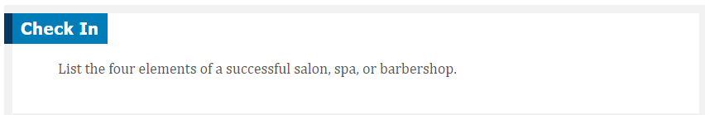
QUESTIONS?

