Slide 1
INFC 215 Infection Prevention and Control
Donning/Doffing
N 95 Mask for Airborne
Precautions
White “ Duck Bill” Type

Slide 2
Donning
Putting ON

Slide 3
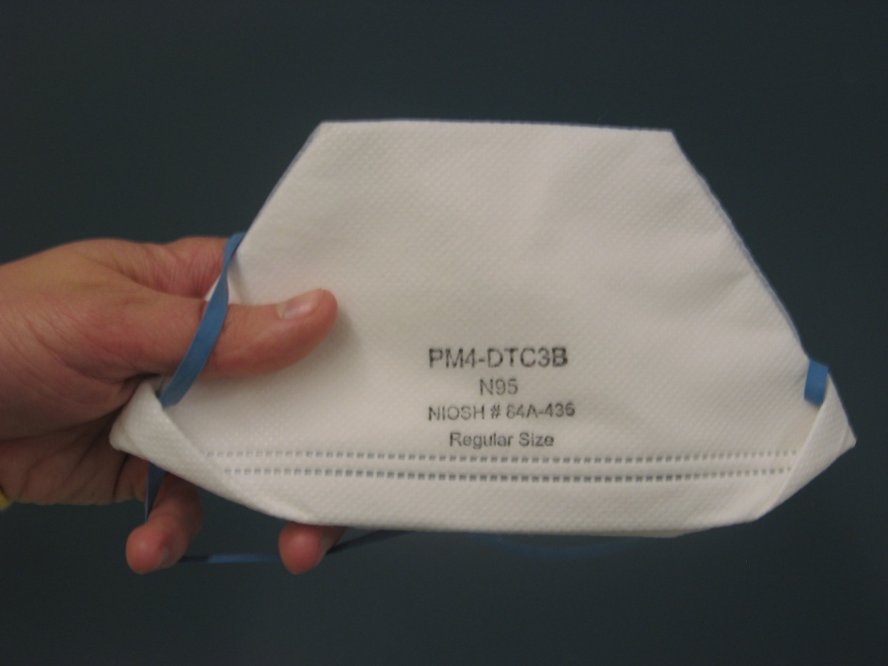
1. Select N 95 mask
When?
Patient requires airborne isolation precautions
Select Brand and style number for which you have been fit tested

Slide 4
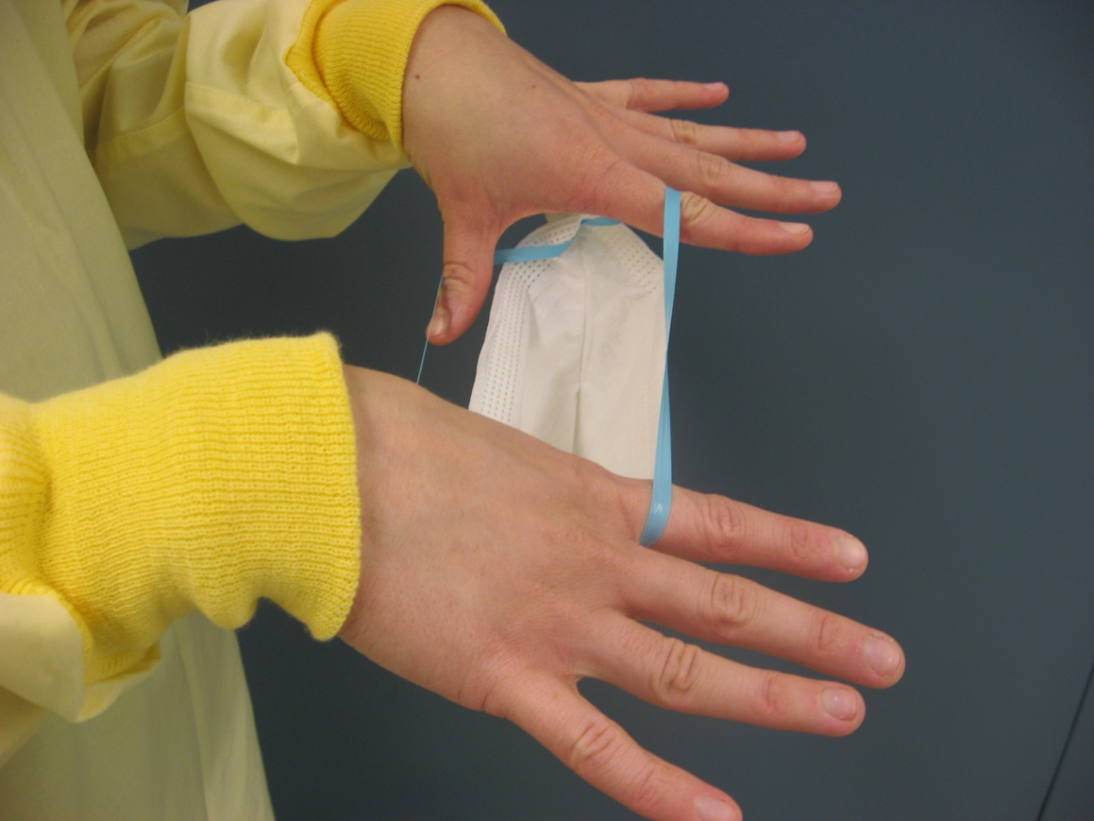
2. Pull the elastics apart with your fingers

Slide 5
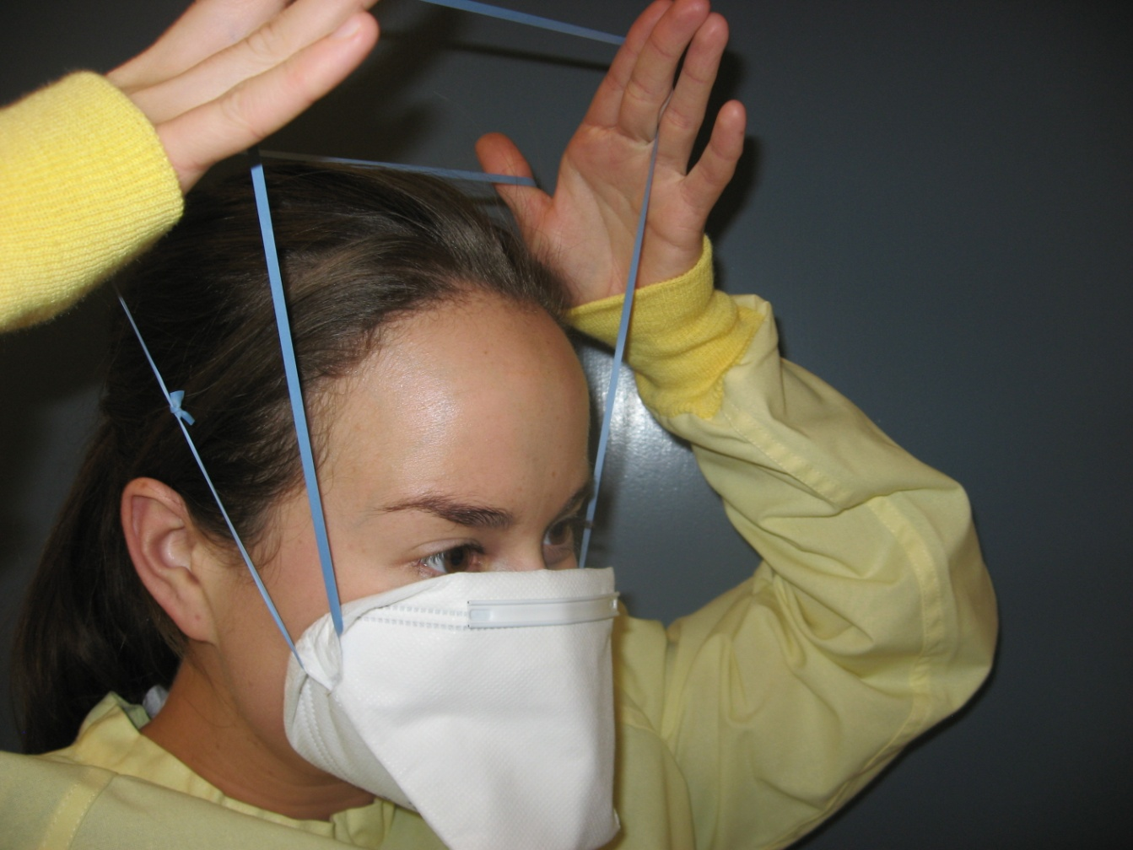
3. Place bottom of the mask under your chin and pull the elastics over your head

Slide 6
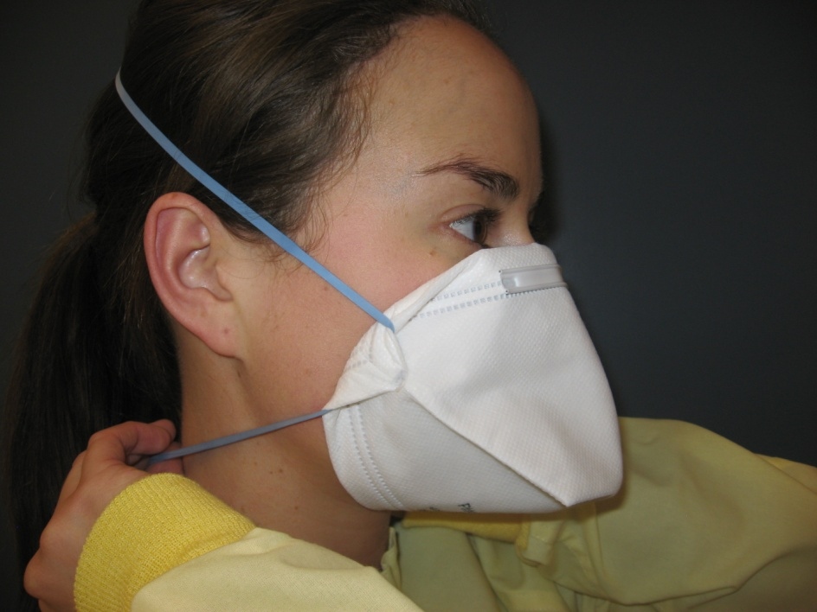
4. Separate the elastics and adjust mask to fit your face
Ensure that your mouth and chin are covered

Slide 7
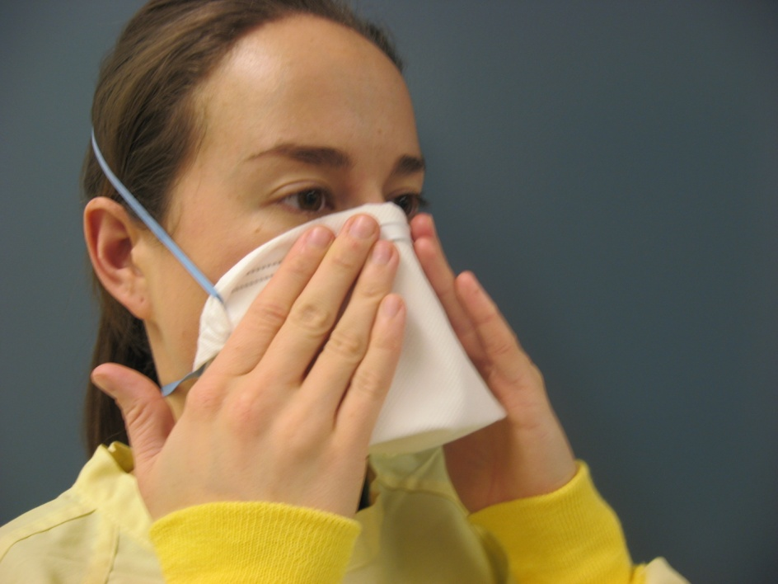
5. Ensure a snug fit over your nose and cheeks
Use fingers of both hands to press the metal strip

Slide 8
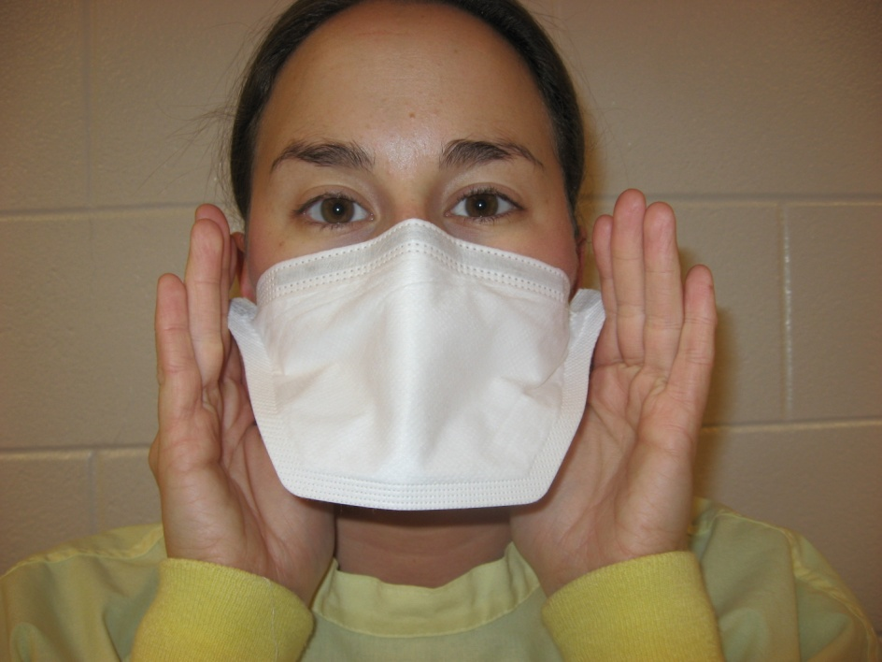
6. Fit check
Inhale deeply to insure that mask adheres to your face
Exhale to ensure that there are no air leaks

Slide 9
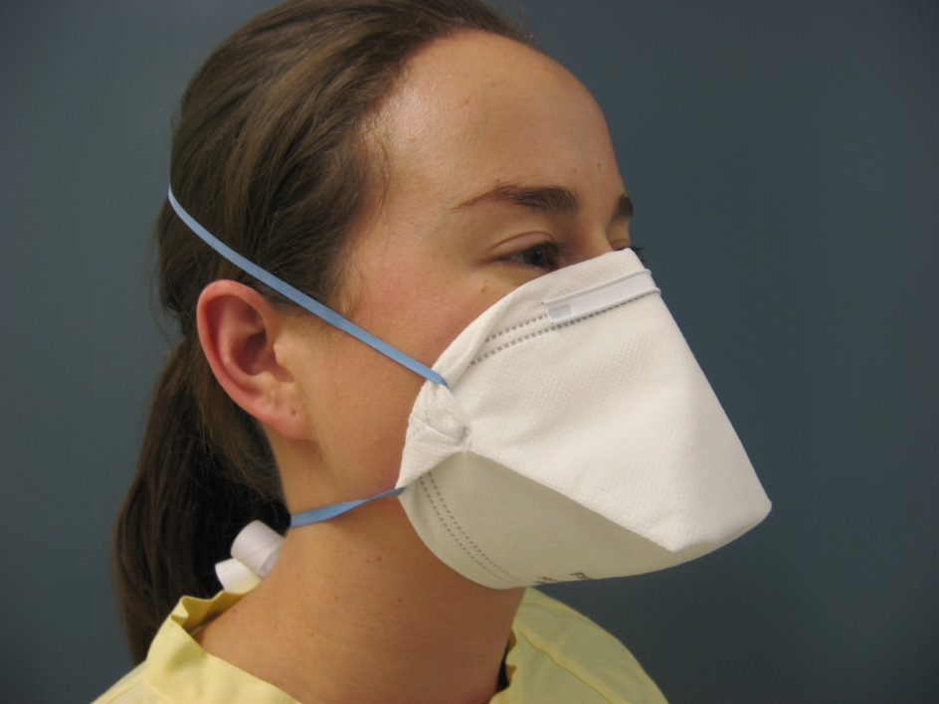
7. Check Appearance
Is the mask properly adjusted?

Slide 10
Doffing
Taking OFF

Slide 11
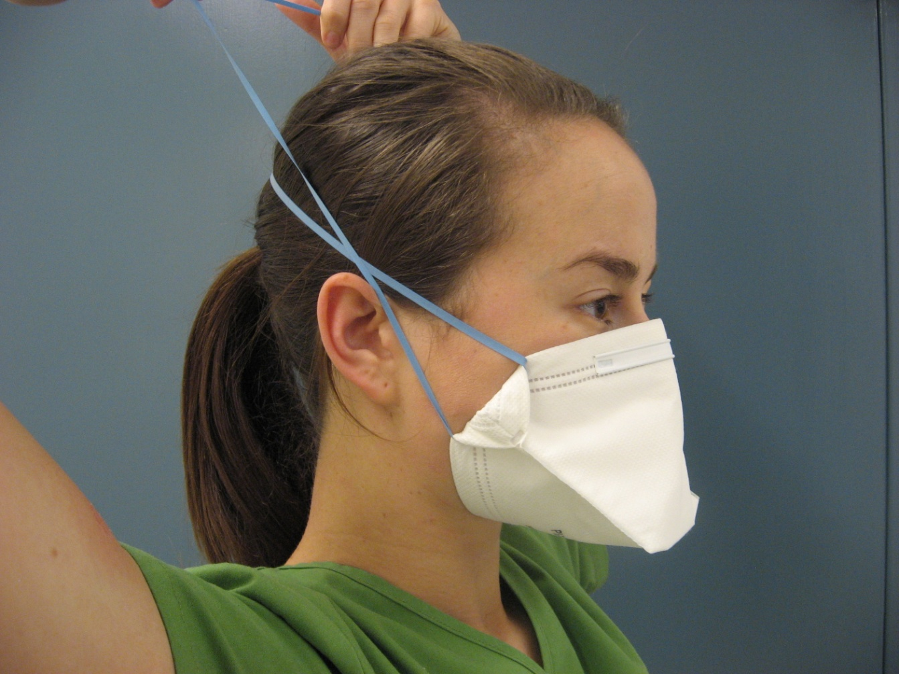
1. Grasp elastics with clean hands

Slide 12
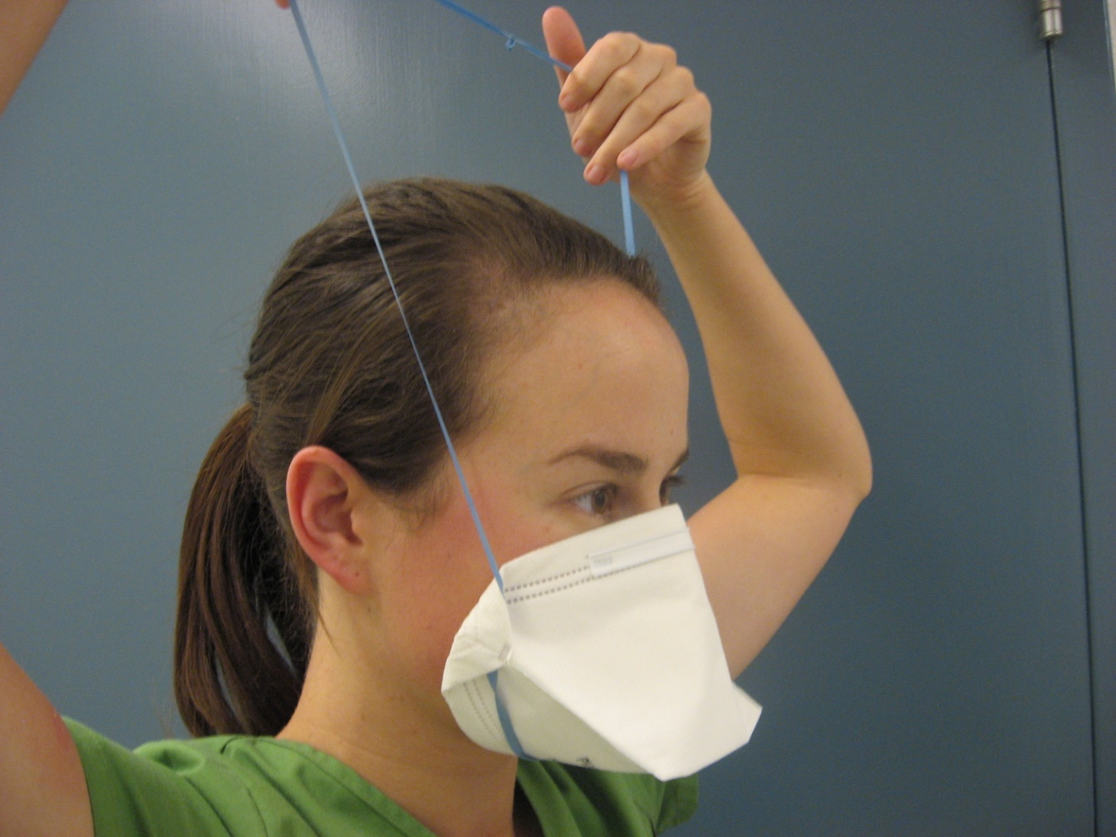
2. Pull elastics over the head and mask away from face

Slide 13
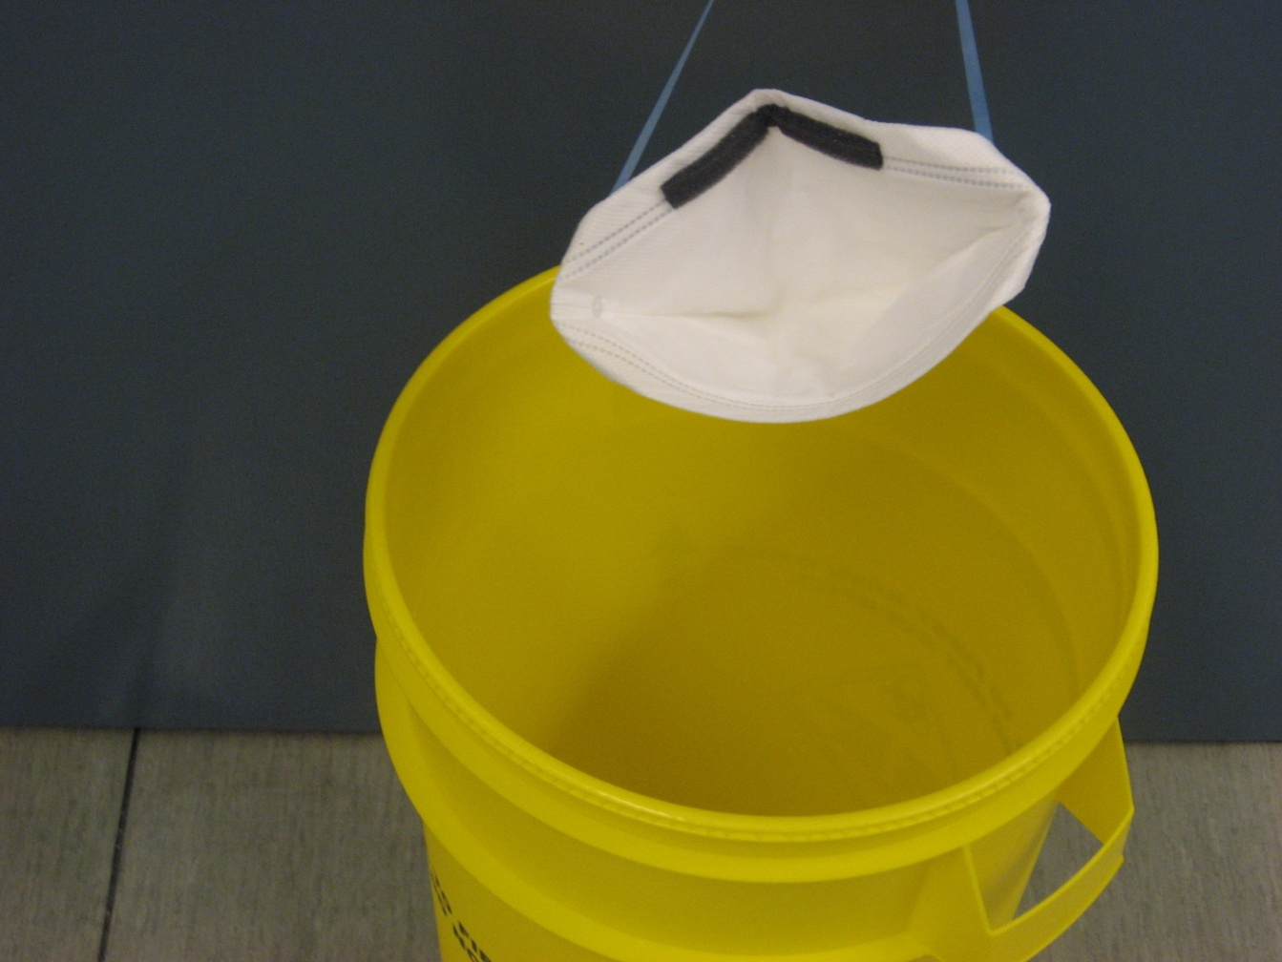
3. Discard in to disposal container

