Slide 1
MRAD 285: Radiographic Applied Skills
Non-Routine Patients

Slide 2
Learning Outcome
Manage a radiological exam for a non-routine patient.

Slide 3
Objectives
Describe strategies used to determine a patient’s mobility.
Assess a patient’s mobility and cooperation.
Prioritize radiography exams when working independently.
Prioritize imaging for a single patient with multiple exams.
Interact with a simulated patient in a caring and professional manner.
Apply patient transfer techniques.

Slide 4
Non-Routine Patient
A “non-routine” patient has physical and/or psychological deficits that may limit their ability to cooperate with the inherent requirements of a routine radiographic exam.
While some of these patient deficits are self-evident (eg. reduced LOC) others can only be detected by assessing your patient beforehand.

Slide 5
Never Assume
A technologist decides to complete a lumbar spine examination on the table without assessing her patient beforehand. Unfortunately when she asks the patient to lie down they suddenly become short of breath…
A technologist sets up the examination room to do a shoulder routine at the wall stand, but it turns out the patient is on morphine, and is too drowsy to sit on a stool, or to concentrate on the radiographer’s instructions…

Slide 6
Always Assess!
Properly assessing all patients to determine whether or not they fall into the “non-routine” category is the key to:
  Ensuring patient safety
  Planning effective exam modifications
  Gaining patient trust and cooperation
  Maintaining diagnostic image quality

Slide 7
Group Activity
Instructions:
Refer to the table below.
Provide examples of specific conditions that would fall under each of the origins listed.
For example: “uncontrolled emotion” = fear
Origins physical deficits | Categories of causes for psychological deficits
Fractures Soft tissue injuries Age related degenerative weaknesses Metabolic imbalances Body habitus Pathologic conditions Physical disabilities | Uncontrolled emotions – fear, …? Confidentiality concerns Medication induced changes Ongoing mental disabilities Pathologic conditions Mental disabilities

Slide 8
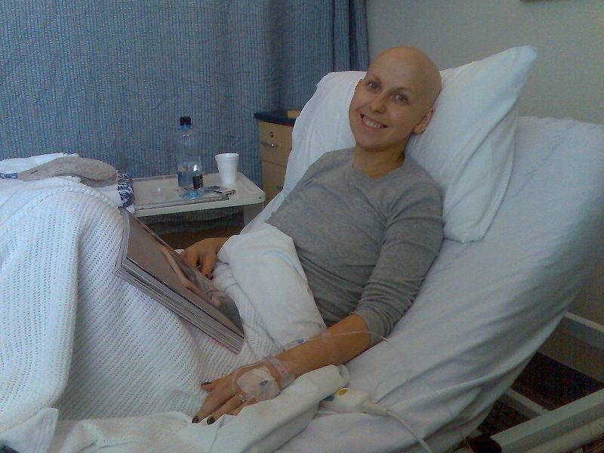
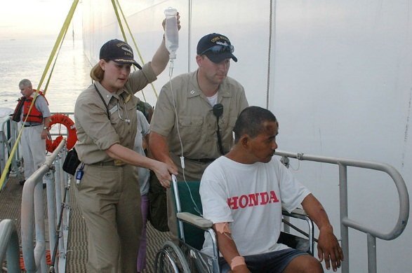
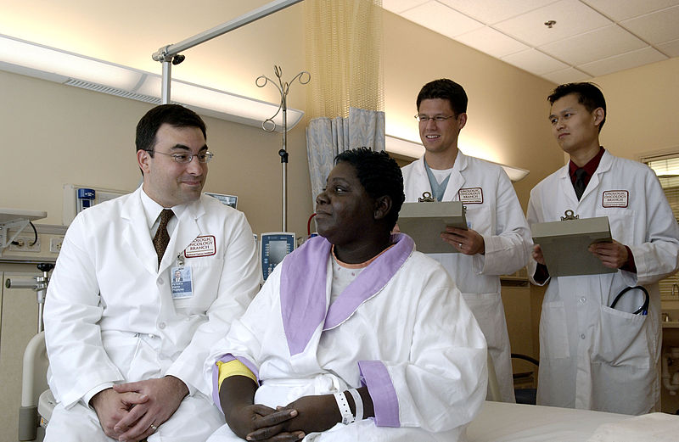
Which of these Patients will be able to Stand for a Chest X-ray?
Source: Jennifrog, https://commons.wikimedia.org/wiki/File:Cancer_patient.jpg (CC BY-S 3.0)
Source: United States Navy, https://commons.wikimedia.org/wiki/File:US_Navy_060611-N-9076B-048_A_recent_car_accident_victim_is_brought_out_to_the_U.S._Military_Sealift_Command_(MSC)_Hospital_Ship_USNS_Mercy_(T-AH_19),_while_the_ship_is_anchored_of_the_coast_of_Tawi-Tawi.jpg (CC BY-S 3.0)
Source: National Cancer Institute. https://commons.wikimedia.org/wiki/File:Doctor_consults_with_patient.jpg
(CC BY-S 3.0)

Slide 9
How will you find out?
Source: Jennifrog, https://commons.wikimedia.org/wiki/File:Cancer_patient.jpg (CC BY-S 3.0)
Source: United States Navy, https://commons.wikimedia.org/wiki/File:US_Navy_060611-N-9076B-048_A_recent_car_accident_victim_is_brought_out_to_the_U.S._Military_Sealift_Command_(MSC)_Hospital_Ship_USNS_Mercy_(T-AH_19),_while_the_ship_is_anchored_of_the_coast_of_Tawi-Tawi.jpg (CC BY-S 3.0)
Source: National Cancer Institute. https://commons.wikimedia.org/wiki/File:Doctor_consults_with_patient.jpg
(CC BY-S 3.0)

Slide 10
Assessment through Initial Observation
Evidence of medication: O2, morphine drip, IV
Presence of assistive devices: splint, zimmer, sling, tensor etc.
Transfer method: wheelchair, stretcher, walker, crutches
Patient position: semi erect; supine; recumbent
Patient posture: deviations from normal sitting or standing
Patient LOC: alert, drowsy, comatose
Patient mood: curious, friendly, cranky, guarded
Patient awareness: tuned in to environment, oblivious
Medical signs and symptoms: wounds, deformities, SOB
Source: United States Navy, https://commons.wikimedia.org/wiki/File:US_Navy_060611-N-9076B-048_A_recent_car_accident_victim_is_brought_out_to_the_U.S._Military_Sealift_Command_(MSC)_Hospital_Ship_USNS_Mercy_(T-AH_19),_while_the_ship_is_anchored_of_the_coast_of_Tawi-Tawi.jpg (CC BY-S 3.0)

Slide 11
Assessments during Initial Conversation
How does the patient respond when you:
  Introduce yourself
  Use their name
  Ask about their circumstances
  Explain what kind of medical care you will be giving them
  Tell them how long the examination will take and what it will involve
  Ask them if they can perform a certain movement
Source: National Cancer Institute. https://commons.wikimedia.org/wiki/File:Doctor_consults_with_patient.jpg
(CC BY-S 3.0)

Slide 12
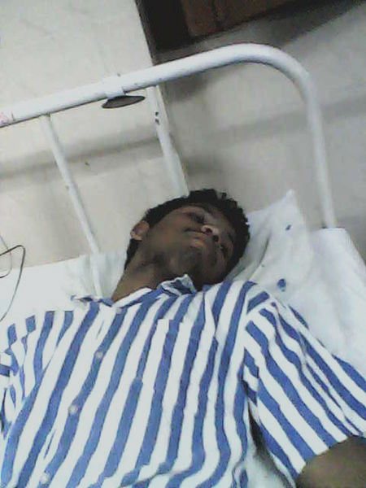
Assessment through Direct Questioning….
If I helped you, would you be able to:
  Sit up: on a stool/in or on the edge of your stretcher?
  Lie flat on your back?
  Roll onto your side?
  Stand up, turn, and sit on the x-ray table?
  Shuffle to the x-ray table on your own?
  Stand in front of the x-ray machine?
Source: https://commons.wikimedia.org/wiki/File:Hospital_Patient.jpg (CC BY-S 3.0)

Slide 13
Remember!
Patient assessment is both an art and a science.
Therefore, as you move through the examination, it may be necessary to modify some of your conclusions regarding the patient’s condition.
For example, the patient says they are fine to stand, but you see them swaying back and forth and they keep closing their eyes.
  Take immediate action! Have them SIT!

Slide 14
Sample Exam Modifications
A patient who is afraid to stand because they feel weak, may be willing to try with a wheelchair behind them for psychological and physical support.
A supine patient on a slider board that cannot externally rotate their leg from the hip, may be able to tolerate being placed in a Judet position instead.
An ambulatory patient that cannot rotate their arm laterally for a external oblique elbow, may be able to rotate from the waist and shoulder, enough to place their humeral epicondyles at a 45 degrees angle from the IR.
A patient who is too disturbed by the appearance of their dislocated finger, to follow directions, may respond to verbal distraction long enough to be physically positioned by the technologist.
A patient with a fractured tibia that is too drowsy to move to the x-ray table, could be examined the stretcher using CR cassettes.

Slide 15
Group Activity
For each of the following scenarios, discuss viable strategies for maximizing the strengths and minimizing the weaknesses of the situation:
  An unconscious patient arrives on a stretcher with their right hip in extreme external rotation. They have a requisition for a hip x-ray.
  A 54-year old woman arrives on a stretcher for a supine abdomen x-ray. She says she can move from the stretcher to the x-ray table on her own, even though it has only been 24 hours since she had a hip replacement.
  A 22-year old man arrives in a stretcher and says he can stand for his shoulder x-rays two hours after dislocating his shoulder playing hockey.
  A combative patient, in a lot of pain, refuses to stand for chest and posterior rib x-rays.
  A patient that fell on her tail-bone wants to remain on her side for her lumbar and sacrum/coccyx examinations.
  A bariatric patient, who exceeded your table limit, requires knee and patella x-rays.

Slide 16
Strategies for Prioritizing Multiple Exams on a Single Patient
Complete images that will provide crucial diagnostic information first. For example, AP pelvis will demonstrate a hip fracture before abducting the leg for hip x-rays.
Establish their positioning preferences (standing vs lying down) and try to minimize movement by completing all of the examination at either the wall stand or the table stand when possible.
Observe the patient’s position when they first arrive and take any of the images that can be completed “as is” with little or no movement.
Minimize the excess patient movement by completing all of the AP projections followed by all of the lateral projections or vice versa.
When oblique images are involved try to examine the part in question by moving in a continuous circle or arch. For example, the reasonable order for 4 views of the knee would be: internal oblique, AP, external oblique, lateral.

Slide 17
Prioritizing Examinations when
Working Independently
The most ill or unstable patients need to be examined first as they are most at risk when they are in the radiography department. These patients should never be left unattended.
Complete remaining examinations in the order they present when possible. Never sift through requisitions looking for the “easy ones”.
If a technologist is working in the department alone, sliding a patient can become an issue. Wait for assistance, if necessary. Depending on the circumstances, the patient may need to be returned to their unit, until staffing levels in the radiography department return to normal.

Slide 18
Lab
During this week’s lab, you will be managing the workflow of a busy emergency x-ray department. An extensive series of routine and non-routine radiographic examinations will need to be completed as efficiently and effectively as possible.
To prepare ahead please ensure you have:
  Completed the learning activities.
  Completed the pre-lab quiz.
  Reviewed the patient transfer techniques and adaptive radiography rules outlined in the assigned readings.
  Familiarized yourself with routine protocols.

