Slide 1
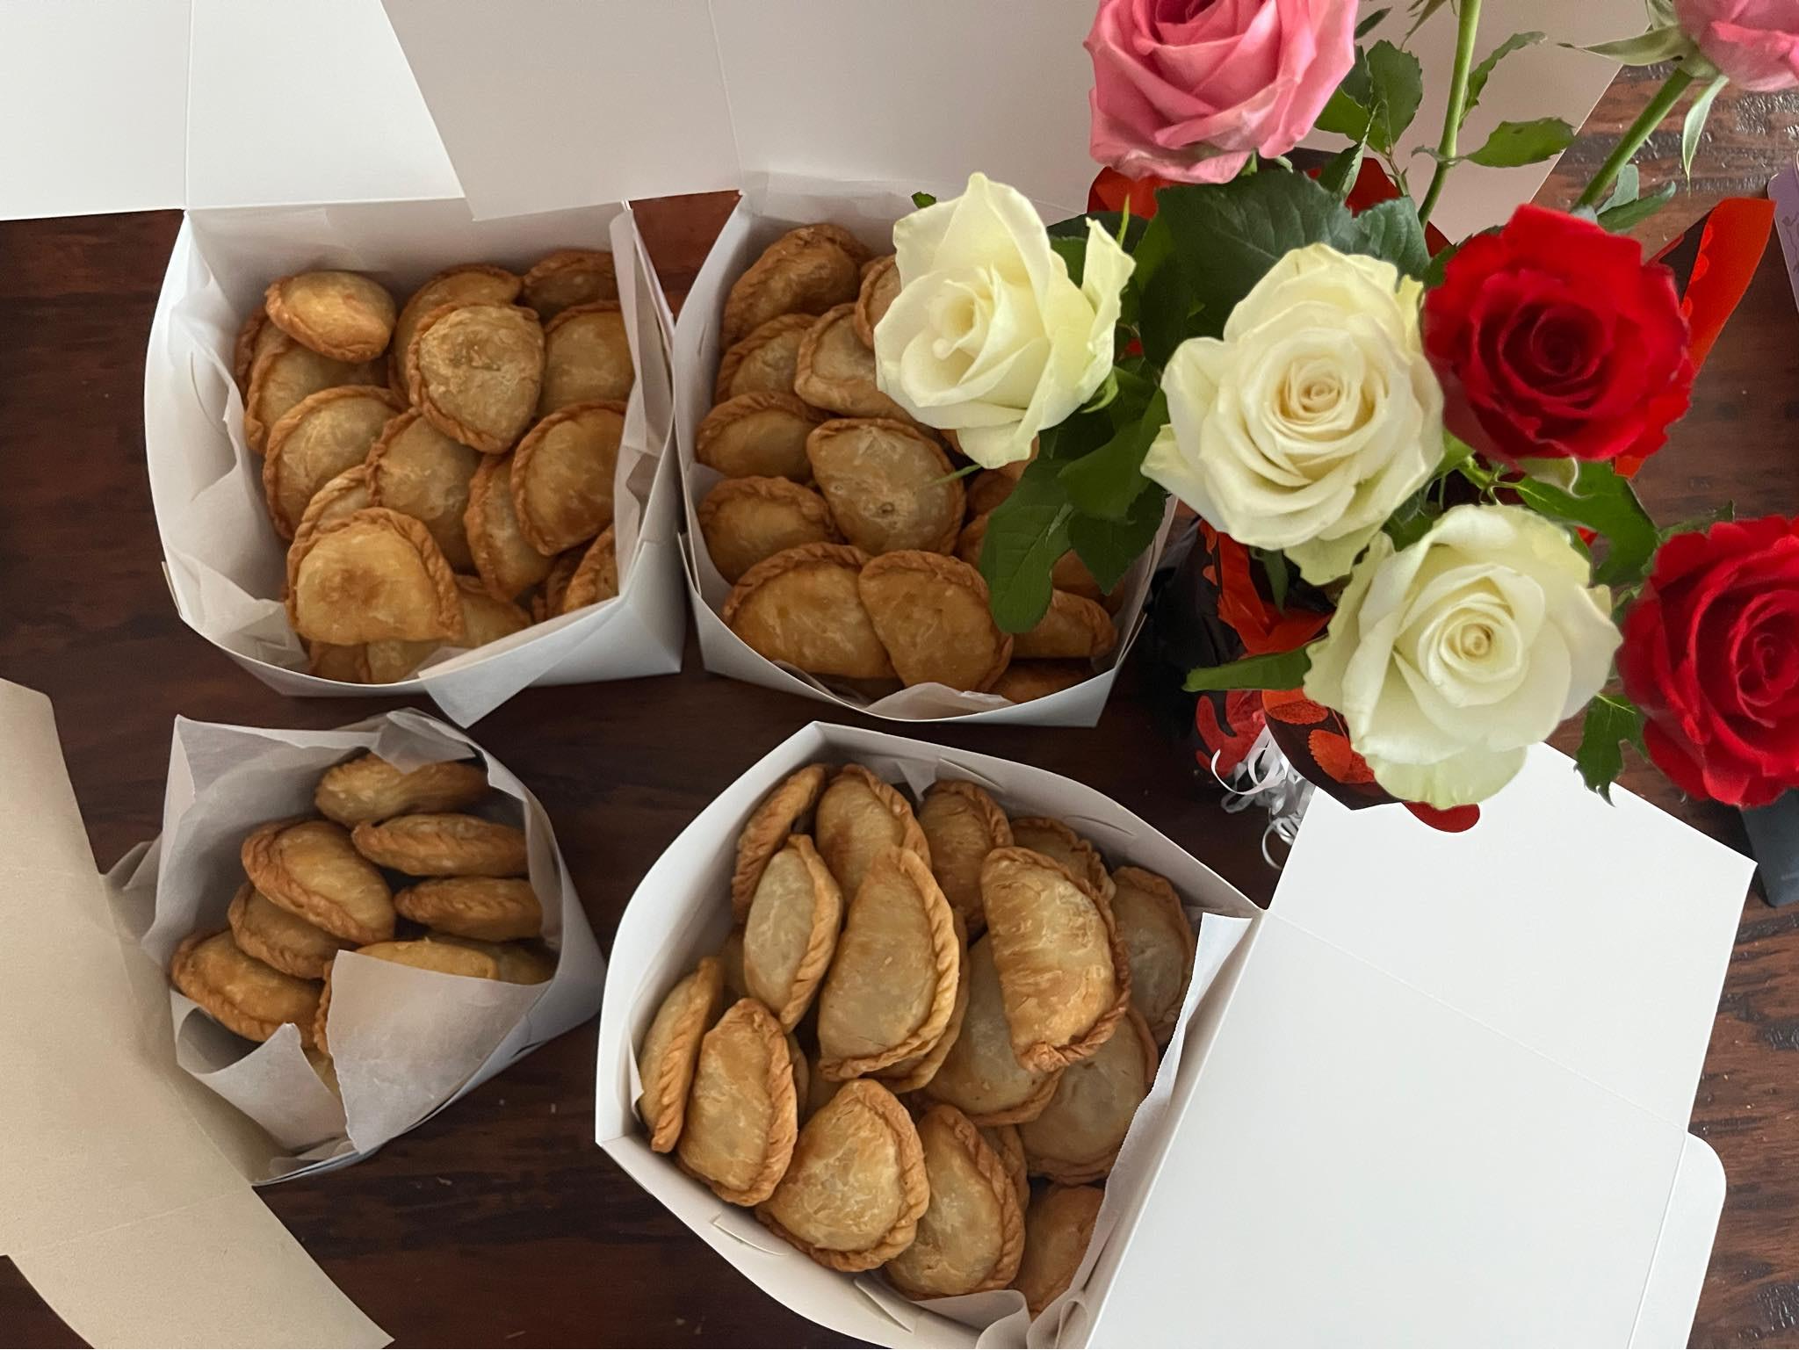
MY HOMEMADE EMPANADAS

Slide 2
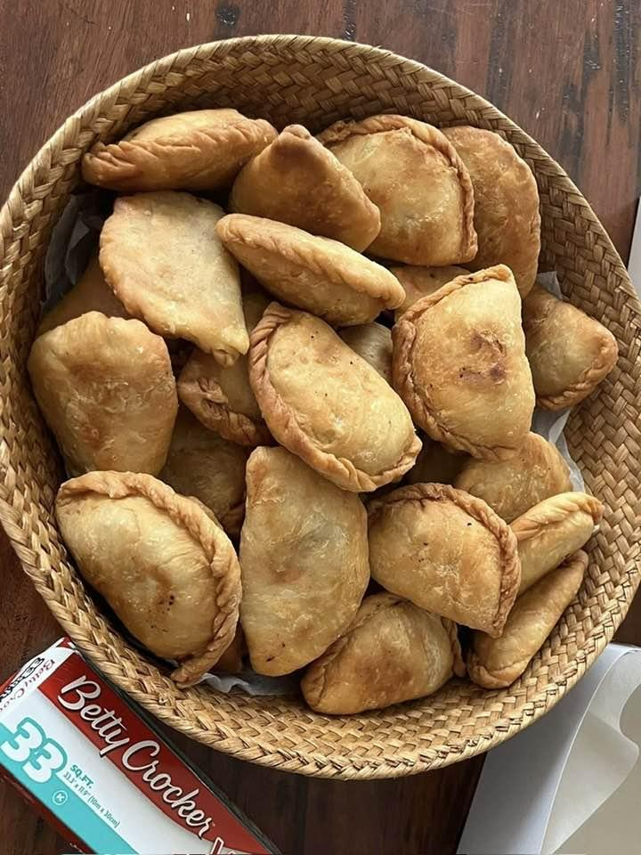
INTRODUCTION
Empanadas are the most popular hand-held foods in many countries. This are stuffe
Pastries or turnovers that are popular across many parts of the world especially in Spain
and Argentina and now also in the Philippines.
Traditionally, empanadas are made by folding dough around a filling, sealing the edges.
They can be savory or sweet, depending the taste that you want and the ingredients that you used.
Either baking or cooking.

Slide 3
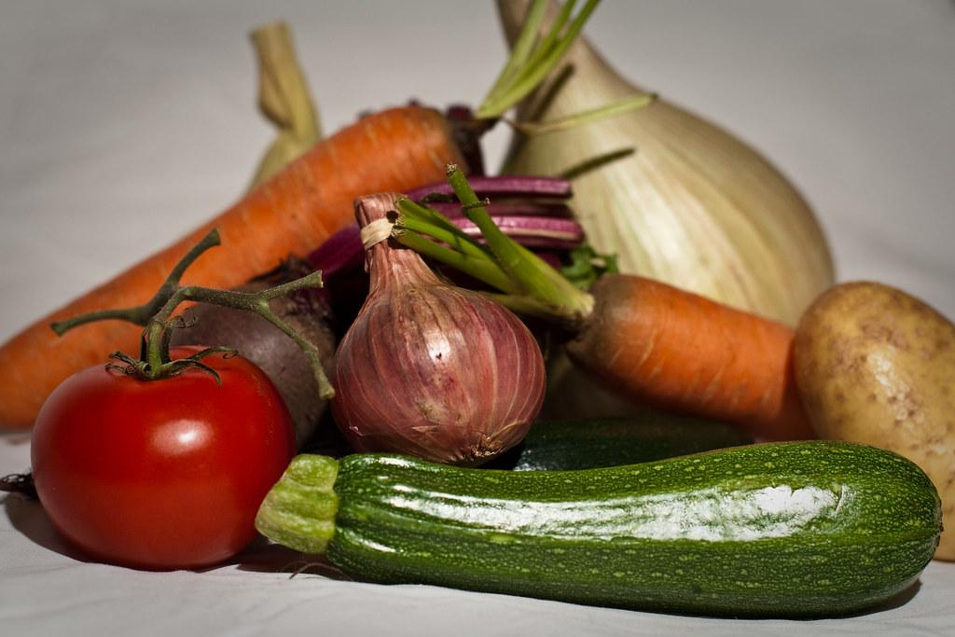
INGREDIENTS:
1.Beef,Chicken,or pork, or seafoods
2.Cheese
3.Vegetables:
Onion, carrots, potatoes, garlic, bell pepper
4.Raisin or any sweet fillings
5.boiled eggs.
6.Add Seasonings

Slide 4
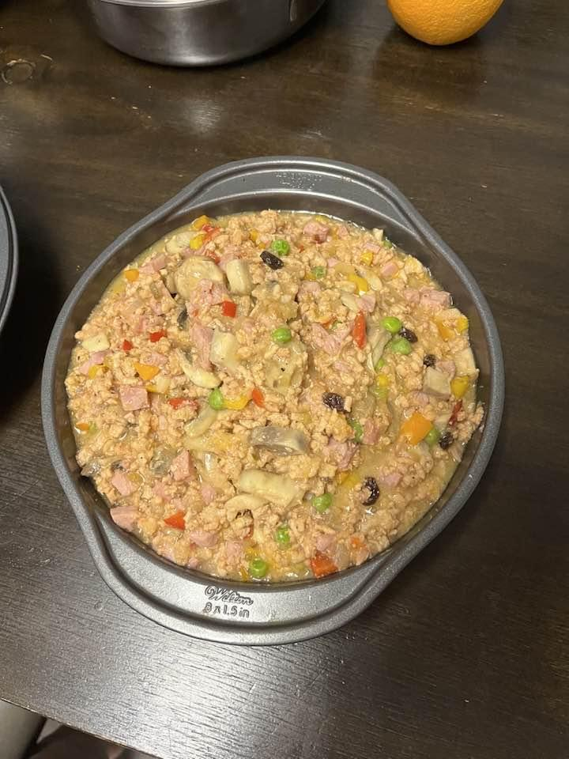
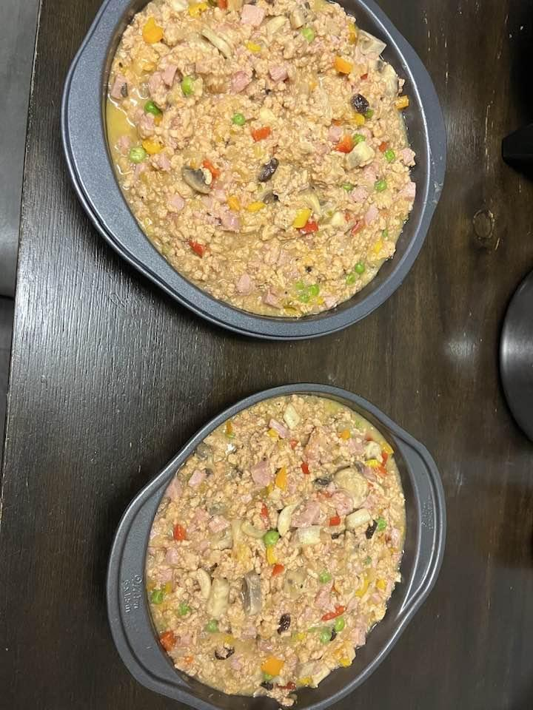
HOW TO COOK MY EMPANADAS
1.prepared your fillings by frying mixing the ingredients with adding your seasonings.
2.Let it cool and wrap it with dough.
3.After wrapping put in freezer .
4.Before frying or baking take out from freezer and let sit for 15 minutes for best well done in cooking.

Slide 5
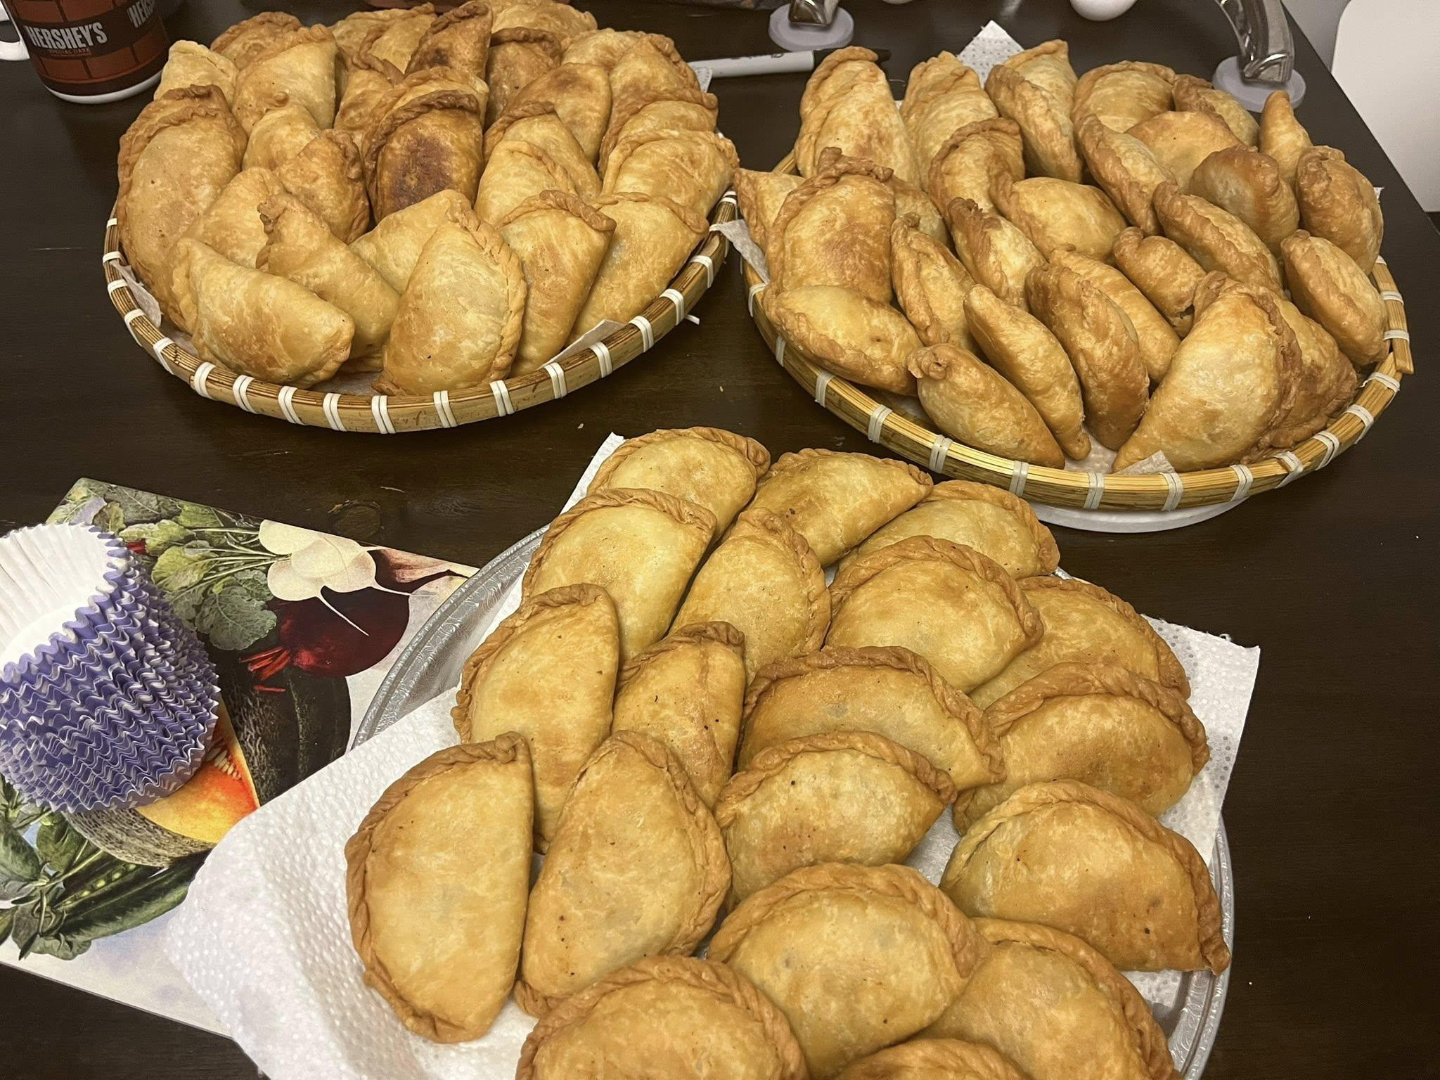
EMPANADAS ARE COMMONLY EATEN
AS:
Street foods
Snacks or appetizer
Party foods
Full meals when you serve with salad or sauces.

