Slide 1
MRAD 285: Radiographic Applied Skills
Trauma and Adaptive Radiography

Slide 2
Learning Outcome
Perform trauma and adaptive radiography.

Slide 3
Objectives
Differentiate between trauma and adaptive radiography
Describe radiographic adaptations used in trauma radiography
Perform trauma imaging of the axial skeleton
Perform adaptive imaging of the appendicular skeleton
Discuss effective strategies for managing the emotional effects of trauma imaging from a technologist’s perspective
Examine trauma images for diagnostic quality
Differentiate between trauma images and routine practice
Discuss methods to improve radiographic images

Slide 4
What is the Difference Between Trauma and Adaptive Radiography?
Adaptive
Trauma
Need to modify standard protocols and procedures
Can be for a variety of reasons, including trauma
Severe physical injury
Most likely need to use adaptive radiography
Usually sudden, dramatic, violent

Slide 5
Principles for Adaptive Radiography
Need, at minimum, two projections 90° to each other
  Preferably a “true” AP/PA and Lateral
  Maintain CR→ part→ IR alignment
    May need to angle tube and IR
    How can you move equipment around the patient to achieve the required views
    Angle patient’s stretcher
  There are exceptions to the rules
  Document details for the Radiologist and ER doctor!

Slide 6
Principles for Adaptive Radiography
Include injury on one image
  Ensure no anatomy is missed
    Chest / Ribs / Abdomen – may require more than one image on a large patient.
    Long bones – include both joints
      Include joint closest to trauma site with as much anatomy as possible, smaller IR for opposite joint
      “Always include a joint” Rule – follow up exams
    Take care when using CR
      Be mindful of divergent rays
      Be mindful of patient’s pillows, mattresses, etc.

Slide 7
Principles for Adaptive Radiography
Maintain patient, staff and your own safety
  Be mindful of accessory equipment
    IV’s, catheters, chest tubes, oxygen tubing
  Side rails and brakes on wheelchairs or stretchers
    Always return side rails to upright when leaving a patient
    Always lock the brakes
  Be mindful of patient injuries
    Patients in splints
    Moving patients with extremity fractures
    Moving patients with casts
  Radiation Safety
  Practice Standard Precautions
    Will be exposed to blood and body fluids

Slide 8
AP Sitting Chest
35x43 cm IR, crosswise for most patients
Almost always non-grid
90kV
Cover IR
Ensure the patient is high enough in bed
Elevate head end of bed as much as possible
Place top of IR approximately 5 cm above shoulders
Ensure no rotation
Internally rotate patient’s shoulders (if possible)
Remove artifacts, IV lines, etc from area of interest

Slide 9
AP Sitting Chest
Direct CR 7-10 cm below jugular notch
Angle CR at least 5 degrees caudad to match the angle of the patient’s sternum
Use SID of 180 cm if possible
Shield gonads
Expose on patient inspiration

Slide 10
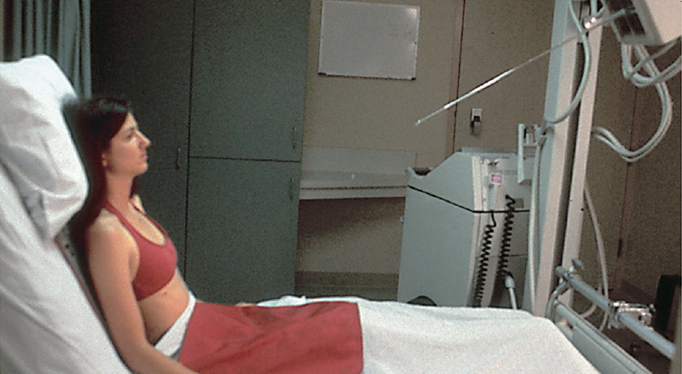
AP Sitting Chest
Source: Textbook of Radiographic Positioning and Related Anatomy, Bontrager & Lampignano. © 2013, Mosby Elsevier. Used with Permission.

Slide 11
Chest: Sitting Lateral
Use same principles as standing lateral chest
Done at upright detector
Place a sponge behind patient so there is no artifact from the stretcher
Have patient hold bar to elevate arms
Be sure to put side rails down so there is no artifact
If not possible, place sponge under their arms

Slide 12
Acute Abdomen in Stretcher
Left Lateral Decubitus
  Preferred in AP position
  35x43 cm IR, lengthwise
  Always use a grid!
  70-80 kV
  Can be done bedside with IR, or more likely an upright detector
  Turn patient onto left side, may need to place support under patient to prevent artifacts from mattress.
  *Patients should lie on left side for approx. 5 minutes prior to exposure to demonstrate any free intraabdominal air.
  Ensure no rotation
  Center to include diaphragm on image
  Image taken on expiration
AP Supine on the Table

Slide 13
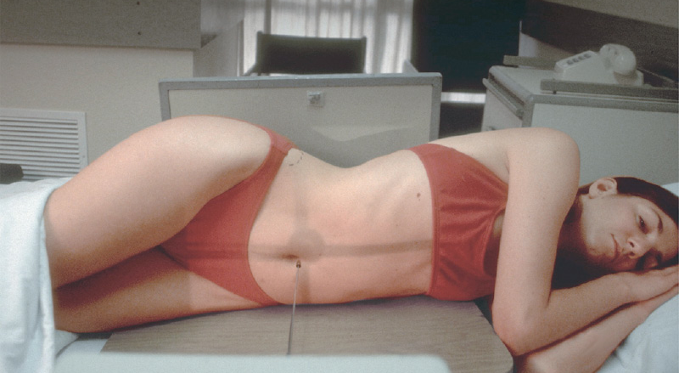
Left Lateral Decubitus
Why left side down most often ?
Source: Textbook of Radiographic Positioning and Related Anatomy, Bontrager & Lampignano. © 2013, Mosby Elsevier. Used with Permission.
Notes:
Image from Bontrager pg. 580

Slide 14
Adaptive Shoulder
AP Shoulder
Lateral Scap Y (AP Oblique)
  24x30 cm IR
  Grid / Table
  75-80 kV
  Rotate patient into posterior oblique position with the affected side elevated.
  Rotate patient so the scapula is in true lateral position – generally 25-30 degrees.
  Support patient with sponge.
  Place affected arm across the body, if possible.
  Direct CR perpendicular to IR
  Center CR to the midlateral border of the scapula
  HINT! Rotate the patient until the medial border of the scapula is in line with the AC joint. Direct your central ray halfway between inferior angle of the scapula and the AC joint, in line with the scapula

Slide 15
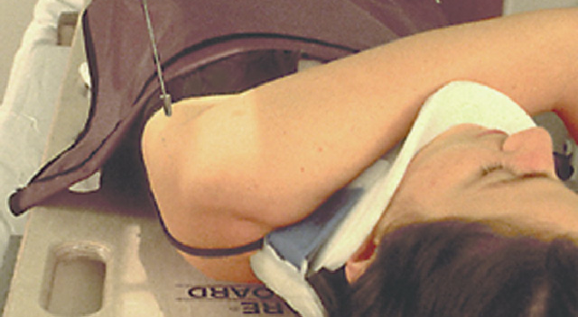
Shoulder- My Patient Can’t Stand
Source: Textbook of Radiographic Positioning and Related Anatomy, Bontrager & Lampignano. © 2013, Mosby Elsevier. Used with Permission.

Slide 16
Adaptive Knee
AP Knee
Oblique
  May need to cross angle if patient is unable to move
X-table lateromedial knee
  24x30 cm IR
  Grid 65-70kV (if knee is greater than 10cm)
  Non-Grid 60-65 kV
  Place support under knee to center knee to IR
  Place vertical IR against medial aspect of knee centered to the level of the knee joint (2 cm distal to apex of patella)
  Ensure no rotation
  Direct horizontal CR to be perpendicular to IR
  A slight 5 degree angle may be required to superimpose the femoral condyles
  Remember the medial condyle is larger and sits inferiorly to the lateral condyle.
  May angle tube or tilt patient slightly to maintain CR / part / IR alignment.

Slide 17
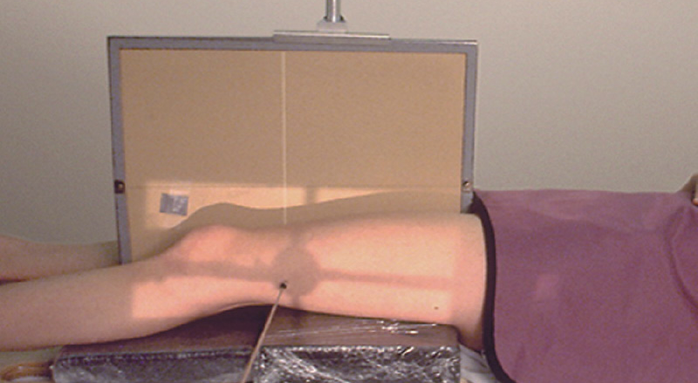
Adaptive Knee
Source: Textbook of Radiographic Positioning and Related Anatomy, Bontrager & Lampignano. © 2013, Mosby Elsevier. Used with Permission.
Notes:
Image from Bontrager pg 589

Slide 18
Trauma Radiography
Trauma describes injury or physical damage to the body
Many causes! Common mechanisms of injury we see as MRT’s:
  MVA/MVC
  Motorcycle accidents
  Work injuries
  Sports / Leisure injuries
Same three principles of Adaptive Radiography apply

Slide 19
Trauma
Not all hospitals are considered “Trauma Centers”
Hospitals will be equipped to handle different levels of trauma
  Level 1 – Ability to care for all levels of injuries, fully-staffed around the clock
  Level 2 – Ability to care for some levels of injuries, ER physician & nurses on-site. Radiologists & MRT’s on-site around the clock
  Level 3 – ER physicians, Radiologist(s) & MRT’s on-call overnight
Notes:
Level 1 in southern Alberta

Slide 20
Trauma
Level 1 trauma centers will have radiographic equipment in ER department:
  Mobile
  Cassettes, grids, accessories
  CR multi-readers
  Trauma c-arms
May be adjacent to Imaging rooms
  Fluoro / Angio suite
  CT
  MRI
May be adjacent to OR

Slide 21
Trauma Team
Transport team consists of EMT’s
Hand-off patient to the Trauma team
Trauma team consists of Physician(s), Resident(s), Nurses, RT(s), LPN/NA(s), Lab, Anesthesiologist & MRT(s)
High-pressure situations
Time sensitive
  “Golden” Hour

Slide 22
Trauma Work Up
A trauma “work-up” consists of assessing the extent of injury and stabilizing the patient
Imaging is frequently part of this work-up
Common radiographic protocol:
  Chest
  Pelvis
  X-table lateral C-spine
    Which is done first?

Slide 23
Trauma Room
Patient may come to the department or images may be done in emergency(trauma room)
Ceiling mounted tube, similar to a c-arm
Wait for direction from the physician
Radiation Protection: What is your responsibility?

Slide 24
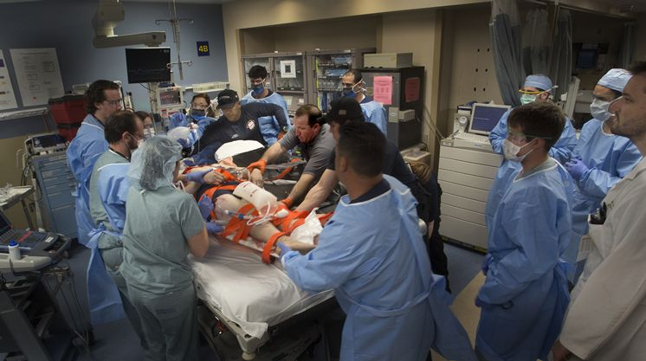
Trauma Room
Source: Tampa Bay Times. Reproduced and used in accordance with SAIT’s Fair Dealing Policy (Schedule A, Copyright of External Materials Procedure AC.2.12.1); further distribution may infringe copyright. Retrieved from http://www.tampabay.com/news/health/need-for-more-hca-trauma-centers-not-clear-cut/2173764

Slide 25
Trauma Situation: Emotional Management
In your career, you will see difficult and sad situations
Participate in de-briefing if available
Grief management programs in place at INSTITUTION NAME HERE and clinical sites
Talk to friends or family (while respecting patient confidentiality)
Talk to preceptors, coworkers and instructors

Slide 26
Trauma Spine
X-rays are common after an MVC
Patient arrives on “spinal precautions”
  C-spine precautions vs. Full Spine precautions
  C-spine is most common
  Terms are often used interchangeably but incorrectly
  Treat all patients as C-spine precautions
Backboard & Cervical collar
Transfer patients with no twisting or moving from the supine position
Patient’s head and neck should be stabilized (not by a student!)
Notes:
-to query whiplash vs. #
C-spine precautions means immobilized on a backboard and should not sit up.
Spinal precautions means T/L spine precautions, instructions can vary. It is not clear in the regions! Treat everyone as a c-spine precaution to avoid risk of further injury!

Slide 27
Trauma Spine
Log-rolling a patient on C-spine precautions
  Should not routinely be done in the x-ray department!
  Patients MUST arrive on a backboard.
  5 people to roll patient (disregard Ehrlich!!!)
Never remove backboard or cervical collar
  Even if Dr. views images
  If Dr. removes collar and clears the patient to stand & move – document it!
Notes:
Dr’s will look at lateral/swimmers and tell you “it’s clear” and ask you to remove the collar for AP and odontoid images. Not ok!

Slide 28
X-table Lateral C-spine – Positioning
Patient remains supine, head/neck is not adjusted.
Can use upright IR or CR cassette.
Align the top of the IR/cassette ~1-2” above level of EAM.
  Include sella turcica – T1
Depress shoulders
  Never pull a trauma patient’s shoulders. A nurse or physician can be asked to. Ask patient to relax shoulders and “reach for their toes”
Notes:
- Grid = not always necessary, dependant on patient size. Increased OID reesults in air-gap (air acts as a “filter” for scatter/low energy radiation that will not reach the IR causing density without detail)
- Include sella turcica

Slide 29
X-table Lateral C-spine
Central Ray
  Perpendicular to IR
  Directed to level of C4 (thyroid cartilage)
  SID = 180 cm if possible
    Why?
Collimation
  Include all required anatomy
  Include all soft tissue (trauma)
    Why?
Technical Factors
  70 - 75kV non-grid OR 75 – 80kV grid
  Non-grid will often work
    Air-Gap Technique
Notes:
- Grid = not always necessary, dependant on patient size. Increased OID reesults in air-gap (air acts as a “filter” for scatter/low energy radiation that will not reach the IR causing density without detail)

Slide 30
X-table Lateral Swimmer’s Projection
  When?
  Patient remains supine, head and neck is not adjusted
  Can use upright IR or CR cassette with grid
Positioning
  Elevate patient’s arm closest to IR
  Depress patient’s arm away from IR and rotate posteriorly if possible
    Why?
  Can rotate patient’s stretcher if necessary
    How & Why?
Notes:
When C7/T1 joint space is not visualized through shoulders
- separate the humeral heads
- mimic the 3-5 degree caudal angle if done in a lateral recumbent or erect position.

Slide 31
X-table Lateral Swimmer’s Projection
Central Ray
  Perpendicular to T1
  ~ 1” above jugular notch
  Bontrager: SID = 150-180 cm
  Clinical Practice: SID = 110-150 cm
Collimation
  Trauma: Include skull base – T4
  Include soft tissue (trauma)
  Tight collimation to increase detail
Technical Factors
  80-90kV, grid
  mAs will vary, depending on patient size
  Use a compensating filter!

Slide 32
Other spinal projections
Similar to routine
Adapt lateral projections to be done x-table.
Do laterals first
  Centering points and collimation will be similar
  AP C-spine
    Adjust tube angle to patient in collar
    Through intervertebral disk spaces
  AP Odontoid
    Adjust tube angle instead of patient’s head!

Slide 33
Other Projections
We have reviewed the most common but be sure to review all readings in Bontrager.
Half the cases in the hospital will require some type of adaptation and problem solving.

