Slide 1
RADP 215: Radiation Protection
Physical Properties of an X-ray Beam

Slide 2
What is Radiation?
Transfer of kinetic energy that passes from one location to another.
  Varying types and sources
  Matter that intercepts or absorbs radiation is said to be irradiated.
Notes:
When sound waves go through a wall is that considered radiation? Yes transfer of energy, mechanical

Slide 3
Wave Theory
All waves have an associated
  Wavelength
  Frequency
  Amplitude
  Period

Slide 4
Wave Theory
Wavelength
  Distance between any two successive points on a wave
  Measured crest-crest or trough-trough
  Represented by Greek letter lambda (λ)
Frequency
  Number of wavelengths in a given time
  Unit is a Hertz (Hz)
  One Hz= 1 cycle/second
Amplitude
  Intensity of wave defined by its maximum height
Period
  Time required to complete one cycle

Slide 5
Wave Equation
Relationship between the frequency, wavelength and velocity of a wave is expressed in a formula.
The Wave Equation
  Velocity = frequency (f) x wavelength (λ)
  v = fλ

Slide 6
Electromagnetic Waves
Electromagnetic waves travel at the speed of light in a vacuum and do not require a medium
Electromagnetic Wave Equation
  c = fλ
  *reference from BushonG
    C - constant (velocity or speed of light)
    *f - frequency
    λ – wavelength
Notes:
Not Ultrasound…it is mechanical needs matter to travel
Ultrasound? Frequency higher than 20 000Hz (20kHz)
Propagation of sound waves longitudinal, the mechanical displacement being in the same direction as propagation.
A medium is needed for sound waves to go through, no medium = no soundwaves???

Slide 7
Particle Theory
High-frequency radiation interacts with matter more like a particle than a wave.
Radiation acts like a discrete bundle of photon energy.
Photons carry a specific amount of energy depending on frequency.
Photon energy and frequency are directly proportional.
Relationship was first described by a physicist named Max Planck.

Slide 8
Particle Theory - Formula
The relationship between photon energy & frequency is described in this formula:
Planck’s Quantum Equation
  E = hf
    E = photon energy (eV)
    h = Planck’s constant (4.15 x 10⁻¹⁵ eV-sec)
    f = photon frequency (Hz)
This equation is used to calculate the frequency of an x-ray when given the x-ray photon’s energy.

Slide 9
Wave-Particle Duality
  Wave-Particle Duality
    X-ray photons can be described as both waves or particles
    Can travel through space in form of a wave
    Can interact with matter as a particle of energy
Notes:
Example: the water of Niagara Falls has a particle behavior during its fall and, once it has reached the river down below, the particles become "eddies", like waves

Slide 10
Electromagnetic Spectrum
Low frequencies, long wavelengths are at the bottom of the spectrum:
  Radiowaves
  Microwaves
  Light
  Ultraviolet
High frequencies, short wavelengths are at the top of the spectrum:
  X-rays
  Gamma rays

Slide 11
Electromagnetic Spectrum
Each frequency has a characteristic wavelength and energy.
  Higher frequencies are associated with shorter wavelengths.
Wavelengths range from largest to smallest.
Frequencies and energy range from smallest to largest.
Lower frequencies and energy at lower end of the spectrum.
Higher frequencies and energy at the top of the spectrum.
Notes:
Each frequency has a characteristic wavelength and energy.
Higher frequencies are associated with shorter wavelengths.
Wavelengths range from largest to smallest.
Frequencies and energy range from smallest to largest.
Lower frequencies and energy at lower end of the spectrum.
Higher frequencies and energy at the top of the spectrum.

Slide 12
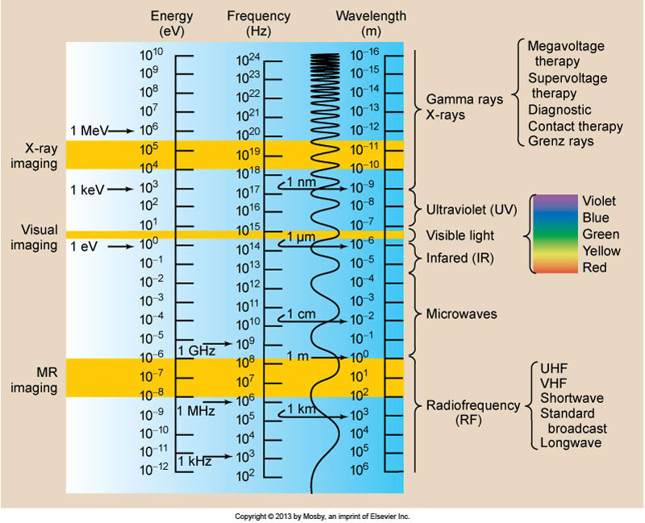
Electromagnetic Spectrum
Top of the spectrum
  Higher energy
  Higher frequency
  Shorter wavelength
Bottom of spectrum
  Lower energy
  Lower frequency
  Longer wavelength

Slide 13
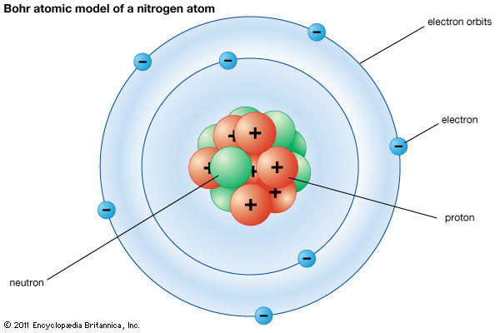
Atoms
Atoms in a normal state are electrically neutral.
Total number of electrons in orbital shell is equal to the number of protons in nucleus.

Slide 14
Excitation of an Atom
Occurs with both ionizing and non-ionizing radiation.
  Electrons are infused with energy
  Jump to a higher energy shell
  Electron will return to its original location
  Excess energy is released as non-ionizing radiation

Slide 15
Ionizing Radiation
Ionizing radiation causes ionization of atoms
  Causes electrons to be ejected from an atom
  This is the foundation of interactions in human tissue
  An atom that has an extra electron or loses one becomes ionized.
  Ionized atom will then carry a charge equal to the difference between number of protons and electrons.
Ion
  Electrically charged atoms (positive or negative)
  Caused by loss or gain of one or more electrons
Free electron and the atom are called an ion pair.

Slide 16
Electromagnetic Radiation
Ionizing Radiation
  X-rays
  Gamma rays
  High-energy ultraviolet radiation
Non-Ionizing Radiation
  Low-energy ultraviolet
  Visible light
  Infrared rays
  Microwaves
  Radiowaves

Slide 17
Particulate Radiation
Alpha and Beta particles
  Associated with radioactive decay
  Alpha Rays
  Highly ionizing, short range in tissue
  Less penetrating than beta particles
  Emitted from nuclei of heavy elements during radioactive decay (uranium and radium)
  Contains two protons and two neutrons
    Helium atom without electrons
  Large mass and positive charge
  Could be absorbed by piece of paper

Slide 18
Particulate Radiation
Beta Rays
  Light particles emitted from nucleus of radioactive atom
  Very high energy ejected at high speed
  8000 times lighter than alpha particle
  Penetrates matter to a greater depth than alpha with less ionization (1-2 cm of soft tissue)

Slide 19
Sources of Radiation (natural)
Terrestrial
  Uranium and radium present in the earths crust
  Radon
    Largest contributor of background radiation
    Arises from the decay of uranium-238
    Colourless, odourless and chemically non-reactive
    Always present in the air
    Comes up through soil, permeates buildings
    Bricks, concrete, gypsum all contain radon
Notes:
Make “Game”

Slide 20
Sources of Radiation (cont’d)
Cosmic
  From nuclear interactions that have taken place in the sun and other stars
  Protected by the atmosphere and earth’s magnetic field
  Greatest intensity at high altitudes and lowest at sea level
  Air travel: 10 hours in the air = 1 chest x-ray
Internal
  Human tissue has naturally existing radionuclides that are inhaled or ingested in tiny quantities

Slide 21
Sources of radiation (artificial)
Manmade
  Industrial
    Nuclear accidents
    Mining
  Research
    Electron microscopes
    Particle accelerators
  Consumer products
    Watches
    Smoke detectors
    Exit signs
  Medical Radiation

