Slide 1
MRAD 240:
Specialized Imaging 1
Operating Room- Types of Surgeries

Slide 2

Objectives
Introduction to the types of surgeries
Hip procedures and Intramedullary Nails (IM Nails)
Distal Limbs and Screws
Small ORIF (Open Reduction Internal Fixations
Spinal procedures and Pacemakers
Mobiles
Exposure patterns and other factors that reduce radiation

Slide 3
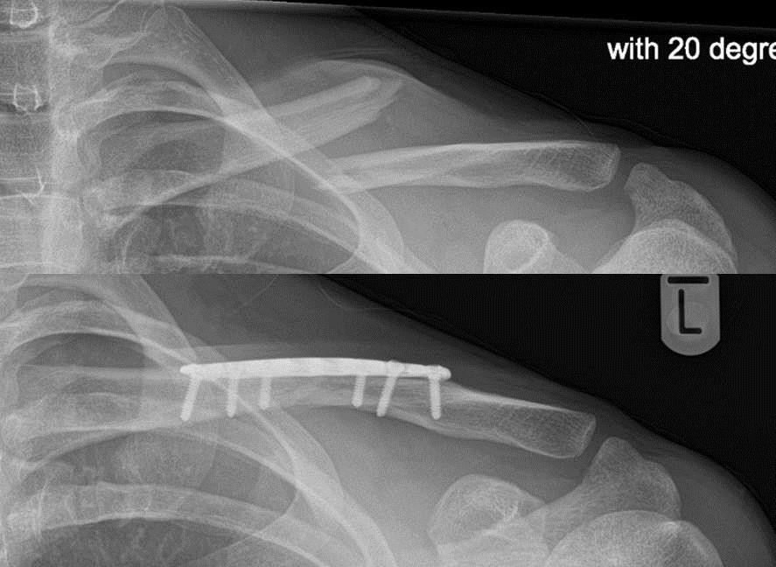
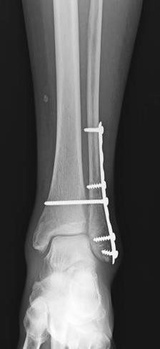
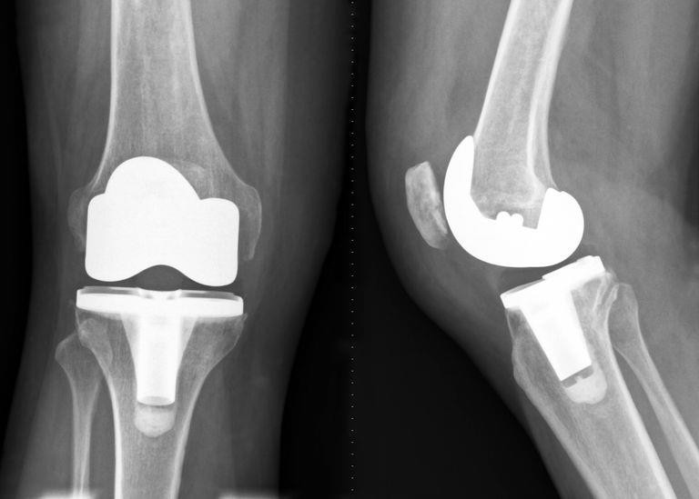
OR Procedures
What kind of surgeries most commonly require x-ray guidance?
  Orthopedics
https://www.londonupperlimbsurgery.co.uk/clavicle-orif-open-reduction-and-internal-fixation/
https://orthoinfo.aaos.org/en/treatmen t/internal-fixation-for-fractures/
https://www.verywellhealth.com/total-knee-replacement-what-you-need-to-know-2552264

Slide 4
Types of Surgeries – Pg 613 in Bontrager
Hip pinning
Kirschner wire (K-wire)
Laminectomy
Laparoscopic
Microdiscectomy
Spinal fusion
Strike-through
THR
TKR
Traction
Arthroplasty
Orthogonal
Cerclage wire
Closed reduction
Open reduction
Internal fixation
ORIF
External fixation (Ex-fix)
Intramedullary rod (IM nail)
Cancellous screw
Cannulated screw
Cortical screw
Dynamic hip screw (DHS)
Fracture table

Slide 5
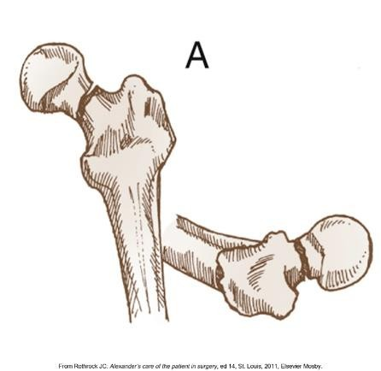
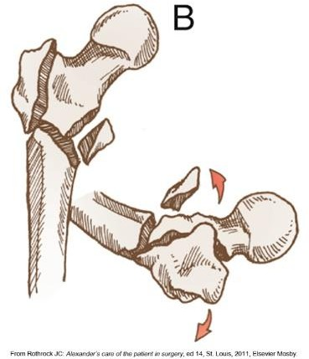
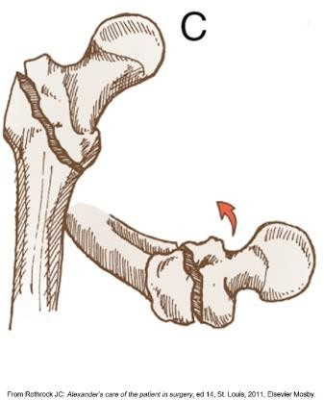
Hip Procedures
Can be total hip replacements or implanted screws
Anterior, posterior or lateral approach for THR
Lateral is traditional
Anterior is becoming more popular
  Minimally invasive
  “Muscle-saving”
  10-15% of all replacements

Slide 6
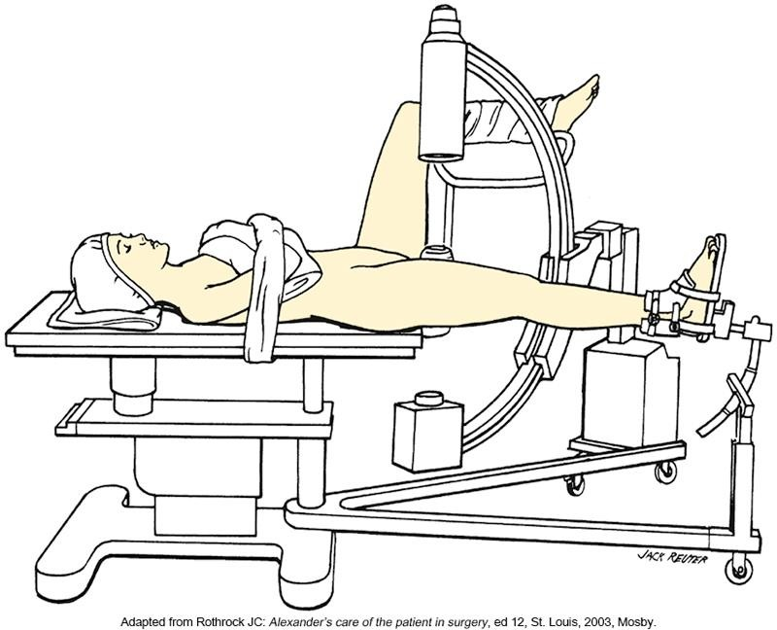
Hip procedures cont.
ROI is always the femoral neck
How do we want to approach the patient with the C-arm?
  Opposite side of the surgeon
  Between patient’s legs
Sterile draping required for C-arm. Type of draping depends on Location of C-arm.

Slide 7
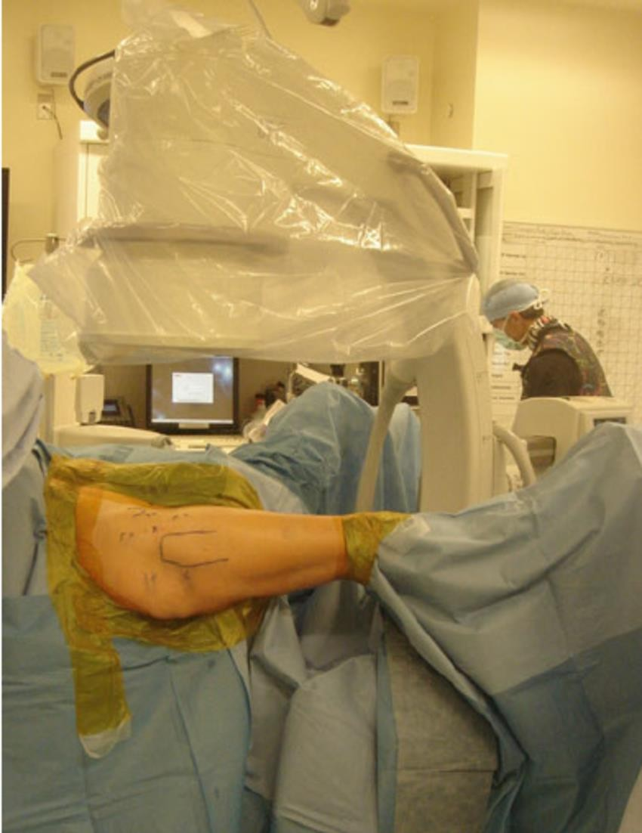
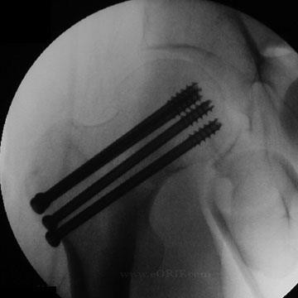
Hip Procedures PA
https://eorif.com/femoral-neck-fracture-cannulated-screws-27235
https://www.researchgate.net/figure/ntraoperative-photo-demonstrating- patient-setup-following-prepping-and-draping-for-a_fig8_305725365

Slide 8
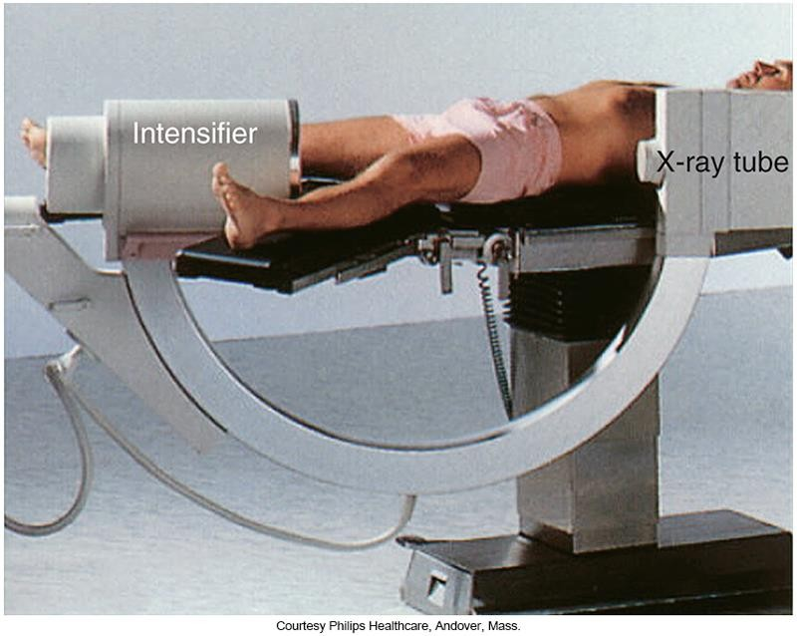
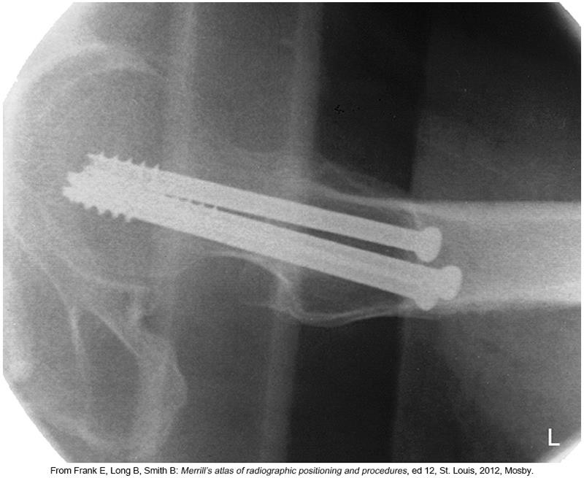
Hip Procedures Lateral

Slide 9
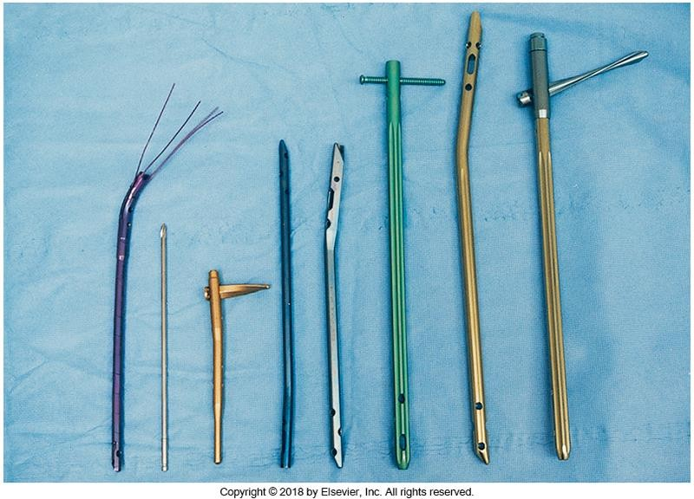
Intramedullary Nails
Stabilize fractured long bones
Inserted within the medullary canal of the bone
  Strength from inside the bone
Common IM nail locations
  Tibia
  Femur
  Humerus

Slide 10
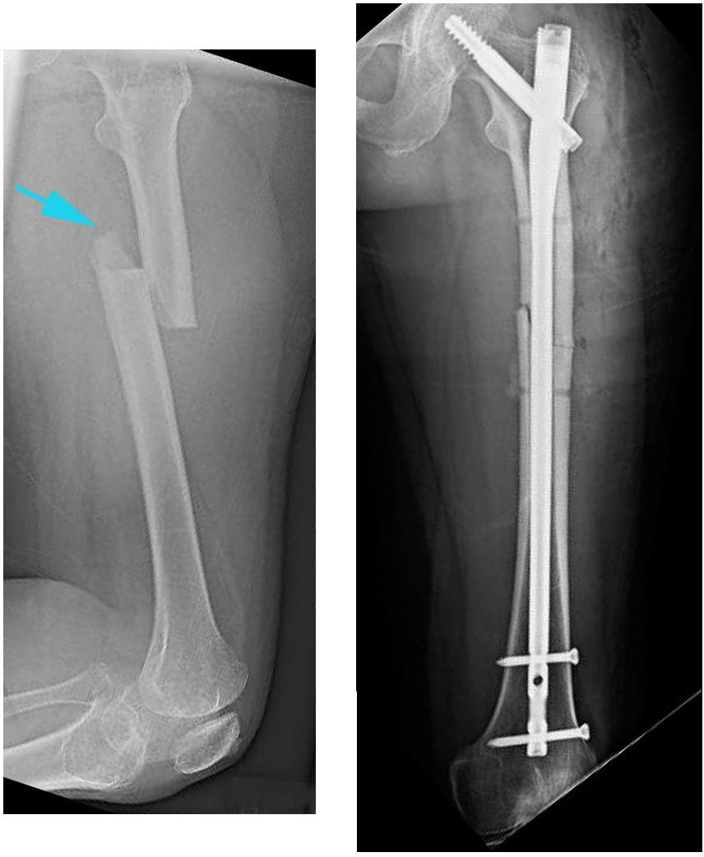
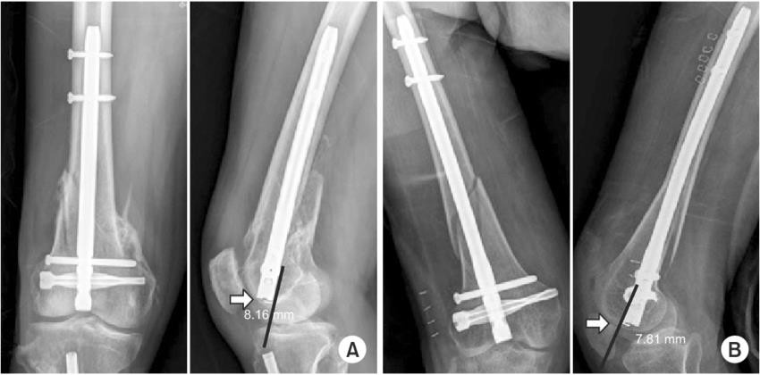
IM Nails cont.
https://www.researchgate.net/figure/Entry-point-of-the-retrograde-intramedullary-nail-which-could-affect-the-posterior_fig2_324749970
Examples of AP and Lateral projections
https://clinicasandalf.com/special-medical-treatment/trauma-surgery/

Slide 11
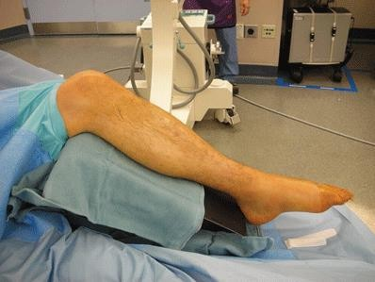
IM Nail Insertion
Sometimes it’s difficult to obtain two perfect 90º projections.
  Orthogonal view is a projection that is 90 degrees to original view.
May not be a straight PA and lateral
image
A radiographic series of images requires 2 orthogonal projections of the region of interest
https://musculoskeletalkey.com/foot-external-fixation/

Slide 12
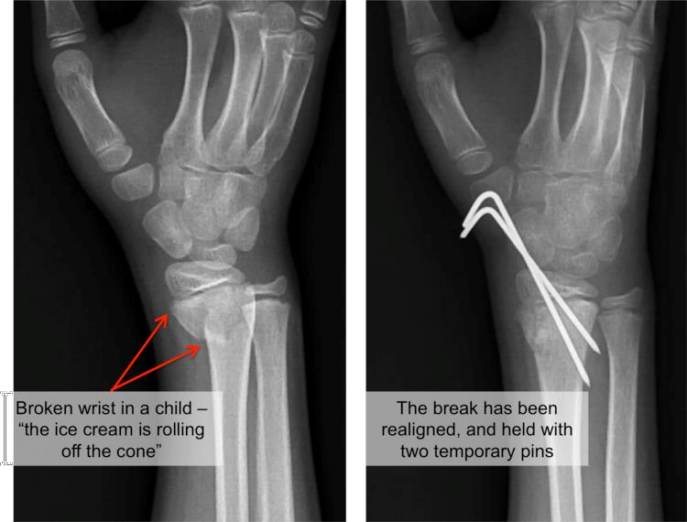
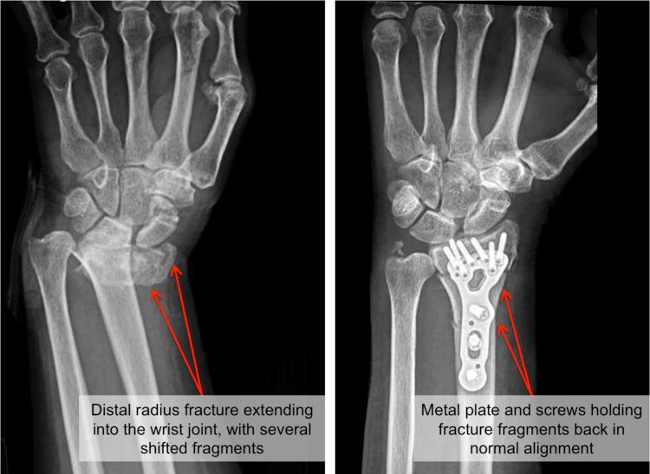
Distal Limb Plates and Screws
Common on wrists and ankles
Sometimes temporary pins are used until healing occurs
https://www.raleighortho.com/blog/3391/
Sometimes they use plates and screws
https://www.raleighortho.com/blog/3391/

Slide 13
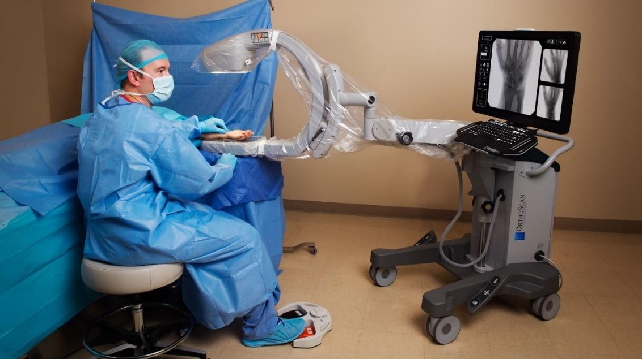
Small ORIF (Open Reduction and Internal
Fixation) insertions
Can be done with the same approach as IM nails
Some surgeons like to flip the C-arm and use the I.I. as a table
Some C-arms are actually designed to be used like this
https://global.orthoscan.com/

Slide 14
Spine Procedures
Counting vertebral levels as well as placement of hardware.
Fusion, laminectomy, or microdiscectomy
Lumbar
  Posterior approach to avoid internal organs
Cervical
  Anterior or posterior approach depending on what hardware is being used

Slide 15
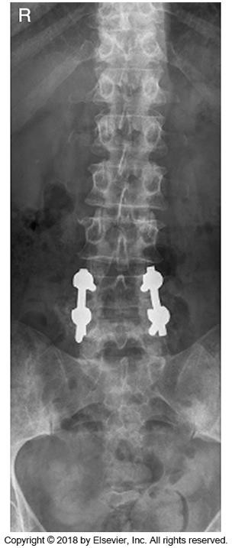
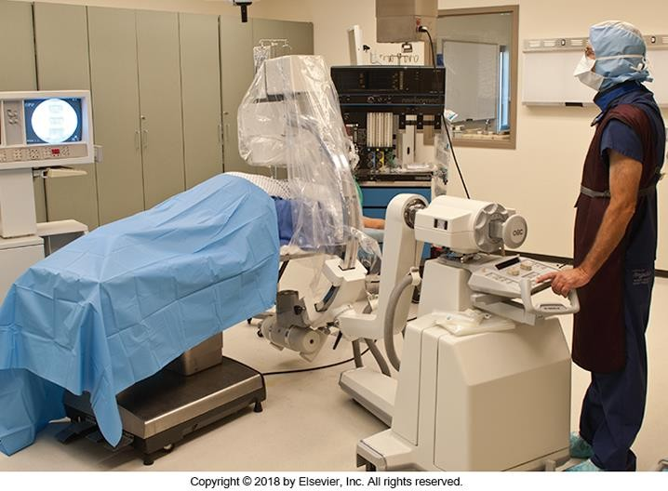
Spinal Fusion

Slide 16
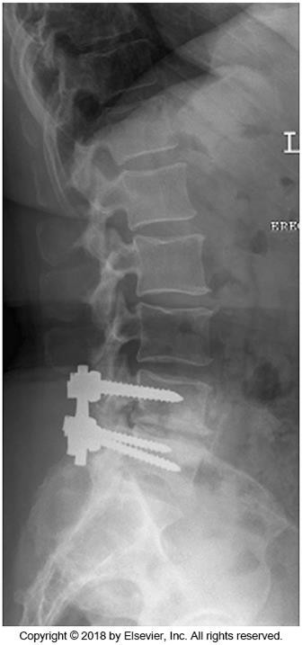
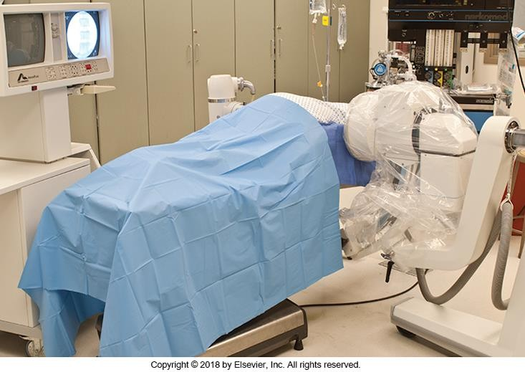
Spinal Fusion

Slide 17
Pacemaker Placement
What is a pacemaker?
Pacemaker leads are radiopaque
Fluoro used to guide the leads into the right ventricle
  Begins at veins in arm or chest and into the right atrium

Slide 18
Mobile X-ray Exams
Like a regular X-ray tube – but mobile. Can also be called a “portable” at some locations
Used in many departments, including the OR. Examples of OR include:
  Incorrect sponge count
  No time for sponge count
  Confirm spine level before fusion

Slide 19
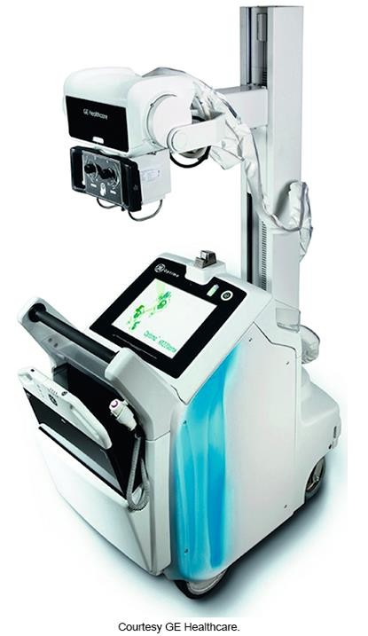
Mobile X-ray Tubes
Battery powered or have a capacitor discharge system
  Must be plugged in when not being used
Locks
  Look for indicators. Example- field size
  Manual vs. Hydraulic- know your mobile
  Use handles and grips provided
Very heavy
  Self propelled. Often have 2 “speeds”
  Deadman switch

Slide 20
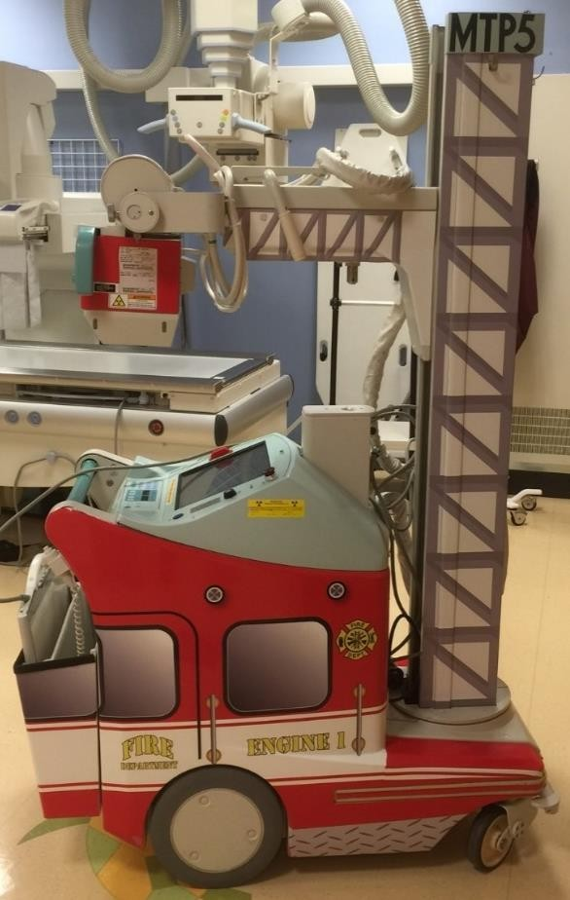
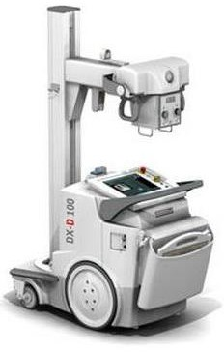
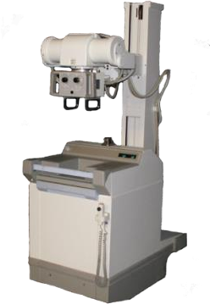
Various designs of Mobiles
New & Fancy!
Old & Not Fancy
Pediatric
https://www.elephantheadgraphics.com/portable-xray-machine-wraps-medical-equipment-vinyl-wraps/
https://www.rentittoday.com/medical-equipment-rentals
http://www.spectrumxray.com/imaging-equipment/portable-mobile

Slide 21
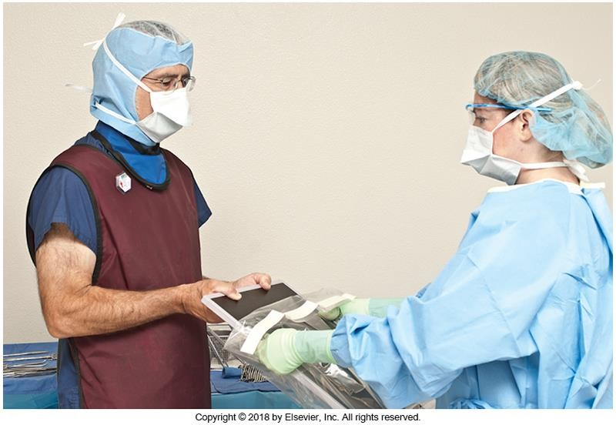
Mobile Image Receptors
Modern machines have detectors and digital screens
Some older mobiles use CR cassettes
  Time consuming and inconvenient
Cover with sterile drapes in OR
Grids, markers, tape, sponges, etc.

Slide 22
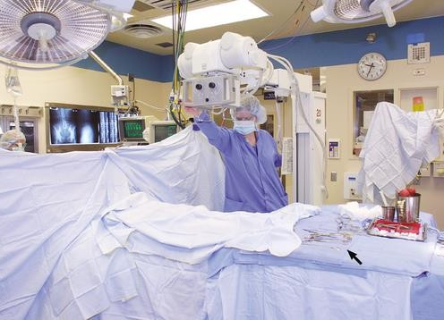
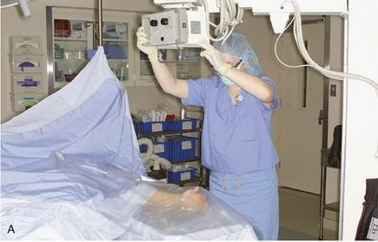
Mobiles in the OR
Don’t want the uncovered mobile tube directly over open incisions.
  Surgeon will temporarily drape surgical site and indicate location with radiopaque object
https://radiologykey.com/surgical-radiography/
Often used cross-table for spines
  Only a large FOV is used length wise. This is for counting vertebral levels. But FOV width is similar to size used in x-ray dept) This is because of high dose required to penetrate lumbar spines.
https://radiologykey.com/surgical-radiography/

Slide 23
Exposure Patterns
What is the most effective way to reduce dose when using the C-arm (fluoroscopy)
  Distance
Who has the most dose during surgery?
  Surgeon and assistants
Can this person move away from the beam?
  No

Slide 24
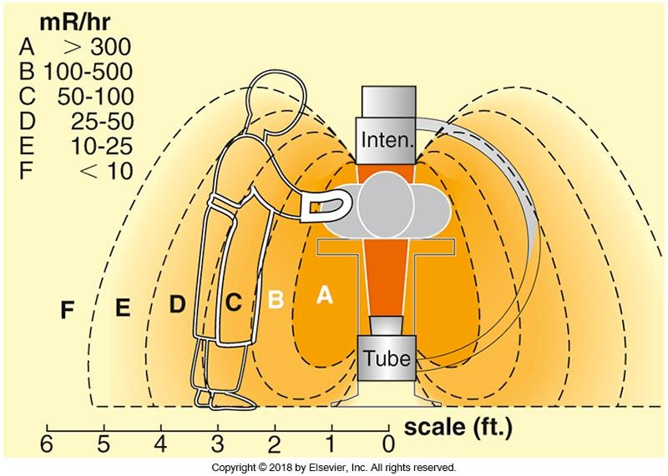
I.I. on top

Slide 25
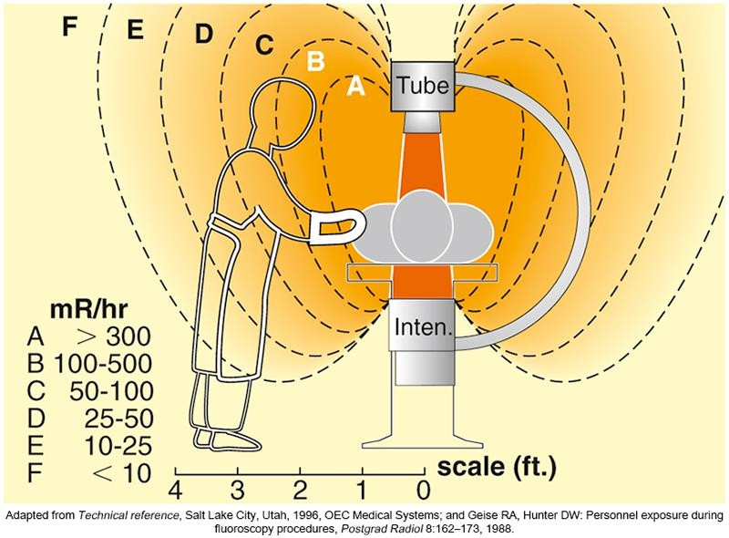
I.I. on Bottom

Slide 26
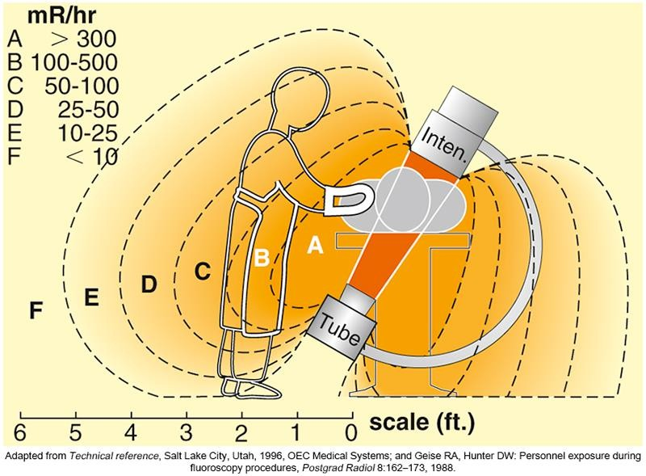
30º Tube Angle

Slide 27
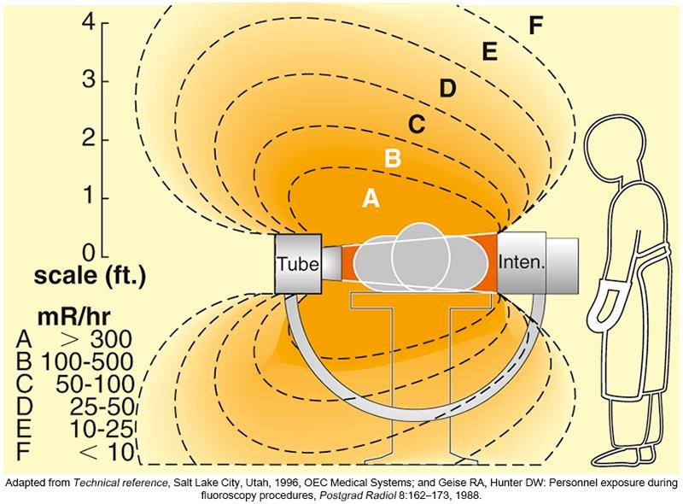
Lateral Tube Angle

Slide 28
Other Factors that Reduce Radiation
Dose Are:
Ongoing inspection and proper use of the OR lead aprons
The technologist ensuring all OR staff are wearing lead shielding
prior to any exposure. This rule especially pertains to the circulating
nurse and anesthetist. Remind staff wearing1/2 aprons to watch their backs.
Monitoring and informing surgeons of amount of fluoro time used.
Let the 5 min fluoro alarm sound for a few moments and then
announce how much exposure time has occurred. Sometimes fluoro times can range between 10-20 minutes.
Record/document the amount of fluoro time used
Inform the surgeon about the “pulsing feature” available on the foot
pedal. This will minimize accidental exposure by the surgeon while they are working at the surgical site.

Slide 29
Language and Culture in the OR
Surgeons will use various words or non-verbal cues to indicate what they want. When they want you to exposure or fluoro , They might say the word “picture or fluoro” Perhaps they will just make eye contact and they move their hands out of the way. Pay attention to the subtle …
Know your equipment and use it efficiently. Nothing worse then appearing incompetent in
your abilities. Surgeons want results not excuses.
It’s your responsibility to understand what the surgeon requires and to seek clarification if necessary. Better to ask them to repeat themselves than to do something incorrectly after being asked.

Slide 30
Language and Culture in the OR cont.
When in the OR, consider the “mood” of the environment. There is also etiquette which can’t be over emphasized such as being professional, courteous and respectful.
Basic manners goes a long way in establishing networks and building resource banks. Example- By using the circulating nurse’s name when asking a question demonstrates their value and they will be much more willing to assist you.
It’s useful to create your own OR cheat sheet/procedure manual. This cheat sheet can include surgeon preferences, terminology, room set up, equipment features etc.
Meet expectations. Surgeon needs results, not excuses. Don’t take things personally.
Advocate your needs.

Slide 31


