Slide 1


Choosing the Correct Peel for the Appropriate Patient

Slide 2
Chemical peels are divided into four categories depending upon the depth of the wound created by the peel . Very superficial peels only penetrate through the stratum corneum and the uppermost portions of the epidermis. Superficial chemical peels penetrate the epidermis but not more than the basal layer of the epidermis. Medium-depth peels penetrate the entire epidermis plus the papillary dermis. Deep chemical peels create a wound to the level of the upper and mid-reticular dermis.

Slide 3
Evaluation of the Paitent
When evaluating a patient for a peel, an extensive history should be taken
Contraindications
Herpes simplex virus (HSV) infection
Human immunodeficiency virus (HIV) status
Keloid formation
Previous x-ray therapy of the skin
Nicotine use
Oral isotretinoin use
Recent history of a previous facelift or browlift.

Slide 4
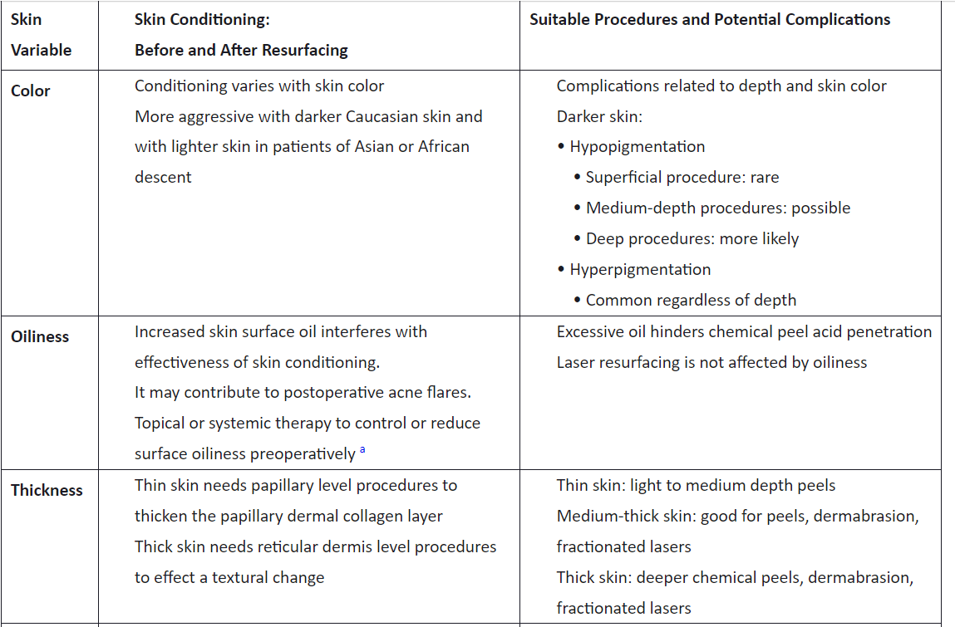
Skin Classification

Slide 5
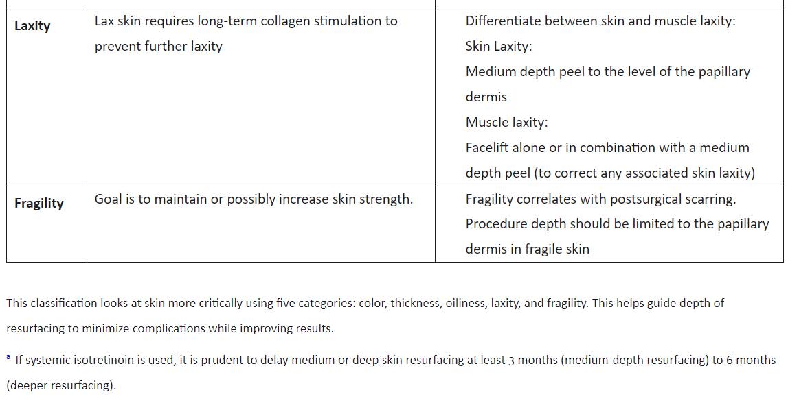

Slide 6
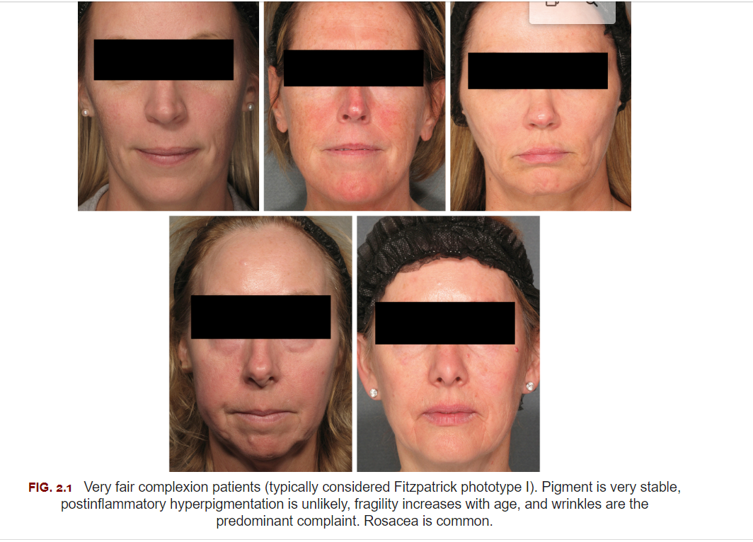

Slide 7
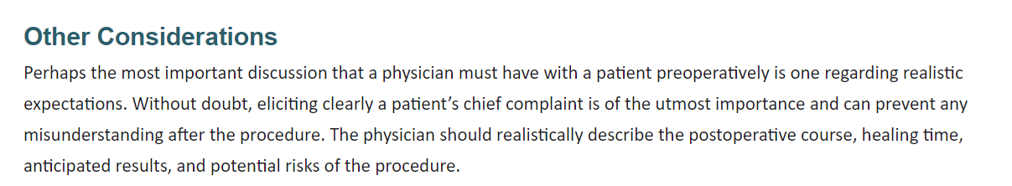

Slide 8
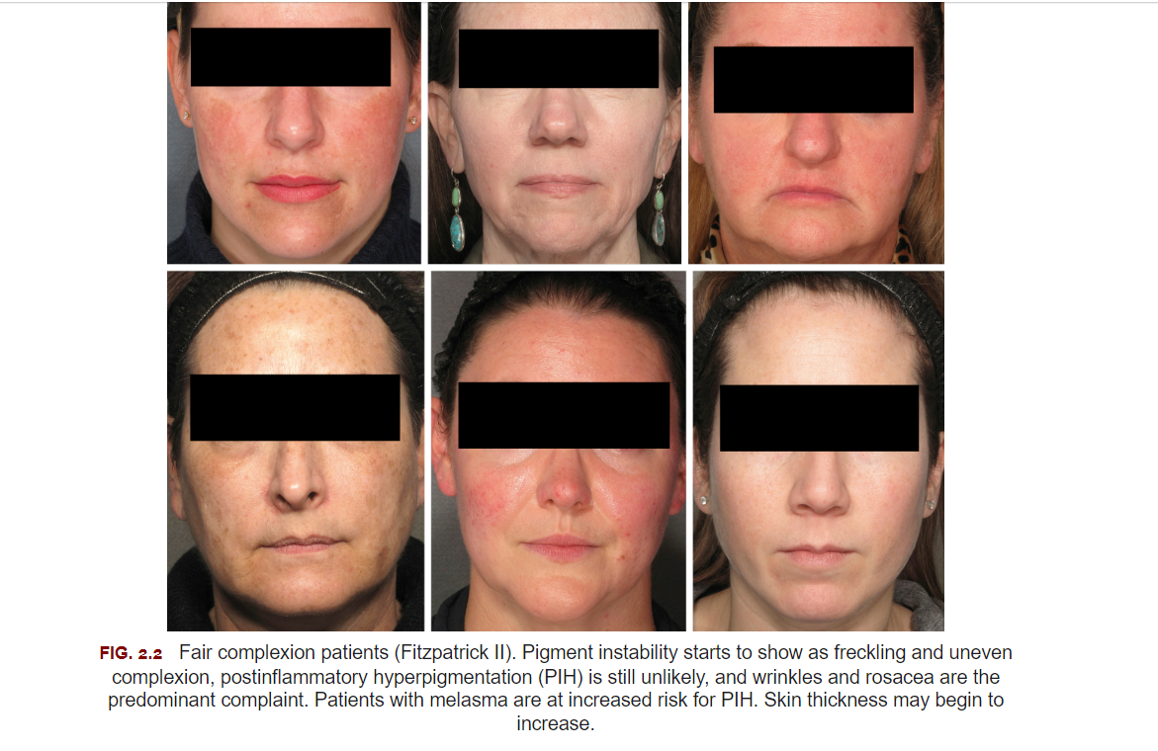
Very Superficial Chemical Peels

Slide 9
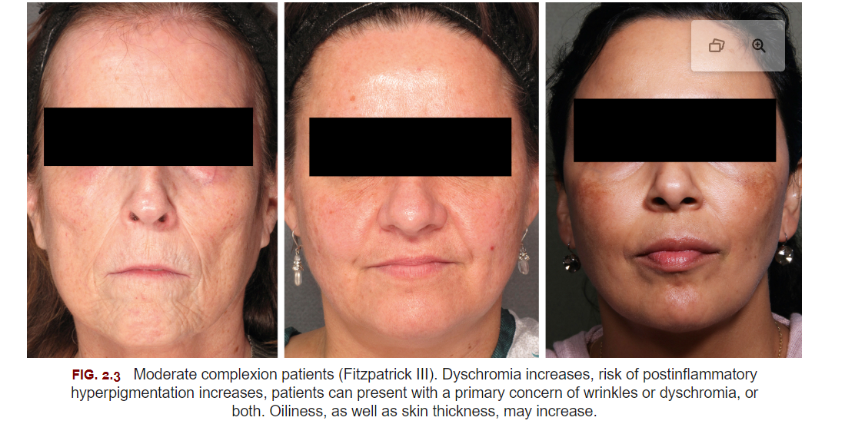
Superficial Chemical Peels

Slide 10
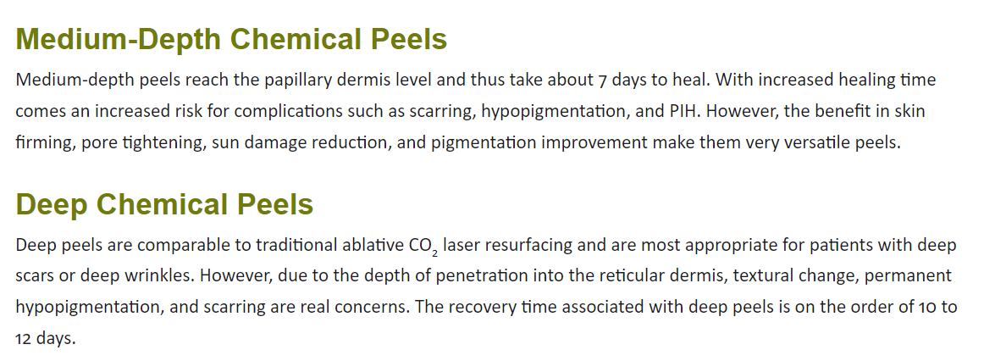

Slide 11
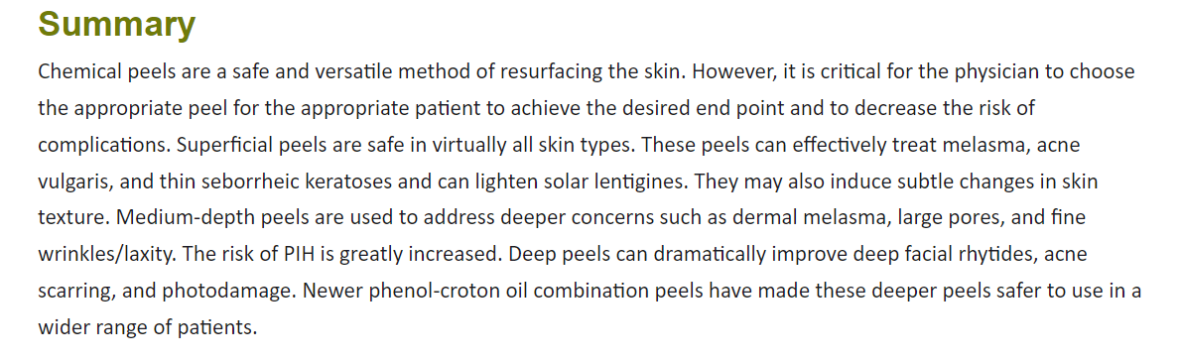

Slide 12
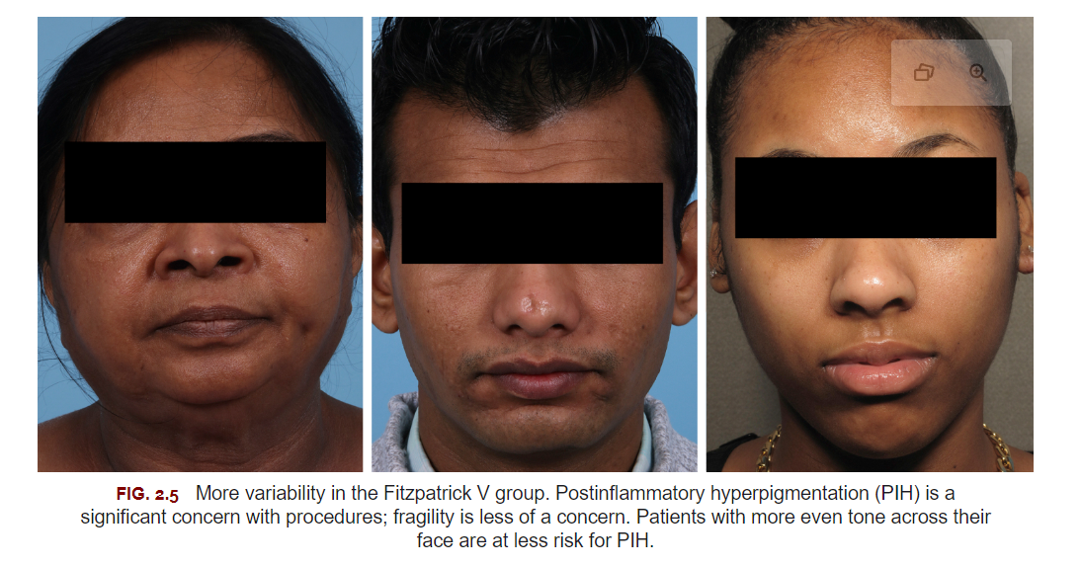

Slide 13

QUESTIONS?

