Slide 1

ANPH 202: Anatomy and Pathology
Body tissues

Slide 2
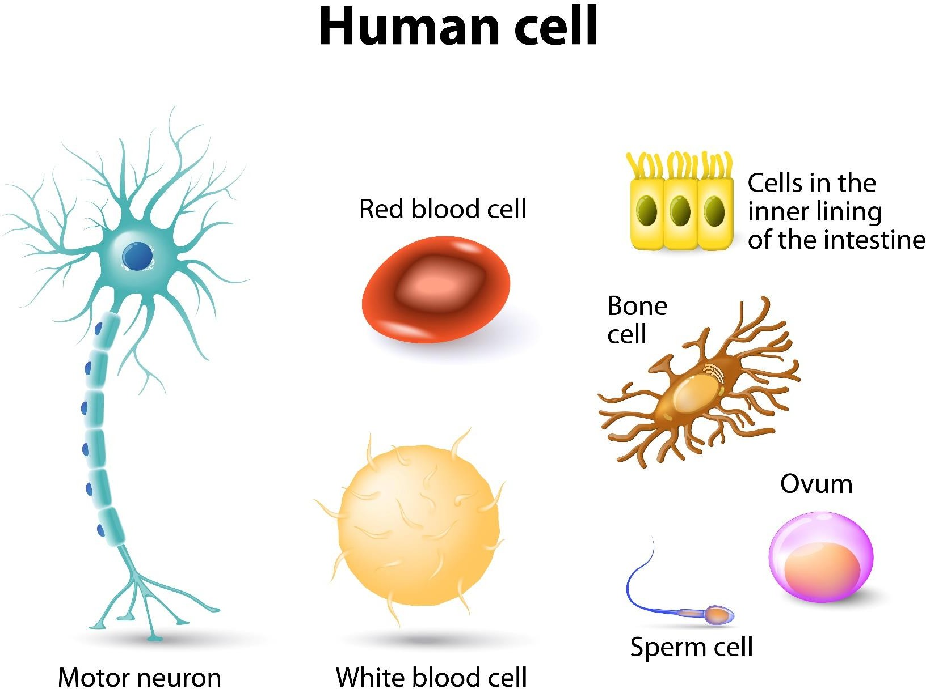

Slide 3
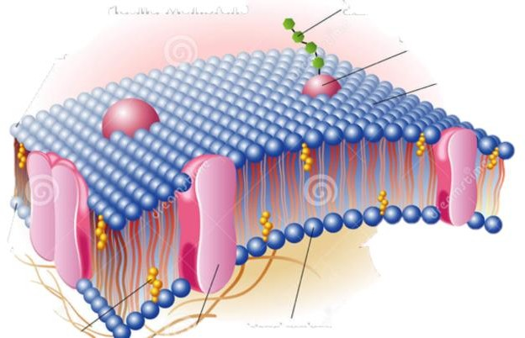
Cells and pathology
Each cell has a plasma membrane that acts as a gateway to control the exchange of substances between the internal environment of the cell and the salty external environment surrounding the cell.
Protein and carbohydrate molecules are integral to the plasma membrane ,involved in: nutrient transport, identifies cell, hormone receptors, anchoring, and chemical processes.

Slide 4
Transporting substances across the plasma membrane may or may not
require energy.
Please familiarize yourself with active and passive transport processes.
Transport Process | Physiological example
Diffusion | CO2 leaving cells
Osmosis | H20 moving in/out of cells
Filtration | Selective filtration of blood by kidneys. H20 and small solutes are filtered, but larger proteins are not
Ion pump* | Moving ions such as calcium, or chloride against the concentration gradient
Phagocytosis/pi nocytosis* | WBC’s consuming bacteria
 | * Requires energy input

Slide 5
Human tissue is made up of cells and intercellular (non-cellular) materials in varying proportions.

Slide 6
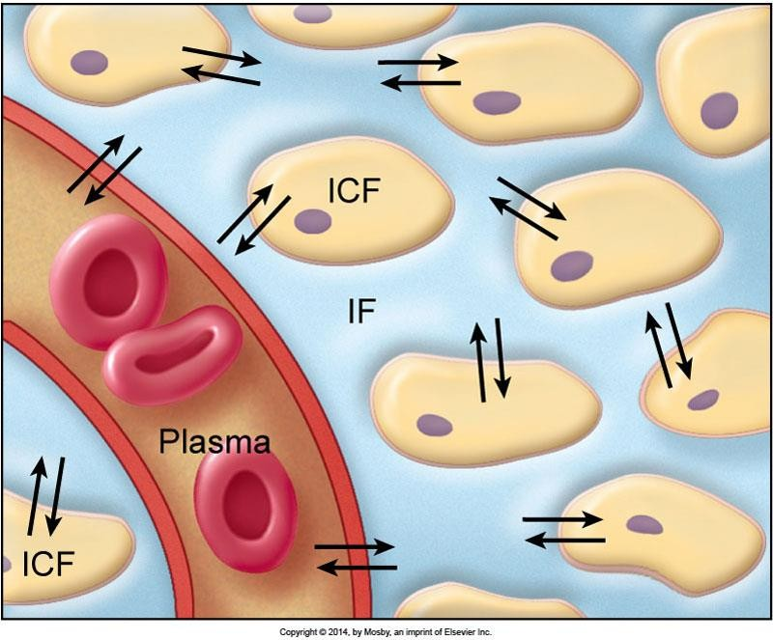
Fluid compartments of the body
Intracellular (ICF)
fluid inside the cells of the body
Interstitial fluid (IF) or matrix
fluid in spaces around the cells for the body
Extracellular fluid
fluid outside the cells (in the interstitial compartment, plasma, joint fluids, cerebrospinal fluid)

Slide 7
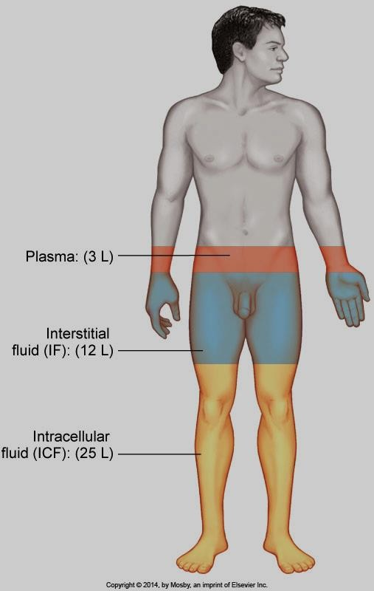
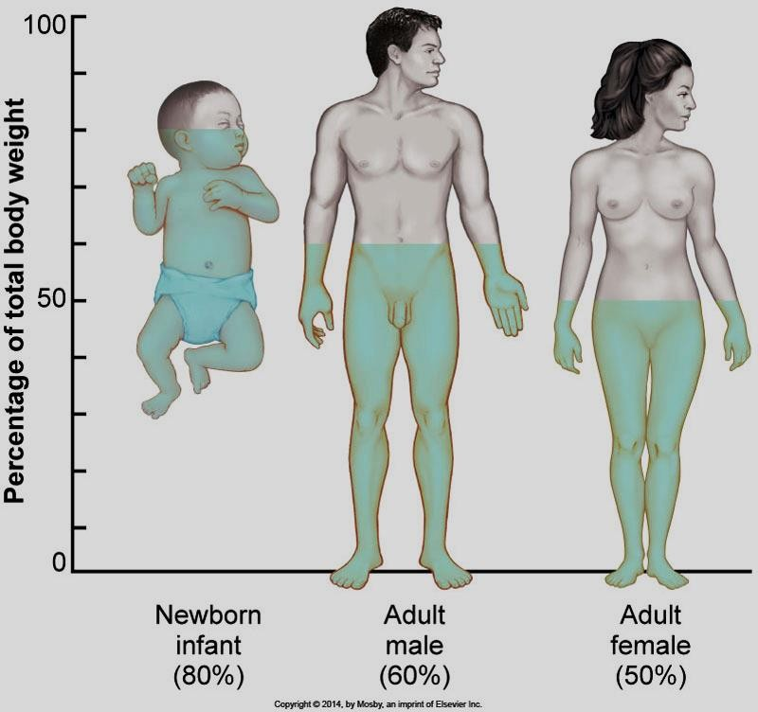
Patton and Thibodeau fig. 21-2

Slide 8
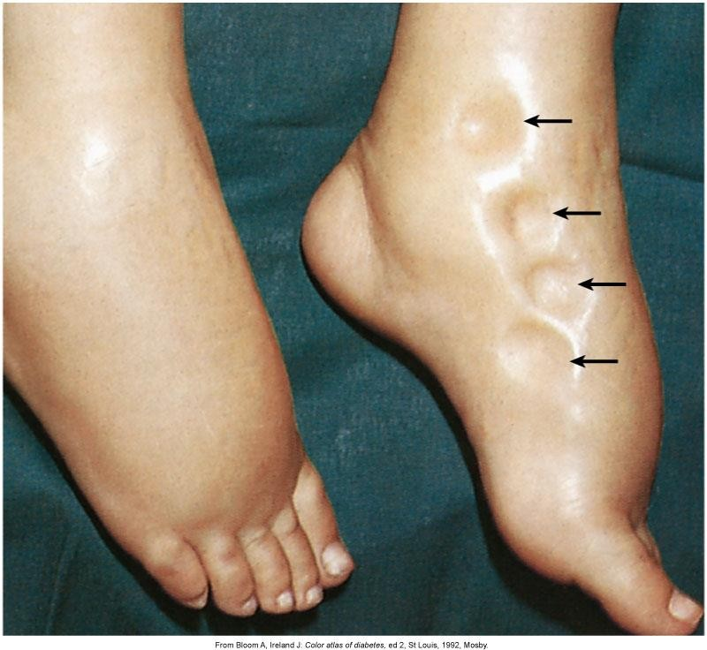
Fluid in the interstitial space
The medical term for this condition is edema.
(swelling due to body fluid buildup in tissues)
Patton and Thibodeau page 590

Slide 9
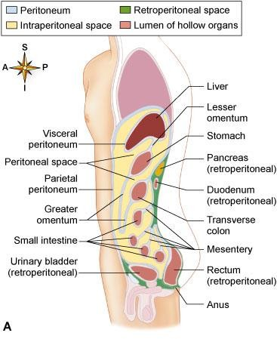
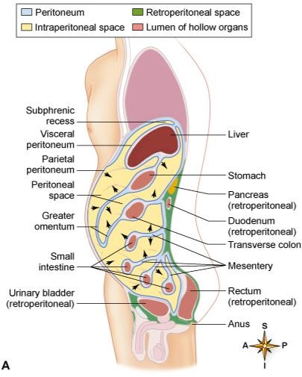
Patton-Thibodeau Figures 18-23 and 24

Slide 10
Types of human tissue
Four kinds of tissue are found in the human body:
Epithelial tissue – nutrients - food and O₂
Connective tissue – structure and safety
Muscle tissue – movement
Nervous tissue – thinking and feeling

Slide 11
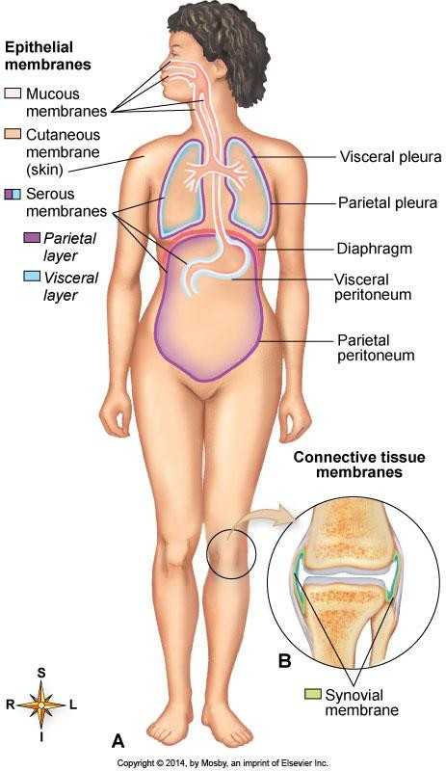
1. Epithelial tissue
Forms mucous, serous and cutaneous membranes in the body
Has little or no interstitial fluid or matrix. Cells are closely packed together in sheets
Contains no blood vessels
Is classified by shape and cellular
arrangement
Patton and Thibodeau 7-1

Slide 12
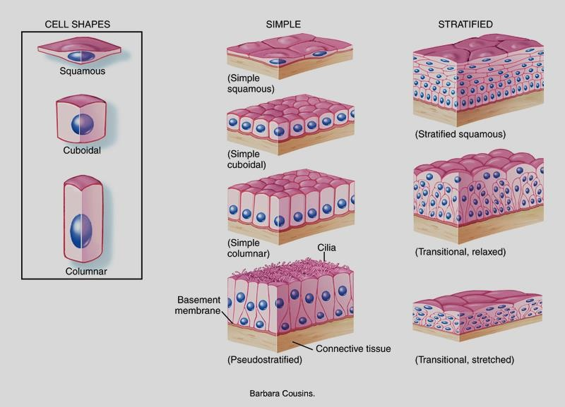
Epithelial tissue classifications

Slide 13
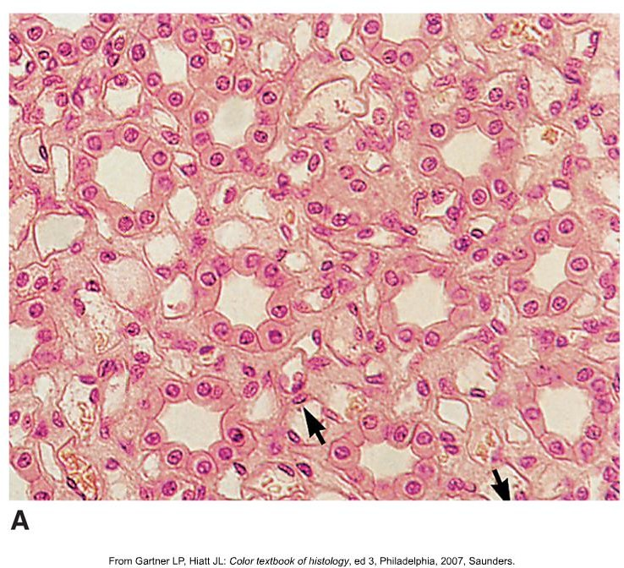
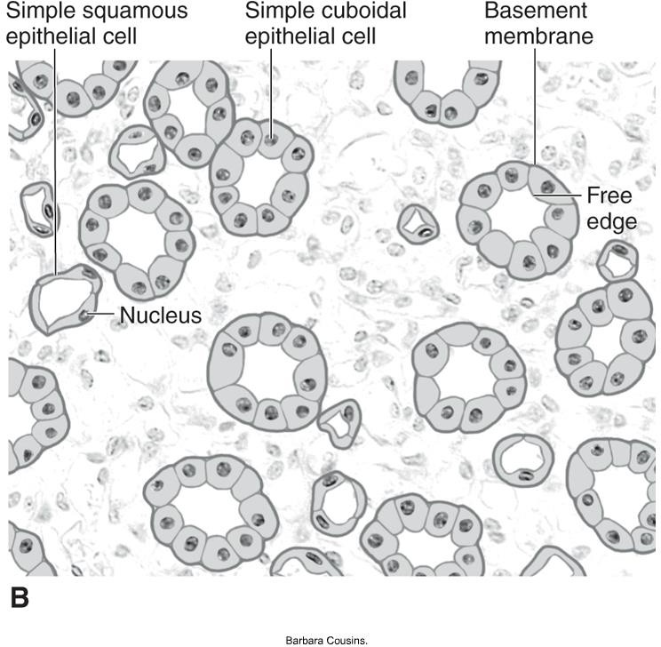
The alveoli in the lungs
Simple squamous epithelium is one cell thick and allows for gas exchange

Slide 14
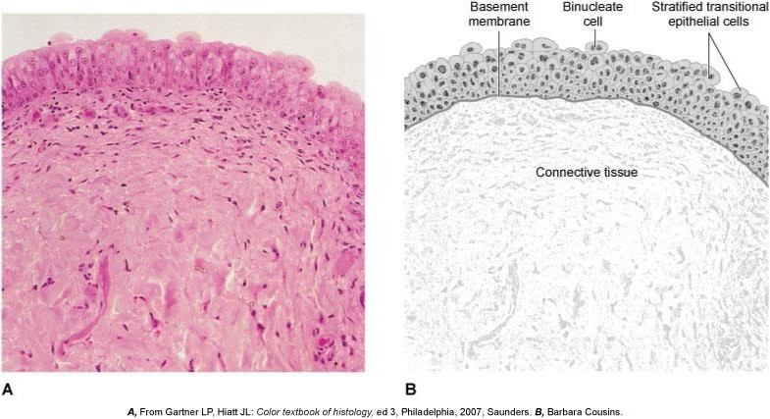
Bladder epithelium
Stratified transitional epithelium is stretchy
Patton and thibodeau fig. 4-6

Slide 15
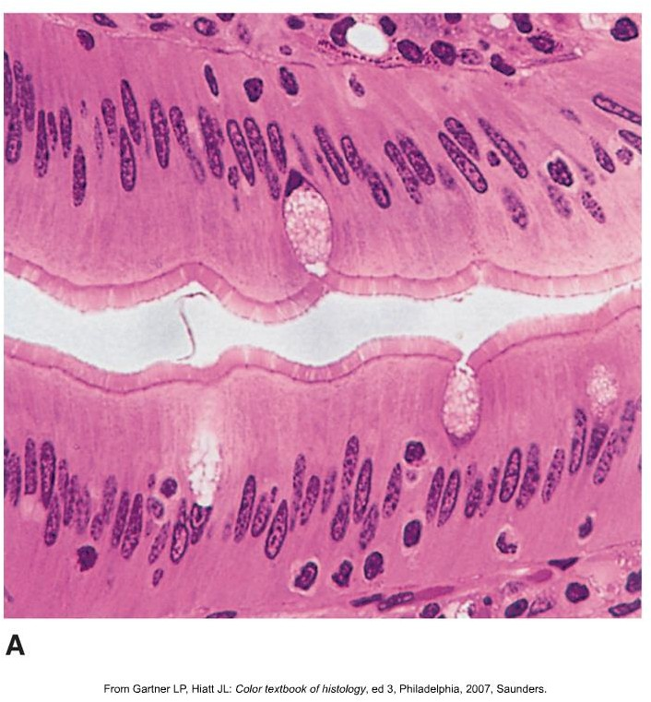
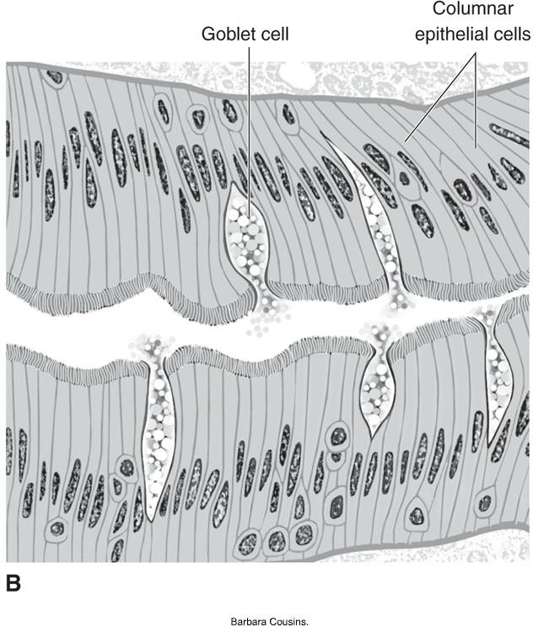
Lining of the GI tract
Simple columnar epithelium has more surface area for absorption of nutrients

Slide 16
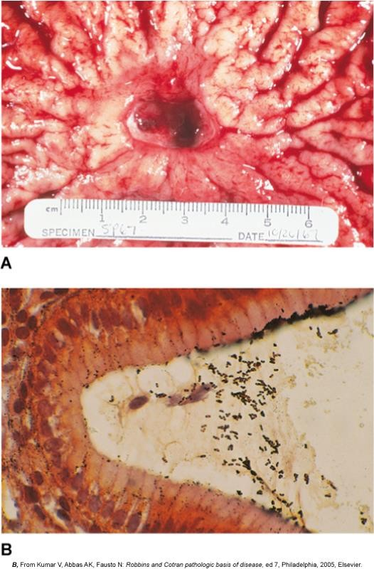
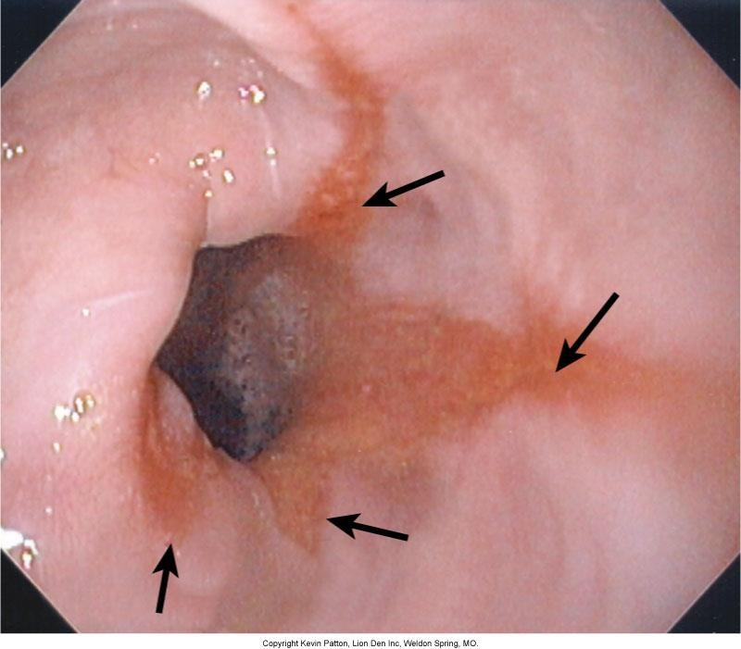
Epithelial tissue and mucous membranes
Patton and Thibodeau 18-13, and 18-16

Slide 17
2. Connective tissue
Is the most abundant and widely found type of tissue in the body
Is largely composed of an intercellular matrix containing a few cells and various types of structural fibers
Varies in strength, elasticity, blood supply, and ability to heal

Slide 18
Types of connective tissue
Loose fibrous tissue (areolar) – the “glue” that holds body organs together
Adipose “fat” tissue
Dense fibrous tissue – (tendons)
Bone and cartilage
Blood and hematopoietic tissue (eg. Bone marrow)

Slide 19
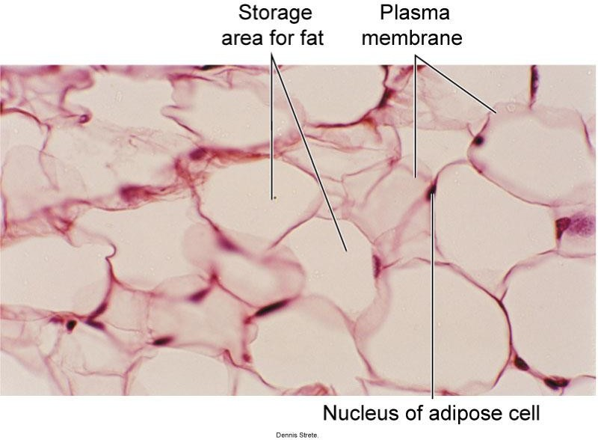
Adipose (fat) tissue

Slide 20
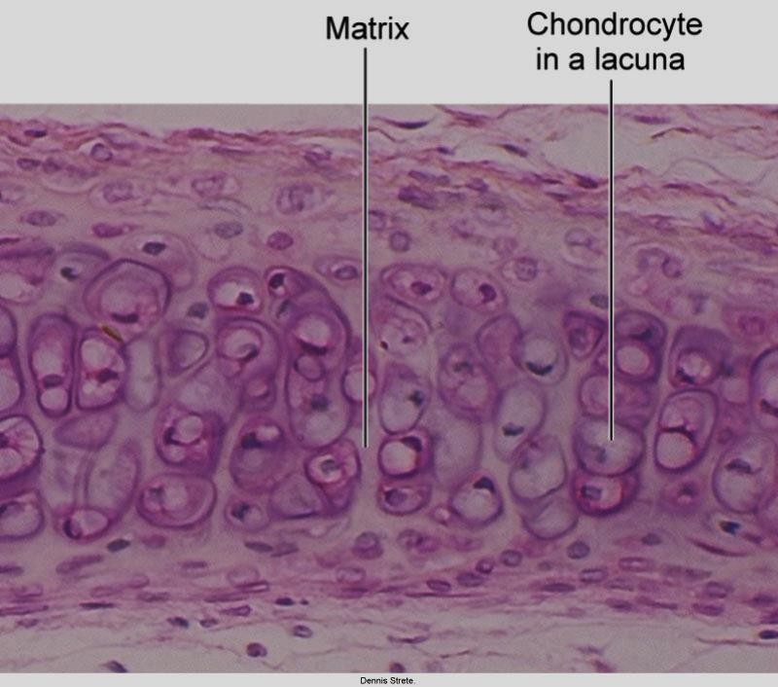
Cartilage
Patton and thibodeau fig. 4-11

Slide 21
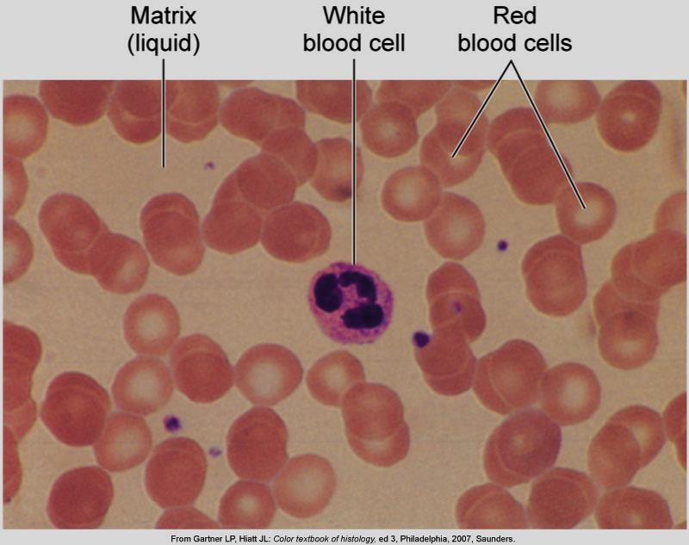
Blood
Patton and thibodeau fig. 4-12

Slide 22
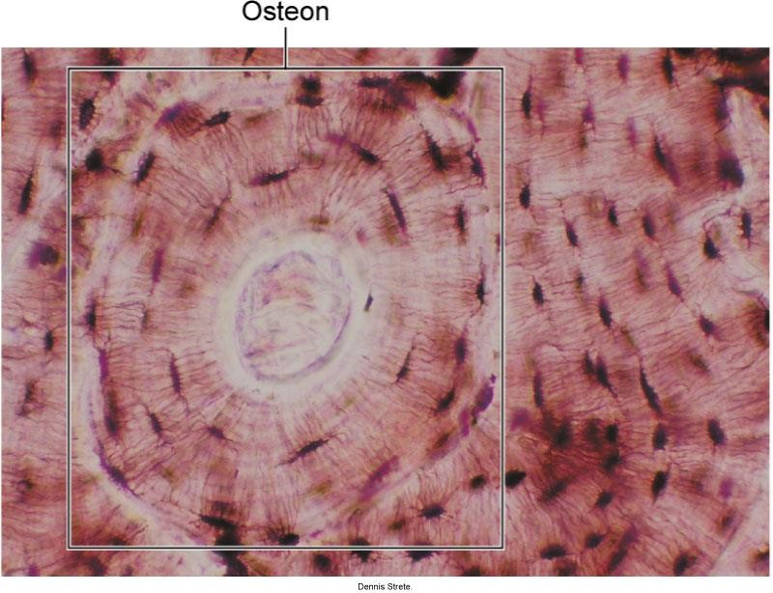
Bone tissue
Calcified matrix and osteocytes in compact bone
Patton and thibodeau fig. 4-10

Slide 23
3. Muscle tissue
Skeletal muscle tissue-attaches to bones; also called striated or voluntary; control is voluntary; striations apparent when viewed under a microscope
Smooth-muscle tissue-also called nonstriated (visceral) or involuntary; no cross striations; found in blood vessels and other tube-shaped organs
Cardiac muscle tissue-also called striated or involuntary; composes heart wall; ordinarily cannot control contractions

Slide 24
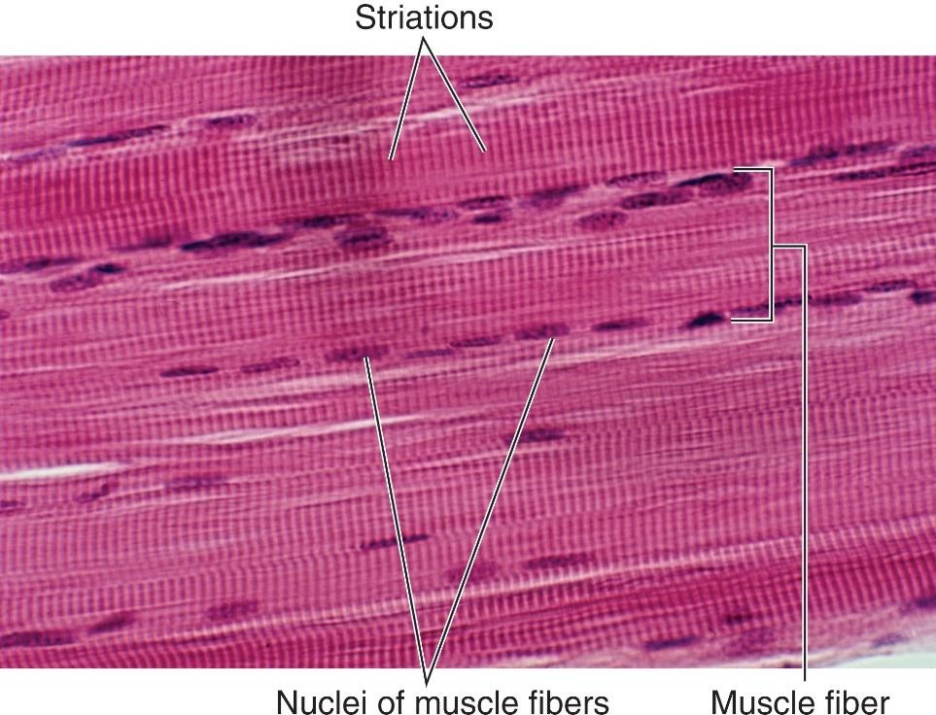
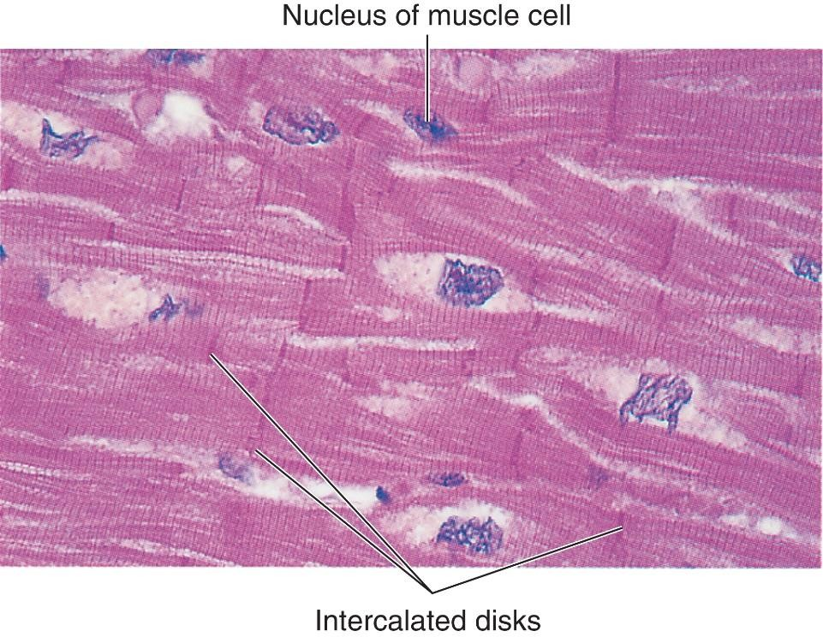
Skeletal vs Cardiac Muscle
Courtesy of Dennis Strete.
Courtesy of Ed Reschke.
24

Slide 25
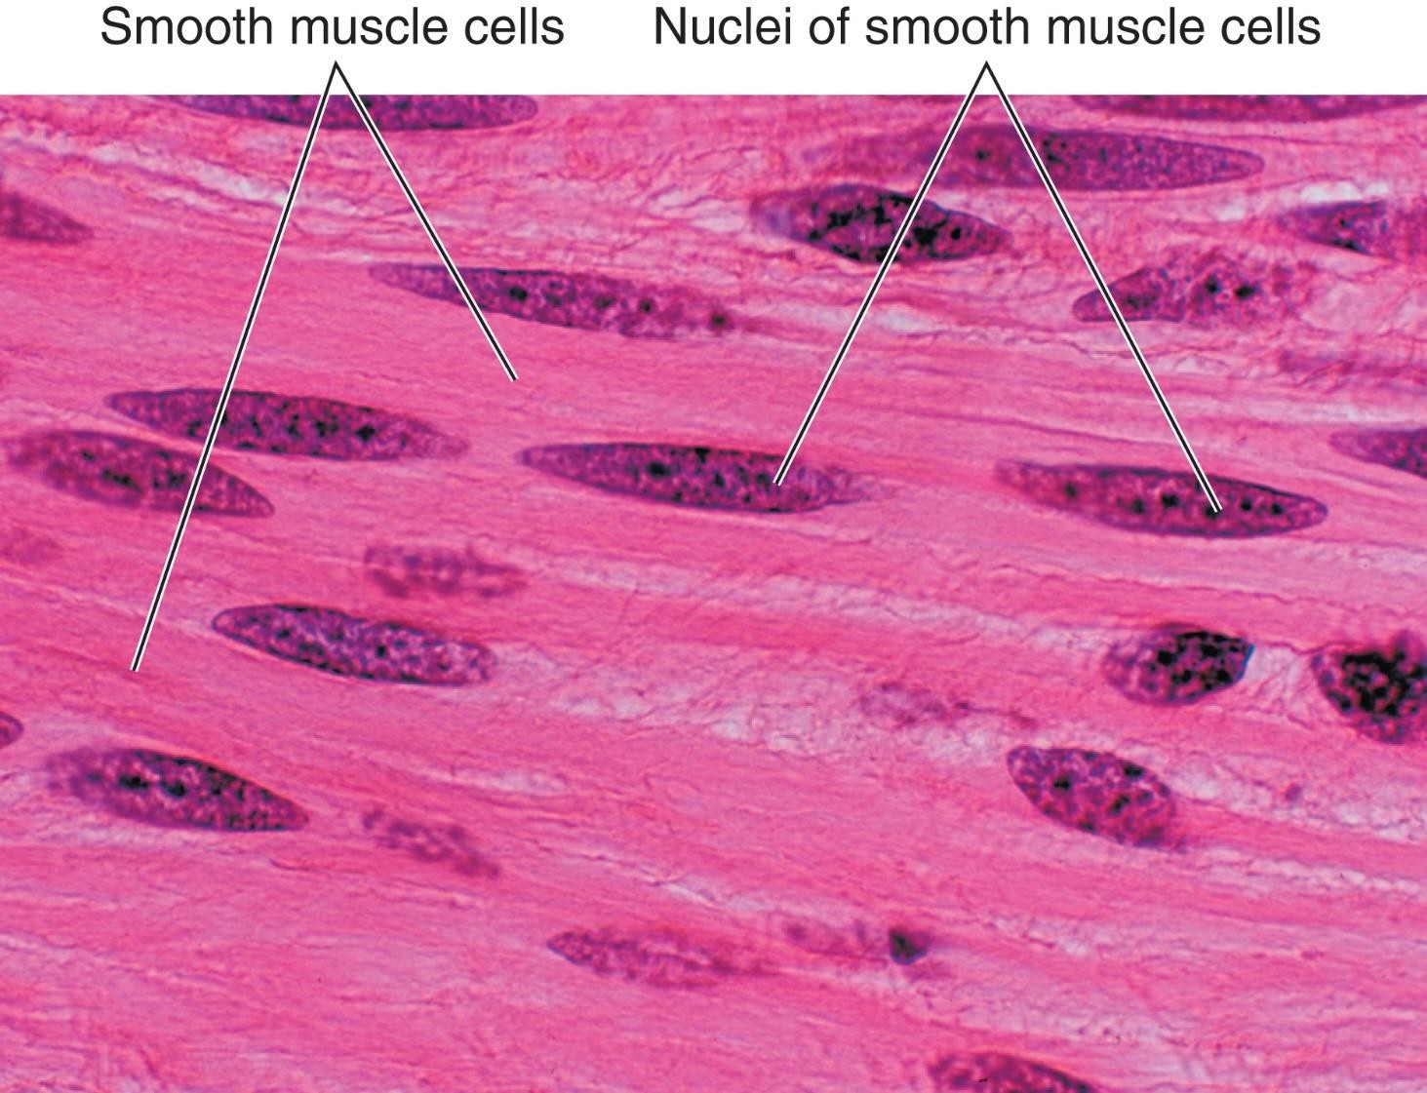
Smooth Muscle
Courtesy of Dennis Strete.
25

Slide 26
4. Nervous tissue
Neurons
  All neurons have a cell body and two types of processes: axon and dendrite
  Axon (one) carries nerve impulse away from cell body
  Dendrites (one or more) carry nerve impulse toward the cell body
Glia (neuroglia)—supportive and connecting cells

Slide 27
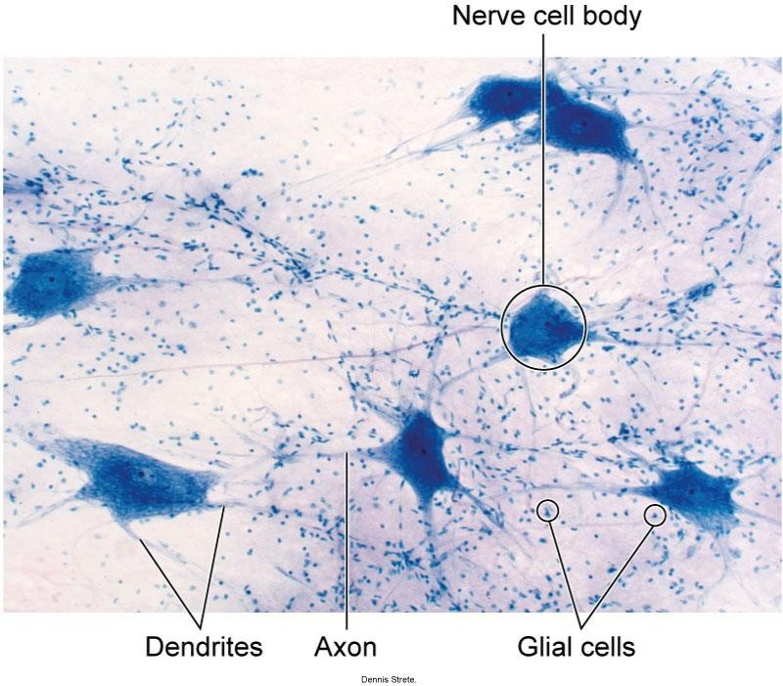
Nervous Tissue

Slide 28
Tissue Repair
Usually accomplished by means of regeneration of tissue
  Epithelial and connective tissues regenerate easily
  Skeletal muscle can regenerate when injured
  Smooth and cardiac muscle are less able to regenerate with more severe damage
  Nervous tissues have limited abilities to repair themselves, but not as limited as once thought

Slide 29
Pathophysiology
Mechanisms of disease
  Genetic mechanisms
  Infectious mechanism (pathogenic organisms and particles)
  Neoplastic mechanism (tumors and cancer)
  Traumatic mechanism (physical and chemical agents)
  Metabolic mechanism (endocrine imbalances or malnutrition
  Inflammatory Mechanism
    Autoimmunity
    Inflammation
    Degeneration

Slide 30
Risk Factors
Genetic factors
Age
Lifestyle
Stress
Environmental factors
Preexisting conditions

Slide 31
Aging
In adulthood-
Growth plates fully close in adult; other structures, such as the sinuses, acquire adult placement
Adulthood characterized by maintenance of existing body tissues
Degeneration of body tissue begins in adulthood
31

Slide 32
Older Adulthood
Degenerative changes characterize older adulthood, or senescence
Every organ system of the body undergoes degenerative changes
  A variety of mechanisms of aging have been described
  The free-radical theory of aging states that the number of oxygen free radicals increases as one ages, thus increasing the rate of cellular damage
Senescence culminates in death – process of growing old

Slide 33
Effects of Aging on Tissues
Skeletal system
  Aging causes changes in the texture, calcification, and shape of bones
  Bone spurs develop around joints
  Bones become porous and fracture easily
  Degenerative joint diseases, such as osteoarthritis, are common

Slide 34
Integumentary system
  With age, skin “sags” and becomes thin, dry, and wrinkled (or inelastic)
  Pigmentation problems are common
  Frequent thinning or loss of hair occurs

Slide 35
Central nervous system
  Risk of dementia, or loss of memory, with aging
  Other degenerative conditions affecting nervous system
  Some risk of depression

Slide 36
Cardiovascular system
  Degenerative heart and blood vessel disease is among the most common and serious effects of aging
  Fat deposits in blood vessels (atherosclerosis) decrease blood flow to the heart and may
cause complete blockage of the coronary arteries
  Hardening of arteries (arteriosclerosis) may result in rupture of blood vessels, especially in the brain (stroke)
  Hypertension, or high blood pressure, is common in older adulthood

Slide 37
Respiratory system
  Calcification of costal cartilages causes rib cage to remain in expanded position, resulting in barrel chest
  Wasting of respiratory muscles decreases respiratory efficiency
  Respiratory membrane thickens; movement of oxygen from alveoli to blood is slowed

Slide 38
Urinary system
  Nephron units decrease in number by 50% between ages 30 and 75
  Blood flow to kidney, and therefore ability to form urine, decreases
  Bladder problems, such as inability to void completely, are caused by muscle wasting in the bladder wall

Slide 39
Special senses
  All sense organs show a gradual decline in performance with age
  Cataracts and glaucoma affect the eyes
  Loss of hearing
  Decreased sense of smell and taste

Slide 40
Tumors and Cancer
Neoplasms (tumors)—abnormal growths of cells
  Benign tumors remain localized
  Malignant tumors spread, forming secondary tumors
  Metastasis—cells leave primary tumor and start a secondary tumor at new location

Slide 41
Classification of tumors
  Benign, epithelial tumors
    Papilloma—fingerlike projection
    Adenoma—glandular tumor
    Nevus—small, pigmented tumor
  Benign, connective tissue tumors
    Lipoma—adipose (fat) tumor
    Osteoma—bone tumor
    Chondroma—cartilage tumor

Slide 42
Classification of tumors
  Carcinomas (malignant epithelial tumors)
    Melanoma—involves melanocytes
    Adenocarcinoma—glandular cancer
  Sarcomas (connective tissue cancers)
    Lymphoma—lymphatic cancer
    Osteosarcoma—bone cancer
    Myeloma—bone marrow tumor
    Fibrosarcoma—cancer of fibrous tissue

Slide 43
Causes of Cancer
Causes of cancer—varied and still not clearly understood
  Cancer involves hyperplasia (growth of too many cells) and anaplasia
(development of undifferentiated cells)

Slide 44
Tissues and radiographic appearances
It is important to understand the nature of body tissue because different shades of grey in radiography are caused by variations in tissue density and thickness.
Air
Soft tissue/fluid
Bone
Radiographic contrast/metal

Slide 45
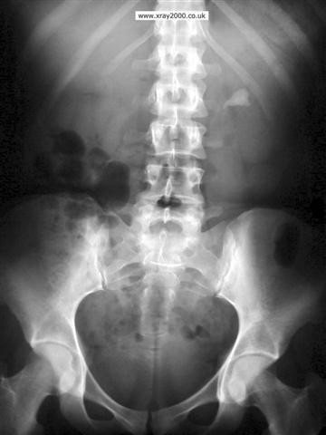
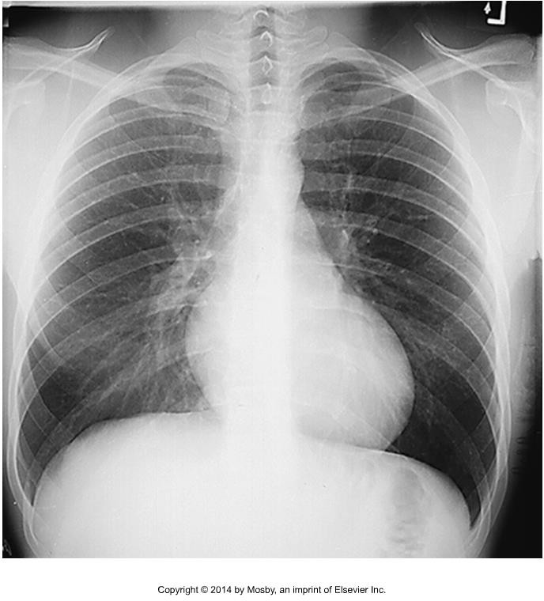
Remember, the more dense a tissue is, the more “white” it appears
Air Water/fluid Blood
Fat Bone

Slide 46
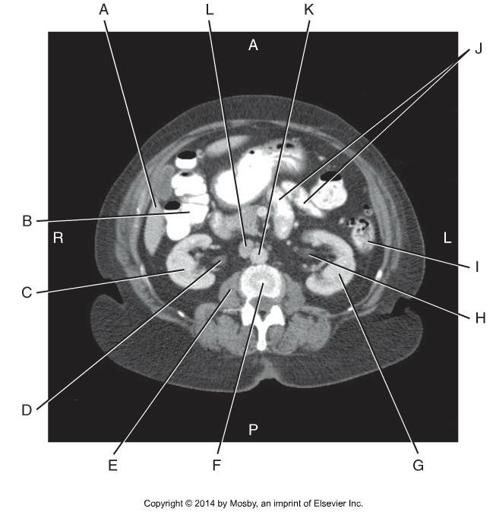
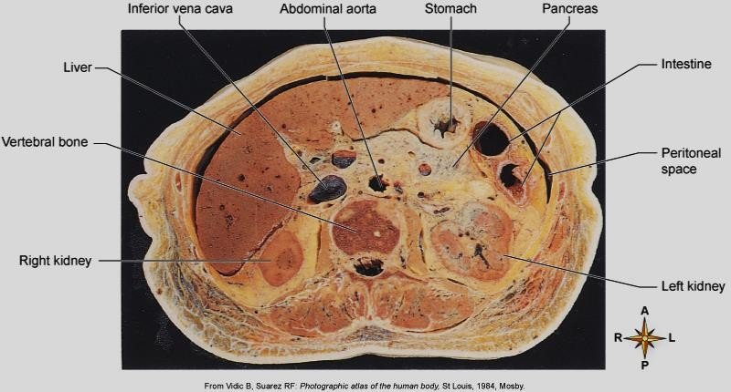
The structure of tissues, and pathological processes, cause varying textures and shades of black, white and grey to be visualized

Slide 47
Tissue density and thickness is affected by disease processes that alter the structure of tissues and the distribution of ICF, IF and ECF:
ICF - intracellular fluid, fluid found inside the cell
IF – interstitial fluid, fluid found in the spaces around cells ECF – extracellular fluid, fluid found outside the cell

Slide 48
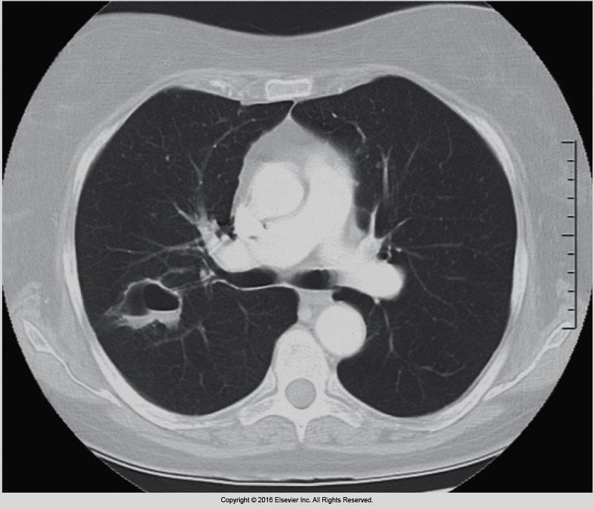
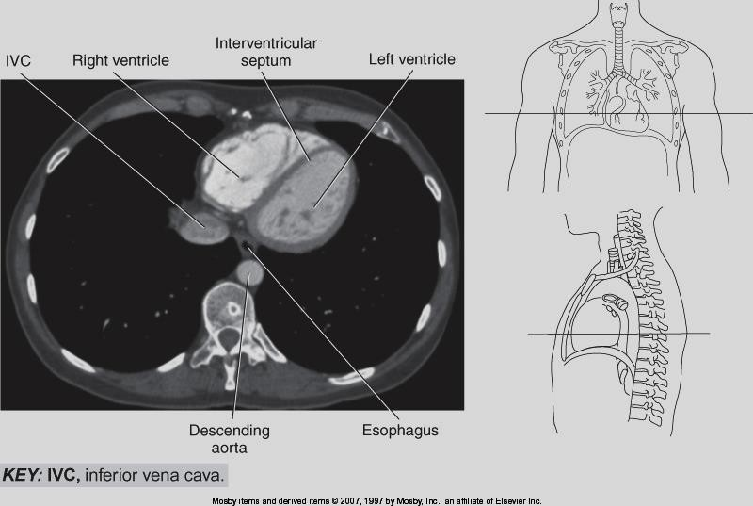
Eisenburg 3-22
Here the CT machine settings have been manipulated to “light up” the lung pathology
(circled in red) more effectively

Slide 49
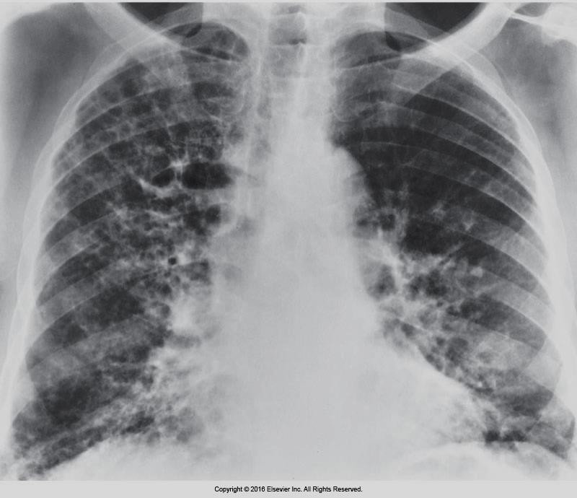
Coughing due to chronic conditions can cause dense scar tissue to form in the airways which alters the appearance of the lung fields on a chest x-ray
Bontrager 2-53
Eisenberg 3-40

Slide 50
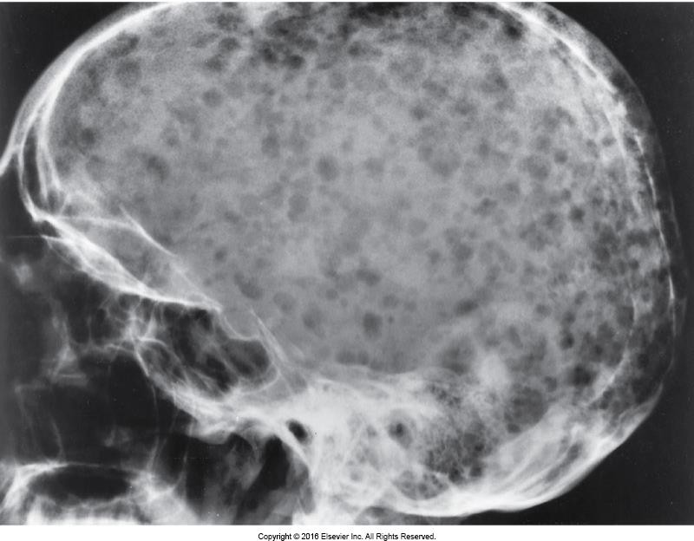
Multiple myeloma, blood cancer, starts in plasma cells in bone marrow
Eisenburg 4-77

Slide 51
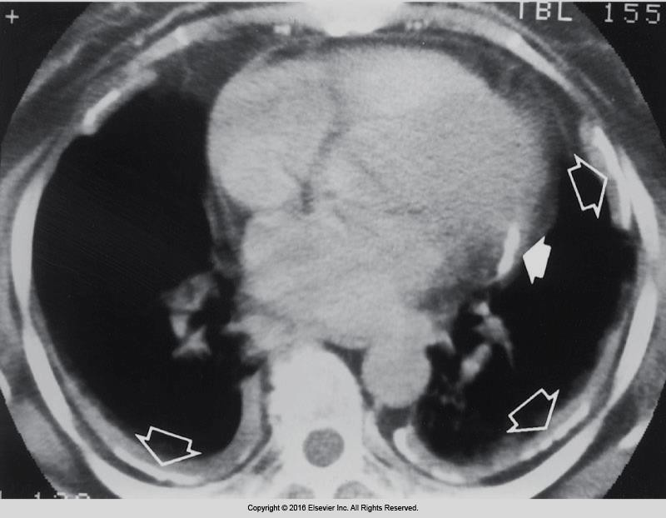
Asbestosis – lung disease, prolonged exposure to high concentrations of asbestos filters in air.
Asbestos is a mineral fiber that occurs in rock and soil. Has been used in variety of building materials.
Eisenberg 3-50

Slide 52
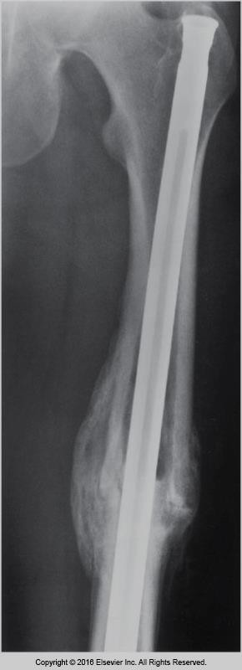
Orthopedic Surgery repairs
Eisenberg 4-88
Calcified callus that has formed around fracture site, changes the appearance and density of the tissues

Slide 53
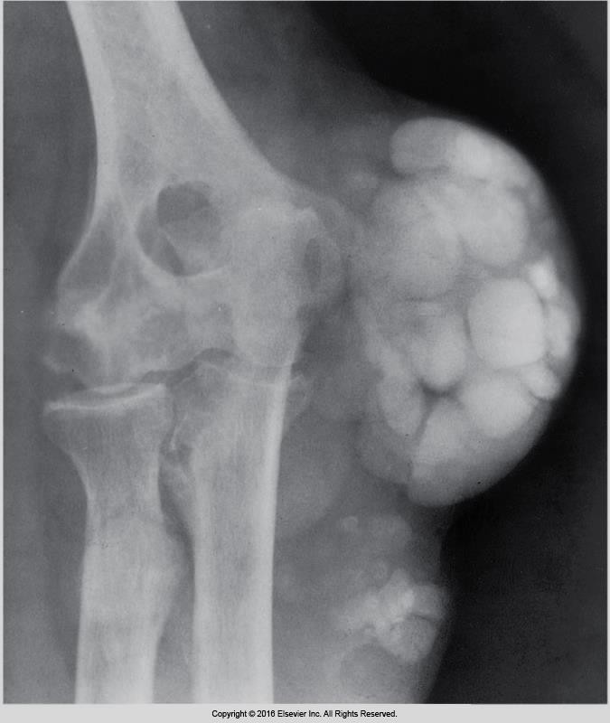
Gout - form of arthritis that causes pain and swelling in joints Buildup of extra uric acid, sharp crystals can form in joints,
usually the big toe
Eisenberg 4-52

Slide 54
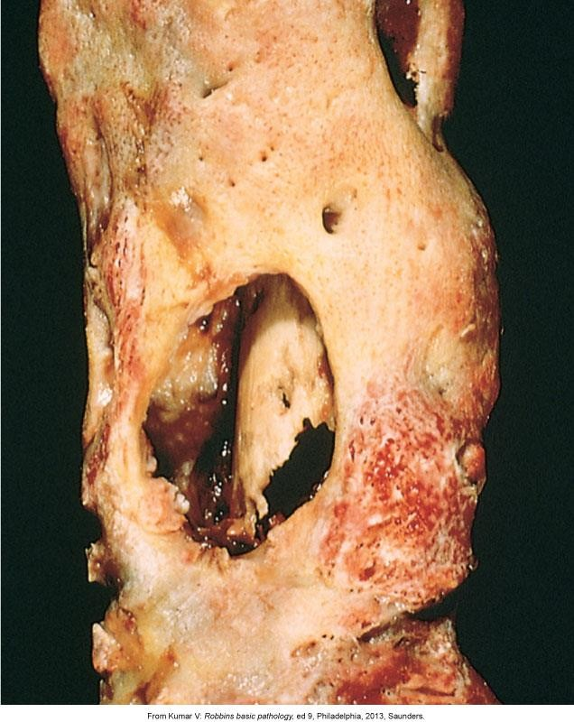
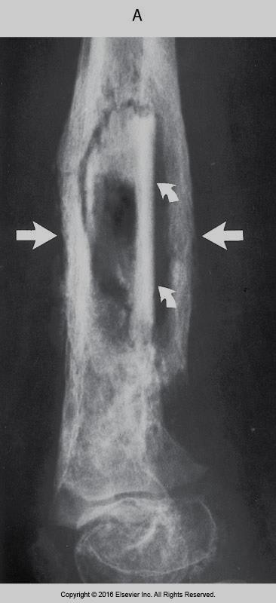
Osteomyelitis – infection of the bone or joint, acute or chronic, caused by bacteria, fungi or other germs.
Patton and Thibodeau 8-34
Eisenberg 4-39

Slide 55
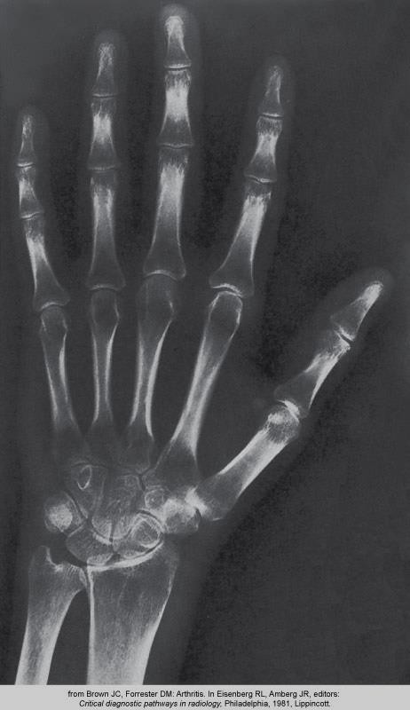
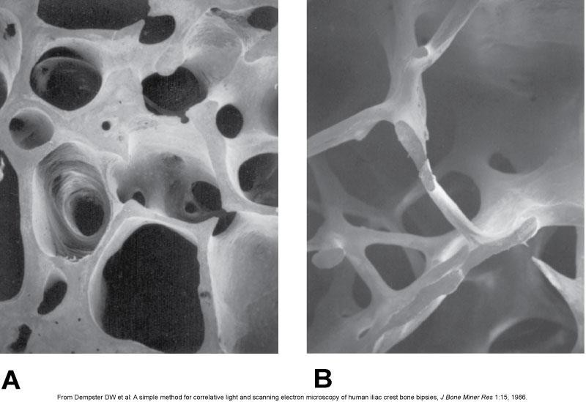
Periarticular osteoporosis – RA (rheumatoid arthritis) - bone loss around the small joints of the hand, decrease in bone mass and density.
Patton and Thibodeau 8-30
Eisenberg 4-14

Slide 56
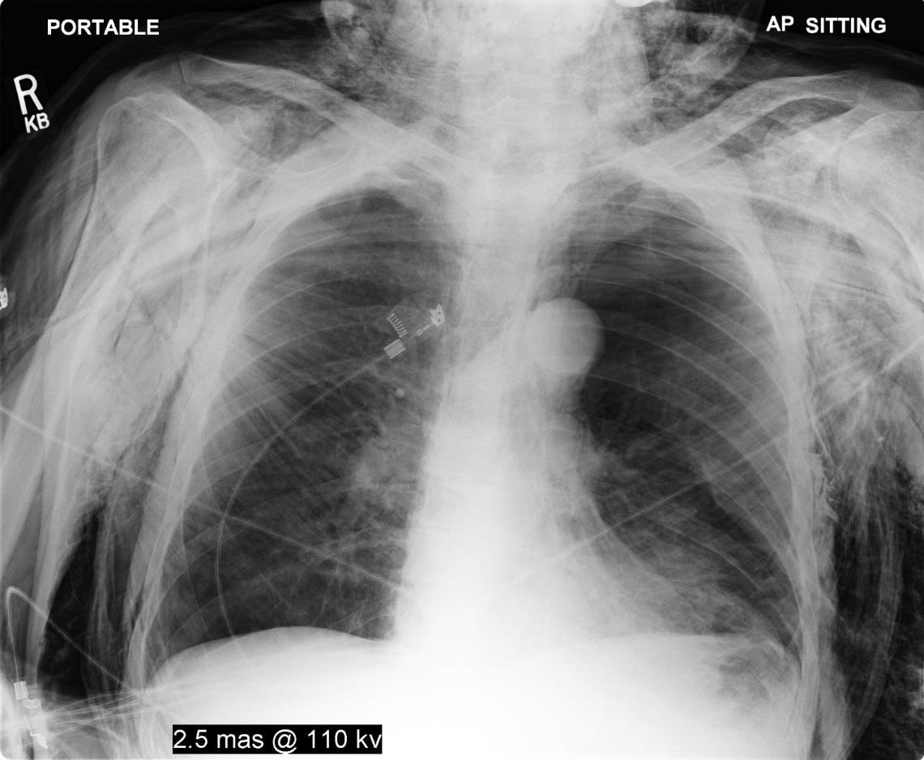
Subcutaneous emphysema - air trapped in tissue under the skin
Areas of radiolucency (dark, less dense)
Sait digital library

Slide 57
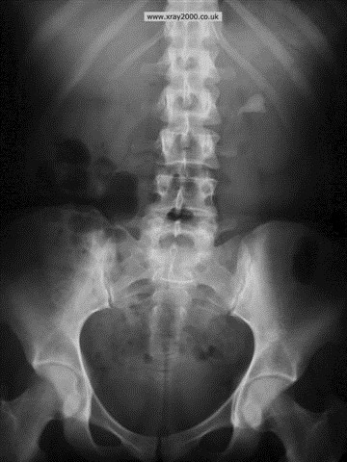
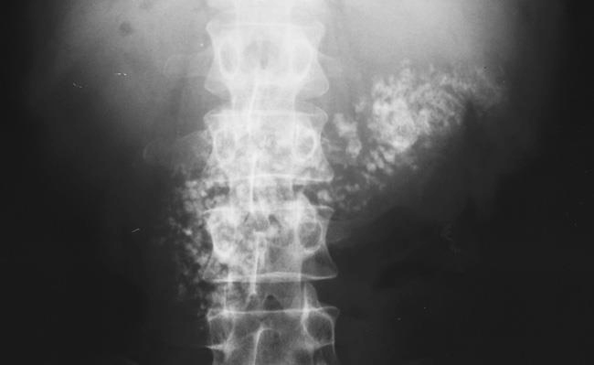
Chronic pancreatitis – inflammation of the pancreas
Fluid buildup around the pancreas

Slide 58
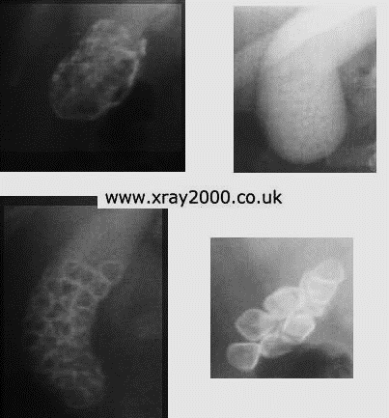
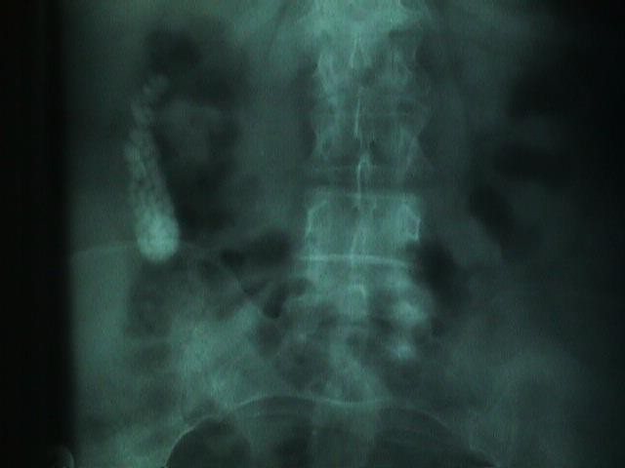
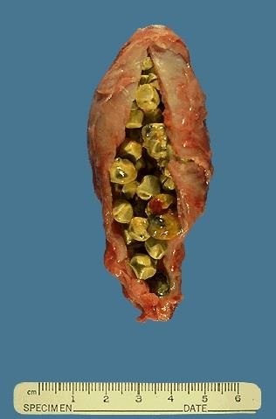
Cholelithiasis – gallstones, hardened pieces of bile in the gallbladder or bile ducts. Bile – digestive fluid produced by the liver and stored in the gallbladder. Bile breaks down fats into fatty acids.

