Slide 1
MRAD 204:
Radiographic Technique 1
Outcome 6-10:
Anatomy of the Foot

Slide 2
Affiliated Readings
Module Reading
Bontrager
Pg: 212→215, 217 & 223

Slide 3
Overview
Bony groups of the foot
Bony anatomy
Joints of the foot

Slide 4
Bony Groups of the Foot
The bones of the foot are divided into three groups:
1. Phalanges (aka. toes/digits) | 14
2. Metatarsals (aka. instep) | 5
3. Tarsals | 7
TOTAL:
26

Slide 5
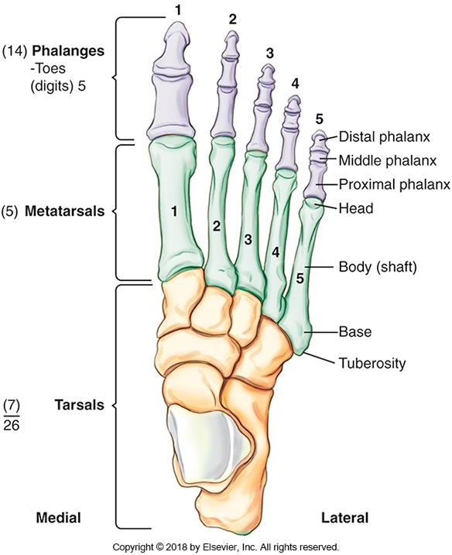
Phalangs
Toes are also known as phalanges or digits
Similar to the hand, digits (and metatarsals) are numbered 1→5 starting with the “big-toe”
  1st digit has two phalanges
  2nd→5th digit have three
phalanges
Shorter and more limited in movement, than those of the hand
Bontrager pg. 212 Fig. 6.2

Slide 6
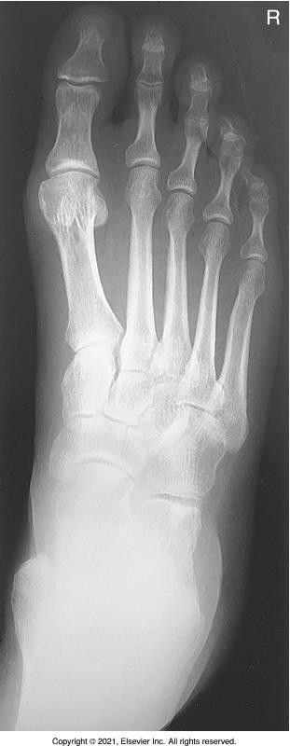
Phalanges
Bontrager pg. 212 & 232 Fig. 6.2 & 6.57

Slide 7
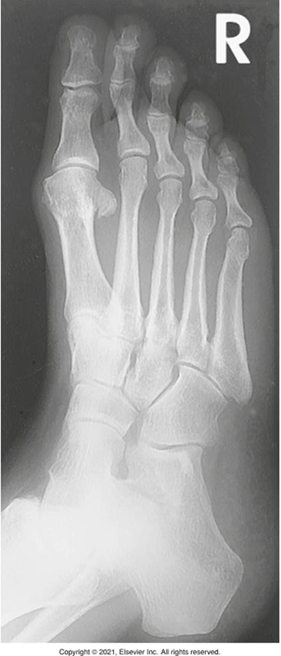
Metatarsals
Metatarsals form the “instep” of the foot
Base of 5th metatarsal has a distinctive palpable tuberosity
Common trauma site
Bontrager pg. 212 & 233 Fig. 6.2 & 6.61

Slide 8
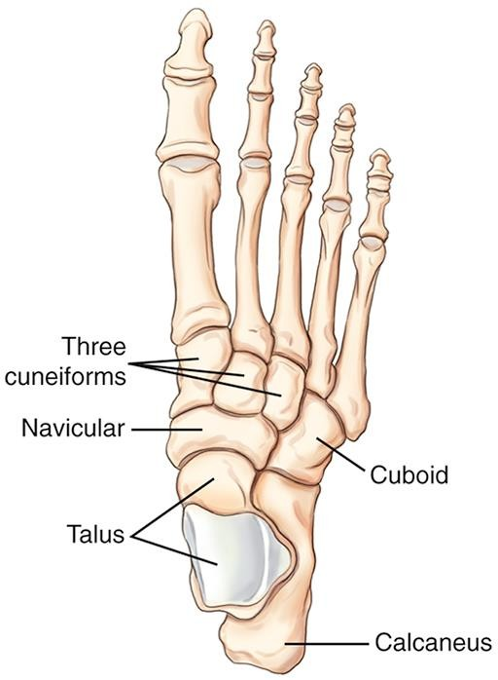
Tarsals
Form proximal part of foot
  Only the Talus is part of the ankle joint
Come to Calgary the Next three Christmases
C = Calcaneus (os calcis)
T = Talus
C = Cuboid
N = Navicular
3 C’s = 1st→3rd Cuneiforms
Bontrager pg. 214 Fig. 6.5

Slide 9
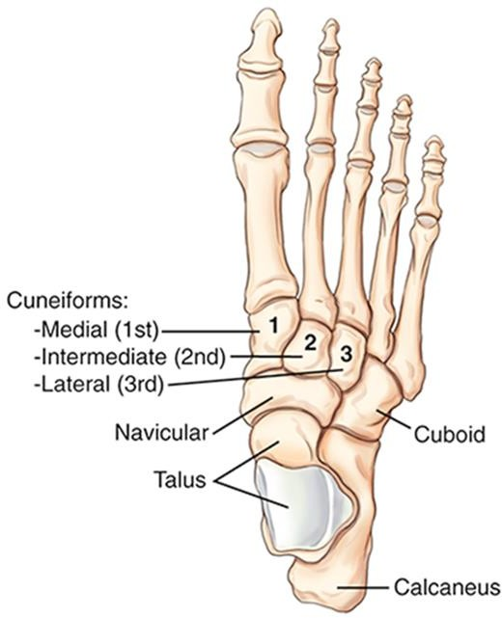
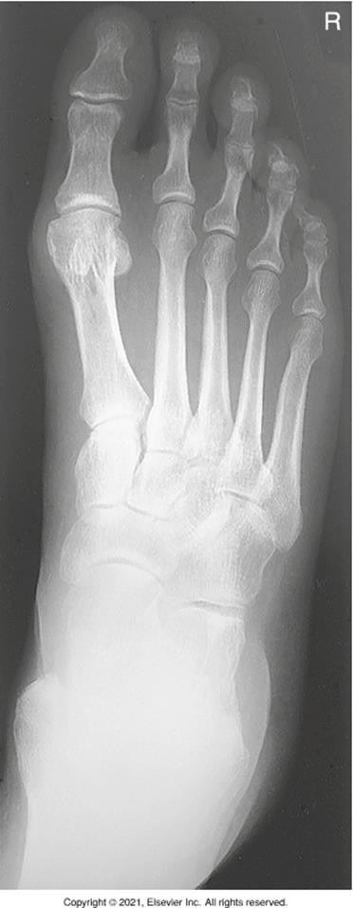
Tarsals
Bontrager pg. 215 & 232 Fig. 6.8 & 6.57

Slide 10
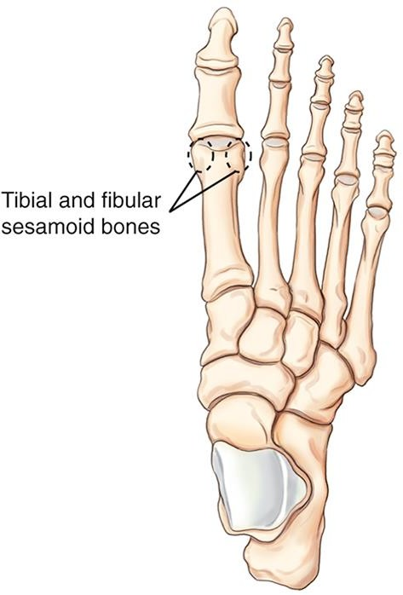
Bony Anatomy – Sesamoid bones
Embedded in tendons
Appear near joints
Located on plantar surface of the first metatarsal head
  Near 1st MTP joint
Bontrager pg. 213 Fig. 6.4

Slide 11
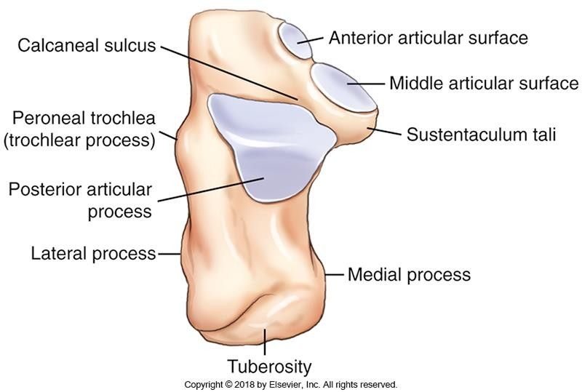
Bony Anatomy - Calcaneus
Posterior portion is the
“heel bone”
Achilles tendon attaches to the calcaneal tuberosity
Calcaneal sulcus helps form the sinus tarsi
  Important opening for ligaments to pass through
Bontrager pg. 214 Fig. 6.6

Slide 12
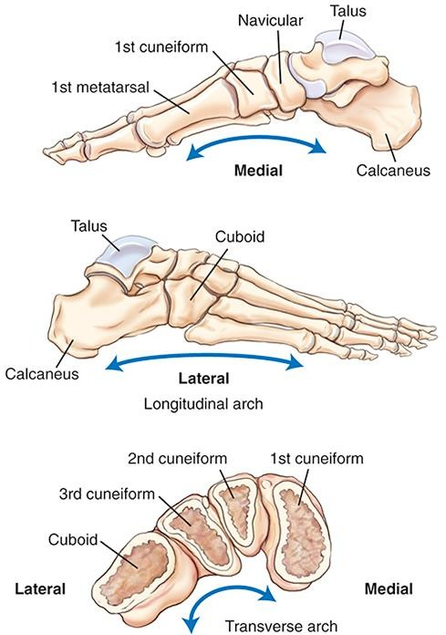
Bony Anatomy – Arches of the Foot
Bontrager pg. 215 Fig. 6.9

Slide 13
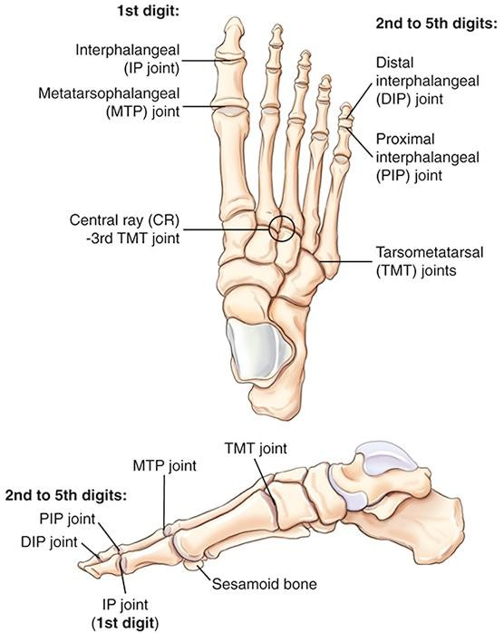
Joints of the Foot
Must state the name of the joint and the digit (or metatarsal) when identifying joints

Slide 14
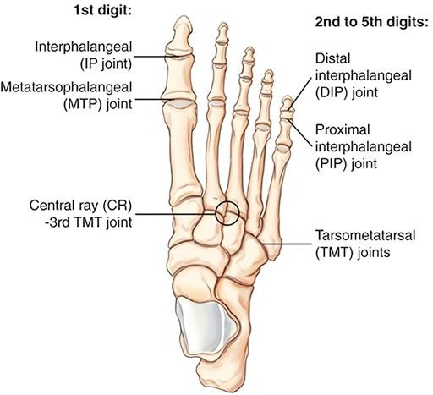
Joints of the Foot
Bontrager pg. 213 & 232 Fig. 6.3 & 6.57

Slide 15
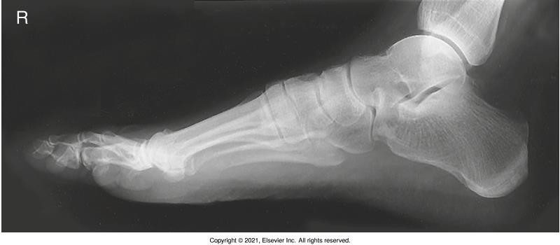
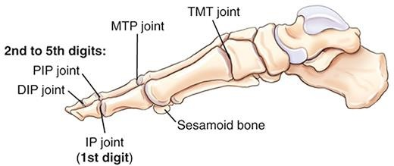
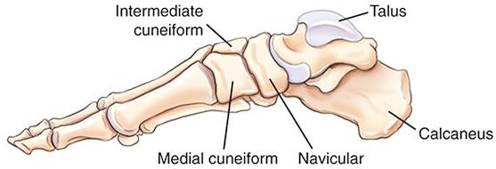
Joints of the Foot
Bontrager pg. 213, 215 & 234 Fig. 6.3, 6.8 & 6.65

Slide 16
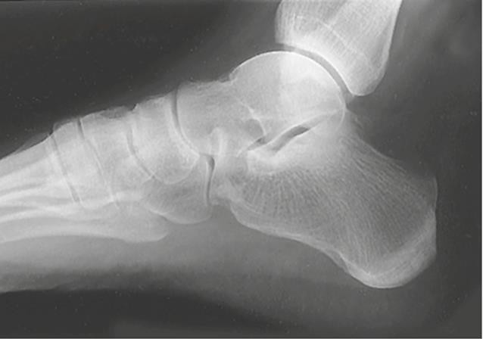
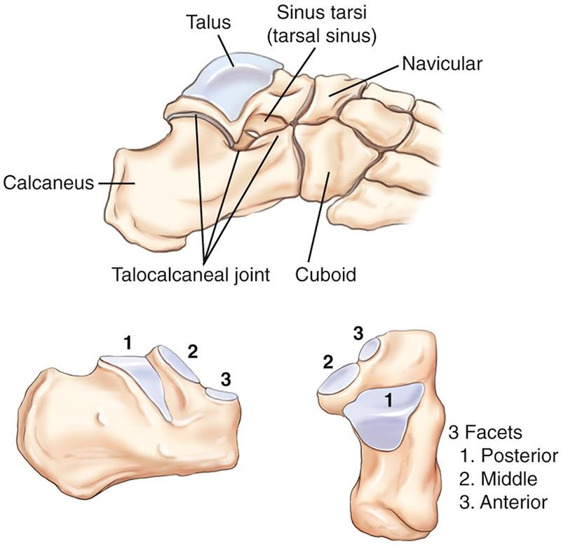
Joints of the Foot
C
Three superior articular surfaces of the calcaneus form the subtalar (aka. talocalcaneal) joint
Bontrager pg. 214 & 234 Fig. 6.7 & 6.65

Slide 17
Helpful Resources
Sketchfab: https://sketchfab.com/3d-models/
  Access to 3D images of bones
    Can tilt/rotate images
  Labelling

