Slide 1
MRAD 256
Radiographic Technique 2
Positioning of the Abdomen

Slide 2
General Positioning Details
SID of 110 cm
Must be taken with a grid
Must have an anatomical marker and an arrow or a
body-position marker i.e. “upright”’ or “supine”
© MRT Program ,

Slide 3
Routine Abdomen Protocols
Acute Abdominal Series
upright PA chest
upright abdomen (or LLD)
supine abdomen
Abdomen – 2 views
supine abdomen
upright abdomen (or LLD)
Abdomen – supine (“flat-plate abdomen or KUB”)
© MRT Program ,

Slide 4
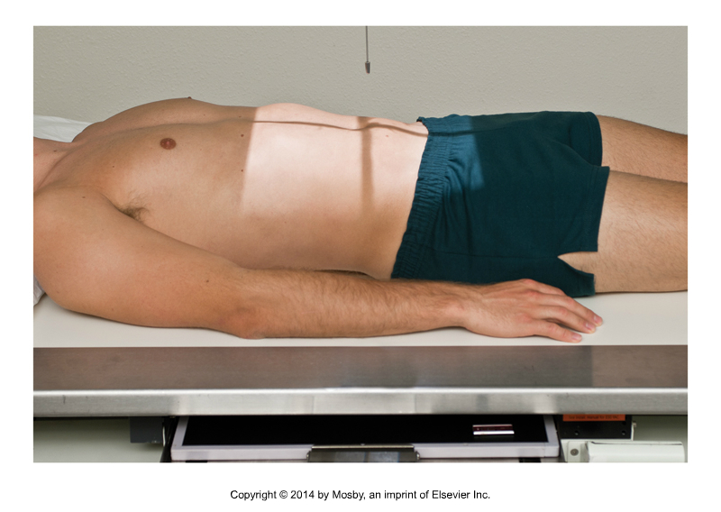
AP Abdomen - Supine
Ensure patient is straight on table
and not rotated
Center on midsagittal plane, at the
level of the iliac crests
Must include symphysis pubis
Expose on expiration so abdominal organs are not compressed
“Supine” marker (or downward arrow) and anatomical marker can be placed in the lower lateral corner of the light field
© MRT Program ,

Slide 5
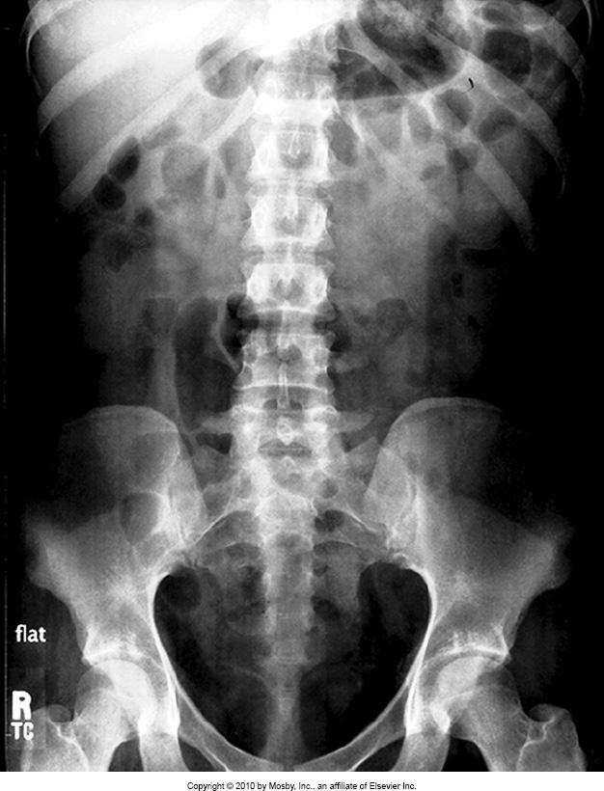
Supine Abdomen –Evaluation Criteria
No rotation: spinous processes centered in spine, ala and obturator foramen are equal in size and shape
Entire abdominal cavity must be included, even if it requires more than one image. (See notes on page 118 Bontrager)
For supine, you must include superior rami of symphysis pubis
© MRT Program ,

Slide 6
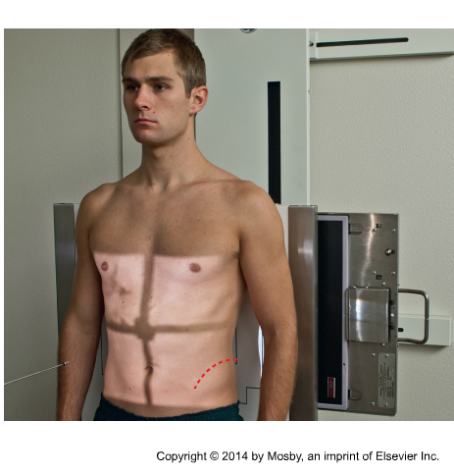
AP Abdomen Upright
Place an “upright” marker (or an upward
pointing arrow) and an anatomical marker
in the lower lateral corner of the IR before
putting your patient’s back against the IR
Center at crests or slightly above to ensure the diaphragm will be demonstrated in the superior edge of the image.
Ensure the light field on the detector comes to the patient’s axilla.
Suspend at the end of expiration
© MRT Program ,

Slide 7
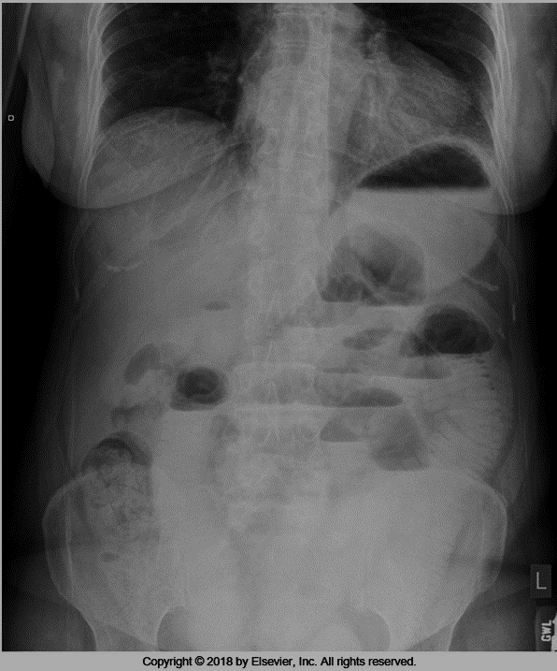
Upright Abdomen – Evaluation Criteria
Bontrager
Evaluation Criteria:
Bilateral diaphragms
As much of lower abdomen as possible
No rotation
Spine centered to IR
© MRT Program ,

Slide 8
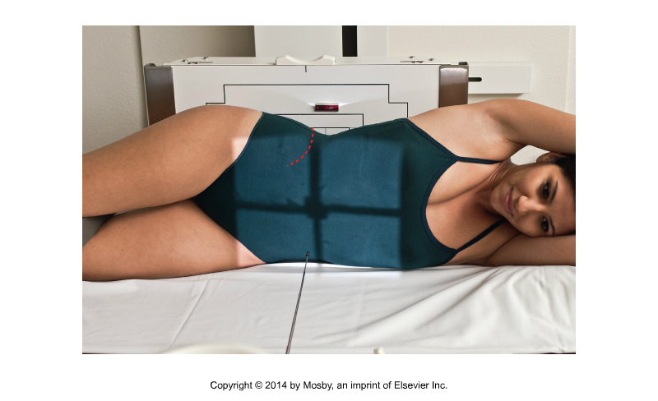
Left Lateral Decubitus (LLD)
Demonstrates air/fluid levels when an upright abdomen cannot be taken
Place arms above head
Flex knees to provide stability, and adjust midcoronal plane to true lateral
Center on the midsagittal plane, 2” above the iliac crests to include diaphragm
Suspend at the end of expiration
Mark with an anatomical marker and an arrow
Display image anatomically
© MRT Program ,

Slide 9
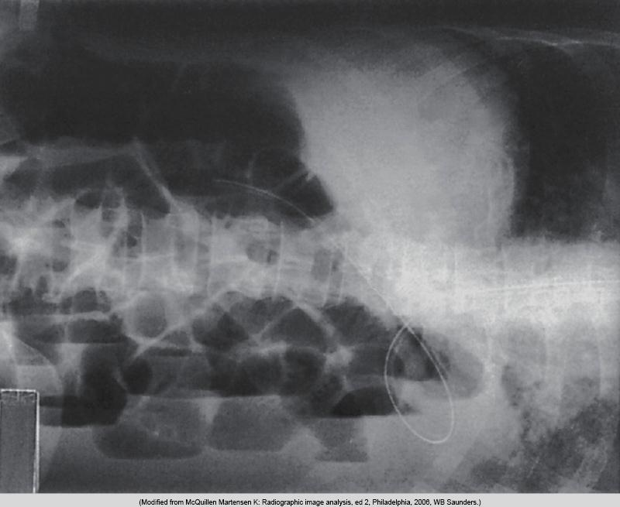
LLD – Evaluation Criteria
Diaphragm without motion
Note: when querying air fluid levels in the abdomen, LLD is preferred because it demonstrates free air above the liver. If a patient is unable to roll onto their side, then a dorsal decubitus is the next best thing.
No rotation
© MRT Program ,

