Slide 1
MRAD 256:
Radiographic Technique 2
Cervical Spine

Slide 2
Overview
Vertebral anatomy
Cervical spine anatomy
Technical factors
Patient preparation
Routine and non-routine imaging
Evaluation criteria

Slide 3
Vertebral Column (Spine)
Midsagittal plane, in the posterior half of the trunk of the body
  Extends from skull to pelvis
Protects spinal cord
Supports trunk and skull
Attachment points for muscles of back and ribs
Articulates with ribs and pelvis
Transmits weight of upper body to the pelvis and lower limbs
Notes:
Vertebra = 1
Vertebrae = multiple

Slide 4
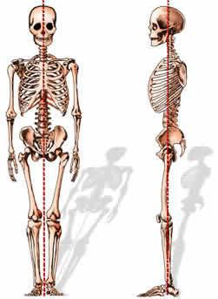
Composition of the Vertebral Column
Small vertebrae stacked with discs of fibrocartilage
  Held together by ligaments
Has curves
  Provide strength and flexibility
  Allow a wide range of movement
  Keep head centered over feet
https://www.columbiaspine.org/condition/spinal-deformities/
Notes:
If spine were straight you would topple as soon as you bent over.
Curves allow you to flex and extend, twist, and bend laterally.
Just try to stand on one foot with your head not over your foot. Can’t do it for long.

Slide 5

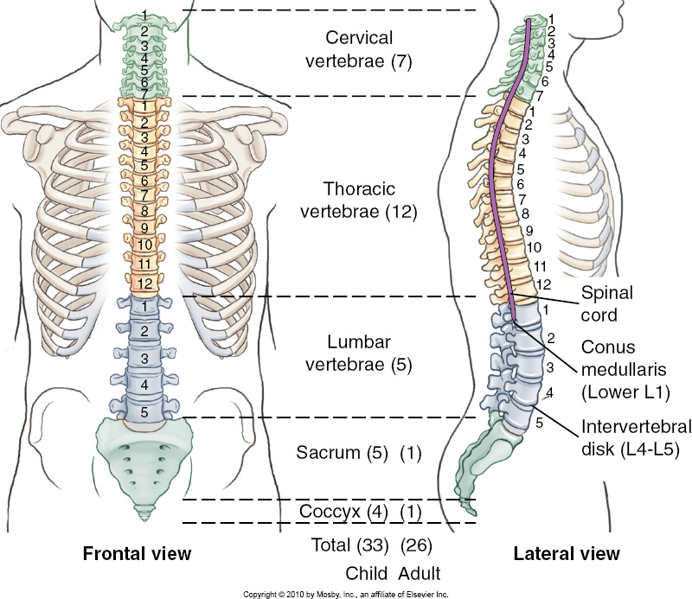
Segments of the Spine
In total: 33 vertebrae in children, 26 in adults
Cervical
  From base of skull to top of shoulders
  7 vertebrae
Thoracic
  From shoulders to lower part of trunk
  12 vertebrae (variation in ~5% of population)
Lumbar
  From lower thorax to pelvis
  5 vertebrae (variation in ~5% of population)
Pelvic / Sacral
  Posterior pelvis
  Sacrum – 5 segments that fuse with age
  Coccyx – 3-5 segments that fuse with age (avg 4)
Notes:
Must know this before we talk more about curves

Slide 6
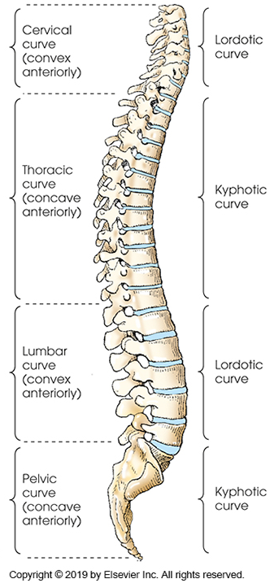
Vertebral Curves
Kyphotic
  Concave anteriorly
  Thoracic and pelvic spines
Lordotic
  Convex anteriorly
  Cervical and lumbar spines

Slide 7
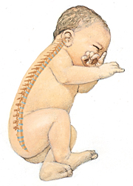
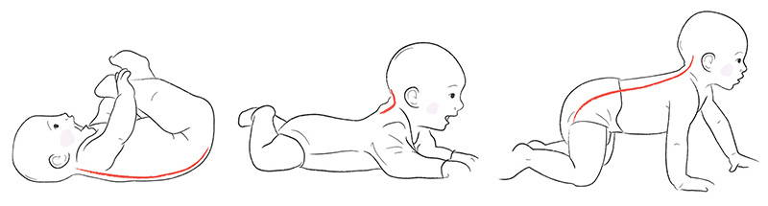
Vertebral Curves cont.
Primary curves
  Kyphotic curves
  Present basically from birth
Secondary curves
  Lordotic curves
  Form in response to the stress of head raising and later sitting / standing
  Cervical curve begins forming at 3-4 months
  Lumbar curve begins to form with crawling
    Fully formed by 12-18 months when standing and walking
https://www.hudsonvalleyscoliosis.com/can-baby-walkers-swings-cause-infantile-scoliosis/
https://boba.com/blogs/boba-reads/strollers-baby-carriers-and-infant-stress
Notes:
The body compensates for the weight of the head by forming a curve in the opposite direction of the one that already exists

Slide 8
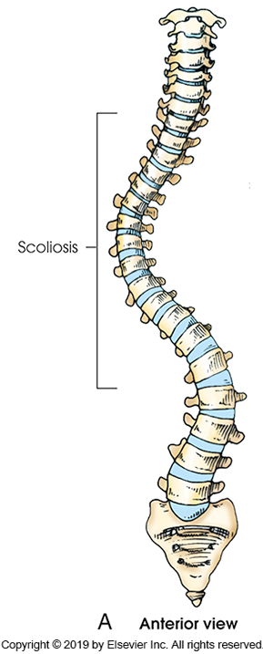
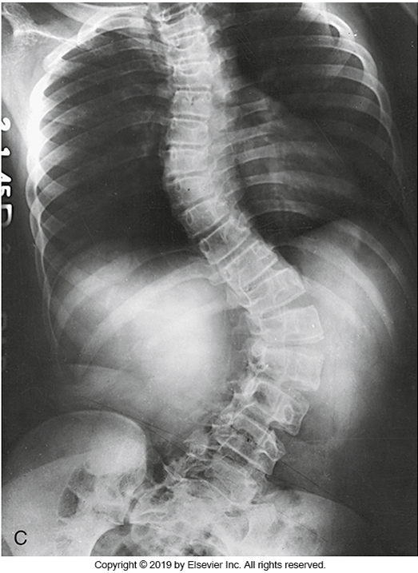
Abnormal Curvatures - Scoliosis
Lateral curvature
  Very slight curve is normal
Usually thoracic
  Lumbar spine curves in opposite direction to compensate
When severe can reduce lung capacity and ability to walk
Notes:
Mostly unknown cause. Occasionally caused by muscular issues
When caught young, can be fixed with bracing or surgery (Harrington rods)

Slide 9
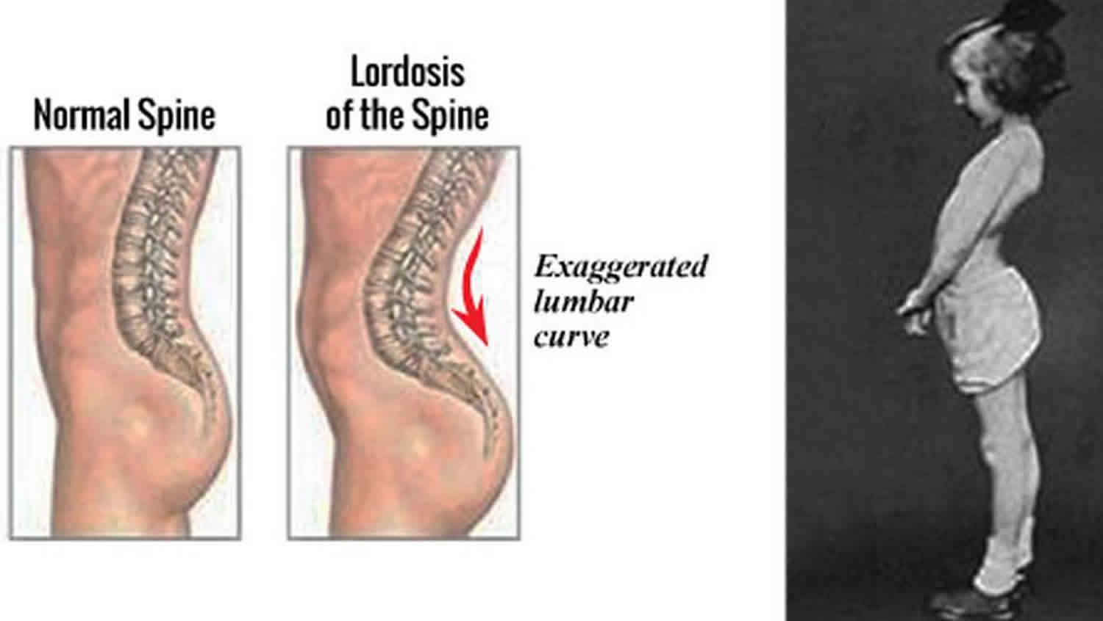
Abnormal Curvatures - Lordosis
Sway back
Exaggerated curvature of the lumbar spine
https://healthjade.net/lordosis/
Notes:
More common in women esp during pregnancy

Slide 10
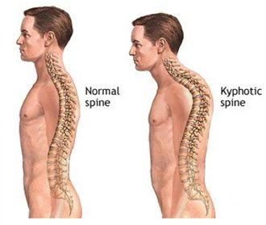
Abnormal Curvatures - Kyphosis
Hunch back
Exaggerated curve of the thoracic spine
Common in the elderly
  Loss of bone density causes vertebrae to compress on anterior surface
  Curve gets larger and larger
https://scoliosisclinic.co.uk/hyper-kyphosis/

Slide 11


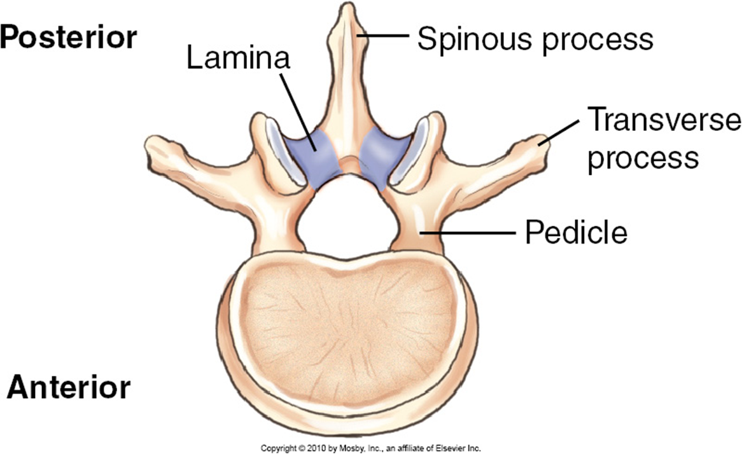
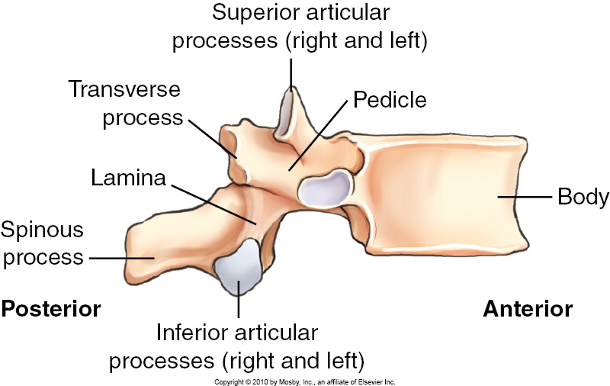
Common Characteristics of Vertebrae
Body
  Thick, weightbearing portion
  Anterior
Vertebral arch
  Ring that the spinal cord runs through (vertebral foramen)
  When stacked, called the vertebral or spinal canal
  Posterior portion
Pedicles
  Anterior part of vertebral arch
  Closest to body
Lamina
  Posterior part of arch
  Meet at the midline
Vertebral Arch
Body
Notes:
All vertebrae have these features in common, no matter where on the column they are.

Slide 12
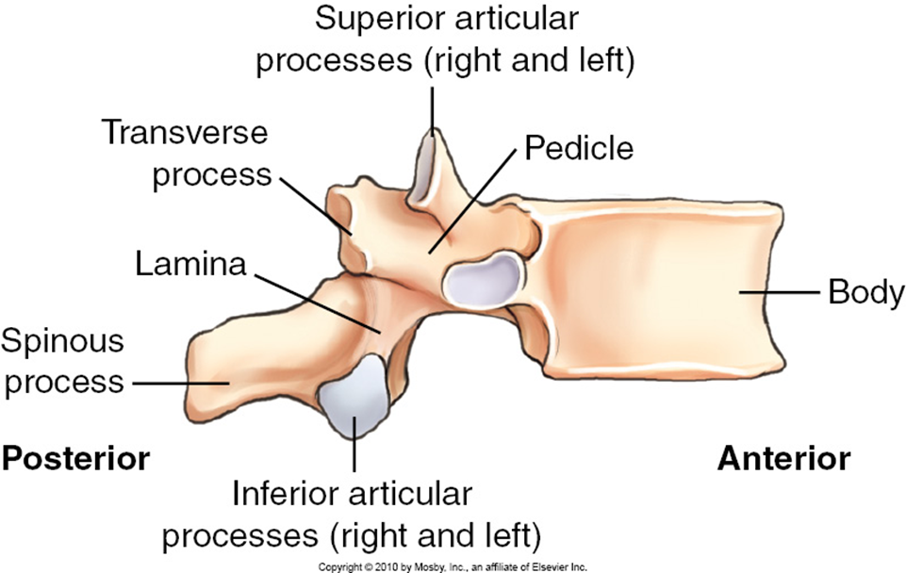
Vertebral Processes
Transverse processes
  Project laterally (as the name implies)
  Between pedicles and laminae
Spinous processes
  Project posteriorly
  Between both laminae
  Can often be palpated
Articulating processes
  Each vertebra has 4
    2 superior and 2 inferior. 1 on each side
  When stacked, the inferior articulating process joins to the superior articulating process of vertebra below

Slide 13
Joints Review
Function
  Immovable joint – Synarthrosis
  Limited movement – Amphiarthrosis
  Freely moveable – Diarthrosis
Structure
  Fibrous
    No joint cavity.
    Bones held together by connective tissue.
    Little or no movement
  Cartilaginous
    Similar to fibrous, but cartilage instead.
    Little or no movement
  Synovial
    Freely movable joint.
    Has joint capsule and synovial fluid

Slide 14
Joints Review – Joint Movement
Plane (gliding)
  Very little movement
  Surfaces slide over each other
Hinge
  Flexion and extension only (elbow joint)
Pivot
  Allows rotational movement (proximal and distal radioulnar joints
Condylar
  Flexion and extension, abduction and adduction (MCP joints)
Saddle
  2 curved surfaces put together at right angles
Ball and socket
  Widest range of motion (shoulder and hip joints)
Bicondylar
  2 convex condyles within a joint capsule (knee joint)

Slide 15

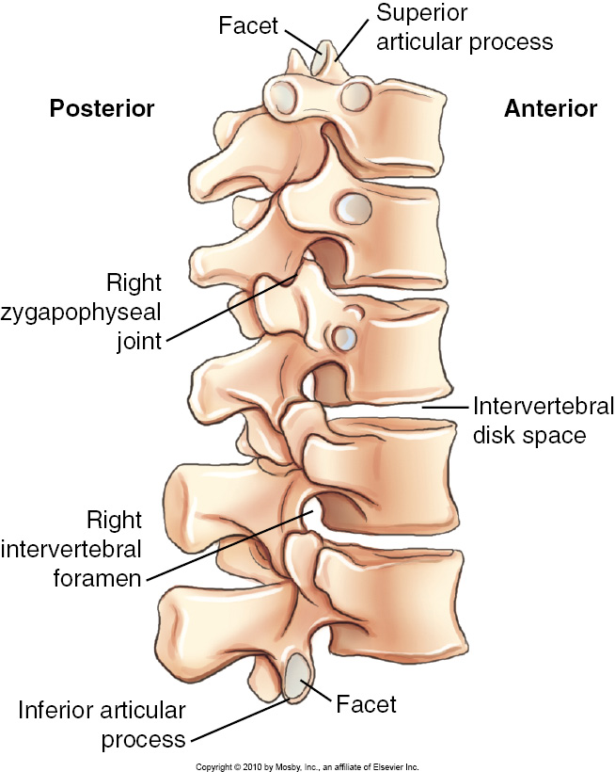
Joints of the Vertebral Column
Zygapophyseal
  Joints between Superior Articulating Process and Inferior Articulating Process
  Also called facet joints
  Diarthrodial, synovial, gliding joints
  Referred to by the vertebrae they join. ie C4/5 or C7/T1

Slide 16
Joints of the Vertebral Column
Intervertebral
  Between the vertebral bodies
  Amphiarthrodial, cartilaginous
  Provide very limited movement between each vertebra, but lots for entire spine
Notes:
Combination of zygapophyseal and intervertebral joints is lots of movement in every direction

Slide 17
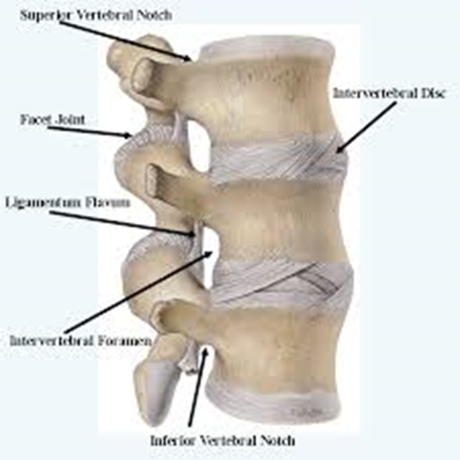
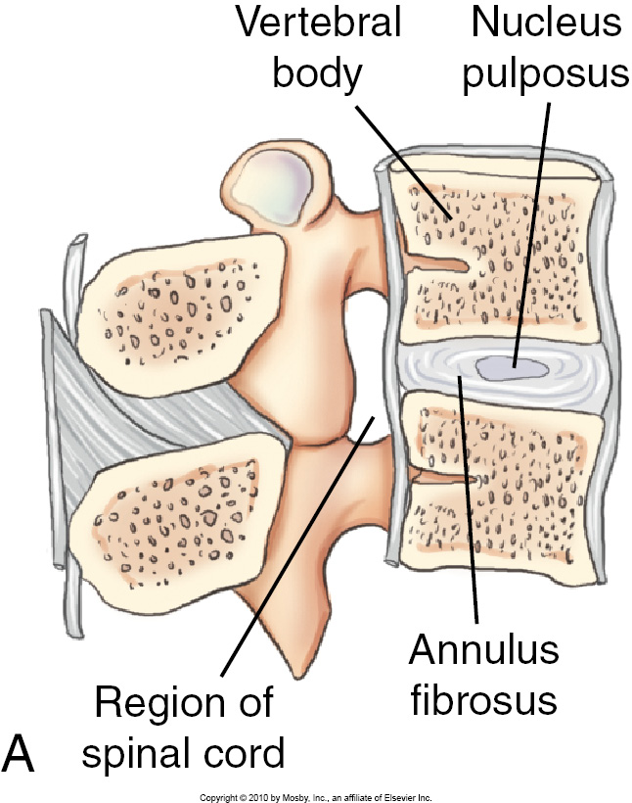
Intervertebral Discs
Thick sturdy discs of fibrocartilage
Between each vertebra (except C1 + C2)
Provide cushion and shock absorption
Built like a jelly donut
  Fibrous outer ring - Annulus fibrosus
  Inner cushioning gel – Nucleus pulposus
Herniated, slipped, or bulging disc = Nucleus pulposus has burst out of Annulus fibrosus
Notes:
Tough fibrocartilaginous discs-separate the vertebrae
Absorption shock from walking, running or jumping
Bound to vertebra tightly to add stability
Discs are the thickest in the lumbar and cervical regions for enhanced flexibility
Discs account for about 25% of the height of the vertebral column – they flatten throughout the day, and as we age making us shorter

Slide 18
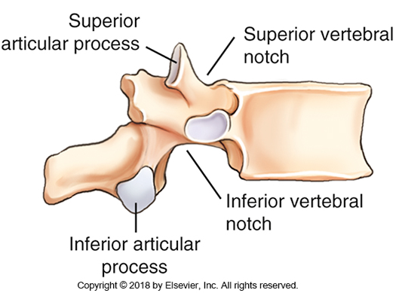
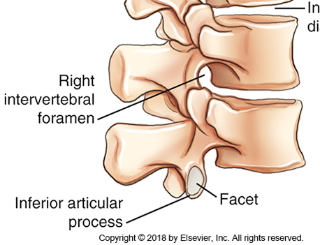
Intervertebral Foramina
Superior vertebral notch is on the superior surface of SAP
Inferior vertebral notch is on the inferior surface of IAP
When stacked, they form a hole that blood vessels and nerves pass through

Slide 19
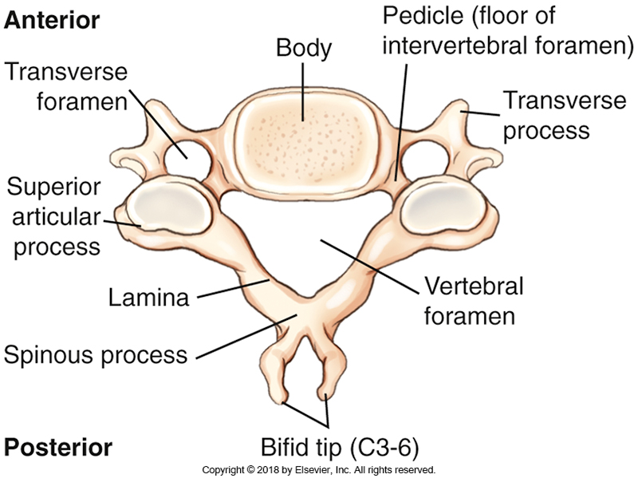
Cervical Anatomy Characteristics C3-6
Transverse foramina
  Transverse processes point more anteriorly
  Have a hole in them
    Vertebral artery, veins, and nerves pass through
Notes:
Going to study the strangest ones first!
C3-6 are considered to be “typical” cervical vertebrae
https://sketchfab.com/3d-models/cervical-vertebrae-c5-labeled-ba09647b8bc347d995f42e5ca471b284
This link is to a model C5
https://sketchfab.com/3d-models/march17-torso-study-cervical-region-neck-0f86d7fb6d0041d6a29ac08b7b2bafcd
This link is to a cervical spine model

Slide 20

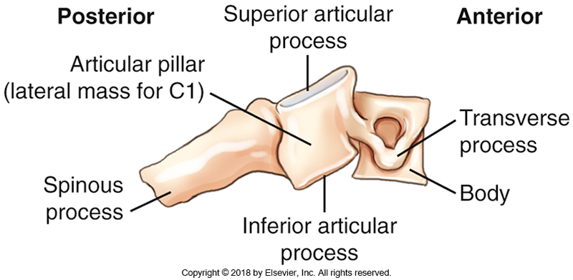
Cervical Anatomy Characteristics C3-6
Bifid spinous process
  Spinous process splits to allow nuchal ligament to pass
Slanted, overlapping vertebral bodies
Articular pillars
  SAP and IAP right on top of each other
  Create a column of bone called the articular pillar (lateral mass on C1)

Slide 21
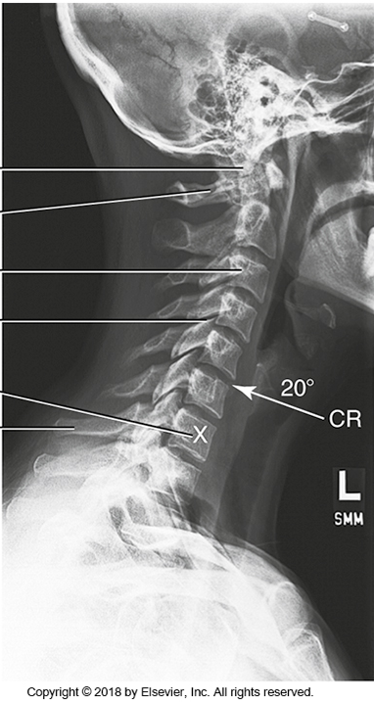
C-spine facet joints
90° to the midsagittal plane
Only visible on true lateral projection
  C1/2 on AP open mouth
Notes:
Can see open zygapohphyseal joint of C3-C7 (green oval)
Cannot see C1/2 (red circle)
Much like the MCP joints in the hands, the zygapophyseal joints are very important and must been seen on radiographic images.

Slide 22
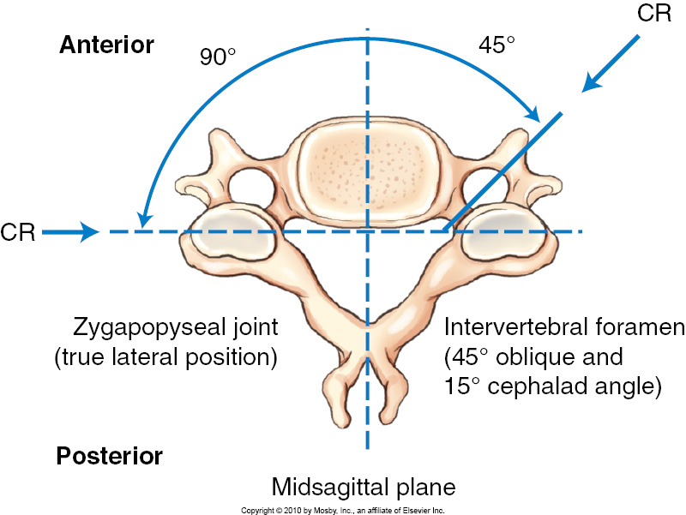
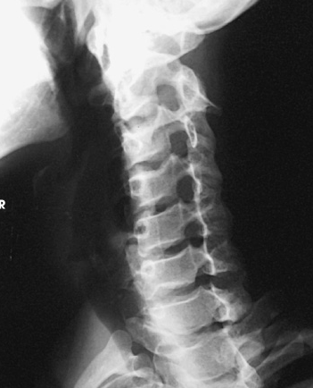
C-spine Intervertebral Foramina
45° from midsagittal plane
Angled 15°inferiorly (due to overlapping cervical bodies)
Must rotate pt 45 ° and angle 15° cephalad to open up
Notes:
https://sketchfab.com/3d-models/march17-torso-study-cervical-region-neck-0f86d7fb6d0041d6a29ac08b7b2bafcd
Cervical spine model

Slide 23
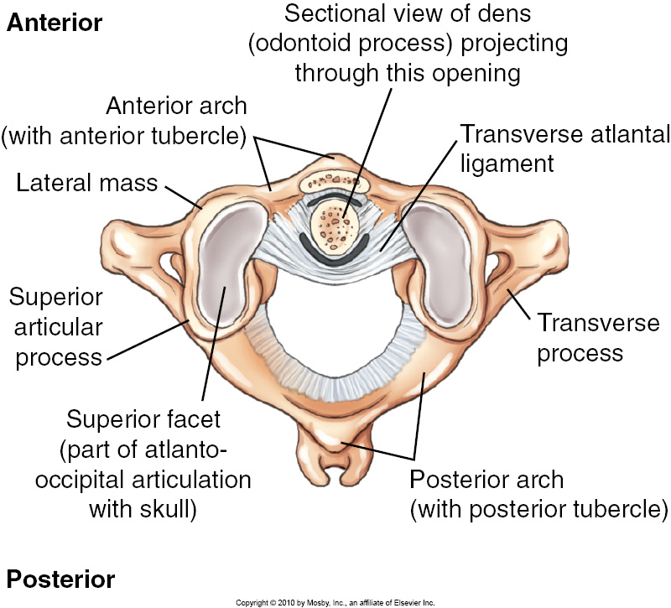
C1
Called Atlas
  Reference to Greek Titan who holds up the Earth
No defined body
  Anterior and posterior arches
Anterior arch
  Superior articulating facets where the spine joins occipital portion of skull (atlanto-occipital joint)
  SAP is right over IAP, creating the lateral masses
    Thickest and strongest part of C1
Posterior arch is very slender
  No defined spinous process (posterior tubercle)
Notes:
Allows you to nod your head
https://sketchfab.com/3d-models/human-atlas-c1-vertebra-03657338956d41158be94cf19b150402
C1 model

Slide 24
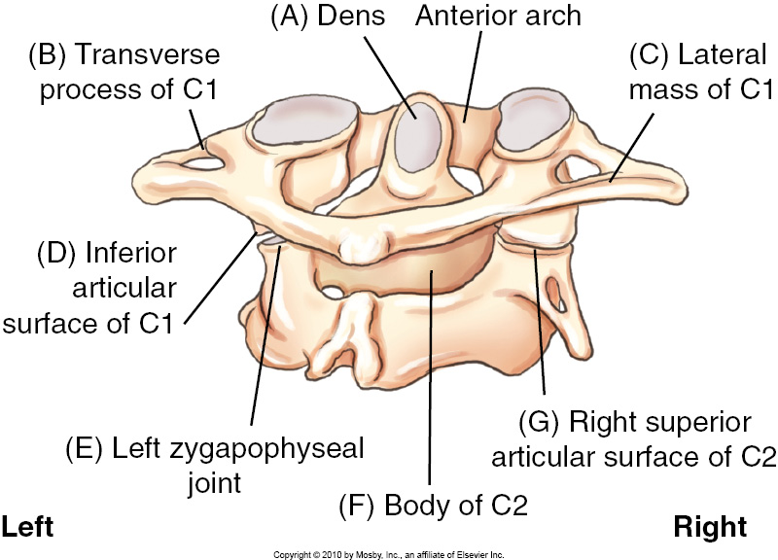
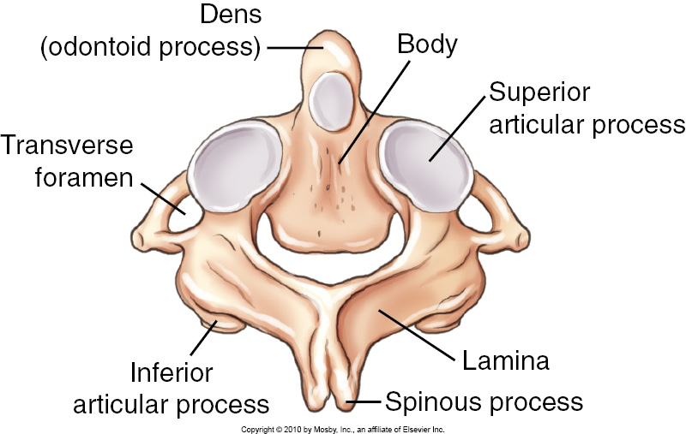
C2
Axis
  The point around which something rotates
Has a body, but no intervertebral disc above
Dens projects superiorly into the anterior arch of C1
  Held in place by Transverse Atlantal Ligament
Notes:
Allows you to shake your head

Slide 25
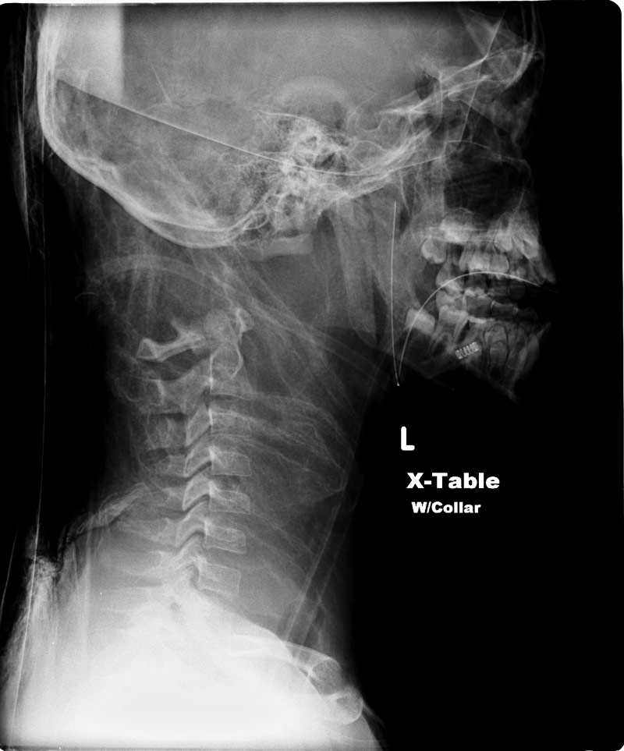
Atlanto-occipital & Atlantoaxial Joints
Extremely important
Whiplash and similar injuries can # the dens
  Dens # and disruption of stabilizing ligaments is often fatal
C-spine images are usually the first ordered after a major trauma

Slide 26
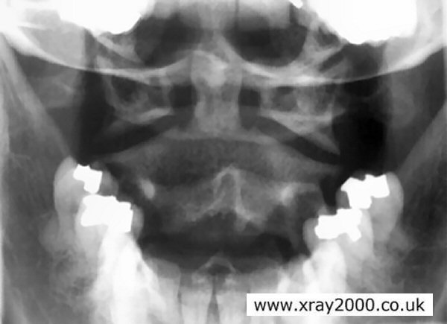
Atlanto-occipital Joints
Bilateral
Articulating surfaces
  Superior articular process and facet of C1
  Condyles of occipital bone of skull
Joint type and movement
  Synovial, diarthrodial ellipsoid (condyloid)
  Freely movable

Slide 27
Atlantoaxial Joints
Actually 3 joints
Medial
  Posterior surface of anterior arch of C1 & Odontoid process of C2
  Synovial, diarthrodial trochoid (pivot)joint
  Freely movable
Lateral (x2) – Zygapophyseal joints
  Inferior articular processes & facets of C1 & Superior articular processes and facets of C2
  Synovial, diarthrodial plane (gliding) joint
  Freely movable
Only visible on an AP through the pt’s open mouth

Slide 28
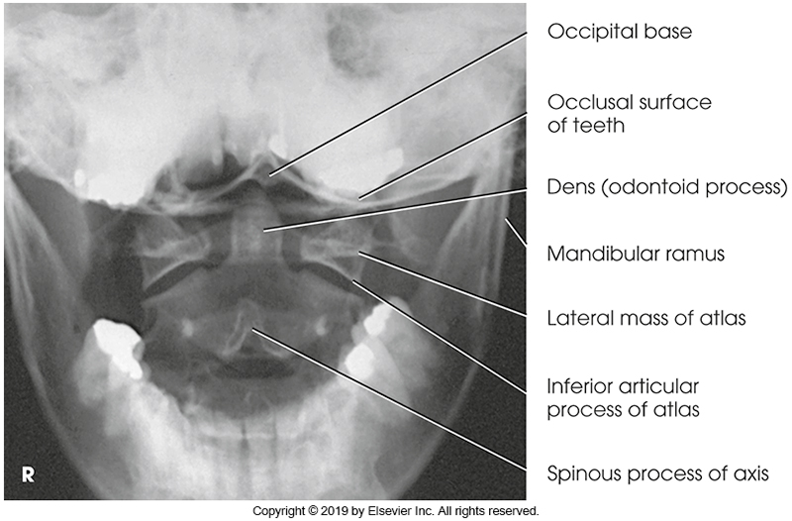
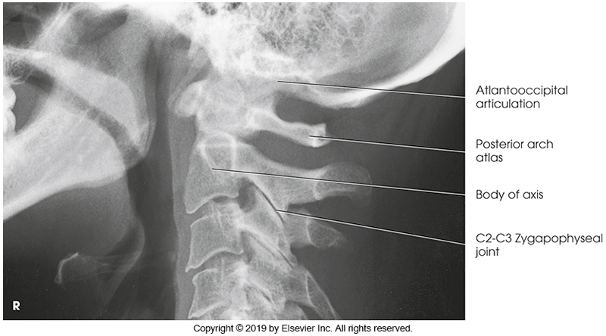
Red line = pivot point of medial atlantoaxial joint
Green oval = bilateral zygapophyseal joints
Blue circle = obscured zygapophyseal joints

Slide 29
C3-6
Typical cervical vertebrae
All previously mentioned characteristics
  Transverse foramina
  Bifid spinous processes
  Sloped vertebral bodies
Get progressively larger as you move inferiorly

Slide 30
C7
Largest cervical vertebra
Looks more like a thoracic vertebra, except for the transverse foramina
Large, non-bifid spinous process
  Called vertebra prominens
  Can be palpated at the base of the neck
  Very important landmark
  Slopes down and is approximate location of T1
Notes:
https://sketchfab.com/3d-models/cervical-vertebrae-c7-unlabeled-a4072a8aa06b4ecf9f7bc1a382cd36c8
C7 model

Slide 31
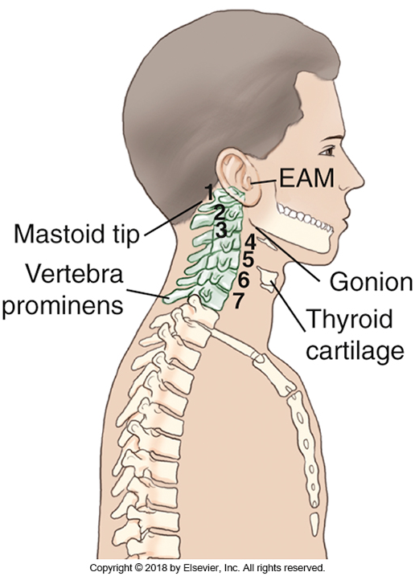
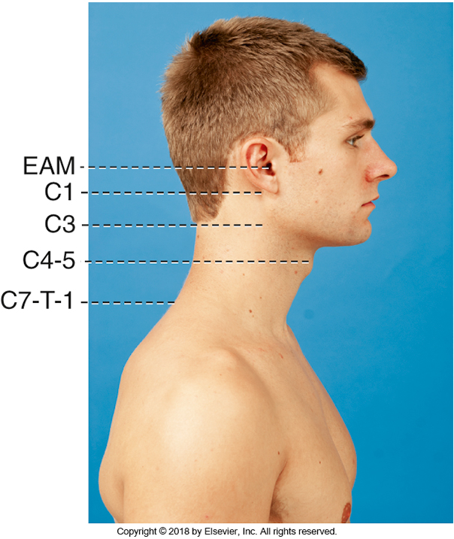
External Landmarks
Acanthion

Slide 32
Patient Preparation
How would you change a patient for a C-spine exam?
  Remove all clothing from the waist up
What artifacts are we worried about?
  Earrings
  Necklaces
  Hair clips and pins
  Buns and ponytails!
  Tongue rings
  Dentures
  Gum

Slide 33
Views
Routine
  Lateral
  15° AP axial
  AP open mouth (odontoid)
  15° axial obliques (AP or PA)
  Swimmer’s *Will be discussed with T-spine*
Non-routine
  Fuch’s
  Flexion & Extension
  Soft Tissue Neck (Nasopharynx or adenoids)

Slide 34
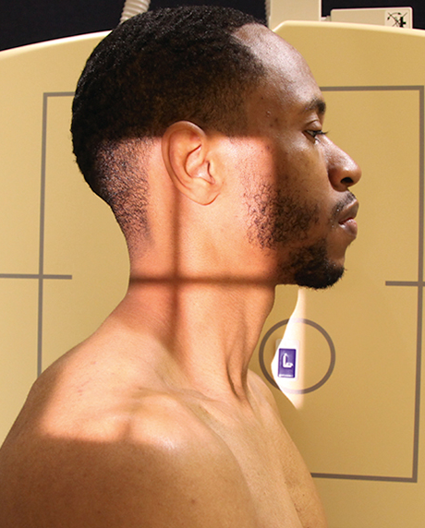
Lateral 75-85kVp
SID
  180 cm
Pt position
  True left lateral
  Raise chin slightly
Central ray
  Straight ray
  Midcoronal plane (may tilt collimator very slightly)
  C4 (laryngeal prominence)
Collimation
  Top of ear superiorly
    Must include Sella turcica (2cm anterosuperior to EAM)
  T1 inferiorly
  Soft tissue anterior & posterior
Marker
  Anterior to soft tissue of neck
Breathing
  Suspend on expiration
Notes:
Usually the first projection done. Dr will evaluate stability before imaging continues (trauma situation)
Sid compensates for large OID
Must

Slide 35
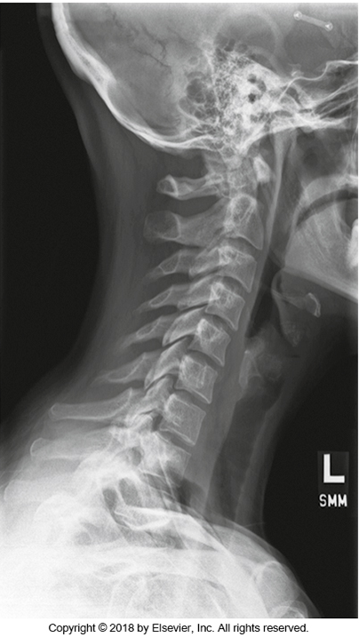
Image evaluation
1
All 7 cervical vertebrae + 1/3 of T1
Sella turcica
Gonion (angle of mandible) off the axis and atlas
Open zygapophyseal joints
CR centered at C 4/5
Soft tissue included
No rotation or tilt
2
3
4
5
6
7
T1

Slide 36
Rotation and Tilt on Vertebrae

Slide 37
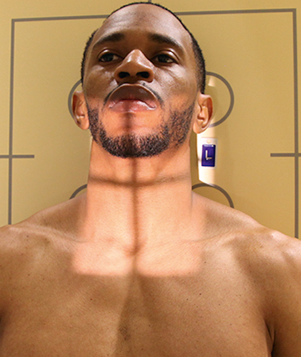
15° Axial AP 75-85 kVp
SID
  110 cm
Pt position
  Midsagittal plane perpendicular to the IR
  Even weight on floor
Central ray
  15° cephalad at level of C4
Collimation
  Mastoids to T2 (jugular notch)
  Soft tissue side to side
Marker
  On detector, lateral to shadow
Breathing
  Suspend respiration
Notes:
Bontrager says 20 degrees. Ignore it.

Slide 38
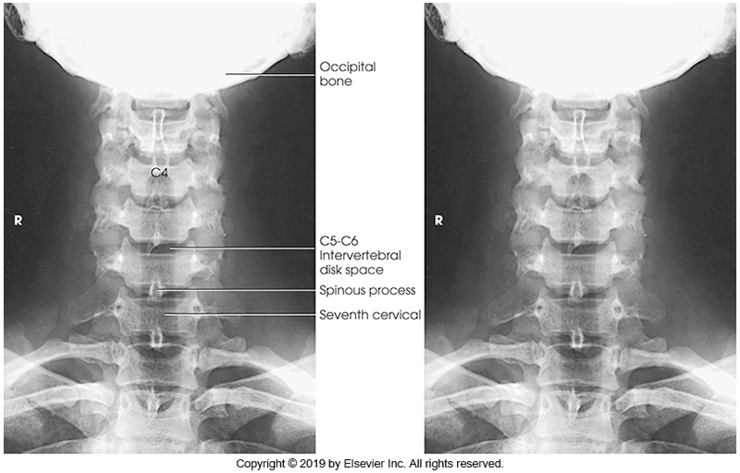
Image Evaluation
C3 to T2/3 and surrounding soft tissue
Centered to C4/5
Chin and base of skull superimposed
Open intervertebral disc spaces
Spinous processes equidistant to the pedicles
Mandibular angles equidistant to the vertebrae
3
4
5
6
7
T1
T2

Slide 39
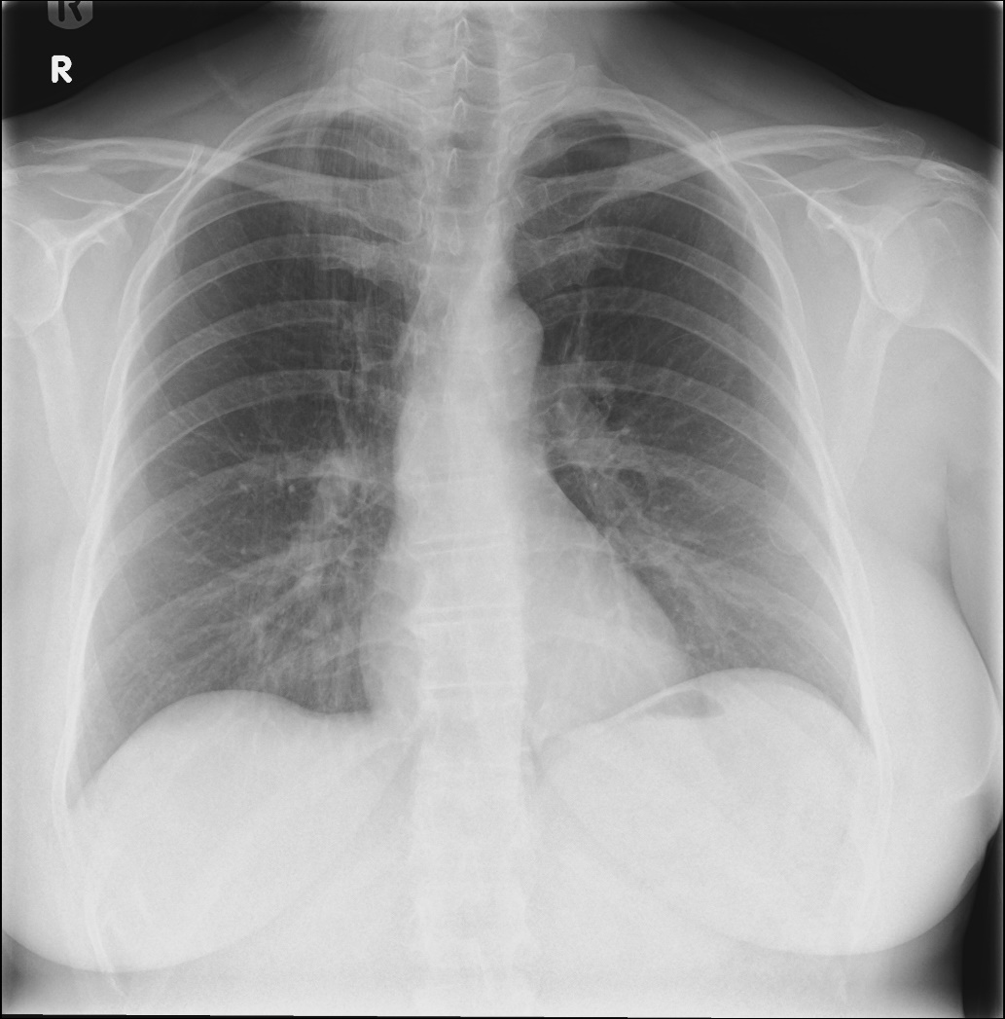
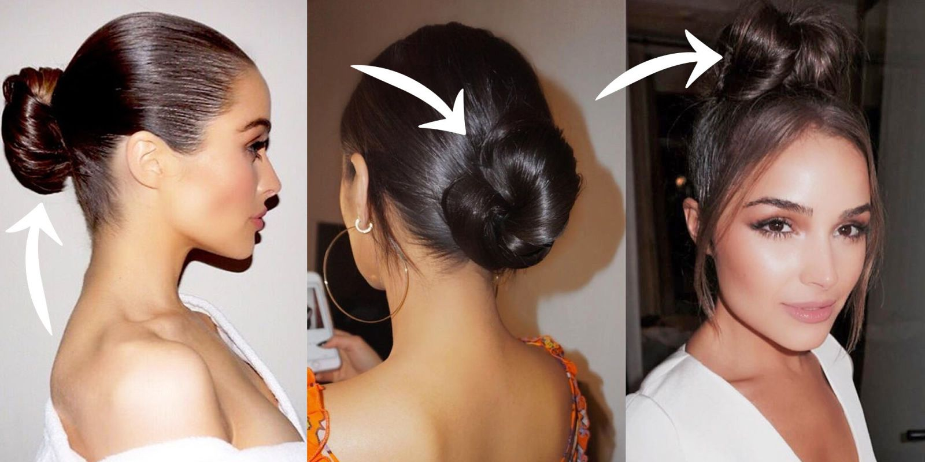
A Note Regarding Hair
Wet hair, product, braids produce artifact
Ponytails or buns make it hard to raise chin
Pile hair on top of head if possible
  Tech note if not
Case courtesy of Dr Sarmad Aslam, Radiopaedia.org, rID: 78223
https://www.marieclaire.com/beauty/news/g4472/hair-bun-styles/

Slide 40
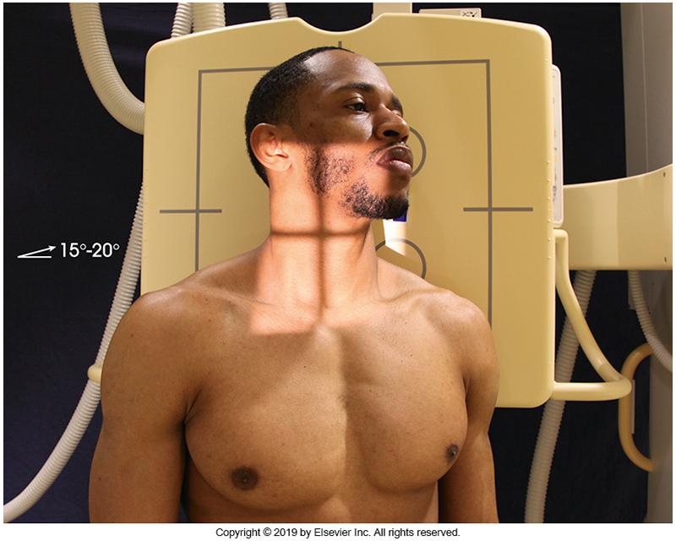
AP 15° Axial Obliques 75-85kVp
SID
  110 cm (Can also be done at 180 cm)
Pt Position
  Midcoronal plane 45° from lateral
  Raise chin slightly
  Optional: turn head to a lateral position. Practice both in the lab!
Central ray
  15° cephalad at level of C4
Collimation
  EAM to T1/2 (jugular notch)
  Soft tissue side to side
Marker
  Similar to AP
  Mark Side down!
Breathing
  Suspend
L
Notes:
180cm SID can be very challenging depending on equipment set up
Raising chin slightly to move mandible off upper vert. Don’t lift too high or base of skull will superimpose C1
Turning the head helps move the mandible, but will rotate upper vert. Usually site protocol.

Slide 41
PA 15° Axial Obliques 75-85 kVp
SID
  110 cm (Can also be done at 180 cm)
Pt Position
  Midcoronal plane 45° from lateral
  Raise chin slightly
  Optional: turn head to a lateral position. Practice both in the lab!
Central ray
  15° caudad at level of C4
Collimation
  EAM to T1/2
  Soft tissue side to side
Marker
  Mark Side down!
Breathing
  Suspend
Notes:
Can be very challenging for short technologists or tall patients
Much less dose to thyroid

Slide 42
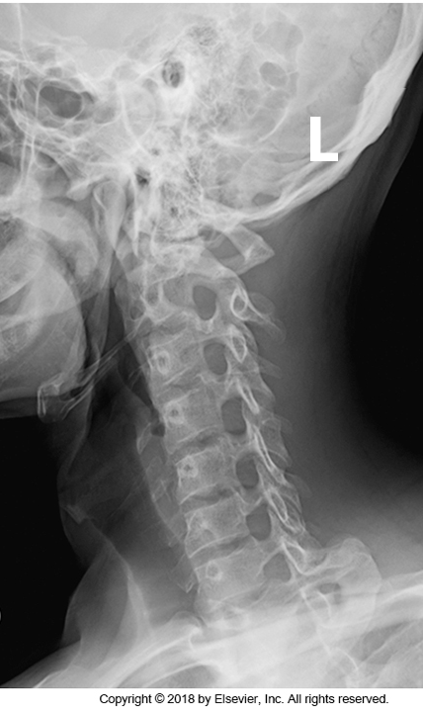
Image Evaluation
C1-T1
Oblique projection of vertebral bodies
Open intervertebral disc spaces C2-C7
Open intervertebral foramina C2-C7
Please note electronic marker
2
3
4
5
6
7

Slide 43
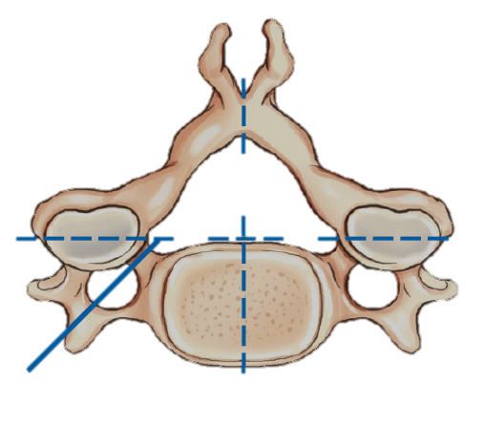
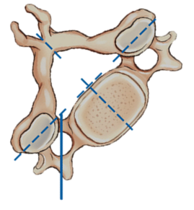
Intervertebral Foramina
Which foramina will you see in an LPO? LAO?
  LPO = Right
  LAO = Left
Why do we care
  Nerves pass through foramina
  Stenosis of foramina leads to pinched nerves, pain, and numbness

Slide 44
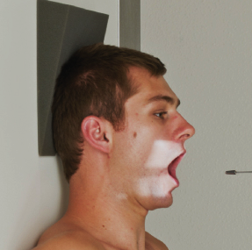
AP Open Mouth (Odontoid) 75-85 kVp
SID
  110 cm
Pt position
  Midsagittal plane perpendicular to IR
  Open mouth
  Occlusal plane and mastoid tips parallel to floor
Central ray
  Straight ray
  In mouth, on MSP (mid sagittal plane)
  At the level of the dens
    Between occlusal plane and corners of open mouth
Collimation
  Acanthion to tip of mandible
  Width of mandible side to side
    If you can see light behind pt, field is too large
Marker
  Bottom corner of light
  Tip: collimate and place marker first
R
Notes:
Occlusal plane = tips of upper incisors
Difficult to hold mouth open for too long. Only open when you have to and for exposure.

Slide 45
Odontoid, atlas and axis are visualized
Mandibular rami equidistant from odontoid (no rotation)
No superimposition of incisors or skull base over dens
Equal space between dens and lateral masses of C1
Notes:
Every 5 degrees of angulation will cause 1 inch of projection

Slide 46
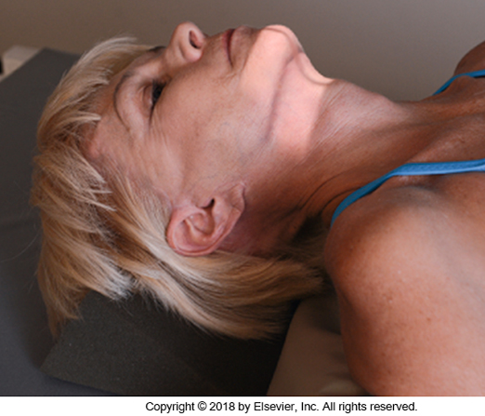
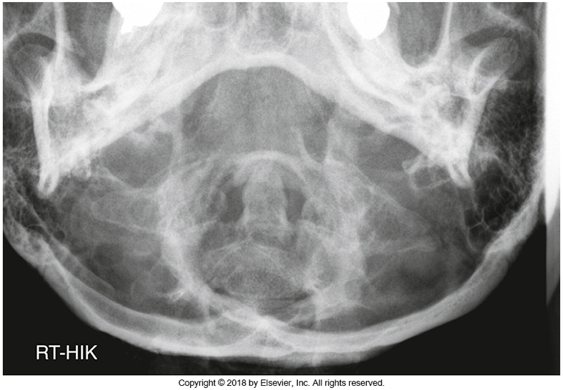
Fuch’s
Can be used when unable to clear dens on the open mouth
Align tip of chin and EAM perpendicular to IR
CR just below chin (Squishy part between gonions)
  CR can be straight or angled if patient unable to raise chin due to cervical collar
Collimation and marker the same as open mouth
Projecting dens over foramen magnum

Slide 47
Flexion & Extension
Evaluates the stability of cervical spine
Common after whiplash injuries
Always accompanied by a lateral projection
Positioning, collimation, centering, etc the same as a lateral, except for flexion and extension of spine
  Flexion = chin down on chest
  Extension = head tipped back
Pt must only move neck. No leaning!
Direction marker required
Uncomfortable. Be fast!

Slide 48
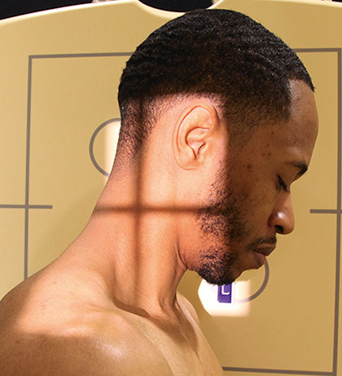
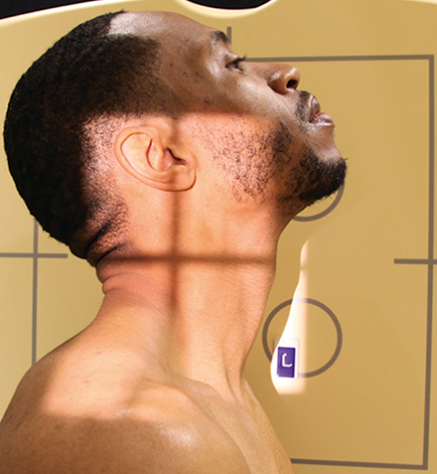
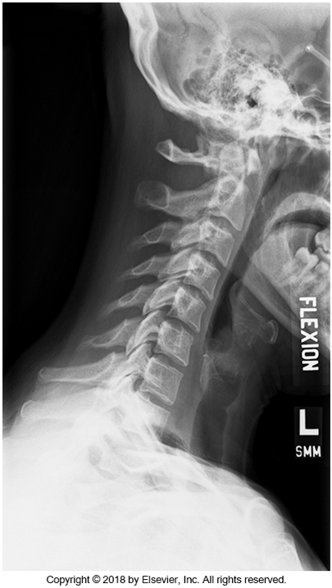
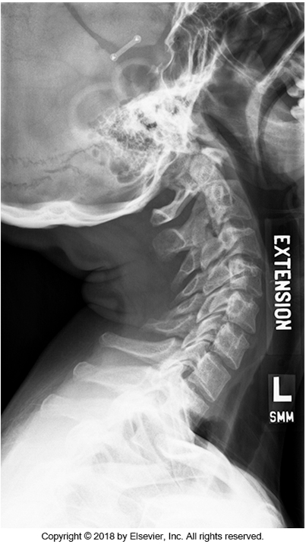

Slide 49
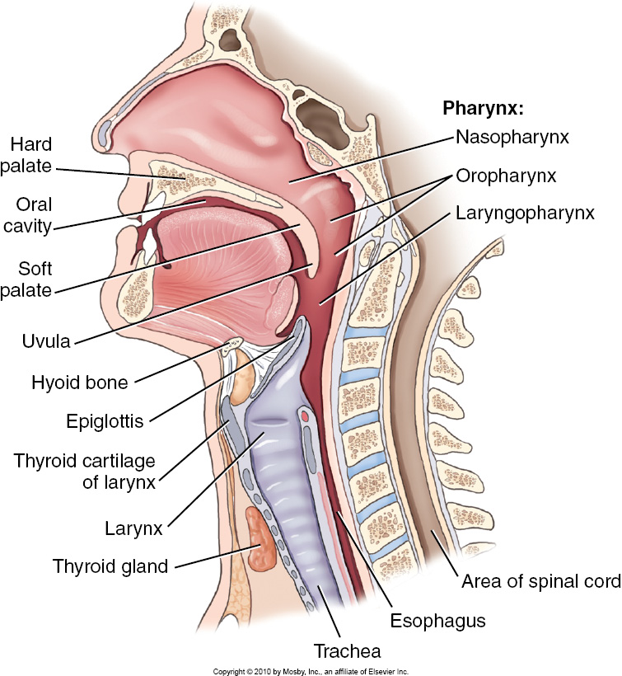
Soft Tissue Neck 75-85 kVp
Also called Adenoids or Nasopharynx
Uses a soft tissue technique
  Reduce kVp
Done to evaluate the soft tissues of trachea and surrounding anatomy
  Rule out foreign body
  Rule out enlarged adenoids
May do only lateral, or may include an AP
Notes:
Why would we want to reduce kvp?
Who do you think we do these on most commonly? Peds! They like to eat random things and their adenoids tend to become enlarged when they get sick.

Slide 50
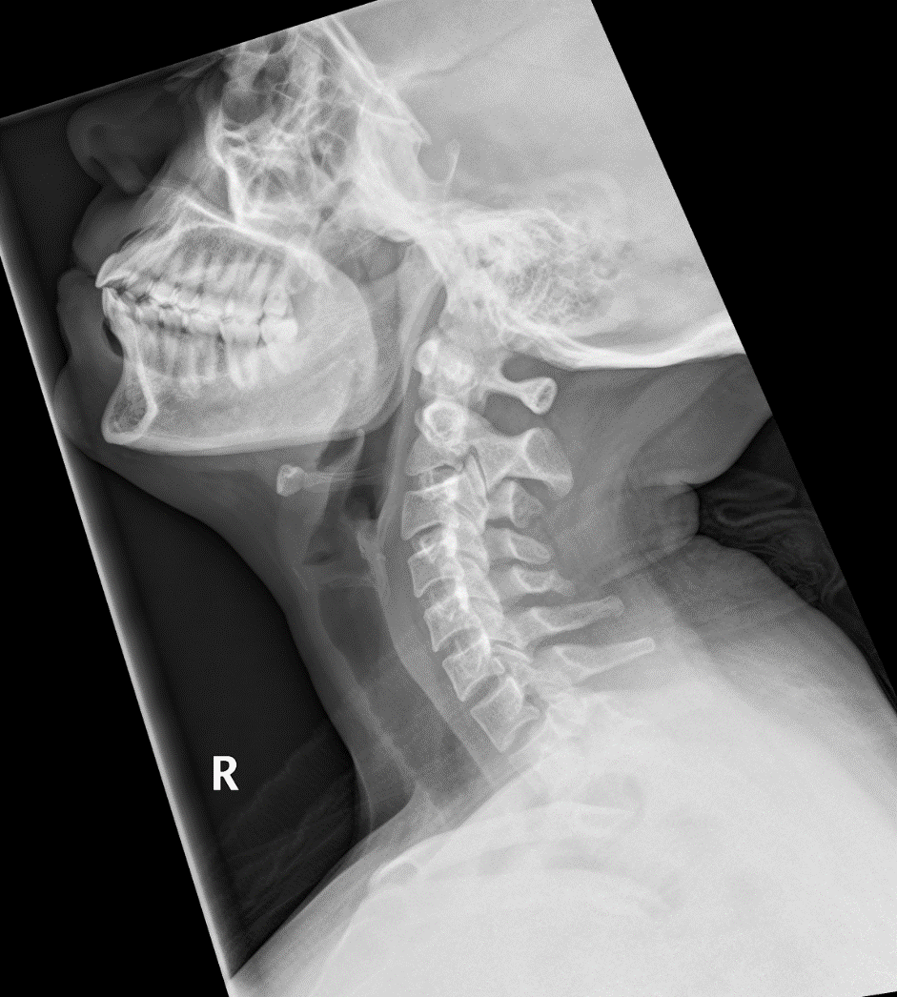
STN - Lateral
SID
  180 cm
Patient Position
  Similar to lateral C-spine. Chin is higher
  Hands behind back
CR
  Straight ray at level of C4
  Anterior to cervical spine
Collimation
  Bridge of nose to apices of lungs
  Side to side site dependant (May need entire nose)
Marker
  Anterior to soft tissue of neck
Breathing
  Slow inhalation to fill trachea with air
Case courtesy of Dr Henry Knipe, Radiopaedia.org, rID: 46366

Slide 51

STN - AP
SID
  110 cm
Pt position
  Same as AP C-spine
CR
  15° cephalad
  Between larynx and jugular notch
Collimation
  Gonions to T4 (1” inferior to jugular notch)
Marker
  Same as AP C-spine
Breathing
  Slow inhalation
Notes:
Text says straight ray. Ignore it

Slide 52

Plum pit
Case courtesy of Gerry Gardner , Radiopaedia.org, rID: 14050

Slide 53
Review
Where should the top of your light field be for a lateral C-spine?
Gonion
EAM
Top of ear
Top of skull

Slide 54
Review
What are the breathing instructions for an AP C-spine?
Hold on inspiration
Hold on Expiration
Quiet breathing
Suspend

Slide 55
Review
What 2 structures need to be lined up for the AP open mouth?
Upper incisors and mastoid tips
Acanthion and base of skull
Tip of chin and mastoid tips
Corner of mouth and base of skull

Slide 56
Review
How much rotation do you need for an oblique C-spine?
30°
25°
45°
60°

