Slide 1
CT Theory
Neurologic Imaging Procedures

Slide 2
CT Imaging of the Head
Module Objectives
Review anatomy of the cranium, facial bones, and brain
Label anatomical structures on a CT image
Scanning protocols including:
  Positioning
  Indications & Contraindications
  Exposure Factors
Most common CT Head exams done
Pathology

Slide 3
CT Imaging of the Head
Positioning for Head CT
Patient Position
  Head holder or molded sponge
  Patient supine, head-first into the gantry
  Reduce patient motion
  Normal respiration
  Eyes – open or closed
Anatomy Position
  Will differ from site to site
  Line up the OML or the Supraorbital Meatal line
    Advantage of using SOML:

Slide 4
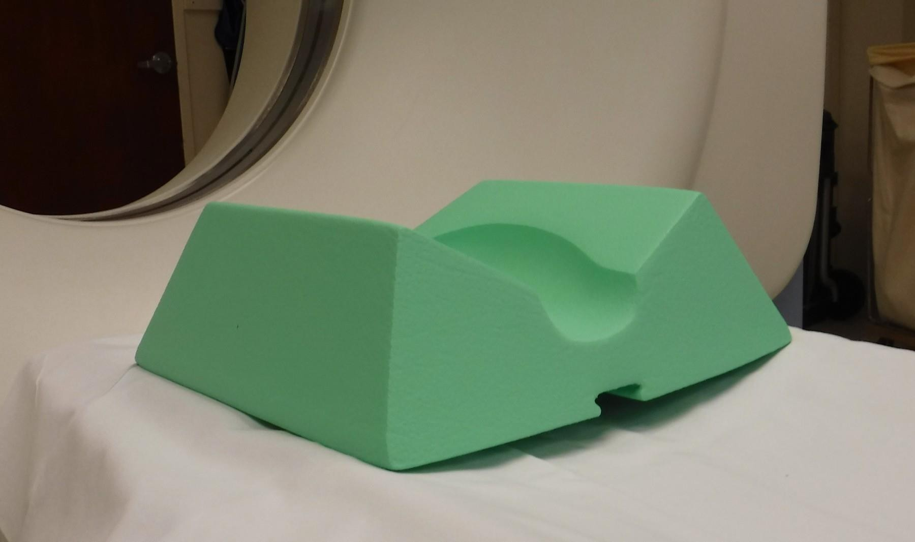
CT Imaging of the Head

Slide 5
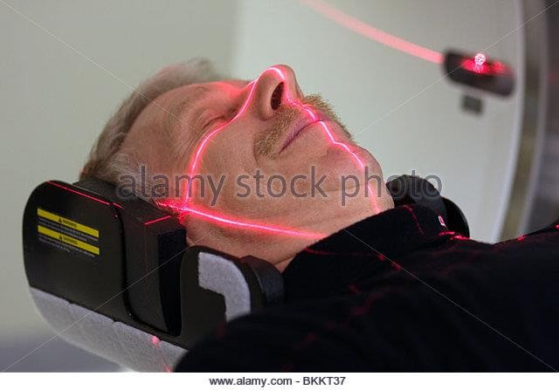
CT Imaging of the Head

Slide 6
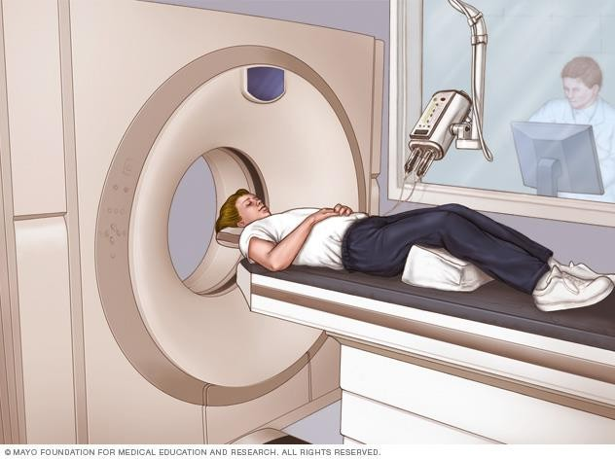
CT Imaging of the Head

Slide 7
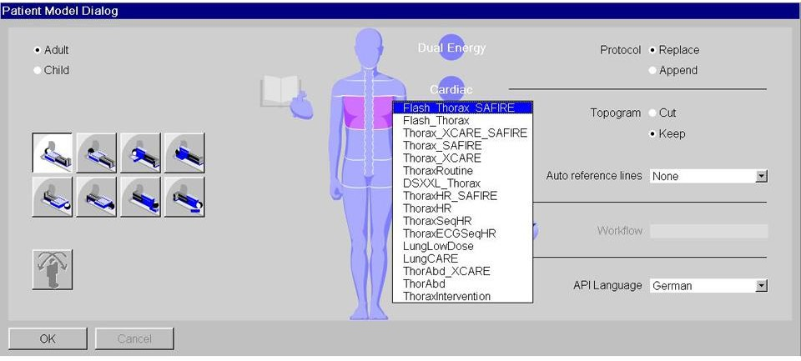
CT Imaging of the Head

Slide 8
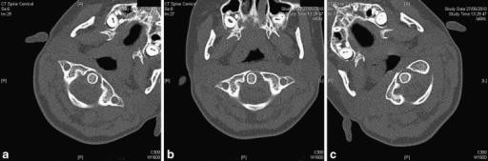
CT Imaging of the Head
Assess positioning for tilt = symmetry
Image Source: http://www.cureus.com
Patient’s head is rotated, but not tilted. Notice symmetry of the c-spine, mandible, etc.

Slide 9
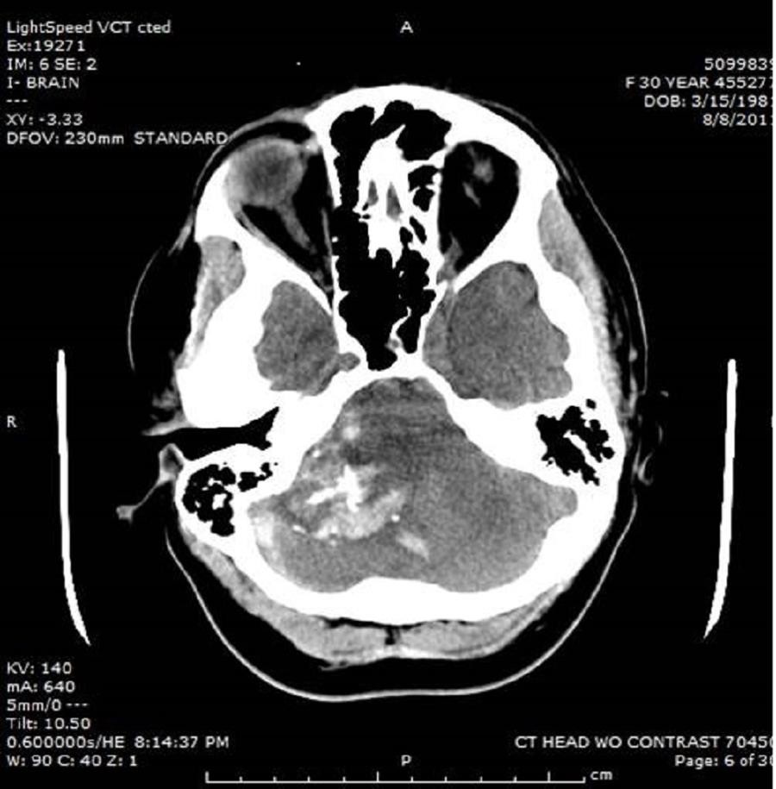
CT Imaging of the Head
Assess positioning for tilt = symmetry
Image Source: http://www.cureus.com

Slide 10
CT Imaging of the Head
How are CT images of the Head acquired?
  In what plane?
  What scanning method – helical or conventional?

Slide 11
CT Imaging of the Head
Conventional Head CT
“Step and Shoot”
“Axial”
Advantages
  Allow gantry tilt to ensure properly positioned slices
  Highest image quality
•
Disadvantages
  Longer examination time – significant for contrast-enhanced studies
•
  Depending on scan settings, or patient motion, possibility of missed anatomy

Slide 12
CT Imaging of the Head
Helical Head CT
“Spiral”
“Continuous”
Advantages
  Shorter examination time – significant for contrast-enhanced studies
•
•
  Allows slice increment to be changed retrospectively
Disadvantages
•
  Does not allow gantry tilt

Slide 13
CT Imaging of the Head
How are CT images of the Head acquired?
  Site dependent
  Non-enhanced studies = conventional
  Enhanced studies = helical
  Trauma – helical
Many factors may go into decision-making!
Check your protocols!
Be observant of what you see in clinical practice!

Slide 14
CT Imaging of the Head
Challenges in scanning
Beam-hardening artifact in posterior fossa
  What causes this artifact?
  Management:
Motion
  What does motion look like on CT?
  Management:

Slide 15
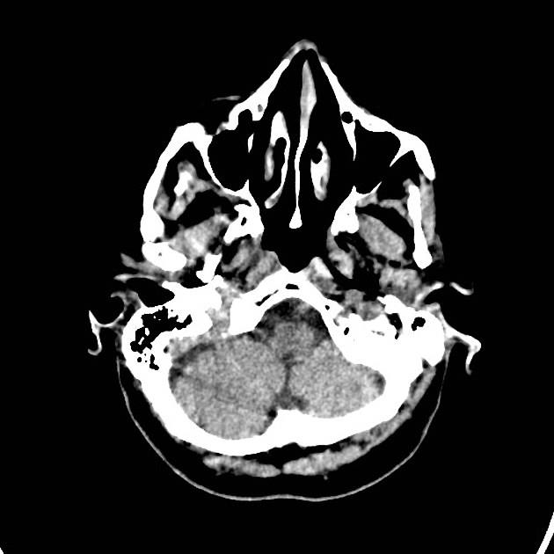
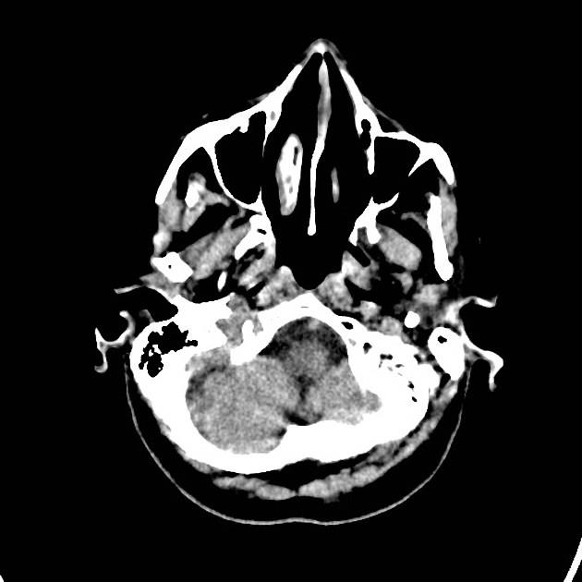
CT Imaging of the Head
Beam Hardening Artifact
Image Source: https://radiopaedia.org/articles/ct-artifacts

Slide 16
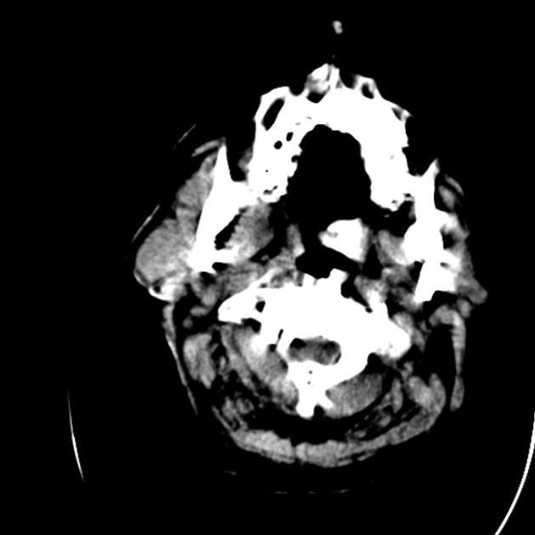
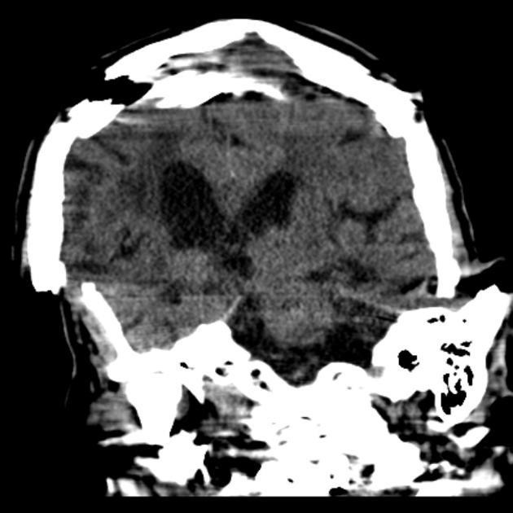
CT Imaging of the Head
Motion Artifact
Image Source: https://radiopaedia.org/articles/ct-artifacts

Slide 17
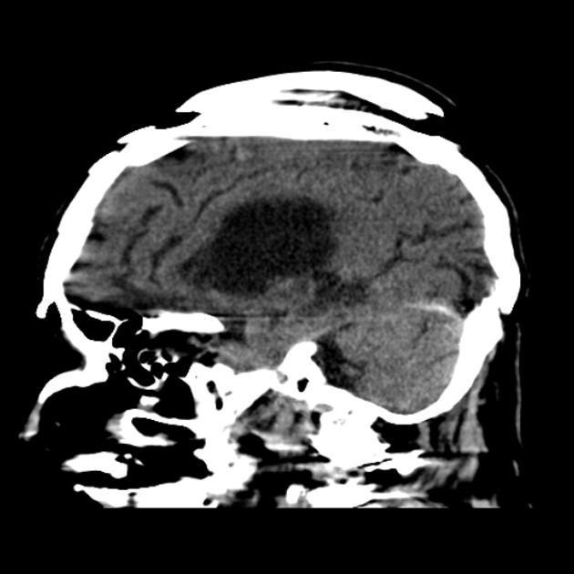
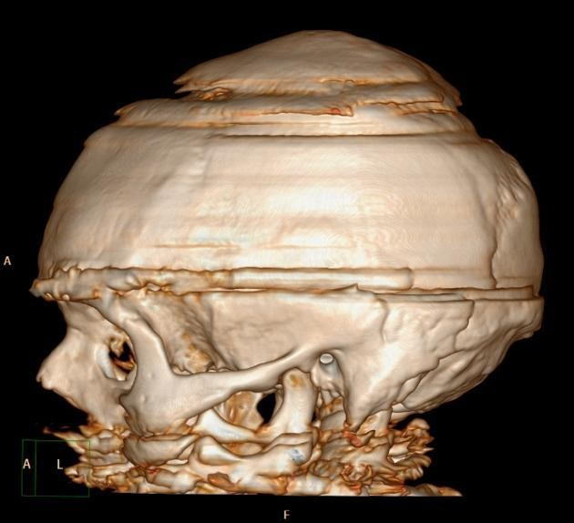
CT Imaging of the Head
Motion Artifact
Image Source: https://radiopaedia.org/articles/ct-artifacts

Slide 18
CT Imaging of the Head
How are CT images of the head viewed?
  Multiple window settings to demonstrate different things!
  Specific window values will vary depending on scanner, patient, and protocols
Examples:
  Standard / Soft-Tissue:
  Bone:

Slide 19
CT Imaging of the Head
Brain - Standard / Soft Tissue setting
  WW 160 WL 40 (Approximate)
  Targets
    Grey Matter: CT number
    White Matter: CT number
  window width due to small difference in the tissue attenuation.
  window width allows best contrast resolution (ability of scanner to differentiate structures with similar CT numbers).

Slide 20
CT Imaging of the Head
Bone Setting
  WW 2500 WL 400 (Approximate)
  Targets bone.
    CT number
  window width due to large difference in the tissue attenuation.
  window width allows many high contrast structures to be demonstrated (bone vs. air)

Slide 21
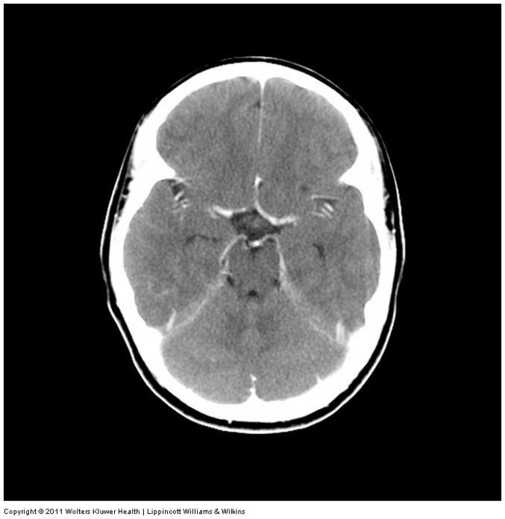
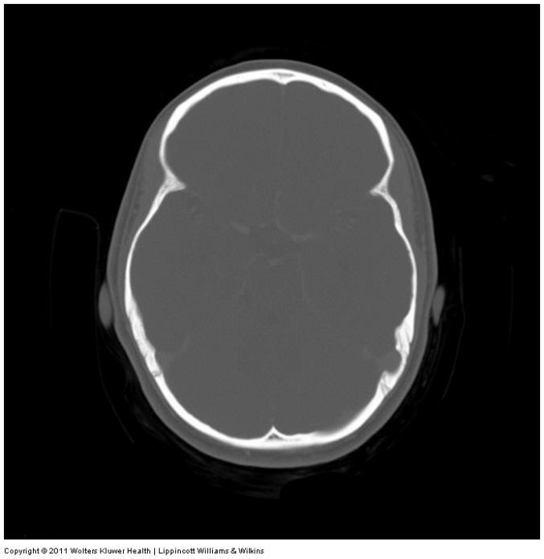
CT Imaging of the Head

Slide 22
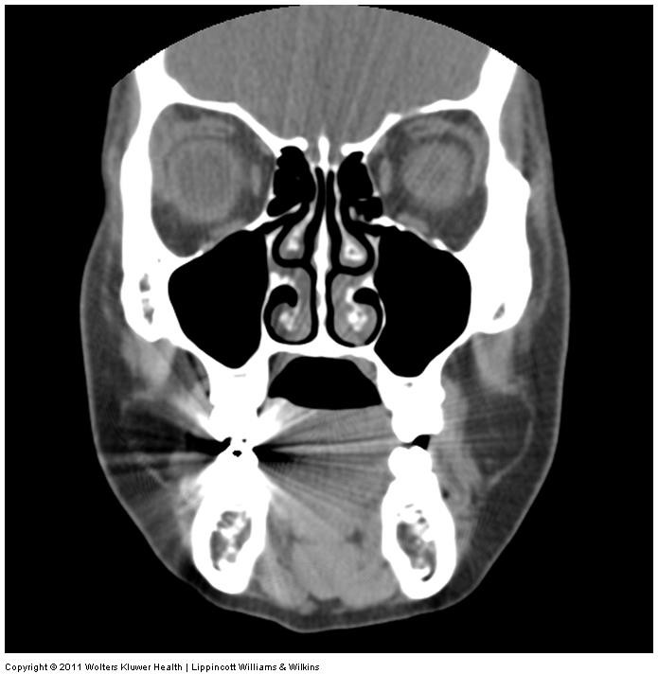
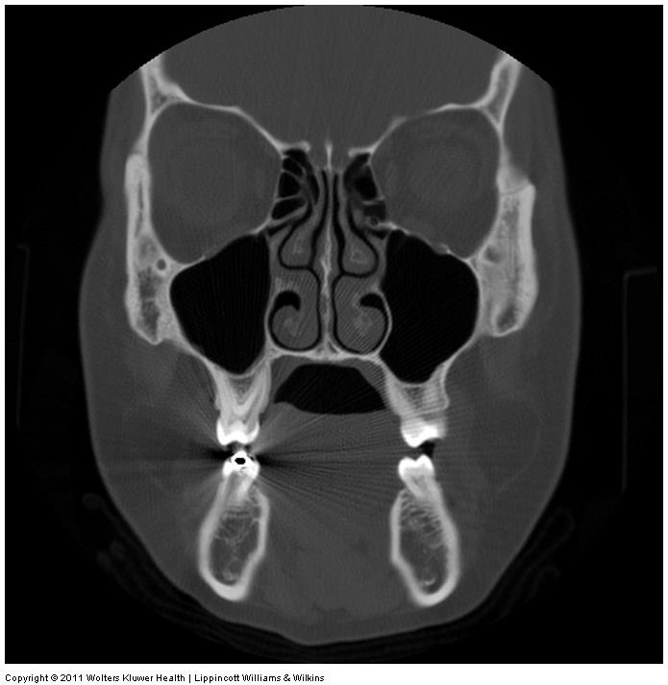
CT Imaging of the Head

Slide 23
CT Imaging of the Head
Slice Thickness
  Thin slices – 1.25 mm is common (but will vary)
  Advantages of thin slices
•
•
  Images are often merged into thicker slices for image viewing.

Slide 24
CT Imaging of the Head
Protocols & Pathology
In Body CT, protocol will vary significantly based on the clinical information, and/or the presumptive diagnosis.
It is extremely important, as the technologist, to correlate the clinical information to the exam
ordered, and perform the right CT scan.
It is not the tech’s job to interpret images or diagnose pathology, but you must be able to
recognize potentially critical pathologic changes, and alert the Radiologist when present.

Slide 25
CT Imaging of the Head
Indications for NECT Head
ICH
Early Infarction
Dementia
Hydrocephalus
Trauma
Indications for both NECT and CECT Head
Mass or Lesion
Arteriovenous malformation
Metastasis
Aneurysm
Headache
Seizure

Slide 26
CT Imaging of the Head
Normal vs. Abnormal – What are we looking at?
Review: CT Numbers
  Water:
  CSF:
  Circulating Blood:
  Clotted Blood:
Mass effect
  Definition:
  Caused by any lesion (mass, hemorrhage, etc) which causes an increase in intracranial pressure.
  Look for midline shift

Slide 27
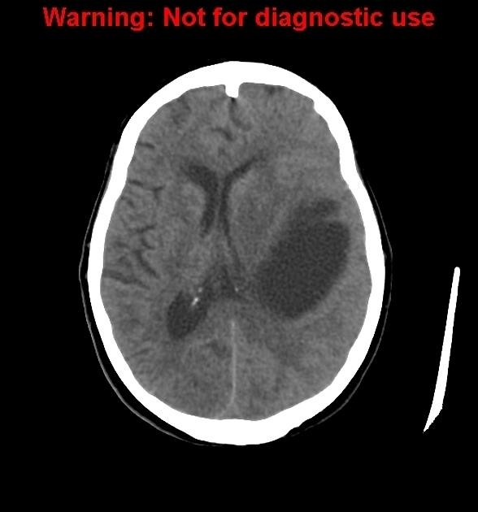
CT Imaging of the Head
Case courtesy of Dr Maxime St-Amant, Radiopaedia.org, rID: 60057

Slide 28
CT Imaging of the Head
https://radiopaedia.org/cases/subacute-subdural-haematoma-3?lang=us

Slide 29
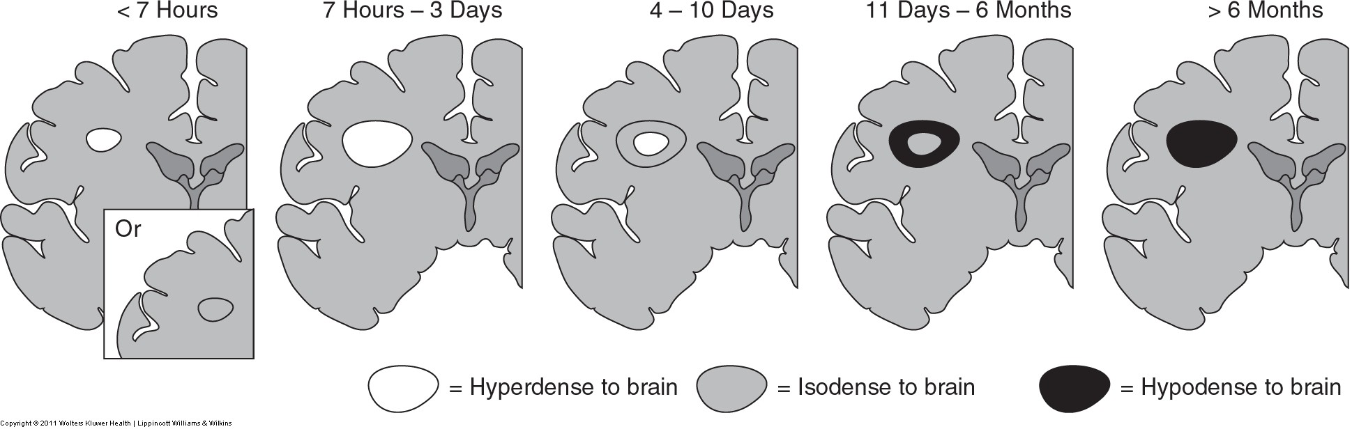
CT Imaging of the Head
CT for Intracranial Hemorrhage
  Acute bleeding inside the brain
    Epidural hematoma
    Subdural hematoma
    Subarachnoid hemorrhage
    Intracerebral hemorrhage

Slide 30
CT Imaging of the Head
Epidural Hematoma
  Traumatic brain injury
  Acute arterial bleeding
  Fast!
  Blood between the and the .
  Bio-convex in shape (lens-shaped), along the border of the skull
  Usually cause “mass effect”

Slide 31
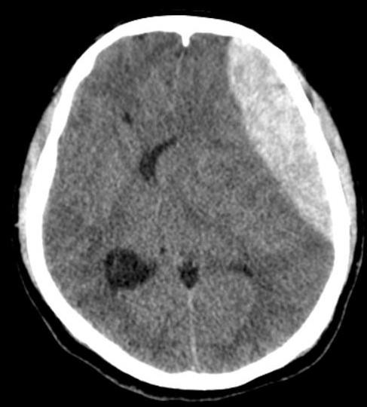
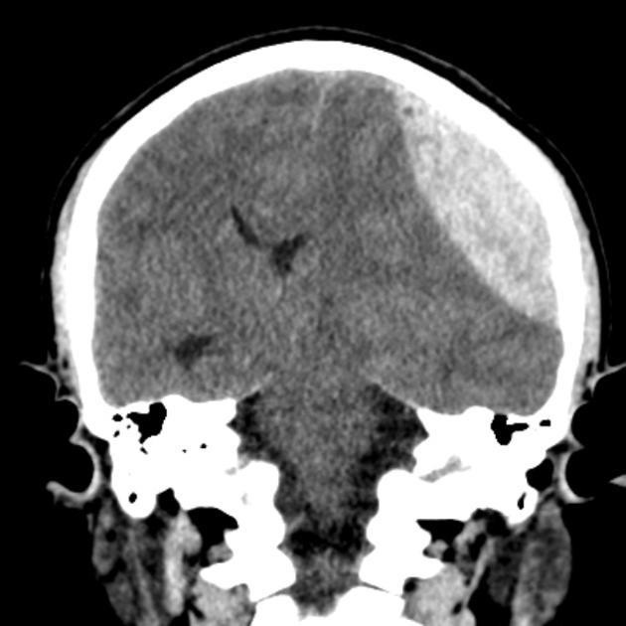
CT Imaging of the Head
Epidural Hematoma
Case courtesy of Dr David Cuete, Radiopaedia.org, rID: 29440

Slide 32
CT Imaging of the Head
https://radiopaedia.org/cases/epidural-haematoma-4

Slide 33
CT Imaging of the Head
Subdural Hematoma
  Venous Bleeding
  Slower, could be acute or chronic
  Between and .
  High-density, crescent-shaped lesion adjacent to inner table of the skill.

Slide 34
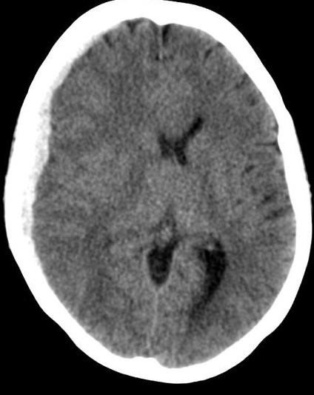
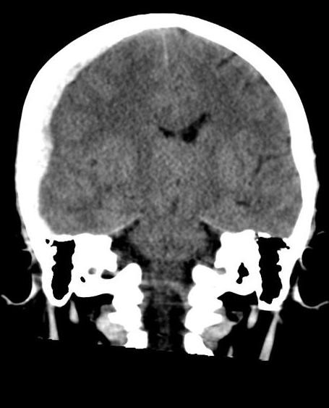
CT Imaging of the Head
Subdural Hematoma
Case courtesy of David Puyó, Radiopaedia.org, rID: 22251

Slide 35
CT Imaging of the Head
https://radiopaedia.org/cases/subdural-haematoma-3

Slide 36
CT Imaging of the Head
Subarachnoid Hemorrhage
  Bleeding into the and/or the .
  Increased density within basiliar cisterns, fissures, sulci, ventricles,etc
  Increased density commonly seen around COW.
  MRI is more sensitive, because as blood mixes with CSF, it becomes more challenging to demonstrate on
CT.

Slide 37
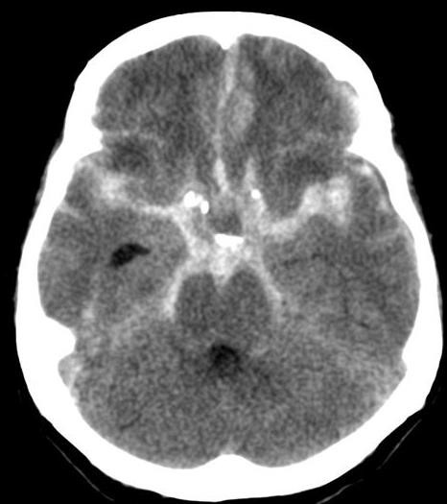
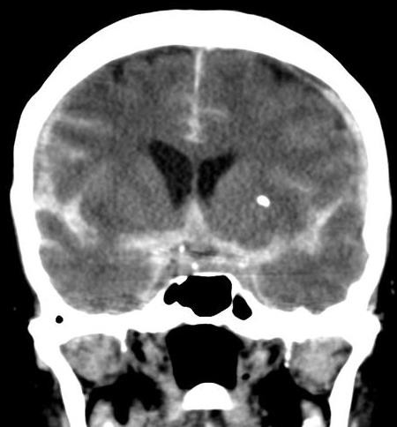
CT Imaging of the Head
Subarachnoid Hemmorhage
Case courtesy of Dr David Cuete, Radiopaedia.org, rID: 22770

Slide 38
CT Imaging of the Head
https://radiopaedia.org/cases/subarachnoid-haemorrhage-teaching?lang=us

Slide 39
CT Imaging of the Head
Intracerebral Hemmorhage
  Describes the extravascular accumulation of blood within different intracranial spaces.
  Can occur in different locations
  Usually an underlying cause, many possibilities:
    Trauma (EDH, SDH, SAH)
    Aneurysm
    Pathological (tumour)
  Well-circumscribed, homogenous, high-density region surrounded by low-density edema.

Slide 40
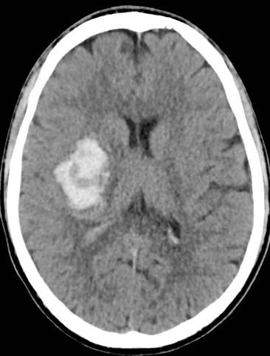
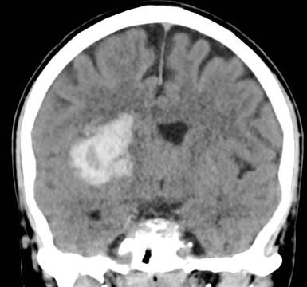
CT Imaging of the Head
Intracerebral Hemorrhage
Case courtesy of Dr Craig Hacking, Radiopaedia.org, rID: 54967

Slide 41
CT Imaging of the Head
https://radiopaedia.org/cases/methamphetamine-induced-intracerebal-haemorrhage

Slide 42
CT Imaging of the Head
CT Angiography
  Describes a CT scan with arterial contrast enhancement
  Evaluate vascular disease
  Advantages over catheter angiography
•
•
•
•
  Becoming the gold standard for stroke imaging
  We will discuss stroke imaging in more detail in the next module (neck).

Slide 43
CT Imaging of the Head
Contraindications for Head CT
•
•

Slide 44

CT Imaging of the Head

Slide 45
CT Imaging of the Head
NECT and CECT Head share many of the same scan parameters
Data will be acquired at very thin slices in the head, to demonstrate anatomy as accurately as possible.
Remember you can only reformat as thin as your slices are acquired!

Slide 46
CT Imaging of the Head
NECT Head
Scouts: AP & Lateral
Anatomy included:
If ”step and shoot” scanning is used: Angle gantry to SOML or OML
If helical scanning is used: Angle SOML or OML to the gantry.

Slide 47
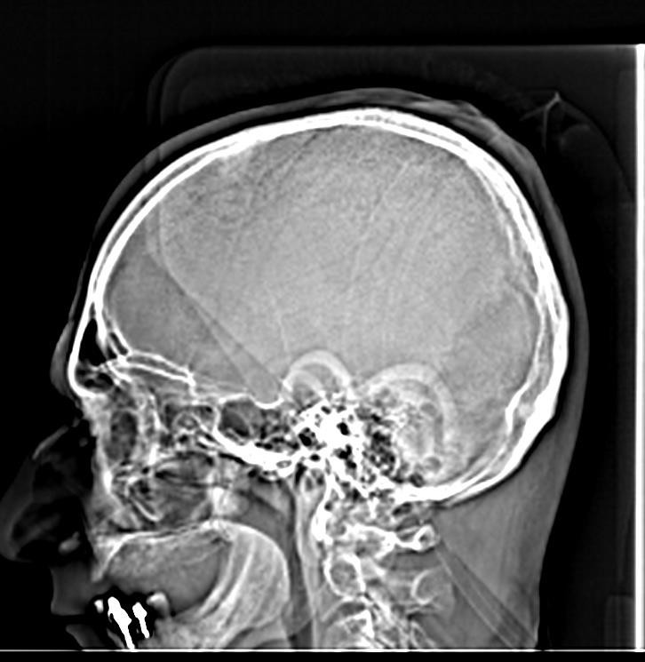
CT Imaging of the Head
Case courtesy of Dr Bruno Di Muzio, Radiopaedia.org, rID: 41030

Slide 48
CT Imaging of the Head
NECT Head
SFOV:
DFOV: 23 cm
Algorithm: Standard
Window:

Slide 49
CT Imaging of the Head
NECT & CECT Head
Acquisition kVp
Acquisition mA 150*
  ATCM used
  Also called
Reconstruction details will vary
  MPR
  Slice thickness
  Windowing
  Apply filters
  3D, if indicated

Slide 50
CT Imaging of the Head
CECT Head
IV Contrast: 100ml at 1.0ml/sec
Scan Delay: 5 min (site dependent)
  Why is the scan delay 5 min?
What phase is this scanned in?
Oral Contrast: none

Slide 51
CT Imaging of the Head
https://radiopaedia.org/cases/normal-ct-brain

Slide 52
CT Imaging of the Head
Common indications for CT Sinuses
•
•
•
Contraindications for CT Sinuses
  Pregnancy
  Extensive hardware

Slide 53
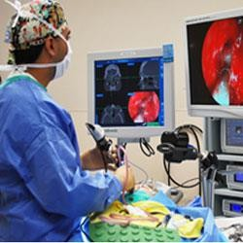
CT Imaging of the Head

Slide 54
CT Imaging of the Head
CT Sinuses
Scout:
Anatomy included: Top/Bottom – above frontal sinus to below the hard palate. Front/Back –
entire frontal sinus to sella turcica.
*Note – Textbook demonstrates the patient is scanned in the coronal plane – this is not common practice at most sites but it is possible!

Slide 55
CT Imaging of the Head
CT Sinuses
If “step and shoot” scanning is used: Angle gantry perpendicular to OML.
If helical scanning is used: Angle patient’s perpendicular to table.

Slide 56
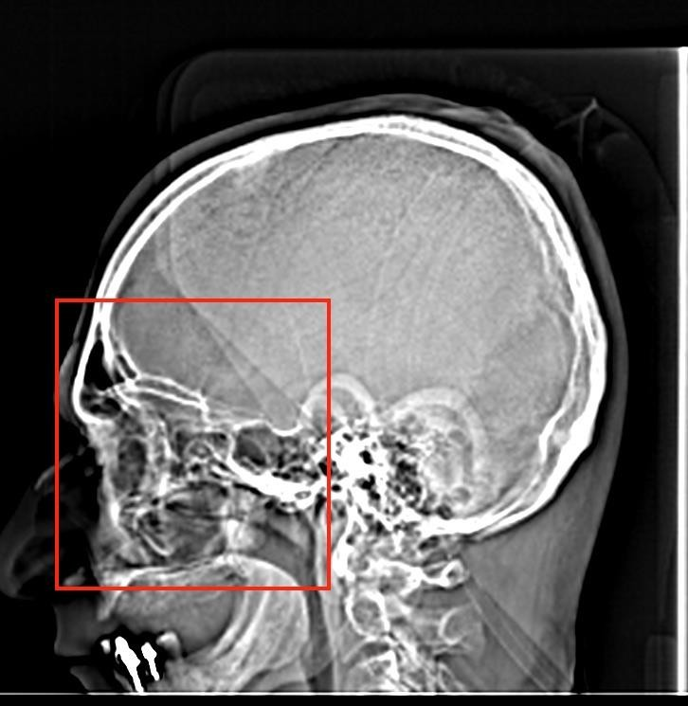
CT Imaging of the Head

Slide 57
CT Imaging of the Head
NECT Sinuses
SFOV: Head
DFOV: 16 cm
Algorithm:
Window: WW WL (site dependent)

Slide 58
CT Imaging of the Head
NECT Sinuses
Acquisition kVp 120-140
Acquisition mA 150*
  ATCM used
  Also called Auto mA
Reconstruction details will vary
  MPR
  Slice thickness
  Windowing
  Apply filters
  3D, if indicated

Slide 59
CT Imaging of the Head
https://radiopaedia.org/cases/paranasal-sinuses-annotated-ct-1?lang=us
https://radiopaedia.org/cases/normal-ct-paranasal-sinuses-1?lang=us

Slide 60
CT Imaging of the Head
Common Indications for CT Facial Bones
  Facial fracture
•
•
Contraindications for CT Facial Bones
  Pregnancy
  Extensive Hardware

Slide 61
CT Imaging of the Head
CT Facial Bones
Scout: AP & Lateral
Anatomy included: Entire frontal sinus – mandible & Nose – sella turcia
If helical scanning is used:

Slide 62
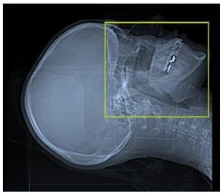
CT Imaging of the Head

Slide 63
CT Imaging of the Head
CT Facial Bones
SFOV: Head
DFOV 18 cm
Algorithm: Standard
Window: WW , WL

Slide 64
CT Imaging of the Head
CT Facial Bones
Acquisition kVp 120
Acquisition mAs 140
Reconstruction details will vary
  MPR
  Slice thickness
  Windowing
  Apply filters
  3D, if indicated

Slide 65
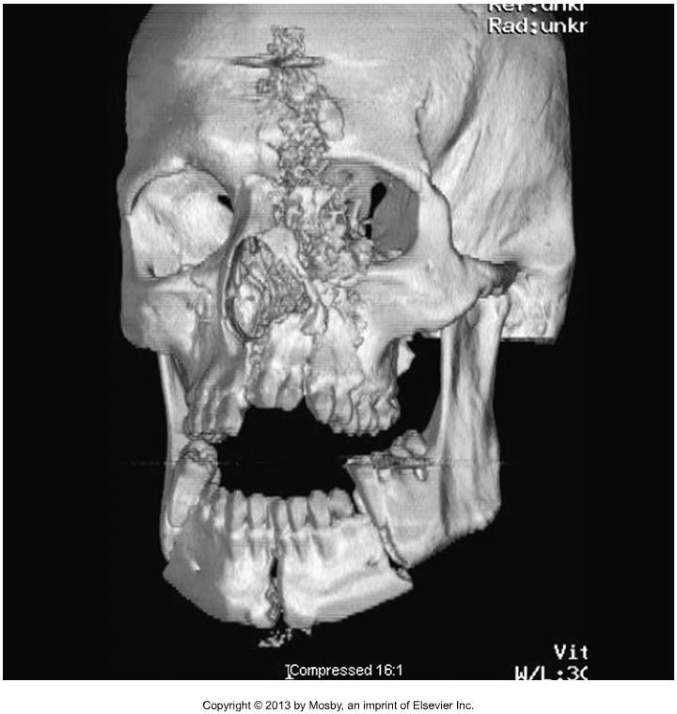
CT Imaging of the Head

Slide 66
CT Imaging of the Head
https://radiopaedia.org/cases/normal-facial-bones-ct?lang=us

Slide 67
CT Imaging of the Head
Common indications for NECT Orbits
•
•
Common indications for CECT Orbits
  Intraorbital mass
  Thyroid ophthalmopathy
  Inflammation
  Infection
  Trauma – vascular injury
Contraindications for CT Orbits
•

Slide 68
CT Imaging of the Head
NECT & CECT Orbits
Scout: AP & Lateral
Anatomy included: Orbital roofs to orbital floor
Helical scan
Position patient’s head so the hard palate is to the table.

Slide 69
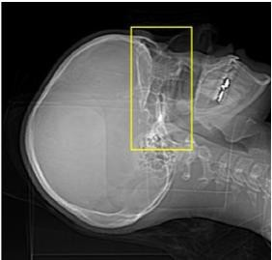
CT Imaging of the Head

Slide 70
CT Imaging of the Head
CT Orbits
SFOV: Head
DFOV: 16 cm
Algorithm:
Window: WW , WL

Slide 71
CT Imaging of the Head
CT Orbits
Acquisition kVp: 120
Acquisition mA: 200-250
  ATCM / Auto mA used
Reconstruction details will vary
  MPR
  Slice Thickness
  Windowing
  Apply filters – “soft”
  3D, if indicated

Slide 72
CT Imaging of the Head
CECT Orbits
IV Contrast:
Scan Delay: Split Bolus.
  50 ml at 1.0 ml/sec
  2 minute delay
  50 ml at 1.0 ml/sec
  Scan immediately following second bolus.
Oral Contrast: none

Slide 73
CT Imaging of the Head
https://radiopaedia.org/cases/normal-ct-scan-of-the-orbits?lang=us

Slide 74
CT Imaging of the Head
Common Indications for CTA Circle of Willis
  Locate / Assess known aneurysm
  Arteriovenous malformation
  Assess known intracranial hemorrhage
Contraindications for CTA Circle of Willis
  Pregnancy
  If a NECT has not been performed! Never do unless a patient has already had a “dry” scan!

Slide 75
CT Imaging of the Head
CTA Circle of Willis
Scout: AP & Lateral
Anatomy included:
Helical scanning
Position SOML parallel with gantry, if possible

Slide 76
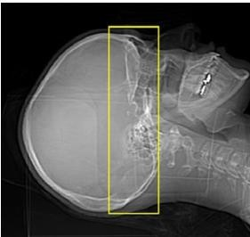
CT Imaging of the Head

Slide 77
CT Imaging of the Head
CTA Circle of Willis
SFOV: Head
SFOV: 25 cm
Algorithm: Standard
Window: WW 140 WL 40

Slide 78
CT Imaging of the Head
CTA Circle of Willis
Acquisition kVp 120
Acquisition mA 500
Reconstruction details will vary
  MPR - oblique
  Slice Thickness
  Windowing
  Apply filters
  3D - MIP

Slide 79
CT Imaging of the Head
CTA Circle of Willis
IV Contrast: 60ml at 4.0ml/sec
Scan Delay: Use Timing Bolus
  ROI :
Oral Contrast: none
*Protocol will vary from site to site, always follow site protocol

Slide 80
CT Imaging of the Head
https://radiopaedia.org/cases/left-middle-cerebral-artery-branch-embolus-causing- stroke?lang=us

Slide 81
CT Imaging of the Head
Summary
Review procedures of the head, sinuses, facial bones and orbits.
Review CT angiography procedures of the Circle of Willis.
Review indications and contraindications, and specific scanning techniques for each procedure.
Procedures for temporal bones, sella turcica, brain perfusion, CT
Venography will not be tested on.
CTA Carotids & COW will be discussed with neck procedures.

