Slide 1


Laser Chapter 1 part 3

Slide 2
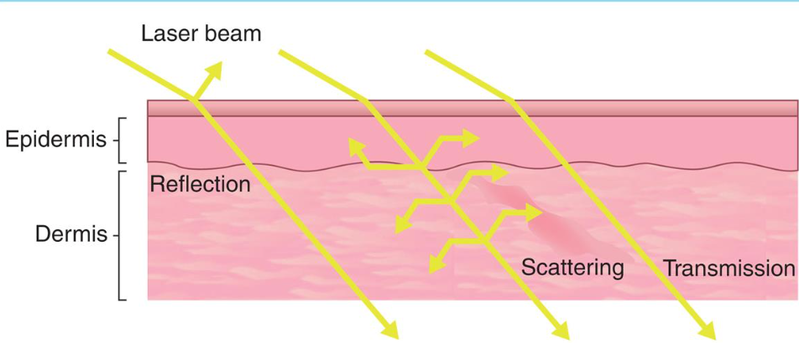
Laser Tissue Interactions

Slide 3
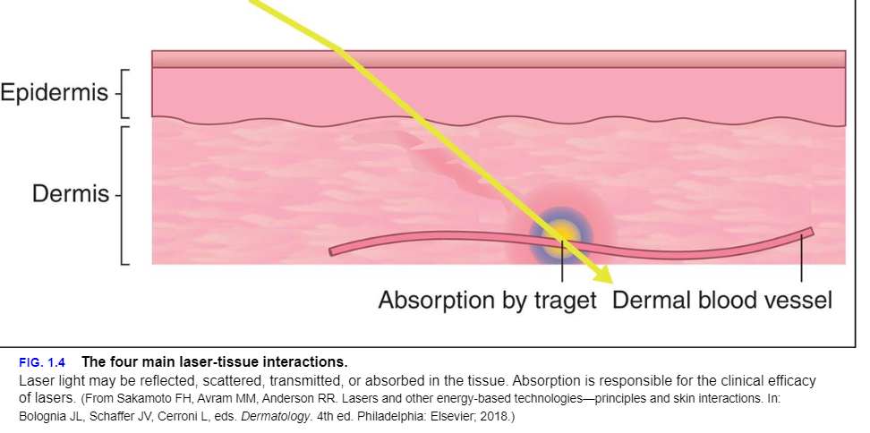

Slide 4
Reflection
Approximately 4% to 7% of light is reflected off skin.2 The amount of light reflected increases with increasing angle of incidence with the least reflection occurring when the laser beam directed perpendicular to the tissue. If enough reflection occurs to create a high-intensity beam, damage to unintended targets could occur. For example, an errant 10,600-nm beam can cause damage to the cornea because of its water content whereas a reflected 595-nm pulsed dye laser beam can damage the retina because of its pigment content. Protective eye wear guards against reflected and direct exposure to laser light.

Slide 5

Laser light absorption by specific tissue targets is the fundamental goal of clinical lasers. Light must be absorbed by tissue to produce an effect .The absorption of the photons of laser light is responsible for its effects on the tissue.
Absorption
Preferentially depend on wavelength. These light-absorbing tissue components are known as chromophores. Frequently targeted chromophores in the skin include melanin, hemoglobin, and water, as well as exogenous tattoo inks. Absorption of energy by a chromophore results in conversion of that energy into thermal energy

Slide 6
Scattering
Scattering of light occurs after light has entered the tissue.
Scattering spreads out the beam of light within the tissue, resulting in radiation of larger area than anticipated.
Scattering also limits the depth of penetration because it can occur backward as well as forward. In skin, most scattered light is due to interaction with dermal collagen.
In general, the amount of scattering of laser light is inversely proportional to the wavelength of the laser.
Longer wavelengths penetrate tissue more deeply. An exception to this rule is laser light beyond the mid-infrared region of the electromagnetic spectrum.5
Laser light with wavelengths above 1300 nm only penetrate superficially owing to the high absorption coefficient of tissue water

Slide 7
Transmission
Transmission is the continuation of laser light that is not absorbed in the tissue. Transmission is dependent on both wavelength and spot size: it occurs more readily at longer wavelengths and larger spot sizes (6).
It is worthwhile to note that the relationship between the penetration depth of laser light and the wavelength of the light are inverted at wavelengths greater than 1100 nm.
Penetration actually decreases at wavelengths greater than 1100 nm because the laser light starts being absorbed by water molecules, which are present in all levels of the skin.

Slide 8
Types of Tissue Destruction
The theory of selective photothermolysis refers to laser energy absorption by a target chromophore without significant thermal damage to surrounding tissue.
To achieve selective photothermolysis, the laser must produce a beam of light with a wavelength preferentially absorbed by the chromophore in the lesion.
Equally important, the pulse duration of the laser beam must be shorter than the thermal relaxation time of the chromophore to prevent the spread of thermal energy beyond the targeted chromophore. The thermal relaxation time is defined as the time needed for the chromophore to cool to half of its peak temperature after laser irradiation, which is proportional to the square of the size of the chromophore.

Slide 9
Do you know…
In general, smaller objects cool faster than larger ones. For example, 0.5- to 1.0-lm melanosomes have a thermal relaxation time of approximately 1 microsecond whereas 10- to 100-lm capillaries have a thermal relaxation time of approximately 1 millisecond.5
If the pulse width is greater than the thermal relaxation time, nonspecific thermal damage occurs because of heat diffusion.
Finally, the energy delivered to the site (fluence/Jouls) must be high enough to destroy the chromophore within the pulse duration.
Based on the theory of selective photothermolysis, pulse duration/width , and fluence of a laser can be tailored to result in selective damage to the lesions without nonspecific thermal damage to the surrounding tissues.

Slide 10
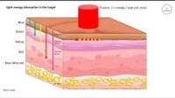
Let’s Watch !

Slide 11
Ablative vs Non Ablative Lasers
Ablative layers create damage to the epidermis and superficial dermis resulting in the removal, or ablation, of tissue
Non-ablative lasers leave the epidermis fully intact
Ablative lasers achieve this level of damage by vaporizing water, which is found in all layers of the skin. Erbium-doped:Yttrium Aluminum Garnet (Er:YAG; 2940 nm) and CO2 (10,600 nm) are examples of ablative lasers because their wavelengths are strongly absorbed by water molecules.
Non-ablative lasers have wavelengths that do not strongly absorb water molecules; instead, their wavelengths target chromophores that are found in more discrete locations in the skin (melanin, hemoglobin, tattoo pigment, etc.)
Abaltive Lasers will use a wavelength of 2940 and up
Non Ablative Lasers will use wavelengths within the range of 1540’s like the Palomar Fractional Laser

Slide 12
Fractionation
The concept of fractionation with an ablative laser was described by Manstein et al. in 2004.
In fractionation, only thin columns of laser light come in contact with the skin.
This creates grid-like pattern in the treatment area, where only a small percentage of the skin is damaged.
The unaffected tissue provides the injured tissue with growth factors and for rebuilding and remodeling, decreasing the wound healing time and resulting in fewer side effects when compared to fully ablative lasers

Slide 13
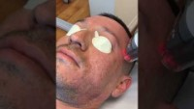
Non Ablative Fractional Treatment

Slide 14
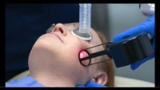
Ablative Co2 Laser

Slide 15
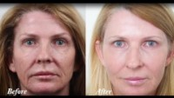

Slide 16
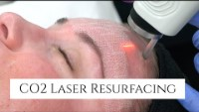

Slide 17
Lets discuss the Graphs !

Slide 18
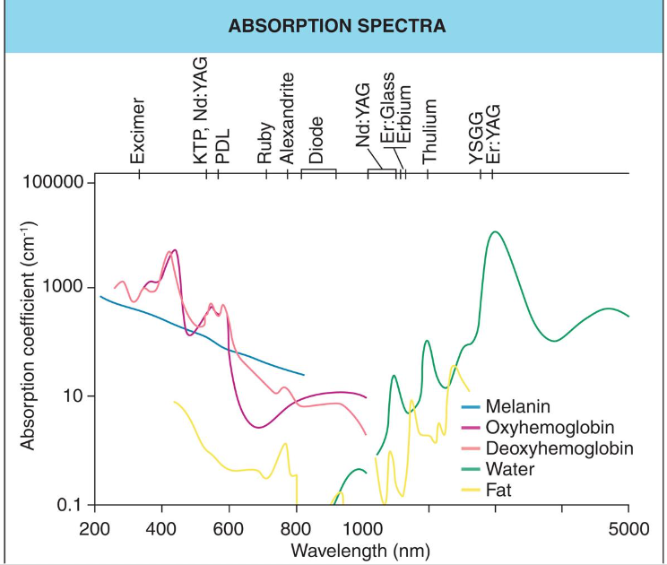

Slide 19
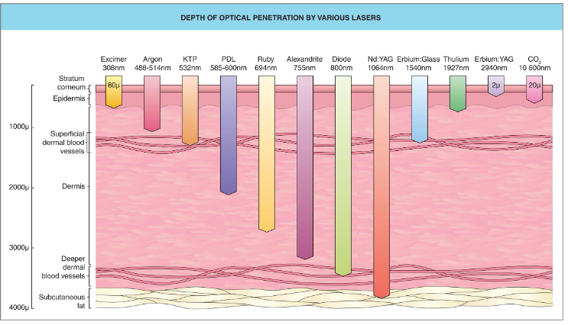

Slide 20
Clinical Endpoints
Tissue reactions that occur immediately or shortly after laser treatments can be used to judge efficacy, as well as side effects.
Clinical endpoints depend on the target chromophore, laser wavelength, pulse width, fluence, and patient’s skin type.
In general, the lowest fluence that generates the expected clinical endpoint should be used to limit unwanted and unnecessary tissue effects.
The clinical endpoints of vascular lesions vary based of the type of lesion. Immediate purpura is the goal when treating port wine stains, while immediate vessel disappearance or vessel coagulation is the goal with telangiectasias.
For pigmented lesions, the type of laser dictates the endpoints: Q-switch and picosecond lasers result in immediate whitening, while long pulsed lasers or IPLs cause darkening after several minutes.
Fractionated and non-fractioned non-ablative lasers also have specific clinical endpoints, although it can be more difficult to assess treatment efficacy and excessive tissue damage.
Fractionated non-ablative lasers tend to produce grids of subtle skin whitening and erythema. Fractionated ablative lasers produce grids of ablated tiny defects with a rim of whitening followed by mild focal hemorrhage from some of the ablated columns.

Slide 21
Adverse Effects
Short- and long-term side effects from laser therapy include
Crusting
Erythema
Edema
Pain
Dyspigmentation
Burns
Infections, and scarring.

Slide 22
Formulaic approaches to laser settings may be well intentioned, but they may lead to side effects due to failure of
Cooling measures
Inappropriate pulse stacking ( not knowing how to set the right Joules and pulse width )
Loss of laser calibration, or variations in skin pigmentation.
While clinical endpoints should be used as guidelines when they are known, each individual patient should be closely monitored during and after laser treatment.

Slide 23
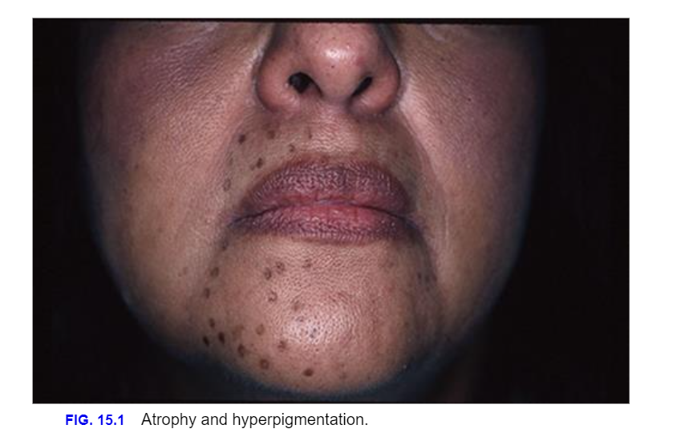

Slide 24
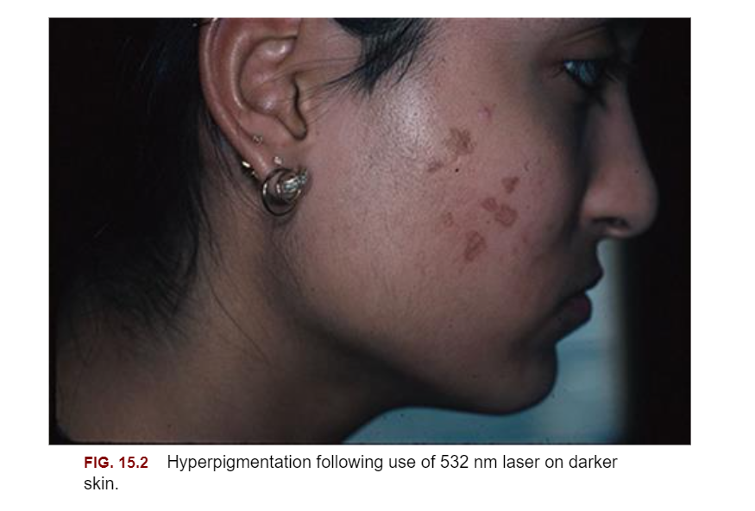

Slide 25
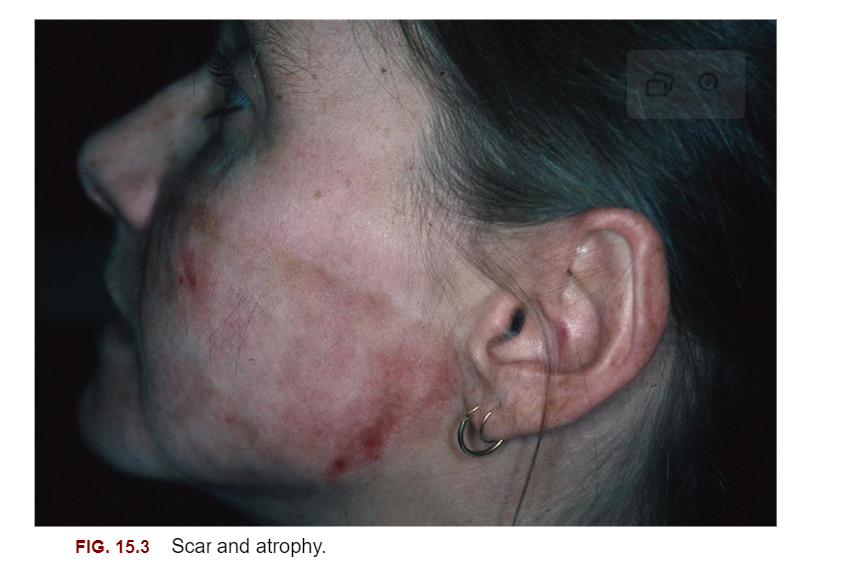

Slide 26
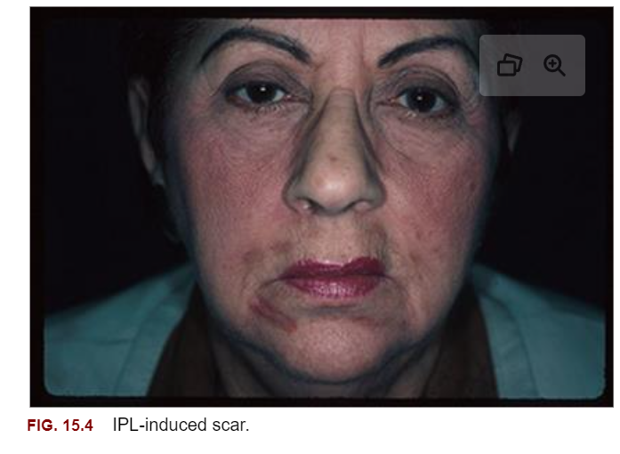

Slide 27
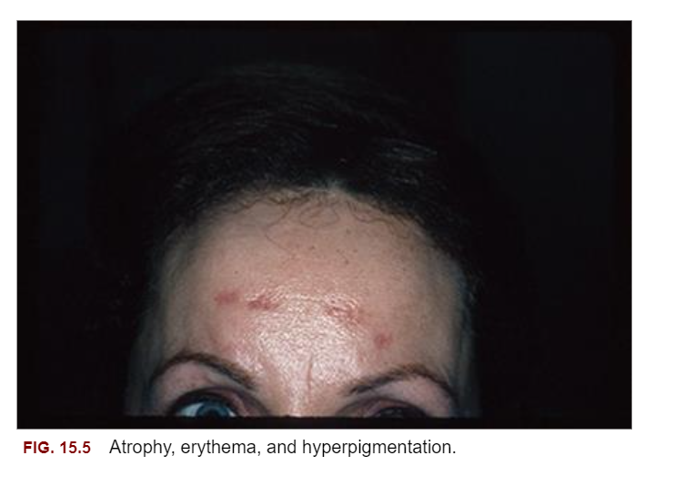

Slide 28
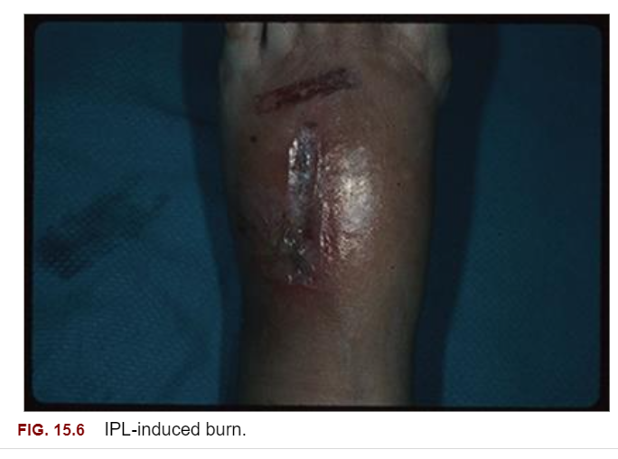

Slide 29
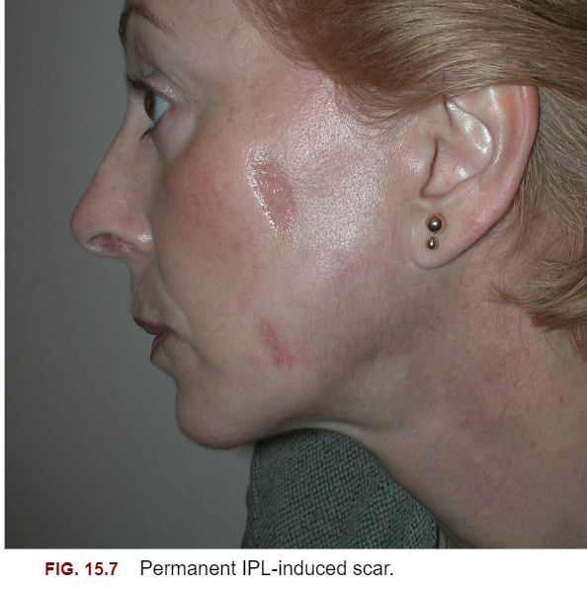

Slide 30
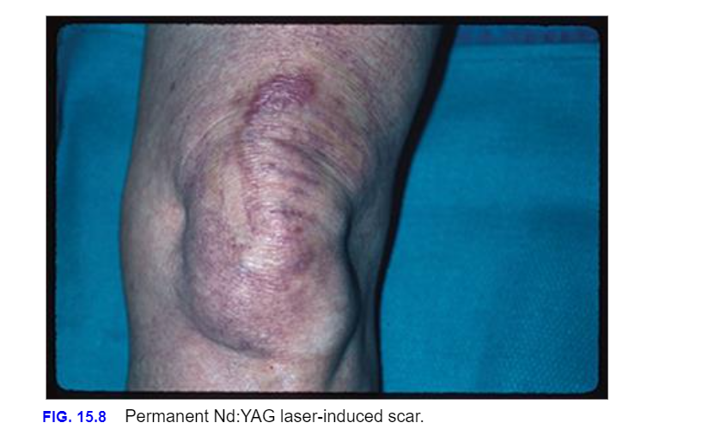

Slide 31

QUESTIONS?

