Slide 1

ANPH 202: Anatomy and Pathology I
Outcome Three: Central Nervous System

Slide 2
Brain Anatomy
Principal parts of the brain that you need to know:
Lobes of the brain
Fissures, sulci, gyri
Cerebrum, cerebellum, vermis
Meninges
Falx cerebri and falx cerebelli,
Ventricles and cerebral aquaducts
Choroid plexus
Brainstem (midbrain, pons, medulla oblongata)
Thalmus and hypothalamus
Corpus collosum
Pituitary and pineal glands
Basal ganglia
Cisterna magna

Slide 3
Hemispheric Lateralization

Slide 4
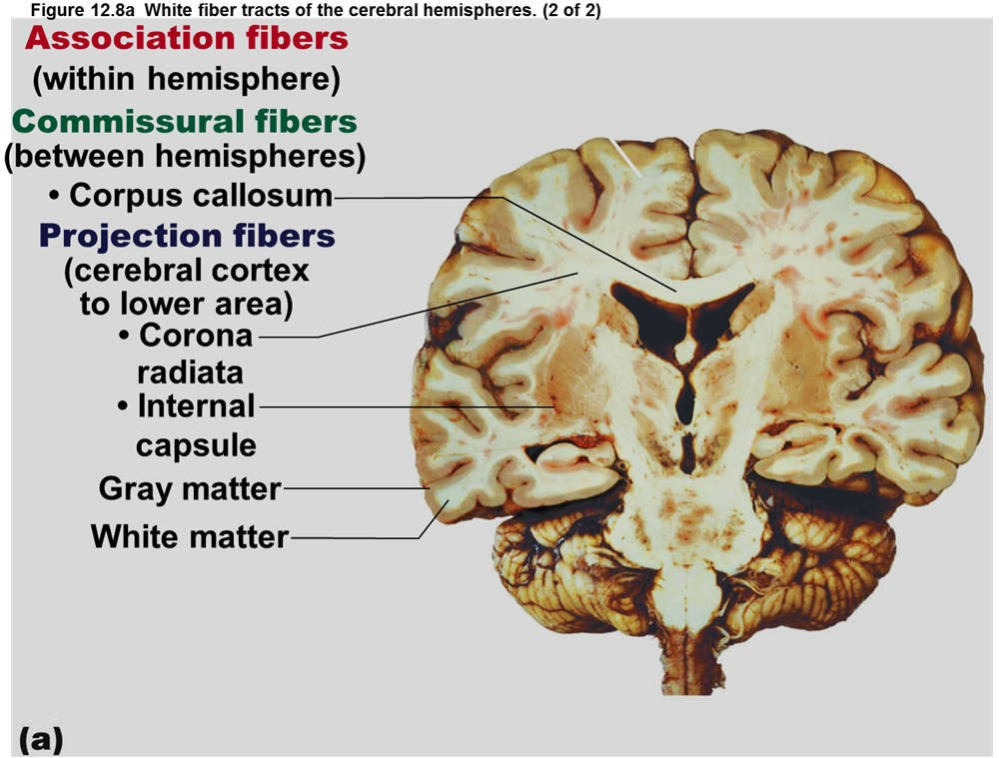
The corpus callosum allows communication between the right and left hemispheres of the cerebrum
Marieb, E. and Hoehn K. (2013 Human Anatomy and Physiology (9th ed.) Glenview, IL. Pearson Education, Inc. p. 438

Slide 5
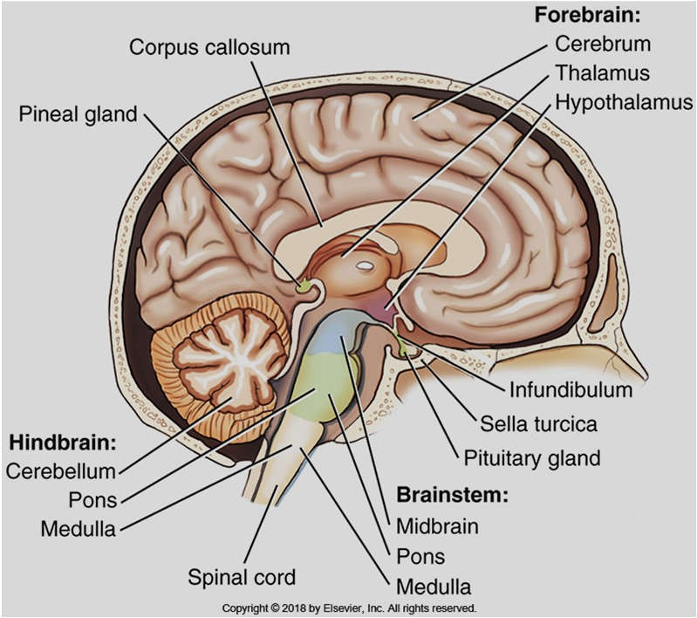
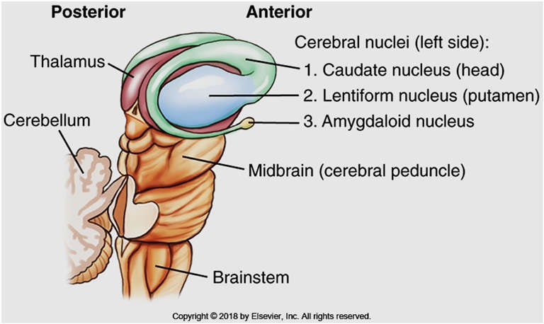
Diencephalon and brainstem
Diencephalon:
Thalmus : relays sensory info to the cerebral cortex, assigns an emotion to feelings, regulates LOC, regulates complex reflex movements
Hypothalmus: hormonal “head quarters”: controls heart beat, blood pressure, digestion, water balance, body temperature, and sleep cycles and hormone secretion
Pineal gland: maintains body’s “clock” through daily, monthly, and seasonal cycles.
Bontrager Fig. 18.16, and 18.20

Slide 6
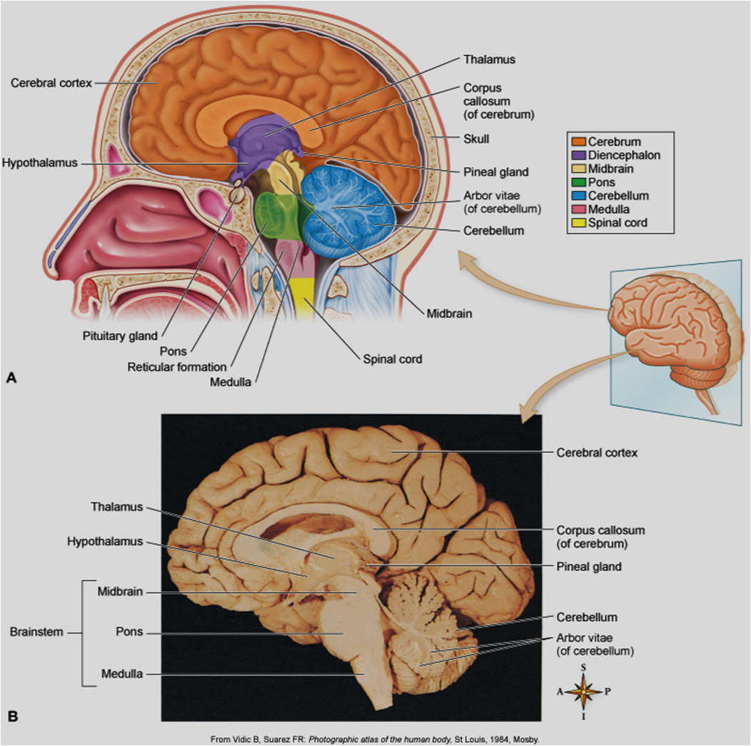
Brainstem
Brainstem:
Midbrain
Pons
Medulla oblongata
The “oldest” part of the brain
Relays sensory and motor impulses between spinal cord and brain.
Controls heartbeat, respiration and vessel diameter

Slide 7
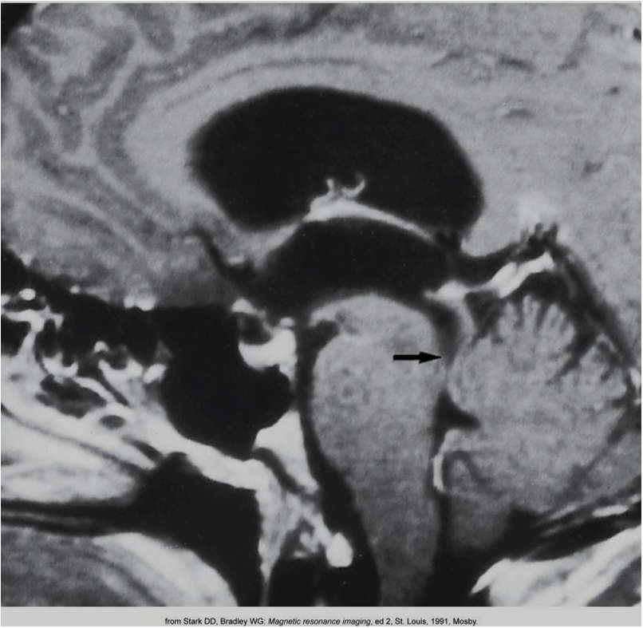

Eisenberg 8-75

Slide 8
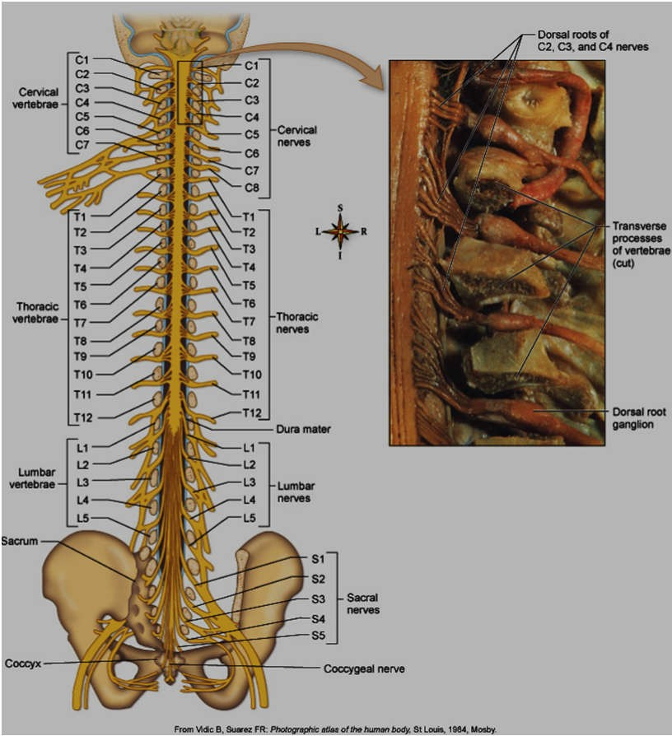
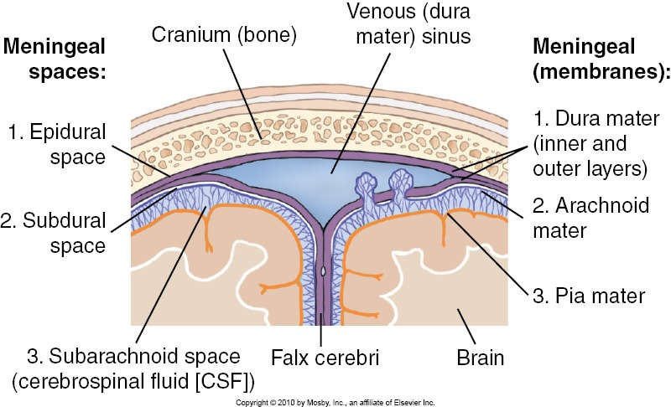
Meninges and falx cerebri etc…
Bontrager 18-3

Slide 9
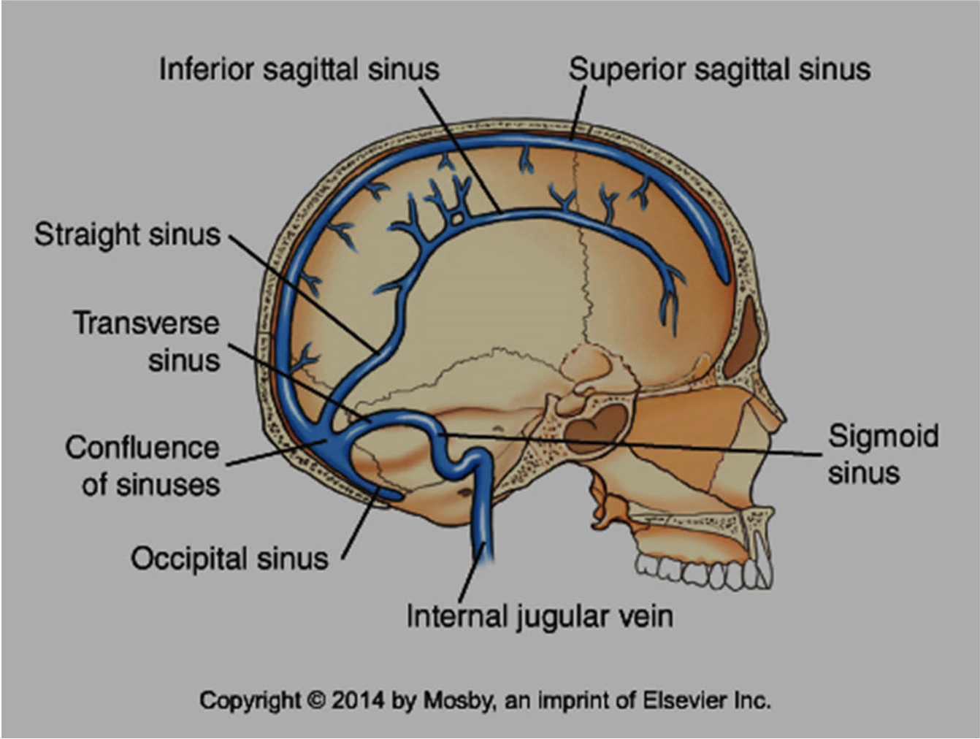
The dural sinuses are venous channels that lie between the two layers of the dura mater

Slide 10
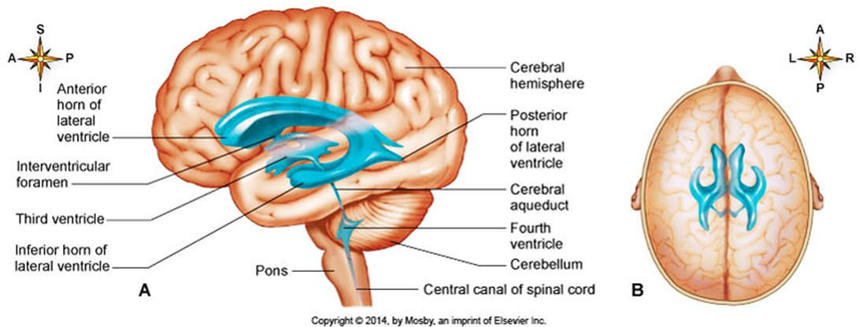
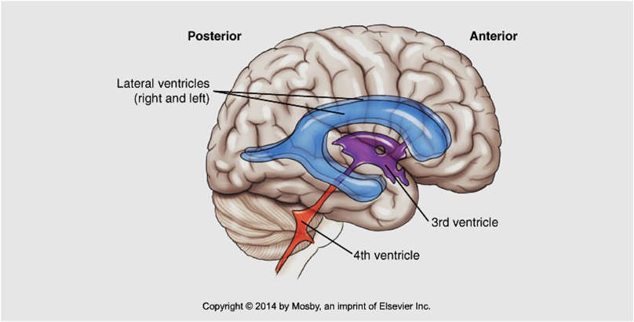
Ventricular system…
Cerebrospinal fluid (CSF) is made from fluid, filtered out of the blood by a network of brain capillaries known as the choroid plexus
Bontrager 18-7, Patton and Thibodeau10-20

Slide 11
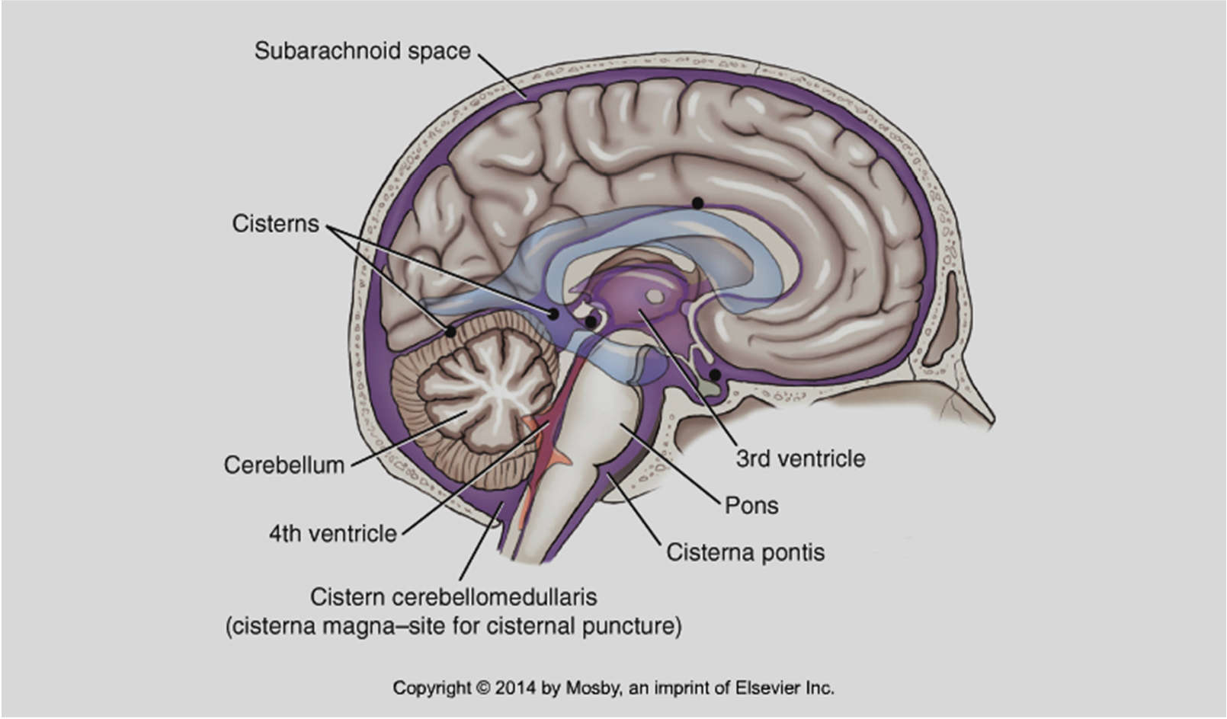
Flow of CSF…
The CSF filled spaces in and around the brain are important in CT, as these fluid filled areas can be used to determine slice level or location.
Patton and Thibodeau 10-21
Bontrager 9th ed. 18.13

Slide 12
How do you think these structures will appear when sliced by a CT scanner?

Slide 13
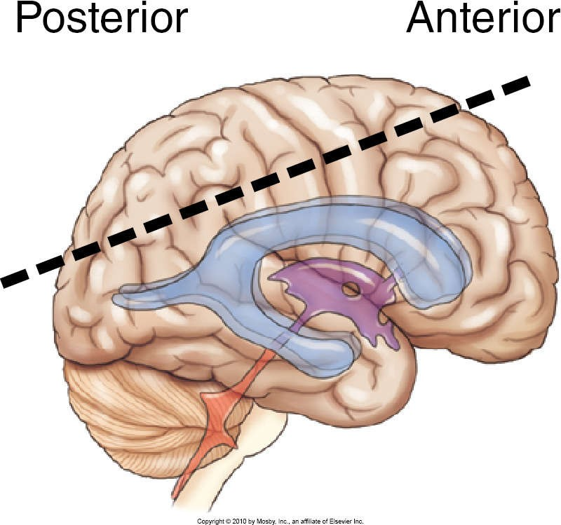
Bontrager 7th ed. 21-47

Slide 14
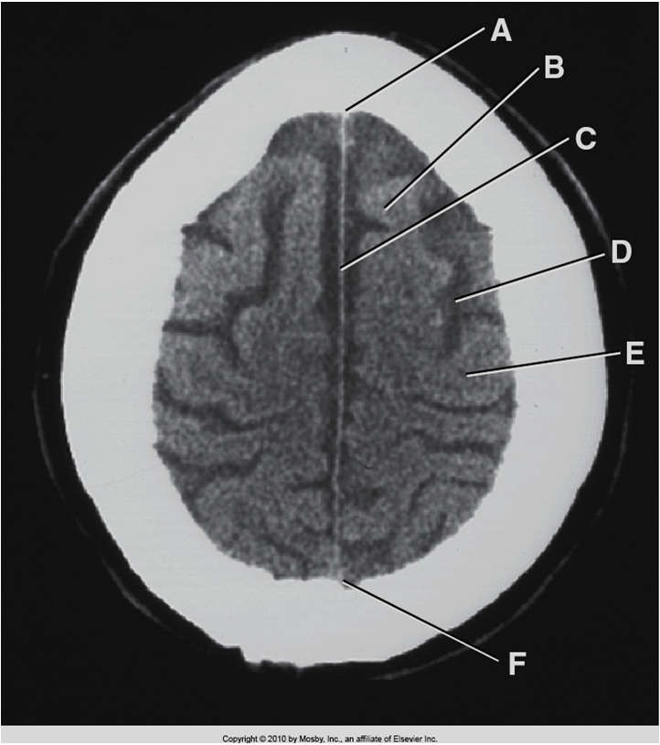
Bontrager 7th ed. 21-47
Bontrager 7th ed. 21-46

Slide 15
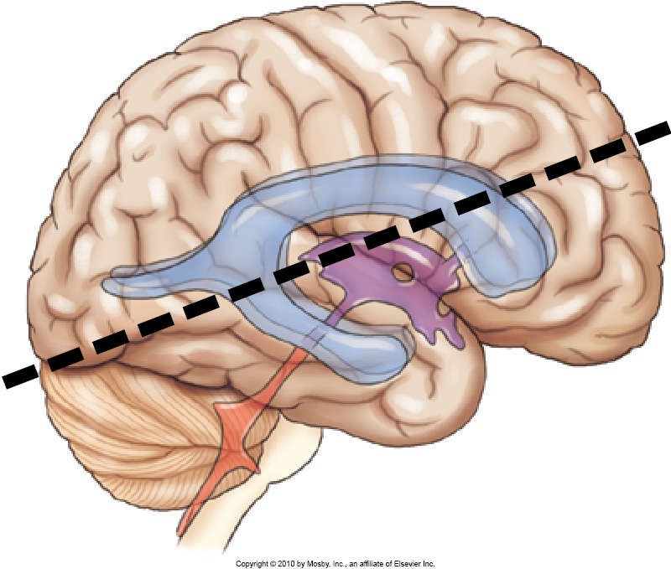
Bontrager 7th ed. 21-49

Slide 16
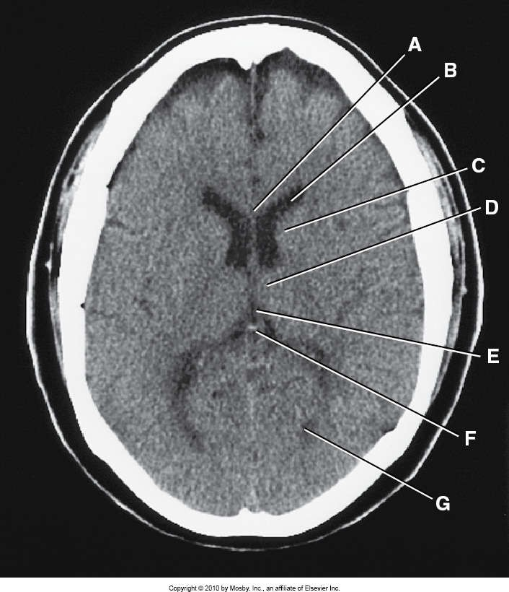
Bontrager 7th ed. 21-48

Slide 17
Pathologies of the CNS

Slide 18
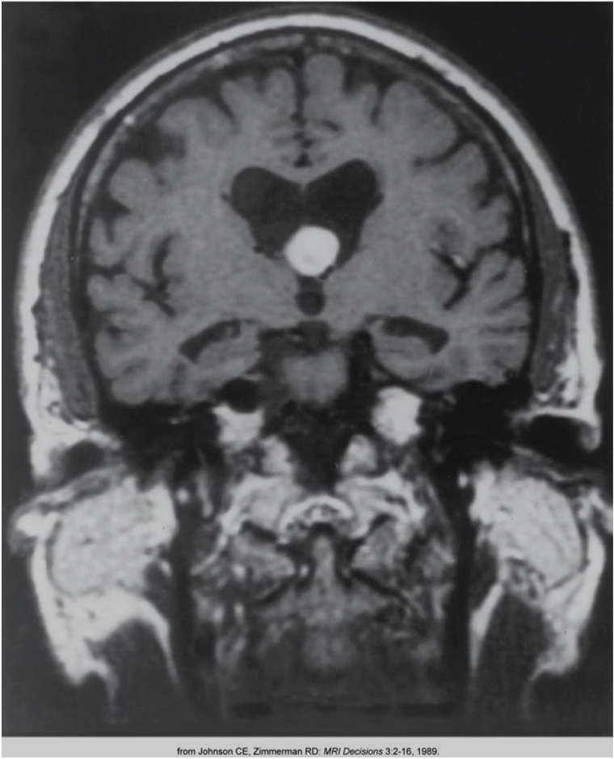
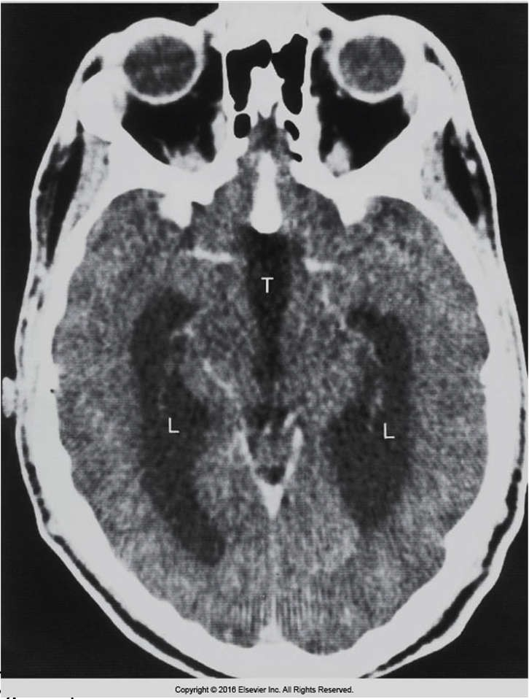
Hydrocephalus
Eisenberg 8-73, 8-74

Slide 19
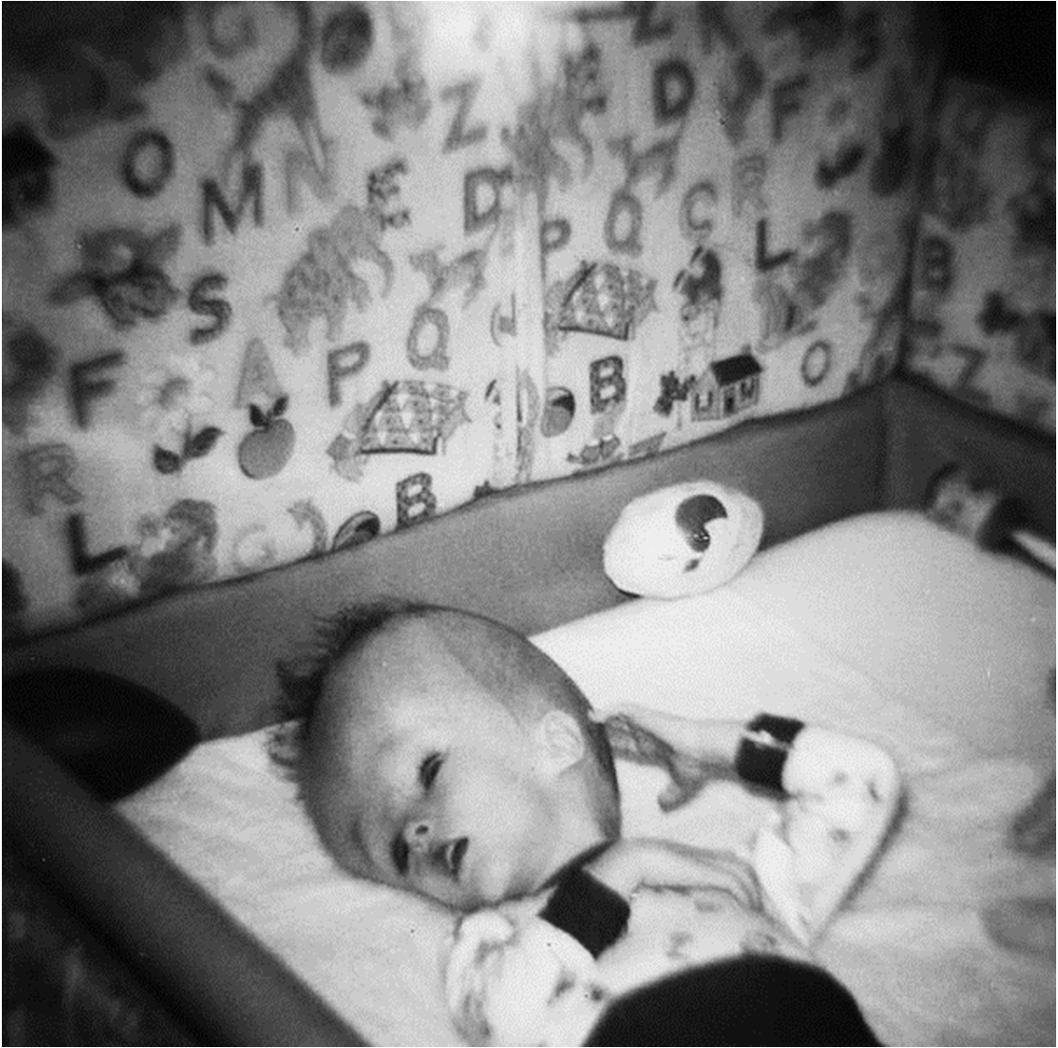
Courtesy of Wikimedia commons
DescriptionBaby with hydrocephalus (9587849190).jpg
Date Source Author
December, 1967
24 August 2013, 04:15
Baby with hydrocephalus simpleinsomnia
Categories: 1967 photographs
Hydrocephalus
Hidden categories: CC-BY-2.0
Flickr images reviewed by FlickreviewR

Slide 20
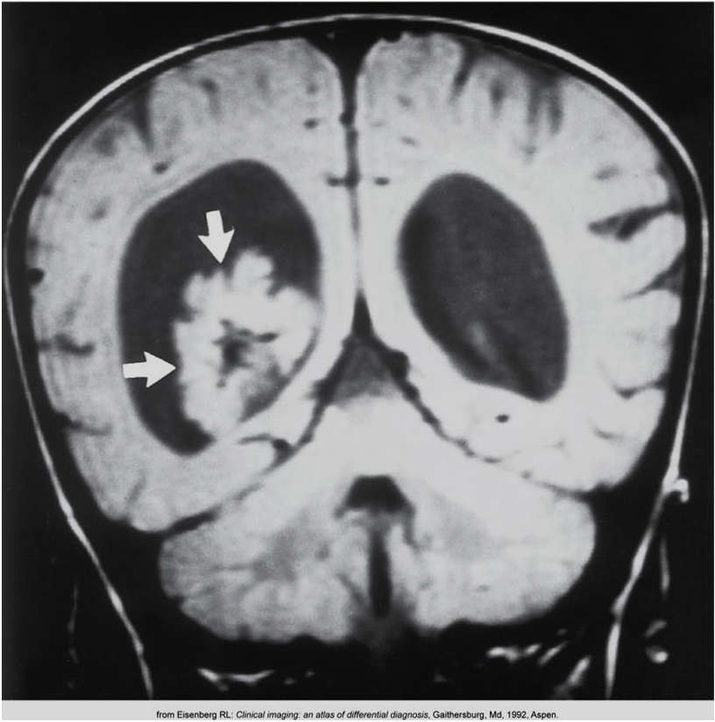
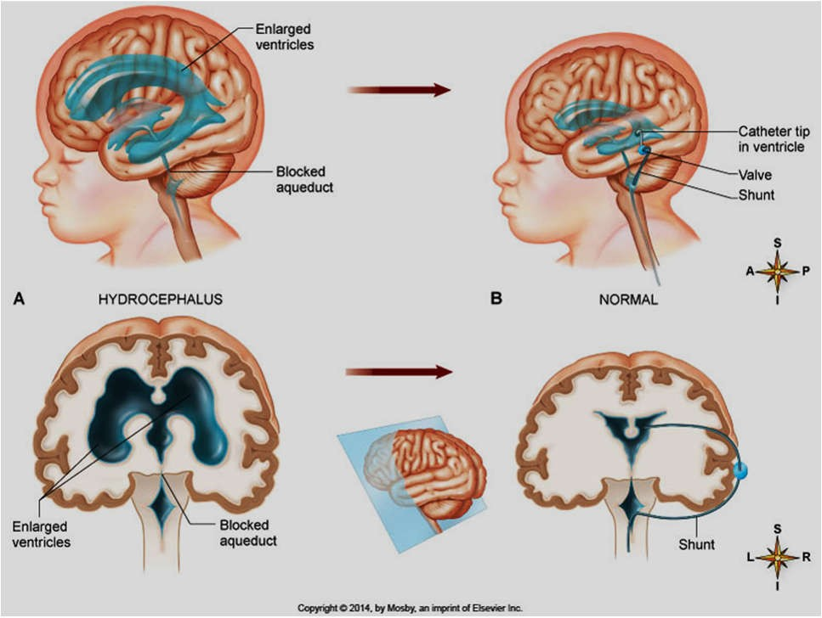
Choroid plexus papilloma
Patton and Thibodeau10-22
Eisenberg 8-77

Slide 21
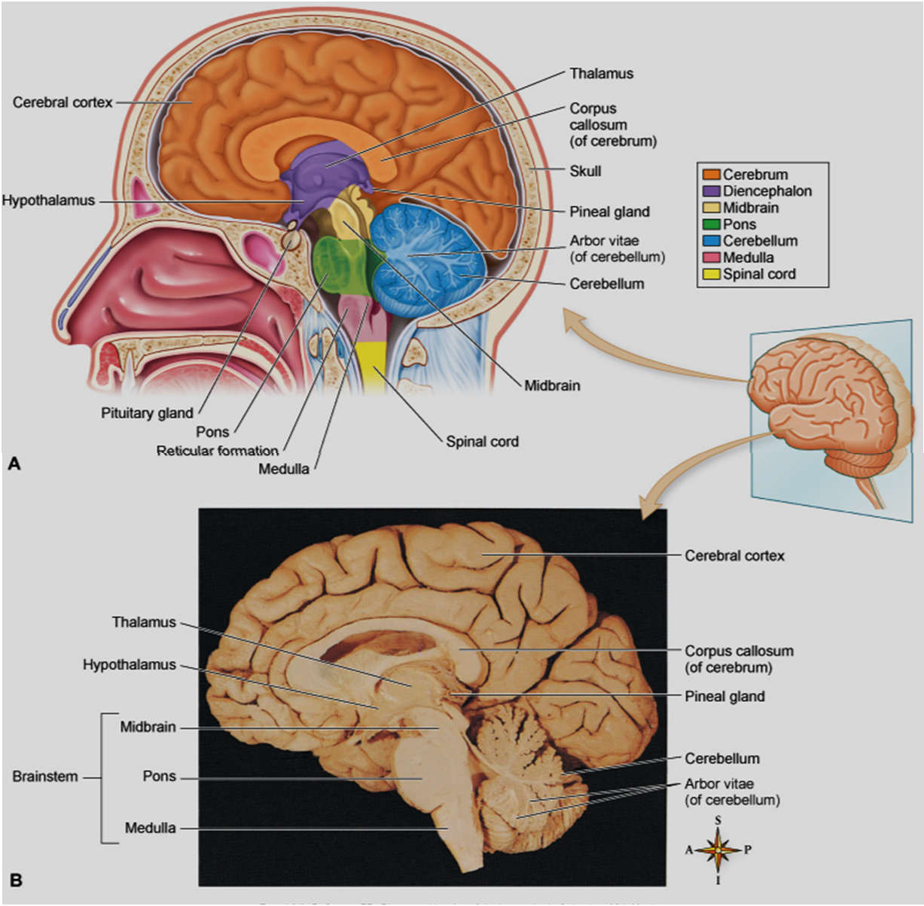
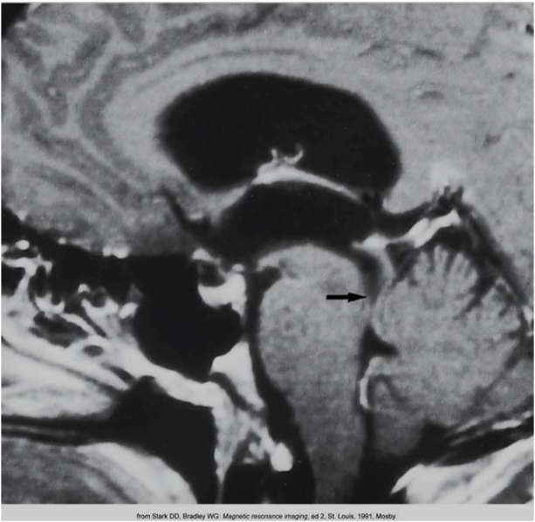
Where is the blockage?
Eisenberg 8-75
Patton and Thibodeau 10-21

Slide 22
Traumatic Brain Injuries (TBI’s)

Slide 23
https://www.neurosurgeonsofnewjersey.com/cerebral- contusion-intracerebral-hematoma/
Symptoms
Any type of TBI, no matter how minor it may appear, should be taken seriously. If you experience any loss of consciousness, no matter how brief, a doctor should be seen as soon as possible. Even if unconsciousness does not occur, the several hours that follow are still very important and you should watch for the following symptoms:
Headache
Nausea, vomiting
Slurred speech
Restlessness
Increased drowsiness
Change in pupils
Confusion about the time or date
Memory loss
Change in personality
Depression
Irritability
Other emotional and behavioral problems
Some people may have seizures as a result of a TBI.
If any of these symptoms occur, a doctor should be seen immediately, for they could mean that the brain is bleeding or swelling.

Slide 24
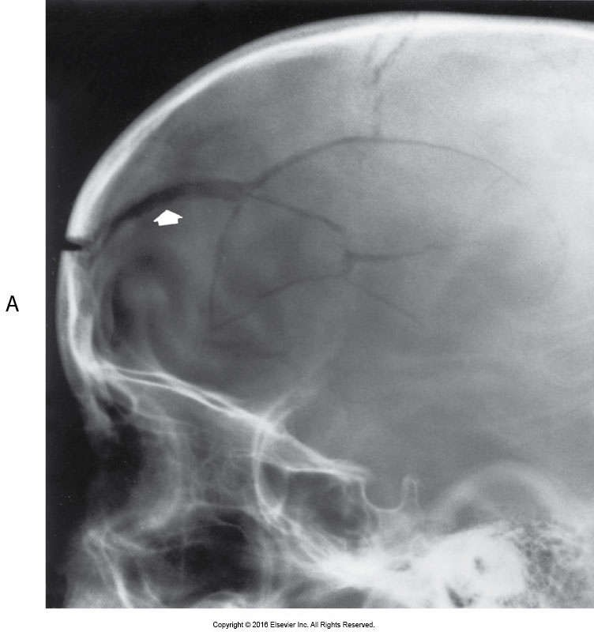
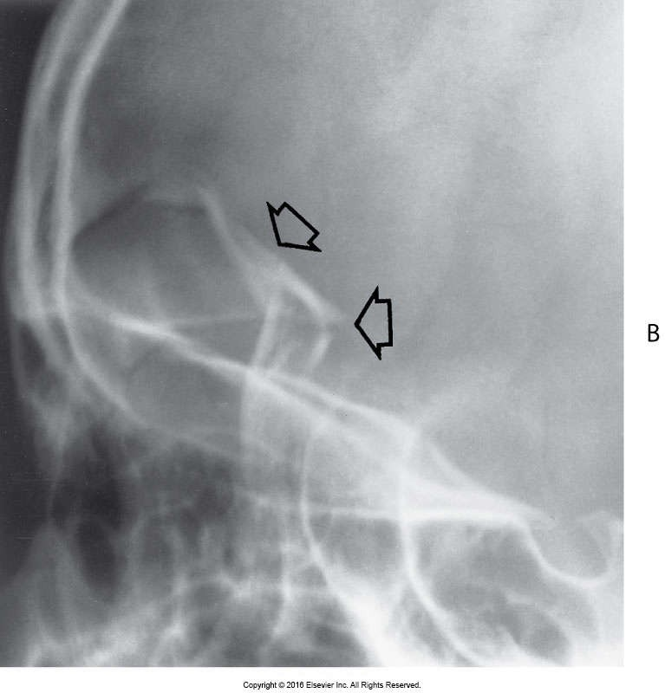
Skull fractures…
Eisenberg 8-33

Slide 25
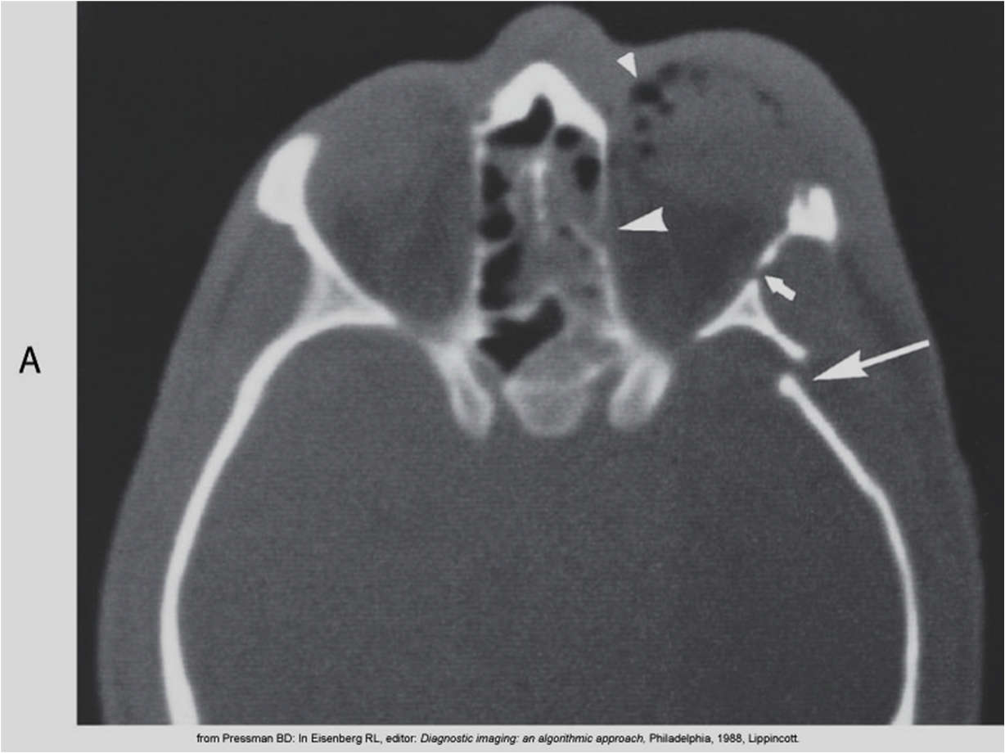
Eisenberg 8-34

Slide 26
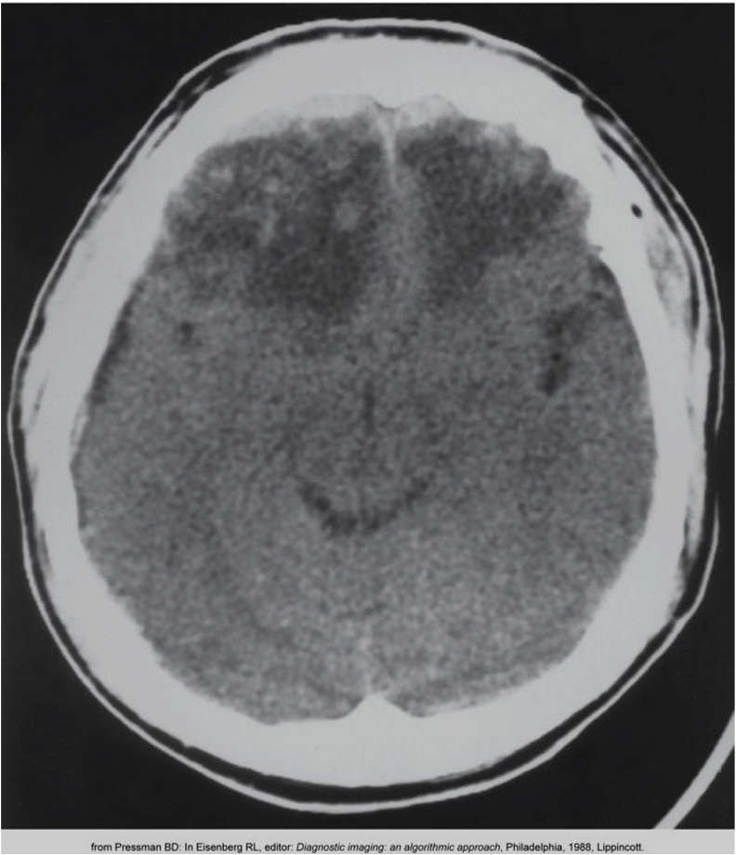
Cerebral contusion…
Bruising of the brain tissue
Usually caused by the brain coming in contact with the rough floor of the calivarium or a fold in the dura mater
May cause edema and swelling
Patient will be monitored for changes in neurologic function
Eisenberg 8-39

Slide 27
Intracranial hemorrhages…

Slide 28
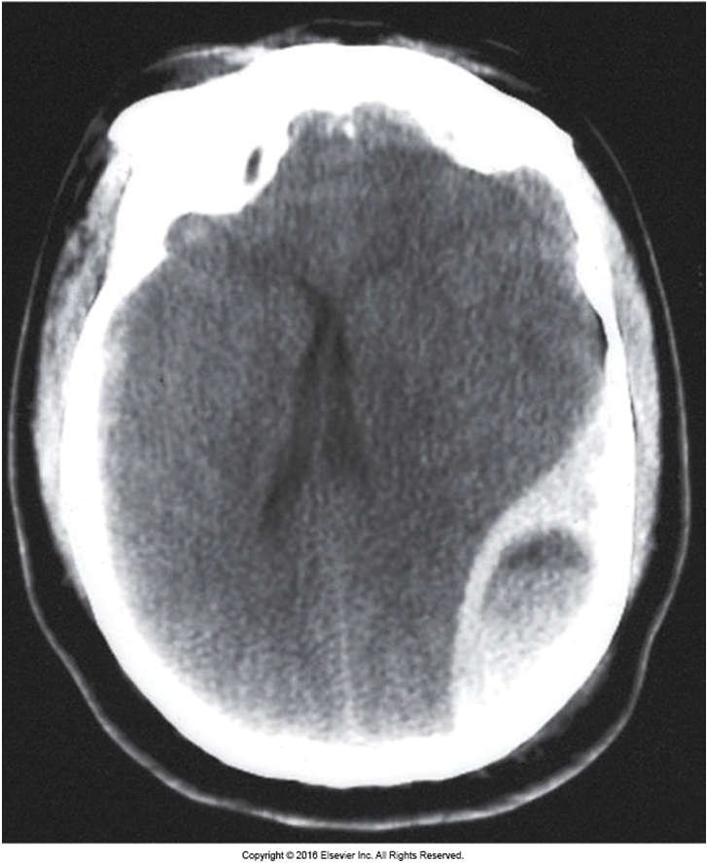
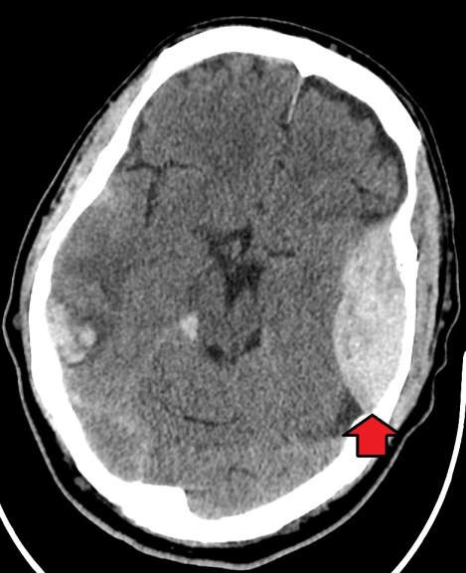
Epidural Hematoma
Courtesy of Wikimedia commons
DescriptionEpiduralHematoma.jpg
English: Epidural hematoma on the persons left (images right) with an associated skull fracture. Also has some bleeding on the persons right.
Date
Source Author
4 April 2018
Own work
James Heilman, MD
Eisenberg 8-35

Slide 29
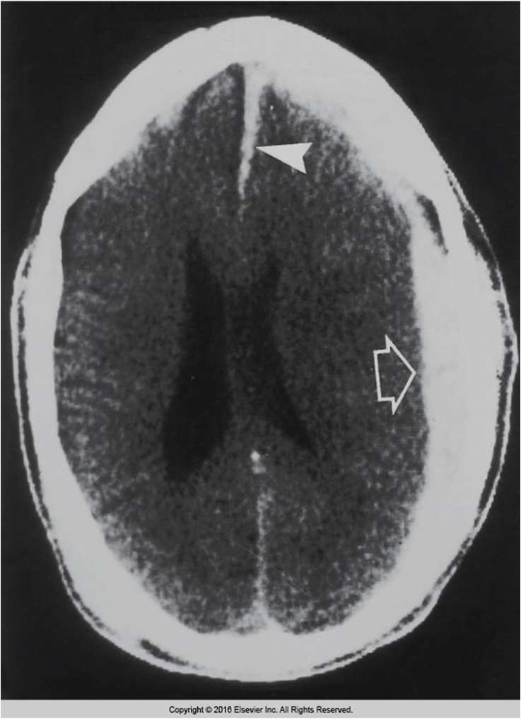
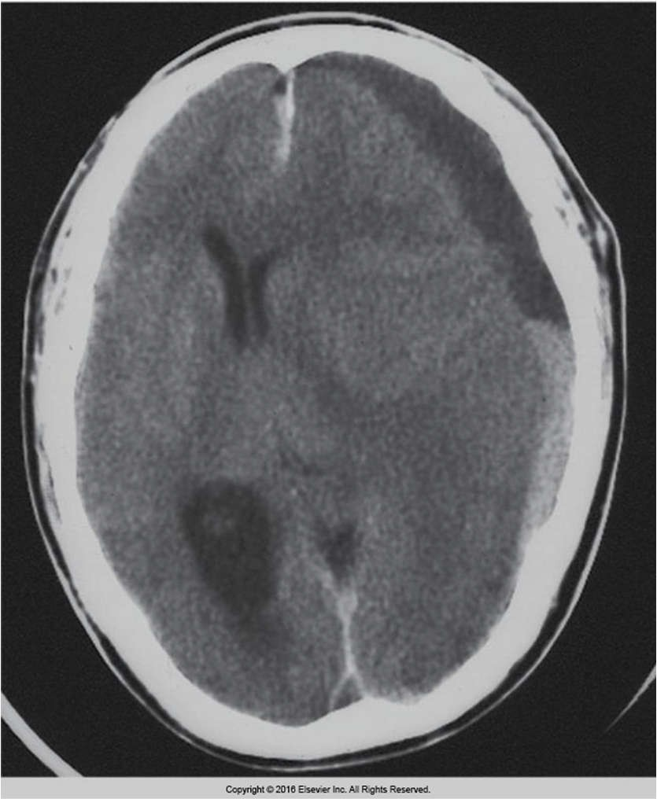
Subdural hematoma
Eisenberg 8-36
Eisenberg 8-38

Slide 30
Bleeding into the ventricular system of the brain is known as a sub- arachnoid hemorrhage.
Radiographic signs: include visualization of
falx cerebri, straight sinus, or sagittal sinus, or increased density in the basilar cisterns, cerebral fissure, and/or sulci on CT
Treatment includes: surgical “evacuation”,vessel
repair, and/or medication or stent placement for decreasing intracranial pressure

Slide 31
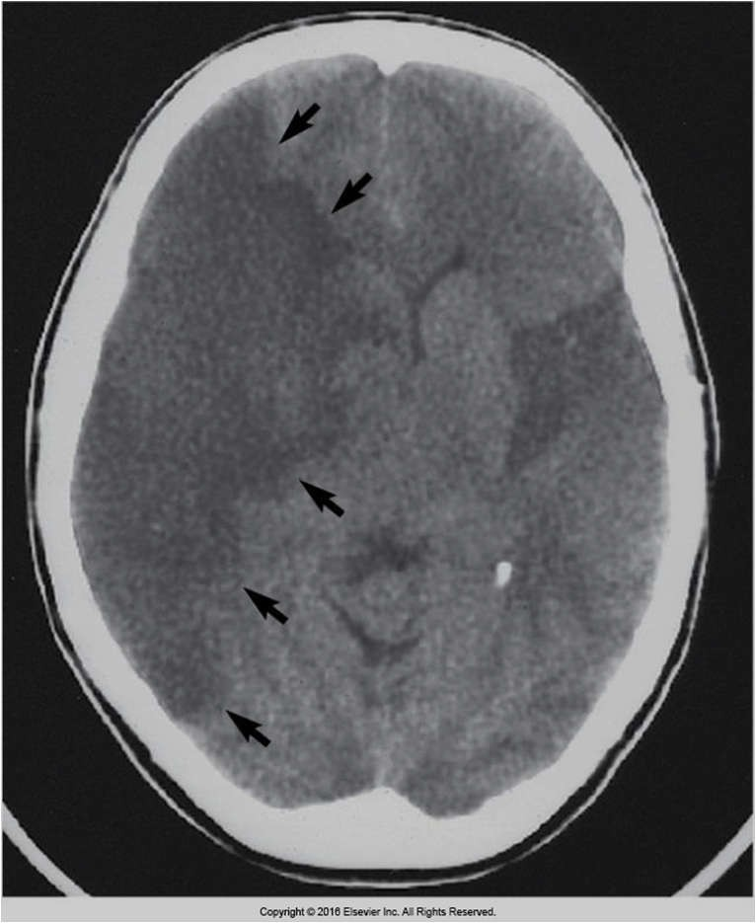
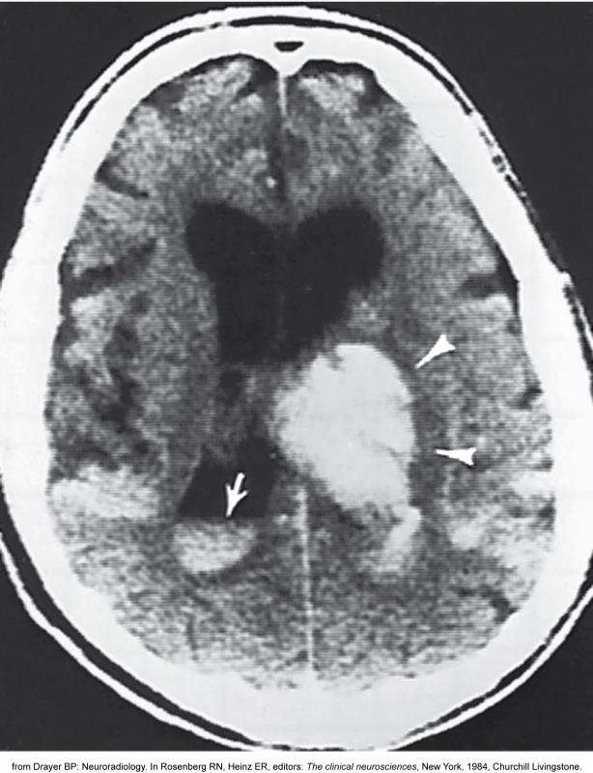
Cerebrovascular accidents
Eisenberg 8-50, 8-58

Slide 32
TIA vs. stroke

Slide 33
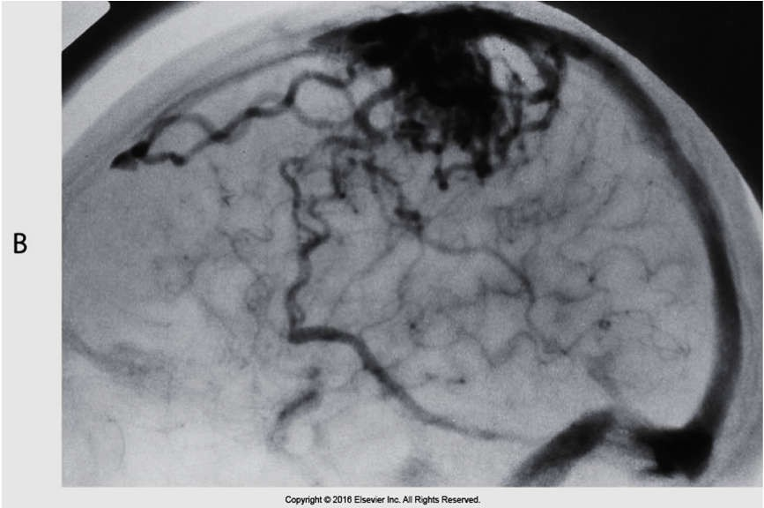
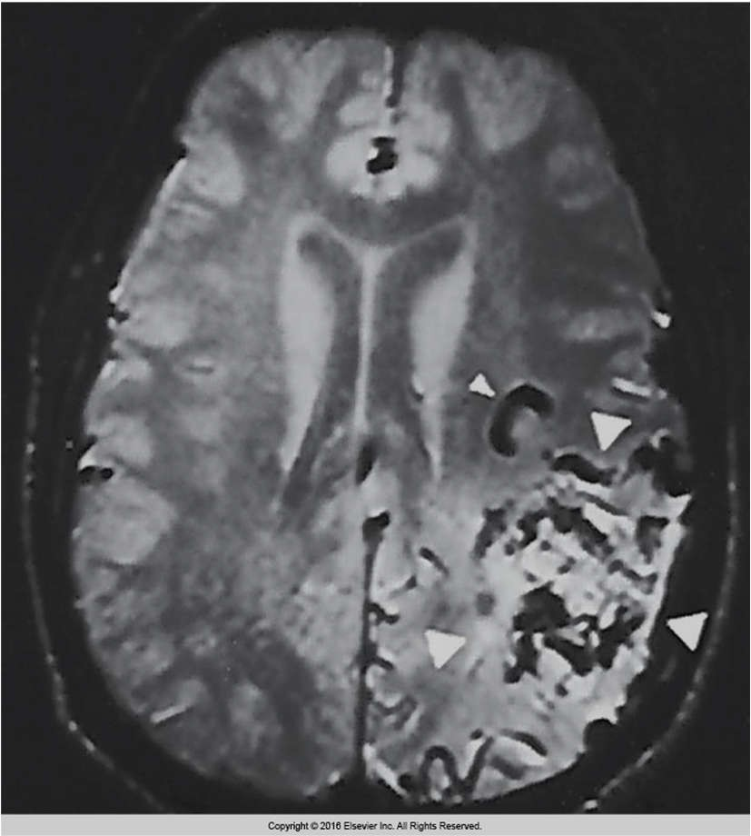
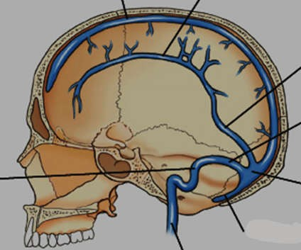
AVM-(arteriovenous malformation)
Eisenberg 8-60, 8-61
And Bontrager 17-19

Slide 34
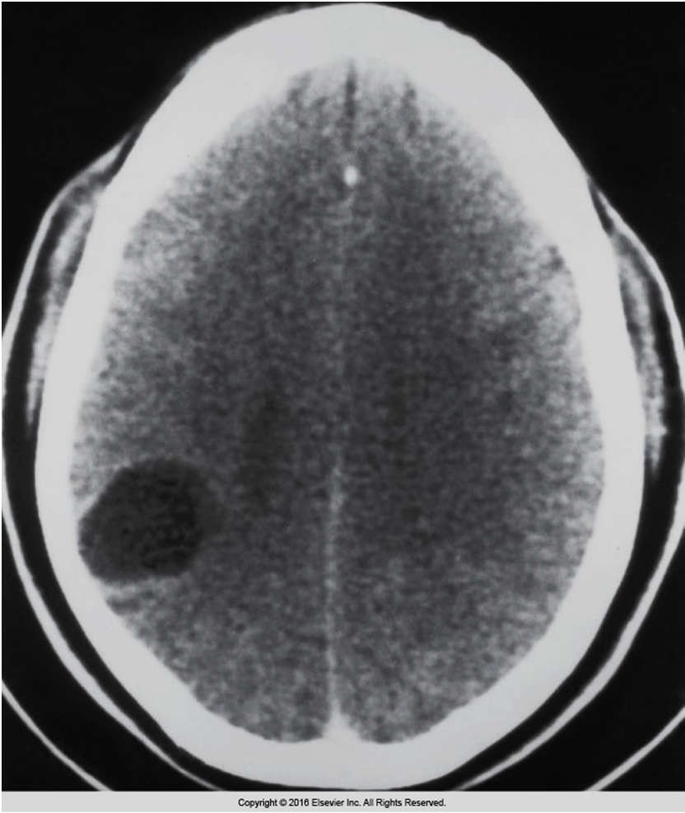
Cystic astrocytoma (glioma)
What protective structure might this affect?
Eisenberg 8-14

Slide 35
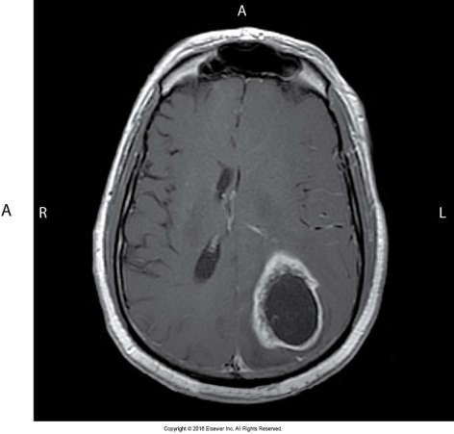
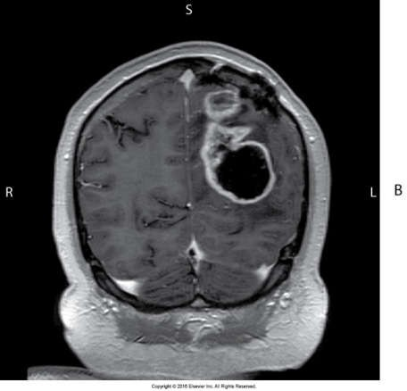
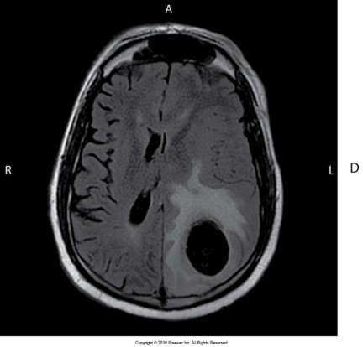
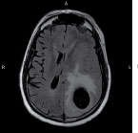
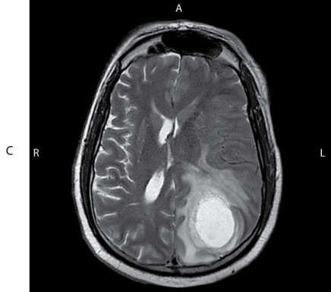
Glioblastoma…
Eisenberg 8-10

Slide 36
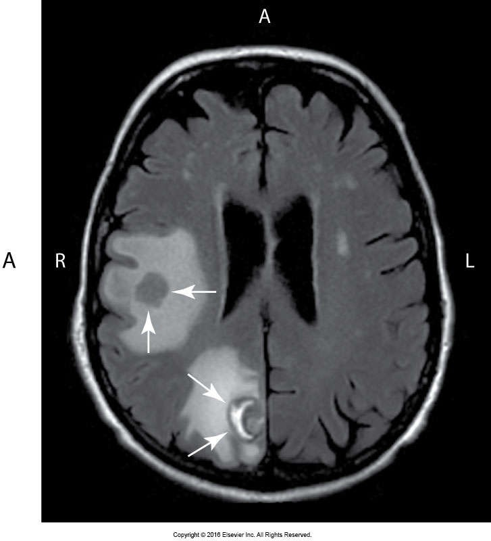
Metastatic carcinoma
Eisenberg 8-10

Slide 37
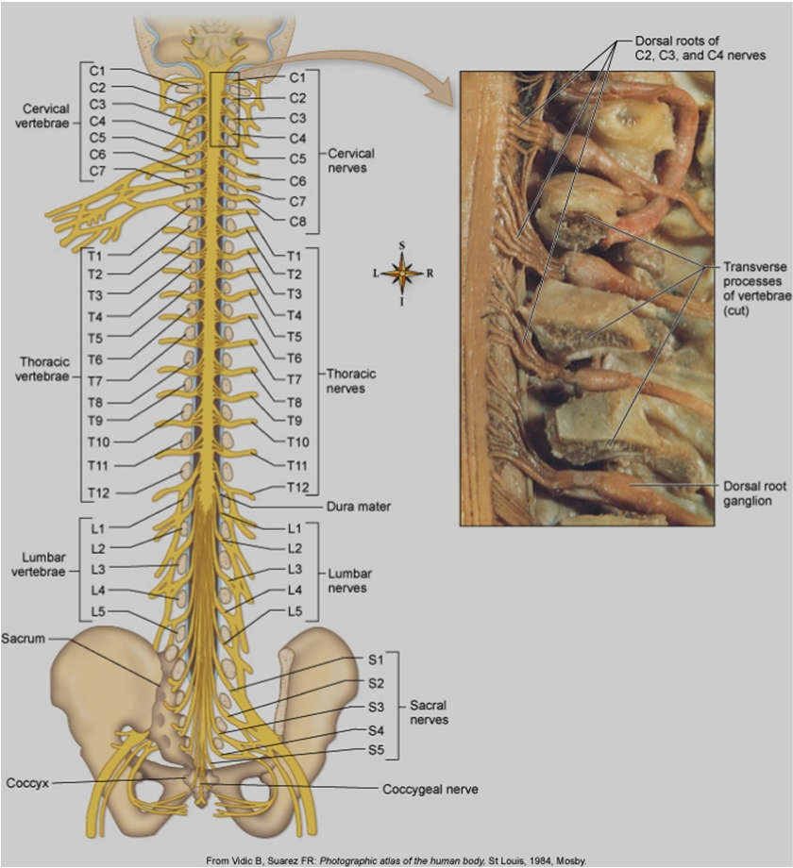
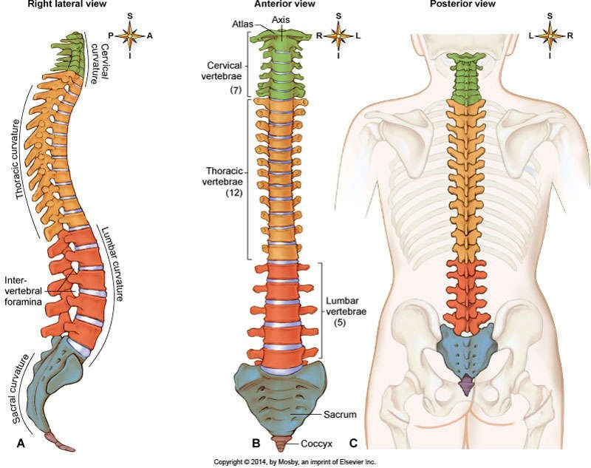
Anatomy of the spinal cord
Patton and Thibodeau fig. 8-14,10-17

Slide 38
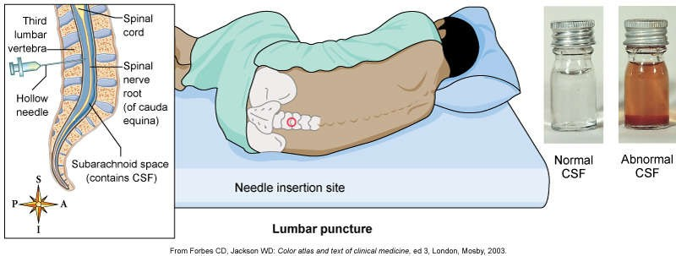
Lumbar puncture/spinal tap
Patton and Thibodeau pg. 264, 265, and Eisenberg 4-125

Slide 39
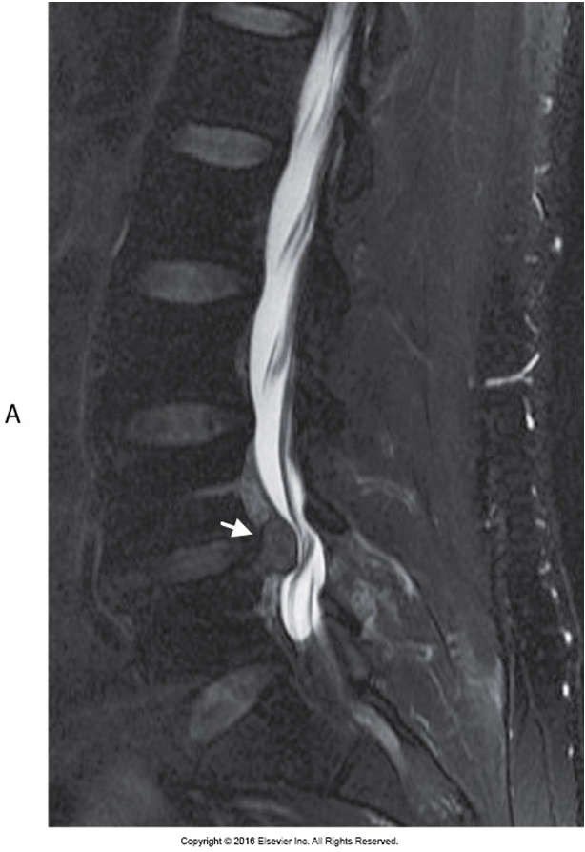
Radiographic contrast in the subarachnoid space

Slide 40
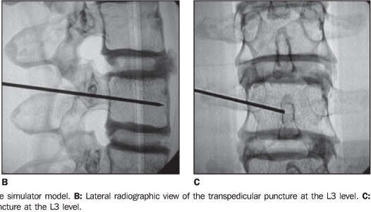
Fluoroscopy guided lumbar puncture.

Slide 41
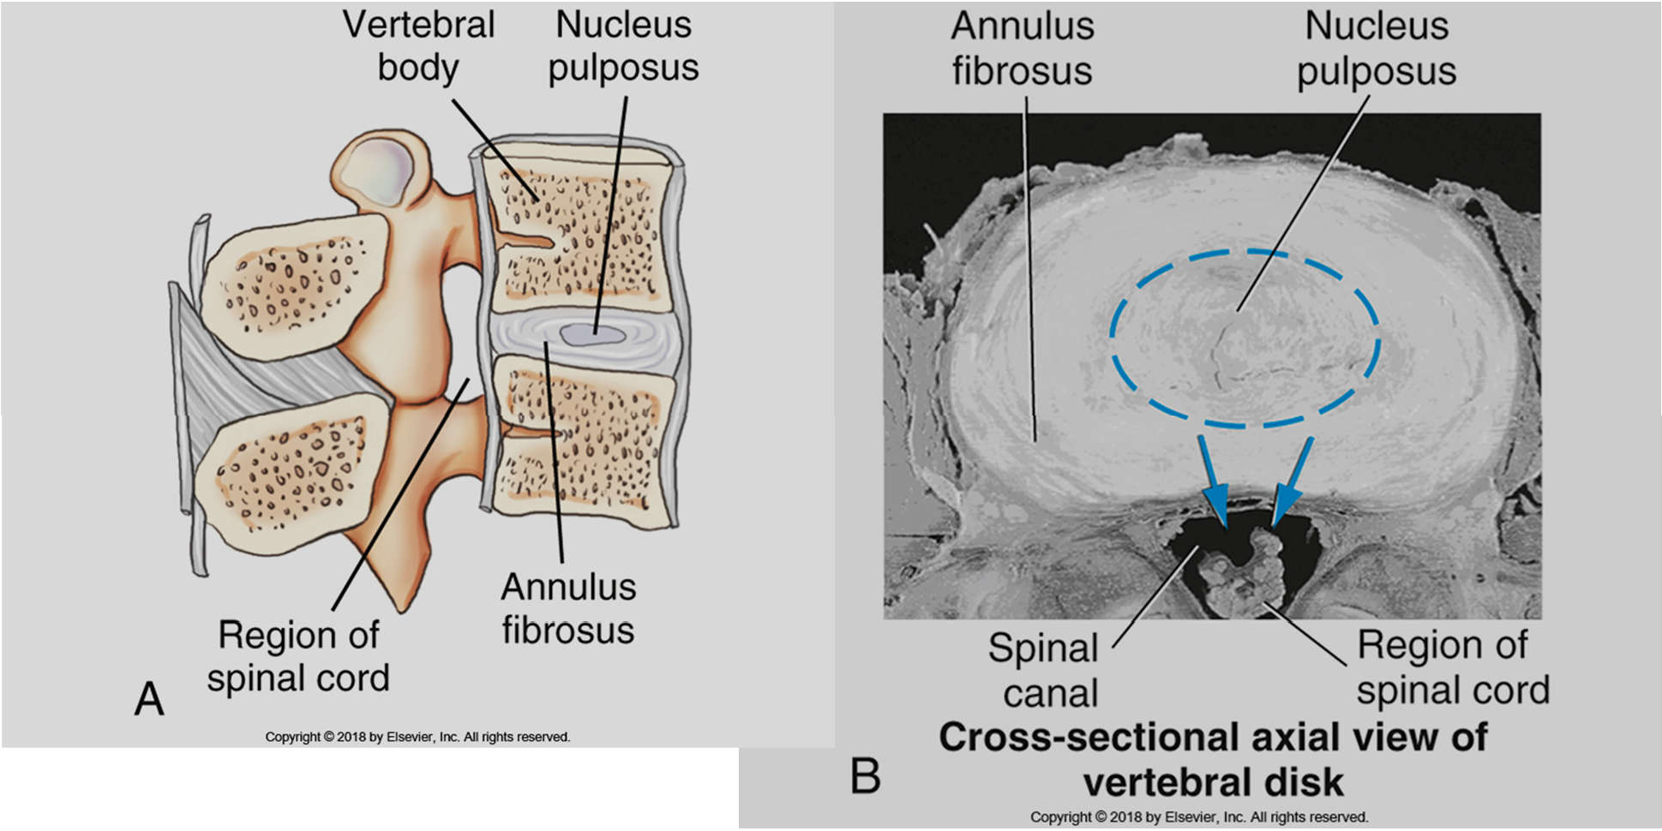
Bontrager 8-9 and 8-10

Slide 42
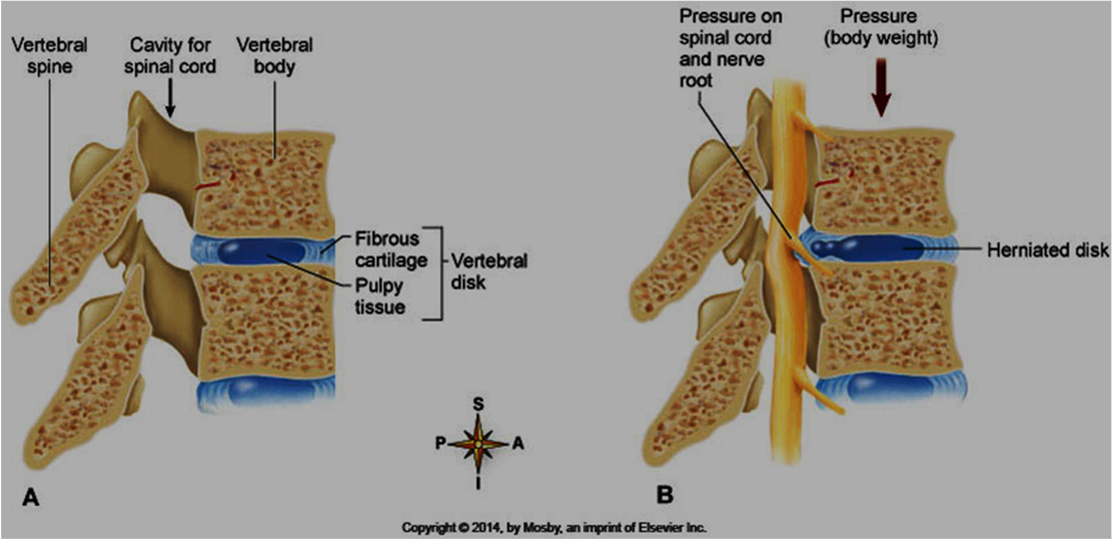
Patton and Thibodeau fig. 8-26

Slide 43
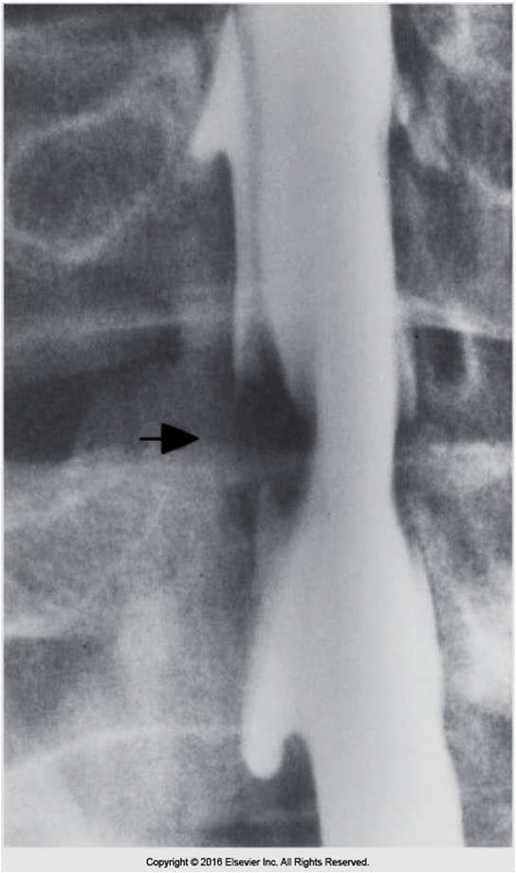

Patton and Thibodeau fig. 4-120, 4-122

Slide 44


Eisenberg fig. 4-124, 4-125

Slide 45

Spinal Bifida…
Eisenberg 4-4

Slide 46

Lack of dopamine leads to Parkinson’s disease
Injections or ingestion of dopamine does not work as the medications fail to cross the BBB.
A new drug, L-dopa, gives new hope but doesn’t’ always work.
Electrical stimulation of brain or transplant of dopamine producing neurons are being tested

Slide 47
Alzheimers …

