Slide 1


Medical Esthetics
Introduction to Skin Analysis

Slide 2
Our Journey Today, the Basics
Being knowledgeable about skin types and conditions is the most important competencies for a skin care professional. This interaction with a client sets you up as the skin care expert. Recommendations for the appropriate skin care treatments and products must be uniquely adapted to each person. The skin analysis is the determining factor in deciding what products to use during the service and what products to recommend for home use . The skin analysis also confirms whether the client is an appropriate candidate for the treatment.

Slide 3
Estheticians should study and have a thorough understanding of skin analysis because:
Before performing services or selecting products, an individual’s skin type and conditions must be analyzed correctly to determine the appropriate treatment and products.
A thorough skin analysis and client consultation is especially important to determine the causes of skin conditions and any contraindications to treatment or products that the client may have.
Using a holistic approach, identifying healthy habits and behavior that is detrimental to skin health will give you a better understanding of how to help your clients.

Slide 4
Skin Types vs Skin Conditions

Slide 5
Skin Type
Is a person’s genetic skin attributes.
Skin type is determined by genetics and ethnicity, but like everything else, skin can change over time.
Generally, skin becomes drier over time because our cellular metabolism and oil/lipid production slow down as we age.
Skin type is based primarily on how much oil is produced in the follicles from the sebaceous glands and on the amount of lipids found between the cells

Slide 6
Skin types are categorized as follows
Normal
Combination
Oily
Dry

Slide 7
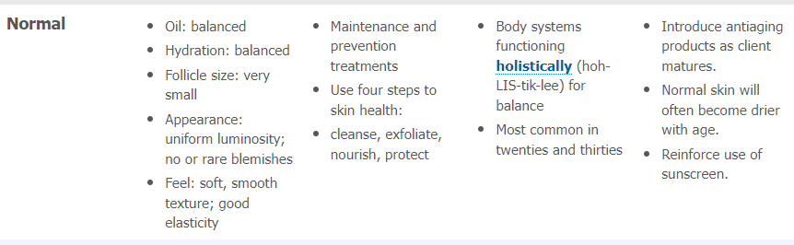
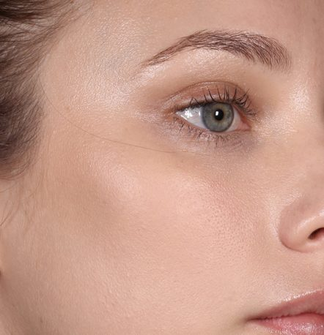

Slide 8
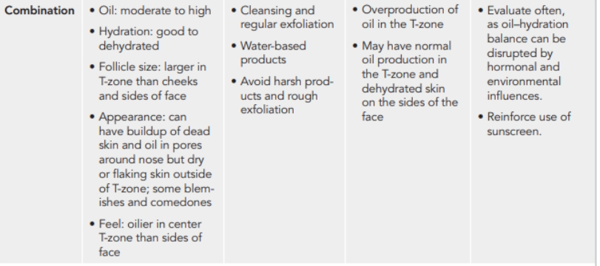
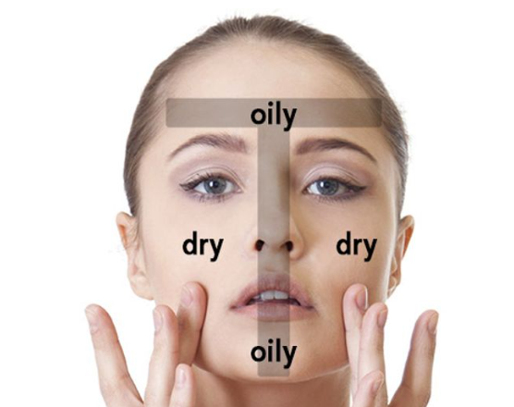

Slide 9
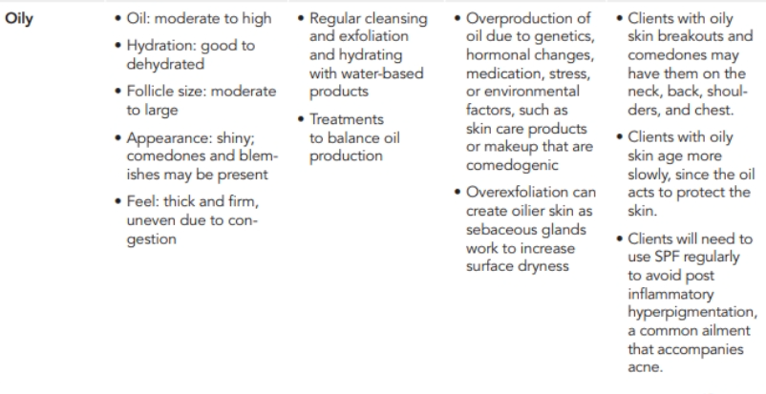
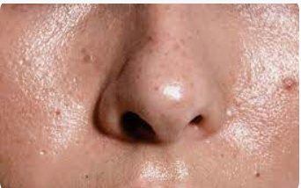

Slide 10
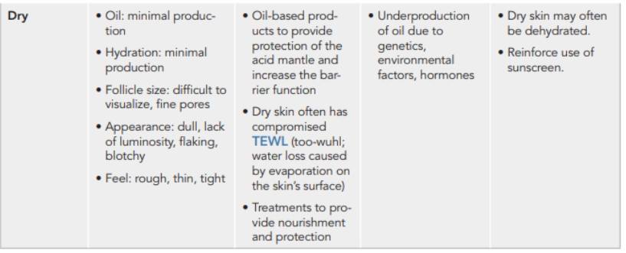
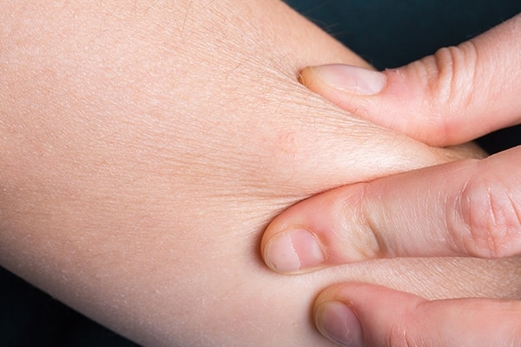

Slide 11
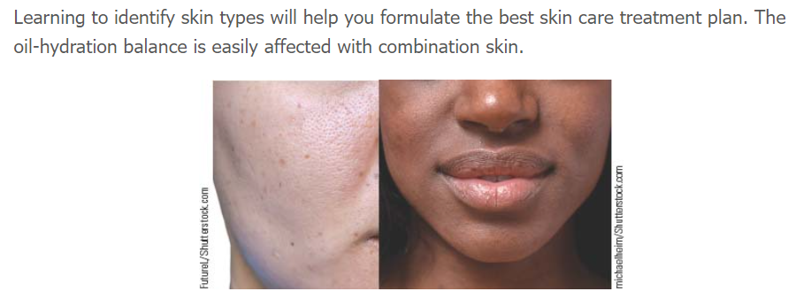

Slide 12
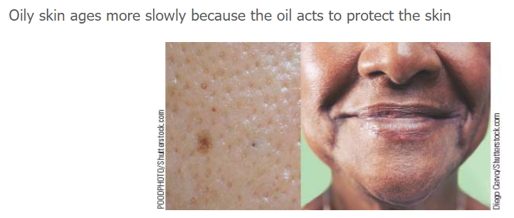

Slide 13
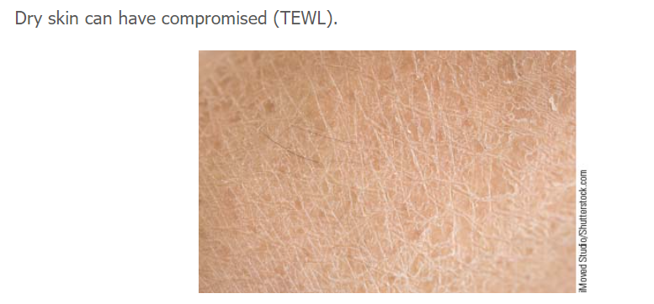
TEWL- Trans Epidermal Water Loss

Slide 14
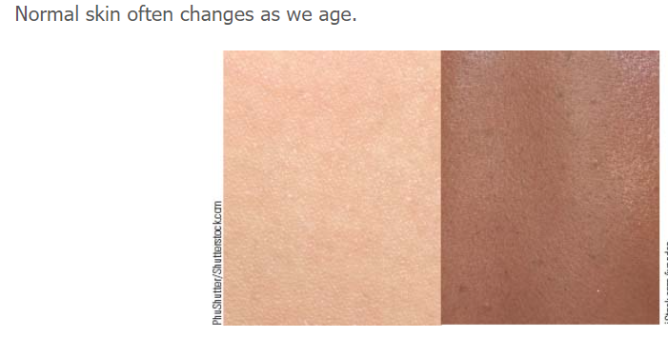

Slide 15
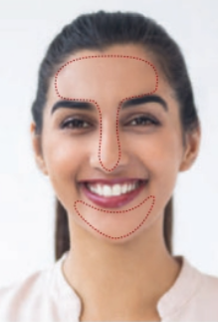
For Skin Analysis we use
Visual clues:
Using a magnifying lamp, after cleansing the skin we look at the skin starting with the T-Zone ( never use toner after cleansing the skin, you want the skin to be as natural as it can after cleansing)
How large are the pores on the T-Zone, how shiny does the T-zone appears to be Does this shine and pore size is all over the face or only on the T-Zone?
How small are the pores on the T-Zone, is the skin not shiny? Does it look dry and dull and flaky?
Overall starting with the T-zone, how the rest of the face compares to it?

Slide 16
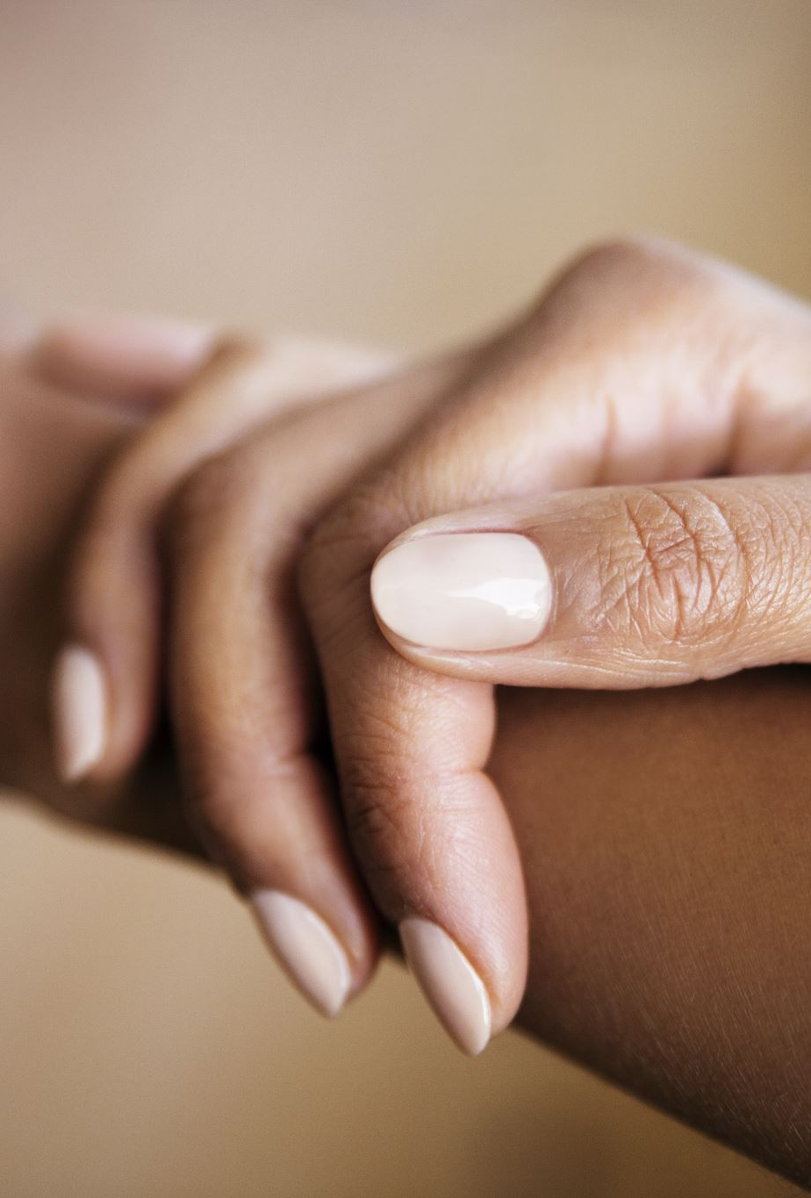
Palpation:
Examine the skin through touch, manipulating it to determine conditions such as oiliness and elasticity.
Use a paper tissue, press against the skin areas, is there oil residue?
Press the skin slightly with your thumb and index , do you see dry very thin lines?

Slide 17
Consultation:
What are your daily skin care rituals
What products are you currently using
What type of job do you have
Are you on any medications
What are your diet habits

Slide 18
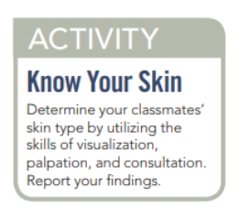
After the Lunch Break

Slide 19

QUESTIONS?

