Slide 1


Laser Hair Removal Part 1

Slide 2
Did you know?
The nonspecific damage of human hair follicles with a laser was noted more than 50 years ago. The theory of selective photothermolysis, first described by Rox Anderson and John Parrish, provided the framework of selectively targeting a particular chromophore based on its absorption spectrum. In 1996, this group also reported the first successful use of a normal-mode ruby laser ( 500 to 550 nm ) for long-term and permanent hair removal. But this wavelength was only applicable to Skin Types 1

Slide 3
Prior to the advent of laser hair removal (LHR), only temporary methods for removing unwanted hair were available, such as bleaching, plucking, shaving, waxing, and chemical depilatories.
In addition to not providing permanent hair removal, these methods are also inconvenient and tedious.
Electrolysis is a technique in which a fine needle is inserted deep into the hair follicle and uses electrical current, thereby destroying the hair follicle and allowing for permanent hair removal of all types of hair. This is the only FDA recognize method of permanent hair removal
However, Electrolysis is impractical for treating large areas, extremely tedious, operator-dependent, and with variable efficacy in achieving permanent hair removal.
Unlike Electrolysis, LASERS (not IPL) provide a method of permanent hair reduction

Slide 4
Reflection
Approximately 4% to 7% of light is reflected off skin.2 The amount of light reflected increases with increasing angle of incidence with the least reflection occurring when the laser beam directed perpendicular to the tissue. If enough reflection occurs to create a high-intensity beam, damage to unintended targets could occur. For example, an errant 10,600-nm beam can cause damage to the cornea because of its water content whereas a reflected 595-nm pulsed dye laser beam can damage the retina because of its pigment content. Protective eye wear guards against reflected and direct exposure to laser light.

Slide 5

Laser light absorption by specific tissue targets is the fundamental goal of clinical lasers. Light must be absorbed by tissue to produce an effect .The absorption of the photons of laser light is responsible for its effects on the tissue.
Absorption
Preferentially depend on wavelength. These light-absorbing tissue components are known as chromophores. Frequently targeted chromophores in the skin include melanin, hemoglobin, and water, as well as exogenous tattoo inks. Absorption of energy by a chromophore results in conversion of that energy into thermal energy

Slide 6
Scattering
Scattering of light occurs after light has entered the tissue.
Scattering spreads out the beam of light within the tissue, resulting in radiation of larger area than anticipated.
Scattering also limits the depth of penetration because it can occur backward as well as forward. In skin, most scattered light is due to interaction with dermal collagen.
In general, the amount of scattering of laser light is inversely proportional to the wavelength of the laser.
Longer wavelengths penetrate tissue more deeply. An exception to this rule is laser light beyond the mid-infrared region of the electromagnetic spectrum.5
Laser light with wavelengths above 1300 nm only penetrate superficially owing to the high absorption coefficient of tissue water

Slide 7
Transmission
Transmission is the continuation of laser light that is not absorbed in the tissue. Transmission is dependent on both wavelength and spot size: it occurs more readily at longer wavelengths and larger spot sizes (6).
It is worthwhile to note that the relationship between the penetration depth of laser light and the wavelength of the light are inverted at wavelengths greater than 1100 nm.
Penetration actually decreases at wavelengths greater than 1100 nm because the laser light starts being absorbed by water molecules, which are present in all levels of the skin.

Slide 8


Slide 9
Basic Hair Biology
The hair follicle is a hormonally active structure divided into an infundibulum (hair follicle orifice to insertion of the sebaceous gland), isthmus (insertion of the sebaceous gland to the insertion of the arrector [erector] pili muscle), and bulb (insertion of the arrector pili to the base of the hair follicle) segments. The dermal papilla provides neurovascular support to the base of the follicle and helps to form the hair shaft.

Slide 10
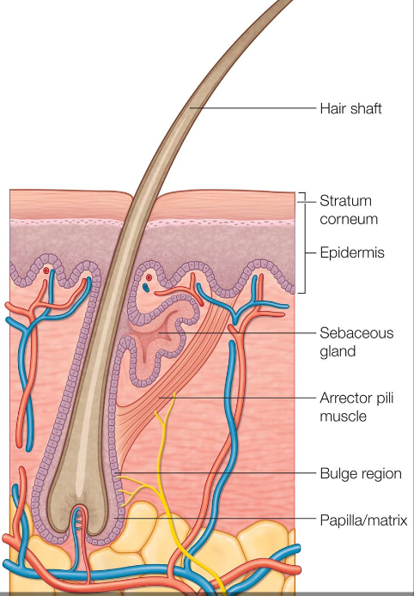

Slide 11
Every hair follicle is controlled by a programmed cycle that is dependent on the anatomic location.
The hair cycle consists of 3 phases
Anagen
Catagen
Telogen

Slide 12
Hair Growth Cycle
Anagen is characterized by a period of active growth in which the hair shaft lengthens.
A catagen transition period follows in which the lower part of the hair follicle undergoes apoptosis.
A resting period, telogen, then ensues and regrowth occurs when anagen resumes.
Hair regrowth (entry into another anagen cycle) is dependent on stem cells within or near the hair bulb matrix.
Slow-cycling stem cells have also been found in the follicular bulge arising off the outer root sheath at the site of the arrector pili muscle attachment.

Slide 13
Types of Hair
Lanugo
Vellus
Terminal hairs.
Lanugo hairs are fine hairs that cover a fetus and are shed in the neonatal period.
Vellus hairs are usually nonpigmented and have a diameter of approximately 30–50 µm.
Terminal hair shafts range from 150 to 300 µm in diameter. The type of hair produced by an individual follicle is capable of change (e.g., vellus to terminal hair at puberty or terminal to vellus hair in androgenic alopecia).

Slide 14
The amount and type of pigment in the hair shaft determine hair color. Melanocytes produce two types of melanin:
Eumelanin, a brown-black pigment
Pheomelanin, a red pigment.
Melanocytes are located in the upper portion of the hair bulb and outer root sheath of the infundibulum.
Definitions of what constitutes excessive or unwanted body hair depend on cultural norms but can usually be classified as either
Hypertrichosis or hirsutism.
Hirsutism is the abnormal growth of terminal hair in women in male-pattern (androgen-dependent) sites, such as the face and chest.
Hypertrichosis is excess hair growth at any body site that is not androgen-dependent. In addition, the use of grafts and flaps in skin surgery can often introduce hair to an area that causes a displeasing appearance or functional impairment.

Slide 15
Mechanism of laser hair removal
Selective photothermolysis enables precise targeting of pigmented hair follicles by using the melanin of the hair shaft as a chromophore
Melanin has an absorbance spectrum that matches wavelengths in the red and near-infrared (IR) portion of the electromagnetic spectrum (approximately 700–1000 nm).
To achieve permanent hair removal, the biologic “target” is the follicular stem cells located in the bulge region and/or dermal papilla.
This requires a laser pulse duration that is longer in duration than if the actual chromophore and desired target are identical.
Temporary LHR can result when the follicular stem cells are not completely destroyed, primarily through induction of a catagen-like state in pigmented hair follicles. Temporary LHR is much easier to achieve than permanent removal when using the wrong wavelength for skin and hair type, wrong pulse width and wrong fluence

Slide 16
Long-term hair removal depends on hair color, skin color, and tolerated fluence
Approximately 15%–30% long-term hair loss may be observed with each treatment when optimal treatment parameters are used
A list of commonly used laser and light devices that are currently commercially available for hair removal is provided in Table 4.1.

Slide 17
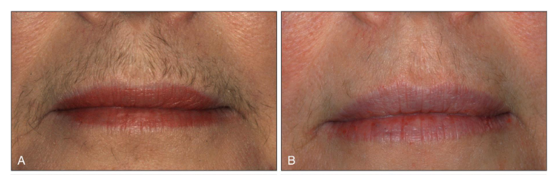

Slide 18
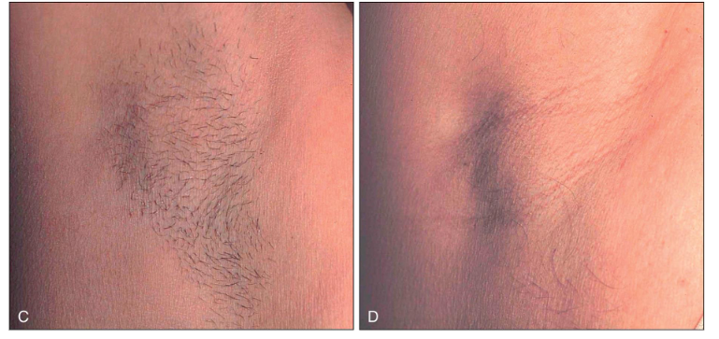

Slide 19
Key factors in optimizing treatment
Proper patient selection
Preoperative preparation
Informed consent
Understanding of the principles of laser safety
Laser and light source selection
Understanding of hair anatomy, growth, and physiology
Understanding of laser–tissue interaction
Choosing optimal laser parameters for effective LHR

Slide 20
Paitent Selection
Patients with evidence of endocrine or menstrual dysfunction should be appropriately assessed
Similarly, patients with an explosive onset of hypertrichosis should be evaluated for paraneoplastic etiologies.
There is not enough data demonstrating safety of laser hair removal in pregnancy, therefore it is generally not recommended.
The past medical history should be reviewed to identify patients with photosensitive conditions, such as autoimmune connective tissue disorders, or disorders prone to the Koebner phenomenon.
A history of recurrent cutaneous infections at or in the vicinity of the treatment area might warrant the use of prophylactic medications.
Any past history of keloid or hypertrophic scar formation
Previous hair removal methods, including past laser treatments,
Any methods of hair shaft epilation (e.g., waxing or tweezing) that entirely remove the target chromophore render LHR less effective for at least 2 weeks.
Although there is little evidence for the time frame a patient must wait after complete epilation of the hair shaft and laser treatment, we recommend a minimum of 6 weeks.

Slide 21
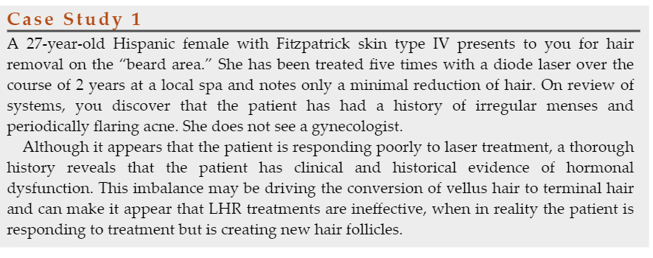
Let’s do the case studies !

Slide 22
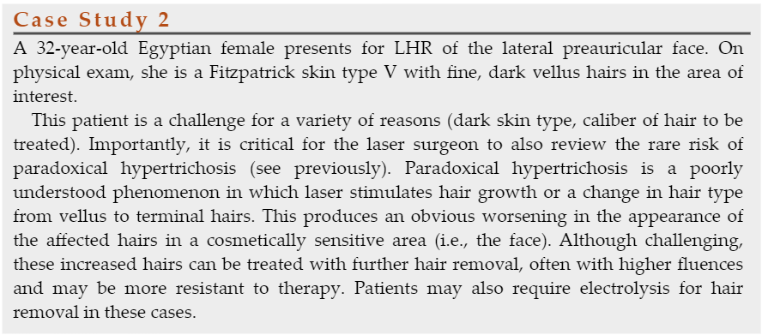

Slide 23
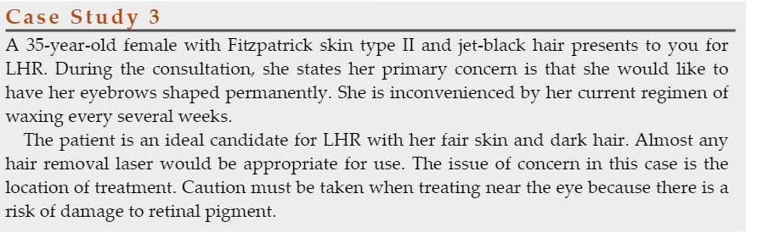

Slide 24
Device Variables
Wavelength
The chromophore for LHR is melanin. Within the hair follicle, melanin is principally located within the hair shaft, although the outer root sheath and matrix area also contain melanin. Melanin is capable of functioning as a chromophore for wavelengths in the red and near-IR portion of the electromagnetic spectrum, and can be targeted by
Ruby
Alexandrite
Diode
(Nd:YAG) lasers
Some specialized IPL devices.

Slide 25
Different Laser Wavelegths
The long-pulsed ruby laser (694 nm) was the first device used. It was only safe for Skin Types I to III. This laser is not in the market any longer
The long-pulsed alexandrite (755 nm) can be safely used in Fitzpatrick skin phototypes I–IV, although some experts limit the use of the long-pulsed alexandrite laser to Fitzpatrick skin phototypes I–III
The long-pulsed diode laser (LPDL; 800–810 nm) can be safely used in patients with Fitzpatrick skin phototypes I–V
The long-pulsed Nd:YAG laser has been thought to offer the best combination of safety and efficacy for Fitzpatrick skin phototype I to VI Long-term hair reduction with 18-month follow-up showed 73.6% clearance following four treatments at 2-month intervals. And is considered to be the most effective and safe for all skin types.

Slide 26
IPL is composed of polychromatic, noncoherent light ranging from 400 to 1200 nm.
Various filters can be used to target particular chromophores, including melanin.
One study of patients treated with a single IPL session reported 75% hair removal 1 year after treatment.
Two studies providing a head-to-head comparison of IPL versus either the long-pulsed alexandrite laser or Nd:YAG laser both found the IPL to be inferior to laser devices for hair removal.

Slide 27
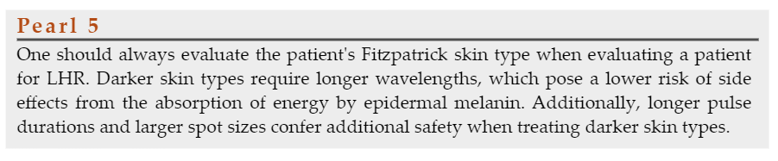

Slide 28

Fluence is defined as the amount of energy delivered per unit area and is expressed as J/cm2. ( also known as Jouels)
Higher fluences have been correlated with greater permanent hair removal but are also more likely to cause burns
Recommended treatment fluences are often provided with each individual laser device for non-experienced operators.
However, a more appropriate method of determining the optimal treatment fluence for a given patient is to evaluate for the desired clinical end point by doing 3 different patch tests before treatment starts
The highest possible tolerated fluence that yields this end point without any adverse effects is the best fluence for treatment.
Fluences that result in epidermal disruption are too high and should be reduced.

Slide 29
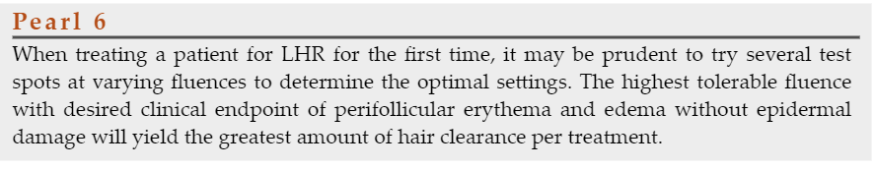
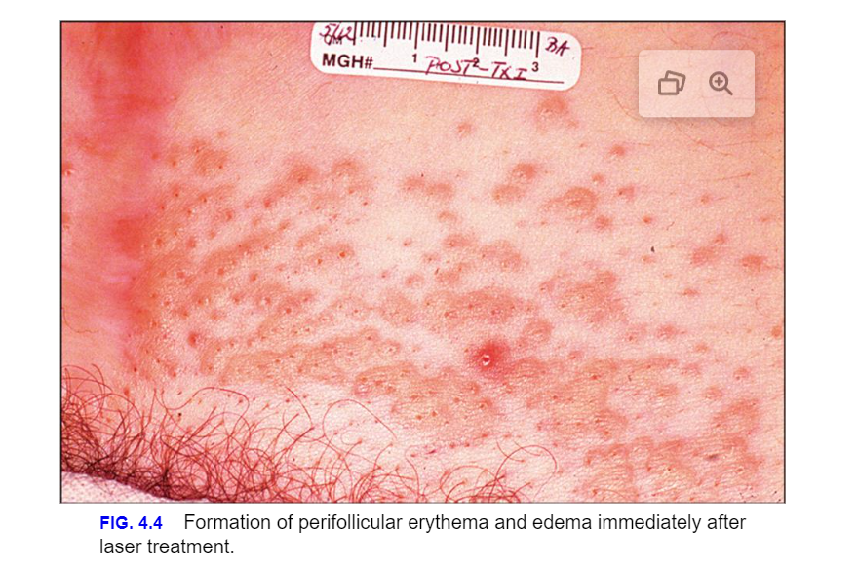

Slide 30
As observed on the previous picture this is the desire end point to LHR treatment
On the following picture you will observe an adverse end point where the fluence was too high

Slide 31
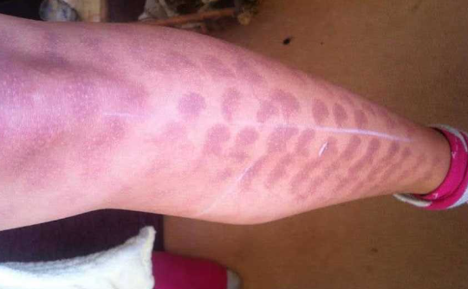

Slide 32
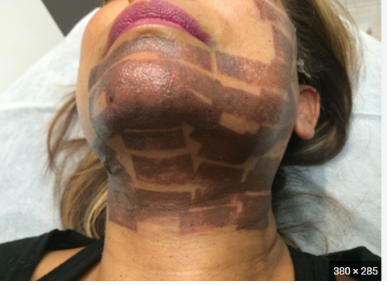
Not Doing your Consultation and Fitzpatrick correctly, wrong machine, wrong settings

Slide 33
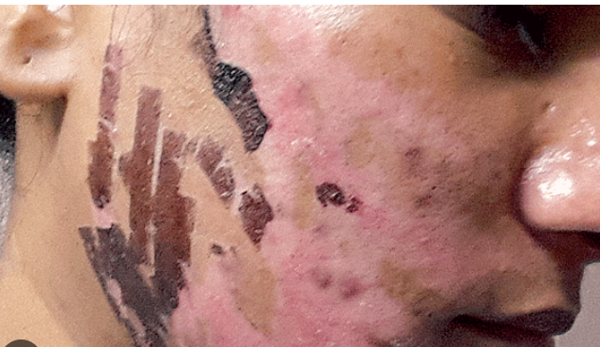

Slide 34
WARNING!
Never trust Laser manufacturing claims that re not physically possible
An Alexandrite can only penetrate up to 3.3 mm on the skin
A diode 4.5 mm
An NDYAG 5
The deeper the wavelength
Provides less trigger to skin melanin and,
More impact on hair melanin

Slide 35
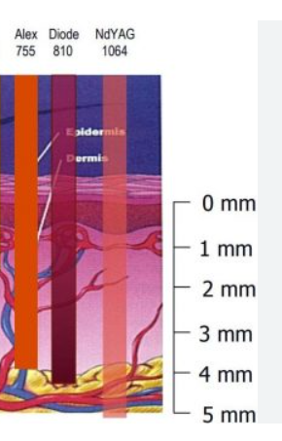
Using the graphic below answer :
Where are the skin melanocytes situated ?
Where is the hair follicle situated
Explain on this picture what does 755nm means , what 810 means and what 1064 means

Slide 36
Pulse Duration
Pulse Duration/Delay
Is the duration in milliseconds of laser exposure between one pulse and another
The theory of selective photothermolysis enables the laser surgeon to select an optimal pulse duration based on the thermal relaxation time (TRT).
Terminal hairs are approximately 300 µm in diameter, and thus the calculated TRT of a terminal hair follicle is approximately 100 ms.
Shorter pulse widths are recommended on skin types I to III when the hair is lighter and
Longer pulse widths are better for darker skin tones as they are more selective for melanin within the hair follicle and can minimize epidermal damage as the pulse widths are greater than the TRT of the melanosomes in epidermal keratinocytes and melanocytes.

Slide 37
Spot Size
The spot size is the diameter in millimeters of the laser beam.
As photons within a laser beam penetrate the dermis they are scattered by collagen fibers, and those that are scattered outside the area of the laser beam are essentially wasted.
Photons are more likely to be scattered outside of the beam area for smaller spot sizes, whereas in a larger spot size the photons are likely to remain within the beam area following scatter.
A double-blind, randomized controlled trial of a long-pulsed alexandrite laser for LHR of the axillary region comparing 18- and 12-mm spot sizes at otherwise identical treatment parameters showed a 10% greater reduction in hair counts with the larger spot size.
A prospective study using an LPDL with a large 22- × 35-mm handpiece at low fluences, and no skin cooling was shown to have similar long-term hair removal efficacy to published studies of LPDLs with smaller spot sizes, using higher fluences and skin cooling. Thus larger spot sizes are preferable to smaller spot sizes.

Slide 38
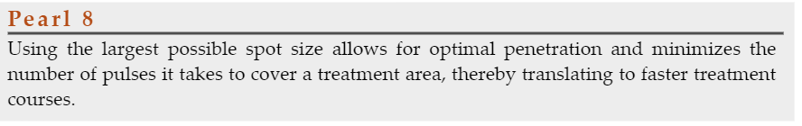

Slide 39
Skin Cooling
Most LASERS nowadays come with cooling systems on the laser tips
Some lasers blow freezing air
Some laser require for the skin to be cooled previously and after
Sometimes cryogen gel is used but is not that wide used in esthetic lasers

Slide 40

Let’s Watch!

Slide 41

QUESTIONS?

