Slide 1
MRAD 256:
Radiographic Technique 2
C-spine Image Critique

Slide 2
What Are We Evaluating?
Anatomy
Positioning
Exposure and technique
Central ray and collimation
Marker placement &/or artifacts

Slide 3
Textbook Pages - Bontrager
pg 310 – 313
Pay special attention to the “pink box” evaluation criteria
*Please note that the box is NOT pink on the electronic version

Slide 4
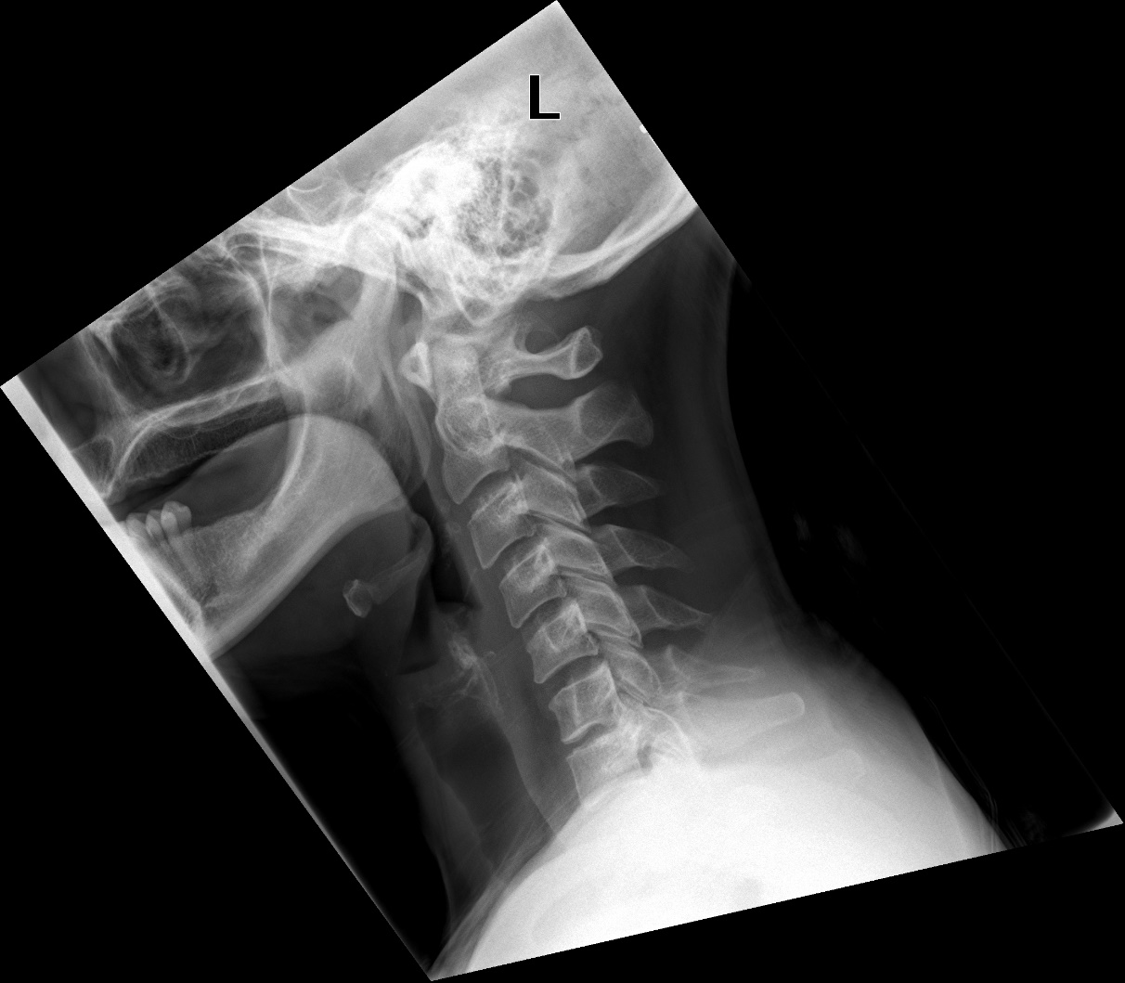
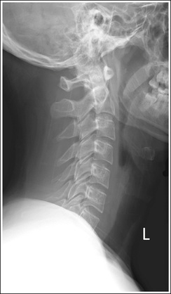
Anatomy - Lateral
1
1
2
2
3
3
4
vs
5
4
6
5
7
6
7
McQuillen Martensen fig 8.32
Notes:
Sella is clipped on the first one

Slide 5
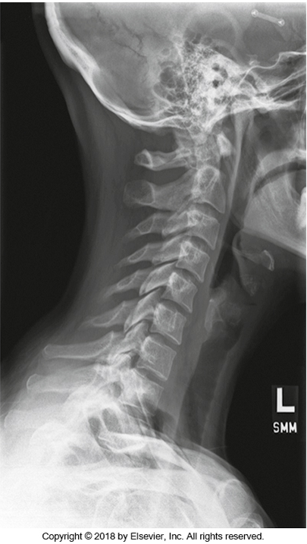
Positioning - Lateral
VS
McQuillen Martensen fig 8.32
Notes:
C1-C7/T1 intervertebral joint spaces open
Mandible does not superimpose C1/2
R&L zygapophyseal joints and articular pillars superimposed
Spinous processes superimposed

Slide 6
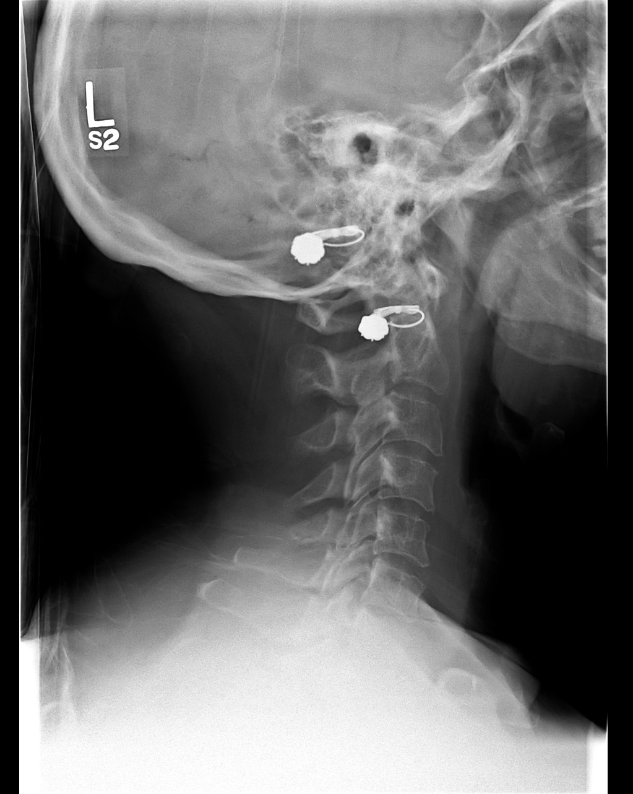
Exposure and Technique - Lateral
92 kVp
78 kVp
vs
McQuillen Martensen fig 8.32
Notes:
kVp too high. Cannot see soft tissue margins

Slide 7
Central Ray and Collimation - Lateral
vs
McQuillen Martensen fig 8.32

Slide 8
Marker Placement and Artifacts - Lateral
X
vs
McQuillen Martensen fig 8.32

Slide 9
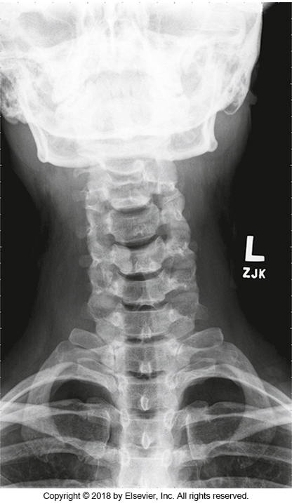
Anatomy - AP
Mandible and skull base –T2
Soft tissue on either side of the neck
Notes:
Couldn’t find an AP that was missing anatomy

Slide 10
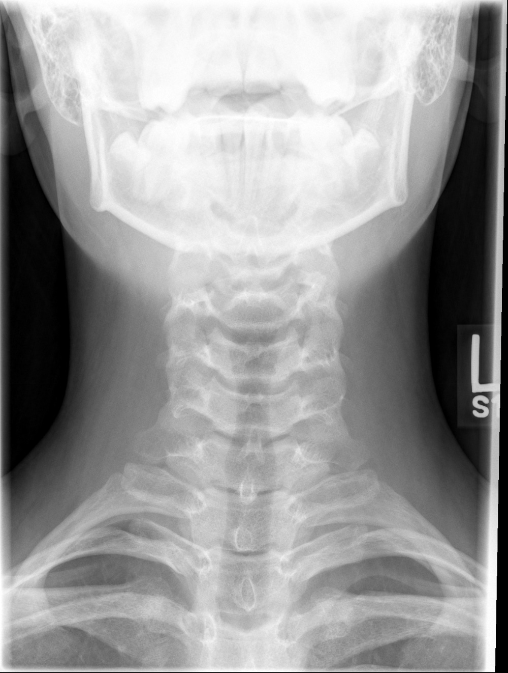
Positioning – AP
3
3
4
4
5
vs
5
6
6
7
7
SAIT image library
Notes:
Mandible of image 1 is obscuring C3
2nd image has tilt
Both images show no rotation

Slide 11
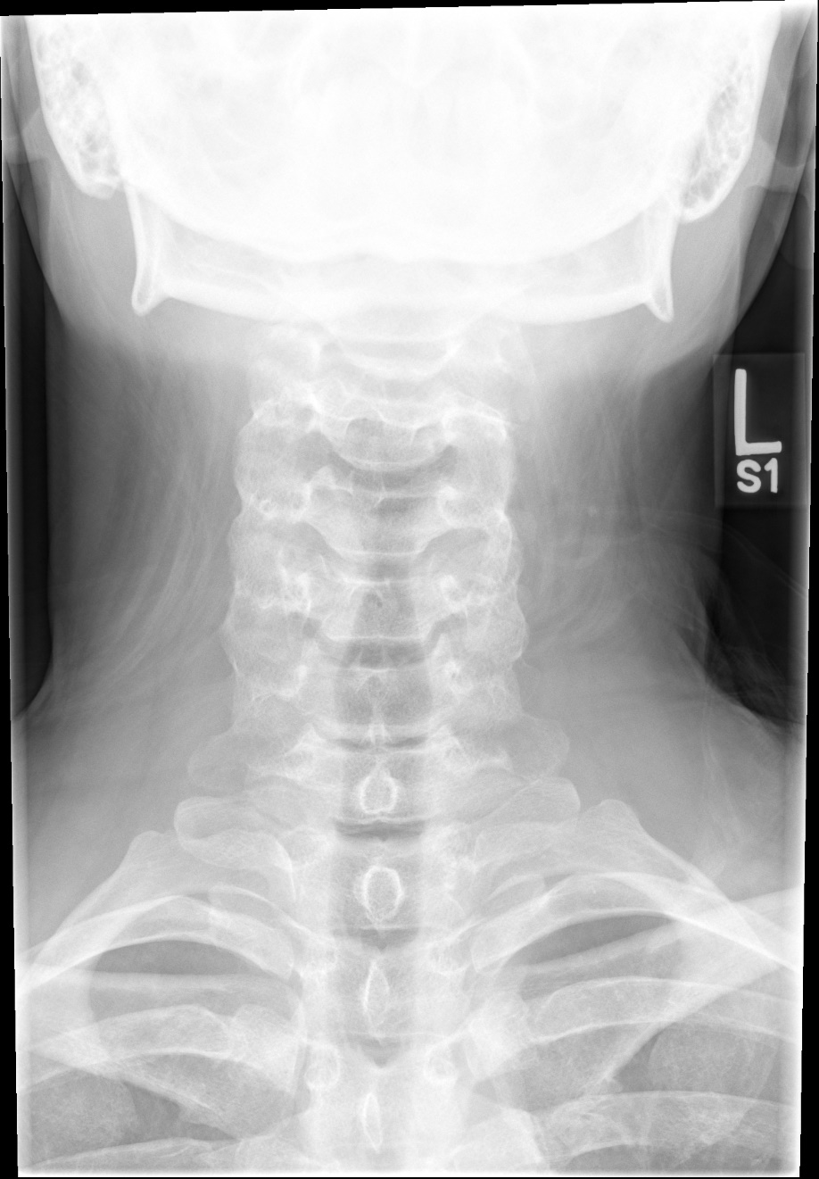
Exposure and Technique - AP
65 kVp
80 kVp
vs
SAIT image library

Slide 12
Central Ray and Collimation - AP

Slide 13
Marker Placement and Artifacts - AP

Slide 14
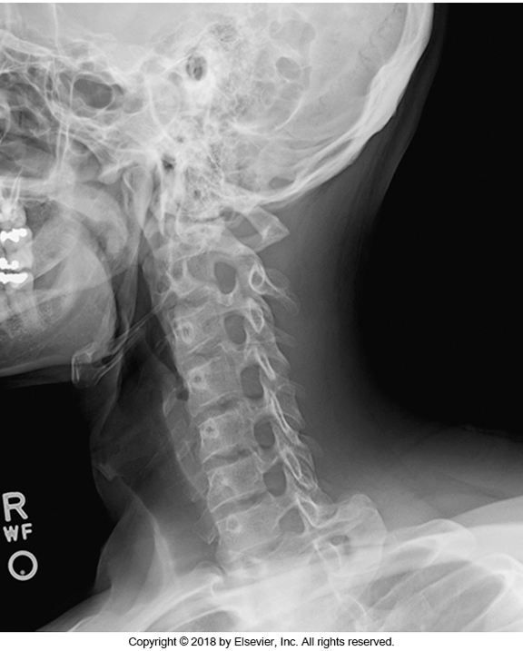
Anatomy - Oblique
1
2
3
4
5
6
7

Slide 15
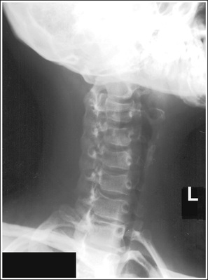
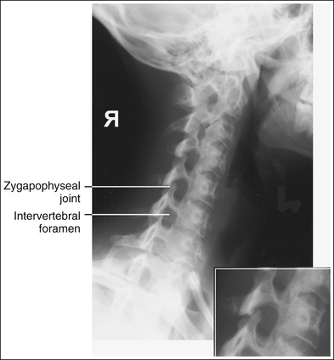
Positioning – Oblique
Good rotation
No mandible or skull superimposition
McQuillen Martensen fig 8.44
McQuillen Martensen fig 8.43

Slide 16
Exposure and Technique - Oblique
80 kVp

Slide 17
Central Ray and Collimation - Oblique

Slide 18
Marker Placement and Artifacts - Oblique

Slide 19
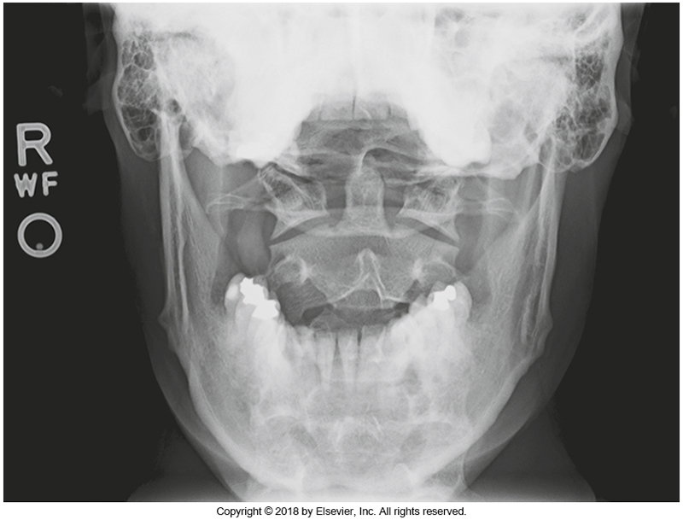
Anatomy – Open Mouth

Slide 20
Positioning – Open Mouth

Slide 21
Exposure and Technique - Open Mouth
80 kVp

Slide 22
Central Ray and Collimation - Open Mouth

Slide 23
Marker Placement & Artifacts - Open Mouth
R

