Slide 1


The Ultrasound Ultimate Facial

Slide 2
Items you will need
Hydra calm Cleanser
Hydra calm Toner
Exfoliating Gommage
Hydrating Ampule
Natigen Gel
Ultrasound Gel
Hydra calm Mask
Moisturizer
Eye Cream
SPF

Slide 3
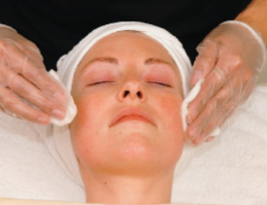
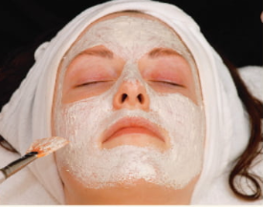
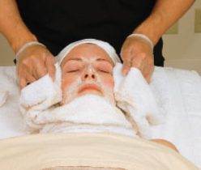
Procedure
1. Drape the client, cleanse the skin with Hydracalm cleansing mils
2. Apply a very thin layer of exfoliating gommage
3. Remove Gommage with lukewarm face cloths

Slide 4
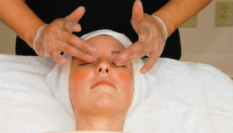
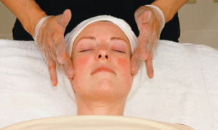
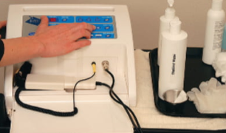
4. Gently apply hydra ampule to the whole face and around the eye area
5. Apply a thin layer of Natigen Gel and let all this absorbed to the skin
6. Set up your machine and the levels you will be using

Slide 5
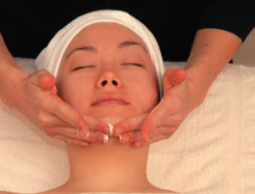
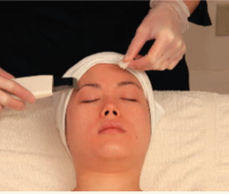
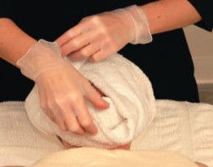
7. Apply a layer of ultrasound gel to the whole face and around the eyes
8. Start your ultrasound procedure on the face first and then following up with the eye contour, the treatment should be 8 minutes on the face and 2 to 3 around the eye area, use a higher frequency around the eye area as this is a delicate area
9. Remove any excess with a cloth or sponges softly , do not rub on the skin

Slide 6
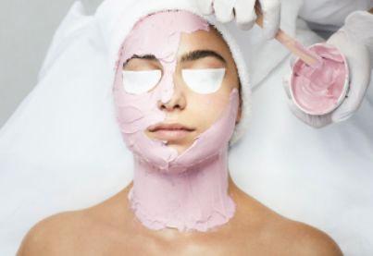
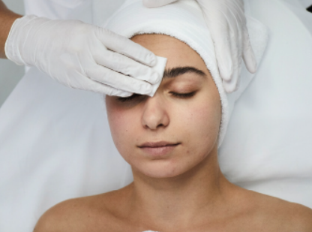
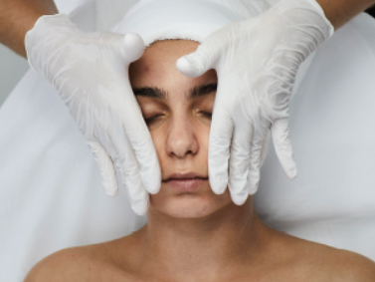
10. Apply the Sensyderm mask or any soothing mask let it rest for 10 minutes
11. Remove the mask and apply Hydraclam toner to the skin
12. Finish with moisturizer, eye cream and SPF with upward moving massage

Slide 7
Do not use ultrasound if you observe
Acne prone skin
Open wounds
Cold sores
Around the mouth area with braces or any metal implants
Epilepsy
Pregnancy
Accutane use on the last 12 months
After waxing
After a chemical peel
After lasers or any abrasive procedure
Beware of rosacea skin
If in doubt always consult to your instructor

Slide 8

QUESTIONS?

