Slide 1


Business Operations
Unit 4

Slide 2

Business Operations

Slide 3

Whether you are an owner or a manager, there are certain skills that you must develop in order to successfully run a salon, spa, or barbershop. To run a people-oriented business, you need:
excellent business aptitude, good judgment, and solid diplomatic skills
knowledge of sound business principles

Slide 4


Because it takes time to develop these skills, you would be wise to establish a circle of contacts—business owners, both within your industry and without—who can give you advice along the way. Consider joining a local entrepreneurs’ group or your city’s chamber of commerce in order to extend the reach of your networking. The chamber of commerce is a local organization of businesses and business owners whose goal is to promote, protect, and further the interests of businesses in a community. Smooth business management depends on the following factors:
This Photo by Unknown Author is licensed under CC BY-SA
This Photo by Unknown Author is licensed under CC BY-SA-NC

Slide 5

Sufficient investment capital
Efficient management
Good business procedures
Strong computer skills
Cooperation between management and employees
Trained and experienced personnel
Excellent customer service
Proper pricing of services

Slide 6
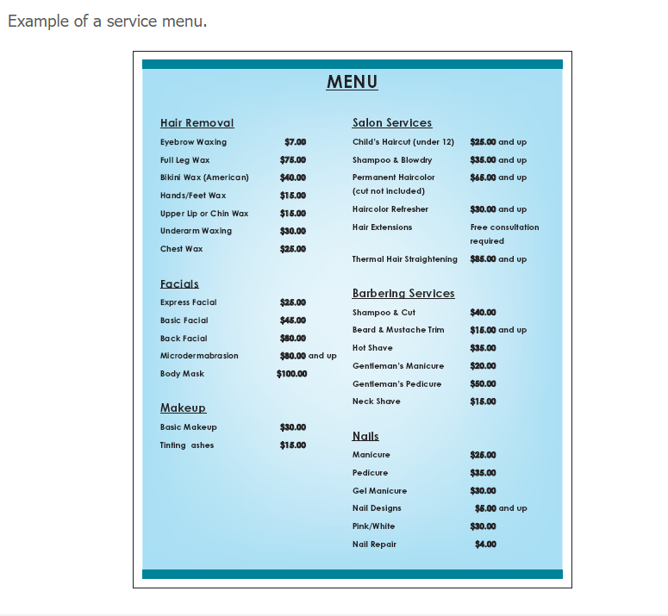

Slide 7

Allocation of Money
As a business operator, you must always know where your money is being spent. A good accountant and an accounting system are indispensable. Provide a guideline for money allocation in a beauty business but will vary depending on locality and discipline.

Slide 8
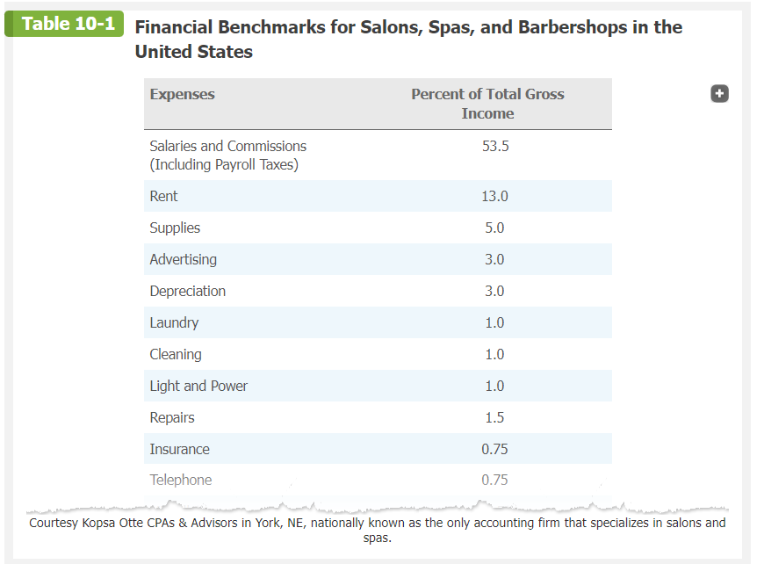


Slide 9

The Importance of Record Keeping
Proper bookkeeping methods include keeping an accurate record of all income and expenses. Income is usually classified as receipts from services and retail sales. Expenses include rent, utilities, insurance, salaries, advertising, equipment, and repairs. Retain all check stubs, cancelled checks, receipts, and invoices. A professional accountant or a full-charge bookkeeper is recommended to help keep records accurate. Percentages can vary from city to city. For example, rent in Toronto City may be a different percentage of sales than in Mississauga.

Slide 10
Purchase and Inventory Records
The purchase of inventory and supplies should be closely monitored. Purchase records help you maintain a perpetual inventory, which prevents overstocking or a shortage of needed supplies, and alert you to any incidents of theft. Purchase records also help establish the net worth of the business at the end of the year.
Keep a running inventory of all supplies and classify them according to their use and retail value. Those to be used in the daily business operation are consumption supplies. Those to be sold to clients are retail supplies . Both categories have different tax responsibilities, so be sure to check with your accountant that you are charging the proper taxes.

Slide 11

Service Records
Always keep service records or client cards that describe the treatments given and merchandise sold to each client. Using a salon-, spa-, or barbershop-specific software program for this purpose is highly recommended. All service records should include the name and address of the client, the date of each purchase or service, the amount charged, the products used, and the results obtained. Clients’ preferences and tastes should also be noted.

Slide 12
Excel Sheet time!

