Slide 1
INFC 215 Infection Prevention and Control
Donning/Doffing
Procedure/ Surgical Mask with Ties

Slide 2
Donning
Putting ON

Slide 3
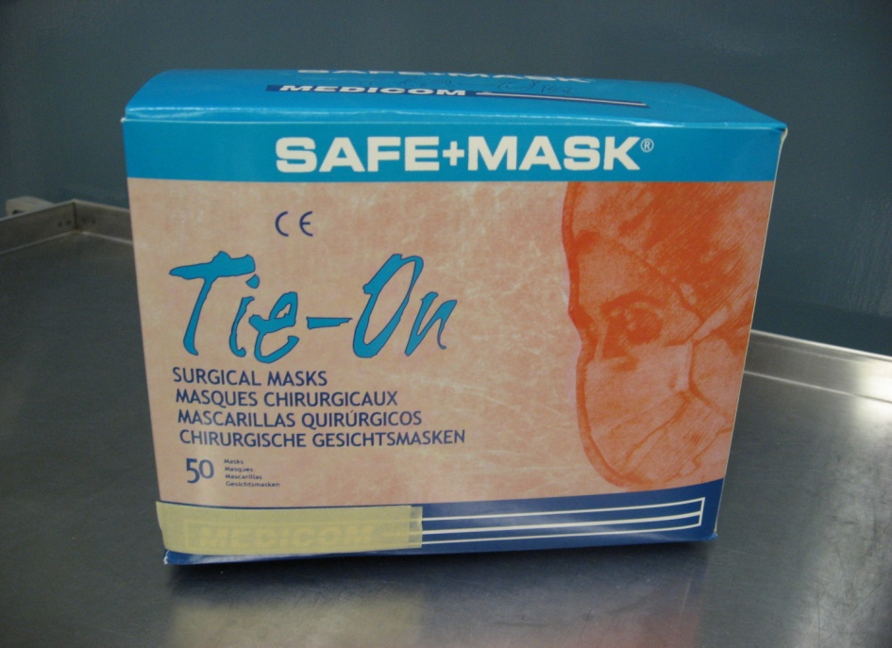
1. Select procedure / surgical mask
When?
As part of Routine Practice
(if anticipating splashes)
or if patient requires droplet isolation precautions

Slide 4
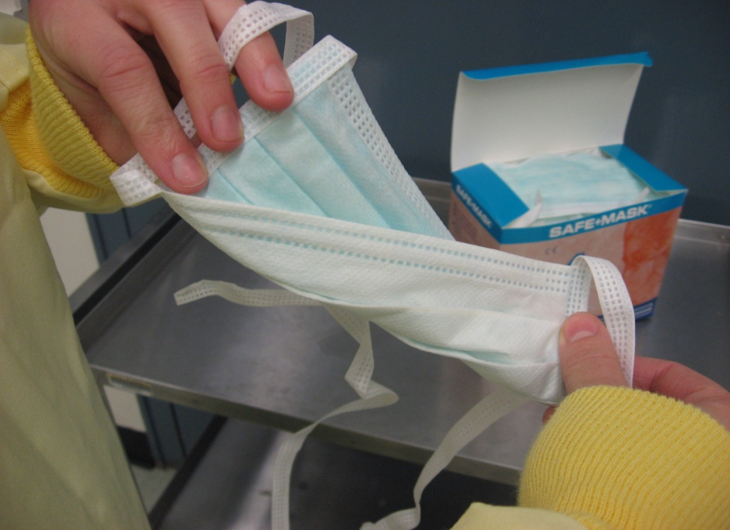
2. Fluid resistant side out
Ensure that the mask is put on with the fluid resistant shield out (not against your face)
The shield is often colored

Slide 5
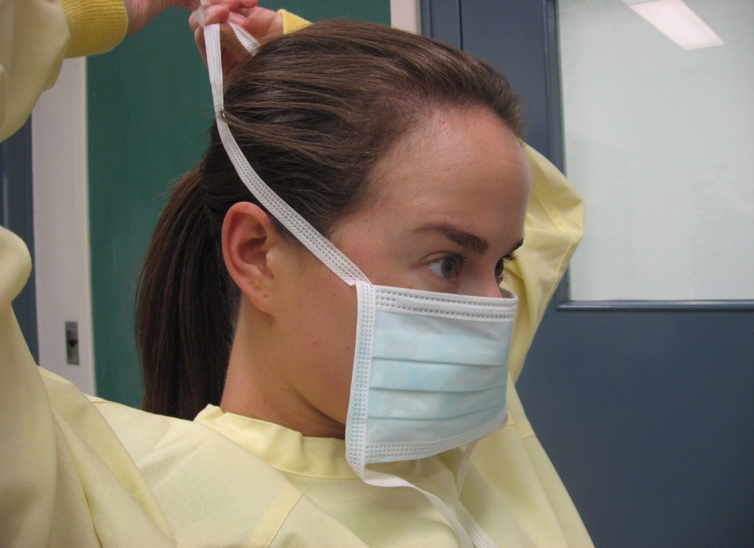
3. Place mask over your nose and mouth
The metal strip goes over the nose

Slide 6
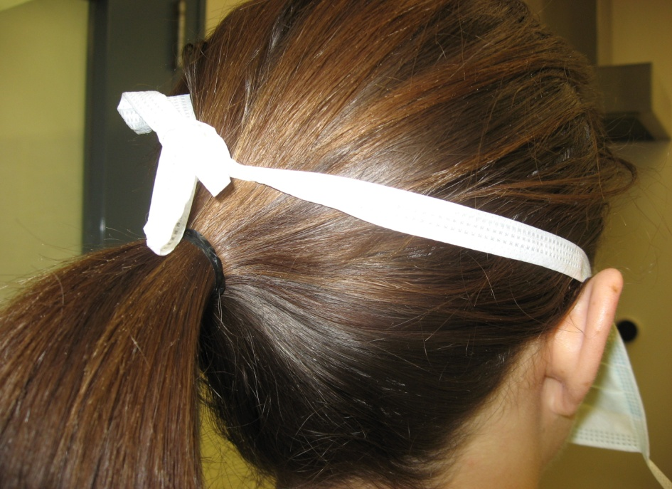
4. Tie top strings first
Over the ears at the back of the head
Over “pony tail” if present

Slide 7

5. Separate folds of the mask
Ensure that your nose and chin are completely covered

Slide 8
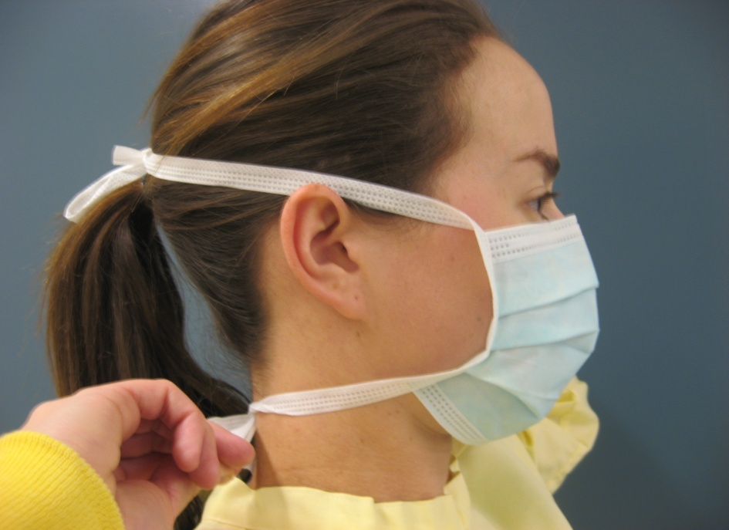
6. Tie bottom strings
Snugly under the ears at the back of the neck
Under the pony tail, if present

Slide 9

7. Ensure a snug fit over your nose and cheeks
Use fingers of both hands to press the metal strip

Slide 10
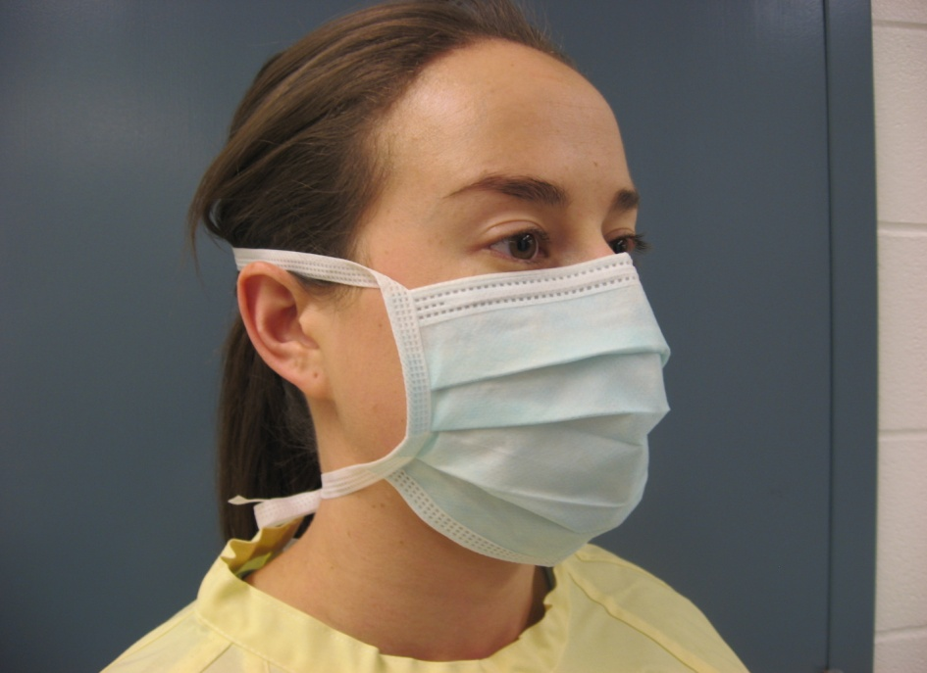
8. Check appearance
Is the mask properly adjusted?

Slide 11
Doffing
Taking OFF

Slide 12
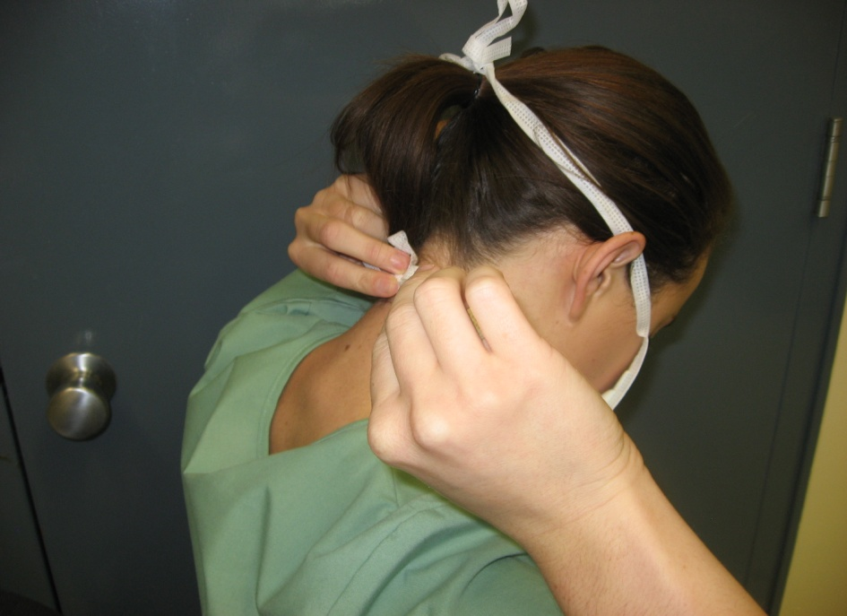
1. Untie bottom ties first
If you untie the top first, the mask will fall so that the contaminated outside touches your skin and clothing

Slide 13
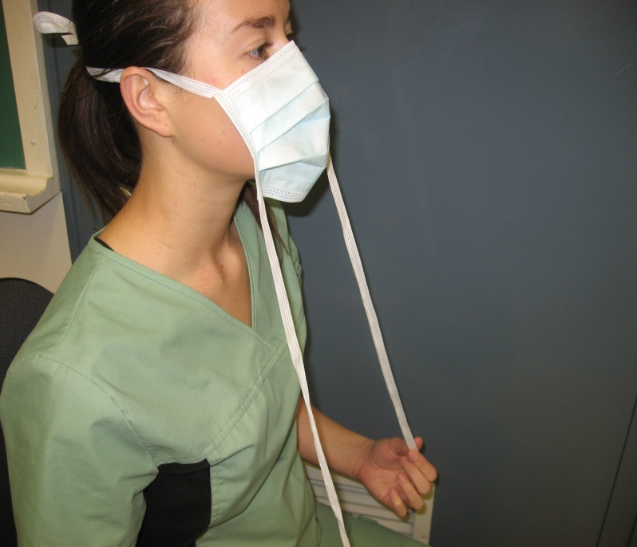
2. Undo bottom ties
Pull mask away from face

Slide 14
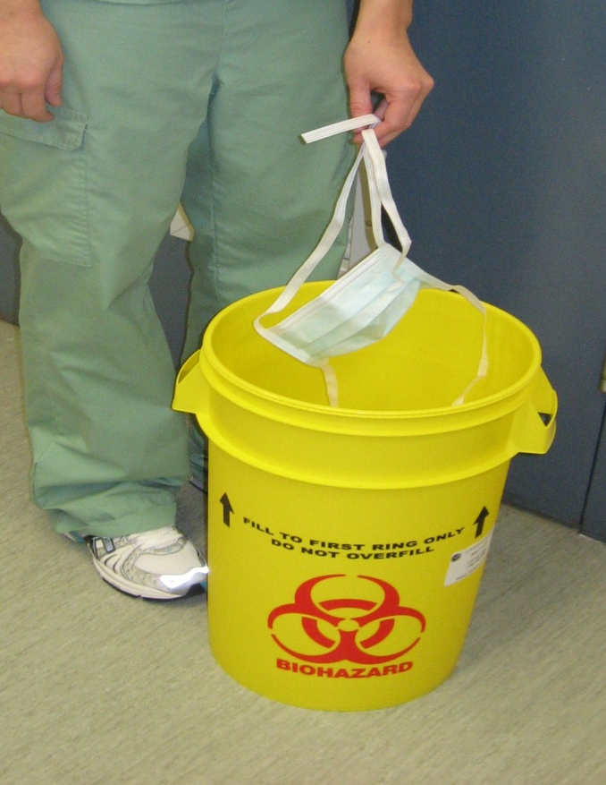
3. Discard in to disposal container
Do not touch outer surface of mask
Use ties to handle mask

