Slide 1


The Galvanic Unit

Slide 2
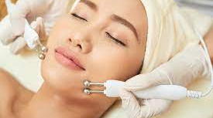
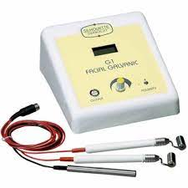
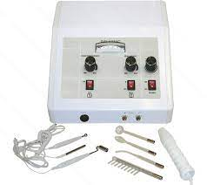
Galvanic Microcurrent

Slide 3
A Constant and Direct Current ​
It has a positive and negative pole and produces chemical changes when it passes through tissues and body fluids ​
Active electrode→ the electrode used on the area to be treated ​
Inactive electrode→ the opposite pole from the active electrode

Slide 4
Two Uses of Galvanic Current
Desincrustation- to soften sebum/oils and grease deposits (used to treat acne, milia, comedones/blackheads)
Iontophoresis- introduction of water-soluble treatment products into the skin with the use of electric current
*no cleansers, moisturisers, ampules or serums during this treatment*

Slide 5
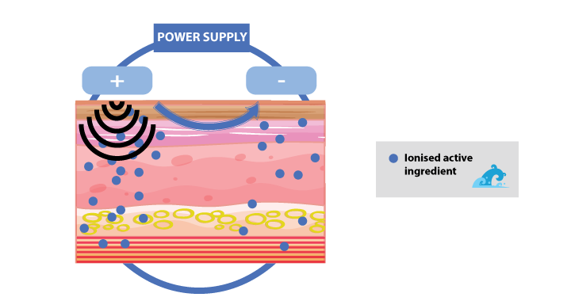
Iontophoresis
The process of introducing water-soluble products in the skin with the use of electric current such as the use of the positive and negative poles of a galvanic machine
Benefits→ hydrating, healing, forces product into skin, soothes nerves

Slide 6
Different treatment solutions can be used to target specific skin conditions
​
Face is covered with moist gauze to help direct current to underlying issue ​
A gel mask can be applied to face and timed according to treatment time

Slide 7
Cataphoresis
This forces acidic substances into deeper tissues using galvanic current from the positive toward the negative pole ​
The infusion of a positive product

Slide 8
Anaphoresis
The process of forcing liquids into tissues from the negative toward the positive pole ​
The infusion of a negative product such as desincrustation fluid

Slide 9
Desincrustation
This is the process used to soften and emulsify grease deposits (oil) and blackheads in hair follicles and pores. ​
This is frequently used to treat acne, milia, and comedones ​
Saponification occurs→ when sebum is transferred into soap, which helps dissolve excess oil, clogged follicles, and other debris on skin while also softening

Slide 10
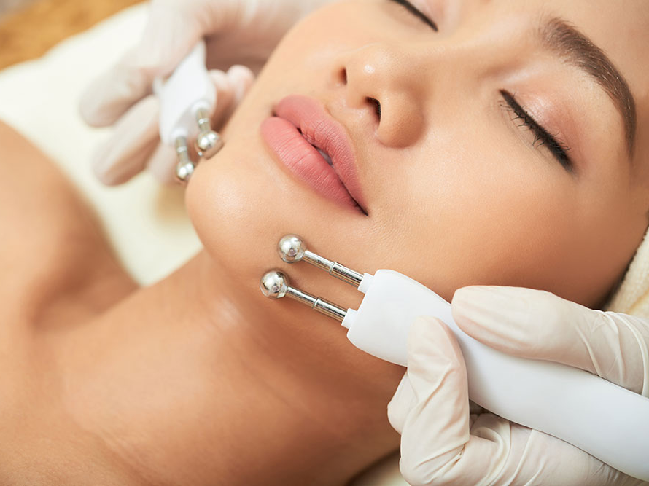
Micro Current
This is a low level of electricity that mirrors the body’s natural electrical impulses
Can be used for iontophoresis, firming, toning, and soothing the skin *see fig 8-13

Slide 11
Benefits
Improves blood/lymph circulation
Produces acidic and alkaline reactions
Opens and closes hair follicles and pores
Increases muscle tone
Restores elasticity
Reduces redness and inflammation
Minimizes healing time for acne lesions
Improves natural protective barrier of the skin
Increases metabolism

Slide 12

Let’s Watch!

