Slide 1
Orientation to Clinical Placement Preparation

Slide 2

Introductions: Titles
Clinical Education Coordinators
Site Liaisons
Preceptors/Clinical Instructors
Instructors

Slide 3
Clinical Placement
Confidence building
Re-familiarize students with equipment and workflow
Clinical Placement prep activities in Edenbrook
Classroom sessions include
  CompTracker
  Introduction to clinical placement

Slide 4
Clinical Placement
Exposure to the career you’ve chosen
Interact with patients
Interact with other healthcare professionals
Practice skills you’ve learned in the lab
Practice communication skills
Practice patient care skills
See exams you haven’t learned in class yet
Learn new ways to complete exams
Prepare for very hands-on work

Slide 5
Dress Code
scrubs
Short warm up coats are permitted (no hoodies)
Hospital OR scrubs provided when necessary, and only allowed to be worn for appropriate rotations
Conservative, clean, closed toe and heel footwear
Clean, long hair must be tied back
Scent-free
Personal Hygiene
Proper hand hygiene - colored nail polish, and excessive jewelry is not permitted
Clean-shaven (for proper N95 mask fitting)

Slide 6
Policies and Procedures: Documentation
CPR – Students must have current certification in CPR. It is the student’s responsibility to
ensure CPR remains current throughout clinical placement.
Immunization – Students must provide current immunization records prior to entering clinical placement.
Security Clearance – Students must provide current security clearance documentation
prior to entering clinical placement.
Fit Testing: All students must be fit tested and carry card with you
Criminal Record Check: Failure to provide current CRC may result in your denial to clinical placement sites.

Slide 7
Attendance
Attendance
  100% expected
  Attendance correlates to success and employability skills
  Days/evenings/weekends
  Notification of absence:
    Absence notification form in CompTracker submitted PRIOR to shift start
    Scheduled site (as per site orientation)

Slide 8
Policies and Procedures: Electronics
Cell phones are not allowed on the clinical floor and site policies regarding all other use of electronic media and devices must be adhered to.
It is also recommended the student adhere to the professional practice standard if any social media tool they use is open to the public.

Slide 9
Professional Expectations
When questions and concerns arise, be sure to utilize available
resources for assistance.
  Instructor
  Clinical Education Coordinator
  Site Liaisons/Clinical Instructor
  Preceptor
Direct supervision from a certified MRT for all procedures.
Ensure all images are approved by an MRT prior to dismissing patients.

Slide 10
Professional Expectations
The MRT Student shall:
  Always demonstrate professional behaviour within the clinical environment
    be respectful of patients and preceptors
    take responsibility for own actions and mistakes
    maintain patient confidentiality
    work safely
  Follow all applicable site policies and procedures

Slide 11
Professional Expectations
The MRT Student shall:
  Demonstrate a positive and willing attitude
  Take advantage of all learning opportunities provided
  Work as part of the Medical Imaging team
  Participate in all tasks performed by MRTs including positioning, documentation, cleaning and stocking rooms, responding to patient care needs, etc.
  Prepare in advance: students should study and review all procedures, especially exams learned in first semester

Slide 12
Feedback
Feedback is a NECESSARY part of your training.
Technologists offering verbal and written feedback.
Instructor feedback.
Your goals:
Try to implement suggestions and show that you are listening.
Try not to focus solely on the negative!
Use feedback to create goals.

Slide 13
CompTracker
Used extensively during clinical placement
  Feedback
  Attendance
  Logbook lines
  Objective forms
Will have thorough orientation before starting in clinical placement.

Slide 14
Emergency Contact Info
Update contact information on CompTracker– this information can only be accessed by instructors, site liaisons/clinical instructors.
  Phone number
  email

Slide 15
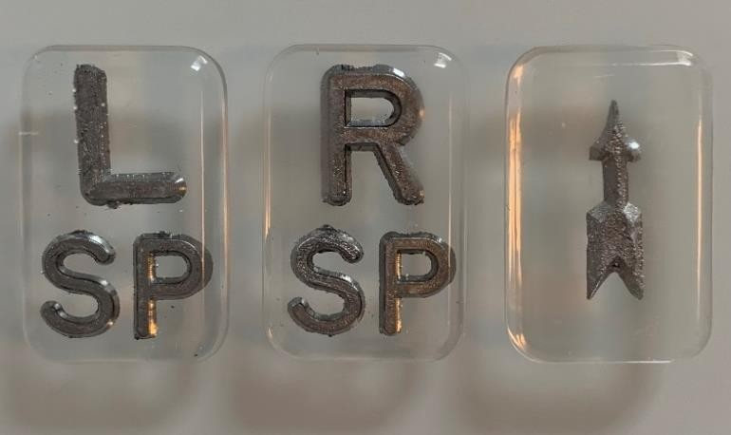
Lead Markers
Lead Markers MUST be visible on all images.
Students will be assigned a specific student number (see list onEdenbrook)
Students are responsible for ordering lead markers and always having
them available during each shift.
Recommended to order a minimum of 2-4 set ^{s}
  Small
  Plain
  L/R/arro
:
©,

