Slide 1
MRAD 240: Specialized
Imaging 1
Venipuncture

Slide 2

Objectives
Discuss anatomy and procedures associated with venipuncture
Describe all equipment required to perform venipuncture
Describe infection control measures needed for maintaining aseptic
technique in venipuncture
Describe the challenges of venipuncture and how to overcome them

Slide 3
Intravenous Cannulation
Administering medication, fluids, or blood products directly into a vein
Rapid infusion into the cardiovascular system
Why do we need it in the X-ray department?
  Most common reason-Contrast administration
  Angiography-Antibiotic and saline administration for lumbar provocative discography

Slide 4
Choosing a Venipuncture Site
How long does the IV need to stay in?
How much fluid will need to be pushed through it?
  More/faster fluids = larger vein
Will we need to reestablish the IV at another time?
  New IVs always started more proximal than previous
  Use most distal site possible
Can the patient’s veins tolerate cannulation at this site?

Slide 5
Choosing a Site cont.
Can be seen and palpated
At least twice the diameter of the needle/catheter
Does not bend or curve for at least the length of the needle
Never start an IV over a joint
Always in the upper limb unless absolutely necessary
  IVs in the lower limb are never done on ambulatory patients

Slide 6
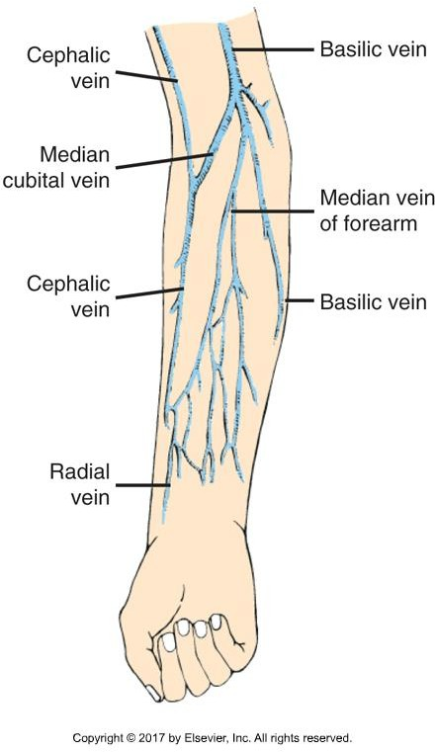
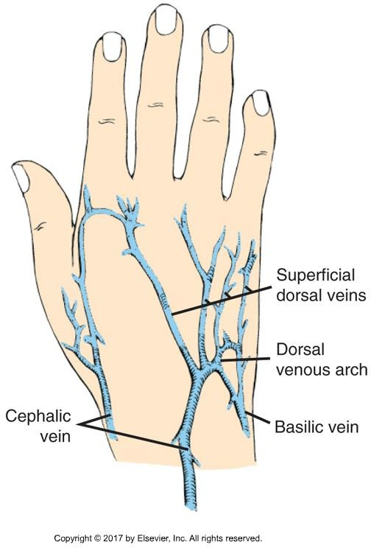
Common Venipuncture Sites

Slide 7
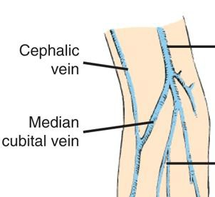
Antecubital Vein IV
Most common choice for contrast administration
  Large
  Strong
  Easily accessed
  Short term

Slide 8
Before Starting an IV
Review the requisition
Follow the “6 Rights Rule”
The right dose
Of the right medication
To the right patient
At the right time
By the right route
With the right documentation
Ehrlich 9th ed. pg 243 Box 14-1

Slide 9
Introducing Yourself to the Patient
Similar to gaining informed consent for an injection procedure
  Consent form signed for administration of contrast or a joint injection doubles as
informed consent for IV start.
    We will be obtaining expressed consent of our “patients” in the lab
SNOD
  Student, Name, Occupation, Duty
Double ID
Contraindications and Risks

Slide 10
IV Equipment
Gloves
  Fit tightly (May want to size down)
Sharps container
  Yellow with biohazard symbol
  Puncture resistant
  Once closed, will not reopen
  NEVER try to retrieve something from the sharps container
Needle
  18-22G
  Purpose and vein condition will determine size
  Faster administration or more viscous fluid = larger needle

Slide 11
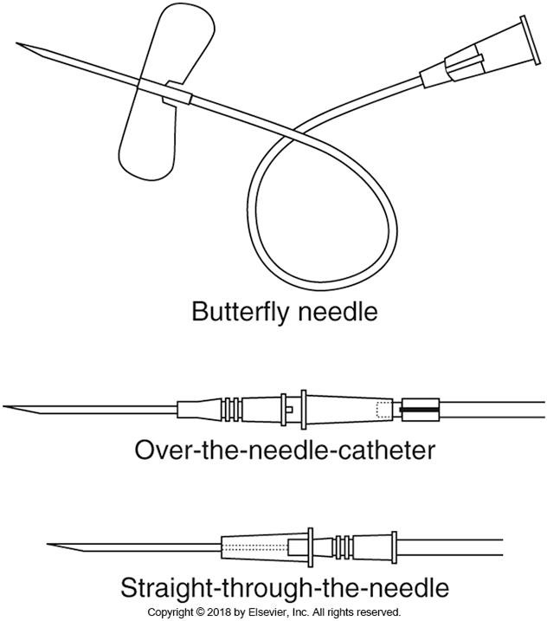
Needles
Butterfly needle
  No catheter
  Used to draw blood
  Not left in pt’s body
  Extension tubing allows movement of syringe without dislodging needle
Over the needle catheter
  Soft flexible cannula is left in the arm
  Angiocatheter
Straight through the needle
  Not used in DI

Slide 12
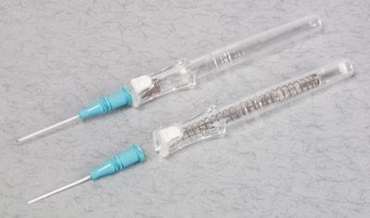
Angiocath
Small plastic catheter surrounding a needle* that punctures skin and vein, and guides catheter into vein
  Gives “flash” when needle enters vein
  Gives second “flash” when catheter enters vein
Push off point on catheter hub
  One handed insertion
Button push for needle retraction
  Cannot be undone!
  Prevents needle sticks
*Bontrager says needle is solid, but it is not really solid. Has a canal to allow for flash
https://www.wolfmed.com/cath-iv-angio-22gx1-200-cs.html

Slide 13
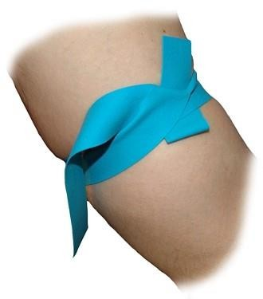
Tourniquet
Flexible rubber band
Restricts venous flow out of arm
3-4 inches above desired IV site
Max 1-2 minutes at once
One per patient
  Leading cause of infections from IV starts
Tight, but not painful
Tie so tails don’t flop onto injection site
No rolls
https://www.wolfmed.com/tourniquet-latex-free-1000-cs.html

Slide 14
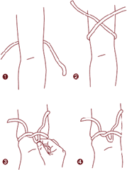
How To Tie a Tourniquet
https://www.youtube.com/watch?v=RFncdUfaJNg
https://www.bluelight.org/xf/threads/injection-iv-complications- and-info-megathread-faq-iii-vs-i-want-blood.602800/page-11

Slide 15
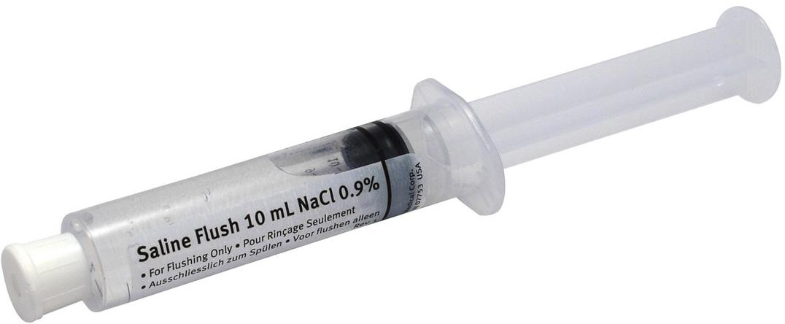
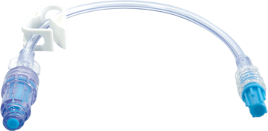
Equipment cont.
Extension tubing
Saline flush
https://www.emsstuff.com/saline-flush-prefilled-10ml-syringe/
https://www.bd.com/en-us/offerings/capabilities/infusion-therapy/iv-administration-sets/iv-extension-sets
Attach saline to tubing and fill with saline to displace air
  “priming” the line

Slide 16
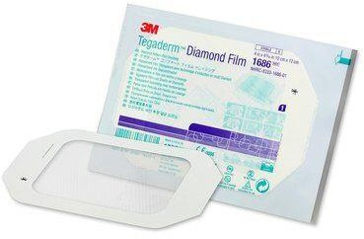
Equipment cont.
Alcohol swabs
Gauze
Tape
Tegaderm
https://www.3m.com/3M/en_US/company-us/all-3m-products/~/All-3M-Products/Health- Care/Medical/Tegaderm/?N=5002385+8707795+8707798+8711017+8711738+3294857497&rt=r3
Blue pads
Cotton balls or bandaids

Slide 17
Selecting a Vein
Non-dominant arm if possible
Palpate with your non-dominant hand
Palpate with flat of 2nd and 3rd digit
  Do not use your thumb
Look for blue vein under skin
Should feel spongy or springy
Takes practice to see and feel

Slide 18
Sites to Avoid
Hematoma, burns, or other broken skin
  Painful insertion
Scars or tattoos
  Very hard to see veins
Mastectomy
  When possible, do not attempt an IV start on the same side as a mastectomy
  Removal of lymph nodes = fluid build up = difficult IV start

Slide 19
Sites To Avoid cont.
Sclerosed or hardened veins
  Disease, inflammation, or scarring
    Chemotherapy or repeated venipuncture
  Difficult to penetrate
  Narrow lumen
Dialysis shunt
  Current or recent
  Excessive scarring and enlarged blood vessels

Slide 20
Starting the IV
Hand hygiene and put on gloves
  Do in front of patient to reduce anxiety
Patient sitting or laying comfortably
  Arm relaxed at side and on a blue pad
Apply tourniquet and select site
Anchor vein with thumb and landmark injection site
Remove tourniquet
Use a marker if necessary
Prepare all equipment for use
  Open packages
  Saline on tubing and line primed
  Gauze and Tegaderm ready
  Everything in arm’s reach

Slide 21
Starting the IV cont.
Reapply tourniquet and palpate vein
Clean site with alcohol swab
  Circular motion starting in center and working out
  Do not cross over clean site with alcohol swab
  Allow to dry or it stings patient
Uncap needle and inspect for damage
Anchor vein with thumb below site
  Prevents vein from rolling away

Slide 22
Starting the IV cont.
Turn needle bevel up
  Hold with thumb and middle finger
  Index finger is free
Insert at 20-45º until you see “flash” in the hub of the needle
  You are now in the vein
Decrease angle of needle to run parallel to the vein
Advance another 0.5cm until you see “flash” in the catheter
  The catheter is now also in the vein

Slide 23
Starting the IV cont.
With index finger, advance catheter into vein until flush with skin
Release tourniquet
  Prevent excessive blood flow for next step
Optional – place gauze below needle hub
Occlude vein with fingers of non-dominant hand 1-2 inches above insertion site
Retract needle and dispose of in sharps
Attach tubing, aspirate, and flush with saline
  Hold hub with non-dominant hand to prevent movement

Slide 24
Securing the IV
If saline flush went smoothly, detach syringe and close lock on tubing
  Prevents flow of blood into tubing
  Tubing will be flushed with saline before and after any medication administration
Place Tegaderm over hub and insertion site
  Removal of paper strips per site protocol
Tape tubing in place to prevent pulling
Write date, time, gauge, and initials on Tegaderm
  May only be done if IV access will remain beyond duration of the current procedure
Document in patient file
  Location, date/time, gauge, flow rate, needle type, and initials

Slide 25
IV Start Video
https://www.youtube.com/watch?v=aq8OwFaIQ4I
This is a great no-nonsense video of how to start an IV smoothly. It is also an excellent demonstration of how a two-handed angiocath needle is used.
The tourniquet tying could use some work….

Slide 26
What If You Miss?
Next attempt must be more proximal if using the same vessel
If you aren’t successful on your second attempt, ask a colleague to try
  This is site protocol in many places

Slide 27
Removing an IV
Hand hygiene
Close lock on tubing
Carefully remove Tegaderm
Hold cotton ball or gauze over injection site
Remove catheter with one smooth pull
Check that catheter tip is intact and discard in sharps container
Apply pressure until bleeding has stopped
Cover gauze or cotton ball with tape or sterile bandage
Hand hygiene
Document discontinued IV

Slide 28
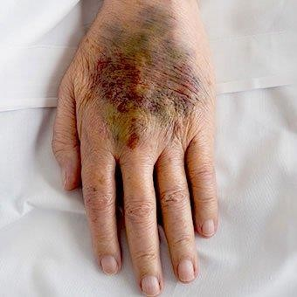
Complications - Hematoma
Bruise
  Blood collects under the skin
  Raised area, red/purple/blue in colour
https://www.medicinenet.com/hematoma/article.htm#can_a_hematoma_resolve_go_away_without_treatment

Slide 29
Hematomas cont.
Happens when:
  Needle penetrates both walls of vessel and blood leaks out the bottom
  Bevel only partially penetrates the vein wall and blood leaks out the top
  If you puncture the vessel multiple times while “fishing” for the vein
  The needle is removed from the arm before the tourniquet
  Insufficient pressure is applied to the site when removing the IV

Slide 30
Hematoma – What To Do
Some people are prone to hematoma formation
  Elderly
  On anticoagulant medication
  Warn these people to expect a bruise
Apply pressure for a longer period when removing the IV. Especially if patient is on blood thinners(heparin)
Apply cool compresses for comfort if hematoma forms
Usually resolves itself in a few days

Slide 31
Complications - Syncope
Some people faint at the sight of needles
Signs
  Pale and sweating
  Disorientation
  Stops talking
  Swaying or slumping
Discontinue IV insertion and remove tourniquet
Prevent patient from falling
Call for assistance
If prone to fainting, lay patient down for IV start if at all possible

Slide 32
Complications - Interstitial
Also called extravasation or infiltration
IV fluid leaks into the surrounding tissue
  Swelling around IV site
  Skin cold to the touch
  VERY painful
Catheter tip is not inside vein when fluids are administered
Flow rate is too high for cannulated vessel
  Fluids leak through the vessel walls
Remove IV, apply pressure to prevent hematoma, raise arm, apply cold compress. BUT
always check site protocol***
  Assure patient the pain is only temporary

Slide 33
Preventing Extravasation
Choose site with care
  Vein should be large enough to handle desired flow rate
Place IV with care
  Avoid piercing both sides of the vein
  Watch for catheter flash before advancing completely
Flush with saline and ensure backflow of blood before administering medication, contrast, or fluids

Slide 34
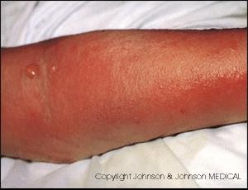
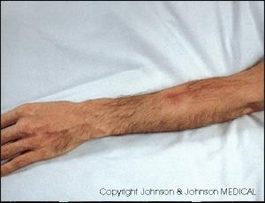
Post Procedural Complications
Local or systemic infection
  Introduction of infection at injection site or into bloodstream
  Caused by lack of aseptic technique or contamination of equipment
  Swelling, fever, chills, or discharge from site
Phlebitis
  Inflammation of a vein
  Swelling, redness, or slow/stopped infusion
Local infection
Phlebitis

Slide 35
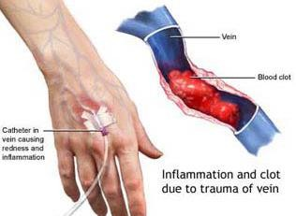
Post Proc Complications cont.
Thrombosis
  Clot inside vein
  Slow/stopped infusion
  Do not forcibly flush catheter to prevent dislodging the clot
Air embolus
  Entry of a bolus of air into the vascular system
  Complications with as little as 20ml of air (length of an average unprimed IV tube)
  SOB, chest, shoulder, or low back pain;
cyanosis, shock, or cardiac arrest

Slide 36
Key Takeaways
Choose site with care
Follow the “6 Rights Rule”
Assemble equipment beforehand
Use rigorous asepsis
Be watchful for complications and know how to respond
Ask for help when needed

