Slide 1


Medical Esthetics
The Respiratory System

Slide 2
OUR JOURNEY TODAY
The Respiratory System

Slide 3
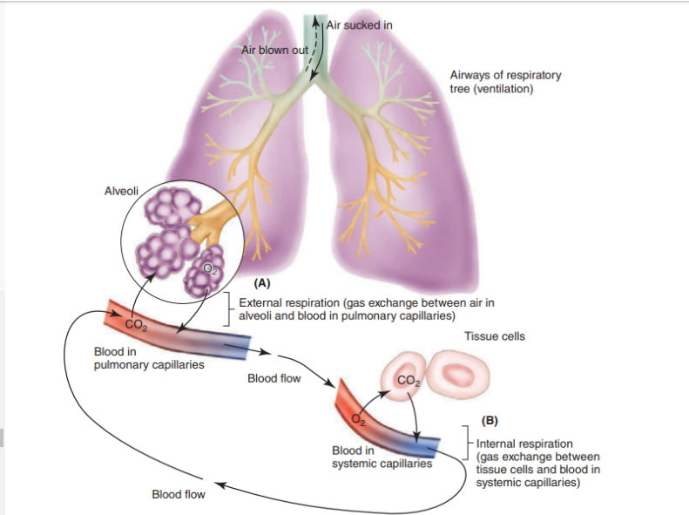


Slide 4
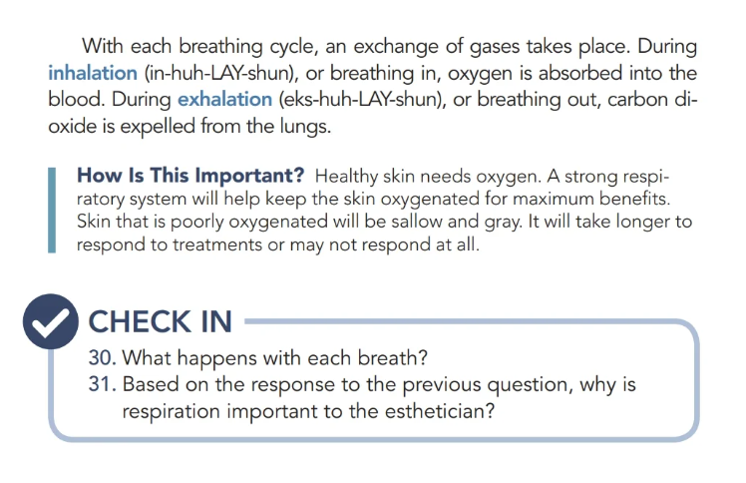

Slide 5

QUESTIONS?

