Slide 1
APPH 226:
Detail and Distortion
Objectives:
5.5 Discuss the effect that geometric factors have on diagnostic quality

Slide 2
Radiographic Quality
How would you describe a high-quality radiograph?
  A radiograph that accurately reproduces structures and tissues as they are in actuality
  Does the image truly represent the anatomy with accuracy?

Slide 3
Factors
What are the four factors that affect radiographic image quality?
  Photographic – a balance between radiographic:
    Density
    Contrast
  Geometric
    Detail (increase detail)
    Distortion (decrease distortion)

Slide 4
Definitions
Recorded detail:
  Degree of sharpness or distinctness of structural lines on a radiograph
Radiographic image quality is determined by the ability of an image to demonstrate structures

Slide 5
Descriptors of Detail
Recorded detail
Definition
Sharpness
Blur
Resolution

Slide 6
Resolution
Defined as:
  The ability of the imaging system to resolve or distinguish between two adjacent structures
  How recorded detail is measured and expressed
  Expressed in line pairs per millimeter
    Lp/mm

Slide 7
Resolution
Is a combination of spatial and contrast resolution
Spatial Resolution
  The ability to image small objects with high subject contrast
  The smallest object that can be seen/visualized
    i.e. microcalcifications
Contrast Resolution
  The ability to distinguish objects with similar subject contrast
    i.e. liver and spleen

Slide 8
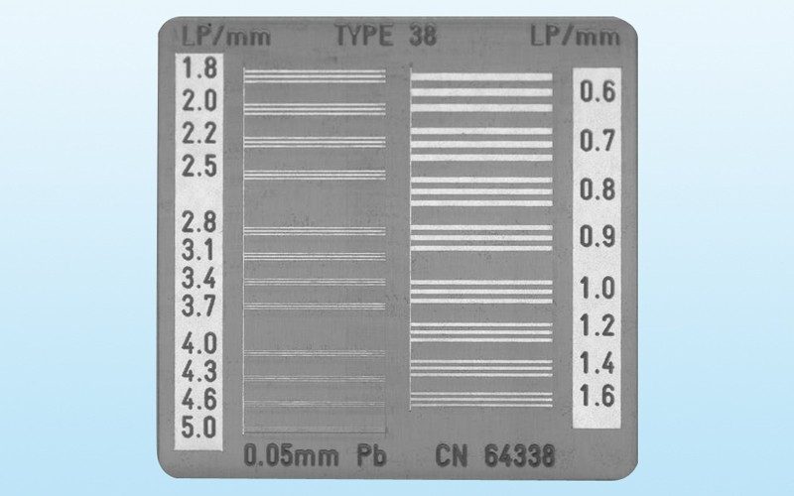
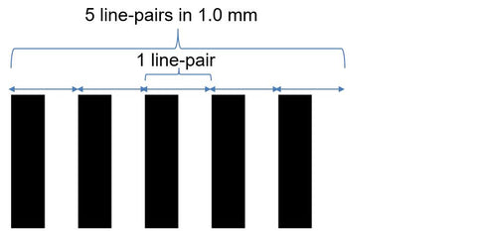
Line Pairs and Test Pattern
Consist of the line and the space
Line pair = line + space
https://coldharboursupply.com/blogs/news/tube-selection-and-specs-a-beginners-guide
https://quart.de/en/products/test-phantoms/resolution-patterns/line-pair-patterns

Slide 9
Resolution – Test Pattern
Device used to record and measure line pairs
Line pairs per millimeter test is used to assess image quality
Describes the spatial resolution of the imaging system
Spatial resolution – ability to differentiate 2 side-by-side (adjacent) structures
Indicates how many pairs of contrasting lines can fit within one millimeter, line pairs per millimeter (lp/mm)
The more line pairs visualized, the higher the resolution and recorded detail
Demonstrates how the imaging system resolves fine details

Slide 10
Detail
Controlled by three factors
  Geometric unsharpness
  Motion unsharpness
  Image receptor unsharpness

Slide 11
Geometric Unsharpness
Factors that affect geometric unsharpness are:
  Focal spot size
  Distance
    OID
    SID

Slide 12
Focal Spot Size
Normally ranges from 0.1 to 3.0 mm
Focal spot size affects the detail

Slide 13
Focal Spot Blur
Occurs because the actual focal spot is not a point source
  Rectangular source
Blurred region on radiograph is a result of the focal spot having size
Undesirable

Slide 14
Focal Spot Blur
Most important factor for spatial resolution
High contrast structures that are smaller than the focal spot blur cannot be imaged
  Cannot visualize the object if it is smaller than the blur

Slide 15
Focal Spot Blur
Geometric relationships that govern magnification will influence blur
If conditions are altered to increase magnification on the image, focal spot blur will also increase
  In the interest of minimizing focal spot blur, these conditions should be avoided whenever possible
    With increased OID/magnification, focal spot blur will also increase

Slide 16
Focal Spot Blur
To decrease the effects of focal spot blur, and increase recorded detail:
  Smallest focal spot possible
  SID as large as possible
  OID as small as possible

Slide 17
SID
Just as radiation intensity changes when the SID is altered, so does the amount of unsharpness recorded on the image
Due to divergence properties of the x-ray beam
  Geometric relationship exists with x-ray source, object and image receptor

Slide 18
SID
When SID is increased, image unsharpness decreases which results in:
  Increased image detail
With a longer SID, the diverging rays become more perpendicular to the object, that is what decreases the unsharpness

Slide 19
OID
Also affects the unsharpness of the image
When the exit beam leaves the patient, it continues to diverge
  If given more distance to diverge, more unsharpness will occur
The most optimal situation would be if the OID = 0
This is impossible in diagnostic imaging

Slide 20
OID
Distance between area of interest and image receptor (OID) has the greatest effect on the amount of geometric unsharpness recorded
  More than SID or focal spot size
  This is a factor that can be controlled by the technologist to a certain degree
For optimal results, try to minimize OID as much as possible

Slide 21
Geometric Unsharpness
Minimizing unsharpness is important, but the effects of these variables must be considered
A small focal spot
  Not suitable for all exams, especially large parts
Large large focal spot
  Not practical for many exams
  Increase in radiographic technique to compensate

Slide 22
Motion Unsharpness
The most detrimental effect on resultant image
Includes motion of:
  Anatomy, part or patient
  Tube
  Image Receptor

Slide 23
Patient Motion
Blur
The most disadvantageous factor to maximizing recorded detail
  Motion artifacts are almost all a result of patient motion
Can be voluntary or involuntary
  Voluntary – within the patient’s control
    Example – suspend respiration
  Involuntary – outside of the patient’s control
    Example - heartbeat

Slide 24
Patient Motion
Sometimes the patient is unable to stop moving
  E.g. Tremors, trauma, intoxication
What are other methods that a technologist can use to try and control/minimize motion artifacts on the image?
  Short exposure times
  Communication
  Immobilization devices

Slide 25
Other causes of Motion
Less typical, but motion unsharpness can also be caused by equipment
Motion from tube, table or image receptor
  Highly unlikely
  Equipment has locks
    Defective equipment, ineffective/damaged locks, not engaged in a lock

Slide 26
Image Receptor Unsharpness
Unsharpness as recorded onto the image receptor
Advances in technology have helped to decrease the amount of exposure required to produce an image with appropriate radiographic density

Slide 27
Film/Screen System – old technology
Factors that affect recorded detail:
Screen properties
  Phosphor size
  Phosphor layer thickness
  Phosphor concentration
  Reflective layer
Film Screen contact

Slide 28
Phosphor Size
Large phosphor size results in the information being spread out and will decrease recorded detail

Slide 29
Screen Speeds and Unsharpness
With higher speed screens, less exposure is required to achieve appropriate density on the IR

Slide 30
Film Screen Contact
Film is sandwiched between two intensifying screens
If there is a space between the screen and the film, it creates an area of unsharpness due to divergence of light
Wire mesh test used to determine appropriate contact between film and screen(s)

Slide 31
Digital Receptors (DR) and Resolution
Primary factors that affect the resolution of all types of digital imaging systems are:
  Geometric properties of the IR
  Image processing system

Slide 32
Intensifying layer with CR
Limitations for recorded detail are similar to that of film/screen
Factors that limit detail are:
  Phosphor size
  Layer thickness
  Concentration
  Scanning of the screen and processing

Slide 33
Resolution and CR
Scanning of the screen and processing phase
  Laser scans the Imaging Plate (IP), which emits light upon stimulation
  Finely focused laser correlates to about one pixel dimension
  The smaller the pixel, the higher the resolution
  Laser beam determines the resolution

Slide 34
Direct Digital Radiography (DR)
Uses a photoconductor made of amorphous selenium and a Thin Film Transistor (TFT)array
DR image receptor consists of a matrix of detector elements - DELs
The x-ray beam is directly converted to an electrical signal
Analog-to-Digital converter changes analog signal to digital signal to produce the digital image on the viewing monitor
Limited by the size of the detector element

Slide 35
Indirect Digital Radiography (DR)
Indirect DR first converts x-rays into light photons and then into an electrical signal
Indirect DR can use charge-coupled device (CCD) system or Thin Film Transistor (TFT)system
Both have a scintillation layer made of either cesium iodide or gadolinium
Scintillation layer converts x-rays into light photons, CCD sensor chips convert the light photons into electrical signals
TFT system have additional layer, the photodiode, made of amorphous selenium. Photodiode converts light photons into an electrical signal that is transferred to the TFT array
Electrical signals are then sent by an Analog-to-Digital Converter which sends the converted digital signal to a computer for processing

Slide 36
DR Resolution
Image processing system sets a limit on recorded detail/spatial resolution
Depends on:
  Matrix size = 1 MP to 5 MP (High Res)
  Pixel size – 1000 x 1000 to 2000 x 2500
  Grey Scale – bit systems
    8 bit – 256 greys
    10 bit – 1046 greys
    14 bit – 16 384 greys
    16 bit – 65 536 greys

Slide 37
Distortion
Results from radiographic misinterpretation of an object
  Can be size or shape
    Size distortion
      Magnification
    Shape distortion
      Elongation
      Foreshortening

Slide 38
Technologist’s Responsibilities
Distortion is directly related to positioning
Can minimize distortion with careful attention to:
  Distances
  Central Ray
  Patient position
  Image Receptor (IR) position

Slide 39
Size Distortion
Defined as:
  A variation in the size of an object’s image as compared to its actual size
In radiography, images are always magnified in comparison to their true size
  Due to presence of OID
SID and OID play a key role in how size distortion is affected

Slide 40
OID
Directly related to magnification
Out of all the factors, has the greatest effect on magnification
When taking radiographs, creating a 2-dimensional image from a 3-dimensional object
Some parts will have more OID than other parts

Slide 41
SID and Magnification
As SID is increased, magnification decreases
  Due to the divergence of the beam
If the straighter rays (closer to the central ray) are creating the image, they are more perpendicular to the part
  Less magnification

Slide 42
Magnification
In some cases, it is done intentionally
  Magnification views
  Digital – can be done with post processing
For the most part, it is undesirable and should be minimized as much as possible

Slide 43
Shape Distortion
When a radiograph misrepresents an object with distortion of its shape
Two forms
  Elongation
    Image appears longer than actual object
  Foreshortening
    Image appears shorter than actual object

Slide 44
Shape Distortion
Can occur from:
  Inaccurate alignment of the x-ray beam to detector
  Inaccurate alignment of the x-ray beam to body part
  Inaccurate alignment of the body part to detector
Any misalignment of the above factors will result in distortion of the body part on the resultant image
  *Central Ray also affects distortion (must be centered accurately to the body part)

Slide 45
Shape Distortion
Sometimes used intentionally for better visualization of anatomy
Generally, shape distortion is not desirable

Slide 46
Shape Distortion
Object Thickness
  OID changes across the object
  More distortion with a thick object vs a thin one
More magnification over areas with more OID
Angling the tube could “throw” anatomy differently on the image
  Can be used to advantage
    Helps reduce superimposition of anatomy

Slide 47
Shape Distortion
Object shape also contributes to shape distortion
The more irregular the shape, the more distortion will occur
  Important to have two perspectives for most exams (e.g. AP and Lateral)
Due to beam divergence and OID
Ideally to minimize the shape distortion from object shape, would be an object that is in the same shape as the diverging beam

Slide 48
Minimizing Shape Distortion
To minimize shape distortion, ensure proper alignment of:
  X-ray tube
  Part
  Image Receptor
  Entry/Exit point of the CR (Central Ray)

Slide 49
Readings
Radiologic Science for Technologists
Pg. 163
Pg.173-184
Pg. 216 (Radiographic Intensifying Screens) – 221 (stop before Screen-Film Combinations)
Pg. 251 (Image Detail)- 252 (stop before Radiographic Technique Charts)

