Slide 1
MRAD 204:
Radiographic Technique 1
Outcome 6-10:
Anatomy of the Distal Tib/Fib and Ankle
MRT Program
Anderson College

Slide 2
Affiliated Readings
Module Reading
Bontrager
Pgs: 216 & 218

Slide 3
Overview
Proximal Tibia & Fibula Review
Distal Tibia & Fibula
Ankle Joint

Slide 4
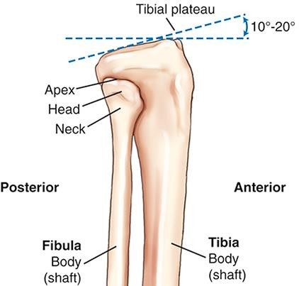
Proximal Tibia & Fibula Review
Superior surface (aka. articular facets) of tibia sit at a 12-20º posterior slope (in relation to
the long axis of the tibial shaft)
Tibial tuberosity
Patellar tendon (of the quadriceps femoris muscle) attaches to the tibial tuberosity anteriorly
The “shin bone” is the anterior crest (i.e. sharp edge of the tibial shaft)
Lateral View
Bontrager pg. 218 Fig. 6.18

Slide 5
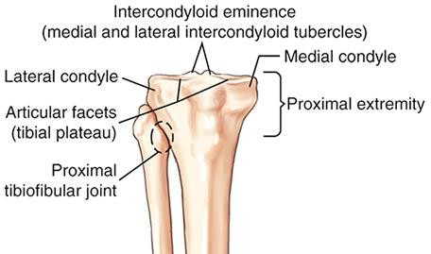
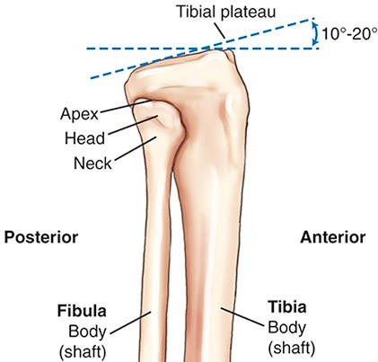
Proximal Tibia & Fibula Review
Remember how to recognize these parts on the proximal tibia and fibula:
1. Intercondyloid eminences
Tibial tuberosity
Anterior crest
2. Tibial plateaus (articular facets)
Lateral
Medial
Anterior View
3. Medial & lateral condyles
4. Head, neck, & apex of the fibula
Tibial tuberosity
5. Tibial tuberosity
6. Proximal tibiofibular joint
Lateral View
Bontrager pg. 218 Fig. 6.17-6.18

Slide 6
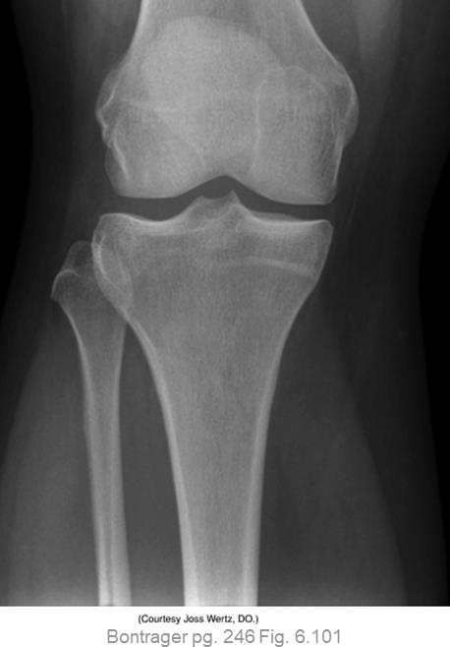
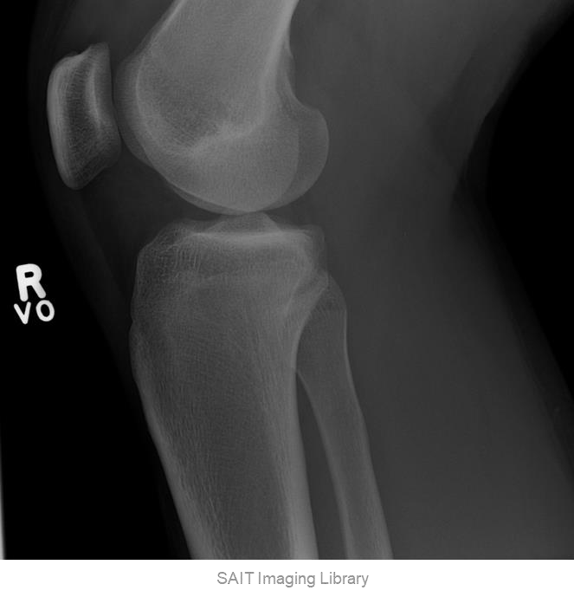
Proximal Tibia & Fibula Review
Bontrager pg. 218 Fig. 6.17-6.18
Tibial tuberosity
Anterior crest
Lateral
Medial
Anterior View
Tibial tuberosity
Lateral View

Slide 7
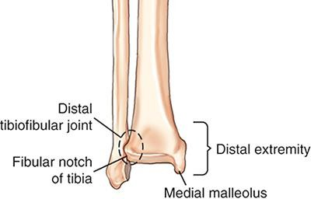
Distal Tibia & Fibula
Teach yourself to recognize the labelled parts of the distal tib/fib:
Distal tibiofibular joint
Fibular notch
3. Medial & lateral malleolus
(plural = malleoli)
Tibial plafond
Tibial plafond
Anterior tubercle
Anterior tubercle
Bontrager pg. 218 Fig. 6.17

Slide 8
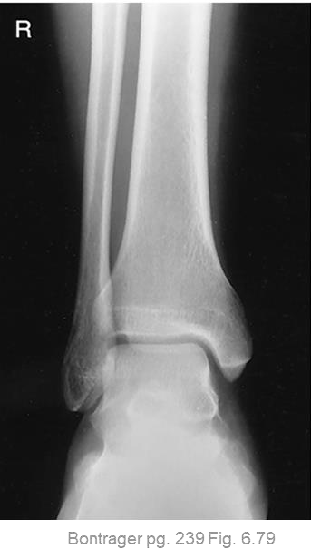
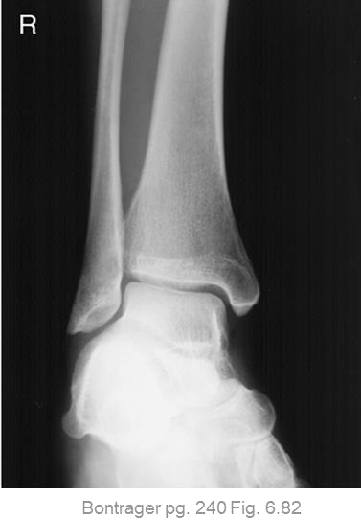
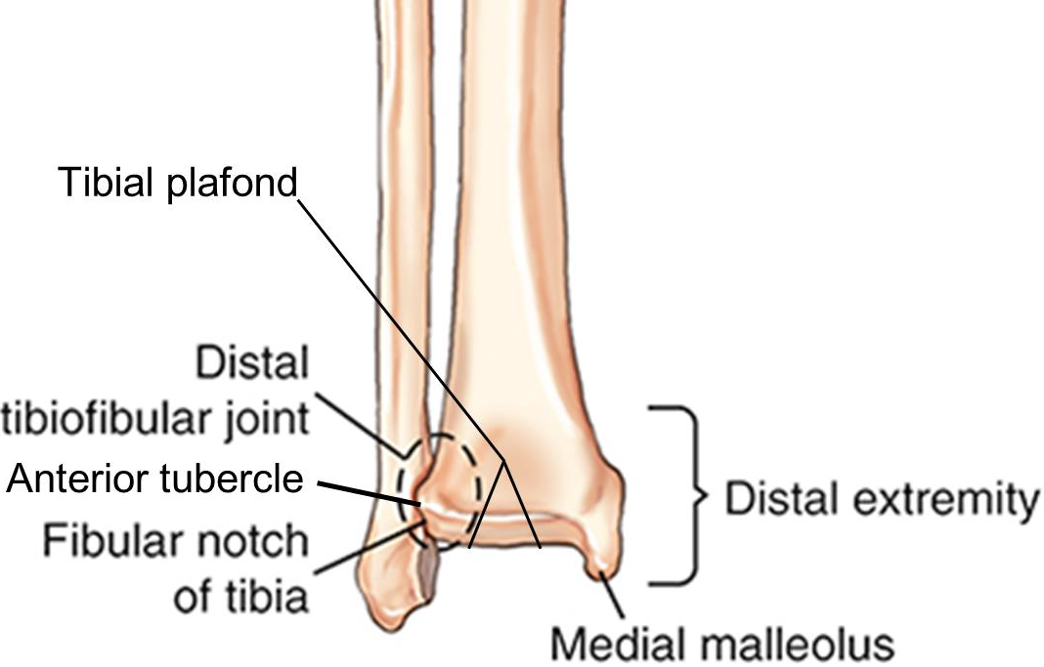
Distal Tibia & Fibula
Teach yourself to recognize the labelled parts of the distal tib/fib:
Bontrager pg. 218 Fig. 6.17

Slide 9
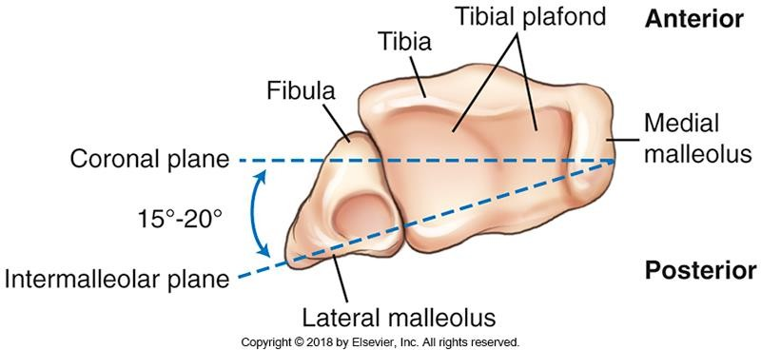
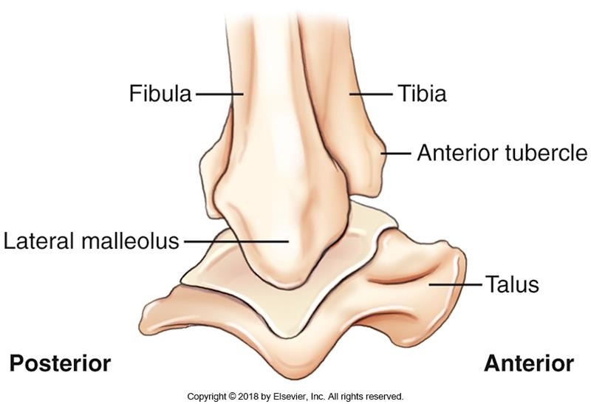
Distal Tibia & Fibula
Intermalleolar plane is 15-20º posterior to the midcoronal plane
Lateral malleolus is ~1cm (³/₈ inch) posterior to the medial malleolus

Slide 10
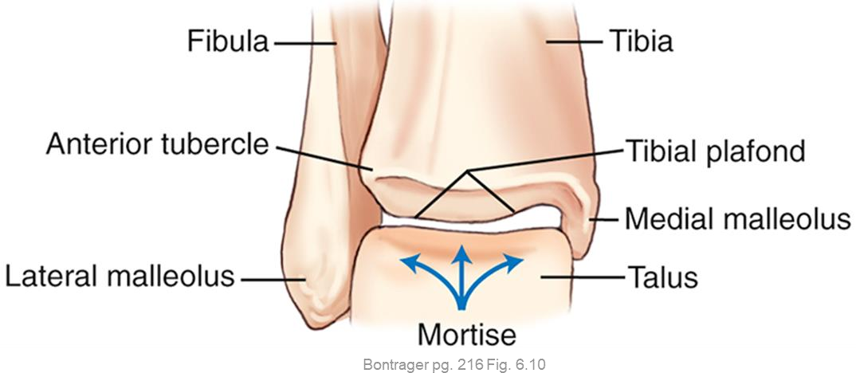
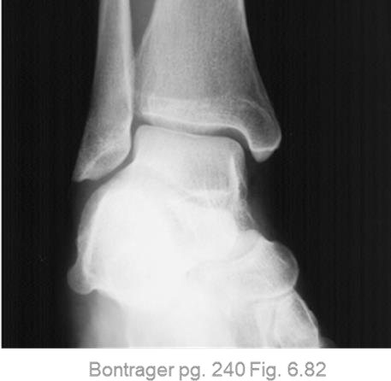
Ankle Joint
Mortise-shaped, diarthrodial, synovial joint formed by three bones: tibia, fibula, and talus
  Allows dorsiflexion & plantar flexion
    side-to-side movements only occur with stretched or torn
ligaments
Frontal view: talus overlaps distal tibia and fibula

Slide 11
Helpful Resources
Sketchfab: https://sketchfab.com/3d-models/
  Access to 3D images of bones
    Can tilt/rotate images
  Labelling

