Slide 1


Complications

Slide 2
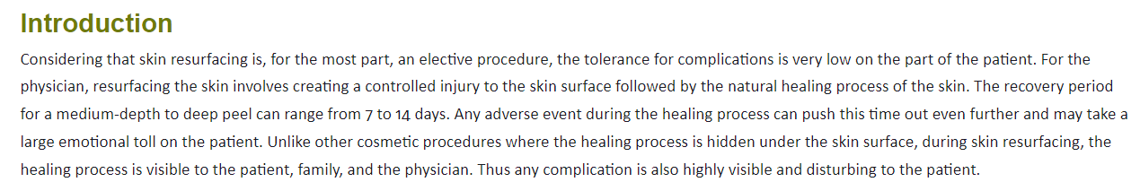

Slide 3
-Contact Dermatitis
-Swelling

Slide 4
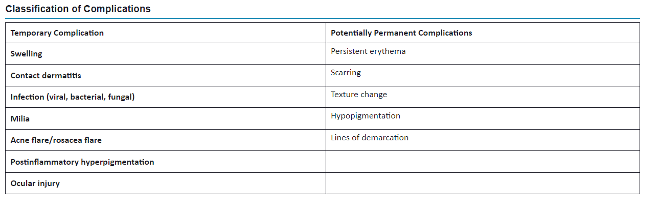

Slide 5
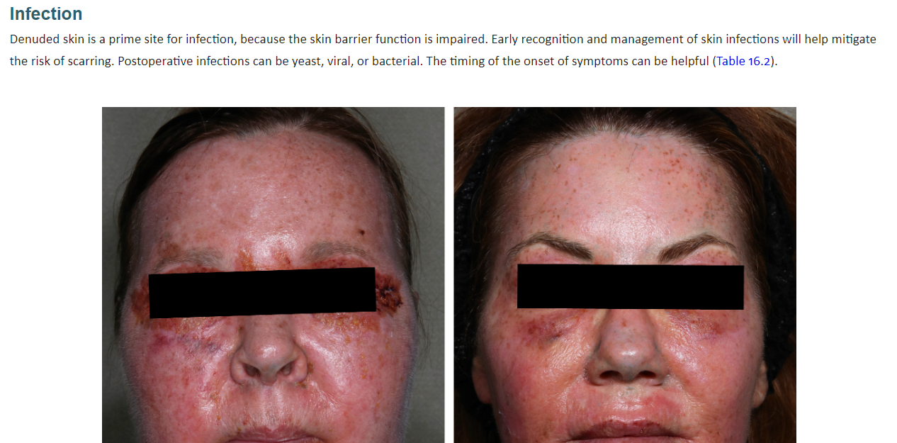

Slide 6
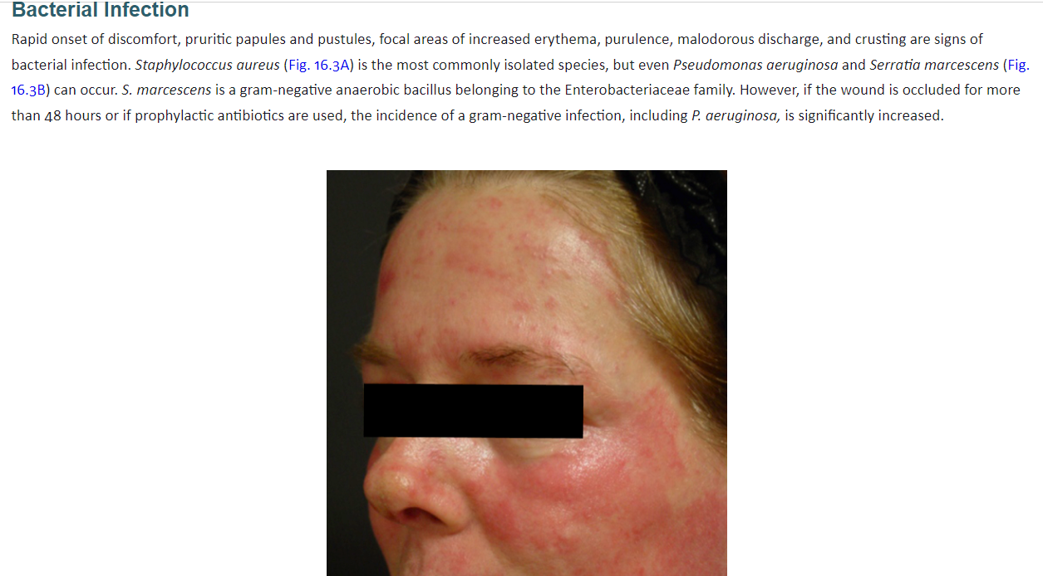

Slide 7
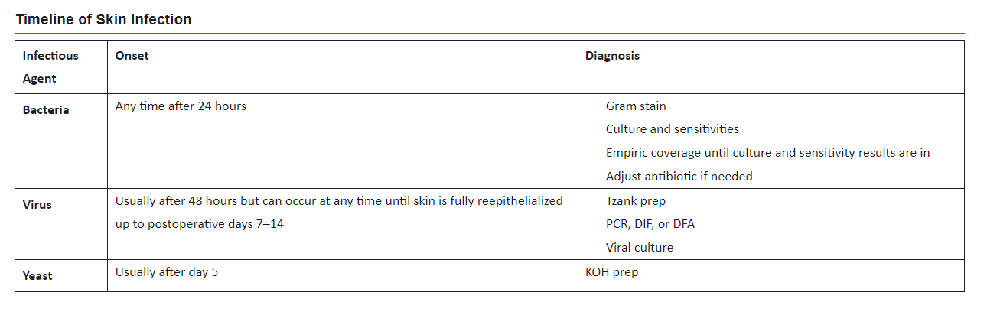

Slide 8
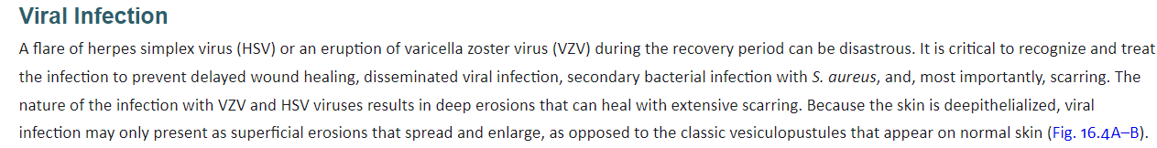

Slide 9
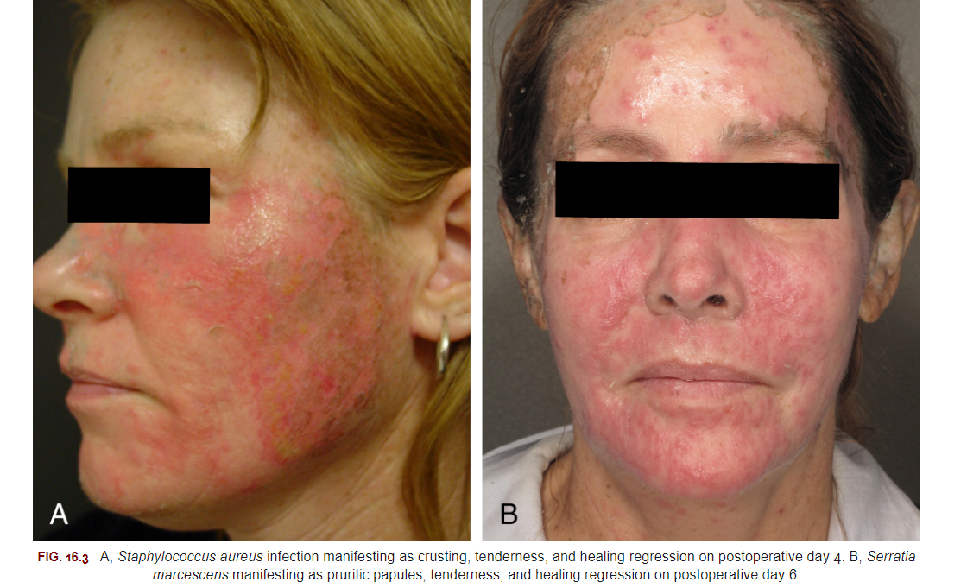

Slide 10
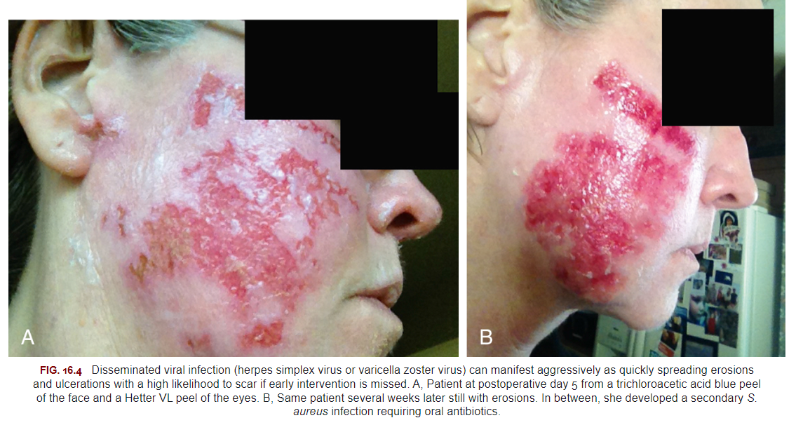

Slide 11
Yest Infection
Other Infections
Milia
Acne
Rosacea
Prolonged Erythema
Scarring
Delayed Wound Healing
Pigmentary Alteration
Hypopigmentation
Ocular Injury
Uneven Peel Penetration

Slide 12
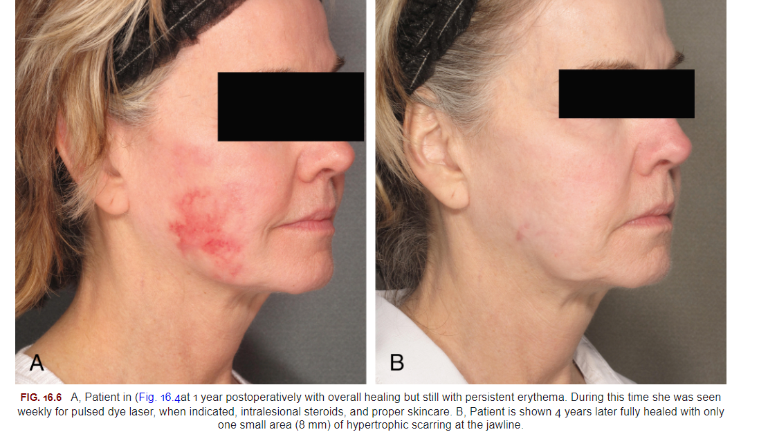

Slide 13
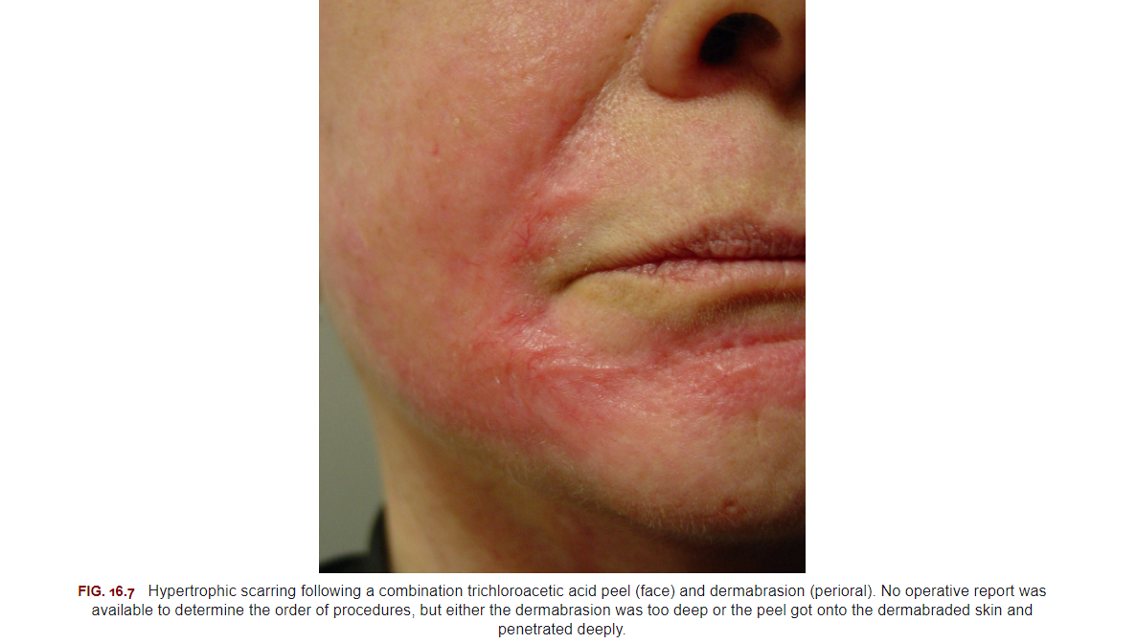

Slide 14
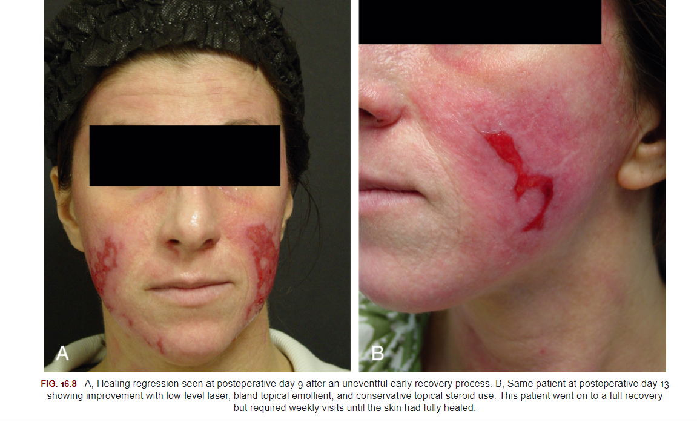

Slide 15
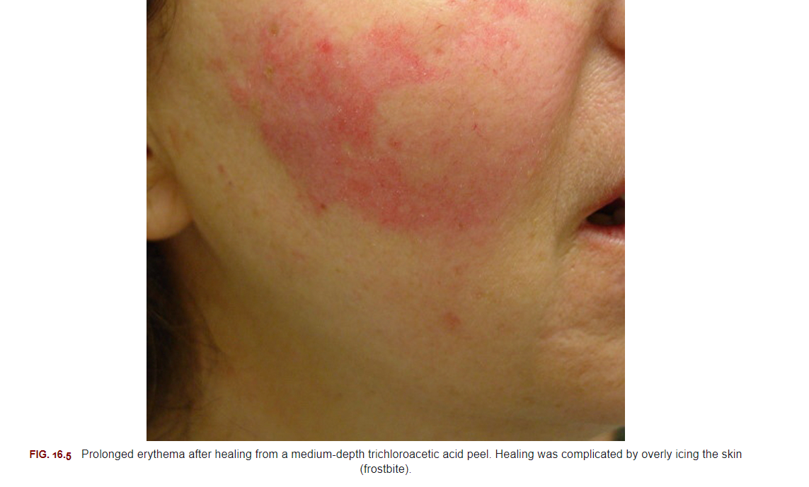

Slide 16
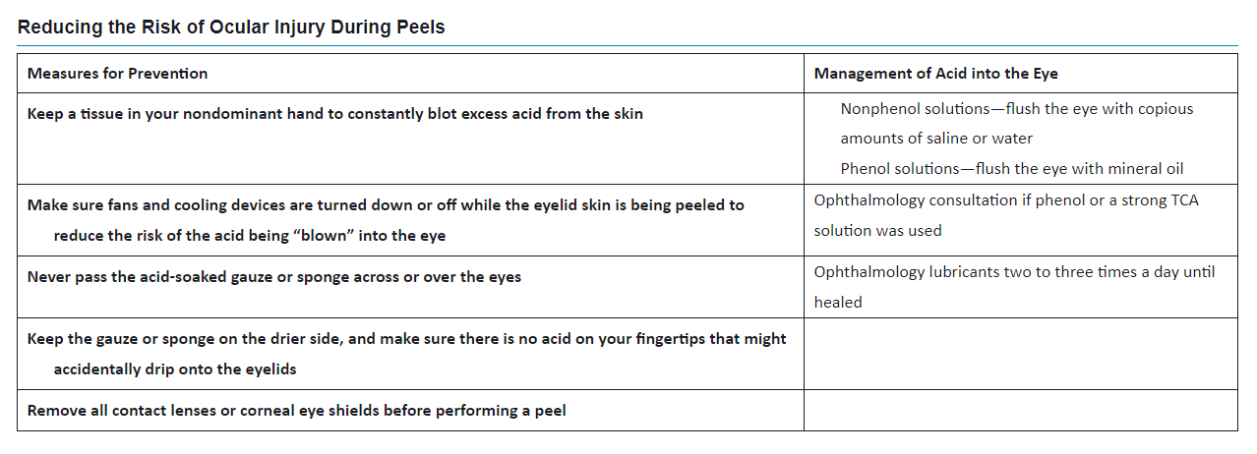

Slide 17
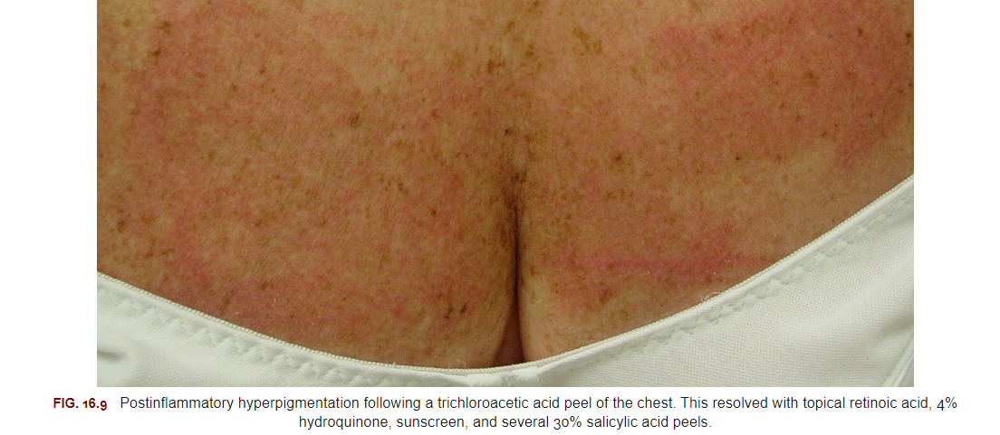

Slide 18
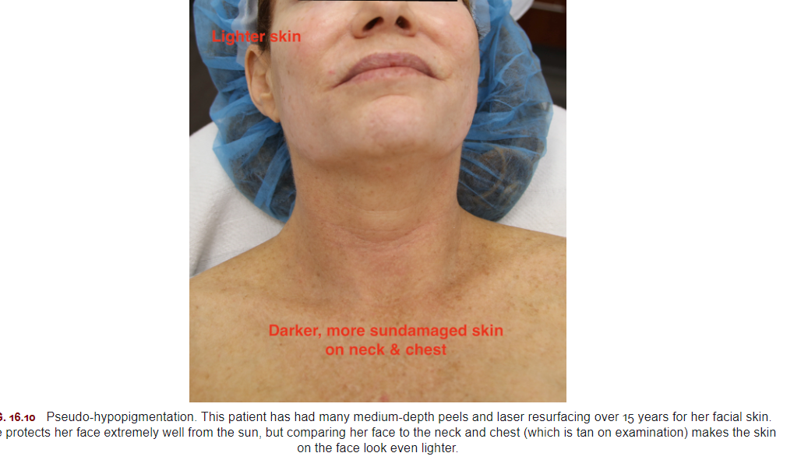

Slide 19
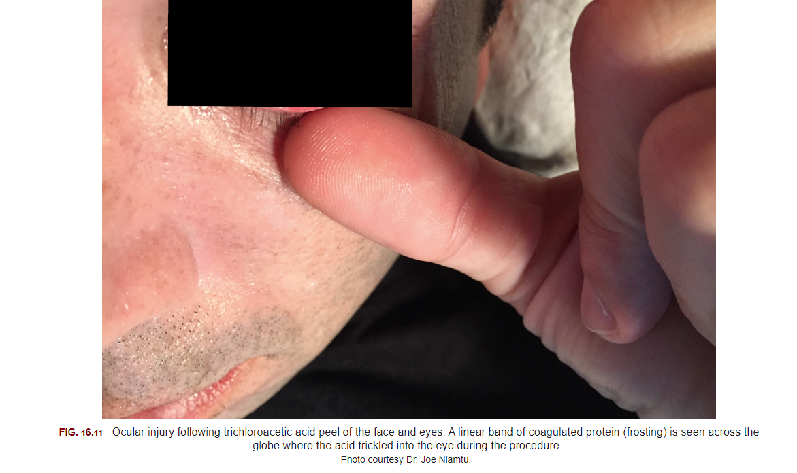

Slide 20
Complications from Deep Phenol Peels
Cardiac Arrythmia
Laryngeal Edema

Slide 21
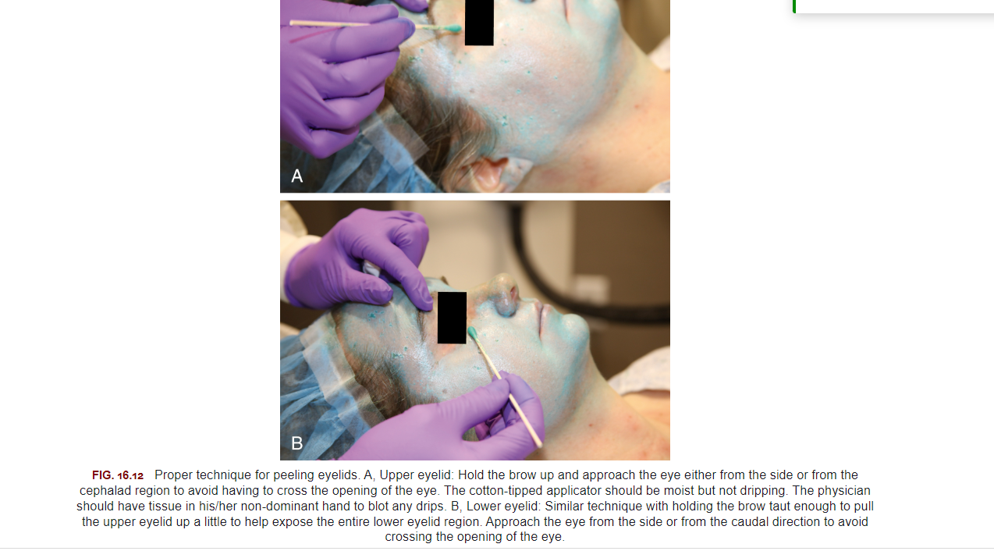

Slide 22
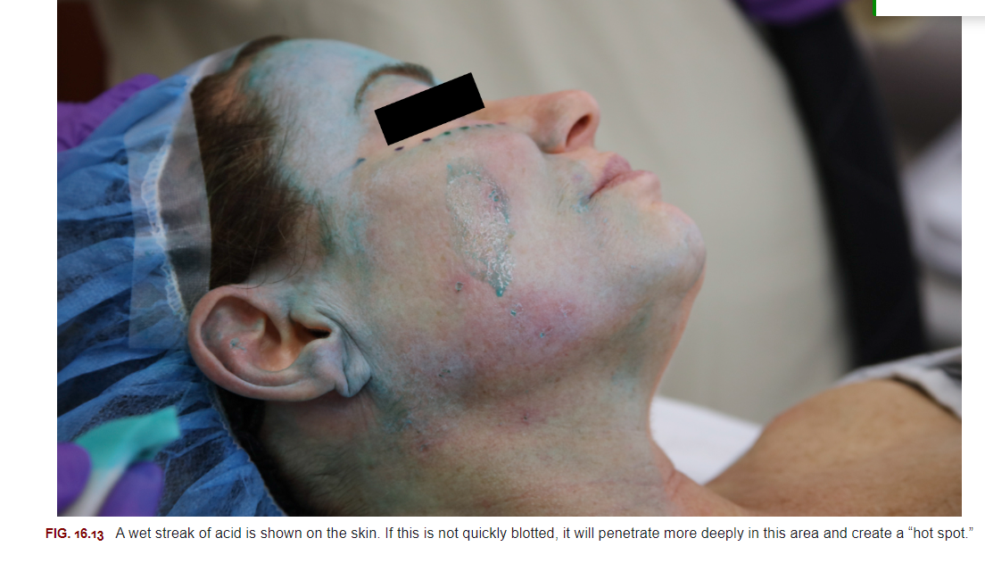

Slide 23
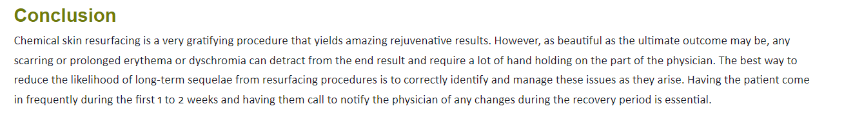

Slide 24

QUESTIONS?

