Slide 1
CT Theory
Abdomen & Pelvis Procedures

Slide 2
CT Imaging of the Abdomen & Pelvis
Module Objectives
Review anatomy of the abdomen & pelvis
Label anatomical structures on a CT image
Scanning protocols including:
  Positioning
  Indications & Contraindications
  Exposure Factors
Most common CT Abdomen & Pelvis exams done
Pathology

Slide 3
CT Imaging of the Abdomen & Pelvis
Positioning for a CT Abdomen & Pelvis
Patient Position
  Supine, arms elevated and resting behind head
•
  Reduce patient motion
  Suspend respiration
Anatomy Position
  No rotation

Slide 4
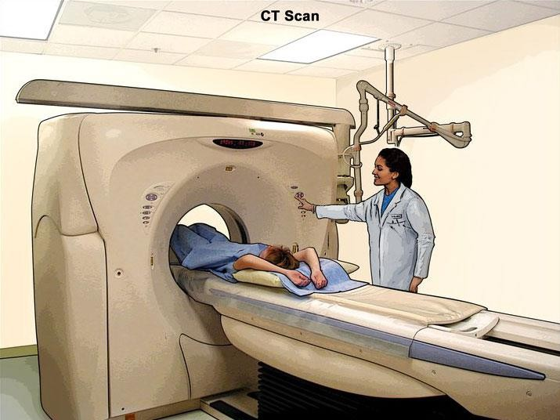
CT Imaging of the Abdomen & Pelvis
Image Source: https://cancer.gov

Slide 5
CT Imaging of the Abdomen & Pelvis
How are CT images of the Abdomen & Pelvis acquired?
  Axial plane
  Helical acquisition
  Oral & IV contrast

Slide 6
CT Imaging of the Abdomen & Pelvis
Oral Contrast
  Demonstrates interstitial lumen
  Distends GI tract
•
  Barium sulfate or water-soluble contrast is used
  Generally, the greater volume = better opacification. Most sites use
.

Slide 7
CT Imaging of the Abdomen & Pelvis
Oral Contrast
  Air & Water also useful as low-attenuation contrast agents
  Advantages of using low-attenuation contrast media (like water), vs. positive contrast agents:
•
    Will not obscure abdominal vessels
    Better spatial resolution on reconstructed images
    Does not mask a radiopaque stone (biliary or urinary)
  Rectal contrast not commonly used, but useful in
.

Slide 8
CT Imaging of the Abdomen & Pelvis
IV Contrast
  Opacify the vessels of the abdomen & pelvis
  Increase the CT density of vascular organs
  Improve image contrast between lesions and normal anatomy
  Timing, dose, rate of IV contrast is essential in performing an accurate scan
  Multi-phase scans also performed to image arterial & venous phases of certain structures, most commonly the liver, pancreas, and kidneys

Slide 9
CT Imaging of the Abdomen & Pelvis
Challenges in scanning
Motion
  Voluntary or involuntary (ie – )
  Management –
Wide range of tissue attenuations (more than can be represented in single window setting)
  Management – Multiple WW and WL reconstructions
  Standard Soft Tissue: WW 450 WL 50
  Liver: WW WL
  Lung bases: WW 1500 WL -600
  Bone: WW 2000 WL 600

Slide 10
CT Imaging of the Abdomen & Pelvis
Challenges in scanning
Anatomy variances
  Management – tech’s attention to detail!
  Ensure all anatomy is included, cannot just go by physical landmarks
Matching DFOV to previous
  Set DFOV to just include skin surface
•
  Purpose – easy visual comparison of any lesions or changes.

Slide 11
CT Imaging of the Abdomen & Pelvis
Protocols and Pathology
Can be very specific, and tailored to area of interest.
We will focus on how CT can image:
  Routine Abdomen & Pelvis
  Acute Appendicitis
  Liver
  Pancreas
  Urinary system & calculi

Slide 12
CT Imaging of the Abdomen & Pelvis
CECT Routine Abdomen & Pelvis
Indications
•
  Tumor staging
  Abscess
  Other non-specific abdominal symptoms
Nickname = RAP.

Slide 13
CT Imaging of the Abdomen & Pelvis
CECT Routine Abdomen & Pelvis
Scout(s): AP & Lateral
Anatomy Included:
Suspend on Inspiration

Slide 14
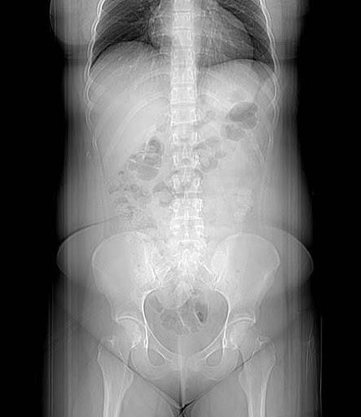
CT Imaging of the Abdomen & Pelvis

Slide 15
CT Imaging of the Abdomen & Pelvis
CECT Routine Abdomen & Pelvis
SFOV: Large Body
DFOV: 38 cm / Set to patient
Algorithm: Standard / Soft Tissue
WW , WL

Slide 16
CT Imaging of the Abdomen & Pelvis
CECT Routine Abdomen & Pelvis
Acquisition kVp: 120
Acquisition mA: Average 230
  ATCM – between
Reconstruction details will vary:
  MPR
  Slice Thickness – thin slices
  Windowing – Liver WW 150 WL 70, Lung WW 1500 WL -700
  Apply filters
  3D, if indicated

Slide 17
CT Imaging of the Abdomen & Pelvis
CECT Routine Abdomen & Pelvis
IV Contrast: 125 ml at 3.0 ml/sec, 50 ml saline flush
Scan delay: seconds
  Phase
Oral contrast: 900 ml barium sulfate
  Give final 225 ml just prior to scanning

Slide 18
CT Imaging of the Abdomen & Pelvis
CECT Routine Abdomen & Pelvis
https://radiopaedia.org/cases/how-to-read-a-ct-of-the-abdomen-and-pelvis
https://radiopaedia.org/cases/large-bowel-obstruction-sigmoid-tumour-
1?lang=us

Slide 19
CT Imaging of the Abdomen & Pelvis
CECT Chest, Abdomen, Pelvis
Indications
o
  Mass
  Trauma
Nickname - CAP
Two scans done
1. venous chest
2.

Slide 20
CT Imaging of the Abdomen & Pelvis
CECT Chest, Abdomen, Pelvis
Scouts – AP & Lateral
Anatomy Included:
  Venous Chest:
  Venous Abdomen: Above diaphragm – 1 cm below iliac crest (abdomen only)
  Venous Abdomen & Pelvis: Above diaphragm – pubic symphysis
Suspend on Inspiration

Slide 21
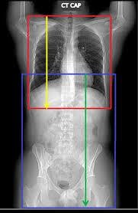
CT Imaging of the Abdomen & Pelvis

Slide 22
CT Imaging of the Abdomen & Pelvis
CECT Chest Abdomen & Pelvis
SFOV: Large Body
DFOV: 38 cm / Set to patient
Algorithm: Standard / Soft Tissue
WW 350, WL 50

Slide 23
CT Imaging of the Abdomen & Pelvis
CECT Chest Abdomen & Pelvis
Acquisition kVp:
Acquisition mA: Average 230
  ATCM – between 100 – 240 (but will vary)
Reconstruction details will vary:
  MPR
  Slice Thickness – thin slices
  Windowing – Liver WW 150 WL 70, Lung WW 1500 WL -700
  Apply filters
  3D, if indicated

Slide 24
CT Imaging of the Abdomen & Pelvis
CECT Chest Abdomen & Pelvis
IV Contrast: 125 ml at 3.0 ml/sec, 50 ml saline flush
Scan delay – Chest: seconds
  Venous Phase
Scan delay – Abdomen Pelvis: seconds
  Portal Venous Phase
Oral contrast: 900 ml barium sulfate
  Give final 225 ml just prior to scanning

Slide 25
CT Imaging of the Abdomen & Pelvis
https://radiopaedia.org/cases/breast-carcinoma-with-pathological- hip-fracture?lang=us
https://radiopaedia.org/cases/metatstatic-colorectal-cancer?lang=us

Slide 26
CT Imaging of the Abdomen & Pelvis
CT for Appendicitis
Review – what is the appendix, where is it located?
CT is considered gold-standard for diagnosing acute appendicitis
CT is considered % accurate for diagnosing acute appendicitis

Slide 27
CT Imaging of the Abdomen & Pelvis
CT for Appendicitis
Appendicitis occurs with of the narrow appendiceal lumen.
Can be caused by:
  Fecaliths
  Infection – causes lymphoid hyperplasia
  Foreign body
  Intestinal parasites

Slide 28
CT Imaging of the Abdomen & Pelvis
CT for Appendicitis
When the lumen becomes obstructed, the mucosa becomes distended.
Distension causes pain and cramping in the RLQ, possibly nausea and vomiting.
Distension causes bacterial growth which triggers an inflammatory response in the body.
Distension compromises blood supply to the appendix, causing
.

Slide 29
CT Imaging of the Abdomen & Pelvis
CT for Appendicitis
Appearance of appendicitis on CT images
•
  Soft tissue inflammation in the fat surrounding the appendix
  Appendicolith

Slide 30
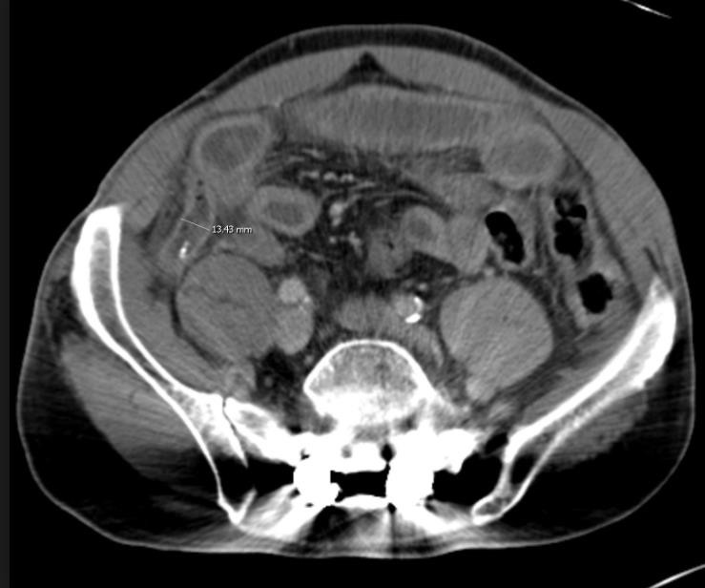
CT Imaging of the Abdomen & Pelvis
Image Source: Direct Radiology

Slide 31
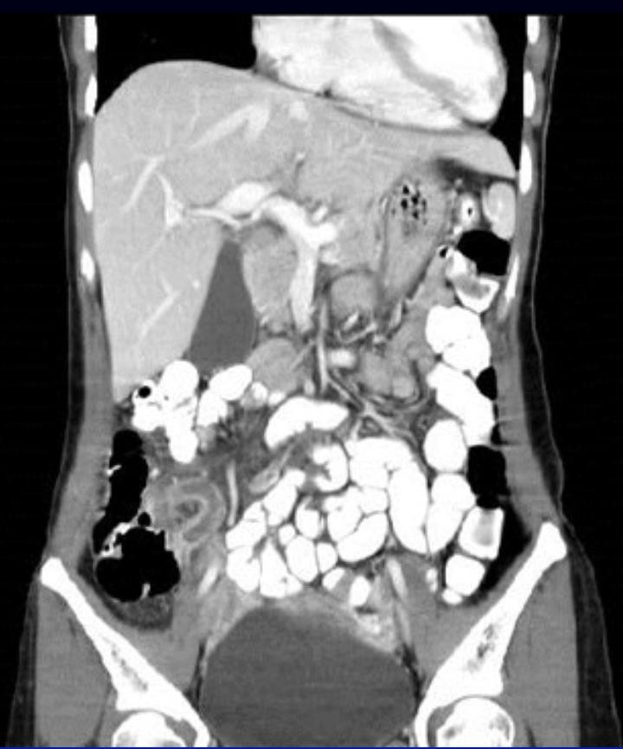
CT Imaging of the Abdomen & Pelvis
Image Source: LearningRadiology.com

Slide 32
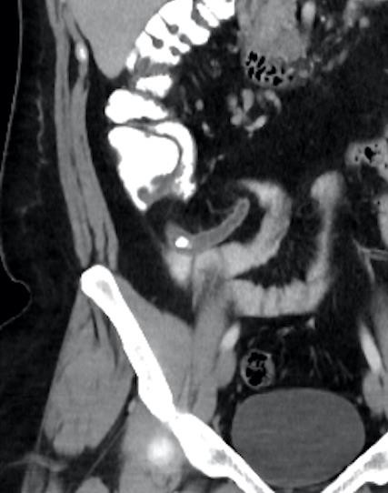
CT Imaging of the Abdomen & Pelvis
Case courtesy of Dr Hani Salam, Radiopaedia.org, rID: 12326

Slide 33
CT Imaging of the Abdomen & Pelvis
CT for Appendicitis
Appendicitis can be ruled out if:
•
  Appendiceal lumen contains air and/or contrast
  Appendix measures less than 6 mm in diameter
  Appendiceal wall is less than 2 mm thick
  No “stranding” is present

Slide 34
CT Imaging of the Abdomen & Pelvis
Diagnosis of Acute Appendicitis on CT
https://www.youtube.com/watch?v=BI6BgaX6u2k

Slide 35
CT Imaging of the Abdomen & Pelvis
CECT Abdomen & Pelvis for Appendicitis
Scout: AP & Lateral
Anatomy Included:
Suspend Breathing:Inspiration

Slide 36
CT Imaging of the Abdomen & Pelvis

Slide 37
CT Imaging of the Abdomen & Pelvis
CECT Abdomen & Pelvis for Appendicitis
SFOV: Large Body
DFOV: 38 cm / Set to patient
Algorithm: Standard / Soft Tissue
WW 500, WL 50

Slide 38
CT Imaging of the Abdomen & Pelvis
CECT Routine Abdomen & Pelvis
Acquisition kVp: 120
Acquisition mA: Average 230
  ATCM – between 100 – 575
Reconstruction details will vary:
  MPR
  Slice Thickness – thinner slices
  Windowing – Liver WW 150 WL 70, Lung WW 1500 WL -700
  Apply filters
  3D, if indicated

Slide 39
CT Imaging of the Abdomen & Pelvis
CECT Abdomen & Pelvis for Appendicitis
IV contrast: 125 ml at 3 ml/sec, 50 ml saline flush
Scan delay: 65 seconds
Oral Contrast: ml
  675 ml, with final 225 ml immediately before scanning
What’s the difference between RAP?
•

Slide 40
CT Imaging of the Abdomen & Pelvis
https://radiopaedia.org/cases/appendicitis-19?lang=us
https://radiopaedia.org/cases/appendicitis-33?lang=us

Slide 41
CT Imaging of the Abdomen & Pelvis
CT for Liver imaging
Normal liver: CT number HU
The attenuation of a healthy liver is at least 10 HU higher than that of the spleen.
Indication - Fatty Infiltration
  Diagnosed by comparing the CT number of liver to CT number of spleen.
  Very common! Can be caused by obesity, alcoholism, diabetes, chemotherapy, corticosteroid therapy, malnutrition.

Slide 42
CT Imaging of the Abdomen & Pelvis
Liver Imaging
Indication – Fatty Infiltration
  Fatty infiltration reduces the attenuation of the liver, at least 10 HU lower than that of the spleen.
  Place ROIs over area of liver and spleen, and compare values.
  Can be diffuse (throughout liver) or focal (inhomogenous)
  Focal infiltrate can be difficult to differentiate from liver mass/tumors.
  Most accurately assessed on .

Slide 43
CT Imaging of the Abdomen & Pelvis
https://radiopaedia.org/cases/fatty-liver-with-focal-sparing?lang=us

Slide 44
CT Imaging of the Abdomen & Pelvis
CT for Liver Imaging
Dual blood supply makes enhancement of the liver unique.
  Hepatic arterial phase: seconds
  Late hepatic arterial phase: 40-55 seconds
  phase: 65 – 80 seconds
  Hepatic venous phase: 75-85 seconds
  Early delayed hepatic phase (or vascular equilibrium phase): 3-5 minutes
  Late delayed hepatic phase (or parenchymal equilibrium phase): 10-15
minutes

Slide 45
CT Imaging of the Abdomen & Pelvis
CT for Liver Imaging
Indication - Cavernous hemangioma
•
  Can be solitary or have multiple lesions
  On NECT, hemangiomas appear as a well-defined, hypodense mass of the
same density as other fluid-filled space (like the IVC).
  On CECT, hemangiomas show progressive pooling of contrast at the lesion’s
periphery.
  With a longer delay, the lesion will become uniformly enhanced.

Slide 46
CT Imaging of the Abdomen & Pelvis
https://radiopaedia.org/cases/cavernous-hepatic- hemangioma?lang=us

Slide 47
CT Imaging of the Abdomen & Pelvis
CT for Liver Imaging
Other indications –
  Hypervascular tumor – intense enhancement in late arterial phase
( sec post injection)
  Liver metastases – majority of liver mets are hypovascular, show best enhancement in portal venous phase ( sec post injection)
So how do we scan the liver?

Slide 48
CT Imaging of the Abdomen & Pelvis
CECT Arterial Venous Liver
Indications
  Fatty Infiltrate
  Liver Tumor / Mass
  Liver metastases
Nicknames
  Multi-phase Liver
  Triphasic Liver

Slide 49
CT Imaging of the Abdomen & Pelvis
CECT Arterial Venous Liver
Scout: AP & Lateral
Anatomy Included: Just above diaphragm – iliac crests (include entire liver)
Suspend on Inspiration
Helical Acquisition

Slide 50
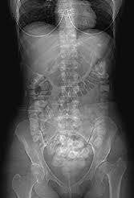
CT Imaging of the Abdomen & Pelvis

Slide 51
CT Imaging of the Abdomen & Pelvis
CECT Arterial Venous Liver
SFOV: Large / Body
DFOV: 38 cm – optimize to patient
Algorithm: Standard / Soft Tissue
WW 500 WL 50

Slide 52
CT Imaging of the Abdomen & Pelvis
CECT Arterial Venous Liver
Acquisition kVp: 120
Acquisition mA: 100-575
  ATCM
Reconstruction details will vary:
  MPR
  Slice Thickness – Thin
  Windowing – Liver WW 150 WL 70
  Apply Filters
  3D, if indicated

Slide 53
CT Imaging of the Abdomen & Pelvis
CECT Arterial Venous Liver
IV contrast: 125 ml at ml/sec, 50 ml saline flush
Scan delay:
  Non-enhanced – Prior to injection
  Arterial – 35 seconds post bolus
  Venous – 65 seconds post bolus
Oral Contrast – 900 ml water
  450 ml, 30 minutes prior to scan
  225 ml, 10 minutes prior to scan
  225 ml, immediately before scanning (in CT room)

Slide 54
CT Imaging of the Abdomen & Pelvis
https://radiopaedia.org/cases/normal-multiphase-ct-liver?lang=us
https://radiopaedia.org/cases/multifocal-hepatocellular-carcinoma-3?lang=us

Slide 55
CT Imaging of the Abdomen & Pelvis
CT for Pancreas Imaging
Indications – Pancreatitis, tumours, calculi or obstruction in the ducts
  Calculi in the pancreatic and/or common bile duct – best seen on
.
  Pancreatitis, mass / tumor – best seen on .
Challenges – Dense contrast may obscure tiny ducts, calculi
  Management - Use low attenuation contrast (often water)

Slide 56
CT Imaging of the Abdomen & Pelvis
CECT Arterial Venous Pancreas
Identical scan parameters to arterial venous liver!

Slide 57
CT Imaging of the Abdomen & Pelvis
CECT Arterial Venous Pancreas
IV contrast: 125 ml at 4 ml/sec, 50 ml saline flush
Scan delay:
  Non-enhanced – Prior to injection
  Hepatic Arterial – seconds post bolus
  Hepatic Venous – seconds post bolus
Oral Contrast – 900 ml water
  450 ml, 30 minutes prior to scan
  225 ml, 10 minutes prior to scan
  225 ml, immediately before scanning (in CT room)

Slide 58
CT Imaging of the Abdomen & Pelvis
CECT Arterial Venous Pancreas
If scans fail to differentiate the pancreas from the duodenum, patient may be scanned in right lateral decubitus position

Slide 59
CT Imaging of the Abdomen &Pelvis
https://radiopaedia.org/cases/pancreatic-sarcoidosis?lang=us

Slide 60
CT Imaging of the Abdomen & Pelvis
CT for Urinary Tract Calculi
Calculi can form anywhere throughout the urinary tract
Review – terminology
Acute, severe pain associated with passing a renal calculi is called
renal colic.
Stones can cause obstruction, dilation, distension of the ureters.
Collective term for these changes is called
.

Slide 61
CT Imaging of the Abdomen & Pelvis
CT for Urinary Tract Calculi
Advantages:
  High diagnostic accuracy ( %)
  Almost all types of stones are visible
  Capable of 3D reconstructions, within the kidney itself
  Provide information about the degree of obstruction
  Provides other valuable diagnostic information (genitourinary system, or
other systems of the abdomen & pelvis)
Disadvantages:
  Radiation dose
  Expensive

Slide 62
CT Imaging of the Abdomen & Pelvis
NECT Abdomen Pelvis, for calculi
Indications
  Urinary tract calculi
  Renal colic, flank pain
Thin slices (2.5mm or less) identify tiny stones
Nickname –

Slide 63
CT Imaging of the Abdomen & Pelvis
NECT Abdomen Pelvis, for calculi
Scouts – AP & Lateral
Anatomy Included: 2 cm above kidneys – symphysis pubis
Suspend on Inspiration

Slide 64
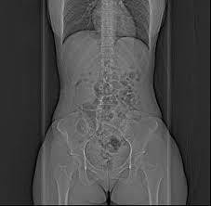
CT Imaging of the Abdomen & Pelvis

Slide 65
CT Imaging of the Abdomen & Pelvis
NECT Abdomen Pelvis, for calculi
SFOV: Large / body
DFOV: 38 cm, set to patient
Algorithm: Standard / Soft Tissue
Window: WW 500, WL 50

Slide 66
CT Imaging of the Abdomen & Pelvis
NECT Abdomen Pelvis, for calculi
Acquisition kV: 120
Acquisition mA: Set mA to reduce dose and image noise
Reconstruction details will vary
  MPR – good for spatial detection
  Slice Thickness – thin slices, small increments
  Windowing
  Apply Filters
  3D, if indicated
No contrast

Slide 67
CT Imaging of the Abdomen & Pelvis
https://radiopaedia.org/cases/ureteric-calculus-2?lang=us
https://radiopaedia.org/cases/horseshoe-kidney-with-renal- stones?lang=us
https://radiopaedia.org/cases/urethral-calculus-3?lang=us

Slide 68
CT Imaging of the Abdomen & Pelvis
Summary
Review anatomy of the abdomen, pelvis, and its vasculature.
Review indications, contraindications and technical factors involved in different CT examinations of the abdomen and pelvis.
Attention to detail and pathology is SO important!
Abdominal Aorta, GI Bleed (mesenteric), Enterography, Colonography, Adrenal Glands, Renal mass and CT urogram procedures will not be tested on!
Next class – Spine Anatomy & Procedures

