Slide 1


Treatment of Acne With Light and Energy-Based Devices

Slide 2
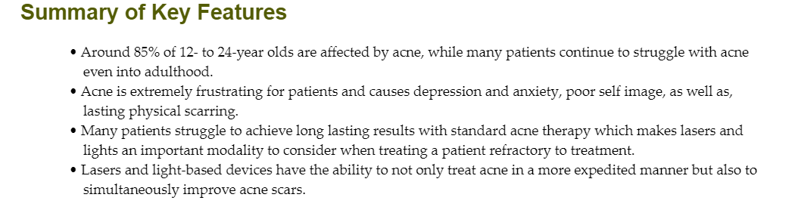

Slide 3
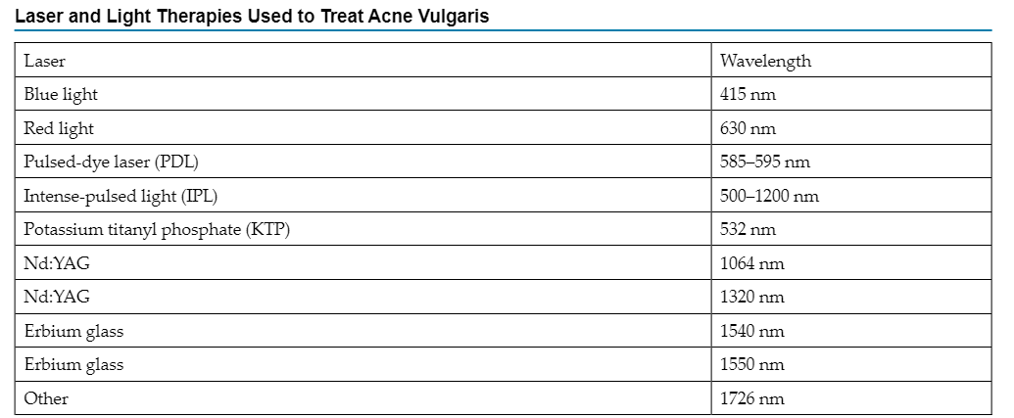

Slide 4
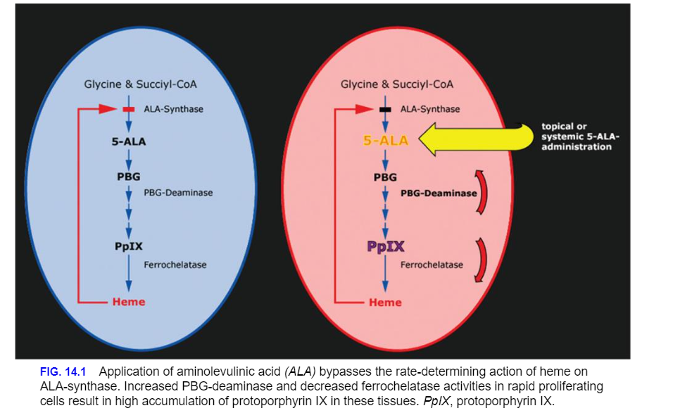
Photodynamic Therapy

Slide 5
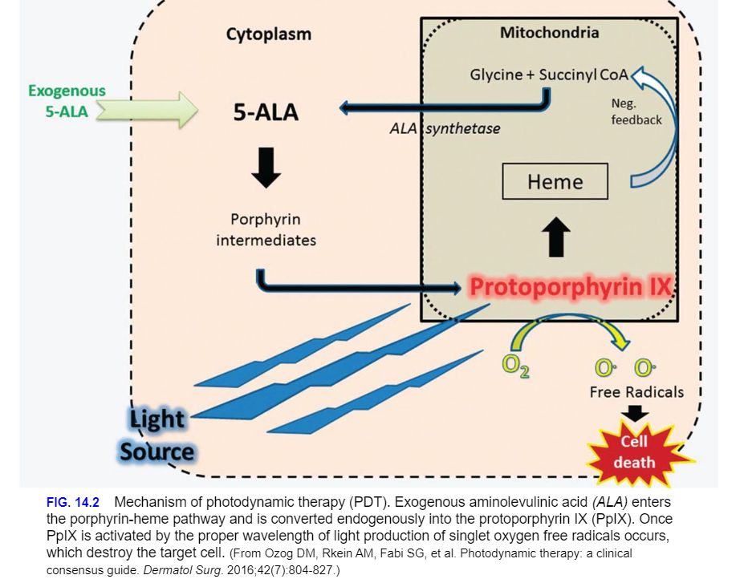

Slide 6
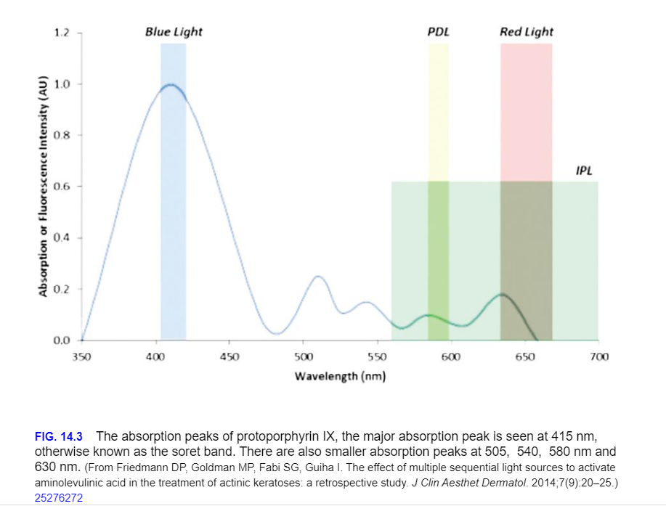

Slide 7
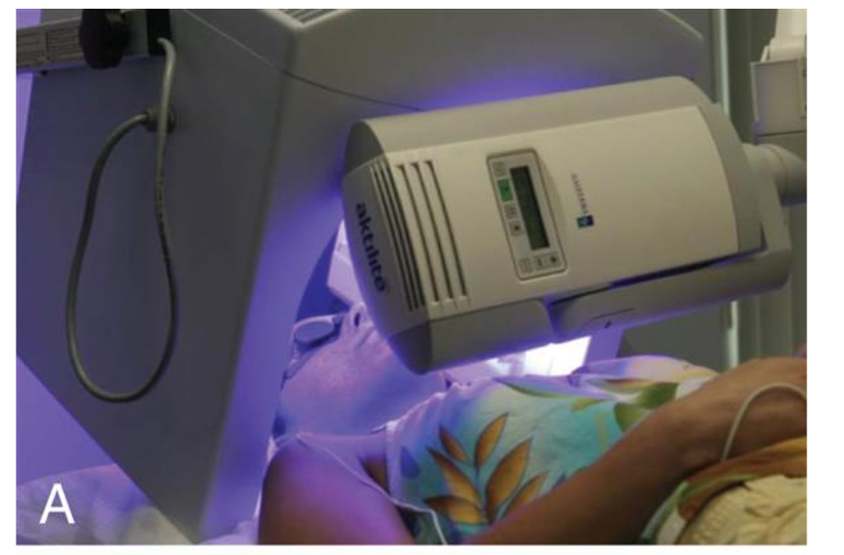

Slide 8
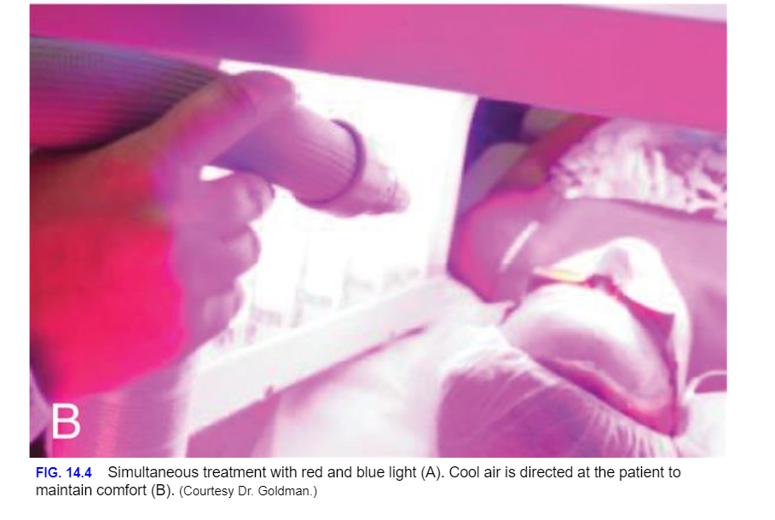

Slide 9
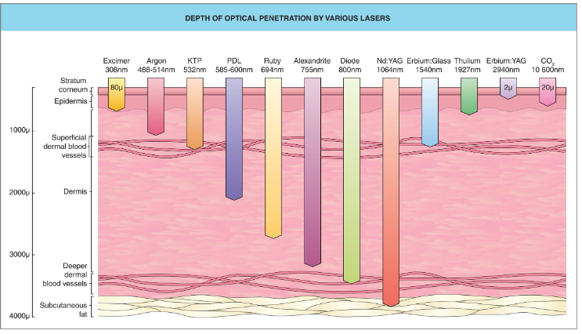

Slide 10
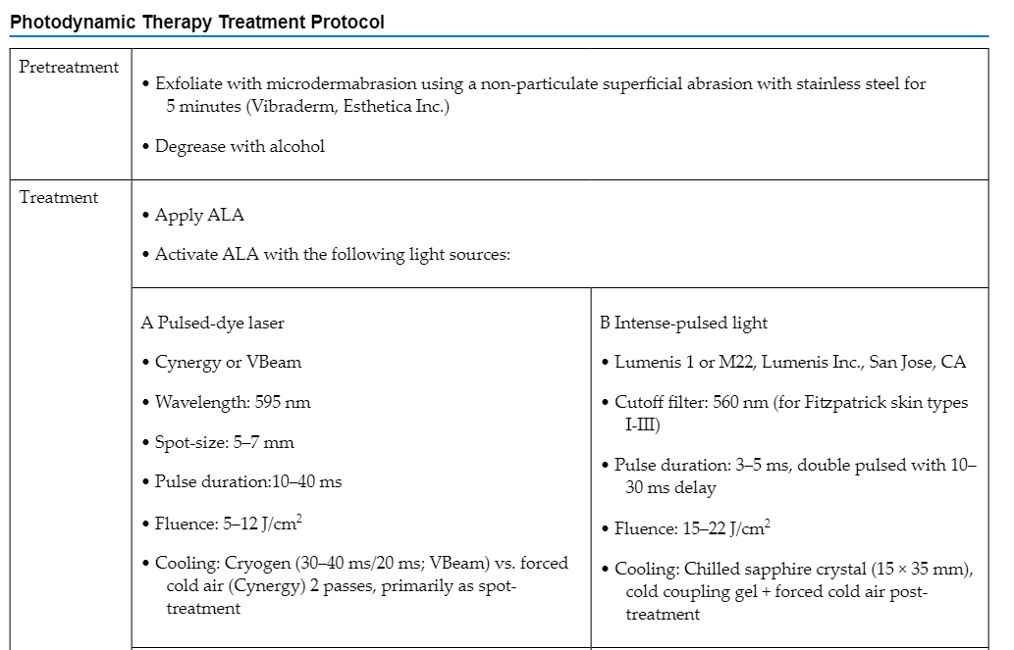

Slide 11
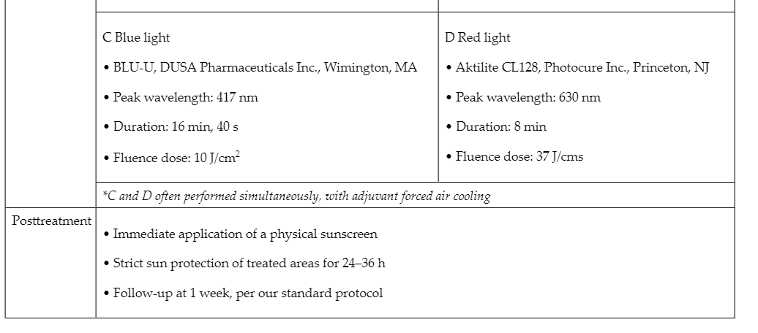

Slide 12
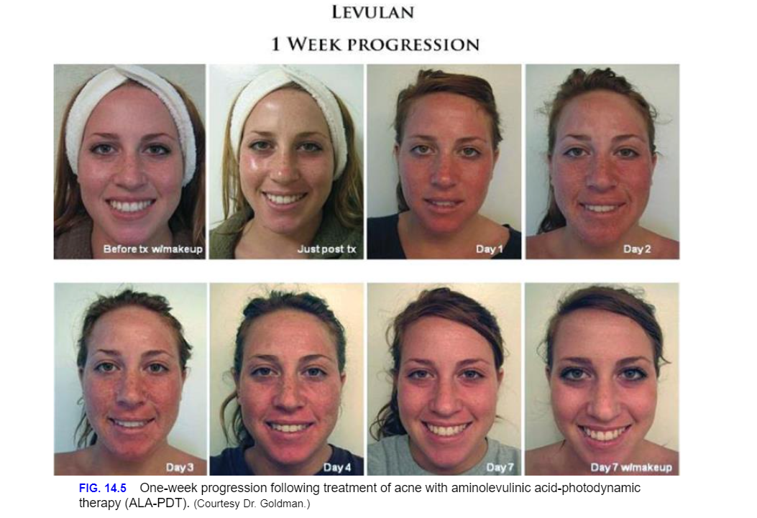

Slide 13
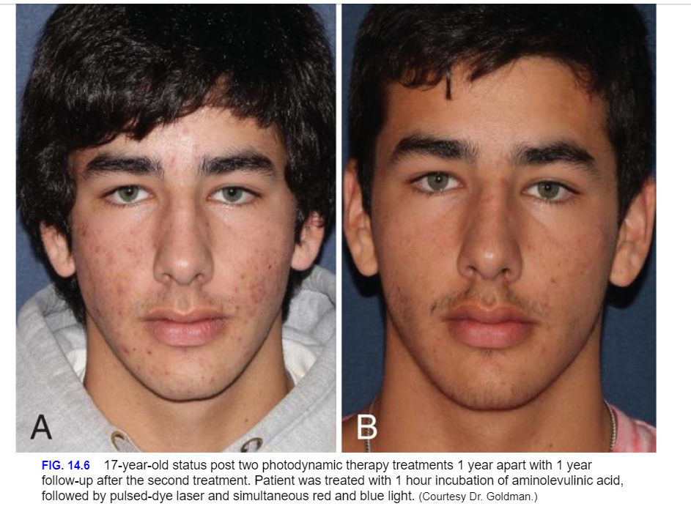

Slide 14
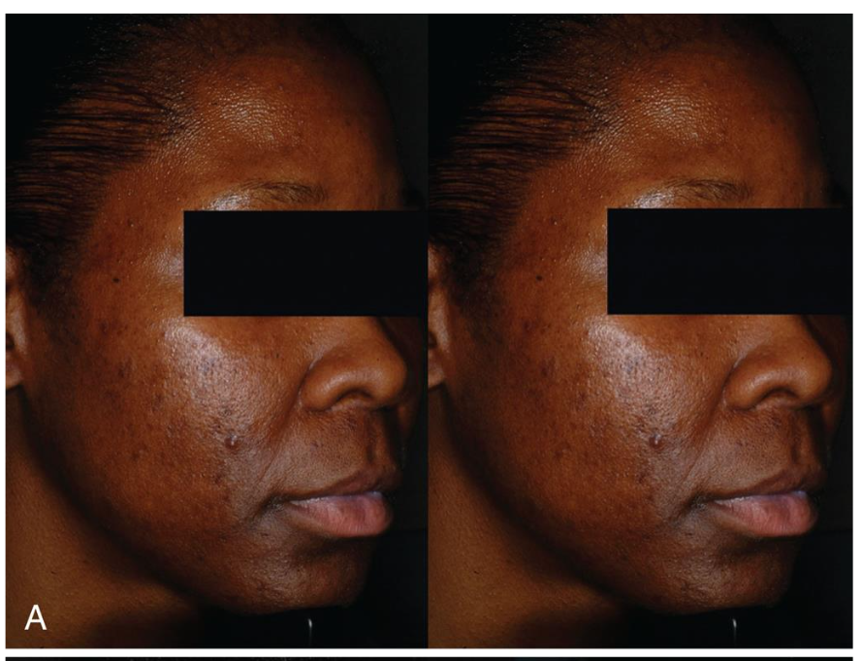
Visible Light Phototherapy
Blue Light Alone

Slide 15
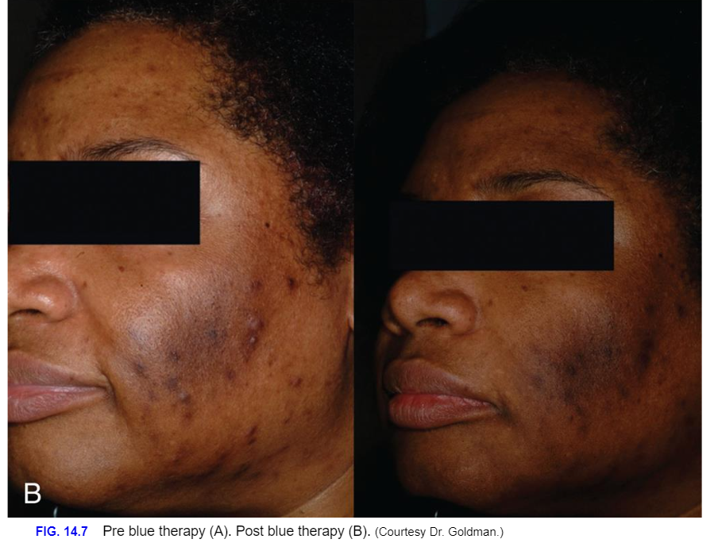

Slide 16
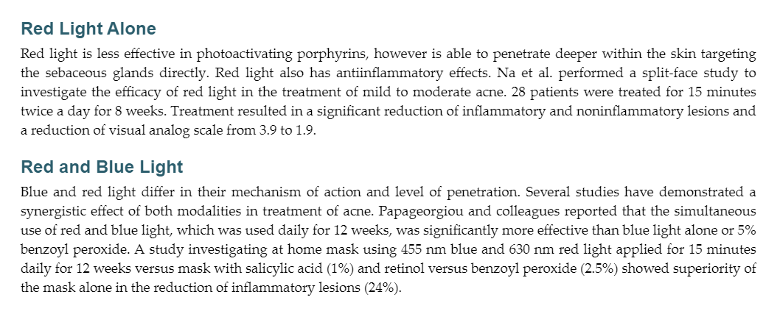

Slide 17
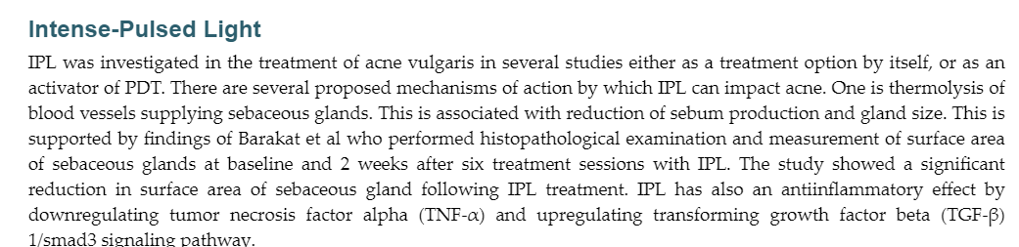

Slide 18
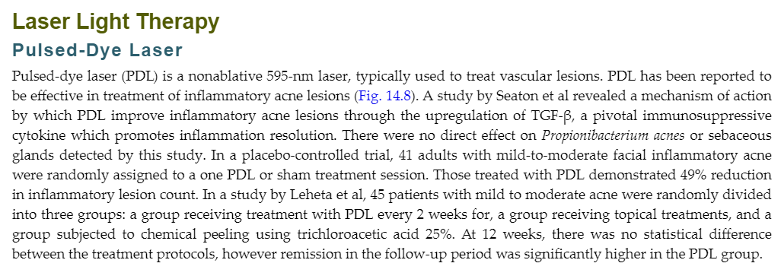

Slide 19
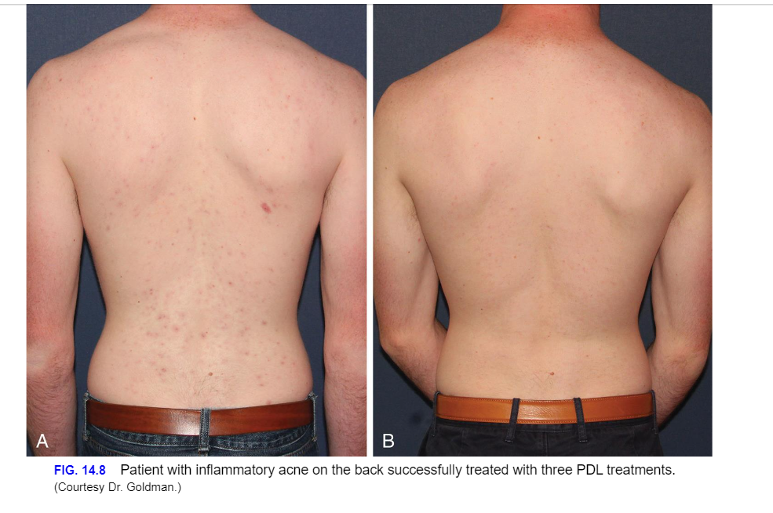

Slide 20
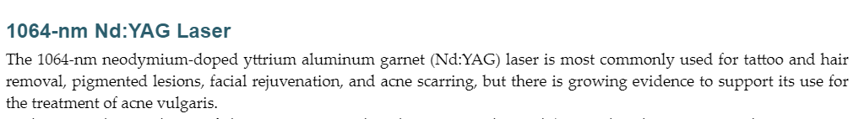
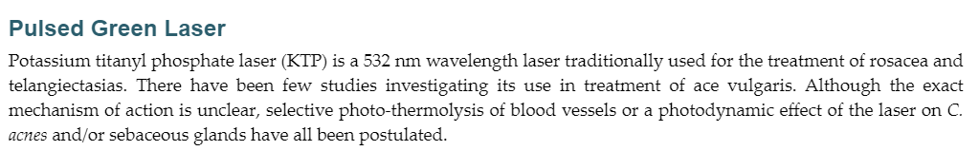
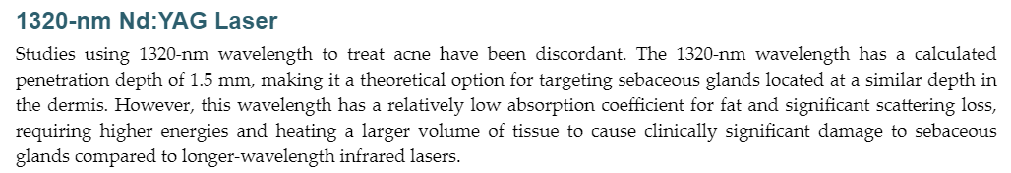

Slide 21
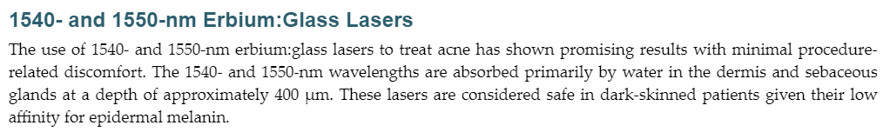

Slide 22
Particle-Assisted Laser Treatment
The selective delivery of an exogenous chromophore into the pilosebaceous unit may enhance the effectiveness with which lasers treat acne. A topical suspension of gold-coated silica microparticles with strong optical absorption at 800 nm has also been used for this purpose. Studies involving these microparticles demonstrate up to 61% reductions in acne lesion counts by 28 weeks after treatment. The gold microparticles, which are small enough to penetrate the follicular infundibulum but large enough to prevent nonselective diffusion through the stratum corneum, are delivered by massage, vibration, or ultrasound. The skin is then exposed to 800-nm diode laser pulses for three treatments at 1- to 2-week intervals.

Slide 23
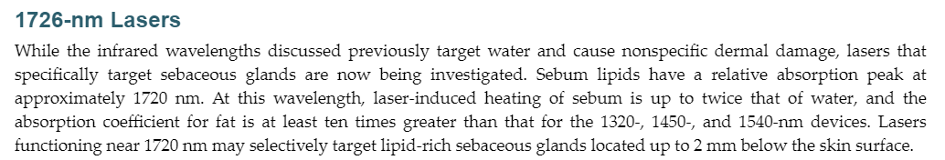

Slide 24
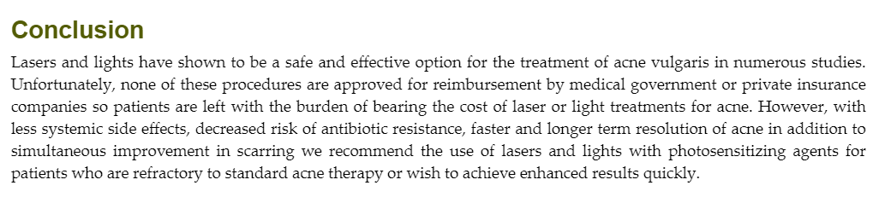

Slide 25

QUESTIONS?

