Slide 1

MRAD 240: Specialized
Imaging 1
Injections – The Technologist’s Role

Slide 2
Objectives
Explain the radiologic technologist’s role in participating in joint injection procedures.
State the required equipment needed to perform a joint injection
Describe the images obtained during a joint injection for documentation

Slide 3
Technologist’s Responsibilities
Check the requisition
Look for/arrange preliminary imaging
Check for relevant medical history
Obtain informed consent
Set up console and room
Set up sterile tray
Give rad necessary info and assist during procedure
Help patient out of exam room and clean up
Send images and document
Provide after care to patient

Slide 4
Requisition
Patient identifiers
  Name, birth date, personal health number, address, etc.
Requested injection type
Clinical history
Physician signature or stamp
Requisitions have various formats depending on hospital or clinic
https://www.mentimeter.com/app

Slide 5
Preliminary Imaging
Depends on site protocol and radiologist preference
Most will want X-ray or U/S of the affected area from within the last 1-2 years
Often performed onsite on the day of the injection
Patient is always free to refuse the additional imaging so ensure consent is accurate and complete

Slide 6
Relevant Medical History
Prior injections
  How many
  Where on the body
  Did they work?
Allergies
Patient response to procedure. Example: Faints at the sight of needles

Slide 7
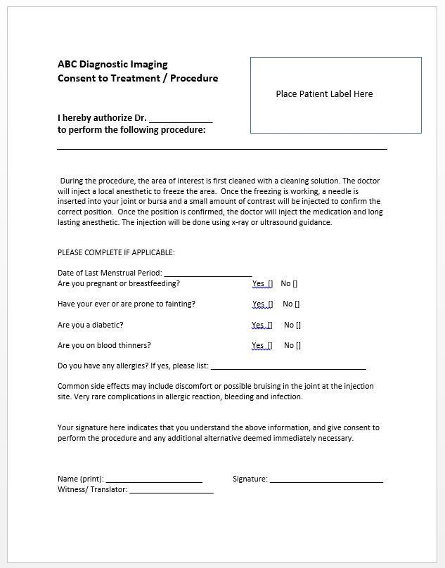
Example of Consent Form

Slide 8
Informed Consent
What does informed consent mean and why do we need it?
  Pt understands the procedure and the risks involved
  We are breaking the skin
Explain using layman’s terms
Allow patient time to process and ask question. Answer questions only within our scope of practice. Forward other questions to Radiologist

Slide 9
Parts of the Consent
Confirm
  Identity
  Body part to be injected and correct side.
  Presence of pain or other issue note on req
Describe procedure
  Marking the skin and cleaning
  Freezing – poke and burn
  Positioning of needle and confirmation with contrast (using X-ray or U/S guidance)
  Medication
  Get dressed and wait for a few minutes

Slide 10
Parts of the Consent cont.
What to expect
  Today
  This week
  Over the next few months
Precautions
  Reduced activity – very injection dependent
Risks
  What to look for
  What to do about it

Slide 11
Procedure Risks
Every procedure has the same two risks
  Infection
    Heat, excessive pain, redness, swelling
    2-5 days post injection
    Follow-up with family doctor or walk-in clinic
  Allergic reaction
    Hives, swelling, trouble breathing
    Within the first 10 minutes after an injection
    Alert medical staff at injection facility
Some procedures have extra risks. Need to disclose

Slide 12
Parts of the Consent cont.
Medical history
  LMP
  Blood thinners
  Allergies
  Diabetes
  Infections
Questions from the patient
Signature MUST be granted prior to starting the injection

Slide 13
Setting Up
Console
  Pt identifiers
  Accession # and exam
  Exposure setting
Room
  Bed and monitor screens in correct orientation
Tray
  Correct items
  Neat
  Sterile

Slide 14
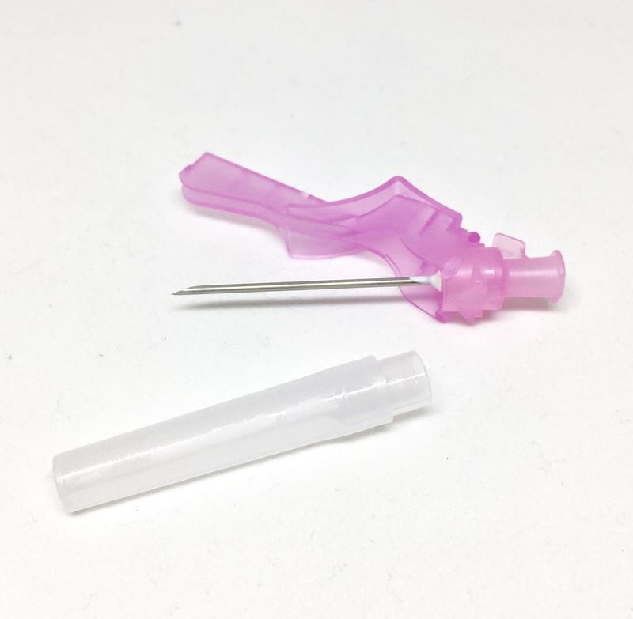
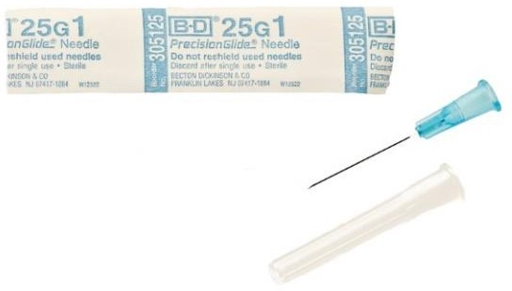
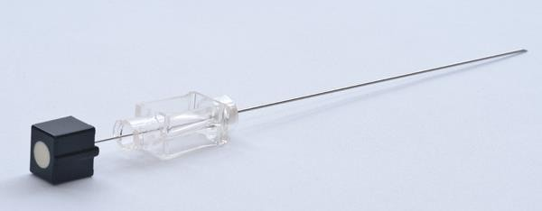
Sterile Tray
Needles
  18G 1-1.5” for drawing up medications
25G 1-1.5” for injecting anesthetic
22G 3.5” spinal needle for rest of procedure
https://www.midwiferysupplies.ca/products/copy-of-bd-eclipse- needle?variant=12288534708324
https://www.lifesupply.ca/bd-305125-precisionglide-sterile-conventional- needle-blue-regular-wall-25g-x-25mm-1-100-bx/
https://cardiomed.com/catalog/anesthesiology/22g-x- 90mm-quinke-spinal-needle/

Slide 15
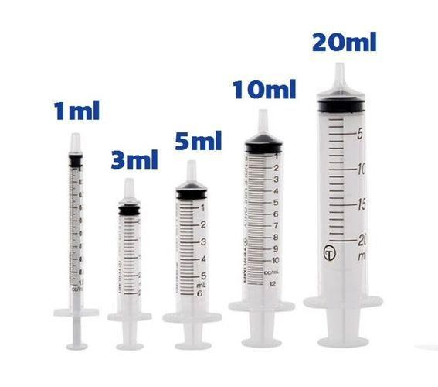
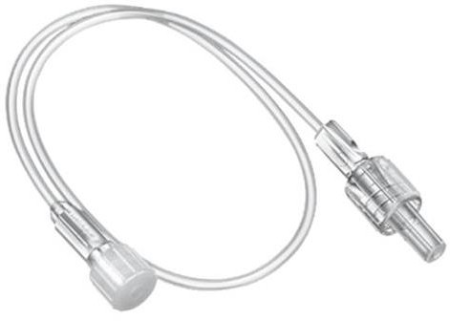
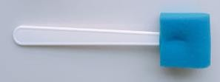
Sterile Tray cont.
Syringes
  Size depends on type of procedure being done
https://www.ebay.co.uk/itm/10-x-Sterile-TERUMO-SYRINGES- Medical-Plastic-2-5ml-5ml-10ml-20ml-50ml-All-Sizes-
/291095152955
Extension tubing
  Keeps radiologist’s hands further away from the field when injecting contrast
Sponge swabs
  Can also be gauze and small forceps
  For applying antiseptic solution
https://www.ebay.com/itm/5pcs-EXTENSION-TUBING- 140cm-MINIMUM-VOLUME-LUER-LOCK-
/282817332027
https://lingchen.en.made-in-china.com/

Slide 16
During the Procedure
Give radiologist relevant history
  Side and site to be injected
  Previous injection history (if relevant)
  Allergies
  Patient concerns
Ensure everything is within grasp for radiologist
Hold medication vials for drawing up if required.

Slide 17
Fluoroscopy
Adjust any settings during procedure
  Magnification, image orientation, AP to lateral
Saving images as needed
  Scout image
  Image with needle and contrast in place
The radiologist has a foot pedal to control the live fluoroscopy and make radiographic exposures.
  Cannot take Last Image Hold

Slide 18
Knee joint Injection Video
https://www.youtube.com/watch?v=bOBElEptG60&has_verified=1

Slide 19
After the Injection
Band-aid on injection site
Assist patient to sit
  Watch for signs of dizziness or other adverse reactions
Walk patient to changing area
  Ask them to wait once they’re changed. You will come visit them in a bit
Clean up tray
  Dispose of sharps and pharmaceuticals appropriately
Disinfect surfaces and prepare room for next patient

Slide 20
After the Injection cont.
Send images to PACS
  Add any site specific annotations
Record details in RIS
  Fluoro time and # of images
  Medications injected (names and amounts)
  Pre and Post injection pain scores
  Notes from the radiologist
  Supportive care given
Check on patient and dismiss them if they are feeling well
  Provide any after-care documentation

