Slide 1


Highlighting and Contouring

Slide 2

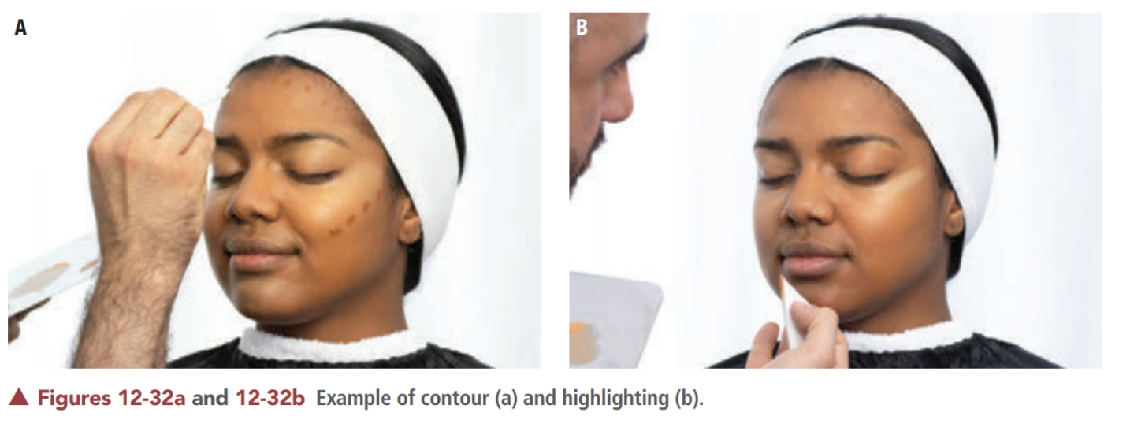

Slide 3
A basic rule to keep in mind for highlighting and contouring is that highlighting a feature emphasizes, and contouring or shadowing minimizes. A highlight is created when the cosmetic used is lighter than the original foundation applied. Conversely, a contour (or shading) is formed when the product used is darker than the skin or foundation color. The use of shading (using dark colors and shades) minimizes prominent features, making them appear less noticeable. Using highlighting and contouring, you can satisfy your client’s desire for a more balanced appearance by enhancing or de-emphasizing facial features or shapes.

Slide 4

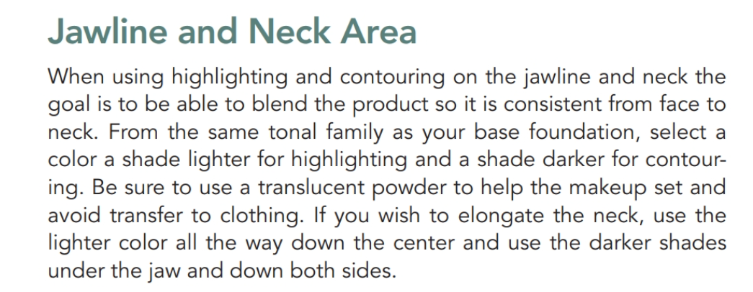

Slide 5
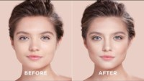

Slide 6
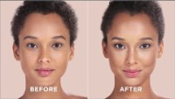

Slide 7
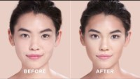

Slide 8
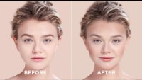

Slide 9
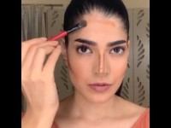

Slide 10


Slide 11
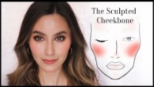

Slide 12

QUESTIONS?

