Slide 1
MRAD 256:
Radiographic Technique 2
Positioning of the cervical spine

Slide 2
Routine Cervical Spine Protocols
Hospital routine:
Lateral
Swimmer’s (depending on patient anatomy)
15° AP axial
AP odontoid
Clinic routine:
Lateral
Swimmer’s (depending on patient anatomy)
15° AP axial
AP odontoid
AP 15° axial obliques

Slide 3
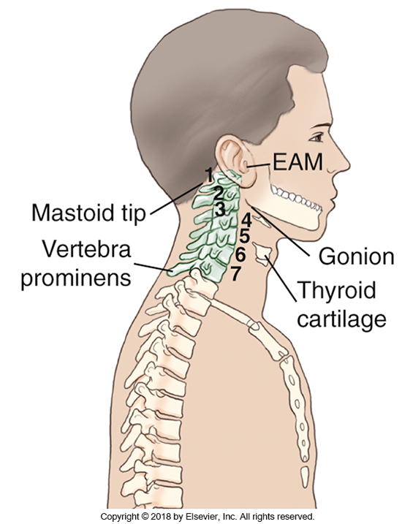
External Landmarks
C1 - Mastoid tip
C3 - Gonion (angle of the jaw)
C4/5 - Laryngeal prominence
C7/T1 - Vertebral Prominens
T2/3 - Jugular notch
Bontrager (9th ed) 8-38

Slide 4
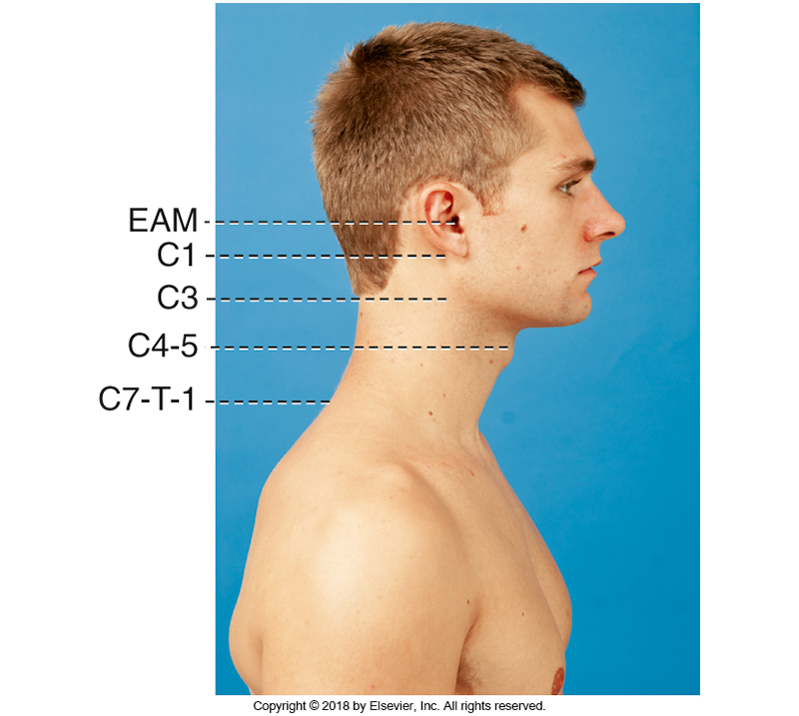

Slide 5
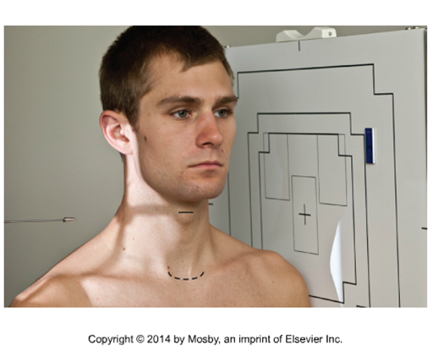
Lateral C-spine
180 cm SID with patient in a true left lateral
Rotate collimator slightly to align with MCP of the neck, and place CR at level of thyroid cartilage (laryngeal prominence)
Remember! C-spine is located at midcoronal plane of neck
Collimate to include top of ear to T1
Depress shoulders to move off of C7
Extend chin to move gonion off of C1/C2
Suspend respiration at end of expiration
Bontrager 8-56

Slide 6
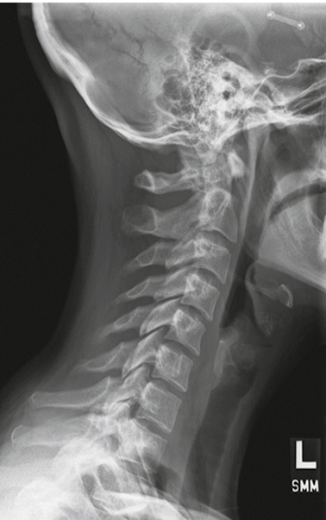
Evaluation Criteria
All 7 cervical vertebrae + 1/3 of T1
Sella turcica
Gonion off of the axis and atlas
Open zygopophyseal joints
CR centered at C 4/5
Soft tissue included
No rotation or tilt
Bontrager 8-57

Slide 7
How to Determine Rotation and Tilt

Slide 8
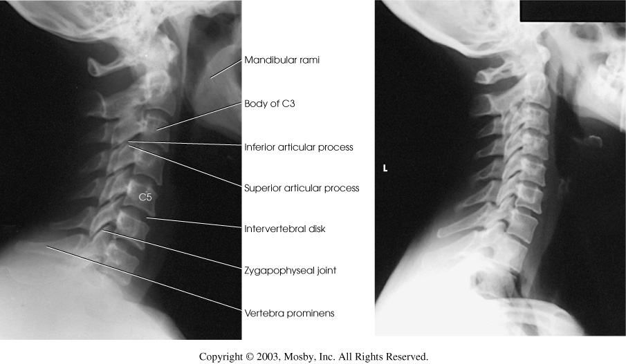
Radiographic Anatomy

Slide 9
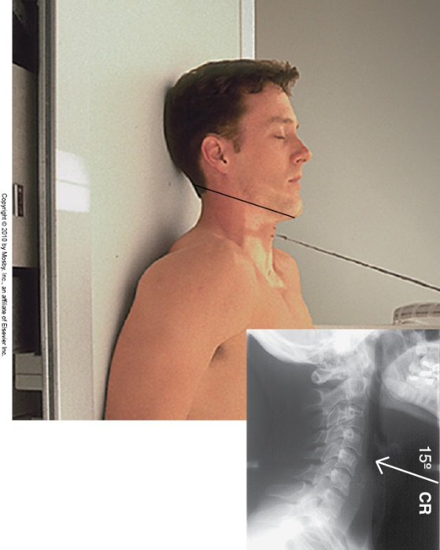

15 º AP Axial C-Spine
110 cm SID
CR 15º cephalad, at level of laryngeal prominence
Adjust chin and base of skull to form a line parallel to CR (top of light field) ~ 1 cm of light above edge of mandible
Suspend respiration
Bontrager 8-49

Slide 10
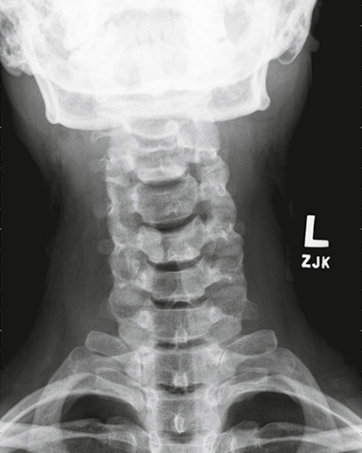
Evaluation Criteria:
C3 to T2/3 and surrounding soft tissue
Chin and base of skull superimposed
Open intervertebral disc spaces
Spinous processes equidistant to the pedicles
Mandibular angles equidistant to the vertebrae
Bontrager 8-50

Slide 11
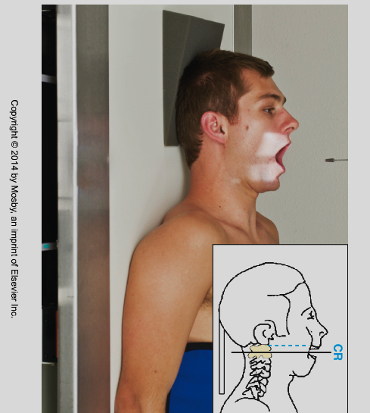
AP Open Mouth (odontoid)
Set a light field to include C1 and C2 and place a marker in an upper lateral corner
Ask patient to open mouth and move light field to place crosshairs at level of corner of mouth
Tell patient to close mouth
Stand at the side of the patient and adjust their head so that a line from lower edge of the upper incisors to the mastoid tip is  to IR
Ask patient to drop jaw open, and hold breath
Bontrager 8-46

Slide 12
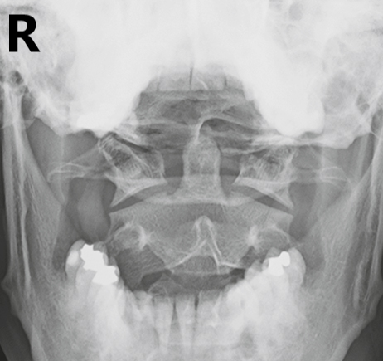
Evaluation Criteria:
Odontoid, atlas and axis are visualized
All articulating surfaces between atlas and axis are visualized
Mandibular rami equidistant from odontoid (no rotation)
Inferior edge of upper incisors superimposed over the base of the skull
Bontrager 8-47

Slide 13
Fuch’s
Standard Fuch’s – if you are unable to demonstrate the odontoid this is another option on a
NON-TRAUMA patient.

Slide 14
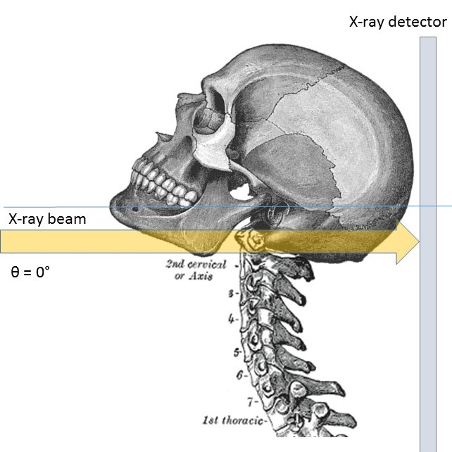
Case courtesy of Dr Matt A. Morgan, Radiopaedia.org, rID: 37348

Slide 15
Fuch’s
Modified Fuch’s – as a replacement for odontoid view, can be done supine with the patient in a c-spine collar

Slide 16
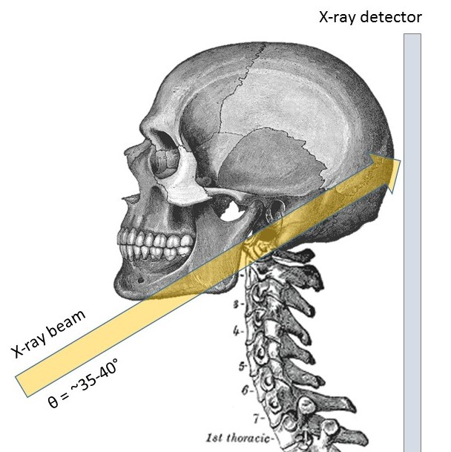
Case courtesy of Dr Matt A. Morgan, Radiopaedia.org, rID: 37348

Slide 17
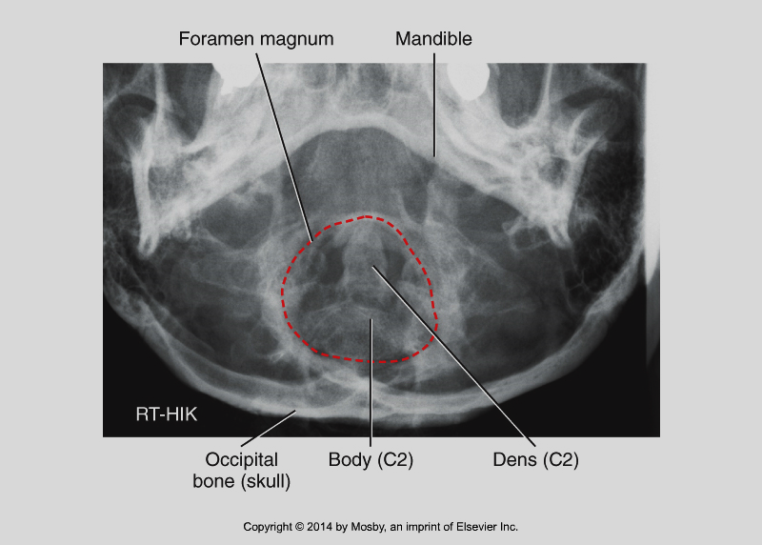
Fuch’s
Bontrager 8-72

Slide 18
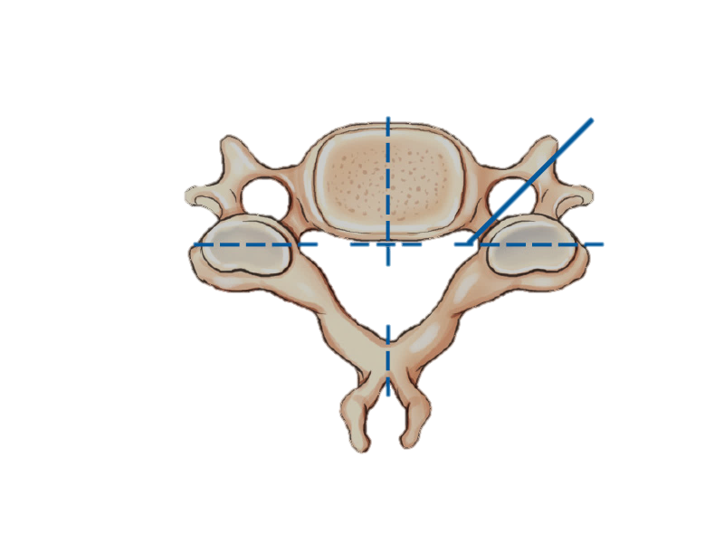
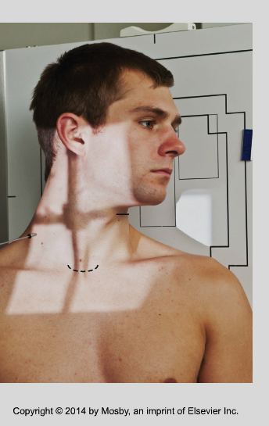
AP/PA Axial Obliques
Recall the internal anatomy of the intervertebral foramen when you set up for these images:
The CR should be adjusted as follows:
AP: 15º cephalad
PA: 15º caudad
Crosshairs adjusted to level of the laryngeal prominence
L
L
Bontrager 8-14, 8-53

Slide 19
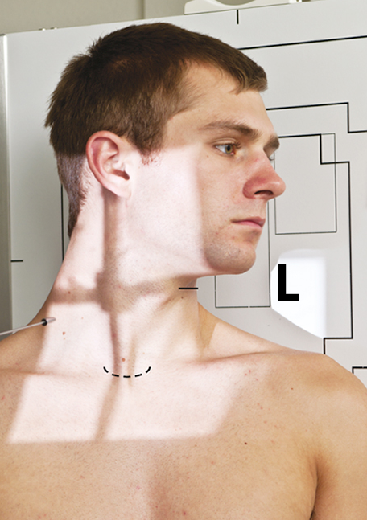
AP Axial Obliques
110 cm SID
Angle CR 15 ° cephalad
Move CR to level of laryngeal prominence
Adjust patient’s MCP 45 from IR
Turn head to lateral if worksite protocol allows
Protrude chin to move gonion off of C1/C2
Collimate to include EAM to jugular notch
Suspend respiration
L
Bontrager 8-56

Slide 20
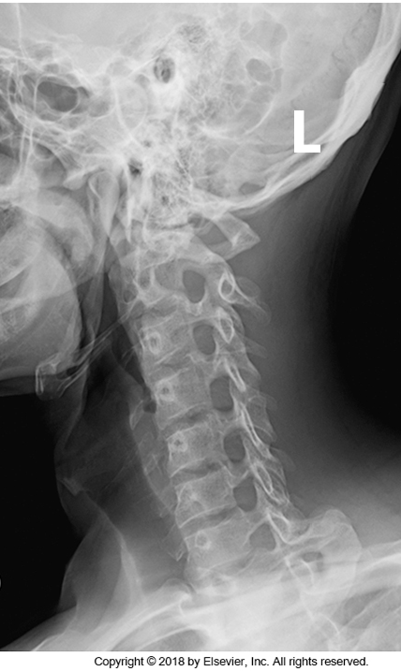
Evaluation Criteria:
C1-C7 and T1
Oblique projection of vertebral bodies
Base of skull should clear C1
Mandible should clear upper vertebrae
Open intervertebral disc spaces C2-C7
Open intervertebral foramina C2-C7
RPO
Bontrager 8-54

Slide 21
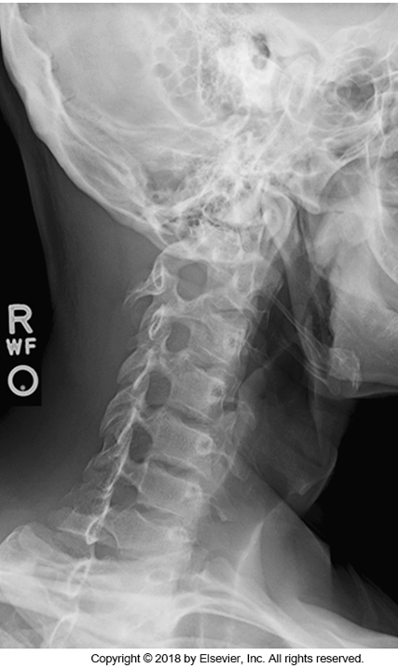
LPO
RPO

Slide 22
A routine request that is very similar to c-spine positioning is soft tissue neck for query foreign body.
Routine
15° AP axial
Lateral

Slide 23
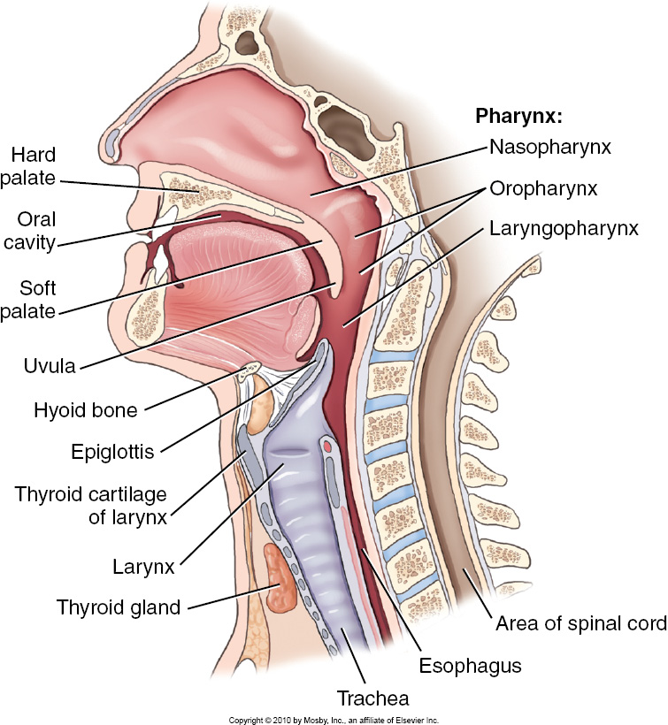
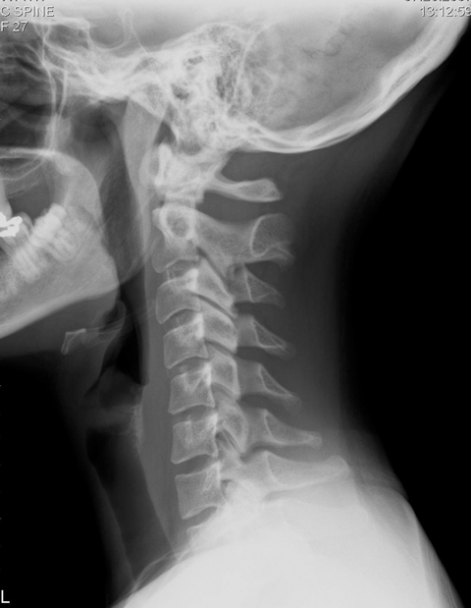
AP and Lateral Soft Tissue Neck
Bontrager 2-4
www.medical.toshiba.com/.../Clinical-Trad-02.jpg

Slide 24
Similar to a lateral C-spine but:
Demonstrates nasopharynx to lung apices
Collimate to exclude eyes
Decreased technique to better visualize soft tissue
Taken on modified Valsalva maneuver to
demonstrate air in the pharynx and
trachea
www.medical.toshiba.com/.../Clinical-Trad-02.jpg

Slide 25
AP projection is similar to C-spine AP
Chin is extended higher than for c-spine AP
Collimate from lower level of nasal bones to sternal angle
Taken on modified Valsalva maneuver to demonstrate air in the pharynx and trachea

