Slide 1
MRAD 204:
Radiographic Technique 1
Outcome 1-5:
Image Critique – Pelvis & Hip

Slide 2
Affiliated Readings
Bontrager
Pgs: 281, 283→286
Pgs: 288→290
Emphasis on the “pink box” Evaluation Criteria

Slide 3
Overview
Image Critique – Pelvis
Image Critique – Hip
Tips & Tricks

Slide 4
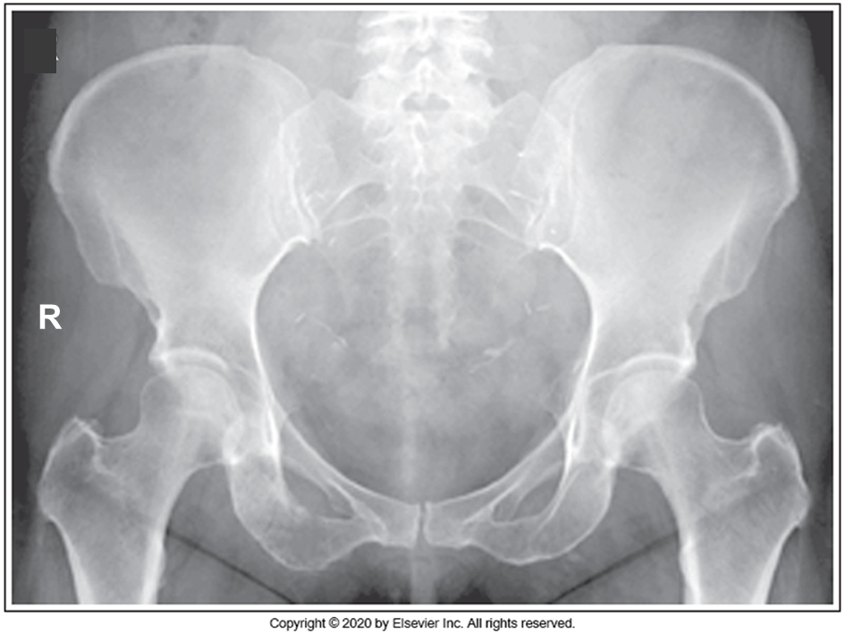
Image Critique – AP Pelvis
Anatomy
R
R
Ideally, routine AP Pelvic radiographs should display:
Entire Pelvis
Proximal femurs

Slide 5
Image Critique – AP Pelvis
Exposure & Technique
R
Routine AP Pelvic radiographs should display:
R
kVp range of 80→90
McQuillen Martensen 5th Ed. Pg.430 Fig. 7.4
Optimal density and contrast:
  no motion (i.e. blur)
  soft tissue margins visible
  clear bony trabecular markings

Slide 6
Image Critique – AP Pelvis
Marker Placement &/or artifacts
Marker placement: lateral side between ASIS and greater trochanter; not obscuring bony anatomy
R
No removable artifacts are visible
McQuillen Martensen 5th Ed. Pg.430 Fig. 7.4

Slide 7
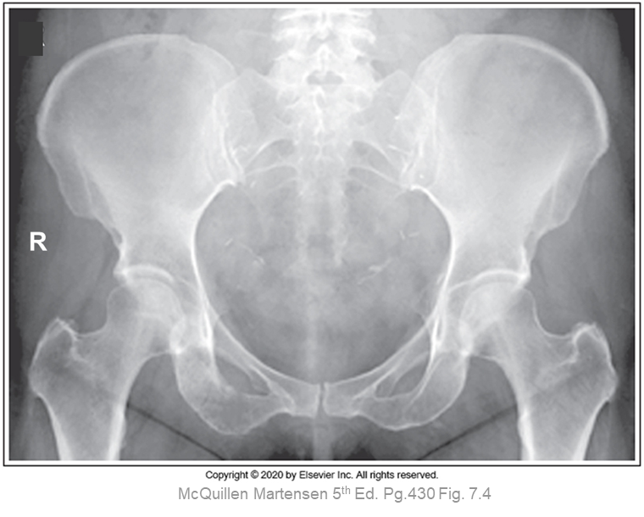
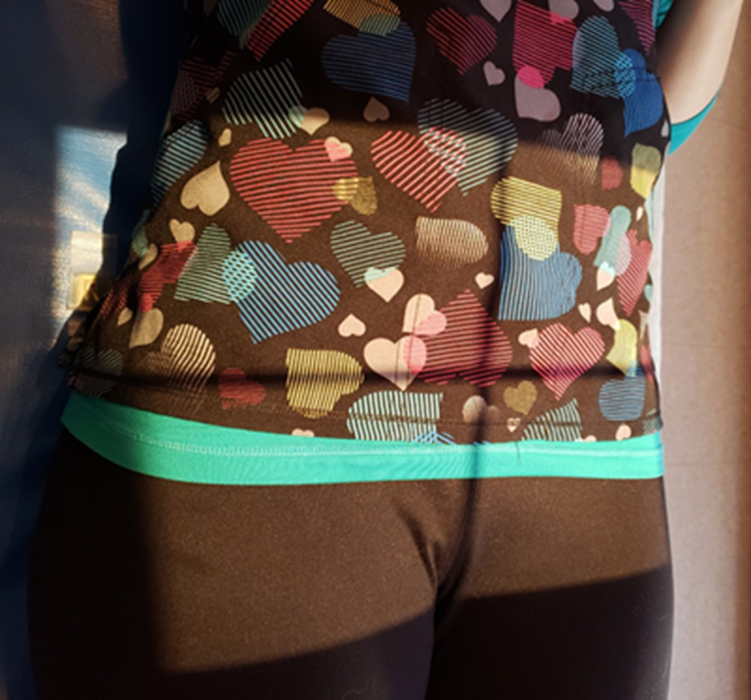
Image Critique – AP Pelvis
R
Four sided collimation centered to MSP & close to level of ASIS
CR & Collimation
SAIT Campus 2021

Slide 8
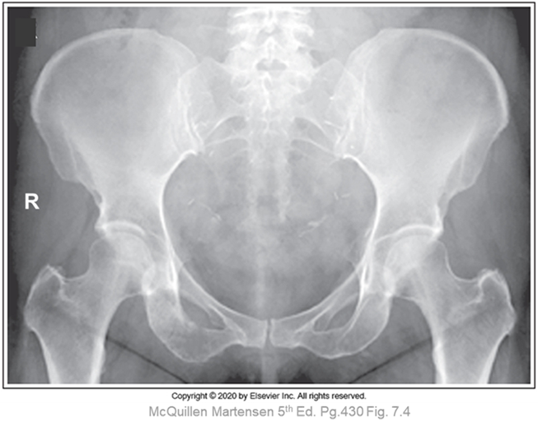
Image Critique – AP Pelvis
Position
Femoral necks in profile
Greater trochanters in profile
Lesser trochanters not visible (or barely seen) on the medial side
No rotation = symmetric iliac alae, ischial spines, and obturator foramina
@ 80 kVp

Slide 9
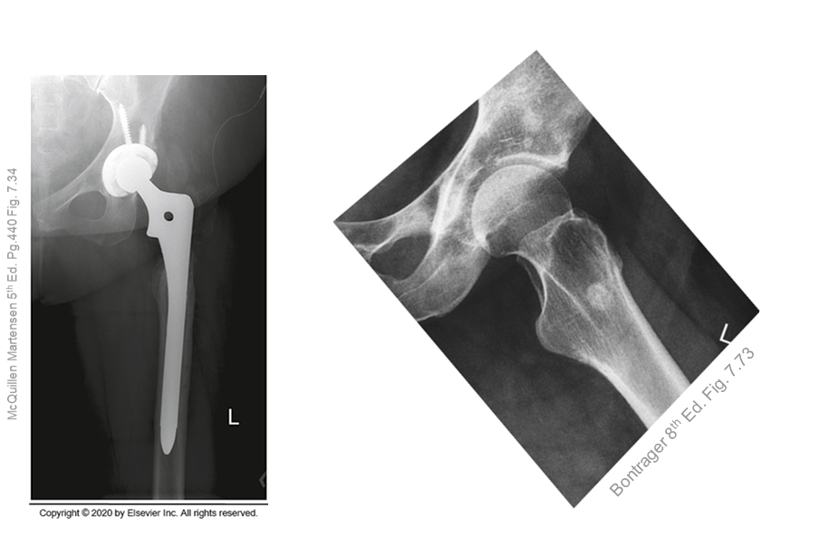
Image Critique – Routine Hip
Anatomy
*Note: AP Hip radiographs also require symphysis pubis
R
Ideally, both routine Hip radiographs should display:
1/3rd of proximal femur
Upper Body of ischium
Body of pubis
Body of ilium
Entire ORIF (if present)
Note: field size will need to be extended if patient has a long hip pin
McQuillen Martensen 5th Ed. Pg.430 Fig. 7.4

Slide 10
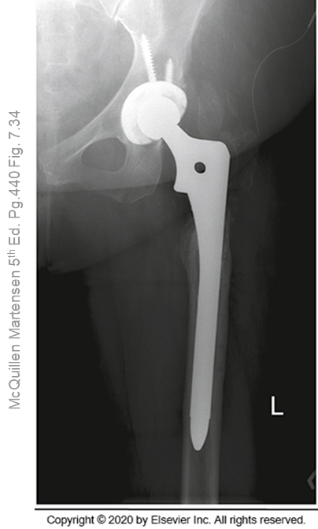
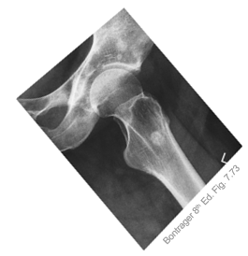
Image Critique –Routine Hip
Exposure & Technique
ALL routine hip radiographs should display:
kVp range of 80→85
Optimal density and contrast:
  no motion (i.e. blur)
  soft tissue margins visible
  clear bony trabecular markings

Slide 11
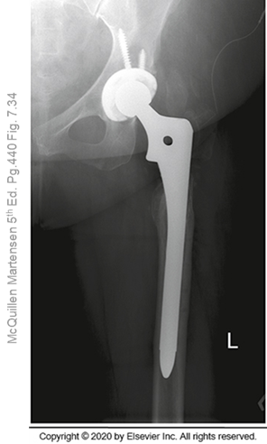
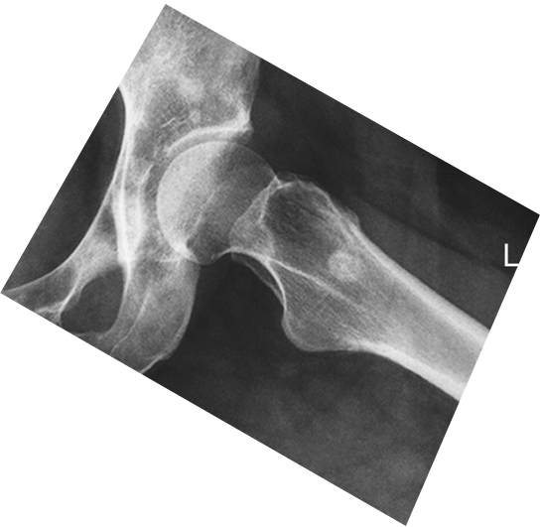
Image Critique –Routine Hip
Marker Placement &/or artifacts
Marker placement: lateral inferior corner of light-field not obscuring bony anatomy
Bontrager 8th Ed. Fig. 7.73
No removable artifacts are visible

Slide 12
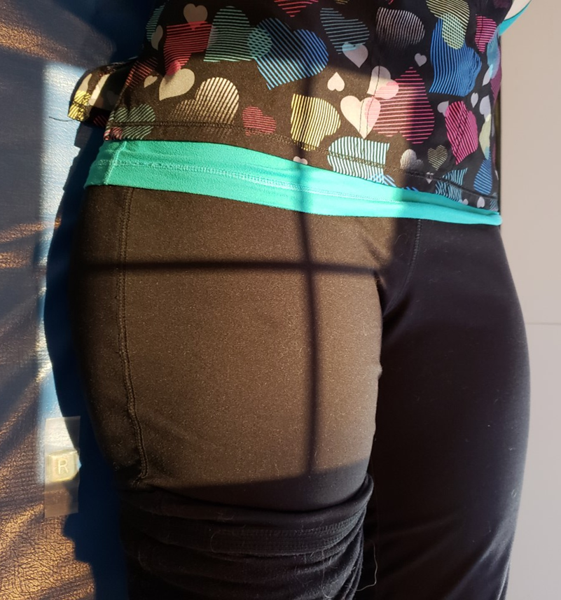
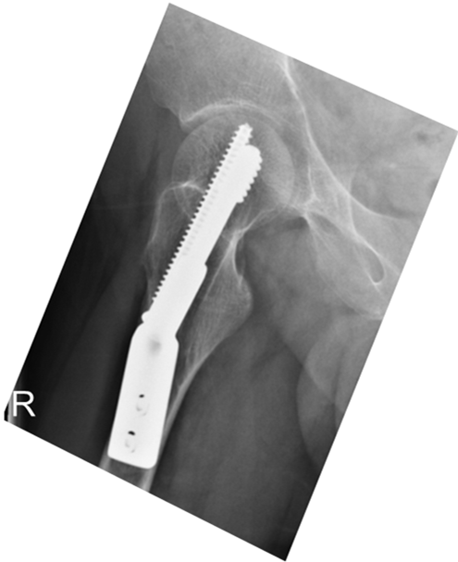
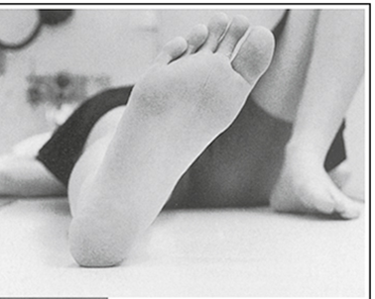
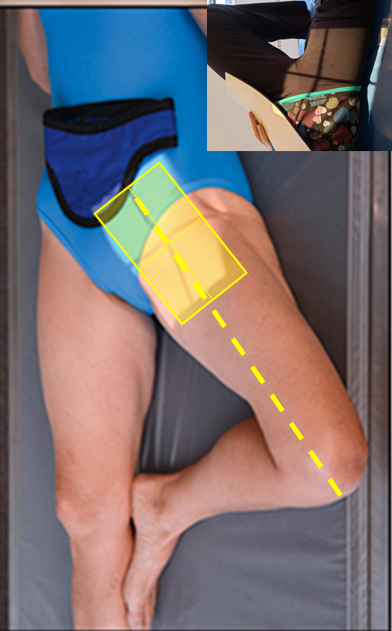
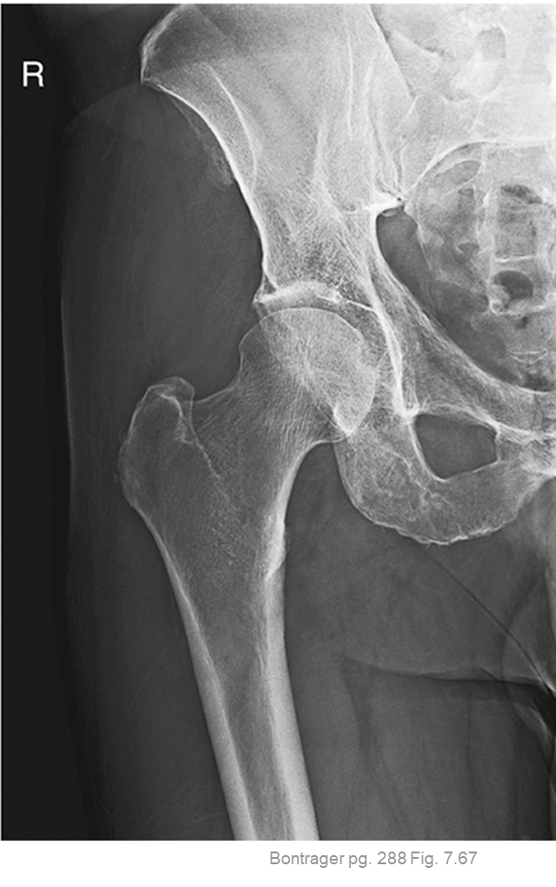

Image Critique –Routine Hip
Four sided collimation centered to femoral neck
*unless long ORIF device present
CR & Collimation
VS.

Slide 13
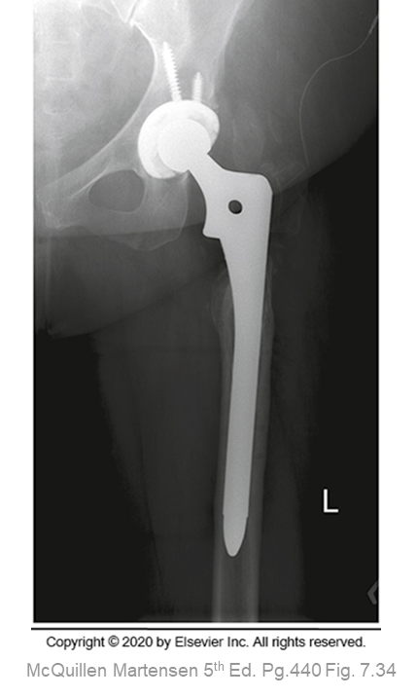
Image Critique – AP Hip
@ 80 kVp
Position
Femoral neck in profile
Greater trochanter in profile
Lesser trochanters barely seen (or not seen at all) on the medial side
Femoral head seen through acetabulum
Bontrager pg. 288 Fig. 7.67

Slide 14
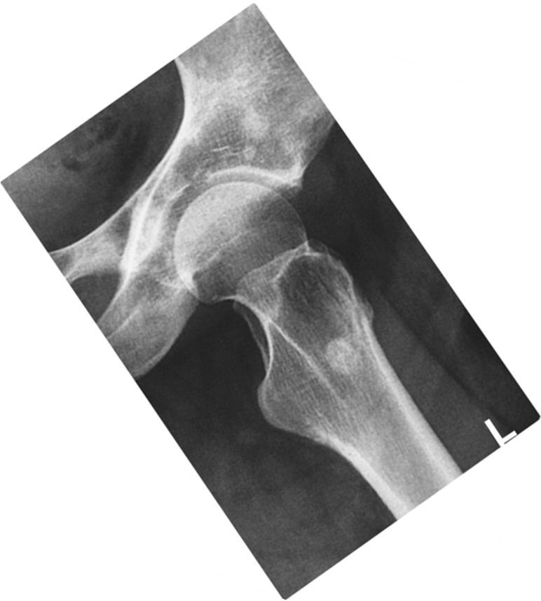
Image Critique – Lateral Hip
@ 80 kVp
Position
Head of femur in acetabulum
Femoral neck foreshortened and superimposed by the greater trochanter
Acetabulum and Femoral head well demonstrated
Bontrager 8th Ed. Fig. 7.73

Slide 15
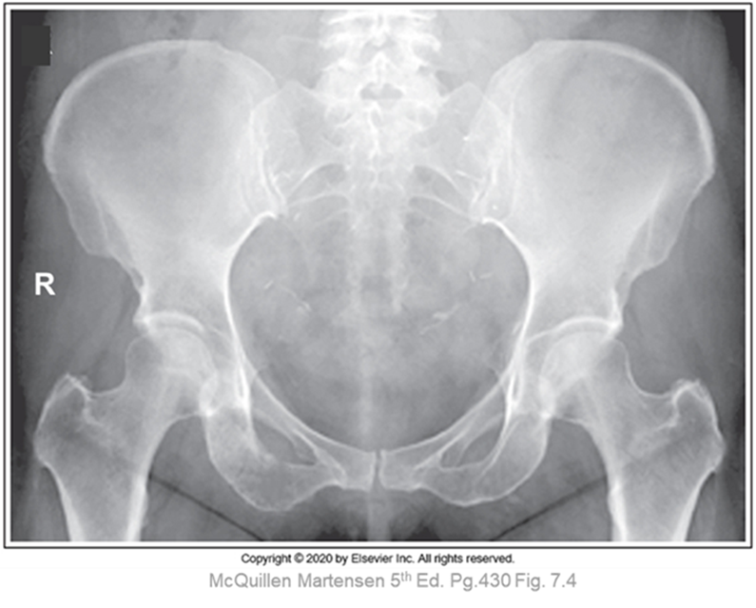
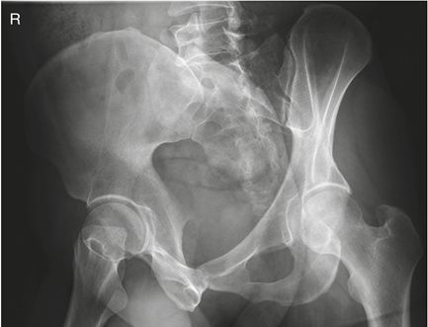
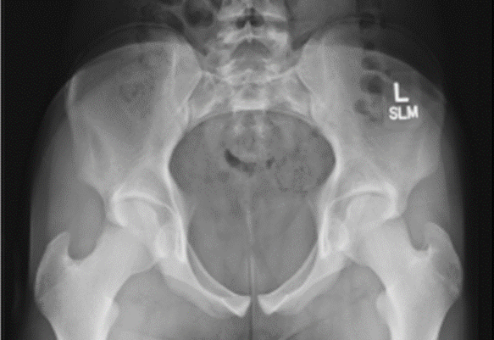
Tips & Tricks – Pelvis Projections
Look at overall appearance to determine projection:
AP Pelvis, Axial Inlet, and Judet Projections should demonstrate entire pelvis & proximal femurs
AP Pelvis
Judet Projection
Note: Symphsis pubis and ischium
Note: Illiac wing or ala & obturator foramen
Good overall radiographic appearance
Axial Inlet
Bontrager pg. 284 & 286 Fig. 7.53 & 7.62

Slide 16
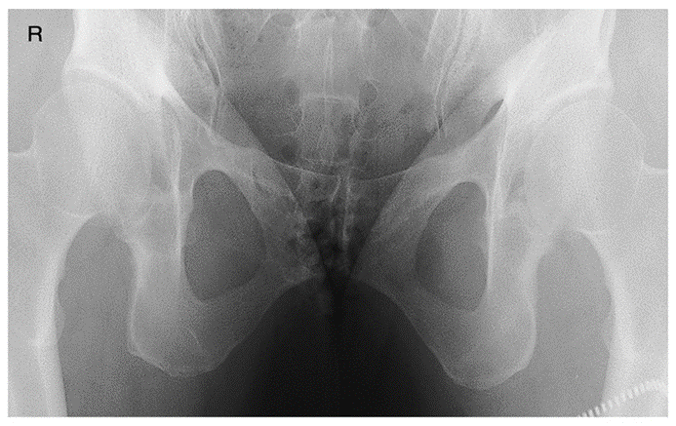
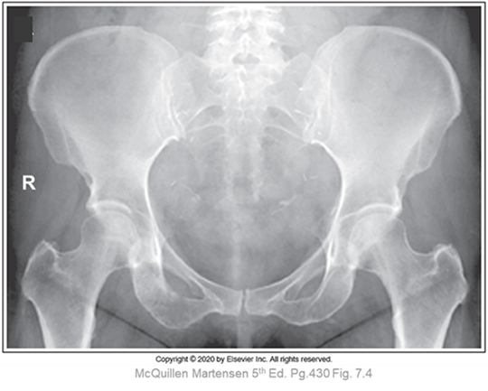
Tips & Tricks – Axial Outlet Projection
The only pelvis projection that does not require demonstration of iliac crests & greater trochanters
Anterior pubic bones superimposed over sacrum & coccyx
VS.
Superimposed obturator foramina
Bontrager pg. 283 & 284 Fig. 7.50 & 7.53
Symmetric obturator foramina

Slide 17
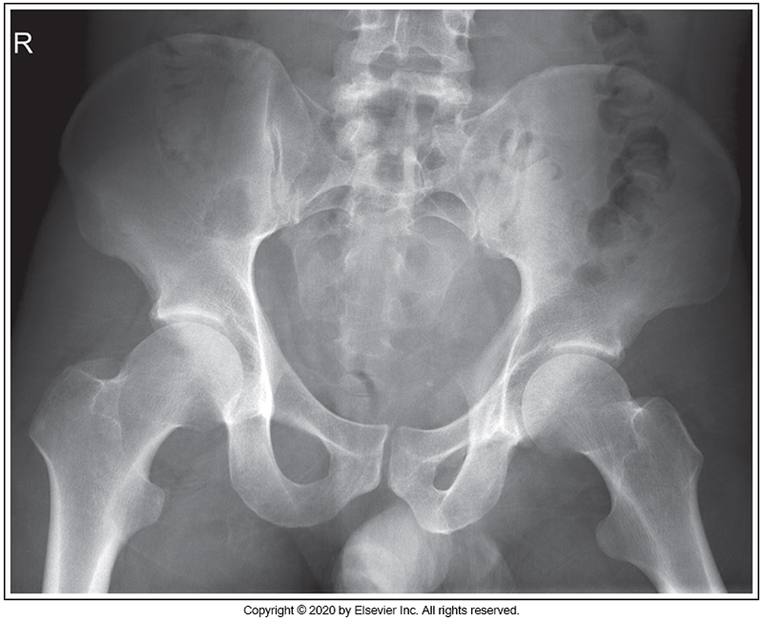
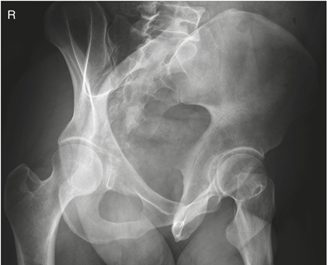
Tips & Tricks – Pelvis Rotation vs. Judet
Look at overall appearance to determine if it was a Judet projection or mal-positioned AP Pelvis:
AP pelvis with rotation will demonstrate asymmetrical obturator foramina
Judet projections will demonstrate one obturator foramina with complete superimposition
VS.
McQuillen Martensen 5th Ed. Fig. 7.5
Bontrager pg. 284 Fig. 7.61

Slide 18

Tips & Tricks: Identifying Rotation
Look at the general shape/size of the obturator foramen & the alae (alae is plural for ala):
“Larger” ala = side of rotation
VS.
“Smaller” obturator foramen
=
side of rotation
McQuillen Martensen 5th Ed. Fig. 7.5

Slide 19
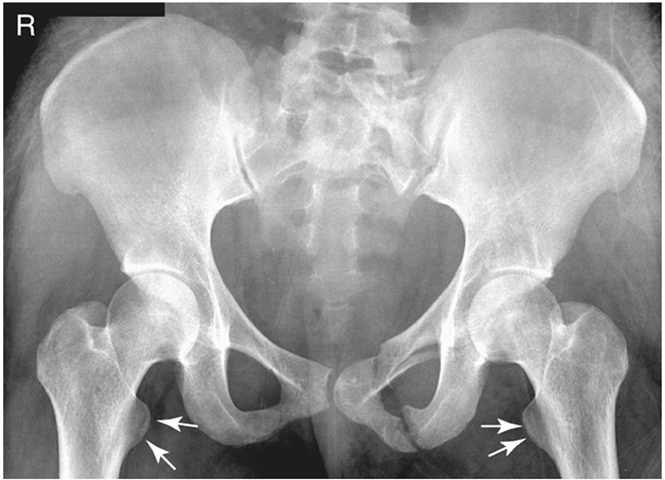
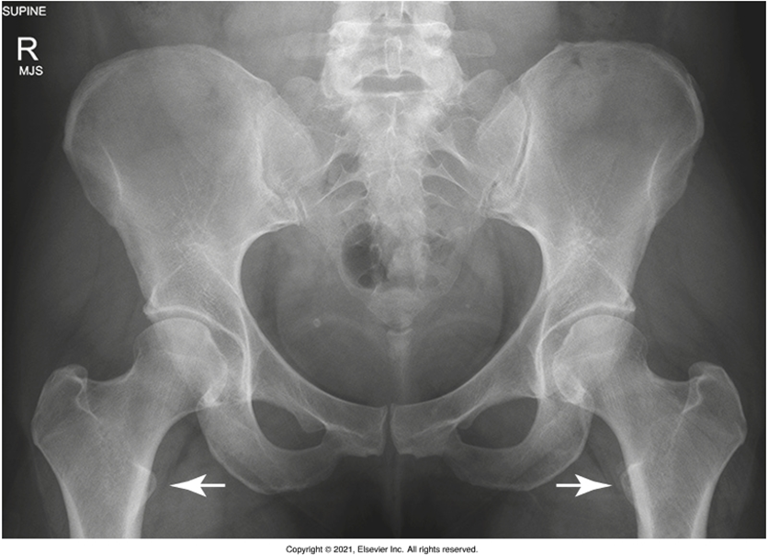
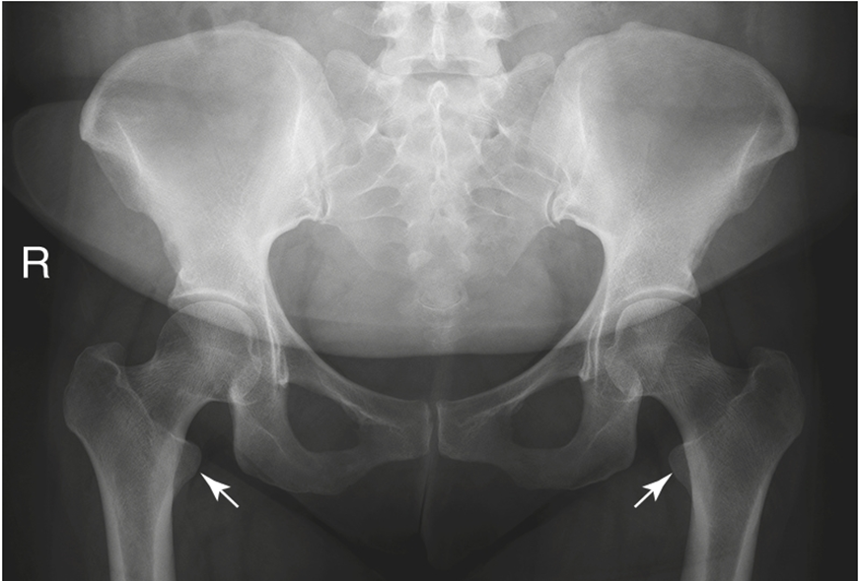
Tips & Tricks – Pelvis/Hip: Review
Look at the general shape/size of the lesser trochanter and femoral neck
Internal rotation = ↓ femoral neck superimposition
Bontrager pg. 274 Fig. 7.26, 7.28, & 7.30

Slide 20

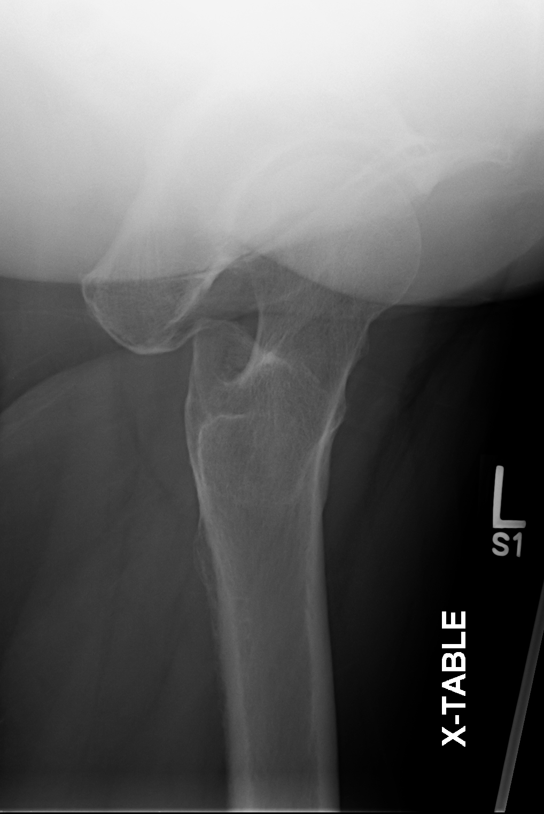
Tips & Tricks – Lateral Hip Projections
Look at the size/shape of the pelvis to determine the projection:
Axiolateral (x-table)
AP Hip
*Note: Acetabulum size & foreshortened obturator foramen
Bontrager pg. 288 Fig. 7.67
*Note: “Open” obturator foramen
Bontrager 8th Ed. Fig. 7.73
SAIT Imaging Library
Lateral Hip
*Note: superimposed obturator foramen

Slide 21
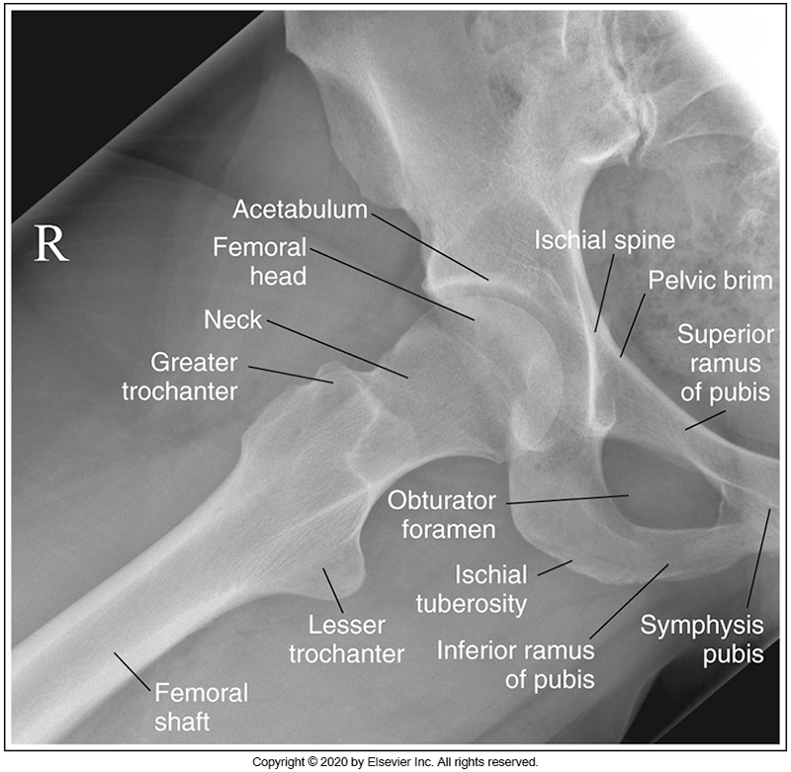
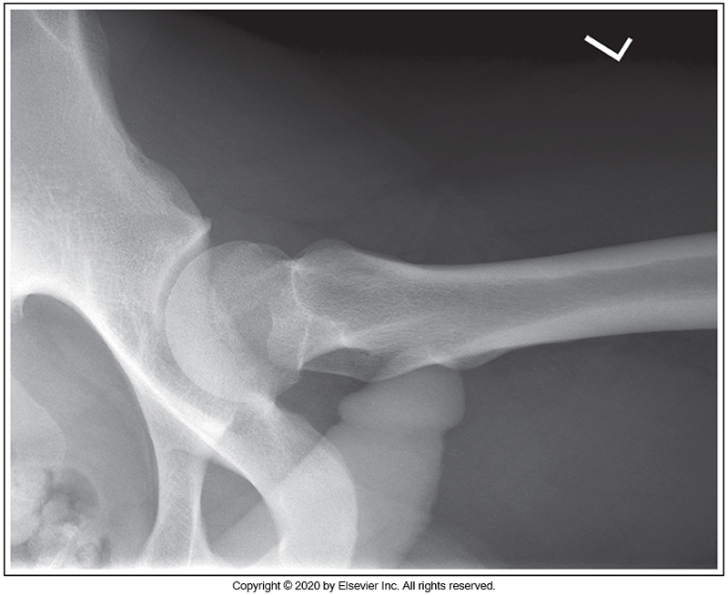
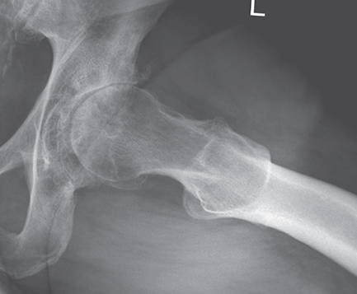
Tips & Tricks – Lateral Hip Projections
McQuillen Martensen 5th Ed. pg. 442, 444 & 445 Fig. 7.36, 7.43 & 7.46
Frog leg (modified cleaves): 45° abduction from vertical: femoral neck partially foreshortened & lesser trochanter in profile medially
Lauenstein-Hickey: 90° abduction from vertical (aka. femur parallel to IR: Femoral neck foreshortened, acetabulum and femoral head well demonstrated
20° abduction from vertical: femoral neck in profile, foreshortening of body of proximal femur

