Slide 1
Introduction to Skull Critique
MRT Program

Slide 2
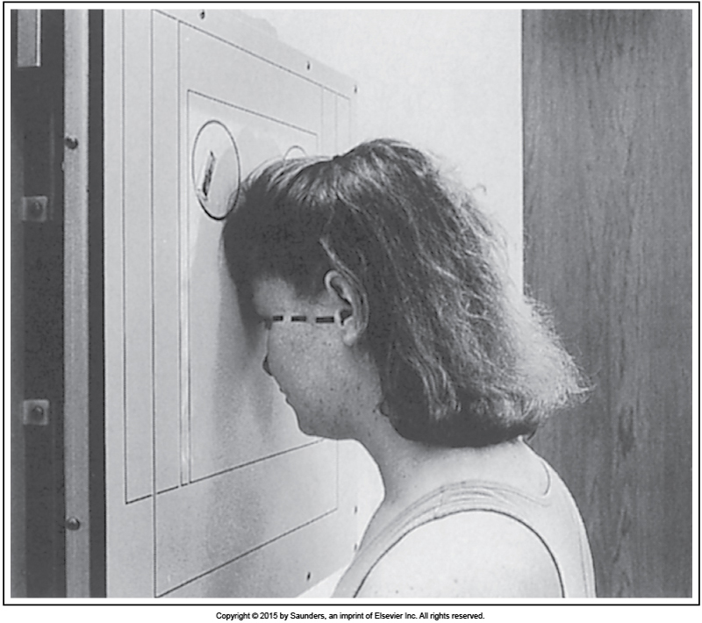

Slide 3
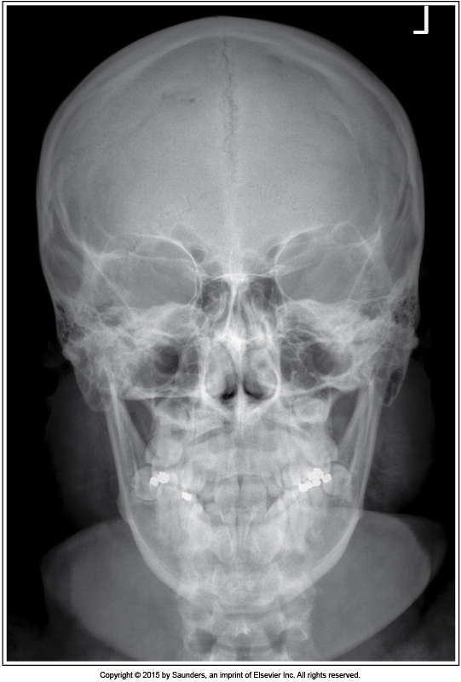

Slide 4
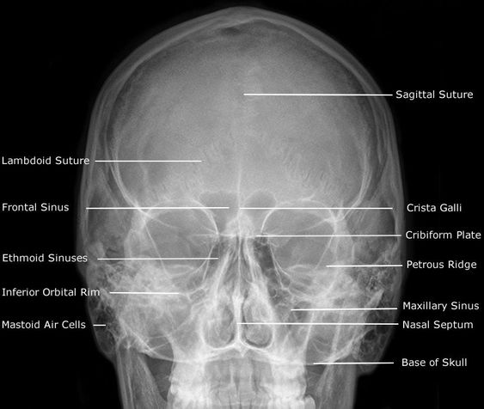

Slide 5
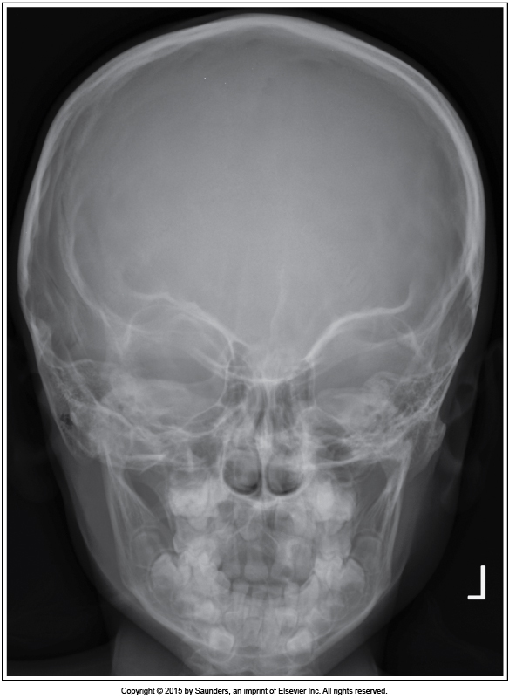

Slide 6
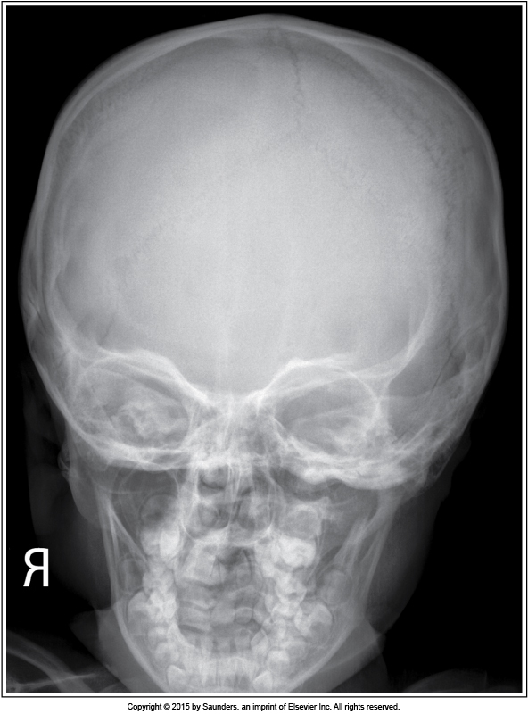

Slide 7
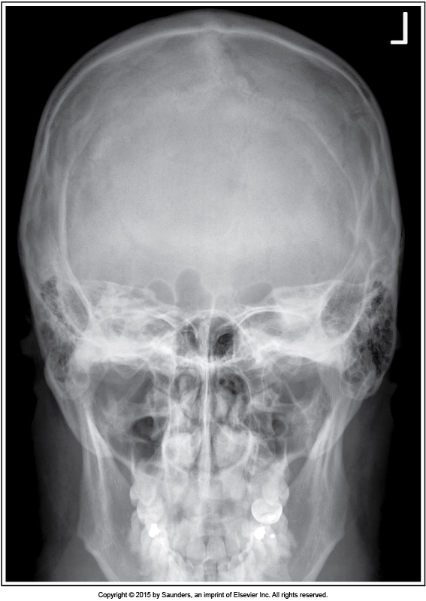

Slide 8
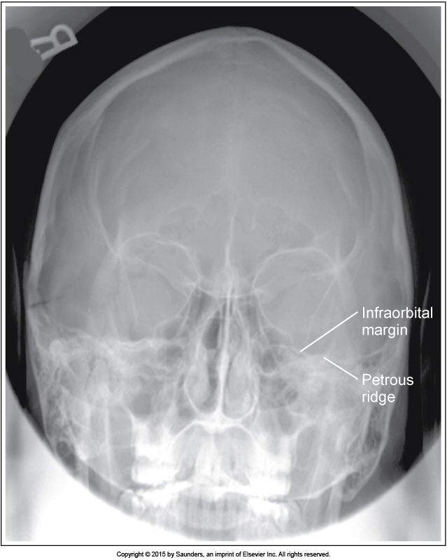

Slide 9
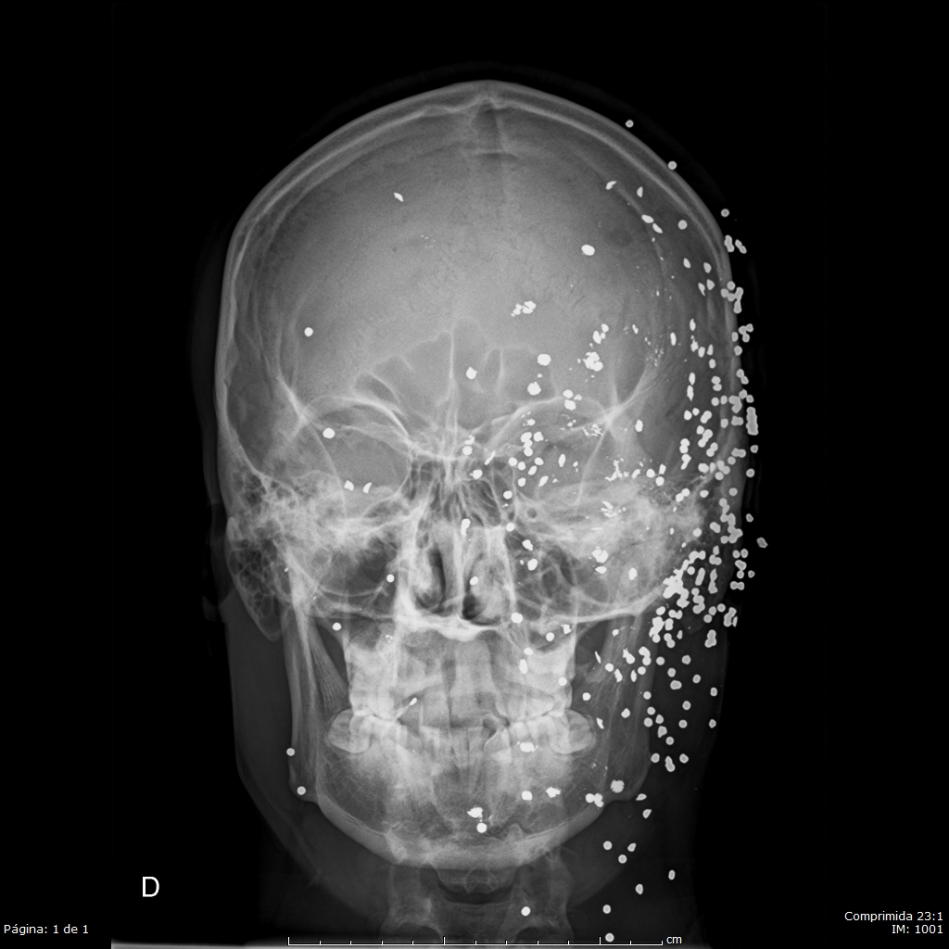
Case courtesy of MD Adrian Herrera Sánchez, Radiopaedia.org, rID: 55710

Slide 10
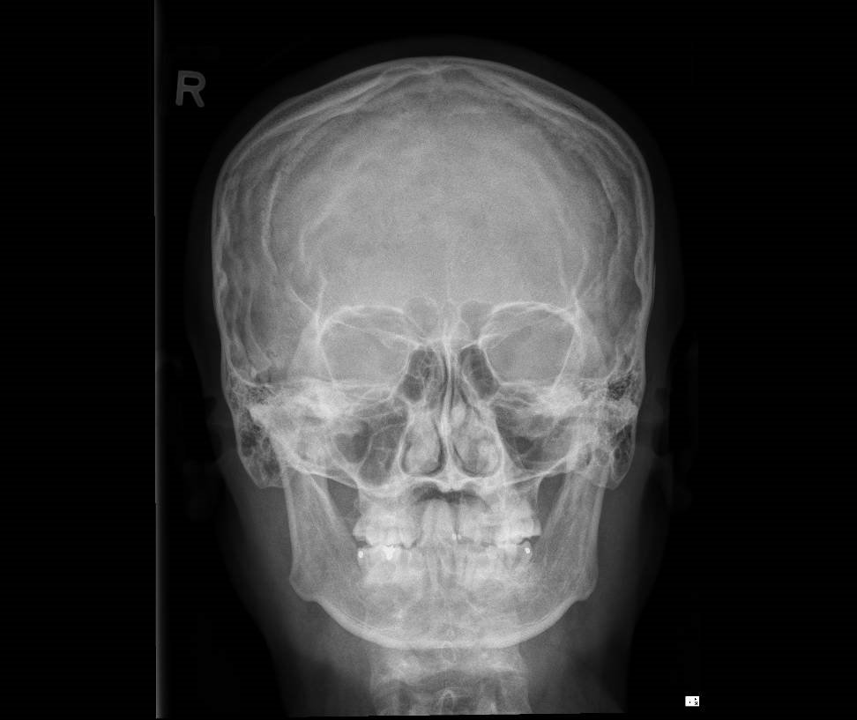
Case courtesy of Amanda Er, Radiopaedia.org, rID: 76406

Slide 11
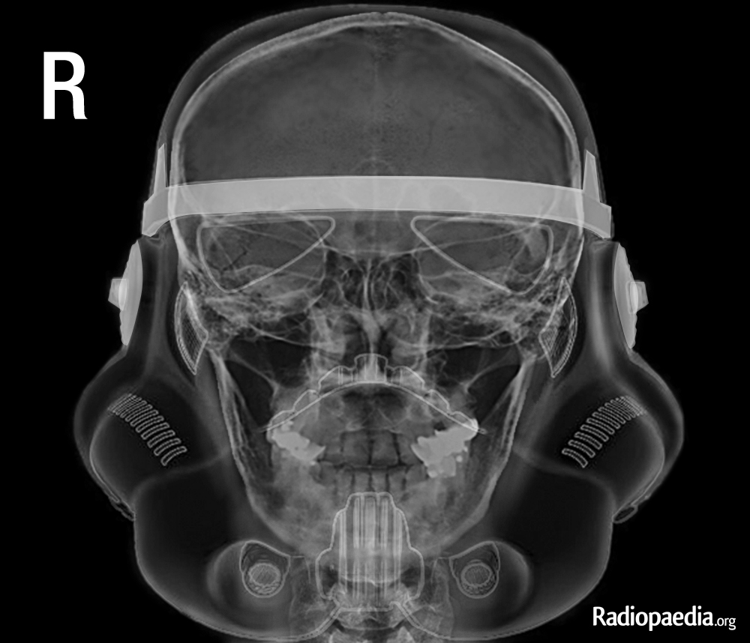

Slide 12
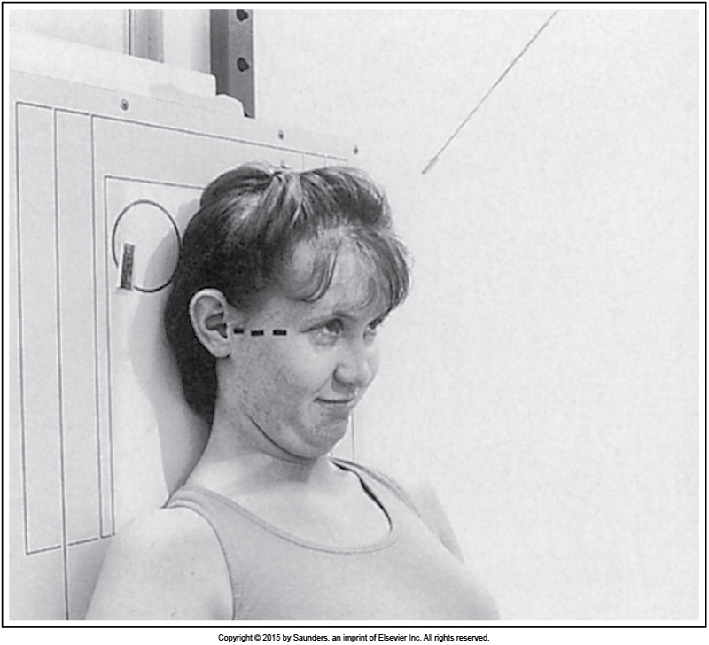

Slide 13
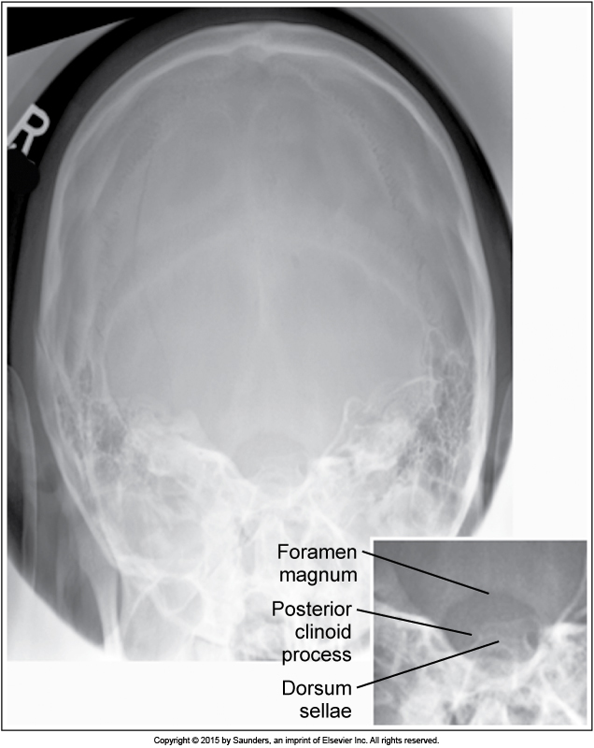

Slide 14
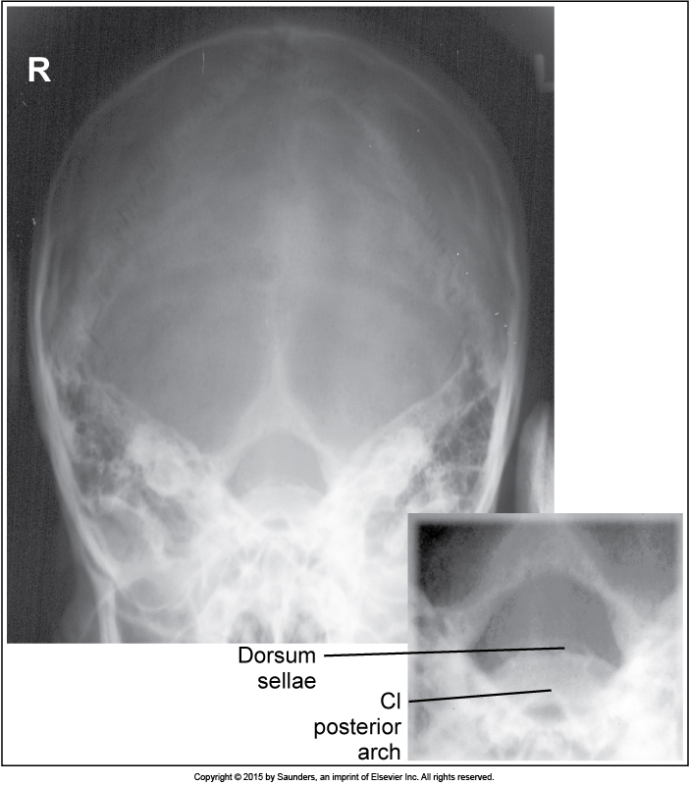

Slide 15
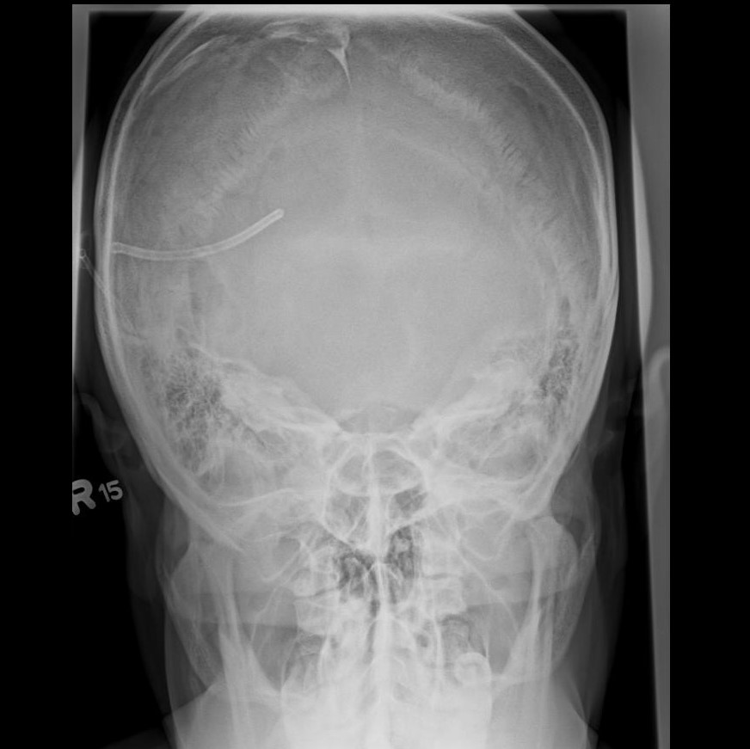
Case courtesy of Dr Matt A. Morgan, Radiopaedia.org, rID: 37238

Slide 16
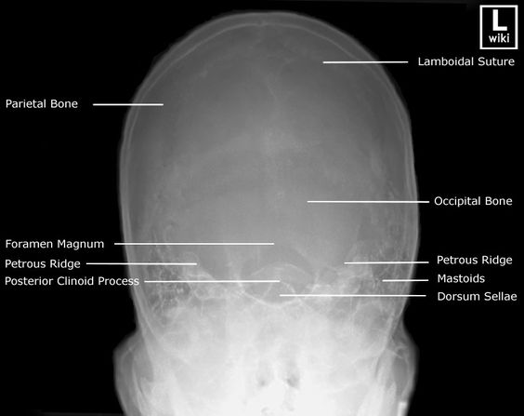

Slide 17
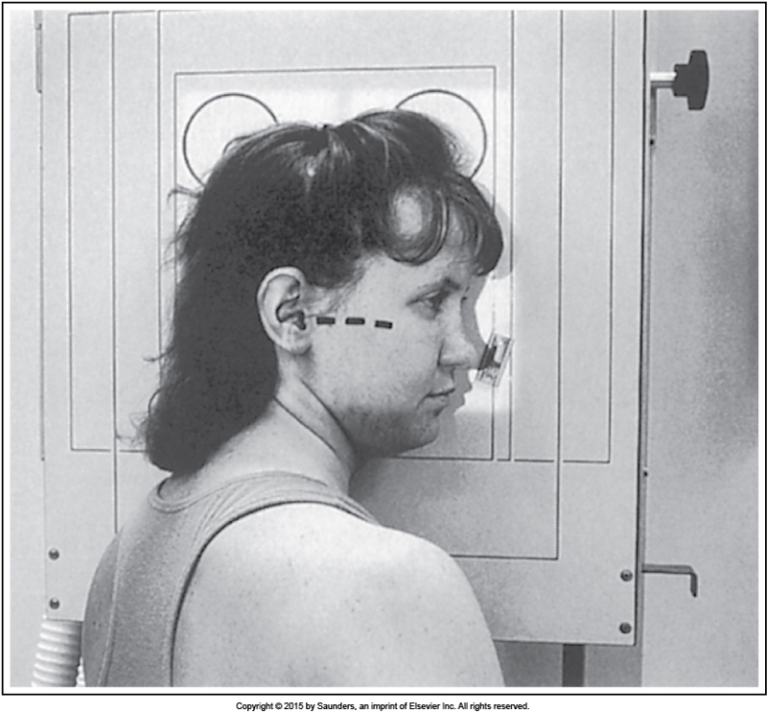

Slide 18
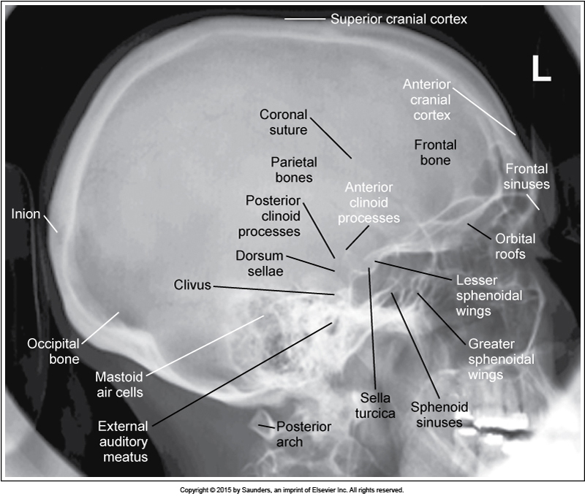

Slide 19
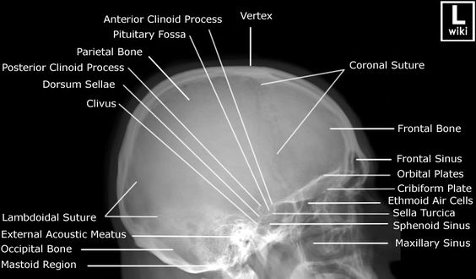

Slide 20
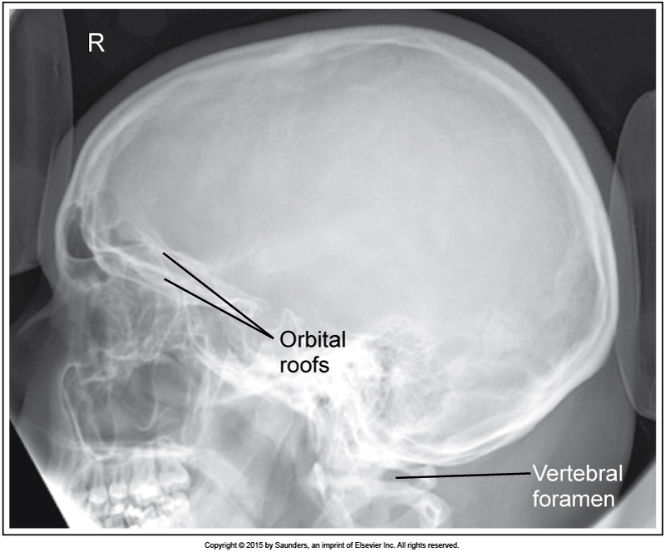

Slide 21
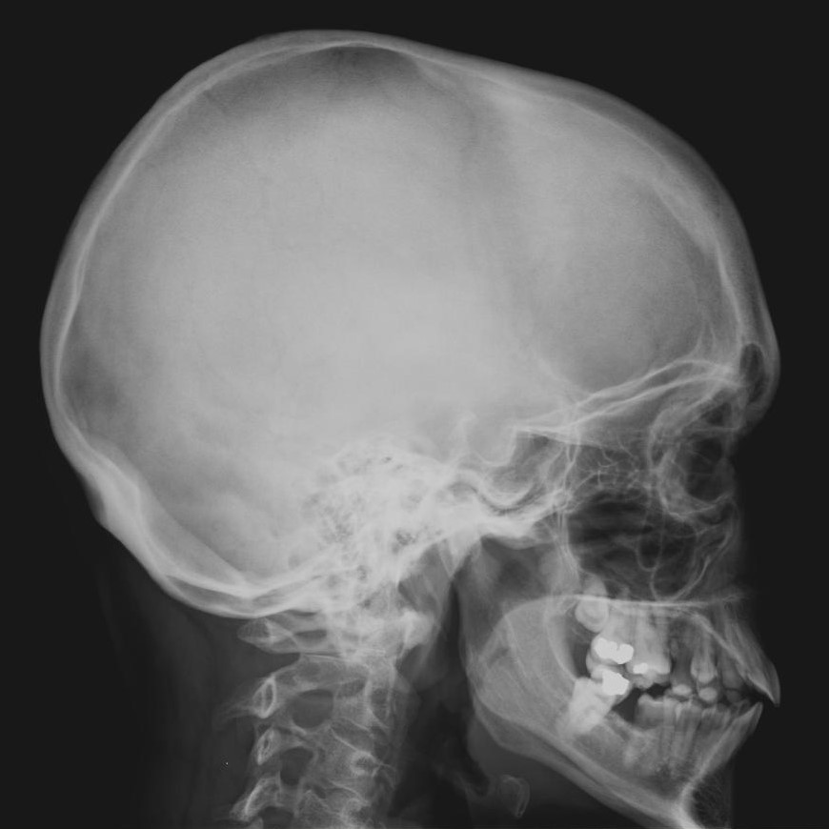
Case courtesy of Dr Matt A. Morgan, Radiopaedia.org, rID: 37222

Slide 22

QUESTIONS?

