Slide 1


Anatomic and Physiology Terminology

Slide 2
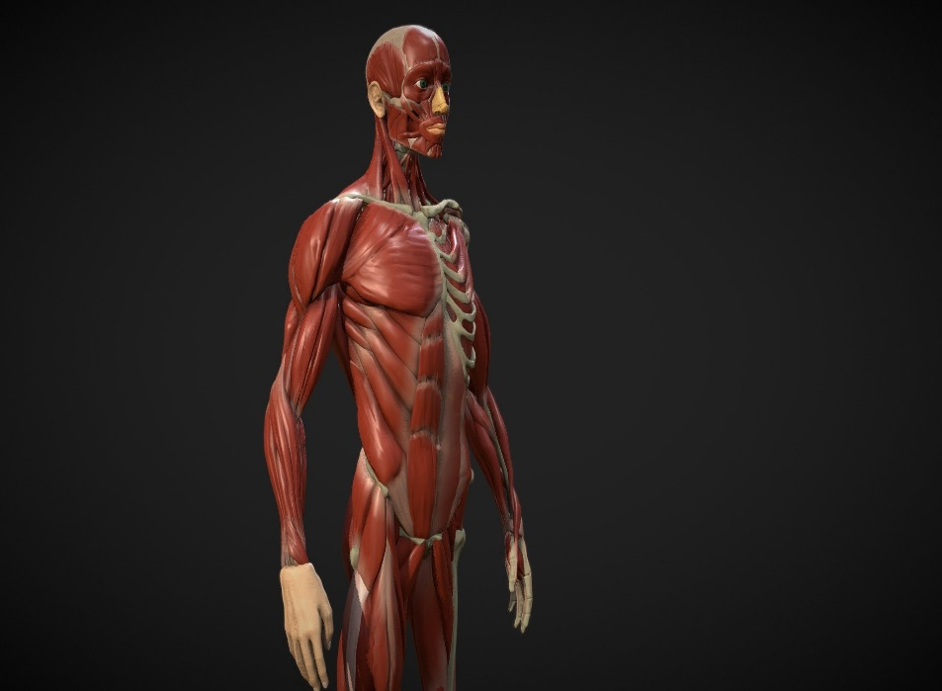
OUR JOURNEY TODAY
Learning Objectives
Lesson 4.2: Anatomic and Physiologic Terminology for Bones, Joints, Muscles, Body Systems, and Documentation
This Photo by Unknown Author is licensed under CC BY

Slide 3
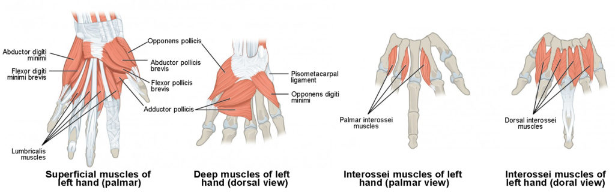
This Photo by Unknown Author is licensed under CC BY
Define anatomical and physiological terminology for bones, joints, and muscles.
Define anatomical and physiological terminology for the nervous, cardiovascular, lymphatic, and immune systems.
Define anatomical and physiological terminology for the respiratory, digestive, endocrine, and integumentary systems.
Use the information in this chapter for effective professional communication and documentation.

Slide 4
Body Structure and Bones,
Joints, and Muscles: Tissues
Tissues are collections of specialized cells performing special functions
The primary types of tissue include:
  Epithelial
  Connective
  Muscular
  Nervous
Notes:
What is histology? (Histology is the study of tissues. Histo is a root word meaning “tissue.”)
Epithelial tissue covers exterior surfaces (e.g., skin cells and mucous membranes) or lines internal passages (e.g., the lining of the stomach).
Connective tissue plays a part in the appearance of cellulite. Collagen fibers stretch unevenly over subcutaneous fat deposits, causing some areas to bulge and others to dimple. There are no proven treatments for cellulite, and liposuction can make it even worse.
4

Slide 5
Organs and Systems
Organ: Collection of specialized tissues
Body as 10 general systems
  Musculoskeletal
  Nervous
  Cardiovascular
  Lymphatic
  Digestive
  Respiratory
  Urinary
  Endocrine
  Reproductive
  Integumentary
Notes:
Refer to Table 4.5.
Organs make up systems.
5

Slide 6
Body Cavities
Body cavities contain organs
Body cavities are divided into ventral and dorsal regions
  Two dorsal cavities: Cranial and vertebral
  Three ventral cavities: Thoracic, abdominal, and pelvic cavities
Notes:
Refer to Fig. 4.4.
Sometimes the abdominal and pelvic cavities are considered one cavity.
6

Slide 7
Posterior Regions of the Trunk
Back (posterior) surface of trunk is divided into regions
  Cervical region
  Thoracic region
  Lumbar region
  Sacral region
  Coccyx
Notes:
Refer to Fig. 4.5.
7

Slide 8
Skeletal System
Bone
  Dense connective tissue composed primarily of calcium and phosphate
Cartilage
  Hyaline
  White fibrocartilage
Ligaments
  Joint or articulation
    Point where the bones of the skeleton meet
  Movable joints
    Covered by cartilage
    Held together by ligaments
Notes:
Human skeleton is composed of approximately 206 bones.
Refer to Figs. 4.5 and 4.6.
There are two types of cartilage:
Hyaline cartilage is very elastic and makes up the articular surface at the joints, between the ribs, and at the nose.
White fibrocartilage is elastic, flexible, and tough; it is found in the joints.
Ligaments are made of white fibrous tissue. They are pliant, flexible, strong, and tough.
8

Slide 9
Articular System
(Slide 1 of 2)
Articulations
  Joints where two or more bones meet
Joints
  Where bones come together, limbs are attached, and the motion of the skeletal system occurs
  Some are rigid
Notes:
What is the function of joints? (Joints allow motion of the musculoskeletal system and hold the skeleton together.)
What is the function of bursae? (Bursae are sacs or saclike structures [bursa] usually close to joint cavities. The bursae lubricate an area between skin, tendons, ligaments, or other structures and bones where friction would otherwise develop.)
9

Slide 10
Articular System
(Slide 2 of 2)
Types of movement permitted by diarthrodial joints include:
  Flexion
  Extension
  Abduction
  Adduction
  Pronation
  Supination
  Eversion
  Inversion
  Plantar flexion
  Dorsiflexion
  Rotation
  Circumduction
  Protraction
  Retraction
  Elevation
  Depression
  Opposition
Notes:
Diarthrodial joints (such as those in the fingers, knees, and shoulders) are freely movable.
Amphiarthrodial joints are the slightly moveable joints found in the chest and pubic area.
Synarthrodial joints (such as those in the head) are immovable.
Refer to Fig. 4.7.
10

Slide 11
Muscular System
Types of muscular tissue
  Cardiac
  Smooth
  Skeletal
Muscle tone
Motor tone
Notes:
Muscle function is determined by the shape and location of the muscle and by the density and pliability of all the fluid, fibers, and connective tissue of the muscles; the term muscle tone is used to describe this aspect of muscle.
The nervous system also controls how long or short a muscle is by regulating the degree of muscle fiber contraction; this is called motor tone.
11

Slide 12
Skeletal Muscle
Skeletal muscles
  Have two ends—proximal and distal—and a belly
  Three types of action
    Concentric
    Eccentric
    Isometric
Notes:
How does the agonist-antagonist-synergist relationship work? (Muscles work in pairs of agonists and antagonists. Agonists are muscles responsible for the primary desired movement, and antagonists are the muscles that oppose the action of the agonist. Synergists are muscles that assist the agonist by holding parts of the body steady. The agonist-antagonist-synergist relationship permits the skeletal muscles to work in a purposeful manner and allows fluidity.)
Refer to Table 4.6 and Fig. 4.8.
12

Slide 13
Naming Muscles
Names of muscles can be broken down into the word elements of medical terminology
Name reflects variety of factors
  Location
  Function
  Shape
Notes:
Instructor’s note: Refer students to Table 4.7, Muscle Descriptions Using Medical Word Elements.
13

Slide 14
Nervous System
Most complex system in body
Composed of:
  Central nervous system (CNS)
  Peripheral nervous system (PNS)
  Autonomic nervous system (ANS)
Notes:
What is the function of the nervous system? (The function of the nervous system is to receive impressions from the external environment, organize the information, and provide appropriate responses.)
14

Slide 15
Central Nervous System
Center of all nervous control
Consists of:
  Brain
  Spinal cord
    Located in dorsal cavity
Notes:
The CNS is the center (central) of all nervous control.
15

Slide 16
Peripheral Nervous System
PNS is composed of cranial and spinal nerves
Spinal nerves
  31 pairs
  Many located in somatic nerve plexuses
    Network of intertwined (plexus) nerves
Notes:
The term nerve refers to a bundle of nerve fibers consisting of individual nerve cells outside the spinal cord or brain.
What is the term for an individual nerve cell? (Neuron. There are two types of nerve cells: sensory and motor neurons.)
16

Slide 17
Autonomic Nervous System
(Slide 1 of 2)
Sympathetic division
  Controls body’s response to feelings (sympath)
    Fight-or-flight response
    Fear response
Parasympathetic division
  Causes effects opposite (para-) those caused by the sympathetic system
Notes:
The ANS is an automatic, or self-governing, system. It also is called the involuntary system, because the effects of the ANS are not usually under voluntary control.
17

Slide 18
Autonomic Nervous System
(Slide 2 of 2)
Proprioception
  Kinesthetic sense
  Maintains motor tone in muscle
Proprioceptive sensory information → CNS → motor impulses → muscles
Notes:
After proprioceptive sensory information is processed in the CNS, motor impulses carry the response message back to the muscles. The muscles then contract or relax to restore or change posture, movement, or position.
18

Slide 19
Reflex
Involuntary body response to a stimulus
Notes:
Important reflexes stimulated by massage are crossed-extension, extensor thrust, flexor withdrawal, gait, intersegmental, monosynaptic, nociceptive, optical righting, ocular pelvic, pilomotor, psychogalvanic, postural, proprioceptive, righting, startle, stretch, tendon, tonic neck, vasomotor, and visceromotor reflexes.
19

Slide 20
Function of the Nervous System
Allows body to react to outside influences
Process
  Outside information enters the nervous system through receptors
  PNS sends sensations to CNS
  CNS sorts information, sends message back by PNS
    Neurotransmitters transfer information from one nerve to another
Notes:
The function of the nervous system is to receive impressions from the external environment, organize the information, and provide appropriate responses.
The nervous system and neurotransmitters, along with the endocrine system, also maintain the internal environment, or the balance of the many activities in the body (homeostasis).
Refer to Fig. 4.9.
20

Slide 21
Cardiovascular System
(Slide 1 of 2)
Heart
  Four-chambered pump
Blood vessels
  Arteries
    Tubes (vessels) that deliver oxygenated blood to the body
  Veins
    Vessels that return the blood to the heart
  Capillaries
    Very small, thin vessels (usually one cell thick) that allow the exchange of blood gasses and nutrients
Notes:
What condition might develop with the breakdown of a valve? (Breakdown of a valve may result in a varicose vein.)
Blood vessels vasoconstrict (become smaller inside) and vasodilate (become larger inside).
Refer to Fig. 4.10.
21

Slide 22
Cardiovascular System
(Slide 2 of 2)
Blood pressure
  Measurement of the pressure exerted by the circulating volume of blood on the walls of the arteries, veins, and heart chambers
  Hypertension
    High blood pressure
  Hypotension
    Low blood pressure
Notes:
Normal blood pressure varies according to age, size, and gender, but the average is approximately 120 mm Hg during systole and 70 mm Hg during diastole.
What is the composition and function of blood? (Blood is composed of a clear, yellow fluid called plasma, blood cells, and platelets. The main function of blood is to transport oxygen and nutrients to the cells and remove carbon dioxide and other waste products.)
22

Slide 23
Lymphatic System
(Slide 1 of 2)
Responsible for several functions
  Returns vital substances, such as plasma proteins, to the bloodstream from tissues of the body
  Helps maintain fluid balance by draining fluid from body tissues
  Aids body’s defense against disease-producing substances
  Aids absorption of fats from digestive system
Notes:
Refer to Fig. 4.11.
23

Slide 24
Lymphatic System
(Slide 2 of 2)
Lymph nodes
  Small bodies in the path of the lymph channels that act as filters for lymph before it returns to the bloodstream
Plexuses of lymph channels
  Mammary plexus
  Palmar plexus
  Plantar plexus
Notes:
The main locations of the more superficial lymph nodes are the cervical area, axillary region, and groin or inguinal area. Table 4.8 lists and describes the different types of lymph nodes.
24

Slide 25
Immune System
Immunity is the body’s ability to resist the toxic effects of pathogens
Upon encountering various pathogens, the immune system stimulates several immune responses to protect the body
Notes:
The immune system can be compromised by excessive stress, a recent or ongoing illness, chronic stress, radiation treatments, and even some medications.
Refer to Table 4.9.
25

Slide 26
Respiratory System
Supplies oxygen to and removes carbon dioxide from cells of body
Respiration is divided into two phases
  External respiration
  Internal respiration
Notes:
Refer to Fig. 4.12.
26

Slide 27
Digestive System
Can be loosely described as a long, muscular tube that travels through the body
Organs of digestive system transport food through this muscular tube
Accessory organs carry out functions directly related to digestion; are connected to the system by means of ducts
Notes:
Refer to Fig. 4.13.
27

Slide 28
Endocrine System
Composed of glands that produce hormones, which are secreted directly into the bloodstream to stimulate cells in a specific way or to set a body function into action
Complex and important
Serves as a control and regulation system for the body
Notes:
Refer to Fig. 4.14.
28

Slide 29
Integumentary System
(Slide 1 of 3)
Skin is composed of three layers of tissue
  Epidermis
    Outer layer
    Contains melanocytes
  Dermis
    Lies under epidermis (true skin)
    Composed of connective tissue; contains blood vessels, hair follicles, and lymphatic vessels
  Subcutaneous tissue
    Fatty, connective tissue
    Attaches dermis to underlying structures
Notes:
The integumentary system consists of the skin and its appendages, including the hair and nails.
Melanocytes give skin its color.
Refer to Fig. 4.15.
29

Slide 30
Integumentary System
(Slide 2 of 3)
Functions of the skin
  Protection
  Control and maintenance of body temperature
  Detection of the sensations of touch, temperature, pain, and pressure
  Secretion of sweat and sebum
  Production of vitamin D
Notes:
Many disease signs (particularly color changes) may first be noticed in the skin.
30

Slide 31
Integumentary System
(Slide 3 of 3)
Sebaceous glands
  Secrete sebum
Sweat glands
  Cool the body
  Eccrine
    Odorless sweat
  Apocrine
    Open into hair follicles
Notes:
What is the function of the sebaceous glands? (The sebaceous glands secrete an oily substance called sebum, which gives the skin and hair a glossy appearance.)
31

Slide 32
Documentation
Client records
  Contain all information related to the client
Documentation
  Process of creating and maintaining client records
Charting
  Systematic form of documentation
Progress or session notes
  Produced by using a charting process to record each massage with the client
Notes:
Instructor’s note: Be sure to cover Box 4.5, Documentation Rules for Medical Records and Health Care Professionals.

Slide 33
Problem-Oriented Medical Record
Problem-oriented medical record (POMR) system
  Method of record keeping that is organized around the problems of the client or patient
SOAP format
  Critical thinking process used to collect information and organize it according to a system
  Subjective, objective, assessment/analysis, and plan
Notes:
The SOAP charting process has become the most used documentation method for therapeutic massage.
“SOAP” stands for subjective, objective, assessment/analysis, and plan.
Because diagnosis and prescribing are out of the scope of practice for massage therapy, the SOAP process has been modified over time to better fit the practice of therapeutic massage.

Slide 34
Progress/Session Notes
Chart each visit by the client
Should follow a systematic method of organizing the information for decision making
Notes:
Good record-keeping skills equip the massage therapist to communicate with other health care personnel. They also help create an accurate record of specified treatment goals, the methods of massage, and the effectiveness of treatment.
Refer to Box 4.5.

Slide 35
Confidentiality of Medical Records
HIPAA’s Privacy Rule: Includes standards that protect a patient’s individually identifiable data
  Protected health information (PHI)
    Information that identifies a patient and his or her health status
Notes:
The Privacy Rule applies to health plans, health care clearinghouses, and other health care providers. It covers a broad range of information.
Most health care providers, and certainly hospitals, have policies and procedures governing the release of any information about a patient.
To ensure compliance, health care providers have implemented policies and procedures that adhere to HIPAA regulations. The massage therapist in the medical environment should be specifically trained in the HIPAA procedures in place in the medical environment.

Slide 36
Documentation in the
Massage Therapy Practice
Record keeping or charting consists of the written (electronic or paper) record of:
  Intake procedures
  Informed consent
  Physical and history assessment
  Release of information
Notes:
What does a professional need to know about record keeping? Isn’t that a clerical responsibility? (A massage professional needs to make clinical decisions about the client’s concerns and the methods to be used to achieve clients’ goals and address their concerns. Clinical decision making is based on maintaining a written account of professional interaction. Massage professionals must be able to gather information effectively, analyze that information to make decisions about the appropriateness of a therapeutic intervention, and evaluate and justify the benefits.)
Refer to Box 4.6.

Slide 37
Clinical Reasoning and Charting
Charting is a written record of the clinical reasoning process
  Assess
    Gather information
  Analyze
    Organize information
  Decision making
    Plan intervention by evaluating and justifying benefits
Functionally oriented goals
  Quantifiable
    How many, for how long, when?
  Qualifiable
    In what way?
Notes:
Why is it important to set goals in a massage therapy session? (To develop a treatment plan, a massage professional needs to set achievable goals and outline a general plan to reach these goals. Because these goals are functional, they must be quantified and qualified.)
Instructor’s note: Be sure to cover Box 4.7, Methods of Organized Thinking.

Slide 38
Goals: Outcomes and Problem Solving
Goals describe desired outcomes
Problems indicate limits in functions
Example
  Description of the problem
    Client has disturbed sleep pattern because of multiple physical and emotional stressors
  Goal
    Reduce physical stress symptoms to support more effective sleep
Notes:
Massage sessions are goal oriented. It is important to develop measurable, activity-based goals that are meaningful to the client, such as improvement in the ability to perform activities of daily living.

Slide 39
Quantifiable and Qualifiable Goals
Quantifiable
  Goals must be measurable in terms of objective criteria
Qualifiable
  Measures for determining when a goal has been achieved
Notes:
What are some examples of quantifiable and qualifiable goals? (Examples are listed in the textbook. Have students see if they can come up with their own examples.)

Slide 40
Database
(Slide 1 of 2)
The database contains all the information gathered from the client
The history interview includes a health history, client profile, history of the current condition, and a history of familial illness
Physical assessments identify deviations from the norm of effective functioning
Notes:
What are four basic questions that support data collection? (1. Will you please explain the situation or tell me what happened? 2. How did/do you feel about the situation? 3. What has been the result of the situation in terms of cost, limitations, or changes in activity or performance? 4. How would you prefer the situation to be handled or what would you like to occur?)
Refer to Figs. 4.16 and 4.17.

Slide 41
Database
(Slide 2 of 2)
Analysis of data includes the following:
  Review information
  Brainstorm possibilities
  Consider logical outcomes of each possibility
  Consider how people would be affected by each possibility
Identify problems, outcomes, and goals
Decide on a care or treatment plan
Notes:
Are all therapeutic goals created as a response to a problem? (No, not all therapeutic goals are related to problems. Clients often use massage for health maintenance, stress management, and fulfillment of pleasure needs. However, the same analysis process should be used to determine the approach to best meet the client’s goal.)
Refer to Fig. 4.18.

Slide 42
SOAP Notes
Record care or treatment plan with SOAP notes
  Subjective data from client’s point of view
  Objective data from inspection and palpation
  Analysis (assessment of data)
  Plan methodology for intervention
Notes:
What is the difference between physical assessment information and the type of assessment in the SOAP model? (“Assessment” in SOAP is analysis of the data and effectiveness of the intervention, whereas a physical assessment identifies deviations from effective functioning.)
Refer to Fig. 4.19 and Box 4.8.

Slide 43
Computer-Based Patient Record and Electronic Health Record
Paper records are becoming a thing of the past
Automated record-keeping systems have a variety of names, such as electronic medical record (EMR), computer-based patient record (CPR), electronic patient record (EPR), computerized medical record, and electronic health record (EHR)
Notes:
Refer to Box 4.9.
Clinical documentation has grown to encompass more than just progress notes. In focus charting, progress notes are used to document progress in meeting the client’s goals, and notes are written to provide documentation related to a specific focus.

Slide 44

QUESTIONS?

