Slide 1


Business Operations
Unit 8

Slide 2

What are the 4 P’s ?
Product
Price
Places
Promotion

Slide 3

These are they key 4 marketing factors for a successful campaign strategy:
What will the product provide the customer?
Why it’s value fits its price
It will appear in the places of the company’s target audience and,
The effective promotion strategies to reach potential customers

Slide 4

The 4 P's should influence your product positioning, marketing channel selection, advertising decisions, promotional strategy, and copy choices throughout the campaign

Slide 5
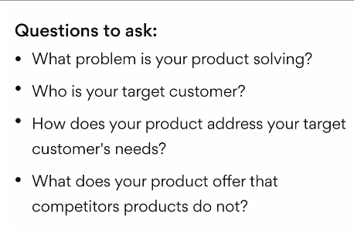
How do the 4 P’s work?
PRODUCT

Slide 6

Example product questions
What problem is your product solving? Consider what challenges your target customers encounter and what impacts those challenges have.
Who is your target customer? Think about what type of person is most likely to find value in your product.
How does your product address your target customer’s needs? Home in on how specific features of your product address specific customer demands.
What does your product offer that competitors' products do not? Determine how your product solves customers' needs more quickly, effectively, or affordably than competing products.

Slide 7
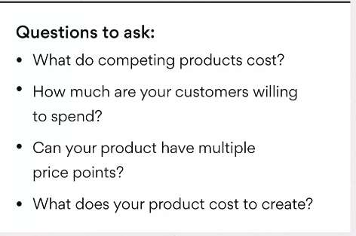
The Second P: Price
PRICE

Slide 8

Example price questions
What do competing products cost? This is a great starting point for market research and gauging your product’s price range.
How much are your customers willing to spend? Thinking about how much your potential customers are willing to spend will help give you a price cap.
Can your product have multiple price points? Looking at the potential to have several price points for different levels of subscriptions or products can open you up to a larger demographic.
What does your product cost to create? Understanding how much it will cost you to make a product or provide a service will help you determine your profit margins.

Slide 9
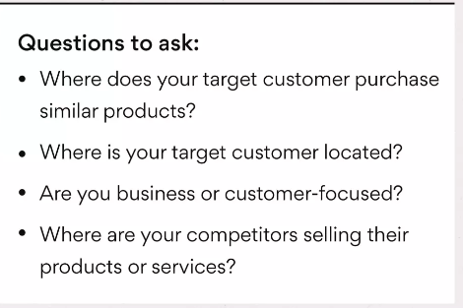
The Third P: Place
PLACE

Slide 10

Example place questions
Where does your target customer purchase similar products? Think about whether your potential buyers will purchase your product in a store, conference, online, etc., in order to determine the best place to sell your product.
Where is your customer located? Knowing where your customer lives or spends their time shopping is an important aspect of developing a marketing strategy.
Are you business or consumer-focused? Deciding whether you are selling directly to individuals or businesses will help you determine where to sell your new product.
Where are your competitors selling their products or services? Use your successful competitors as a guide on where to sell your products. They are great indicators of which place(s) will be most successful.

Slide 11
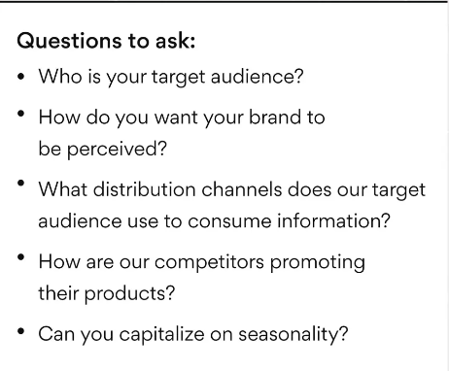
The Fourth P: Promotion
PROMOTION

Slide 12
For Example
Who is your target audience? Understand who you're speaking to so you can decide what voice and tone will resonate the most.
How do you want your brand to be perceived? Think about what brand personality makes sense for your product and industry.
What distribution channels does our target audience use to consume information? Don't sabotage your message by promoting it in the wrong place.
How are competitors promoting their products? Using your competitors as your guinea pigs for promotion experiments is a great way to find out what works and learn from their mistakes.
Can you capitalize on seasonality? If your target audience's behavior changes drastically from summer to winter, create different marketing strategies for different times of the year.

Slide 13

Use the 4 P's to start your marketing campaigns on the right foot
The 4 Ps aren't something you can implement as an afterthought. To utilize the 4 P's effectively, incorporate them into every step of your marketing campaign.
From your initial stage all the way through to campaign launch, the presence of the 4 P's should be evident in your marketing strategy every step of the way.

Slide 14

Group Exercise
The class should be divided into small groups
The Groups should have a product they want to sale in mind
The groups should develop the marketing plan using the 4 P’s
The groups should present their marketing plan to the other students who will play the role of the “client”
HAVE FUN!

Slide 15

QUESTIONS?

