Slide 1
MRAD 256
Radiographic Technique 2
Facial Bones Anatomy

Slide 2
Facial Bones
Contribute to the shape and form of the face
14 Facial Bones
      2 Maxillae
      2 zygomas
      2 lacrimal bones
      2 nasal bones
      2 inferior nasal conchae
      2 palatine bones
      1 vomer
      1 mandible

Slide 3
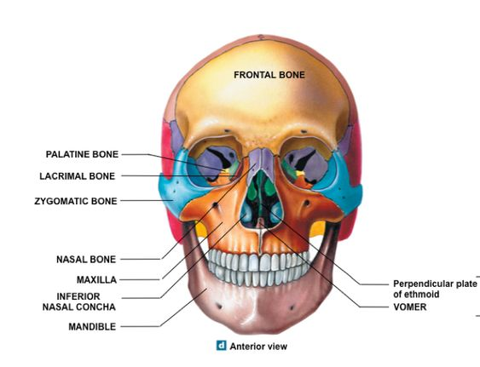

Slide 4
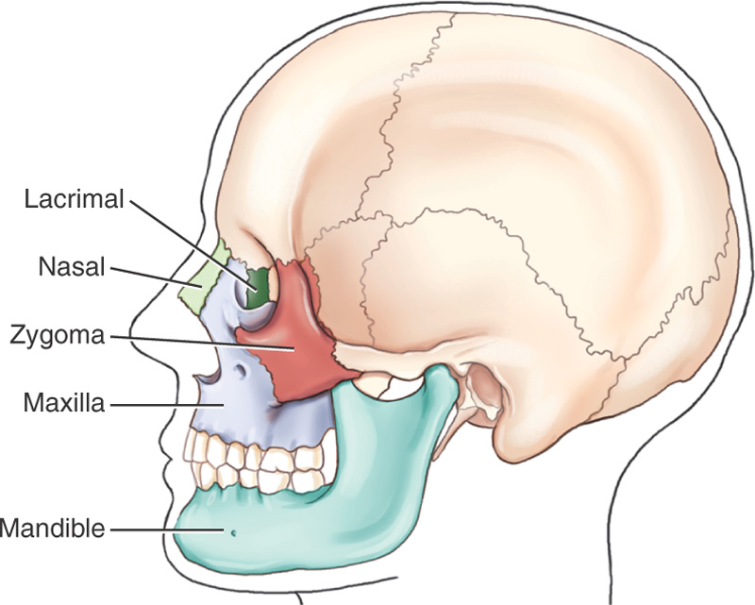
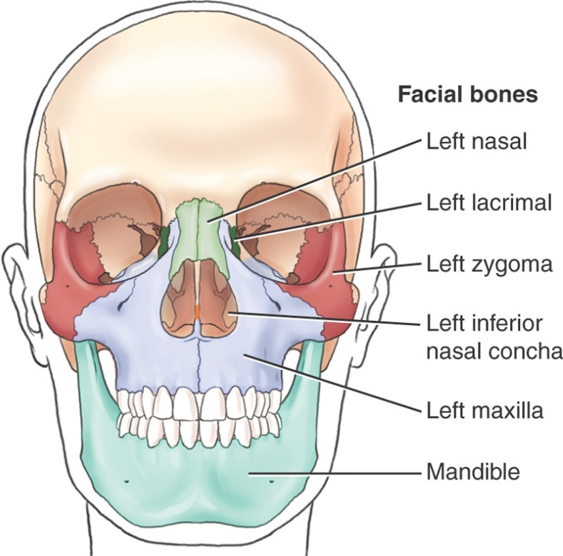
Facial Bones

Slide 5
Maxillary Bones
Largest immoveable bones of the face
All other bones are closely associated with the 2 maxillae
Structurally the most important bones of the upper face
Solidly united at the midline below the nasal septum, the upper part of this union is the anterior nasal spine

Slide 6
Maxillary Bones
Consists of a centrally located body and 4 processes
Body is centrally located and lies lateral to the nose
The frontal process projects up along the nose
The zygomatic process projects laterally to unite with the zygoma
The alveolar process is the inferior aspect of the body, where 8 upper teeth occur along the inferior edge

Slide 7
Articulations
Each maxilla articulates with:
  Frontal and ethmoid bones
  Zygoma
  Lacrimal
  Nasal
  Palatine
  Inferior nasal concha
  Vomer
  Adjacent maxilla

Slide 8
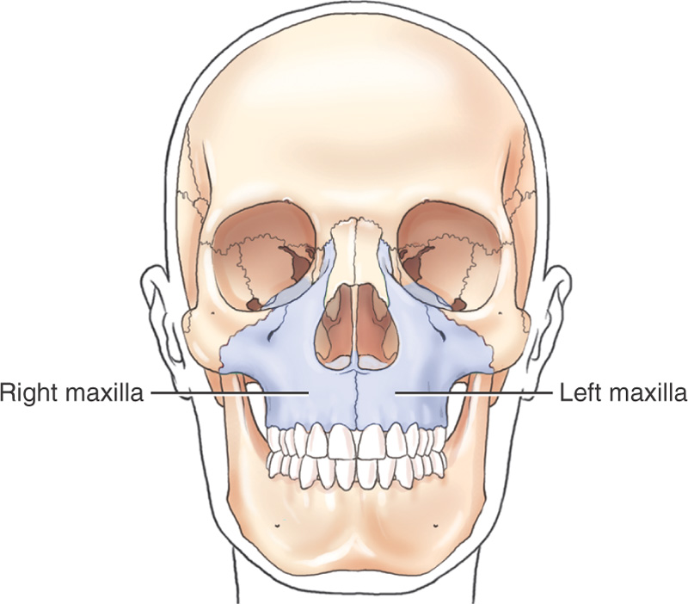
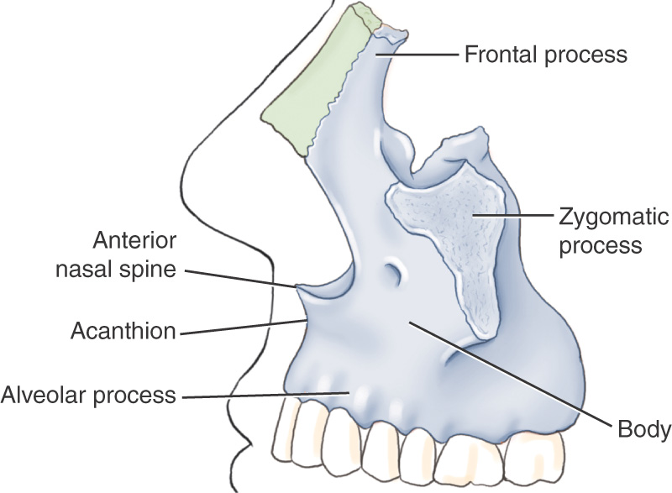
Maxilla
Right and Left Maxillary Bones
Articulates with 2 cranial bones and 7 facial bones

Slide 9
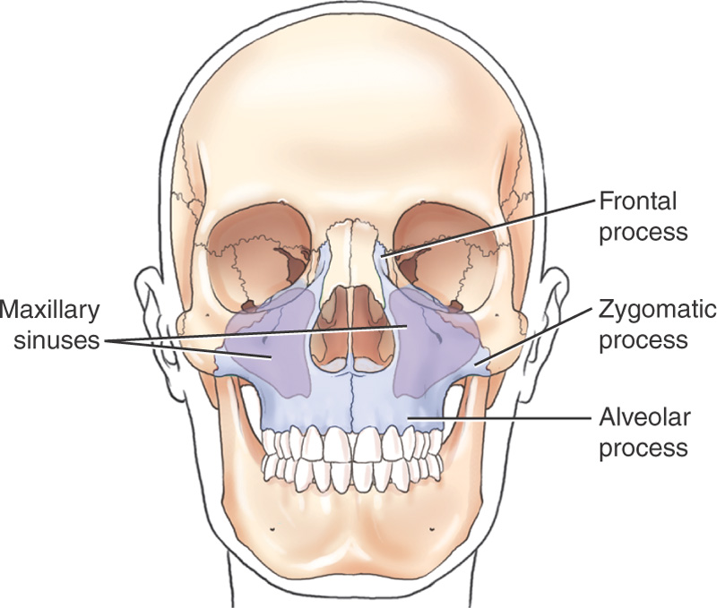
Maxillae Frontal View

Slide 10
Maxilla, Palatine Bones
The fourth process of each maxillary bone is the palatine process
The 2 palatine processes form the anterior portion of the roof of the mouth, called the hard palate
The horizontal portion of the 2 palatine bones form the posterior portion of the hard palate

Slide 11
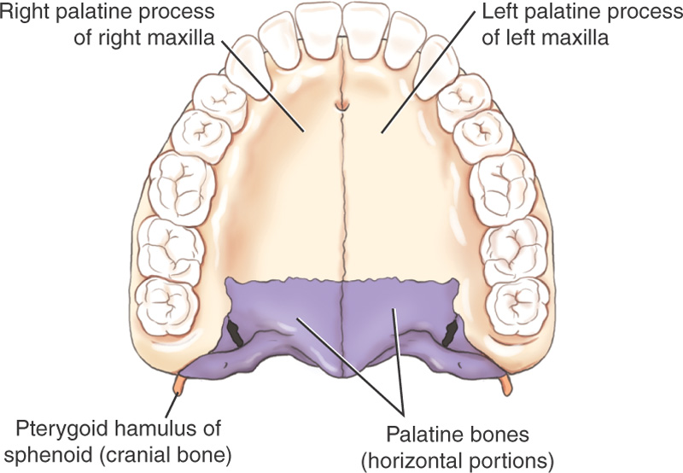
Hard Palate: Inferior Surface

Slide 12
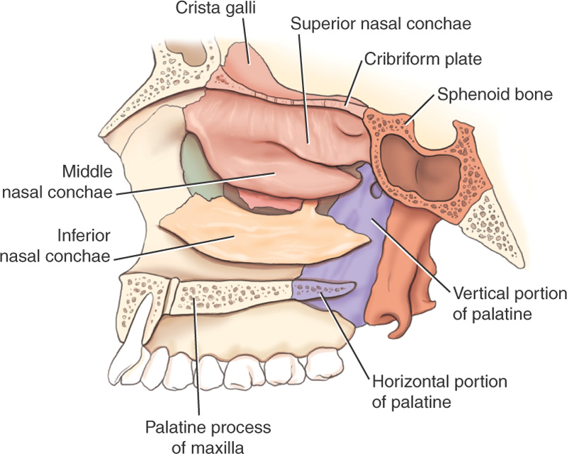
Right and Left Palatine Bones

Slide 13
Palatine Bones
2 bones, right and left
Contribute to the walls of three cavities:
      Floor and lateral walls of nasal cavity
      Roof of the mouth
      Floor of the orbits
Somewhat “L” shaped, with a horizontal plate, perpendicular plate and 3 projecting processes: pyramidal, sphenoidal and orbital
Articulates with 6 bones:
      Cranial: sphenoid, ethmoid
      Facial: maxilla, inferior nasal concha, vomer and opposite palatine

Slide 14
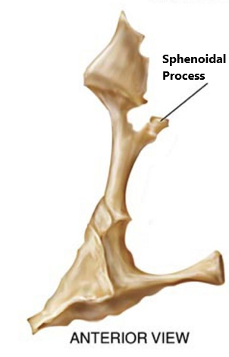
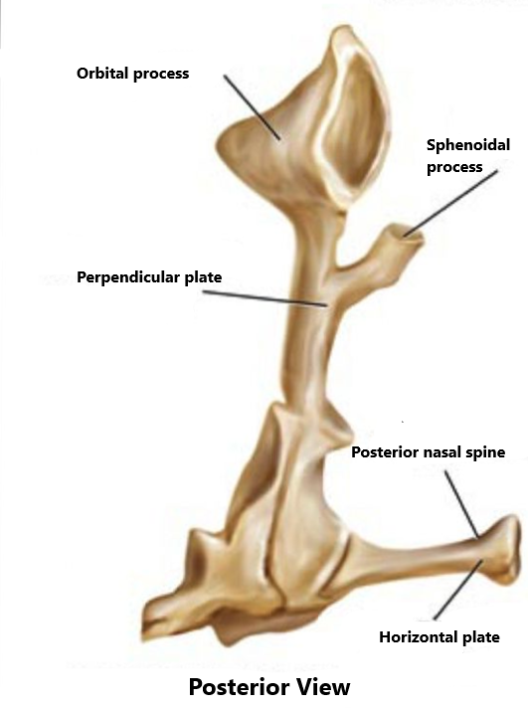

Slide 15
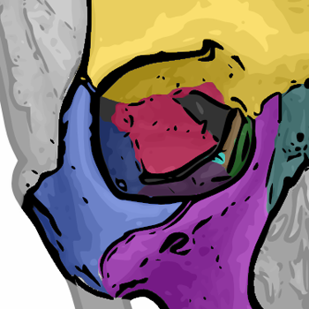

Slide 16
Zygomatic Bones
“Cheek bones”
Form lower outer portion of orbits as well as prominence of cheeks
Process projecting posteriorly connects with zygomatic process of the temporal bone forming the zygomatic arch

Slide 17
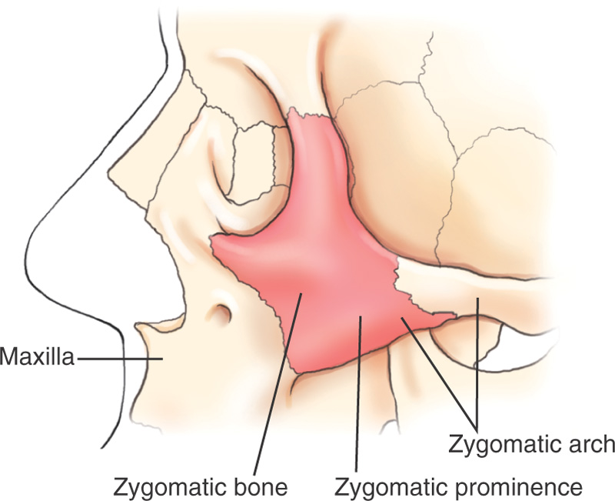
Zygomatic Bones
Articulates with:
3 cranial bones : frontal, sphenoid and temporal bones
1 facial bone (maxilla)

Slide 18
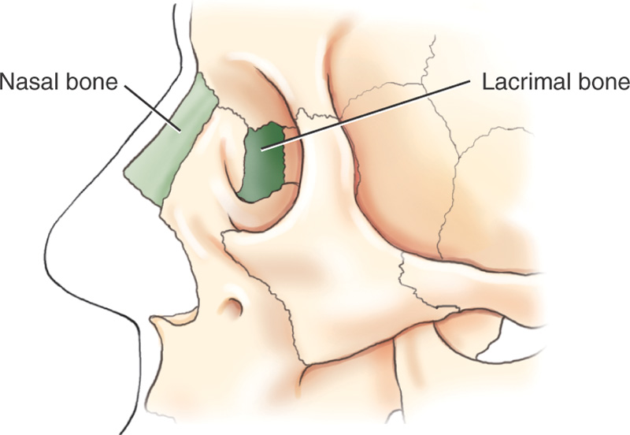
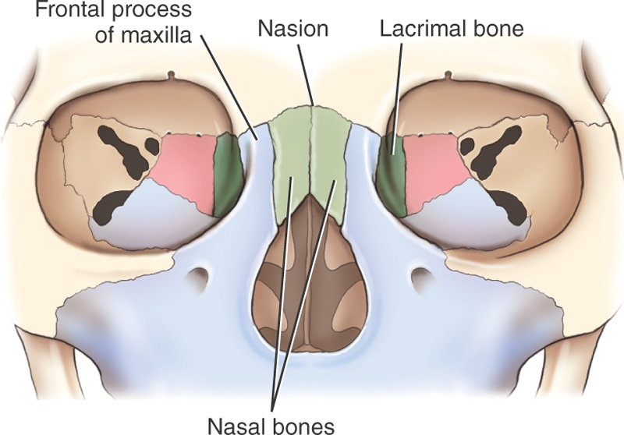
Nasal and Lacrimal Bones
Lacrimal and nasal bones articulate with 2 cranial bones and 2 facial bones

Slide 19
Nasal Bones
Form bridge of the nose
Anterior and superomedial to the frontal process of the maxillae
Inferior to the frontal bone
Junction between two nasal bones and frontal bone is called the nasion
Articulates with frontal, ethmoid, maxilla and adjacent nasal bone

Slide 20
Lacrimal Bones
Small size
Anterior and medial to each orbit
Posterior to frontal process of maxilla
Closely associated with tear ducts (“lacrimal” means “tear”)
Articulates with frontal, ethmoid, maxilla and inferior nasal concha

Slide 21
Inferior Nasal Concha
Project medially from lateral walls of the nasal cavity
Thin, plate-like, curved (scroll shaped)
Purpose of conchae – swirls incoming air around in different compartments to warm and clean air before entering the lungs

Slide 22
Inferior Nasal Concha
They are the largest of the three pairs of conchae
Superior – part of ethmoid bone
Middle – part of ethmoid bone
Inferior is a separate pair of facial bones
Articulations
Ethmoid, Maxillae, lacrimal, and palatine bones

Slide 23
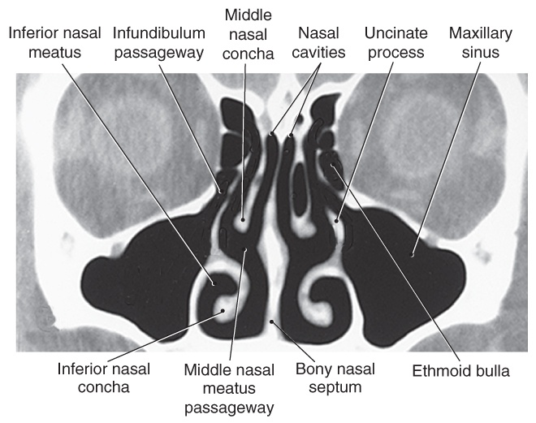
CT of Sinuses: Coronal Perspective

Slide 24
Bony Nasal Septum
Formed by the perpendicular plate of the ethmoid superiorly and the vomer bone inferiorly
Septal cartilage covers the bony nasal septum anteriorly
Articulations
  Sphenoid and ethmoid
  Right and Left palatine bones and right and left maxillae

Slide 25
Vomer
A slender, plow shaped bone found in the nasal cavity
Helps form the inferoposterior portion of the bony nasal septum
“Deviated septum” is when the nasal septum is displaced laterally , usually at the site of the junction of the septal cartilage and the vomer

Slide 26
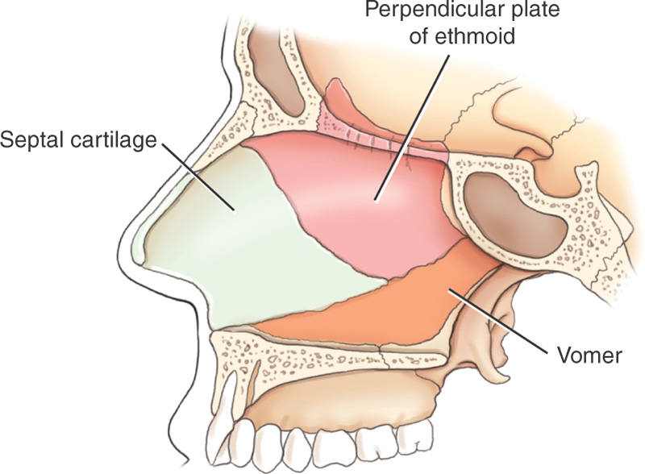
Bony Nasal Septum and Vomer

