Slide 1
MRAD 256
Radiographic Technique 2
Positioning of the mandible and TMJ’s

Slide 2
Routine Mandible Protocol
Regular routine:
PA (w/ OML┴ to IR)
35˚ axial Towne (for rami and condyles)
Bilateral - 25˚ Axiolateral Oblique projections (0° rotation)
Alternative for those who can’t hold the Townes
25˚ PA axial (as per CAMRT competency guide)

Slide 3
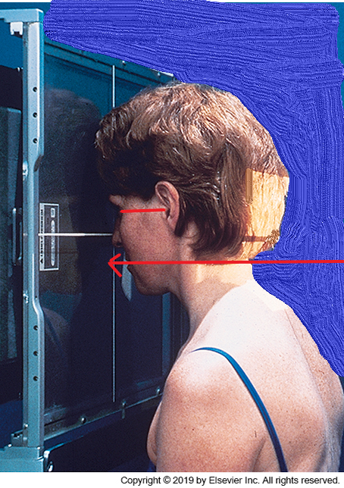
PA Projection – Page 430
Place OML perpendicular to IR
Align MSP to long axis of the IR
CR to exit at lips
Check for rotation and tilt
Collimate to include entire mandible
Suspend respiration

Slide 4
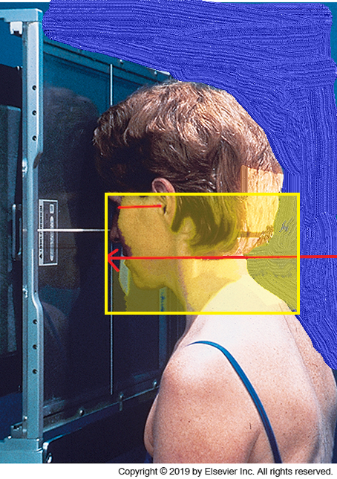
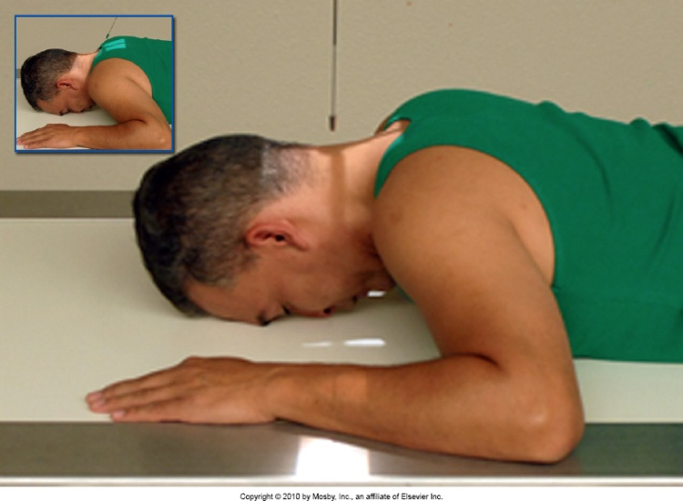
PA Mandible
Bontrager 11-160
Merrill’s 11-132

Slide 5
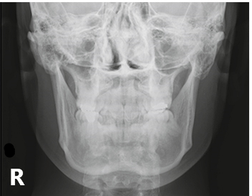
Evaluation Criteria
  Mandibular rami and lateral portion of body are seen free of superimposition
  Anterior body and mentum is seen superimposed over cervical spine
  No rotation or tilt

Slide 6
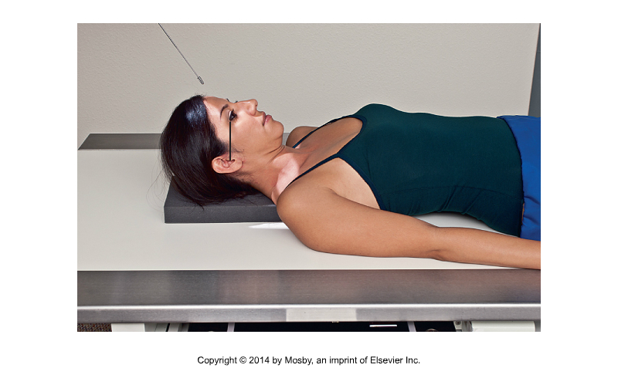
35˚Axial Townes – pg. 431
  Place OML perpendicular to the IR
  Use a 35°angle to ensure the mandibular condyles are thrown inferior to the mastoid tips.
  Collimate to include rami (EAM to gonion)
Bontrager 11-163

Slide 7
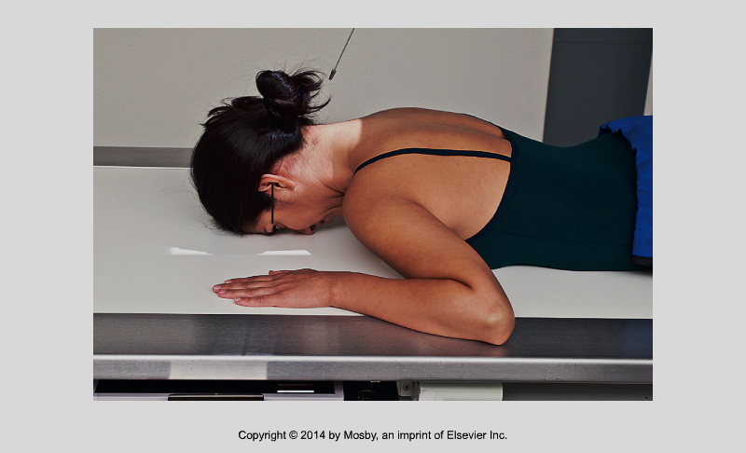
25º PA axial
If the Townes image is not possible due to patient condition, this image is taken in lieu
Bontrager 11-116

Slide 8
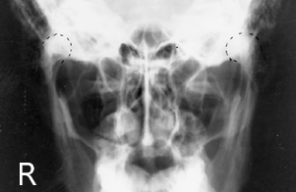
Evaluation Criteria
  Mandibular rami (condyles to gonions) are shown
  No rotation or tilt
Bontrager 11-162

Slide 9
Axiolateral Oblique Bontrager Version
15° head tilt + 10° cephalad tube angle OR 25° cephalad angle on tube with no head tilt.
Place head in true lateral, with the side of interest at the IR
Have patient close mouth, with teeth together
Rotate head to place the anatomy of interest parallel with the IR AS REQUIRED: 1) ramus 0º
Body 30º 3) Mentum 45º
With no head tilt, CR to exit at level of required anatomy
With head tilt, CR to enter at level of 5cm below the upside mandibular angle, to exit in middle of required anatomy
Move gonion off of cervical spine
Collimate to include the anatomy closest to the IR, which is the side of interest

Slide 10
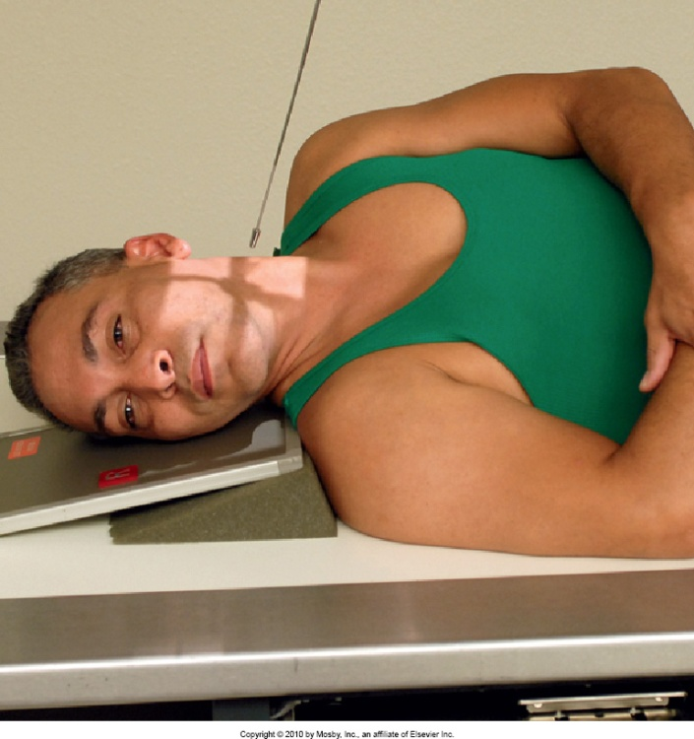
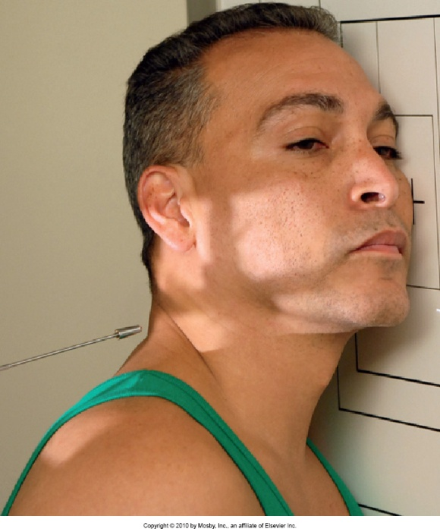
Axiolateral Oblique – pg. 429
Posterior obliques are easier for most people than anterior obliques
TMJ
Mentus
Bontrager (8th ed.) 11-152,153

Slide 11
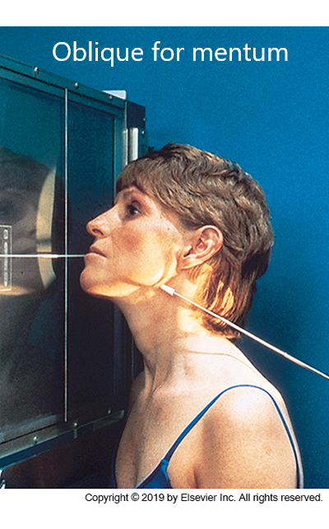
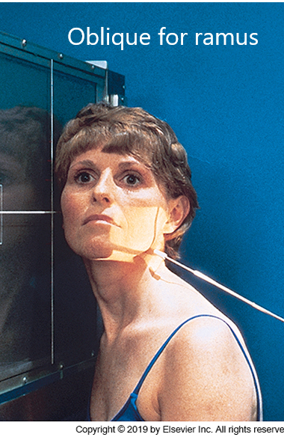
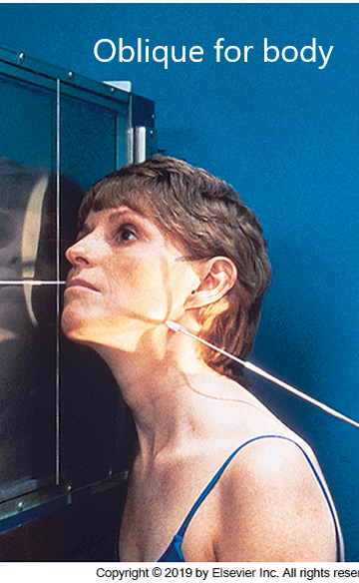
Axiolateral Oblique
CR @ 25° cephalad

Slide 12
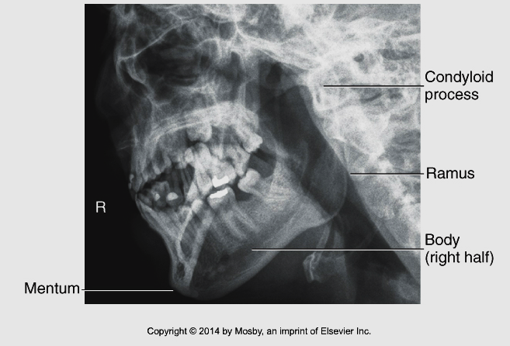
Evaluation criteria
Anatomy of the side closest to IR is visualized: ramus, condylar process, coronoid process, body and mentum
No superimposition of side farthest from IR
No superimposition of c-spine over mandible
Anatomy of interest demonstrated in profile, with minimal foreshortening
Bontrager 11-152,155

Slide 13
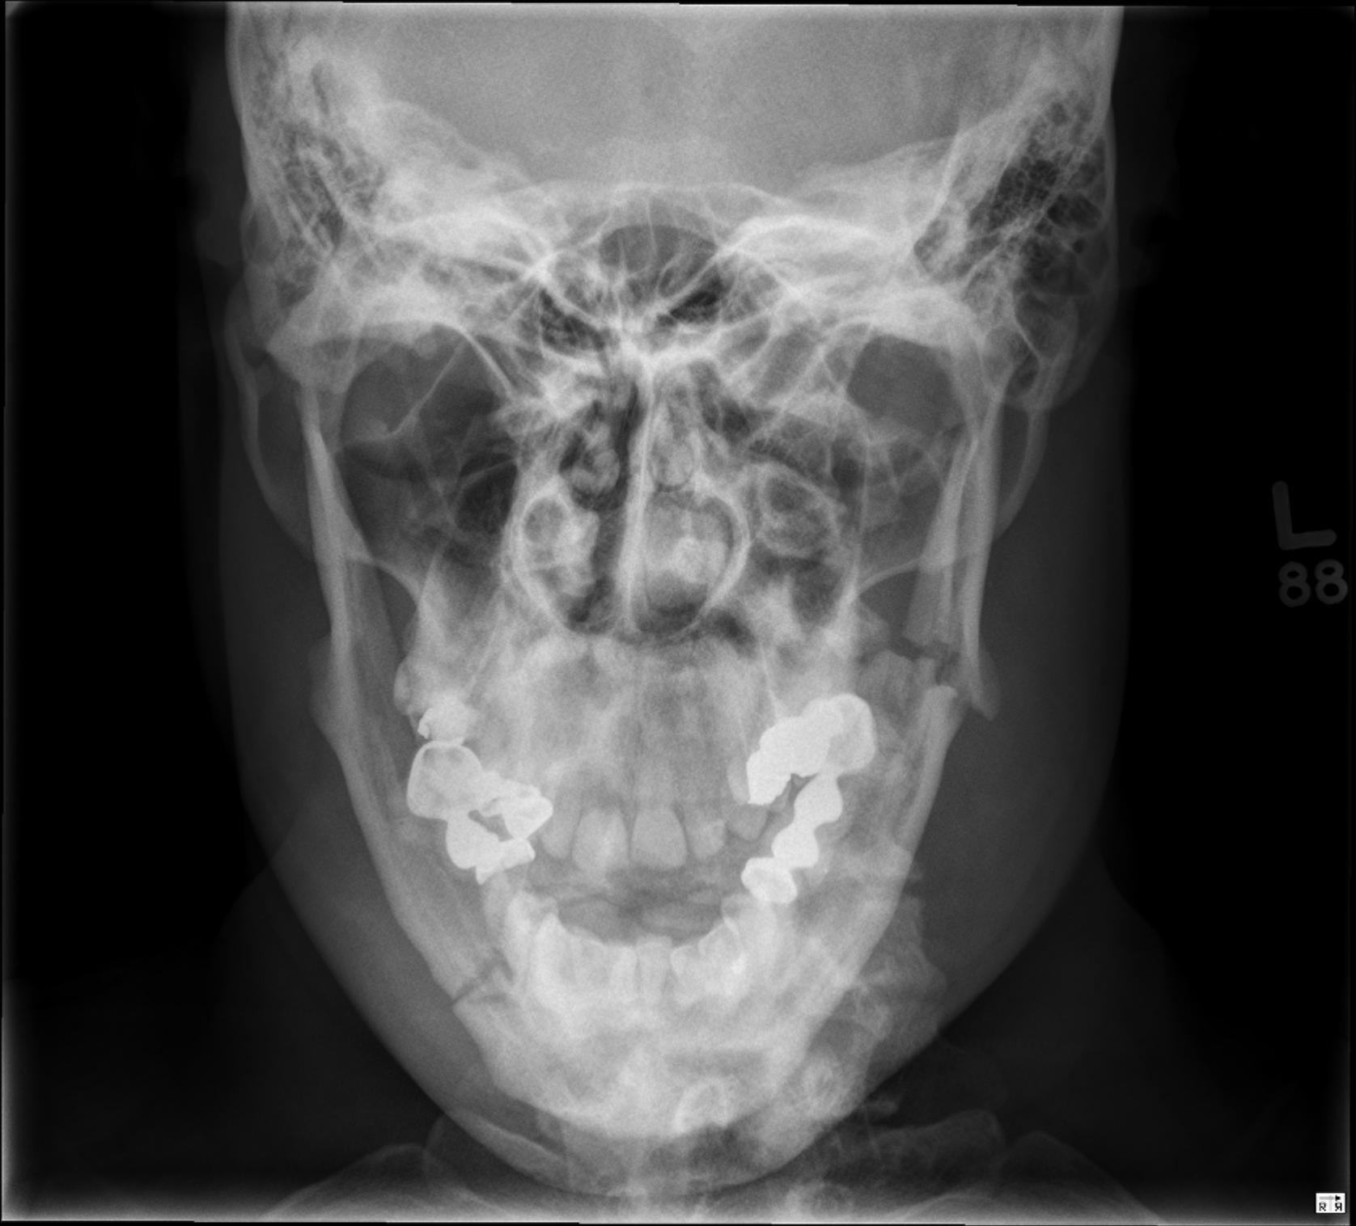
Case courtesy of Mr. Dom LeGros, Radiopaedia.org, rID: 40540

Slide 14
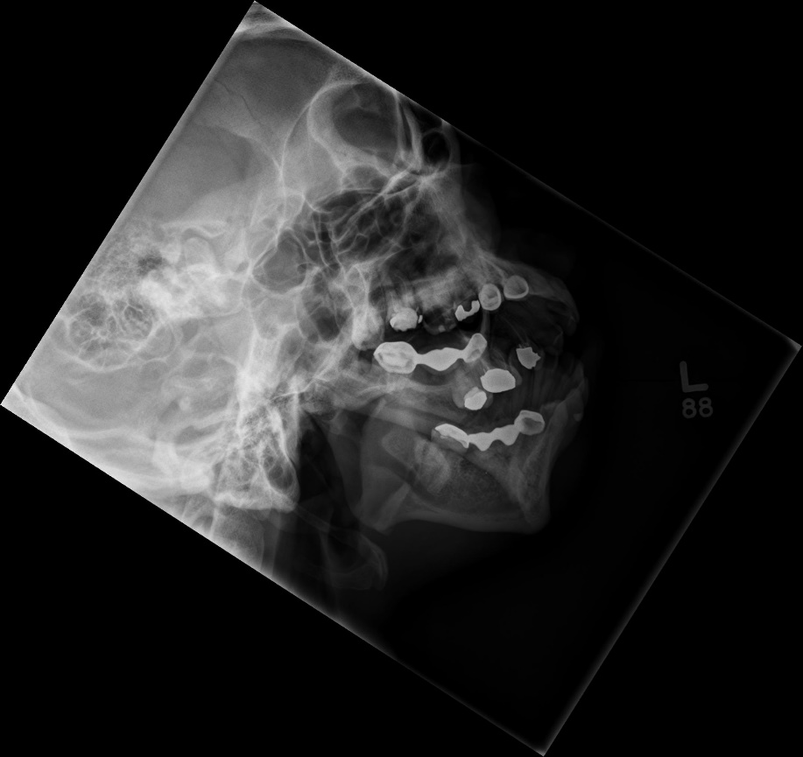
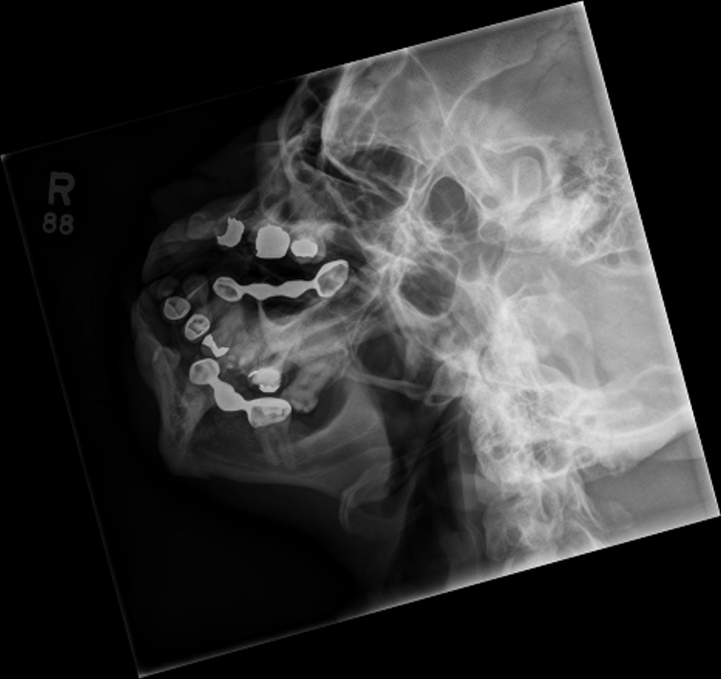

Slide 15
Routine protocol for TMJ’s
AP modified Towne (35˚)- pg. 434
Bilateral axiolateral (Schullers)
- open and closed mouth- pg. 436
Panoramic Tomography (site dependent)- pg. 433

Slide 16
35˚Axial Townes – pg. 434
  Place OML perpendicular to the IR
  Use a 35° angle to ensure the manibular condyles are thrown inferior to the mastoid tips.
  Collimate to temporomandibular joints only
Bontrager 11-175

Slide 17
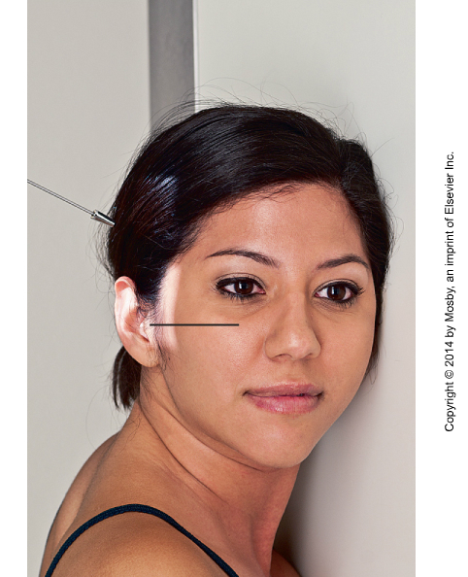
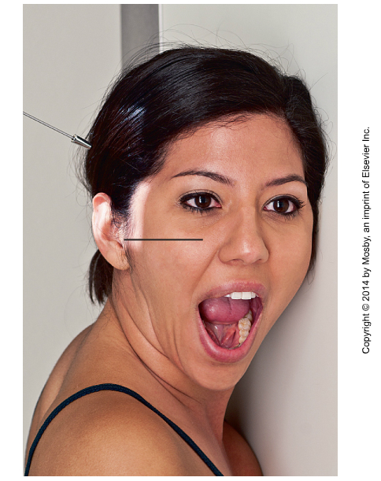
Axiolateral TMJ (Schuller method)
Angle 30˚ caudad
Place patient in true lateral, side of interest on the IR
Adjust CR to enter 1-1.5 cm anterior, and 5 cm superior to the upside EAM
CR will exit at downside level of downside TMJ / EAM
Collimate to include downside TMJ
Place an anatomical and “closed” marker in light field
Change markers, and take a second image with patient’s mouth open
Bontrager 11-181,182,183,184

Slide 18
Evaluation Criteria
Closed mouth
Posterior teeth must be in contact. In normal patient the condyle will be visualized in the temporomandibular fossa
Open mouth
Mouth should be open as wide as possible, but without the mandible jutting forward. In normal patient the condyle will be visualized anterior and inferior to the temporomandibular fossa

Slide 19
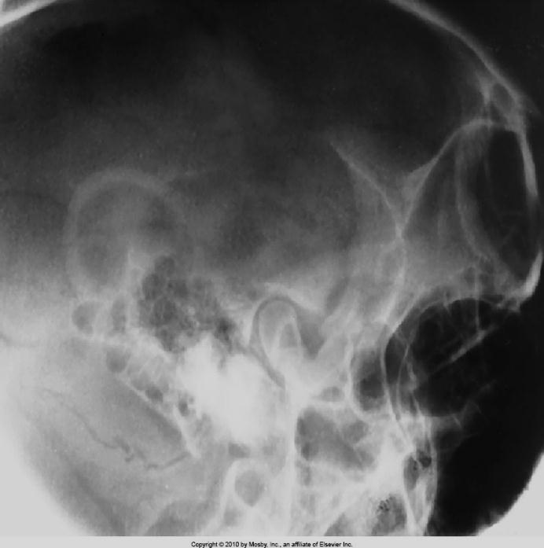
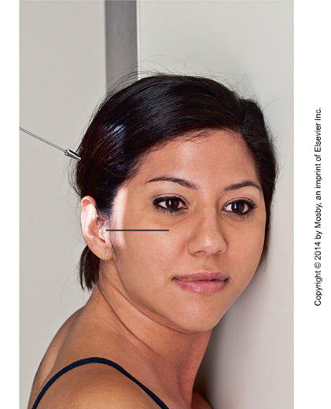
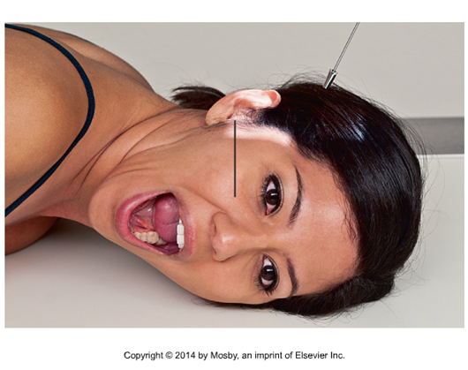
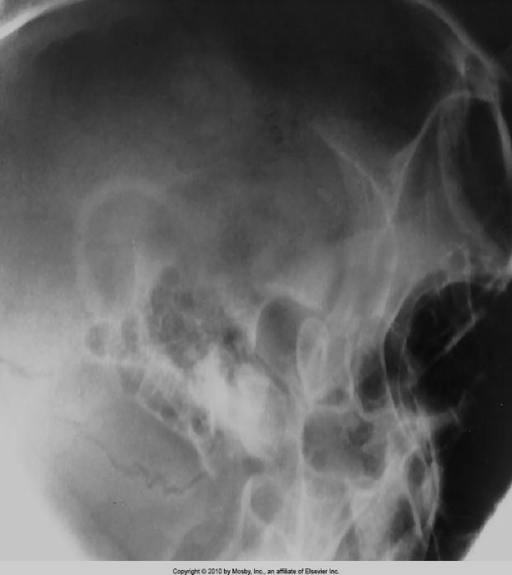
Evaluation criteria
Closed
Open
Bontrager 11-181,182,183,184

Slide 20
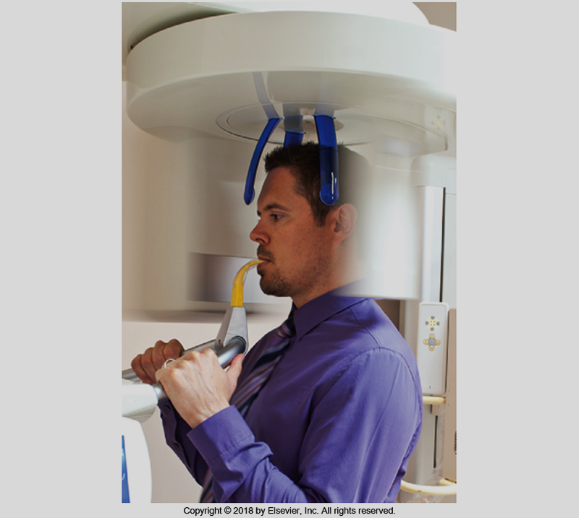
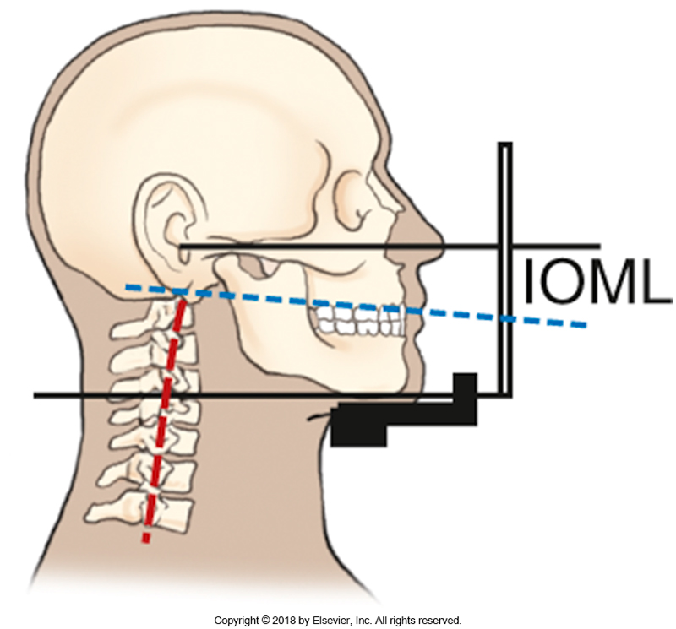
Orthopantomography
Bontrager 11-169, 11-170

Slide 21
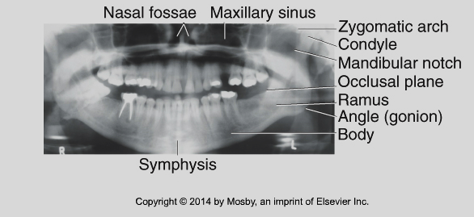
Panorex
Read page 433 Bontrager
Bontrager 11-174
Condyles perpendicular to the bottom edge of the IR and equidistant from the coronoid process
Right and left structures will be symmetrical

