Slide 1


Medical Esthetics
The Circulatory system

Slide 2
Let’s Take a Look!
What is the Circulatory system?

Slide 3
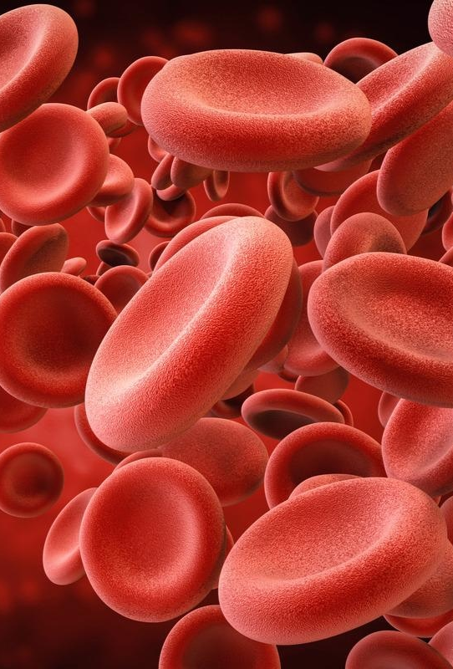
How Is This Important?
The circulatory system and the role it plays in nourishing and oxygenating the cells is important to the esthetician’s ability to interpret skin reactions to treatments. Impaired circulatory function can create a sallowness in the skin, as the tissue is not being oxygenated. Impaired circulatory function can also delay healing times. Recognizing the fragility of couperose skin (redness; distended capillaries from weakening of the capillary walls) and revising a treatment plan to benefit the client is a skill that comes from a knowledge of the circulatory system. Impaired circulatory conditions are often a contraindication to treatment.

Slide 4
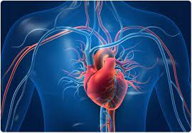

The Heart

Slide 5
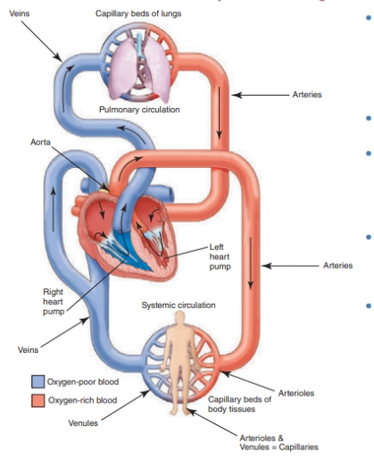
Pulmonary and Systemic Circulation

Slide 6
Blood Vessels

Slide 7
The Blood
Blood is a nutritive fluid circulating through the circulatory system and is considered connective tissue because it connects body systems together, bringing oxygen, nutrients, and hormones and removing waste products.

Slide 8
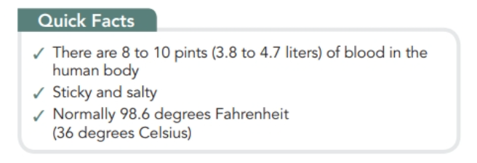

Slide 9
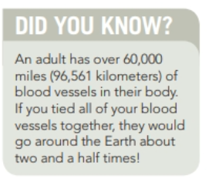

Slide 10
Functions of the Blood
Blood performs the following critical functions: Carries water, oxygen, nutrition, and minerals to all cells and tissues of the body
Carries away carbon dioxide and waste products to be eliminated through the lungs, skin, and kidneys
Helps to equalize the body’s temperature, thus protecting the body from extreme heat and cold
Aids in protecting the body from harmful bacteria and infections through the action of the white blood cells
Closes injured tiny blood vessels by forming clots, thus preventing blood loss.

Slide 11
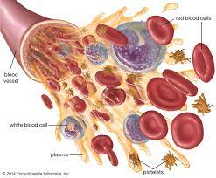
Composition Of The Blood

Slide 12

Arteries of the Head, Face, and Neck

Slide 13
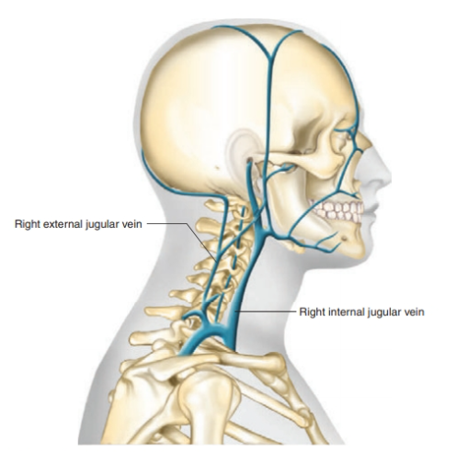
Veins of the Head, Face, and Neck

Slide 14

QUESTIONS?

