Slide 1

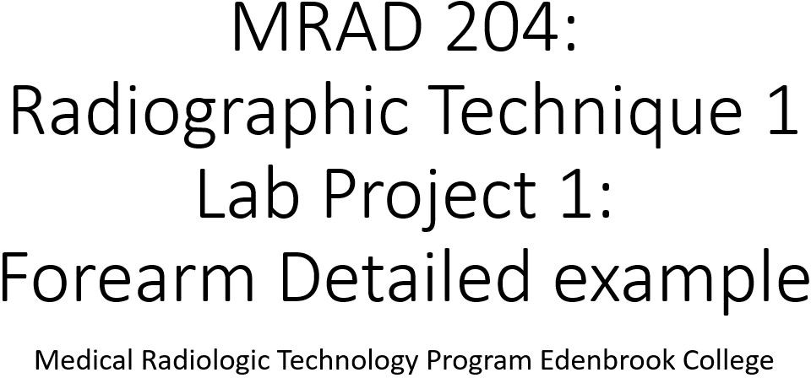

Slide 2
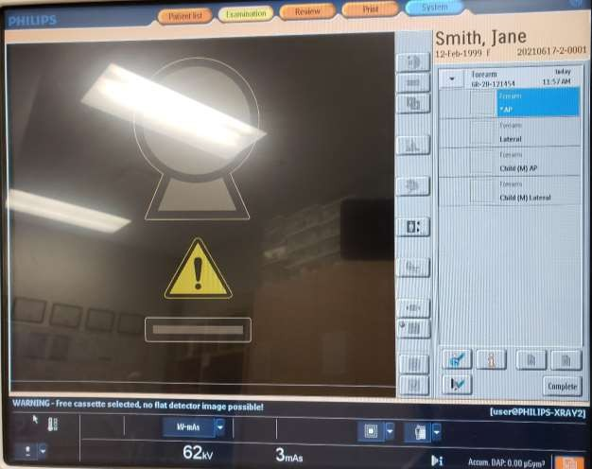

AP Forearm – Equipment Setup
*For full marks under the “console” criteria, the image must include these four points:
Patient selection matches exam performed
Set to “Examination” screen
Correct technique selected (view selected matches view performed
Correct IR selection

Slide 3
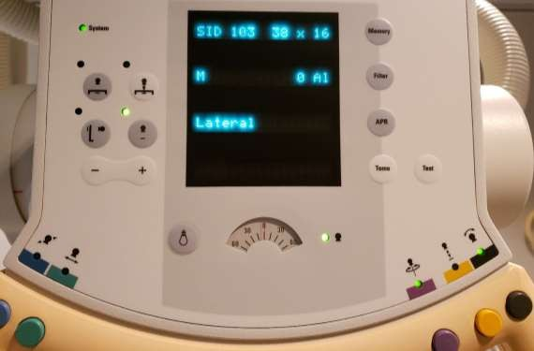
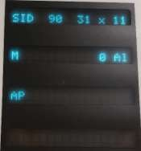
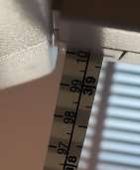
AP Forearm – Equipment Setup
Note: SID readout incorrect on Tube; however full marks awarded for including measuring tape SID display
Set to AP projection
Correct tube angle
displayed
Correct IR selected
All locks visualized, with correct “lights” engaged
Manual measuring tape with correct SID displayed

Slide 4
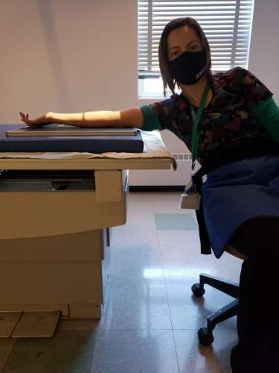
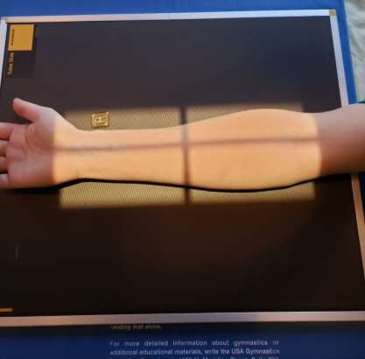
AP Forearm - Positioning
Patient was shielded properly
Collimation includes all required anatomy (& anatomy shadow)
Correct IR size used
Correct IR orientation and placement
Marker follows Edenbrook Marker rules
Correct CR centering
Required anatomy is appropriately centered to the IR
Correctly positioned patient for the view selected (entire upper limb on same horizontal plane, legs NOT under cassette)
Correctly positioned patient anatomy for the part ordered
(aka. required anatomy in correct AP position)

Slide 5
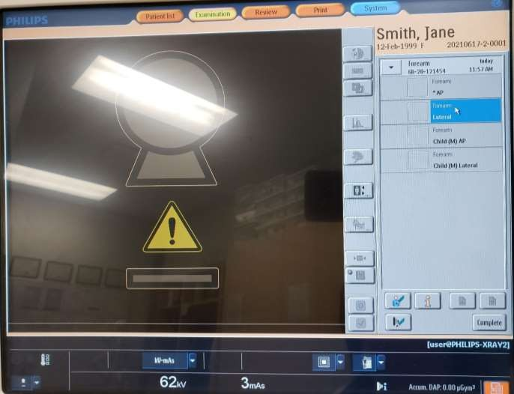
Lateral Forearm – Equipment Setup

Slide 6
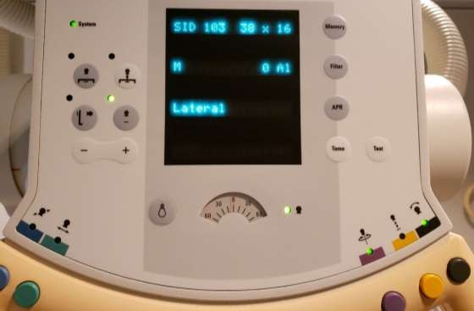
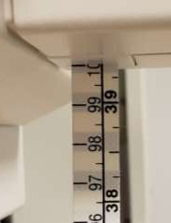
Lateral Forearm – Equipment Setup

Slide 7
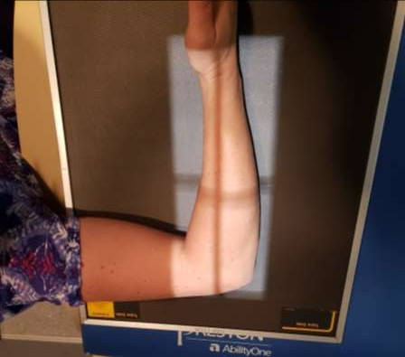
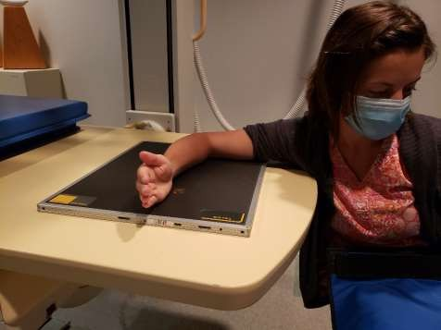
Lateral Forearm - Positioning
Collimation includes all required anatomy (& anatomy shadow)
Patient was shielded properly
Marker follows SAIT’s
Marker rules
Correct IR orientation and placement
Correct IR size used
Correct CR centering
Required anatomy is appropriately
centered to the IR
Correctly positioned patient for the view selected (entire upper limb on same horizontal plane flexed 90º, legs NOT under cassette)
Correctly positioned patient anatomy for the part ordered
(aka. wrist and elbow in correct lateral position)

Slide 8
Notes
For all routine projections:
100cm SID is manually measured
Bontrager recommended technique: 65-75kVp
Lap shield placed over patients waist
Large cassette was used
  Cassette was changed after first exposure
  Cassettes cleaned after dismissing the patient

Slide 9
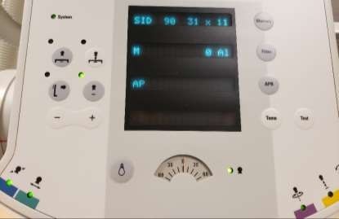
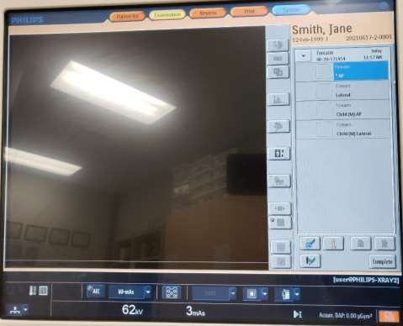
Examples of “image” errors
“Black” (aka. tube angle lock) not visualized
Incorrect IR selected

Slide 10
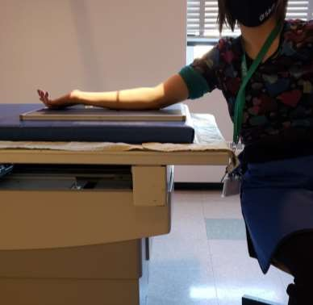
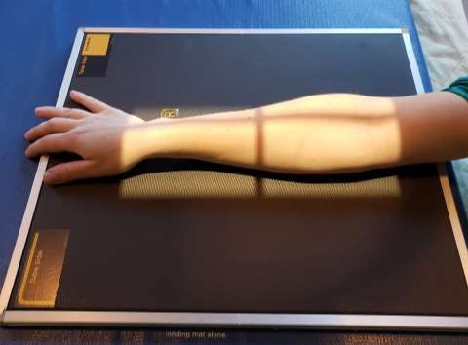
Examples of “image” errors
Incorrectly positioned patient for the view selected (entire upper limb NOT on same horizontal plane)
Incorrectly positioned patient anatomy for the part ordered
(aka. hand is pronated, elbow is in an AP
position)

Slide 11
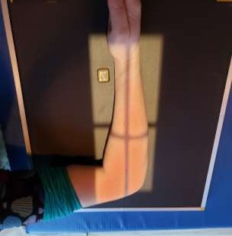
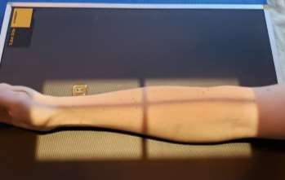
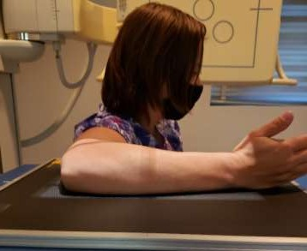

Examples of “image” errors
Incorrectly positioned patient for the view selected (arm is not flexed 90º)
Collimation does not include all required anatomy (½ - 1 inch of light posterior to elbow not clearly visualized)
*Note: be mindful of your “image angle” from this angle: Collimation does not include all required anatomy (½ - 1 inch of light not visualized around all required anatomy)

Slide 12
Copyright Information
This learning material is property of Anderson College.
Any sharing, reproduction or use of this information or material other than educational purposes at Anderson College is prohibited.

