Slide 1
MRAD 256:
Radiographic Technique 2
Vertebral Anatomy

Slide 2
The Vertebral Column
“Spine” or “Spinal Column”
Consists of 26 irregular bones
Bones connect to form a flexible, curved structure
Serves as an axial support for the trunk
Extends from the skull to the pelvis
Surrounds and protects the spinal cord
Provides attachment points for the ribs and for the muscles of the back and neck
Notes:
In a fetus and infant, the vertebral column consists of 33 separate vertebrae. Inferiorly, nine of these eventually fuse to form two composite bones, the sacrum and the tiny coccyx. The remaining 24 bones persist as individual vertebrae separated by intervertebral discs

Slide 3
Sections of the Vertebral Column
5 Major Sections
Cervical – 7
Thoracic – 12
Lumbar – 5
Sacrum – 5 (fuse to form 1)
Coccyx – 3 – 5 (fuse to form 1)
Remember Breakfast at 7 am, Lunch at 12 noon, and Dinner at 5 pm
Notes:
Vertebral column in an average adult is approximately 70 cm (28 inches) long
Thoracic – connects to a pair of ribs
Lumbar – largest and strongest individual vertebrae. Helps carry the increasing load of the body weight, and so a common site of injury
Sacrum and Coccyx – develop as separate bones and then fuse with age
Coccyx – average of 4
**We all have the same number of cervical vertebrae. Variations in numbers of vertebrae in other regions occur in about 5% of people
*** Vertebrae increase in size from cervical to lumbar as they must support greater and greater weight
****Fusion of the sacral vertebra starts at puberty, beginning with the costal elements. The VBs begin fusing when the individual reaches 18 years of age; this continues during the next two decades in a caudal to cranial fashion. Complete fusion of the sacrum has been reported to occur between Years 25 and 33 of life and is related to the load-bearing aspects of this region

Slide 4
Vertebral Column
Vertebral column in an average adult is approximately 70 cm (28 inches) long
Thoracic – connects to a pair of ribs
Lumbar – largest and strongest individual vertebrae
Helps carry the increasing load of the body weight, and so is a common site of injury
Sacrum and Coccyx – develop as separate bones and then fuse with age
Coccyx – average of 4
Vertebrae increase in size from cervical to lumbar as they must support greater and greater weight

Slide 5
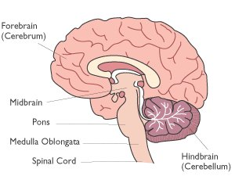
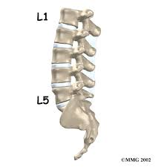
Spinal Cord
Enclosed and protected by the spinal canal
Notes:
Medulla oblongata-starts here-The medulla oblongata is the lower half of the brainstem. It is often referred to simply as the medulla. The medulla contains the cardiac, respiratory, vomiting and vasomotor centers and deals with autonomic, (involuntary) functions, such as breathing, heart rate and blood pressure
Passes thru foramen magnum and continues down to lower border of 1 st lumbar vertebra-here it tapers off to a point called conus medullaris-lumbar punctures can be done at this point however usually occur at the l3-l4 level to make certain the spinal cord is not involved in the spinal puncture

Slide 6
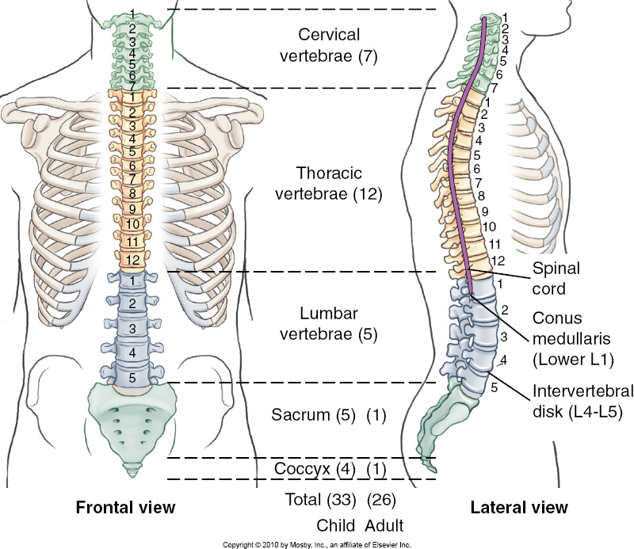
Vertebral Column

Slide 7
Curvature
Curvature in the spine increases it’s strength and flexibility as well as helps to maintain balance
Primary Curves
  Thoracic and sacral (convex) curves develop soon after birth
Secondary Curves
Compensatory Curves
  Cervical and lumbar (concave) curves develop as a child begins to raise their head, and sit up and later when learning to walk
Notes:
Curvatures increase the resilience and flexibility of the spine, allowing it to function like a spring rather than a solid rod
Both lumbar and sacral curves are greater in women than in men (generally)
Abnormal curvature may be congenital or may result from disease, poor posture, or unequal muscle pull on the spine

Slide 8
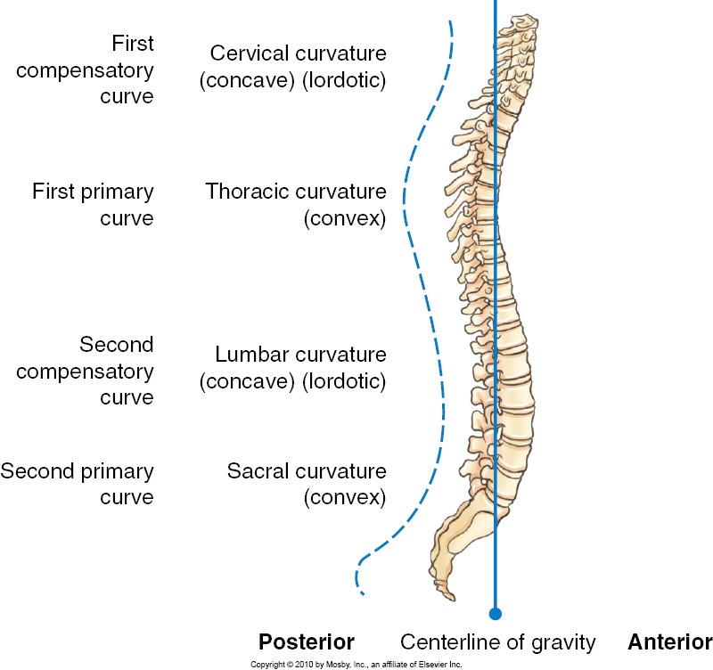
Normal Adult Curvature

Slide 9
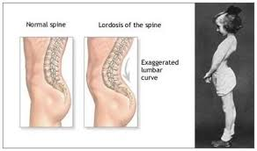
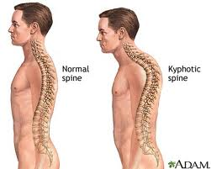
Lordosis and Kyphosis
Lordosis – “swayback”
  Meaning bent backward
  Exaggerated lumbar curvature
Kyphosis – “humpback”
  Meaning hump
  Exaggerated thoracic curvature
Notes:
Lordosis - Temporary lordosis is common in men with “potbellies” and pregnant women in an attempt to restore their centre of gravity
Kyphosis - Common in elderly people due to osteoporosis

Slide 10
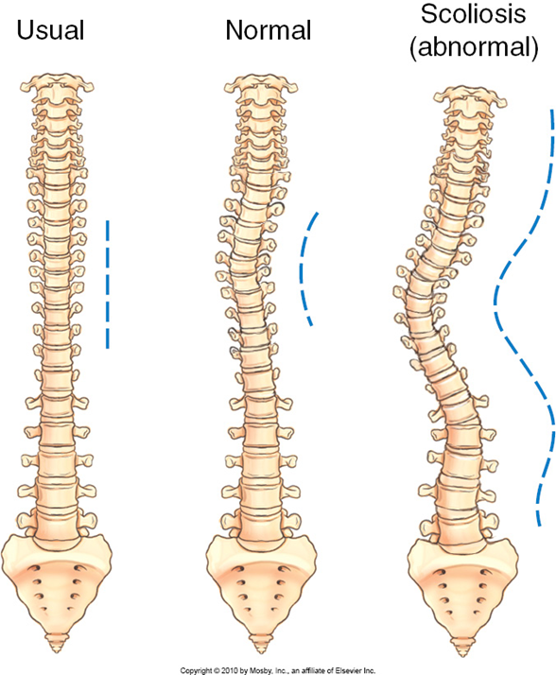
Scoliosis
Abnormal lateral curvature of the spine
Occurs most often in the thoracic region
May cause severe deformity of the entire thorax
Notes:
Quite common during late childhood, particularly in girls, for some unknown reason
Treated with body braces or surgery before growth ends to prevent permanent deformity and breathing difficulty due to compressed lungs

Slide 11
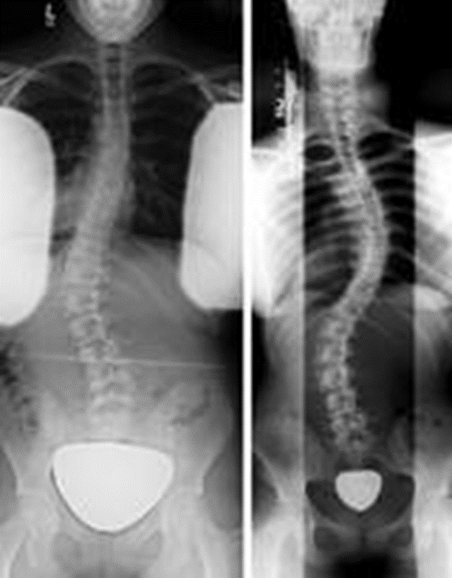
Scoliosis

Slide 12
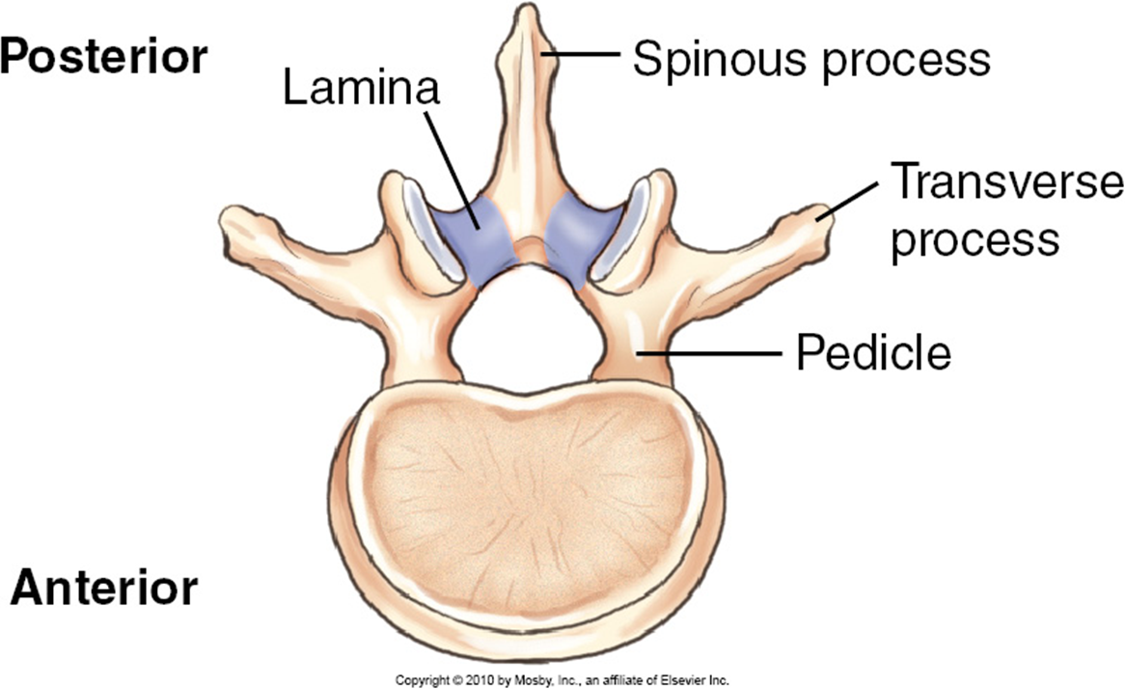
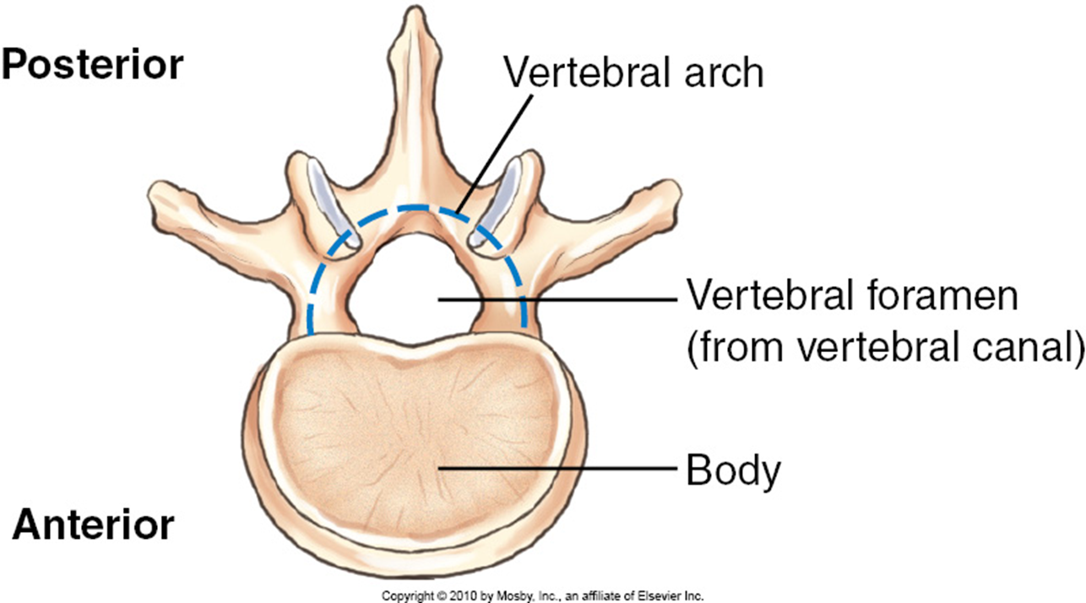
Typical Vertebral Anatomy
Body
Vertebral Arch
Lamina
Pedicle
Notes:
2 main parts
1. Body_Thick, weight-bearing, anterior part
Flat, rough surfaces on superior and inferior aspects for attachment of intervertebral disks
2. Vertebral Arch-Ring or arch extending posteriorly
Posterior surface of the body and arch form circular opening called the vertebral foramen (contains spinal cord)
Vertebral canal formed by succession of vertebral foramina
Pedicles
“little feet”
Short pillars projected posteriorly from the body
Form the sides of the arch
Lamina
Each lamina extend posteriorly from each pedicle to unite in the middle
Flat plates of bone that complete the posterior aspect of the arch-unite in the middle

Slide 13
Vertebral Arch
Formed by the lamina and pedicles
Notes:
Pedicles
“little feet”
Short pillars projected posteriorly from the body
Form the sides of the arch
Lamina
Each lamina extend posteriorly from each pedicle to unite in the middle
Flat plates of bone that complete the posterior aspect of the arch-unite in the middle

Slide 14
Arch Processes
Transverse process
  Extend laterally from each side of the arch
Spinous process
  Extends posteriorly from midline junction of laminae
  Palpable along the posterior surface of the neck and back
Superior and Inferior articular processes
  Protrude from pedicle-lamina junctions
  Smooth joint surfaces called facets (“little faces”)
  Inferior articular process of one vertebra forms a movable joint with superior articular process of vertebra immediately below
Notes:
Spinous and Transverse processes are attachment sites for muscles that move the vertebral column and for ligaments that stabilize it
Superior and inferior articular processes are seen on the lateral view of the vertebra
**** Summary for drawing ****
The typical vertebra consists of two pedicles and two laminae that form the vertebral arch and the vertebral foramen containing the spinal cord, two transverse processes extending laterally, one spinous process extending posteriorly, and the larch anterior body. Each typical vertebra also has four articular processes, two superior and two inferior

Slide 15

Superior View
Notes:
**** Summary for drawing ****
The typical vertebra consists of two pedicles and two laminae that form the vertebral arch and the vertebral foramen containing the spinal cord, two transverse processes extending laterally, one spinous process extending posteriorly, and the large anterior body. Each typical vertebra also has four articular processes, two superior and two inferior

Slide 16
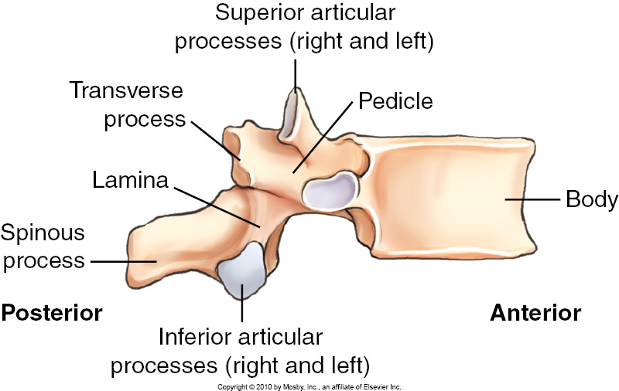
Lateral View

Slide 17
Joints in the Vertebral Column
Intervertebral Joints
  Amphiarthrodial joints between vertebral bodies
  Allow for flexibility and movement of the vertebral column
  Where intervertebral discs are located
Zygapophyseal Joints
  Formed by the four articular processes
Costal Joints are only part of the thoracic vertebrae and will be discussed in detail later
Notes:
While the vertebrae have general common features, there are regional differences of the column which allows for different functions and movements.
In general, movements that occur between the vertebrae are
1)flexion and extension
2) Lateral flexion
3) Rotation
Zygapophyseal Joints sometimes referred to as facet joints, but the facet is only the articulating surface, not the joint

Slide 18
Intervertebral Foramina
Formed by the inferior vertebral notch of a pedicle on one vertebra with the successive superior vertebral notch on the pedicle of the next vertebra
One on each side for every two vertebrae
Spinal nerves and blood vessels pass through

Slide 19
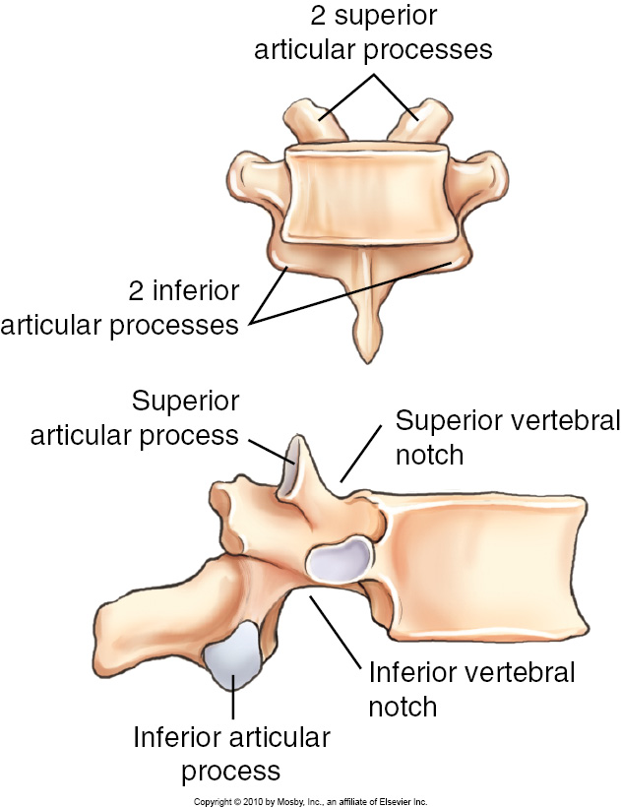
Articular Processes

Slide 20
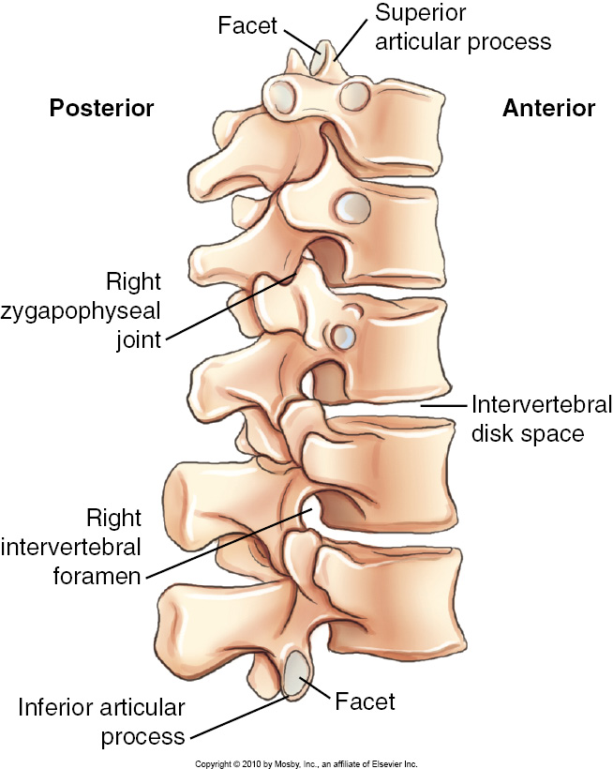
Zygapophyseal Joints and Intervertebral Foramina

Slide 21
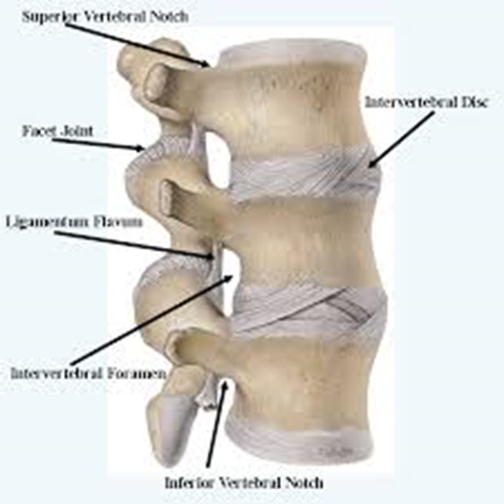
Intervertebral Discs
Cushion-like pads sandwiched between the bodies of the discs that act like shock absorbers
They allow flexion and extension of the spine
Notes:
Tough fibrocartilaginous discs-separate the vertebrae
Absorbption shock from walking, running or jumping
Bound to vertebra tightly to add stability
Discs are the thickest in the lumbar and cervical regions for enhanced flexibility
Discs account for about 25% of the height of the vertebral column – they flatten throughout the day, and as we age making us shorter

Slide 22
Intervertebral Disc
Each disc consists of:
  Annulus fibrosus
    outer fibrous portion binding successive vertebrae together
  Nucleus pulposus
    soft inner portion acting like a rubber ball
Notes:
Slipped disc” – when inner portion protrudes through the outer fibrous layer pressing on the spinal cord (Herniated nucleus pulposus, HNP)

Slide 23
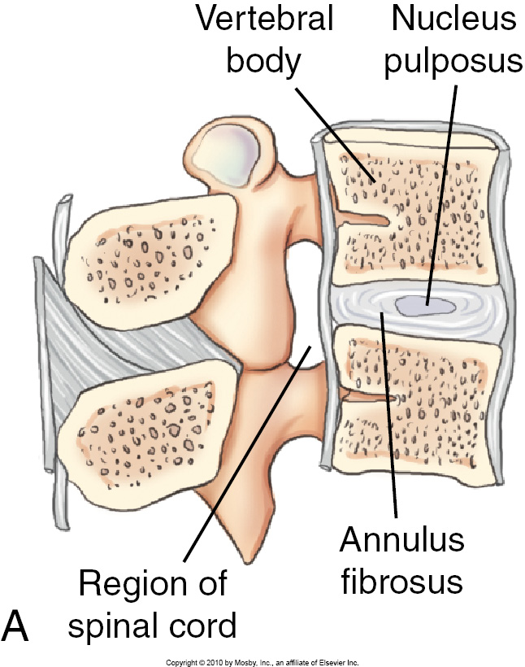
Intervertebral Disc

Slide 24
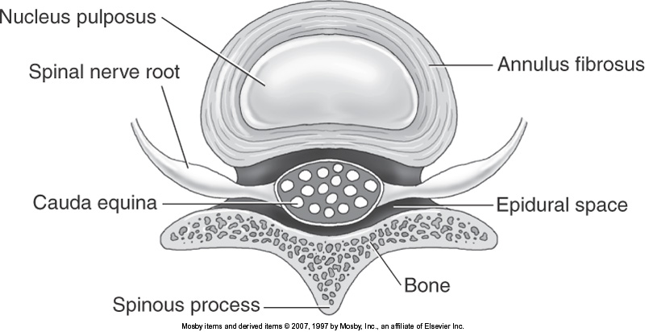
Axial View
Notes:
Another view on intervertebral disc
Annulus fibrosus – outer fibrous portion binding successive vertebrae together
Nucleus pulposus – soft inner portion acting like a rubber ball

Slide 25
Disc Complications
When the soft inner part protrudes through the outer fibrous layer, it presses on the spinal cord and causes severe pain and numbness that radiates into the lower limbs.
The condition, informally known as a “slipped disc”, is termed herniated nucleus pulposis (HNP)

Slide 26
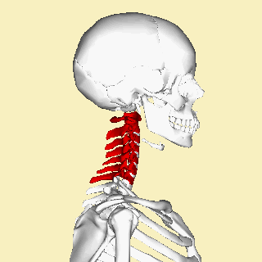
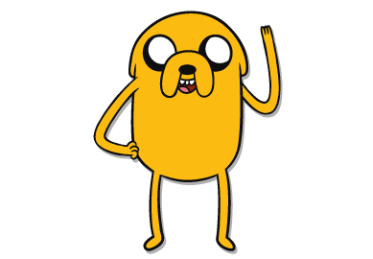
The Cervical Spine

Slide 27
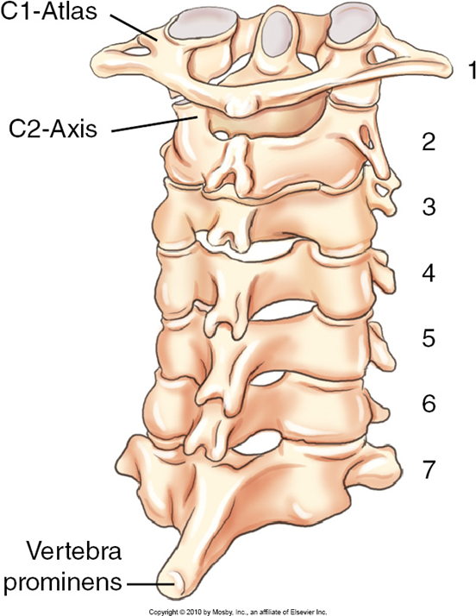
Cervical Vertebrae
Increase in size from C1 to C7
Smallest and lightest vertebra
First two are unusual
C3 – C6 are the typical cervical vertebrae
C7, also called the vertebra prominens has many features of the thoracic vertebrae, including an extra long and more horizontal spinous process that can be palpated at the base of the neck.
It is an important bony landmark for positioning.

Slide 28
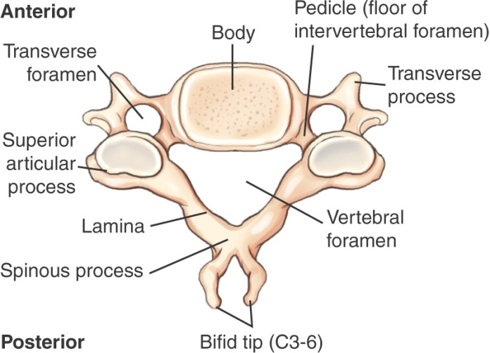
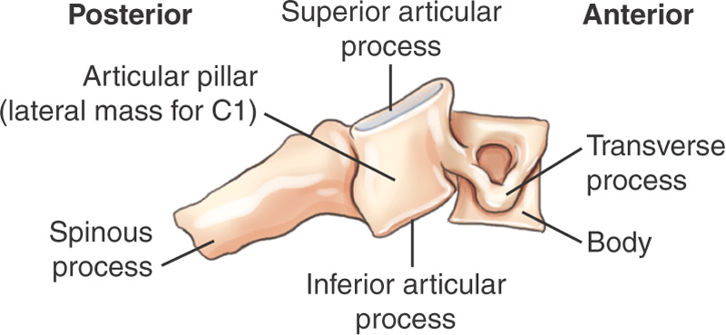
Typical Cervical Vertebrae
Three unique characteristics:
Bifid spinous process
Articular pillar
Three foramina

Slide 29
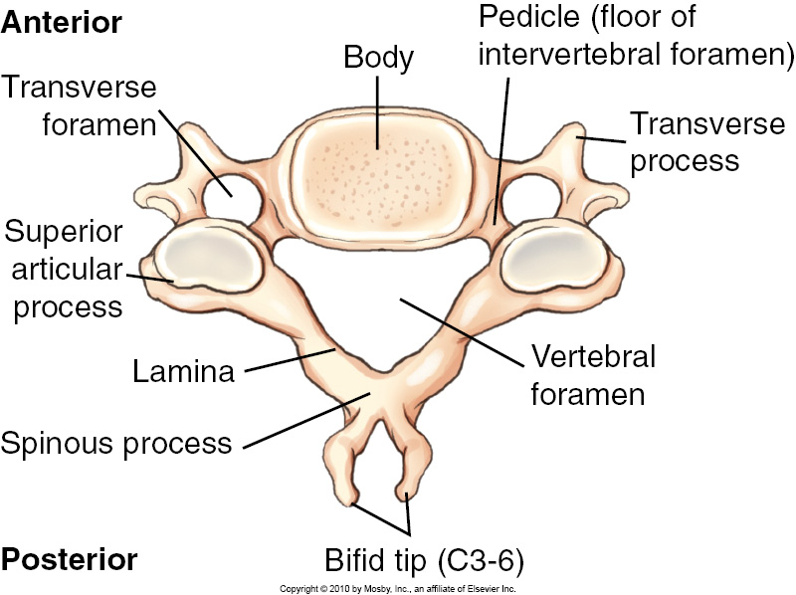
C3 to C6
Body
  Oval
Vertebral Foramen
  Large and triangular
Transverse Processes
  Small
  Arise from both pedicle and the body
Transverse Foramen
  Holes in each transverse process
  Where vertebral artery and vein and certain nerves pass through
Notes:
Unique to all cervical vertebrae – three foramina (vertebral foramen plus two transverse foramen)

Slide 30
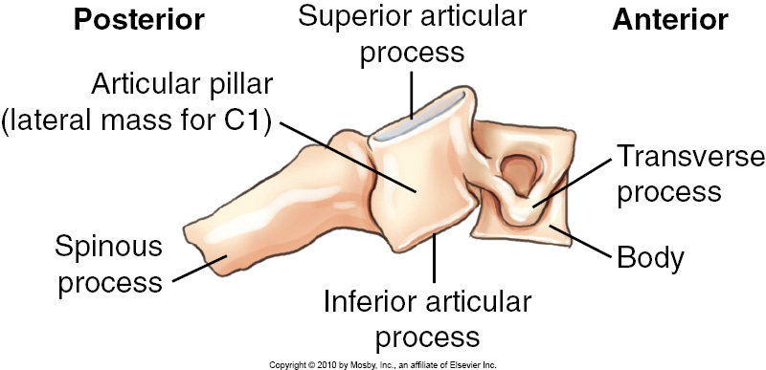
C3 to C6
Spinous Process
  Short
  Bifid tips (double pointed)
Articular Pillar
  Short column between the superior and inferior articular processes
  More supportive in cervical spine than in any other region
Lateral View
Notes:
Articular pillar referred to as the lateral mass on C1

Slide 31
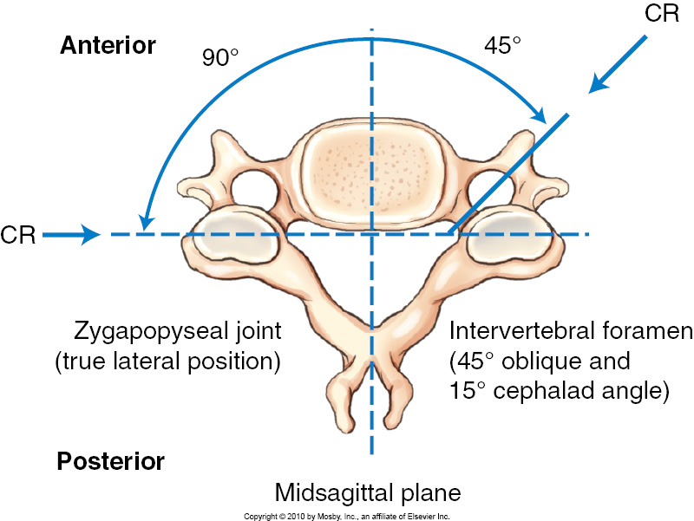
Zygapophyseal joints
Zygapophyseal joints of the second through seventh cervical vertebrae are located at right angels, or 90°
  Visualized only in a true lateral position C3-C7
  Visualized on true AP for C1 and C2
Notes:
Zygapophyseal joints of the second through seventh cervical vertebrae are located at right angels, or 90°
Visualized only in a true lateral position
Visualized on true AP for C1 and C2
Intervertebral foramina
Can be identified by the pedicles, which form the superior and inferior boundaries of these foramina
Intervertebral foramina are situated at a 45° angle to the midsagittal plane, and open anteriorly
They are also directed at a 15° inferior angle because of the shape and overlapping of the cervical vertebrae

Slide 32
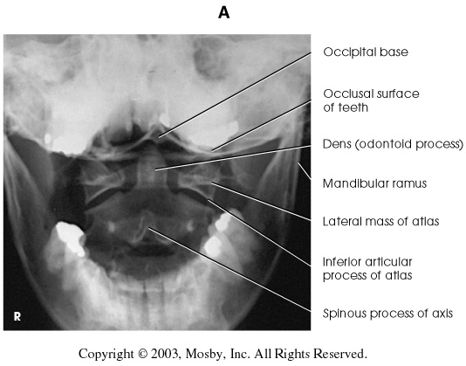

Slide 33
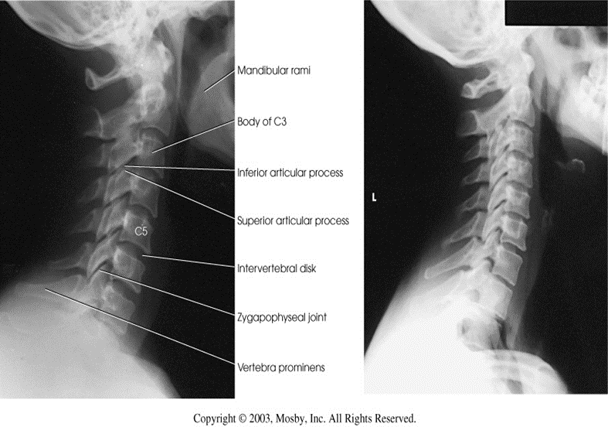

Slide 34
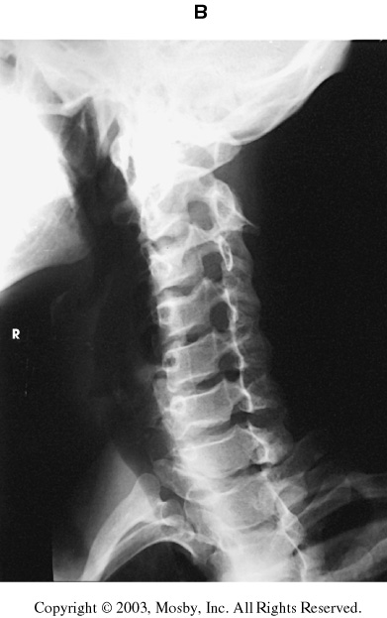
Intervertebral foramina
Intervertebral foramina
  Identified by pedicles, which form the superior and inferior boundaries of these foramina
  Intervertebral foramina are situated at a 45° angle to the midsagittal plane, and open anteriorly
  They are also directed at a 15° inferior angle because of the shape and overlapping of the cervical vertebrae
Notes:
Zygapophyseal joints of the second through seventh cervical vertebrae are located at right angels, or 90°
Visualized only in a true lateral position
Visualized on true AP for C1 and C2
Intervertebral foramina
Can be identified by the pedicles, which form the superior and inferior boundaries of these foramina
Intervertebral foramina are situated at a 45° angle to the midsagittal plane, and open anteriorly
They are also directed at a 15° inferior angle because of the shape and overlapping of the cervical vertebrae

Slide 35
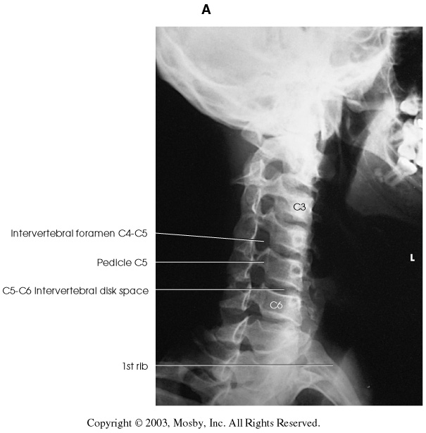
Intervertebral Foramina
R
L

Slide 36
Atlas (C1)
No body, no spinous process
Anterior arch
  Thick arch of bone replacing the body
  Includes a small anterior tubercle
Posterior arch
  Replaces the two laminae and spinous process
  Includes a small posterior tubercle
Transverse processes
  Smaller but have transverse foramina as other cervical vertebrae
Notes:
The atlas holds up the skull, articulating with the occipital condyles of the skull.
got it’s name from the Greek god Atlas who bore the world upon his shoulders
Least resembles a typical vertebra

Slide 37
Atlas (C1)
Atlantooccipital articulations
  Superior articular processes have a large depressed surface called a superior facet for articulation with respective left and right occipital condyles of the skull
Lateral masses
  Articular pillars between superior and inferior articular processes
  Support the weight of the head and assist in rotation and so are the bulkiest of any in the cervical vertebrae
Notes:
C1 and C2 are more robust than the typical cervical vertebra, they have no intervertebral disk between them
C1 is essentially a ring of bone consisting of the anterior and posterior arches and a lateral mass on each side
The articulation between the skull’s occipital condyles and the atlas is a joint that permits “nodding”

Slide 38
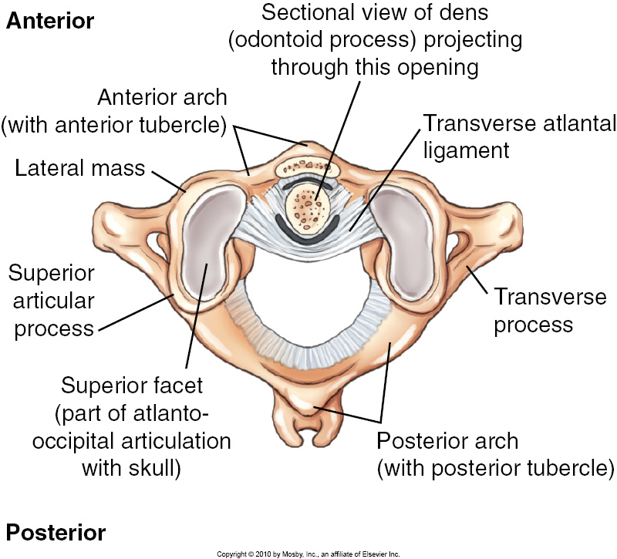
Atlas – Superior View

Slide 39
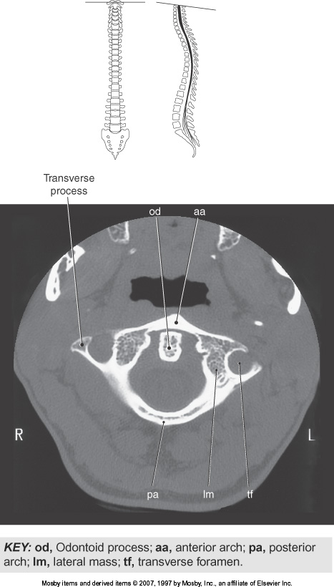
Notes:
C1 CT image

Slide 40
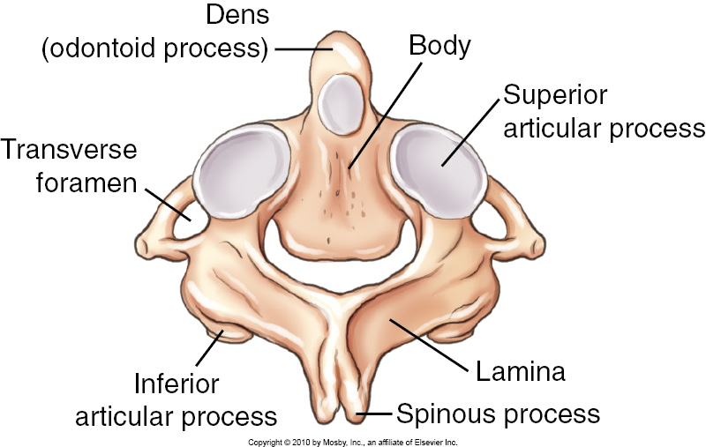
Axis (C2)
Odontoid process or dens
  Most distinctive feature
  Conical process projecting up from superior surface of the body
  Acts as a pivot allowing rotation of the head
Notes:
During development the body of the atlas fuses to the body of the axis, where it forms the odontoid.

Slide 41
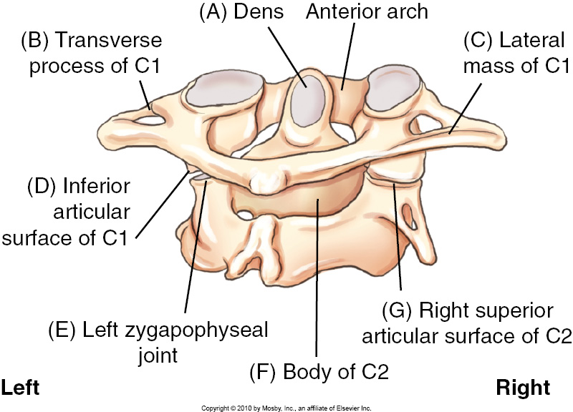
C1 - C2 Posterior Oblique View

Slide 42
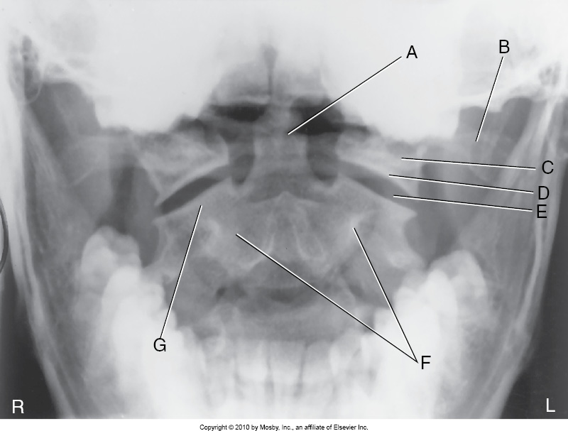
AP Open Mouth
Notes:
Centrally located odontoid
Left transverse process of C1
Left lateral mass of C1
Inferior articular surface of C1
Left zygapophyseal joint
Body of C2
Right superior articular surface of C2

Slide 43
Joints of the Cervical Spine
Atlanto-occipital joint
Atlantoaxial joint (medial and lateral)
Intervertebral joints
Zygapophyseal joints

Slide 44
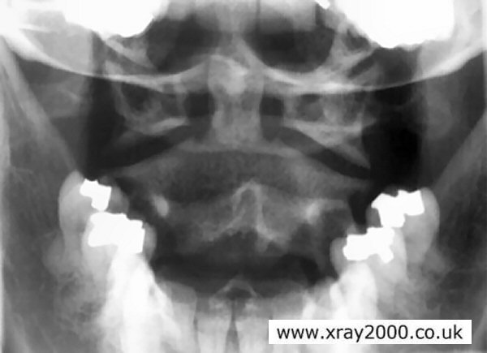
Atlanto-occipital Joint
Articulating surfaces:
Superior articular process and facet of C1
Condyles of occipital bone of skull
Synovial, diarthrodial ellipsoid (condyloid) joint
Freely movable

Slide 45
Atlantoaxial Joint (Medial)
Articulating surfaces:
Posterior surface of anterior arch of C1
Odontoid process of
C2
Synovial, diarthrodial trochoid (pivot)joint
Freely movable
Notes:
Allows us to laterally turn our head left and right or indicate no

Slide 46
Atlantoaxial Joint (Lateral – 2)
Articulating surfaces:
Inferior articular processes & facets of C1
Superior articular processes and facets of C2
Synovial, diarthrodial plane (gliding) joint
Freely movable
*This joint is the zygapophyseal joint of C1-2.
*Clearly demonstrated radiographically in AP odontoid view.

Slide 47

Zygapophyseal Joints
Articulating surfaces:
  Inferior articular process / facet
  Superior articular process/facet of adjacent vertebra
  Lie at right angles to midsaggital plane
  Clearly demonstrated
  in lateral position

Slide 48
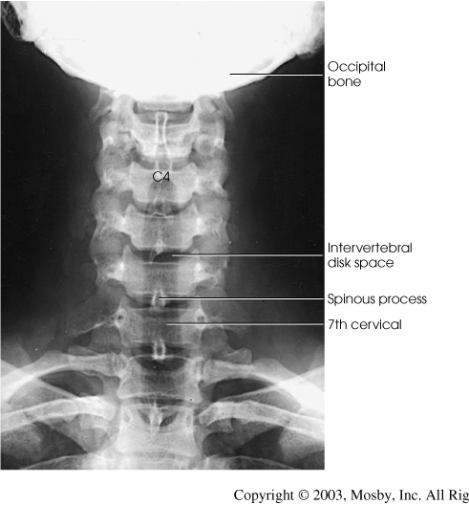
Intervertebral Joints
Articulating surfaces:
  Adjacent bodies of cervical vertebrae
  Slight movement individually
  Considerable movement for entire column

Slide 50
Summary of Vertebral Joints in Cervical Spine
Joints
Skull-C1
C1-C2
Classification
Synovial
Synovial
Ellipsoid(condyloid)
Plane (gliding)R and L lateral atlanto-axial
Trochoid (pivot) C1-C2 odontoid
C2-C7
Synovial
Cartilaginous
N/A
Intervertebral
Zygapohyseal
Synovial
Plane(gliding)
Movement Type

