Slide 1
Introduction to Medical Terminology
MEDT 211

Slide 2
Concepts of Medical Terminology
Distinct vocabulary used by health care professionals for effective and accurate communication
Based on Latin and Greek words
Consistent and uniform throughout the world

Slide 3
Word Parts
Root
  Fundamental unit of each medical word
  Establishes basic meaning of word
  Part to which prefixes and suffixes are added

Slide 4
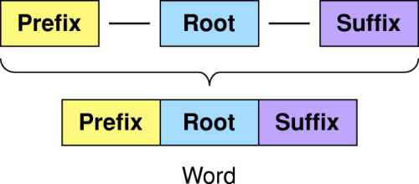
Word Parts (cont’d)

Slide 5
Word Parts (cont’d)
Suffix
  Short word part or parts added to the end of a word
  Modifies the meaning of the root
  Indicated by a dash before the suffix (-itis)

Slide 6
Word Parts (cont’d)
Prefix
  Short word part added before a root
  Modifies the meaning of the root
  Followed by a dash (pre-)

Slide 7
Word Parts (cont’d)
Begin with “learn”
  Learn + -er = one who learns
  Re + learn = to learn again
Greek word for heart is kardia
  Forms word root cardi
Latin word for lung is pulmo
  Forms word root pulm

Slide 8
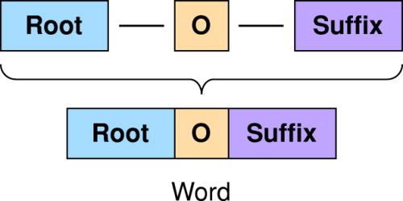
Combining Forms (cont’d)

Slide 9
Combining Forms
Insert an ‘o’ before a suffix beginning with a consonant when added to a root
  -logy = “study of”
  Neur = “nerve or nervous system”
Neur + o + logy = neurology (study of the nervous system)

Slide 10
Combining Forms (cont’d)
Roots shown with a combining vowel are called combining forms
  Vowels added after a slash
  Called roots
  Neur/o
Combining vowel omitted if suffix begins with a vowel
    Neur + itis = neuritis (inflammation of a nerve)

Slide 11
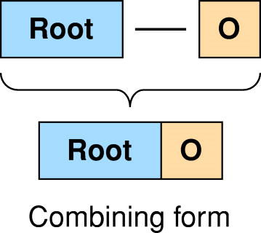
Combining Forms (cont’d)

Slide 12
Word Derivations
Most word parts derived from Greek (G) and Latin (L)
  Muscle is Latin for ‘mouse’
  Coccyx named for the bill of a cuckoo

Slide 13
Pronunciation
Use phonetic pronunciations provided
Repeat words aloud
Pronunciations may change when parts are combined

Slide 14
Pronunciation (con’t)
Vowels with no pronunciation marks get short pronunciation
  ‘a’ as in hat
Short line over vowel gives it long pronunciation
  ‘a’ as in say
Accented syllable indicated with capital letters

Slide 15
Soft and Hard c and g
Soft c, as in racer = (RA-ser)
Hard c, as in candy = (KAN-de)
Soft g, as in page, written as j = (paj)
Hard g, as in grow = (gro)

Slide 16
Silent Letters and Unusual Pronunciations
Gnathic = (NATH-ic)
  Pertaining to the jaw
Apnea = (AP-ne-a)
  Cessation of breath
Nephroptosis = (nef-rop-TO-sis)
  Dropping of the kidney

Slide 17
Symbols
Used as shorthand in case histories
® = right
↑ = increase

Slide 18
Abbreviations
Can save time
May cause confusion
Acronym = abbreviation formed from first letter of each word in a phrase
  ASAP = as soon as possible

Slide 19
Words Ending in x
Change x to c or g when adding a suffix
  Pharynx (throat) becomes pharyngeal (fa-RIN-je-al) (pertaining to the throat)
  Thorax (chest) becomes thoracotomy (thor-a-KOT-o-me) (an incision into the chest)

Slide 20
Suffixes beginning with rh
Double the r in suffixes beginning with rh
  Hem/o (blood) + -rhage (bursting forth) = hemorrhage (a bursting forth of blood)
  Men/o (menses) + -rhea (flow, discharge) = menorrhea (menstrual flow)

Slide 21
References
Cohen, B. J., & DePetris, A. (2014). Chapter 1 Concepts of medical terminology. In Medical terminology: an illustrated guide Canadian edition (2nd ed., pp. 4-13). Philadelphia, PA: Lippincott Williams & Wilkins.

