Slide 1


Laser Chapter 1 part 2

Slide 2
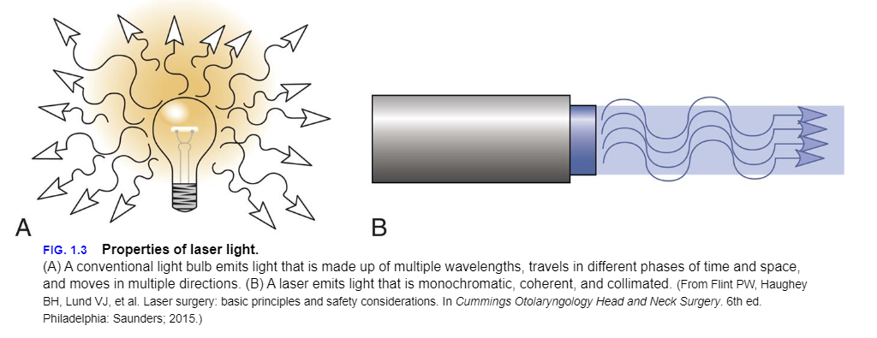
Properties of Laser Light
Monochromatic , using the spectrum of radiation and the different colors, Lasers will use one specific wavelength, from visible light to invisible this means that the stream of photons is composed of a single wavelength of light, This differs from other light sources, such as sunlight, light bulbs, and intense pulsed light, which emit photons with many different wavelengths

Slide 3
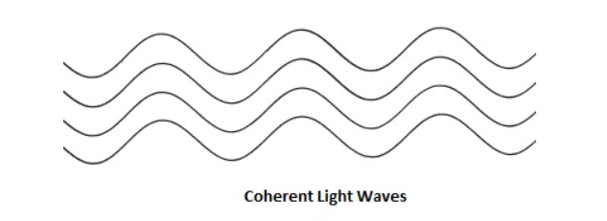
Coherent:
The light from a laser is said to be coherent, which means the wavelengths of the laser light are in phase in space and time.

Slide 4
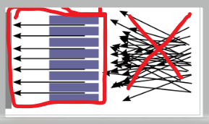
Collimated
It has parallel rays and therefore will spread minimally as it propagates.It will would not disperse with distance.

Slide 5

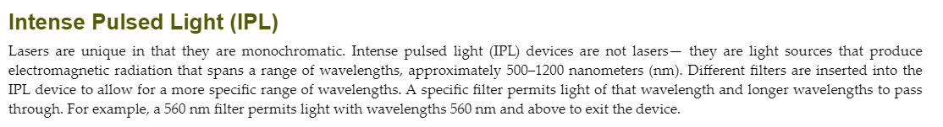
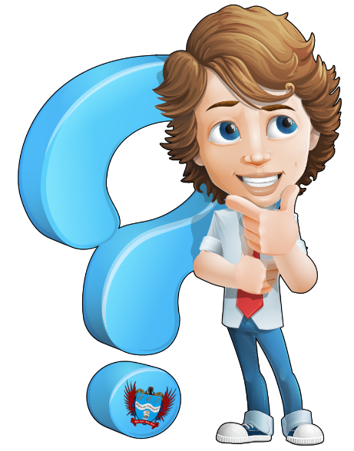
Did you know ??
This Photo by Unknown Author is licensed under CC BY-SA-NC

Slide 6
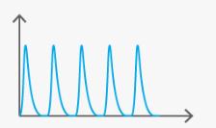
Fluence
Fluence is the measurement of laser energy delivered to an area of skin, expressed in Joules per centimeter squared (J/cm2). The time over which the energy is delivered is known as the pulse duration, expressed in seconds. The rate of energy delivery is the power, expressed in watts (Joules per second [J/s]).

Slide 7

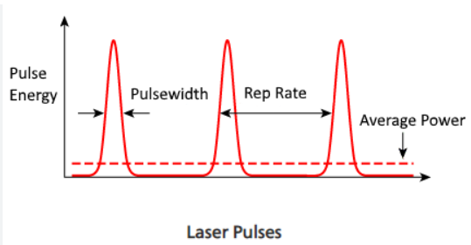
Pulse width
The most important factor to become a qualified Laser Technician is to understand pulse width, pulse delay and TRT ( thermal relaxation time )
The pulse width as shown in picture below is how the Energy ( Joules ) is delivered into the skin. The pulse with can be short or long.

Slide 8
Long Pulse Width : Usually a long pulse width will be chosen by the technician when working with Fitzpatrick Skins Type III and up, Black coarser hair or areas of concentrated targets, etc.
Short Pulse Width: Usually is chosen on Skin types I to III with brown hairs that are more disperse or when the treatment allows for a more aggressive approach.
Because P/W affects TRT ( thermal relaxation time ) this is fine work and a very preliminary tests in the skin to be treated need to always be conducted.

Slide 9
Thermal Relaxation/Damage Time
This is strictly related to the duration of the laser pulse.
When targeting the chromophore, the TRT time needs to be for the entire target, including the primary chromophore (e.g. melanin) and the surrounding target (e.g. hair follicle), to cool by about 63%.
Anything more or less than that could cause 2 effects:
Less the 63% Damage to the surrounding tissue
More than 63% not effective treatment

Slide 10
Beam Type
Laser light can be delivered in a continuous or pulsed fashion.
A continuous beam has no to minimal variation in power output over the pulse duration.
The major drawback to continuous beams is that they are limited by the amount of power they can produce over time but are safer for the user
As opposed to a shuttered continuous beam, a pulsed beam is a discrete and intermittent output of laser light.
Pulsed beams are able to generate higher power outputs than continuous beams by limiting the time period over which the light is generated and emitted.
Greater peak powers can generate more targeted destruction and improved clinical outcomes.

Slide 11
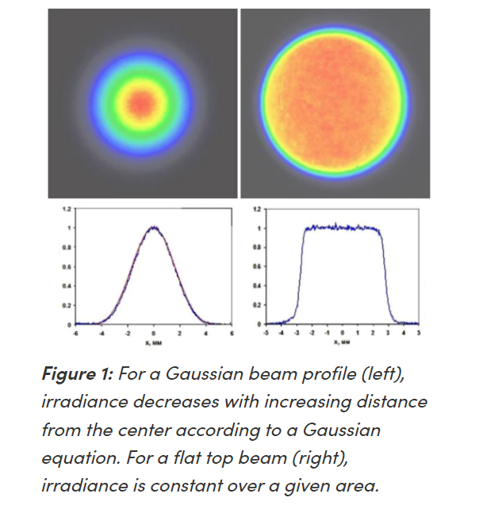
A laser beam shape is typically defined by its irradiance distribution and phase. This is essential in determining the uniformity of a beam profile over its propagation distance and when choosing what type of treatment.
Top Hat beams ( right picture) Is usually found on Hair Removal, skin rejuvenation, ablating etc,
Gaussian beams ( left picture) are used for large vascular lesions and targeted areas . Gaussian beams are found mostly on Medical Settings and training is required as the amount of power delivered is 1000 times higher than top hat beams

Slide 12
Let’s see examples
Top Hat Beam
Gaussian Beam

Slide 13
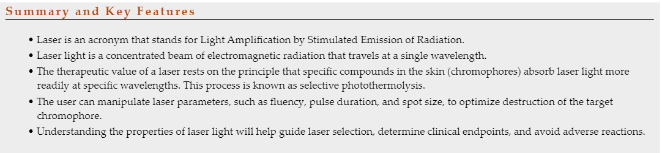

Slide 14

QUESTIONS?

